Slide 1
CHILD LANGUAGE ACQUISITION
Nikhil Vij 07005035
Zibran Shaikh 07D05002
Ashish Paliwal 07D05013
Anurag Sharma 07D05016

Slide 2
Language is the medium of communication and mostly manifested in written, oral and manual forms.
Language Acquisition is the process by which humans acquire the capacity to perceive, produce and use words to understand and communicate.

Slide 3
Why to learn language acquisition
Long range influences on adult behaviour
Children change rapidly compared to adults.
It encompasses various research fields like –
Natural Language Processing
Neural networks
Psychology
"The direction in which education starts a man will determine his future life."
--Plato (427 BC-347 BC)
"Decisions that are made about what will be accessible to children help shape the kinds of minds they will come to own."
--Elliott Eisner

Slide 4
“Language learning is doubtless the greatest intellectual feat any of us is ever required to perform”
--Leonard Bloomfield

Slide 5
How is Language Structured
(in the Human Brain)
The basic elements of Language are:
Syntax- Set of rules and principles for constructing sentences
Semantics- Study of meaning of sentences.
Pragmatics- Studies the ways in which context contributes to meaning

Slide 6
Language Elements
Phones - speech sounds (produced)
Phonemes – mental representation phones that are categorized
Syllables - smallest unit of speech perception
Morphemes - smallest unit of meaning

Slide 7
Stages of language acquisition
There are five basic stages of language acquisition:
Cooing
Babbling
One-word utterances
Telegraphic speech
Normal speech

Slide 8
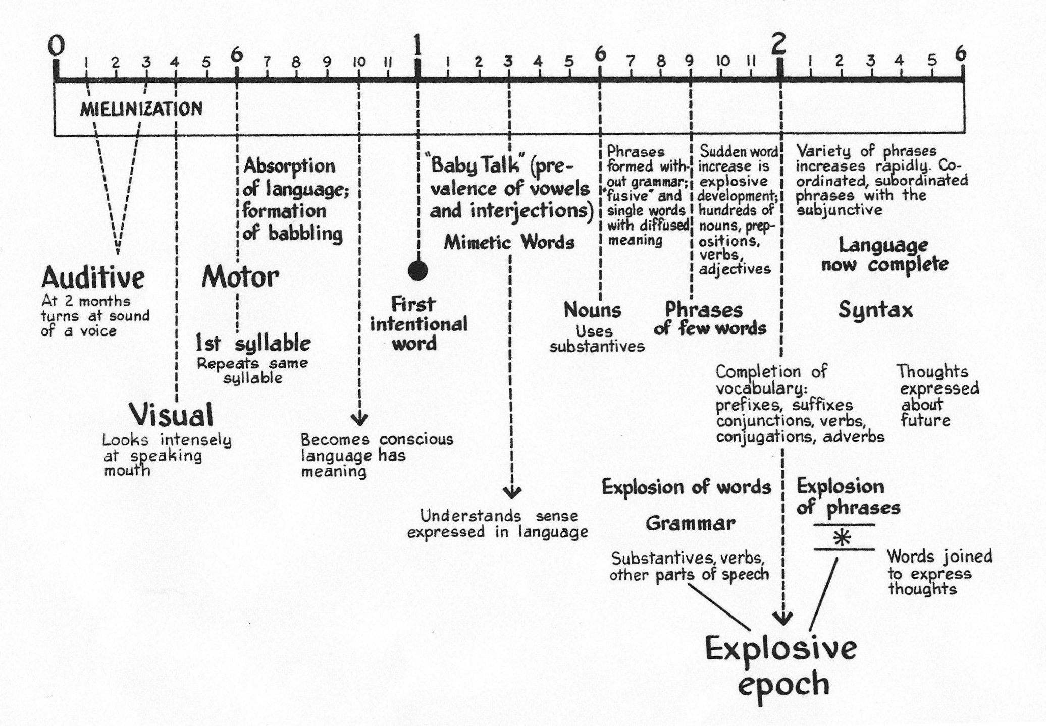
Stages of language acquisition

Slide 9
Stages of language acquisition (contd.)
Cooing: Appears at about 6 months or so. All infants coo using all the phonemes from every language. It comprises mostly of vowel sounds like “aaa”, “ooo” etc.
Babbling: Appears at around 9 months. Infants are starting to selectively use the phonemes from their native language. Consonants are also introduced along with vowels and he is able to correlate words with objects or people. It starts using words with repetitive sounds like “dada”, “mama” etc.

Slide 10
Stages of language acquisition (contd.)
One-word utterances: At around 12 months, children start using words. Starts using fairly complex words. Also can recognize correct pronunciation of familiar words. The next stage observed is two word utterance by age of 18 months.
Telegraphic speech: Children start making multi-word utterances that lack function words i.e. conjunctions & articles. (about 2 years old) for eg. “water now”
Normal speech: By about 5-6 years of age, children have almost normal speech with good command over syntax and semantics. In later stage development of vocabulary and pragmatics takes place.

Slide 11
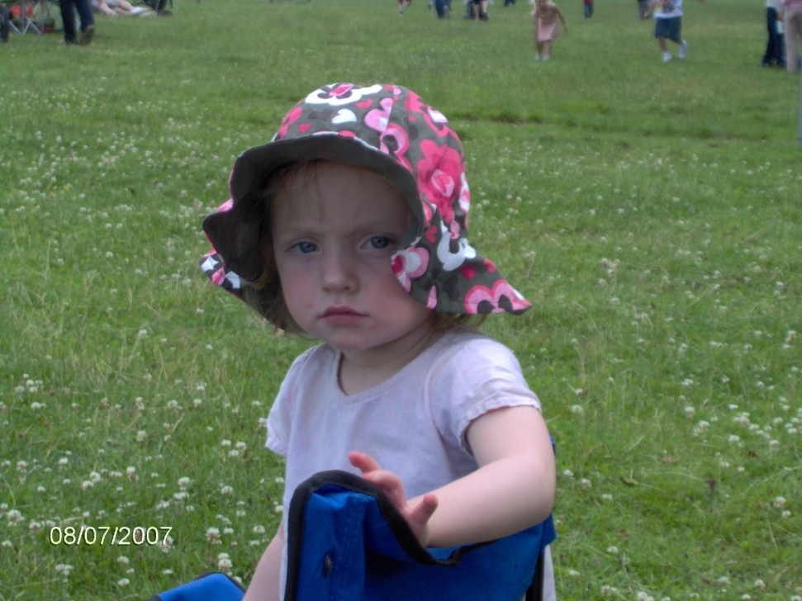
Stages of language acquisition (contd.)
Two-word utterances:
I walking

Slide 12
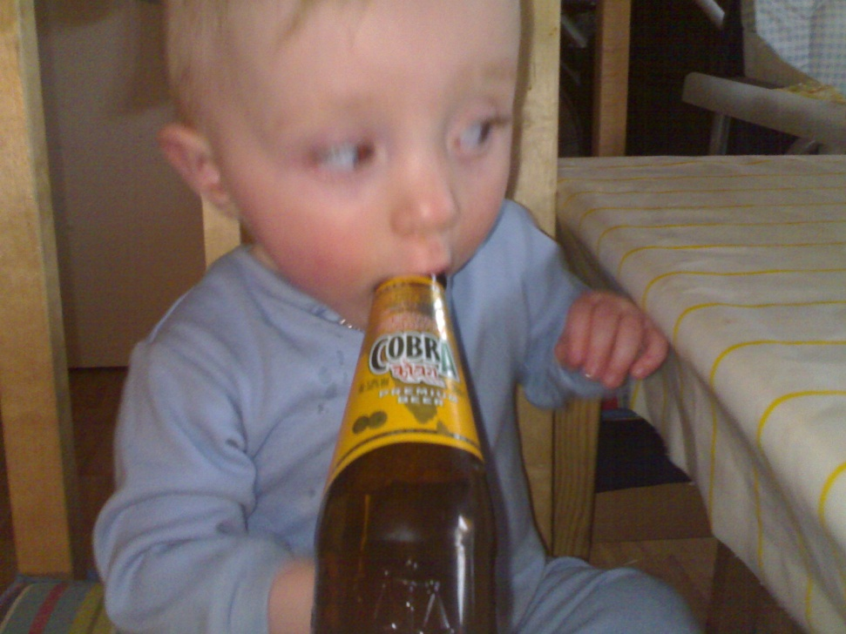
Stages of language acquisition (contd.)
Telegraphic Speech:
I drink daddy beer

Slide 13
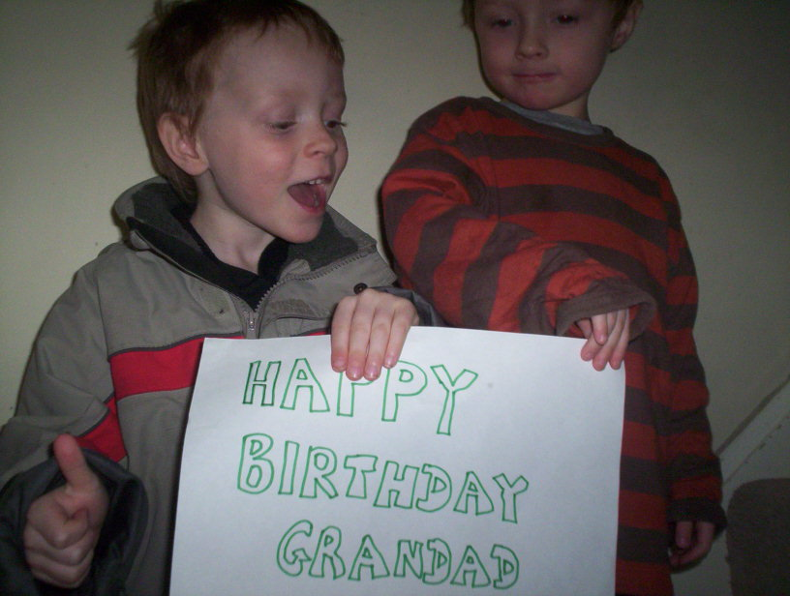
Stages of language acquisition (contd.)
Normal Speech:
Grandad’s happy cos we remembered his birthday

Slide 14
Critical Questions
Children learn to speak language in an extraordinarily short period of time after they are born.
How is it that language is acquired this quickly?
Is the ability to learn language innate, or is it the result of children being exposed to lots of language early on?
“One free lunch in the world is to learn another language in early childhood.”
--Stephen Pinker, The Language Instinct

Slide 15
HISTORY
Plato felt that the word-meaning mapping in some form was innate.
Under Behaviorism, B.F. Skinner's Verbal Behavior (1957), suggested that the successful use of a sign such as a word or lexical unit, given a certain stimulus, reinforces its "momentary" or contextual probability.
This behaviorist idea was strongly attacked by Noam Chomsky in a review article in 1959 where he argued for a more theoretical approach, based on a study of syntax.

Slide 16
NATURE
v/s
NURTURE

Slide 17
NATURE
Perception for speech sounds is better than perception for other sounds.
Congenitally deaf children will learn sign language at about the rate that normal children learn spoken language, and will progress through roughly the same stages.
Children are not exposed to as rich a variety of speech as they are able to develop.
Parts of the brain seem to be specialized for language processing.

Slide 18
NURTURE
Nurture is explained by the Theory of Cognitive Development. It is a comprehensive theory about the nature and development of human intelligence first developed by Jean Piaget. Also important was Zone of proximal development , which is a concept developed by Vygotsky.
Under Behaviorism, B.F. Skinner proposed that language was learnt mainly through the principles of reinforcement and conditioning just like that for any other stimuli.
Skinner suggested that a child imitates the language of its parents or carers. Successful attempts are rewarded because an adult who recognises a word spoken by a child will praise the child and/or give it what it is asking for. Successful utterances are therefore reinforced while unsuccessful ones are forgotten.

Slide 19
NURTURE
Since 1980, linguists studying children, such as Melissa Bowerman, and psychologists following Piaget, like Elizabeth Bates and Jean Mandler, came to suspect that there may indeed be many learning processes involved in the acquisition process, and that ignoring the role of learning may have been a mistake.
“Language is not a genetic gift, it is a social gift.”
-- Frank Smith

Slide 20
NATURE and NURTURE
Consequently, attempts were made to integrate Nature and Nurture.
As kids are exposed to language, they form hypotheses, which are kind of like tentative rules for the language. As these hypotheses are confirmed or disconfirmed, they are modified appropriately.

Slide 21
Thus, it can be concluded that Child Language Acquisition is a very fine interweaving of Nature and Nurture.

Slide 22
Chomsky’s Theory
Chomsky was the pioneer as far as formalizing the process of Language Acquisition is concerned.
Chomsky's generative grammar ignores semantics and language use, focusing on the set of rules that would generate syntactically correct strings.
What is innate was claimed to be a universal grammar, initially connected to an organ called the language acquisition device(LAD).

Slide 23
Chomsky’s Theory
Chomsky has gradually abandoned the LAD in favour of a parameter-setting model of language acquisition .
Although trained linguists working for decades have not been able to identify a grammar for any human language, Chomsky suggested that what was universal across all languages were a set of principles, that were modified for each particular language by a set of parameters.

Slide 24
“Language is a process of free creation; its laws and principles are fixed, but the manner in which the principles of generation are used is free and infinitely varied. Even the interpretation and use of words involves a process of free creation“
-- Avram Noam Chomsky

Slide 25
Chomsky’s Theory
Chomsky developed the idea that each sentence in a language has two levels of representation — a deep structure and a surface structure.
The deep structure represented the core semantic relations of a sentence, and was mapped on to the surface structure via transformations.
Chomsky believed that deep structure was innate and was Universal to all languages while transformations were learnt by interaction with Society(Nurture).

Slide 26
Theory of Cognitive Development
Jean Piaget placed acquisition of language within the context of a child’s mental or cognitive development. He argued that a child has to understand a concept before he can acquire particular language form which expresses the concept.

Slide 27
Stages of Cognitive Development
Sensorimotor: 0-2yrs experiencing the world through senses and actions.
Object permanence and Stranger Anxiety
Preoperational: 2-6/7 representing things with words and images, intuitive thinking
Pretend play, Egocentrism
Concrete Operational: 7-11 thinking logically about concrete events, arithmetic
Conservation, Mathematical Transformations
Formal Operational: 12 – adulthood abstract reasoning
abstract logic, mature moral reasoning

Slide 28
Emergentist Theories
Because of Limitations of Chomsky’s theory, such as:
The theory relies on children being exposed to language but takes no account of the interaction between children and their carers.
The concept of a Language Acquisition Device is unsupported by evolutionary anthropology.
The underlying rules as mentioned in Chomsky’s universal grammar have not been found despite significant research by linguistic in that area.
This has led proposing of new emergentist theories of Language
Acquisition.

Slide 29
Emergentist Theories
Proponents of Emergentists language acquisition including Elissa Newport, Richard Aslin, and Jenny Saffran, believe that language acquisition is based primarily on general learning mechanisms, rather than based on innate, language-specific mechanisms completely dependent upon one's experience with language or the influence of the environment.

Slide 30
Competition Model of Language Acquisition:
Language learning involves psycholinguistic processes such as cues(including context, such as word order, morphology, and semantic characteristics), storage, chunking etc.
These cognitive mechanisms control the interpretations in the target language that compete in the mind of the learner during acquisition and usage of the language.
The weights of the competing representations are computed and adjusted on the fly based on the learner's experience with the target language. Thus understanding of language improves with experience.
Connectionist models supporting this and other emergentist theories have been developed proving the validity of the theory.
“My work on perspective-taking, competition, and brain mechanisms suggests that the most likely account of the origin of language is one grounded on social mechanisms”

Slide 31
Coalition Government Model of Language Comprehension
Proposed by Hirsh-Pasek and Golinkoff.
Language comprehension is an emergent property.
Children mine the coalition of input cues.
Innate: There are some boundary conditions.
Different cues at different stage of development(prosodic, semantic and grammatical).
Changes in weighting of cues give way to phase shifts.

Slide 32
Coalition Government Model of Language Comprehension (contd.)
Three Phases:
PHASE 1: Acoustic packaging (integrating different sources of coalition of inputs) for later use.
PHASE 2: Children begin to use the correlates of prosody, semantics, and even syntactic cues.
Marked by rapid growth of lexicon
Associative learning gives way to referral system.
. Language comprehension governed by semantics or pragmatics. Example.
PHASE 3: At the age of around 24 months the reliance on coalition of inputs fades away.
As children become aware of more complex relations among objects and people they’ll need to discover more ways of communicating.

Slide 33
AI and Language acquisition
As Leonard Bloom said
“Language learning is doubtless the greatest intellectual feat any of us is ever required to perform”
The capability to learn First Language is therefore a challenging requirement and a litmus test for a truly intelligent system.
Significant amount of research has gone into this area and several models for learning language have been developed based on neural networks, computational models, and other connectionist approaches.

Slide 34
AI and Language acquisition
Some of the interesting and most promising work in this field has been done by researchers from Institute of Cognitive Science and Technology and Sony.
They developed robots that can evolve their own language, bypassing the limits of imposing human rule-based communication.
Two AIBOs develop their own language by agreeing upon a name when they see and unrecognized object.

Slide 35
AI and Language acquisition
To ensure continuous learning process, the researchers instilled their robots with a sense of ‘curiosity.
The curiosity system, or ‘metabrain,’ continually forced the AIBOs to look for new and more challenging tasks, and to give up on activities that did not appear to lead anywhere.

Slide 36
AI and Language acquisition
Another inspiring initiative in this field was taken by Brian MacWhinney and Catherine Snow in the form of CHILDES(Child Language Data Exchange System), a repository for first language database.
Now merged with TalkBank and also includes the data from aphasics, second language acquisition, conversation analysis, and classroom language learning
Since long played a vital role in encouraging study and research in this field.

Slide 37
References
MacWhinney, B. (2005) Language evolution and human development. In Bjorklund, D. & Pellegrini, A. Origins of the Social Mind: Evolutionary Psychology and Child Development (pp. 383-410). New York: Guilford.
MacWhinney, B. (2002) Language emergence. In Burmeister, P., Piske, T., and Rohde, A.(Eds.) An integrated view of language development - Papers in honor of Henning Wode. pp. 17-42. Trier: Wissenshaftliche Verlag
MacWhinney, B. (2007). The TalkBank Project. In Beal, J., Corrigan, K. & Moisl, L. Creating and Digitizing Language Corpora: Synchronic Databases, Vol.1. Houndmills, Basingstoke, Hampshire, Palgrave-Macmillan.
Luc Steels , Frederic Kaplan (2001) AIBO's first words. The social learning of language and meaning
Golinkoff, R. M., & Hirsh-Pasek, K. (2006). The emergentist coalition model of word learning in children has implications for language in aging.

Slide 38
References
A report on EMERGENTISM by William O’Grady published in Cambridge Encyclopedia of Language Sciences
Theories of Child Language Acquisition http://cobcenglang.homestead.com/CLA/CLA_theories.doc.
Wiki link on Language Acquisition (http://en.wikipedia.org/wiki/Language_acquisition)
Lectures from Timothy Mason’s Site
(http://www.timothyjpmason.com/WebPages/LangTeach/Licence/CM/OldLectures/)
Lecture notes on “Basic Course on Psychology” HS 303
Some other resources on internet.

Slide 39
THANKS!!

