Slide 1
Emotional Intelligence
“It is very important to understand that emotional intelligence is not the opposite of intelligence, it is not the triumph of heart over head -- it is the unique intersection of both”
- David Caruso
(From “Emotional What?”)
A Seminar Presentation by :
Ankush Bajoria, 07005013
Ajay Singh Meena, 07005015
Achyut Jagani, 07005017
Jayant Ameta, 07005020
Achin Bansal, 07005025

Slide 2
Abstract
We address
Emotion : What it is and theories relating to it
Emotional Intelligence : What it means
Measuring Emotional Intelligence
Affective Computing : What does this mean
Survey a few techniques applied in affective computing, and
Motivate the reason for controlled integration of these techniques in AI.

Slide 3
Emotions: Introduction
“Karl Andrews held in his hand the envelope he had been waiting for. It could be the ticket to his future, an offer of admission to his first-choice college. But what was it going to say? He knew it could go either way, his grades were pretty good and he had been involved in some extra-curricular activities, but his SAT scores had not been so terrific. He felt so nervous that his hands shook as he opened the thin envelope (not a good sign, he thought. Here it comes ‘Dear Mr. Andrews’ it read. ‘The trustees of this university are pleased to admit you…”. That was all he needed to see. With a whoop of excitement, Karl found himself jumping up and down gleefully. A rush of emotion overcome him as it sank in that he had, in fact, been accepted. He was on his way. “
“Essentials of Understanding Psychology – Feldman”
Everyone has an idea of what emotion is.
But, how do we formally define “emotion” ?

Slide 4
Emotions : Psychological Viewpoint
Emotions are feelings that generally have both physiological and cognitive elements.
Physiological elements
Increase in heart-rate, jumping with joy in case of Karl.
Cognitive elements
The understanding of the meaning of the fact that he had been admitted to his first-choice college.

Slide 5
Theories of Emotions:
James-Lange Theory
“We feel sorry because we cry, angry because we strike, and afraid because we tremble”
(James, 1890)
Cannon-Bard Theory
Rejects the view that physiological arousal alone leads to the perception of emotion.
Instead, both the physiological arousal and emotional experience are produced simultaneously.

Slide 6
Theories of Emotions
Schachter Singer Theory of Emotion
Emotions are determined jointly by the physiological arousal and the labeling of that arousal on the basis of cues from the environment
Emotions are experienced by observing our environment and comparing ourselves with others
Demonstrated by Schachter Singer Experiment.
What’s take away from all this?
That no one has a clear theory formulating emotion!

Slide 7
Functions Of Emotions
Following are the functions:
Preparing us for actions
For example, on seeing an angry dog charging, the emotional reaction (Fear) would get us moving out of the dog’s way - quickly
Shaping our future behavior
The emotional response that occurs when we experience something unpleasant – such as a threatening dog – teach us to avoid similar circumstances in future.
Helping us interact more effectively with others
Promotes more effective and appropriate social interaction

Slide 8
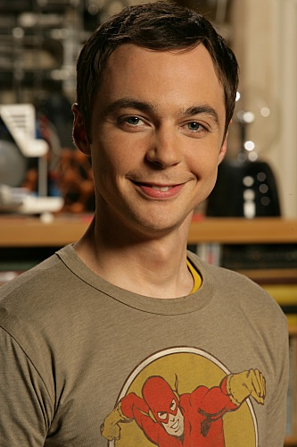
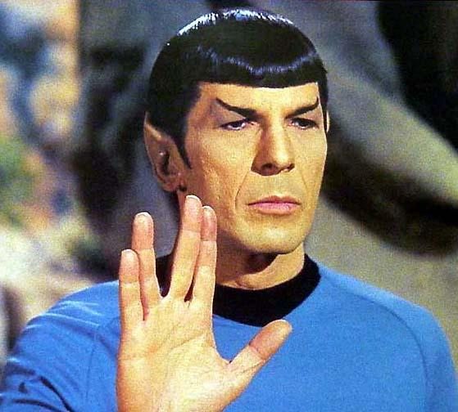
Role of Emotion in Intellect
Three major areas of intelligent activity are influenced by emotions
Learning
Long-term Memory
Reasoning
Popular (exaggerated) examples of highly intelligent, but emotionally challenged characters have been shown here.
Images courtesy Google Images

Slide 9
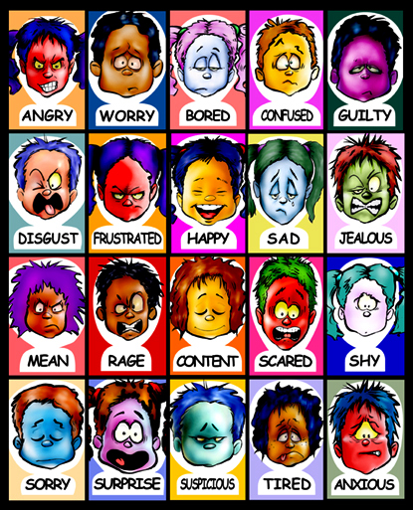
Emotional Intelligence
Emotional Intelligence is the set of skills that underlie accurate assessment, evaluation, expression and regulation of emotions
(Mayer, Salovey, Caruso,2004)

Slide 10
Continued…
Another Definition :
The subset of social intelligence that involves the ability to monitor one’s own and others’ feelings and emotions, to discriminate among them and to use this information to guide one’s thinking and actions.
Models of EI
Ability Model of EI
Mixed Models of EI
Trait EI Model

Slide 11
Ability EI Models
Based on Salovey and Mayer’s conception of EI
The model claims that EI includes 4 types of abilities
Perceiving Emotions
Identify emotions in feelings and thoughts, designs, artwork
Discriminate - accurate and inaccurate, honest vs dishonest
Using Emotions
Prioritize thinking
Mood swings – from optimistic to pessimistic– multiple viewpoints
Happiness facilitates creativity

Slide 12
Continued
Understanding Emotions
Relationships among emotions – loving and liking
Meaning - Sadness often accompanies a loss
Complex feelings – awe as a combination of fear and surprise
Managing emotions
To stay open to feelings – pleasant as well as unpleasant
Moderating negative emotions and enhancing pleasant ones
The current measure of Mayer and Salovey’s model of EI, the Mayer-Salovey-Caruso Emotional Intelligence Test (MSCEIT) is based on a series of emotion-based problem-solving items

Slide 13
Mixed Models of EI
Introduced by Daniel Goleman
Goleman’s model outlines four main EI constructs :
Self-Awareness
Ability to read one’s emotions and recognize their impact while using gut feelings to guide decisions
Self-Management
Involves controlling one’s emotions and impulses, and adapting to changing circumstances

Slide 14
Cont…
Social Awareness
Ability to sense, understand and react to other’s emotions while comprehending social networks.
Relationship Management
Ability to inspire, influence and develop others while managing conflicts
Two measurement tools are based on the Goleman model:
The Emotional Competency Inventory (ECI)
The Emotional Intelligence Appraisal

Slide 15
Trait EI Model
It refers to an individual’s self-perception of emotional abilities
Some traits
Adaptability , Assertiveness , Emotion perception, Emotion expression , Emotion management, Emotion regulation , Impulsiveness , Relationships, Self-esteem, Self-motivation , Social awareness, Stress management ,Trait empathy , Trait happiness, Trait optimism
Measure of this construct is the Trait Emotional Intelligence Questionnaire (TEIQue)

Slide 16
Emotional Computers
[xkcd] a webcomic
www.xkcd.com

Slide 17
Use of Emotional Computers
Musical Tutor for piano lessons
Is it maintaining interest?
Is the student making mistakes?
Is the lesson tough or the piano key stuck?
Should it just make the user happy?
Human teachers use affective cues
Imagine an emotionless tutor.
How to make computers emotional??

Slide 18
Answer : Affective Computing
Affective Computing
Deals with the design of systems that can recognize, interpret, and process human emotions.
Avenues
Perceive Emotions
Express Emotions
Act on Emotions
Influence Emotions

Slide 19
Major Technologies of Affective Computing
Emotional Speech
To recognize the user’s emotional state by analyzing speech patterns and prosody features.
Facial Expressions
To detect and process facial expressions through methods such as optical flow, hidden Markov model, neural network processing.
Body Gesture
To detect position and the changes in body, esp. hand gestures. Methods include 3-D modeling methods.

Slide 20
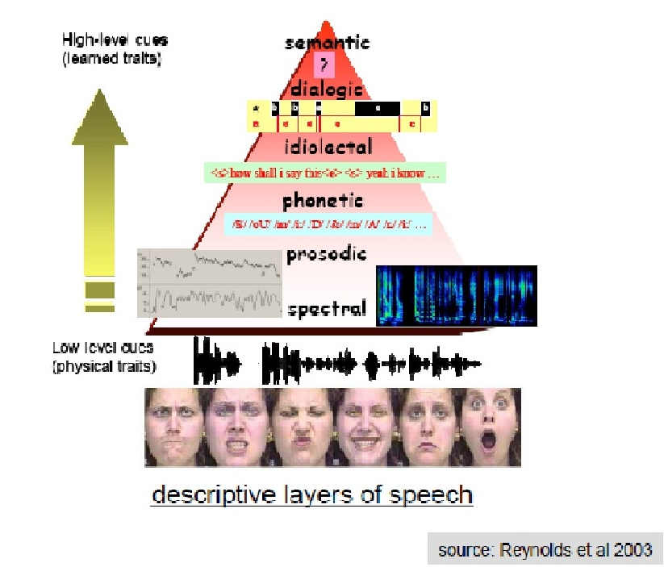
Speech Features
Emotional speech processing is done by either modeling the data using the descriptive layers of speech

Slide 21
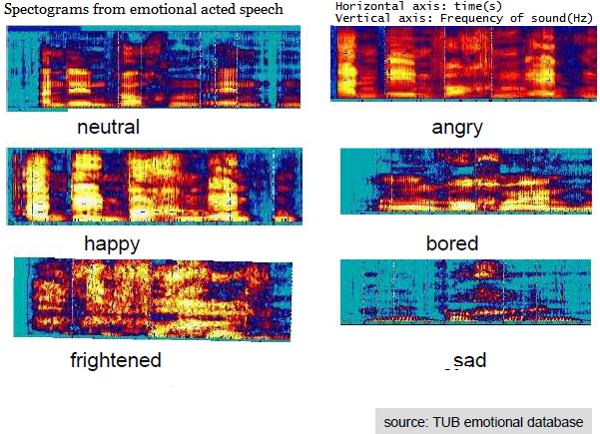
Continued
Or by including emotional data.

Slide 22
Optical Flow
Pattern of ‘apparent’ motion of objects caused by relative motion between observer and object.
Motion is estimated as discrete image displacement using sequences of ordered images taken at every voxel (volumetric pixel) position.
Hence, Optical Flow helps infer motion observer and object, as well as, structure of object and environment.

Slide 23
An Example
Imagine you have a robot embedded with emotional intelligence. The robot comes into your room, looks happy to see you and greets you with a cheery "Good morning." Suppose you are having a bad day, and hence you mumble something it does not understand. It notices your face and vocal tone and infers that you do not appear to be having a good morning. Immediately, it adjusts its internal state to "subdued," which has the effect of lowering its vocal pitch and amplitude settings, eliminating cheery behavioural displays, and suppressing unnecessary conversation. While the robot's speech recognition may not have high confidence that it accurately recognized all of your words, its assessment of your affect and actions indicates a high probability that you are upset and possibly hurt. At this moment it might turn its head with a look of concern, search its empathetic phrases and select, “Are you OK?” or “Can I help you?”
-Dr. Rosalind W. Picard, MIT Media Laboratory

Slide 24
A Computational Model of Emotions
Wright’s CLE model(1997) :
Wright's computational libidinal economy unites the model of an
intelligent system with a learning mechanism and a motivational
Subsystem.
It imitates human brain by considering it as a adaptive-multi-
agent-system(AMAS).
An AMAS is compared to an economic society which works on
production, distribution and consumption.
Both kinds of system consist of a set of mutually connected,
interacting subcomponents that are able to perform work.

Slide 25
CLE Model
Four pillars of CLE :
The libidinal selective system : Libidinal selective system is a
cognitive sub-system whose main task is the development of social relations
The co-native universal equivalent (CUE) : CUE represents the
scalar quantity form of value(like money). CUE is the universal means of
exchange between the substates of the libidinal system.
Credit assignment : In libidinal system, a substate must pay the
substate which supplied the semantic product to which the first substate
reacts. The amount to be paid is decided by credit-assignment.
Circulation of value : It needs a module of the overall system which
observes and registers the internal flow of CUE. At any instant, it
determines the CUE-movement within the system.

Slide 26
Conclusion – A Dilemma
Computers without emotions – not creative or intelligent.
Computers acting on emotions may someday wipe out their creators.
Possible solution : Give computers ability to perceive, express and heuristically act on emotions, but ensure that the emotions are always visible

Slide 27
Acknowledgement
Seminar on “Affective Computing” : Karthik Raman, Adith Swaminathan, Omkar Wagh, Samhita Kasula, CS344, Under Prof. Pushpak Bhattacharya, 2009

Slide 28
References
Feldman : Essentials of Understanding Psychology, McGraw Hill, 2007 (Edition 2)
http://www.scholarpedia.org/article/Affective_computing
http://www.scholarpedia.org/article/Image:Research_areas.jpg
http://www.psychometriclab.com
Ian Wright (2000), "The Society of Mind Requires an Economy of Mind", in the Proceedings of the AISB'00 Symposium on Starting from Society - the Application of Social Analogies to Computational Systems, Birmingham, UK
http://www.ruebenstrunk.de
Wikipedia : Emotions, Emotional Intelligence, Affective Computing, Optical Flow

Slide 29
Thank You!

