Slide 1
Role of Search in Computer Games
CS344 Seminar Presentation
Group 4
Team Members
(In the lexicographic order of roll number):
Adhip Agarwal (07005009)
Raman Sharma (07005010)
Gaurav Malpani (07005011)
Sumit Somani (07005012)
Abhinav Gokari (07005029)

Slide 2
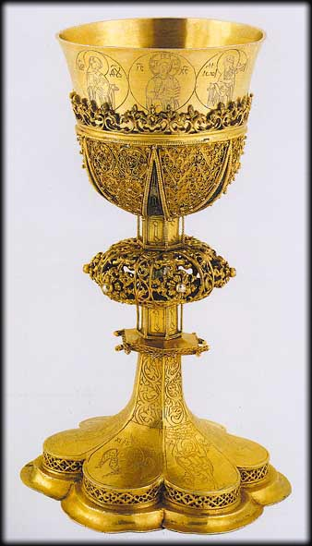
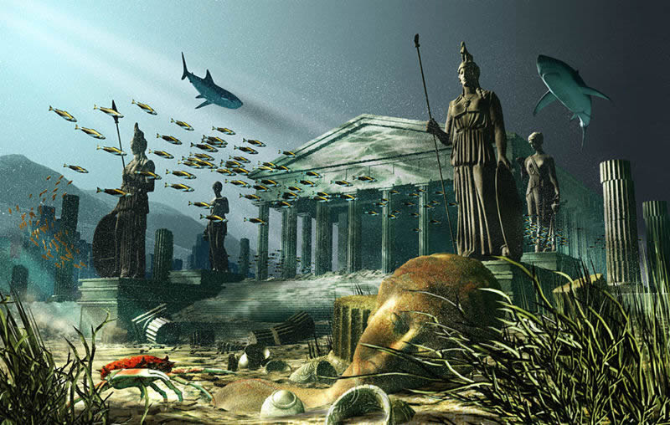
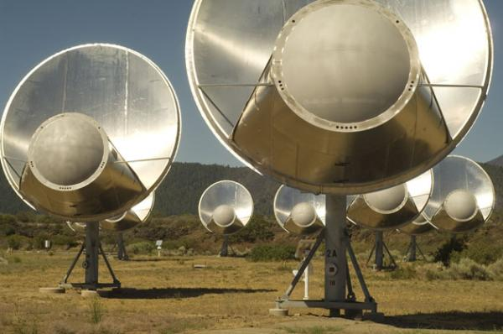
Motivation
Search for Osama
Courtesy Asia News
Search for Holy Grail
The Atlantis City
http://whoyoucallingaskeptic.wordpress.com/2009/02/17/atlantis/
Search for AIDS cure
Search for extra-terrestrial intelligence
The Allen Telescope Array.
(Credit: Image courtesy of SETI Institute)
Hide & Seek
Search Engines

Slide 3
Search
Search is to Try and Find something
In AI, a problem is “a goal and a set of means for achieving that goal”. [Courtesy: Beyond Adversarial: The Case for Game AI as Storytelling ]
Search is the process of exploring the possible ways in which these means can be applied to realize the goal.
Attempt the end, and never stand to doubt.
Nothing's so hard but search will find it out.
- Robert Herrick

Slide 4
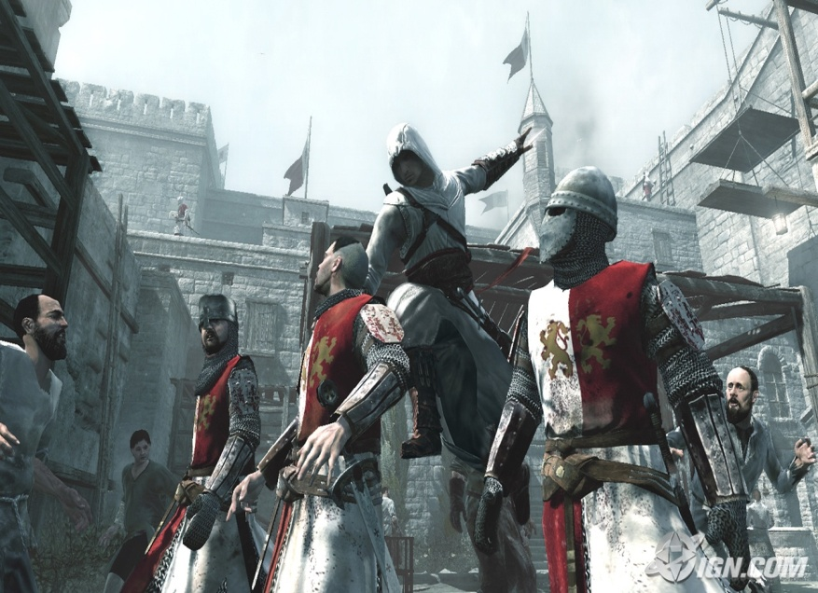
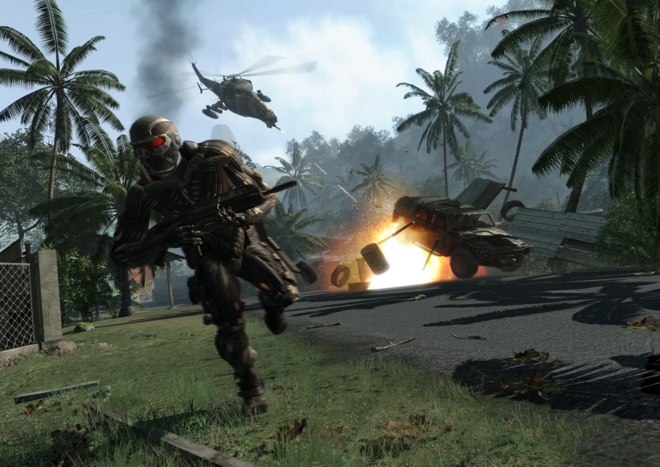
Computer Games
A computer game is a game that involves interaction with a user interface to generate visual feedback on a video device.
(Courtesy : Wikipedia)
Assassin’s Creed
Crysis

Slide 5
Classification of Games
S.No | Type of Game | Examples
1. | Real Time Strategy Games (RTS) | AOE, AOM, WoW.
2. | First-Person Shooter Games (FPS) | Wolfenstein, Counter Strike, Hitman.
3. | Role-Playing Games(RPG) | Sims, Tribal Wars, Khan Wars.
4. | Turn-Based Strategy Games (TBS) | Civilization 4, Heroes of Might & Magic.
5. | Simulation Games (SIM) | GL117, Sims
6. | Sports Games(SPT) | FIFA, PES, Cricket.

Slide 6
Classification of Games (contd.)
 | Perfect Information | Imperfect Information
Deterministic | Go, Chess, Othello, Checkers, etc. | Stratego, Battleships, etc.
Chance | Backgammon, Monopoly, etc. | Bridge, Poker, Scrabble, etc.

Slide 7
When (& Where)
God is a challenge because there is no proof of his existence and therefore the search must continue. – Donald Knuth
If God is everywhere then search is everywhere.
But search in comp. games is not as vague as search for God :P.
It can be summarized as states or places where
There are more than one choices available.
There is controlled change to the outcome of the game.

Slide 8
When (& Where)
“There are more than one choices available.”
In checkers if one player's piece, the other player's piece, and an empty square are lined up, then the first player must "jump" the other player's piece.
OR in chess, if one’s king is under check, and he has only one move to make for the king, then there is no choice for the player but to move the king to that particular block.
No choice → No Search

Slide 9
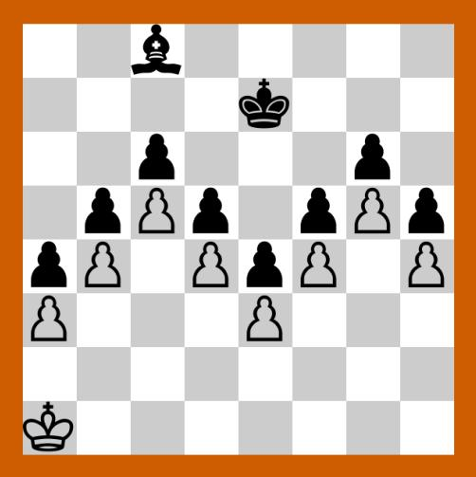
When (& Where)
“There is controlled change to the outcome of the game.”
White – Human Player
Black – AI player
Clearly choices are available, but there would be no change to the outcome of the game so search is useless.
A possible chess game scenario – The pawn wall

Slide 10
What to Search
“Computers are useless. They can only give you answers” – Pablo Picasso
So let us make them useful by giving them the
correct question to find answer to.
Non Trivial and Requires Human Intelligence
In subsequent slides we will study what all we
search for in a computer game

Slide 11
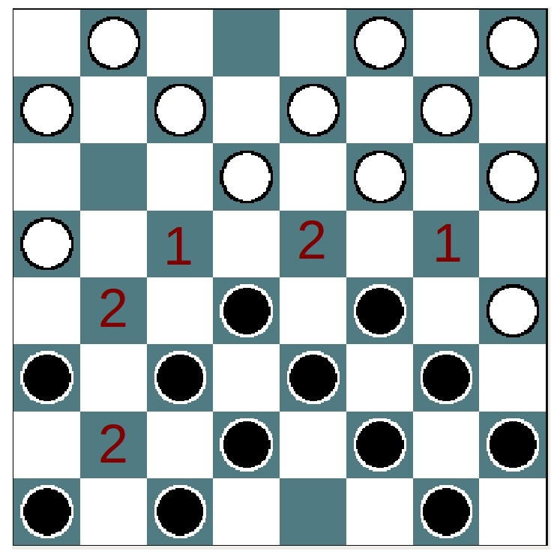
What to Search (contd.)
Search for the optimal choice
Search for the optimal choice among the available choices – This search involves looking for choices available and also metrics for search.
A possible checkers game scenario

Slide 12
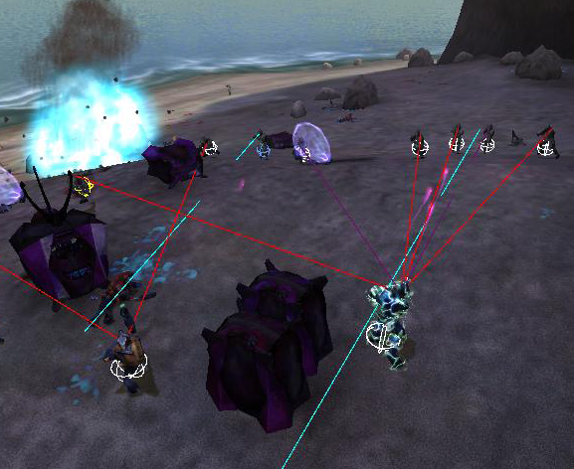
What to Search
Search for information
In games with incomplete information at times, player ( AI specifically ) has to search for information that too in manner that tends to imitate the human capabilities.
“This is my goal. Where should I be standing?” Need a discrete answer to a continuous problem
E g:- AI in Halo imitates techniques like vision, hearing, touch, sense, etc to get information and behave accordingly. In Halo it is done by using multiple ray-casting for vision
Application of ray casting for vision Courtesy : Illusion of Intelligence by C. Butcher and J. Griesemer

Slide 13
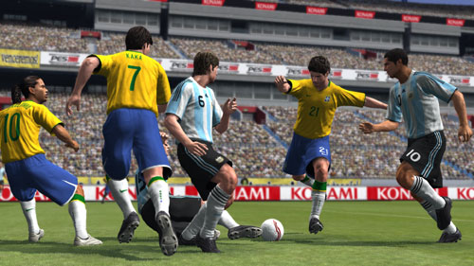
What to Search (contd.)
Search for strategies and patterns
Search & Identify for strategies and patterns of regular player
Develop Counter strategies or improve itself against the same.
Konami PES (2008 onwards) included a component to their AI called as Team Vision which is focussed in improving or evolving over time
But most of our focus would be on Search for the optimal choice among the available choices.
A screenshot of the game PES

Slide 14
Game Tree
Initial State: Initial board position and player.
Operators: One for each legal move
Terminal states: A set of states that mark the end of the game.
Utility function: Assigns numeric values to each terminal state.
Game tree: Represents all possible game scenarios.

Slide 15
How to Search
Brute-force or Uninformed search
A* algorithm
Minimax and its derivatives
Normal
Alpha-Beta Pruning
Iterative Deepening (can also be used with other algorithms)
Expectiminimax for Chance Games
Many more

Slide 16
Brute-force or Uninformed Search
Given the graph of states in a 2-player game, this search uses basic BFS to search for the most optimal move at a given state.
Chinook and Deep Blue are examples of search by brute force, the exploitation of search and knowledge on a heretofore-unprecedented scale. Each of them had a search engine that explored enormous sub trees and supported that search with extensive opening and closing books.
Courtesy : Game Playing: The Next Moves by Susan L. Epstein

Slide 17
Minimax algorithm
Competitive environments, in which the agents’ goals are in conflict, give rise to adversarial search problems – alternatively known as games.
The most prevalent adversarial search algorithm is minimax (Invented by Von Neumann & Morgenstern in 1944 as part of game theory).The idea behind minimax is that an AI player looks ahead to predict the outcome of the different possible moves available to them.
The player’s goal is to maximize payoff, while the opponent’s goal is to maximize their own payoff which amounts to minimizing the player’s payoff (due to the zerosum nature of the game).

Slide 19
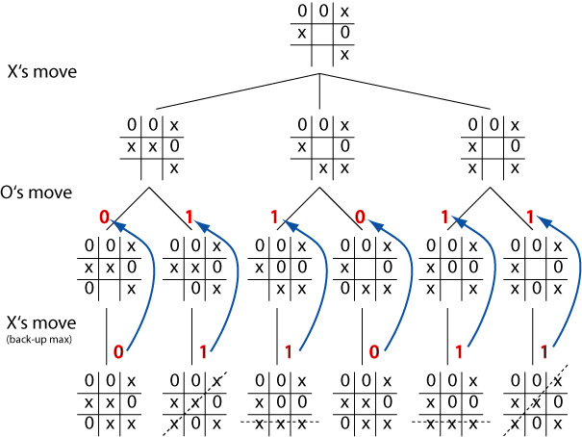
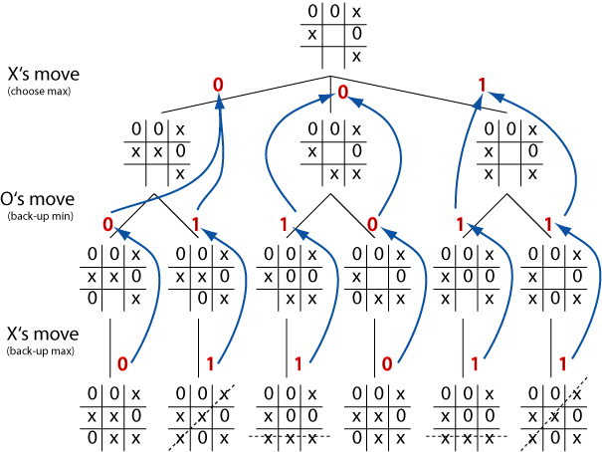
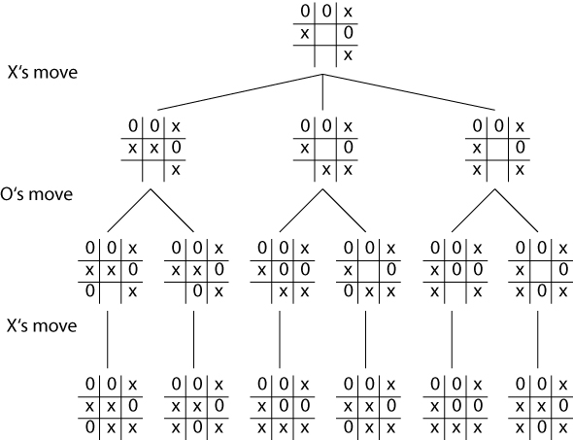
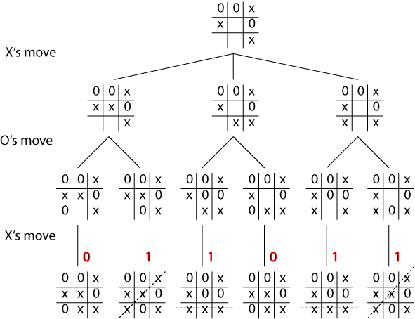
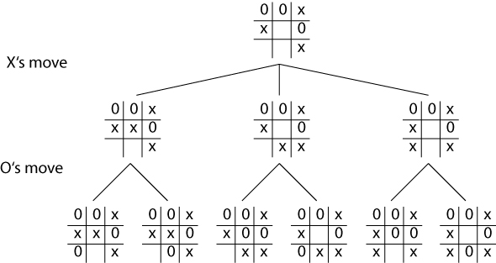
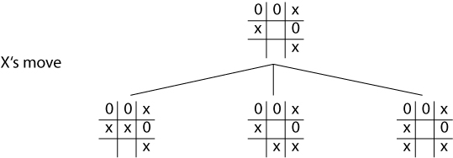
An example
Courtesy : www.cogs.susx.ac.uk/courses/kr/lec05.html

Slide 20
Properties of Minimax
b – branching factor or legal moves at a point
m – maximum depth of the tree
Complete: Yes, if tree is finite (chess has specific rules for this)
Optimal: Yes, against an optimal opponent. Otherwise??
Time complexity: O(b^{m})
Space complexity: O(bm) (depth-first exploration)
For chess, b ~ 35, m ~ 100 for “reasonable” games => exact solution completely infeasible

Slide 21
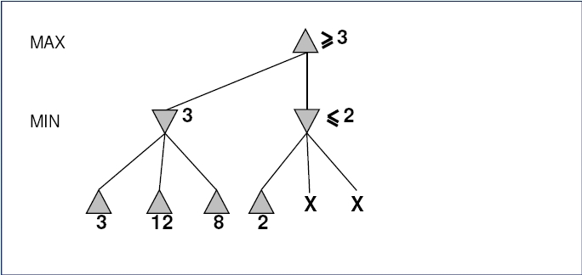
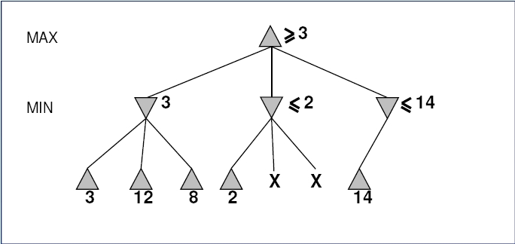
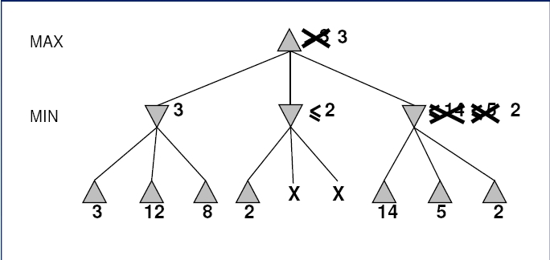
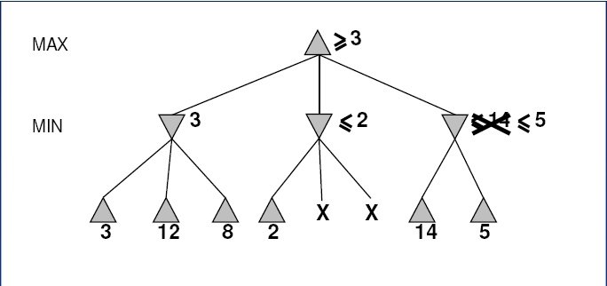
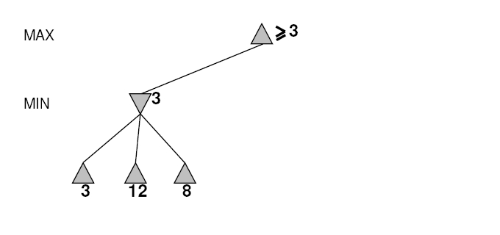
Alpha-Beta Pruning

Slide 22
Alpha-Beta Pruning
α – highest value found along the path so far for MAX
β – lowest value found along the path so far for MIN

Slide 23
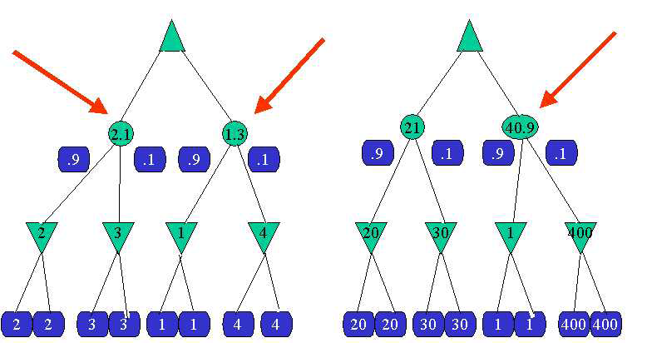
Element of chance
Backgammon is a game which combines both luck and skill. Dice are rolled at the beginning of a player's turn to determine the legal moves, thus a standard game tree can't be constructed.
A game tree in backgammon must include “chance nodes” in addition to MAX and MIN modes.
A typical chance game tree

Slide 24
Limiting Search
The critical problem of search is the amount of time and space necessary to find a solution. As the chess and checkers estimates suggest, exhaustive search is rarely feasible for nontrivial problems. Examining all sequences of n moves, for example, would require operating in a search space in which the number of nodes grows exponentially with n. Such a phenomenon is called a combinatorial explosion.

Slide 25
Limitations of minimax
It requires search all the way to the terminal nodes which becomes infeasible in the context of games which require a move within a certain time limit. The solution is to cut off search earlier. (Programming a computer for playing chess, Shannon, 1950)
The required modifications are:
➢ Utility function => Eval function : Returns an estimate of the expected utility of a game tree node heuristically.
➢ Terminal test => Cutoff test:
if CUTOFFTEST(state, depth) then return EVAL(state)

Slide 26
Evaluation function
Uses a heuristic for estimation of the expected utility of a game tree node. Humans do it all the time because of their limitations in search.
Question: How to design good evaluation functions?
Properties:
✔ Eval(terminal nodes) must be equal to Utility(terminal nodes).
✔ It must be computationally fast.
✔ It must actually give an indication of actual “chances of winning” via its value of a node.

Slide 27
Cutting off search
In general, CUTOFFTEST(state, depth) is designed such that it returns true for all depth ≥ d, and also for all terminal nodes. 'd' is chosen appropriately, so as to meet the time constraints.
“Iterative Deepening” is a robust way of applying this concept, with the feature that when time runs out, the program returns the move selected by the deepest completed search.

Slide 28
Speeding Up Search
Database of standard openings
Thinking on the opponent's time
Iterative Deepening
Transposition table
Move ordering
Specialized hardware
We can take advantage by using a transposition table, a cache of recently visited positions and their minimax values.
Courtesy Adversarial Search By Dana S. Nau, University of Maryland

Slide 29
Search in End games
Aims at making end-game playing completely flawless.
Calculate for all positions for a few end pieces and develop database for all position leading to flawless game.
Uses – It effectively increases the depth algorithms can go while analyzing their moves, as soon as if they reach one of the solved states the job is done.
E.g. – Chinook, the state of the art computer program for checkers, used a database of 444 billion positions with 8 pieces or less to make its endgame flawless.
Deep Blue also uses an enormous end game database containing all positions with 5 pieces and many with 6 pieces.

Slide 30
Search in MMORPG
MMORPG is Massively Multiplayer Online Role Playing Games E.g. –World of Warcraft, Everquest, Tribal wars.
Search to detect problematic behaviour, work against teammates, undue advantages, code hacks, violation of game play conventions
Search for obscene language in text-based communication -an NLP problem
Search for information in databases, to manage games - a database and IT system problem

Slide 31
BEYOND ADVERSARIAL SEARCH
For industrial developers primary design consideration → “fun”
Common in RTS, individual non-player characters (NPCs) in FPS.
Invincible AI creates disinterest
Designers thus dumb down AI systems by limiting
Perceptual Abilities
Computational Resources
West proposes that the use of “intelligent mistakes” is a better approach [6]

Slide 32
E.g. of ILLUSION of INTELLIGENCE
The classic arcade game Pac Man makes the player believe that the enemies hunting him - the ghosts - are intelligent pack-hunters. In fact this perception of group-intelligence is only an illusion. To make sure that the ghosts do not all follow the same route through the maze and to provide them with an individual personality, they are each given a slightly different variation of the same algorithm which is a very simple alternative selection of the direction whenever the ghosts reach a junction in the maze. If a junction is reached the ghost needs to decide whether it should change it's direction or not - sometimes the ghost changes it's direction to move in the direction of the player, sometimes it chooses a random direction.
One ghost may move in a random direction 75% of the time and in the direction of the player in the other 25% of cases when it reaches a junction. Another ghost would have the random choice of direction weighted at 50% of the time etc.

Slide 33
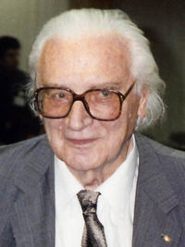
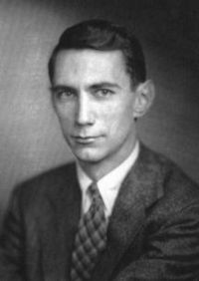
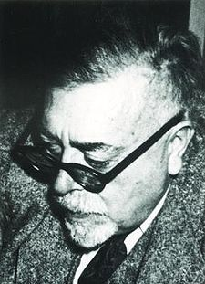
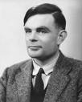
GAMES, SEARCH and AI
Historical Relevance – Search algorithms have been applied to games.
Game Playing – one of the first tasks undertaken by AI
Chess was tackled by
Konrad Zuse,
Claude Shannon,
Norbert Weiner and
Alan Turing
AI researchers find abstract nature of games, an appealing subject for study
Games unlike toy problems are interesting because they are too hard to solve

Slide 34
GAMES, SEARCH and AI
Games are thus interesting (and difficult too)
Some interesting points that games reveal about AI
Perfection is unattainable → Must approximate
Good idea is to think about what to think about
Uncertainty constrains the assignment of values to states

Slide 35
Conclusion
Search is everywhere
Search is core to writing Game AIs
Large number of techniques exist for search and its usage depends on the games involved.
Games and AI problems have strong resemblances, thus generates interest
Search has applications in evolutionary AI, and developing counter-strategies on-fly remains topic for active research.

Slide 36
References
Susan L. Epstein. Game playing: The next moves. In Proceedings of the sixteenth national conference on Artificial intelligence and the eleventh Innovative applications of artificial intelligence conference, pages 987–993. Association for the Advancement of Artificial Intelligence (AAAI), Menlo Park, CA, USA, july 1999.
David L. Roberts, Mark O. Riedl, and Charles L. Isbell. Beyond adversarial: The case for game AI as storytelling. In Atkins Barry, Kennedy Helen, and Krzywinska Tanya, editors, Breaking New Ground: Innovation in Games, Play, Practice and Theory: Proceedings of the 2009 Digital Games Research Association Conference, London, September 2009.

Slide 37
References
Eike Falk Anderson. Playing smart artificial intelligence in computer games. In Proceedings of zfxCON03 Conference on Game Development. ZFX3D Entertainment, 2003.
Stuart J. Russell and Peter Norvig. Artificial Intelligence: A Modern Approach. ISBN 0131038052. Prentice Hall, 2nd edition, December 2002.
Dana S. Nau. Adversarial search. In Encyclopedia of Cognitive Science. Nature Publishing Group, 2002.

Slide 38
References
David Pinelle, Nelson Wong, Tadeusz Stach, and Carl Gutwin. Usability heuristics for networked multiplayer games. In GROUP ’09: Proceedings of the ACM 2009 international conference on Supporting group work, pages 169–178, New York, NY, USA, 2009.
Jaime Griesemer and Chris Butcher. The Illusion of Intelligence : The Integration of AI and Level Design in Halo. Game Developers Conference, 2008.
Mick West, Neversoft cofounder. Intelligent Mistakes: How to Incorporate Stupidity Into Your AI Code. Game Developer magazine, Gamasutra.com, 2009.

Slide 39
References
http://www.gamedev.net/reference/list.asp?categoryid=18
http://www.intelligentgo.org/en/computergo/overview.html
http://www.gamasutra.com/features/index_ai.htm
www.cogs.susx.ac.uk/courses/kr/lec05.html

Slide 40
Thank You
For Your Attention
And Time

Slide 41
Questions???

