Slide 1
CS344: Introduction to Artificial Intelligence
Pushpak Bhattacharyya CSE Dept., IIT Bombay
Lecture 10– Club and Circuit Examples

Slide 2
Resolution - Refutation
man(x) → mortal(x)
Convert to clausal form
~man(x) mortal(x)
Clauses in the knowledge base
~man(x) mortal(x)
man(shakespeare)
mortal(shakespeare)

Slide 3
Resolution – Refutation contd
Negate the goal
~mortal(shakespeare)
Get a pair of resolvents

Slide 4
Resolution Tree
Resolvent₁
Resolvent₂
Resolute

Slide 5
Search in resolution
Heuristics for Resolution Search
Goal Supported Strategy
Always start with the negated goal
Set of support strategy
Always one of the resolvents is the most recently produced resolute

Slide 6
Inferencing in Predicate Calculus
Forward chaining
Given P, , to infer Q
P, match L.H.S of
Assert Q from R.H.S
Backward chaining
Q, Match R.H.S of
assert P
Check if P exists
Resolution – Refutation
Negate goal
Convert all pieces of knowledge into clausal form (disjunction of literals)
See if contradiction indicated by null clause can be derived

Slide 7
P
converted to
Draw the resolution tree (actually an inverted tree). Every node is a clausal form and branches are intermediate inference steps.

Slide 8
Terminology
Pair of clauses being resolved is called the Resolvents. The resulting clause is called the Resolute.
Choosing the correct pair of resolvents is a matter of search.

Slide 9
Himalayan Club example
Introduction through an example (Zohar Manna, 1974):
Problem: A, B and C belong to the Himalayan club. Every member in the club is either a mountain climber or a skier or both. A likes whatever B dislikes and dislikes whatever B likes. A likes rain and snow. No mountain climber likes rain. Every skier likes snow. Is there a member who is a mountain climber and not a skier?
Given knowledge has:
Facts
Rules

Slide 10
Example contd.
Let mc denote mountain climber and sk denotes skier. Knowledge representation in the given problem is as follows:
member(A)
member(B)
member(C)
∀x[member(x) → (mc(x) ∨ sk(x))]
∀x[mc(x) → ~like(x,rain)]
∀x[sk(x) → like(x, snow)]
∀x[like(B, x) → ~like(A, x)]
∀x[~like(B, x) → like(A, x)]
like(A, rain)
like(A, snow)
Question: ∃x[member(x) ∧ mc(x) ∧ ~sk(x)]
We have to infer the 11th expression from the given 10.
Done through Resolution Refutation.

Slide 11
Club example: Inferencing
member(A)
member(B)
member(C)
Can be written as

Slide 12
Negate–

Slide 13
Now standardize the variables apart which results in the following
member(A)
member(B)
member(C)

Slide 14
10
7
12
5
13
4
14
2
11
15
16
13
17
2

Slide 15
Assignment
Prove the inferencing in the Himalayan club example with different starting points, producing different resolution trees.
Think of a Prolog implementation of the problem
Prolog Reference (Prolog by Chockshin & Melish)

Slide 16
Application of Predicate Calculus
Systematic Inferencing
Knowledge Representation
Puzzles
-- Circuit Verification
- Robotics
- Intelligent DB

Slide 17
Circuit Verification
Does the circuit meet the specs?
Are there faults?
are they locatable?

Slide 18
Example : 2-bit full adder
C1 | X2 | X1 | Y | C2
0 | 0 | 0 | 0 | 0
0 | 0 | 1 | 1 | 0
0 | 1 | 0 | 1 | 0
0 | 1 | 1 | 0 | 1
1 | 0 | 0 | 1 | 0
1 | 0 | 1 | 0 | 1
1 | 1 | 0 | 0 | 1
1 | 1 | 1 | 1 | 1
X₁, X₂: inputs; C₁: prev. carry; C₂: next carry; Y: output

Slide 19
K-Map
Y
x2x1
c1
00
01
11
10
0
0 | 1 | 0 | 1
1 | 0 | 1 | 0
1

Slide 20
K-Map (contd..)
C2
x2x1
c1
00
01
11
10
0
0 | 0 | 1 | 0
0 | 1 | 1 | 1
1

Slide 21
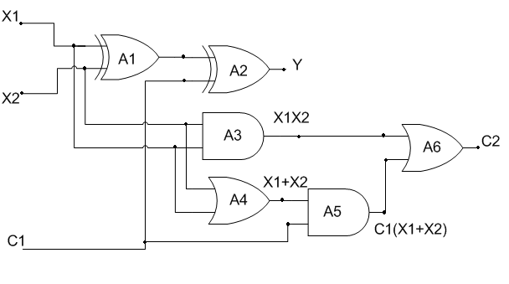
Circuit

Slide 22
Verification
First task (most difficult)
Building blocks : predicates
Circuit observation : Assertion on terminals

Slide 23
Predicates & Functions
Function–1 | signal(t) | t is a terminal ; signal takes the value 0 or 1
Function–2 | type(x) | x is a circuit element; type(x) takes the value AND, OR, NOT, XOR
Predicate – 3 | connected(t1,t2) | t1 is an output terminal and t2 is an input terminal
Function-3 | In(n,x) | n^{th} input of ckt element x
Function-4 | Out(x) | Output of ckt element x

Slide 24
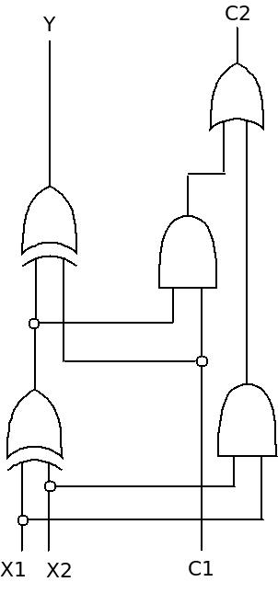
Alternate Full Adder Circuit

Slide 25
Functions
type(X) : takes values AND, OR NOT and XOR, where X is a gate.
in(n, X) : the value of signal at the n^{th} input of gate X.
out(X) : output of gate X.
signal(t) : state at terminal t = 1/0
Predicates
connected(t1,t2): true, if terminal t1 and t2 are connected

Slide 26
General Properties
Commutativity:
∀t₁,t₂ [connected(t₁,t₂) → connected(t₂,t₁)]
By definition of connection:
∀t₁,t₂ [connected(t₁,t₂) → { signal(t₁) = signal(t₁)}]

Slide 27
Gate properties
OR definition:
AND definition:

Slide 28
Gate properties contd…
XOR definition:
NOT definition:

Slide 29
Some necessary functions
no_of_input(x), takes values from N.
Count_ls(x), returns #ls in the input of X

Slide 30
Circuit specific properties
Connectivity:
connected(x₁, in(1,A₁)),
connected(x₁, in(2, A₁)),
connected(out(A₁), in(1, A₂)) ,
connected(c1, in(2, A₂)),
connected(y, out(A₂)) …
Circuit elements:
type(A₁) = XOR,
type(A₂) = XOR,
type(A₃) = AND …

