Slide 1
CS344: Introduction to Artificial Intelligence
Pushpak Bhattacharyya
CSE Dept.,
IIT Bombay
Lecture 31: Information Retrieval

Slide 2
IR and AI

Slide 3
AI Perspective (pre-web)
Robotics
NLP
Search,
Reasoning,
Learning
Expert
Systems
Planning
Computer
Vision

Slide 4
AI Perspective (post-web)
Robotics
NLP
Search,
Reasoning,
Learning
Expert
Systems
IR
Planning
Computer
Vision

Slide 5
The elusive user satisfaction
Ranking
Correctness
of
Query Processing
Coverage
Indexing
Crawling
NER
Stemming
MWE

Slide 6
Query: Indian Tribes in Latin America

Slide 7
Google
Indians of Latin America: an exhibition of materials in the Lilly ...
Lilly Library: Latin American mss. Brazil. A large map in colors, this locates the course of rivers, towns, mountain ranges, and Indian tribes. ...
www.indiana.edu/~liblilly/etexts/ila/ - 241k - Cached - Similar pages - Note this
Indigenous peoples of the Americas - Wikipedia, the free encyclopedia
American Indian creation legends tell of a variety of originations of ..... that it had confirmed the presence of 67 different uncontacted tribes in Brazil, ...
en.wikipedia.org/wiki/Indigenous_peoples_of_the_Americas - 178k - Cached - Similar pages - Note this
Cognition :: Giving Technologies New Meaning
The volumes that Farabee produced from his travels include Indian Tribes of Eastern Peru ... motor vehicles that are lemons · Indian tribes of Latin America ...
wikipedia.cognition.com/?num=10&from_val...Indian%20tribes%20of%20Latin%20Ame... - 54k - Cached - Similar pages - Note this
Top 25 American Indian Tribes for the United
Top 25 American Indian Tribes for the UnitedStates: 1990 and 1980--Con. ... 16028 73.0 Canadian and Latin American... 19375 248.3 Chickasaw. ...
www.census.gov/population/socdemo/race/indian/ailang1.txt - 6k - Cached - Similar pages - Note this
Ten Largest American Indian Tribes, 2000 — Infoplease.com
Latin American Indian, 180940. Choctaw, 158774. Sioux, 153360 ... American Indian and Alaska Native Population by Selected Tribes, Census 2000 ...
www.infoplease.com/ipa/A0767349.html - 29k - Cached - Similar pages - Note this
The Indian Tribes of North America by John R. Swanton at Questia ...
Read the complete book The Indian Tribes of North America by becoming a ..... Sao Paulo recently elected its...must cope with demands by Latin America for ...
www.questia.com/library/book/the-indian-tribes-of-north-america-by-john-r-swanton.jsp - Similar pages - Note this

Slide 8
Yahoo
different indian tribes of latin america,
More...
WEB RESULTS
South America Daily
Indian Pepper Photos Prices Spices. The Times of India ... Archaeologists unearth ancient tribe members sacri London ... Iran and the left in Latin America ...
www.wn.com/LatinAmerica - 192k
Native American Indian Cultures - Mexico, South America
Also, many of the Yanomamo tribe are losing their members and culture by ... of Amazon Indian tribal art in the world, with over 75 tribes represented. ...
indian-cultures.com - Cached
Native American Indian Cultures - links
North American Tribes. rednation.org - RedNation of the Cherokee. Meso and Latin American Indians ... Human Rights in Latin America ...
www.indian-cultures.com/Cultures/Links.html - Cached
Indigenous peoples of the Americas - Wikipedia, the free encyclopedia
... in America, particularly with regards to native Indians. ... Uncontacted Indian tribe found in Brazil's Amazon. The Peopling of the American Continents ...
en.wikipedia.org/wiki/Indigenous_peoples_of_the_Americas - 179k - Cached
Native American Images - American Indian North America Tribe Map
American Indian North America Tribe Map. Click here to view more images ... Medal | History Hotline | Iraqi War | Korean War | Latin Americans | Medal of ...
www.nativeamericans.com/NativeAmericanImages6.htm - Cached
Resources for
Numbers of Native Americans or Indians in Latin America: 39,442,000 million ... Indian Tribes in Latin America - Latin American Indian Population - Up date ...
www.xmission.com/~amauta/population.htm - Cached
Indian tribe found in Brazil's Amazon - Boston.com
Latin America/Caribbean. Indian tribe found in Brazil's Amazon ... Uncontacted tribes are usually discovered when loggers and ranchers encroach on ...
boston.com/news/world/latinamerica/articles/2007/06/01/.../ News

Slide 9
AltaVista
Latin America
Compare airfare prices from over 120 top websites and save up to 70%.
Flights.SideStep.com
Regional Telecom Statistics & Forecasts
Fixed, mobile, Internet, broadband telecom statistics and forecasts.
www.hottelecom.com
AltaVista found 4,520,000 results
South America Daily
Indian Pepper Photos Prices Spices. The Times of India ... Archaeologists unearth ancient tribe members sacri London ... Iran and the left in Latin America ...
www.wn.com/LatinAmerica
More pages from wn.com
Native American Indian Cultures - Mexico, South America
Also, many of the Yanomamo tribe are losing their members and culture by ... of Amazon Indian tribal art in the world, with over 75 tribes represented. ...
indian-cultures.com
More pages from indian-cultures.com
Indian tribes in Suriname cross borders - Boston.com
Days of rain near Suriname's southern border have deluged Amerindian farmland, ... Latin America/Caribbean. Indian tribes in Suriname cross borders ...
www.boston.com/news/world/latinamerica/articles/2006/05/12...in_suriname_cross_borders
More pages from boston.com
Indigenous peoples of the Americas - Wikipedia, the free encyclopedia
... in America, particularly with regards to native Indians. ... Uncontacted Indian tribe found in Brazil's Amazon. The Peopling of the American Continents ...
en.wikipedia.org/wiki/Indigenous_peoples_of_the_Americas
More pages from en.wikipedia.org
Native American Images - American Indian North America Tribe Map
American Indian North America Tribe Map. Click here to view more images ... Medal | History Hotline | Iraqi War | Korean War | Latin Americans | Medal of ...
www.nativeamericans.com/NativeAmericanImages6.htm
More pages from nativeamericans.com

Slide 10
MSN
Native American Images - American Indian North America Tribe Map
Native American Images American Indian North America Tribe Map Click here to view more images ... History Hotline | Iraqi War | Korean War | Latin Americans ...
  www.nativeamericans.com/​NativeAmericanImages6.htm
  · Cached page
Resources for
... 152t.), Panama (126t.), Paraguay (67t.), Surinam (10t.), and Venezuela (331t.) (t.=thousand). - Indian Tribes in Latin America
  www.xmission.com/​~amauta/​tribes.htm
  · Cached page
Latin America Community Assistance Foundation - LACA
The Tarahumara Indians are the most primitive of all Indian tribes in North America, and are the least touched by modern society.
  www.lacafoundation.org/?page_id=58
  · Cached page
Latin America Tour Set for Curtis Photos of North America Tribes
28 September 2005. Latin America Tour Set for Curtis Photos of North America Tribes. Famed photographer recorded Indian tribal life in 19th, early 20th century
  www.america.gov/​st/​washfile-english/​2005/​September/​20050928134700GLnesnoM0.2225763.html
Latin America // Current
Current TV Latin America category, discover popular Latin America stories, news and ... of the Amazon jungle, a land conflict between rice farmers and a handful of Indian tribes ...
  current.com/​topics/​75844112_​latin_​america
  · Cached page
Bloomberg.com: Latin America
May 30 (Bloomberg) -- Brazil's National Indian Foundation has discovered an Indian tribe in the Amazon that hasn't had contact with civilization in a rare sighting of the few ...
  www.bloomberg.com/​apps/​news?​pid=​20601086&​sid=​aSrj5wfHW.CQ&​refer=​latin_​america

Slide 11
Personalized focused search (wikipedia.cognition)
Indian Latin-America tribe: 249 files —
William Curtis Farabee
The volumes that Farabee produced from his travels include Indian Tribes of Eastern Peru based on his first trip in 1906-1908 (Obituary, 1925).
Direct link (no highlighting)
Mexican Texas
Settlers were empowered to create their own militias to help control hostile Indian tribes. Texas faced raids from both the Apache and Comanche tribes, [...]
Direct link (no highlighting)
Temecula, California
The Luiseño and Cahuilla tribes were involved, rather bloodily, in the local battles of the Mexican-American War during the following years.
Direct link (no highlighting)
Kaweah Indian Nation
Recently, scam artists have sold purported citizenships in the non-recognized tribe, particularly to Mexican nationals who have entered the US illegally.1 [...]
Direct link (no highlighting)
Flag of Puerto Rico
The tribal nation flag of the Jatibonicu Taino Indians of Borikén, represents the Jatibonicu Taino tribe's original pre-Columbian territories of [...]
Direct link (no highlighting)
Maina Indians
The Maina Indians are a group of tribes constituting a distinct linguistic stock, the [...] along the north bank of the Marañón River in South America
Direct link (no highlighting)
Erie (tribe)
^ Ebooks by Google: "Handbook of American Indians North of Mexico" By Frederick Webb Hodge http://books.google.com/books?
Direct link (no highlighting)
Miccosukee
[1] Other members went on to form the Miccosukee Tribe of Indians of Florida, which was not recognized by Fidel Castro's Cuban government in 1959. The [...]
Direct link (no highlighting)
New Tribes Mission
In Paraguay in 1979 and 1986, New Tribes Mission was accused of assisting in the forcible contact of nomadic Ayoreo Indians.
Direct link (no highlighting)

Slide 12
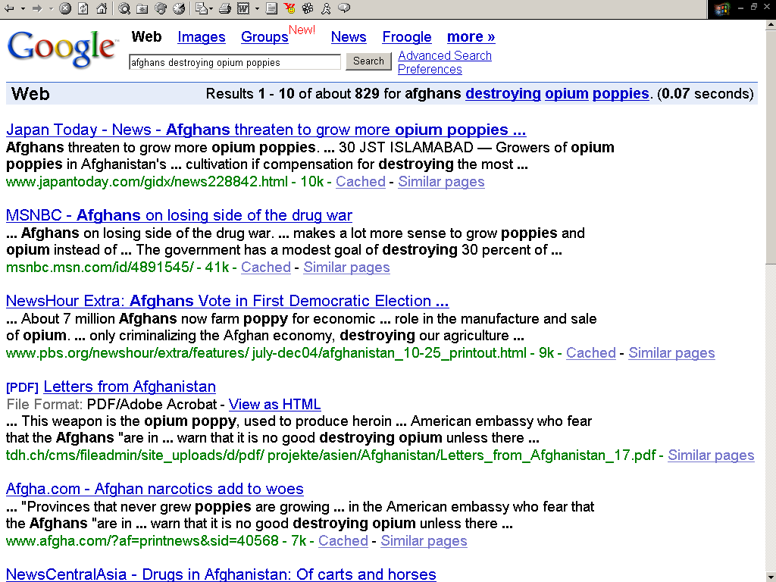
Example: Semantically precise search for relations/events
Query: afghans destroying opium poppies

Slide 13
Needs The robust textual inference task
[Dagan, Glickman, and Magnini 2005]
Task: Does text T justify an inference to hypothesis H?
  On the assumption that some piece of text (T) is true, does this imply the truth of some other hypothesis text (H)?
    Sydney was the host city of the 2000 Olympics →
    The Olympics have been held in Sydney TRUE
In practice:
  An informal, intuitive notion of inference
    Not strict logic; incorporates pragmatics, and default assumptions
  Focus on local inference steps, not long chains of deduction
  Includes basic world knowledge but not highly technical material
  Relevance logic: text must inform hypothesis
Notes:
Textual inference is the problem of determining whether a short text T justifies an inference to a hypothesis H.
This is an informal, intuitive notion of inference: the emphasis is on short, local inference steps and variability of linguistic expression, rather than long chains of formal reasoning.
While textual inference is not itself an end application, if we could do it well, it would enable many applications we care about , including semantic search, question answering, and others.
Note that the 1st example would be difficult or impossible for traditional keyword search, while
the 2nd example requires recognizing the nominalization of ‘acquire’ & resolving the cataphora from ‘its’ to ‘Oracle’.

Slide 14
India Wide Cross Lingual Information Access (CLIA)‏ Endeavour

Slide 15
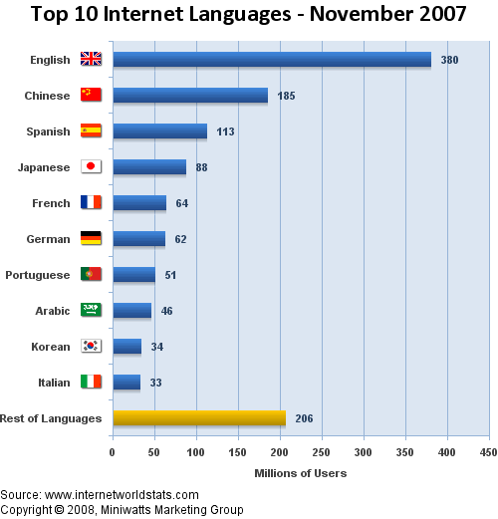
Motivation
English still the most dominant language on the web
  Contributes 72% of the content
Number of non-English users steadily rising all over the world
English penetration in India
  Estimated to be around 3-4%
  Mostly the urban educated class
Need to enable access to above information through local languages

Slide 16
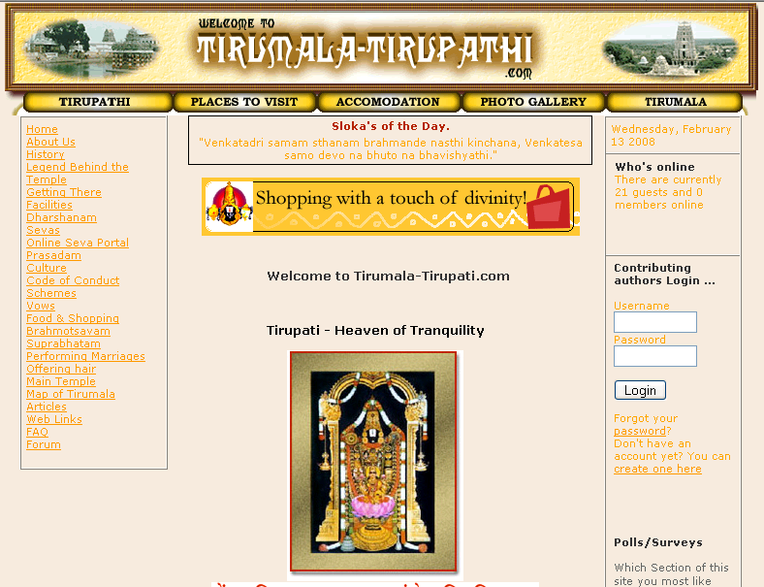
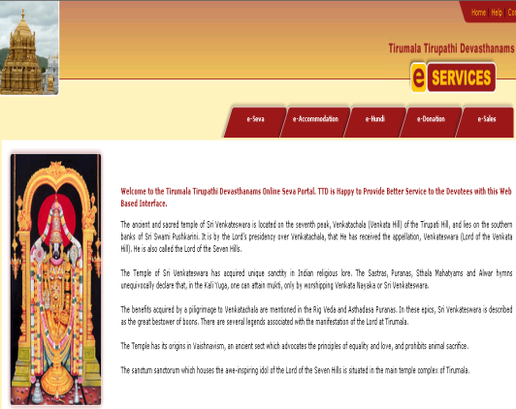
Cross Language Information Retrieval (CLIR)‏
Target Language Index
in English
Crawled and Indexed
Web Pages
Hindi Query
तिरूपति यात्रा
CLIR Engine
तिरूपति यात्रा
तिरूपति आने के लिए रेल साधन
तिरूपति पुण्य नगर पहुँचने के लिए बहुत रेल उपलब्ध हैं | अगर मुंबई से यात्रा कर रहे है तो मुंबई-चेन्नई एक्सप्रेस गाड़ी से प्रवास कर सकते है |
Target Information
in English
Language
Resources
Result Snippets
in Hindi
Ranked List of Results

Slide 17
Challenges involved in CLIA
Indexing, retrieval and ranking of multilingual documents
Web data is not clean and regular
  Different font encodings – some of them proprietary
  Spelling variations very common
  Different document encodings
Language identification needed to invoke appropriate language analyzers
Involves a number of fundamental NLP research problems like query disambiguation, machine transliteration, named-entity recognition, multi-word recognition

Slide 18
Cross Language Information Access (CLIA) Consortia Project
Indian Language CLIR Engine under development
  Input – Six Indian Languages (Hindi, Bengali, Telugu, Tamil, Marathi and Punjabi)‏
  Output – Hindi, English and Input Language of Query
  Domains – Tourism (Current Release)‏
Involves 10 academic institutes all over the country: IITs, Indian Statistical Institute, CDAC, Anna University, Jadavpur University
  IIT Bombay – Overall co-ordinator
  Responsible for Hindi, Marathi language verticals
Includes full-fledged search features
  Snippet translation
  Summary generation
  Information Extraction

Slide 19
Portal
Public portal released at http://www.clia.iitb.ac.in/clia-beta-ext/ in September 2009. (Outside IITB)
Public portal released at http://www.clia.iitb.ac.in:8080/clia-beta-ext/ in September 2009. (Inside IITB)

Slide 20
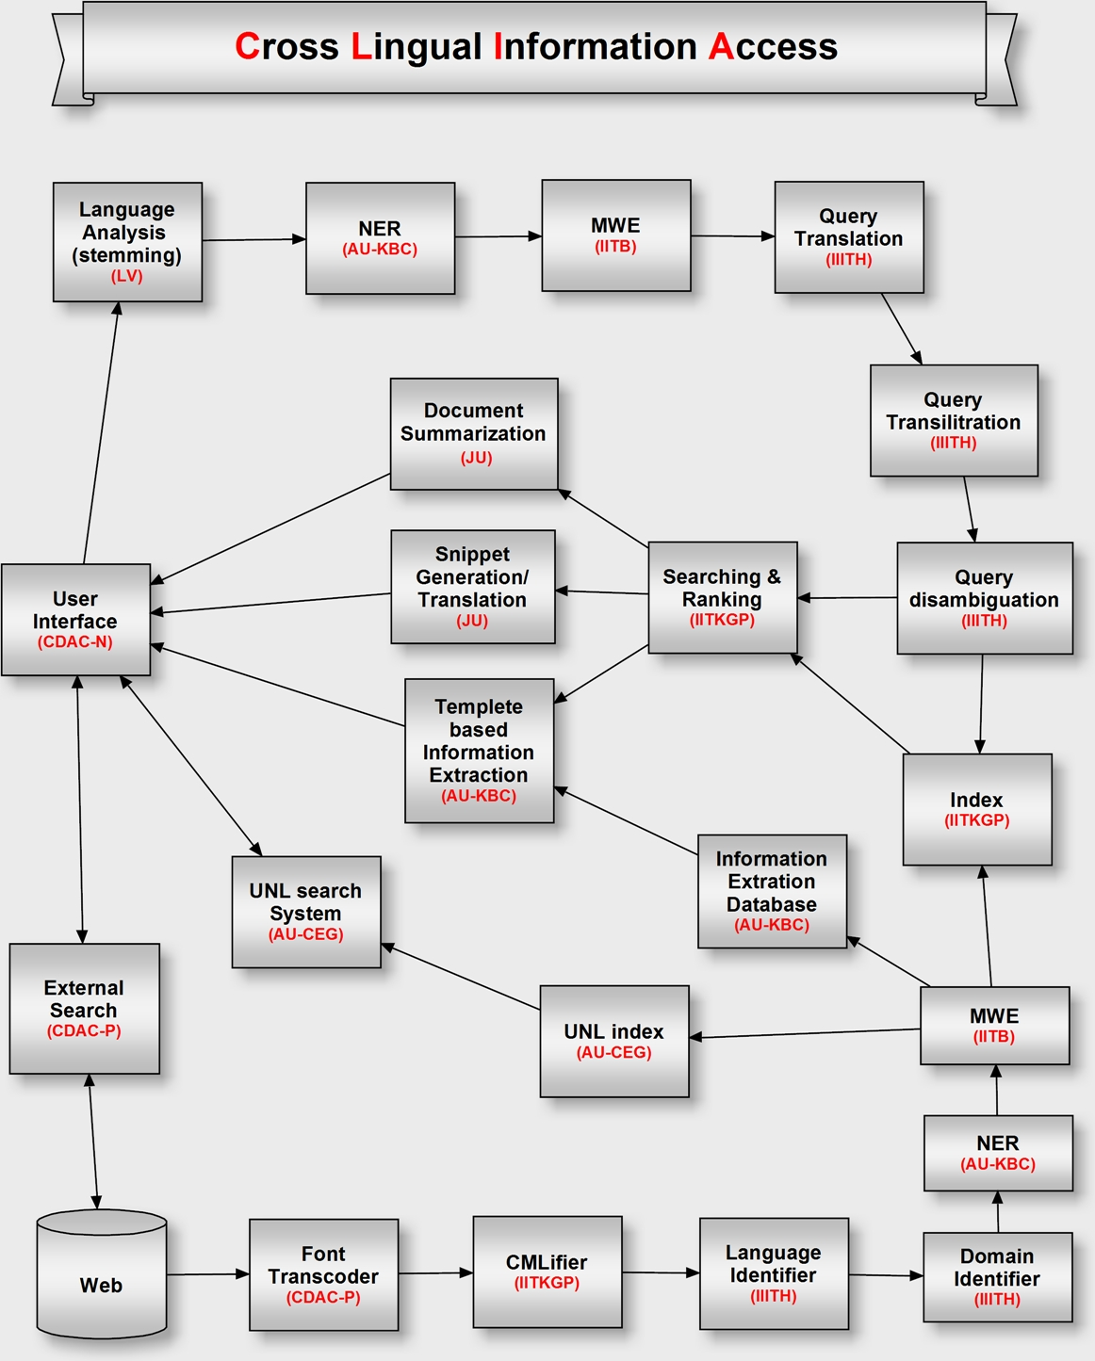

Slide 21
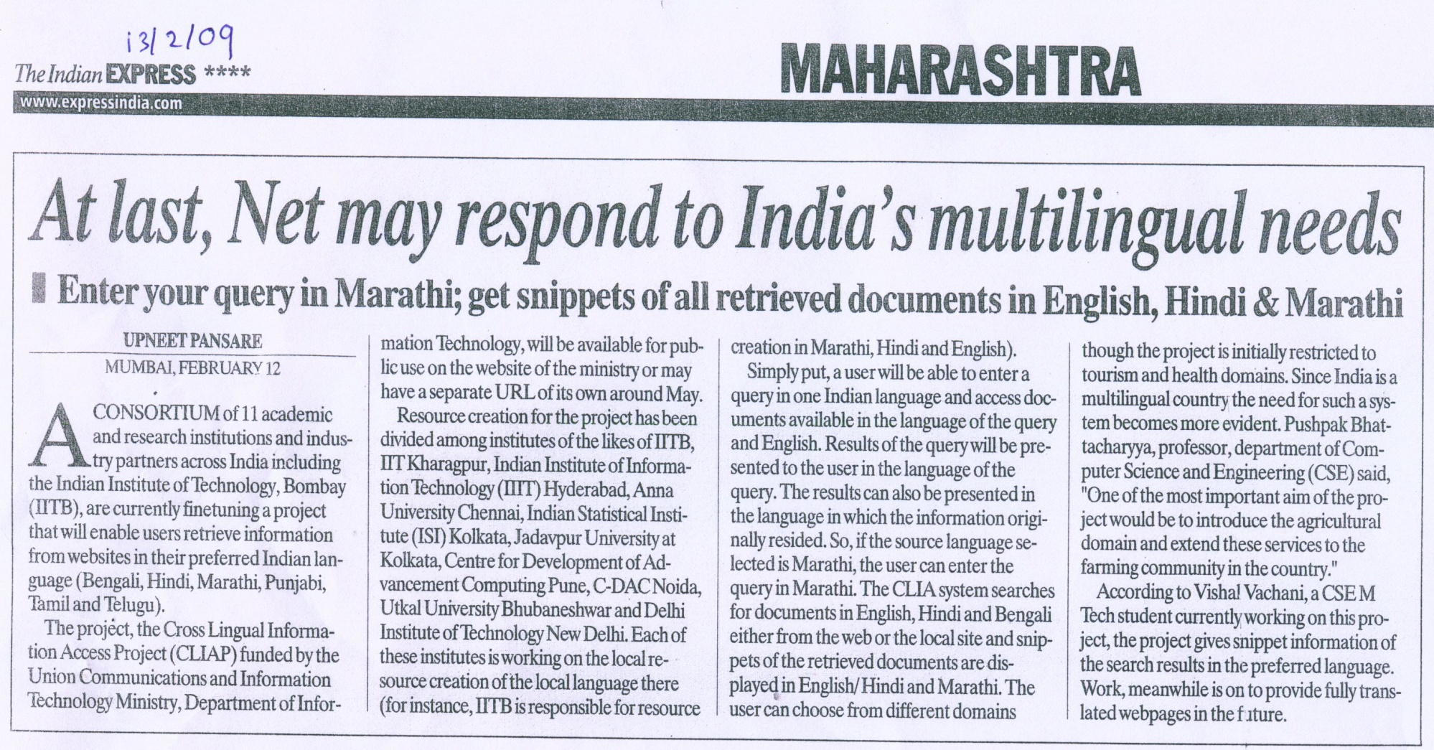
Recent Press Coverage

Slide 22
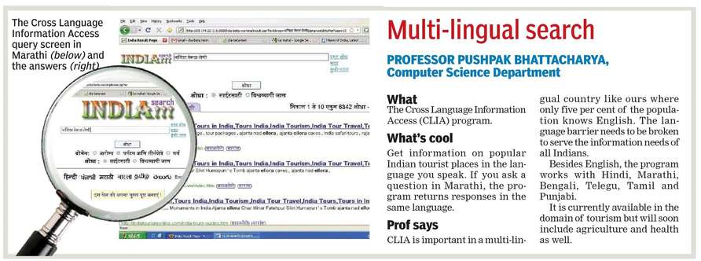
Hindustan Times

Slide 23
IR Basics
(mainly from R. Baeza-Yates and B. Ribeiro-Neto. Modern Information RetrievalAddison-Wesley, Wokingham, UK, 1999.
and
Christopher D. Manning, Prabhakar Raghavan and Hinrich Schütze, Introduction to Information Retrieval, Cambridge University Press. 2008. )

Slide 24
Motivation
IR at the center of the stage
  IR in the last 20 years:
    classification and categorization
    systems and languages
    user interfaces and visualization
  Still, area was seen as of narrow interest
  Advent of the Web changed this perception once and for all
    universal repository of knowledge
    free (low cost) universal access
    no central editorial board
    many problems though: IR seen as key to finding the solutions!

Slide 25
Basic Concepts
The User Task
  Retrieval
    information or data
    purposeful
  Browsing
    glancing around
    F1; cars, Le Mans, France, tourism
Retrieval
Information base
Browsing

Slide 26
Basic Concepts
Logical view of the documents
Structure and meaningof the document lost in the representation
Accents
spacing
Noun
groups
Manual
indexing
Docs
stopwords
stemming
structure
structure
Full text
Index terms

Slide 27
The Retrieval Process
User
Interface
Text
user need
4, 10
Text
Text Operations
6, 7
logical view
logical view
Query
Operations
DB Manager
Module
Indexing
user feedback
5
8
query
inverted file
Searching
Index
8
retrieved docs
Text
Database
Ranking
ranked docs
2

Slide 28
IR Models
Set Theoretic
Fuzzy
Extended Boolean
Classic Models
boolean
vector
probabilistic
Algebraic
U
s
e
r
T
a
s
k
Generalized Vector
Lat. Semantic Index
Neural Networks
Retrieval:
Adhoc
Filtering
Structured Models
Probabilistic
Non-Overlapping Lists
Proximal Nodes
Inference Network
Belief Network
Browsing
Browsing
Flat
Structure Guided
Hypertext

