Slide 1
CS344: Introduction to Artificial Intelligence (associated lab: CS386)
Pushpak Bhattacharyya CSE Dept., IIT Bombay
Lecture 12, 13: Sequence Labeling using HMM- POS tagging; Baum Welch
1st Feb, 2011

Slide 2
POS tagging sits between Morphology and Parsing
Semantics Extraction
Parsing: Syntactic Processing
Rules and
Resources
POS tagging
Morphological Processing

Slide 3
Morph→POS->Parse
Because of this sequence, at the level of POS tagging the only information available is the word, its constituents, its properties and its neighbouring words and their properties
W₀
W₁
W₂
…
W_{i}
W_{i+1}
W_{n-1}
W_{n}
Word of interest

Slide 4
Cannot assume parsing and semantic processing
Parsing identifies long distance dependencies
Needs POS tagging which must finish earlier
Semantic processing needs parsing and POS tagging

Slide 5
Example
Vaha ladakaa so rahaa hai
(that boy is sleeping)
Vaha cricket khel rahaa hai
(he plays cricket)
The fact that “vaha” is demonstrative in the first sentence and pronoun in the second sentence, needs deeper levels of information

Slide 6
“vaha cricket” is not that simple!
Vaha cricket jisme bhrastaachaar ho, hame nahii chaahiye
(that cricket which has corruption in it is not acceptable to us)
Here “vaha” is demonstrative
Needs deeper level of processing

Slide 7
Syntactic processing also cannot be assumed
raam kaa yaha baar baar shyaam kaa ghar binaa bataaye JAANAA mujhe bilkul pasand nahii haai
(I do not at all like the fact that Ram goes to Shyam's house repeatedly without informing (anybody))
"Ram-GENITIVE this again and again Shyam-GENITIVE house any not saying GOING I-dative at all like not VCOP“
JAANAA can be VINF (verb infinitive) or VN (verb nominal, i.e., gerundial)

Slide 8
Syntactic processing also cannot be assumed (cntd.)
raam kaa yaha baar baar shyaam kaa ghar binaa bataaye JAANAA mujhe bilkul pasand nahii haai
The correct clue for disambiguation here is 'raam kaa', and this word group is far apart
One needs to determine the structure of intervening constituents
This needs parsing which in turn needs correct tags
Thus there is a circularity which can be broken only by retaining ONE of VINF and VN.

Slide 9
Fundamental principle of POS tagset design
IN THE TAGSET DO NOT HAVE TAGS THAT ARE POTENTIAL COMPETITORS AND TIE BETWEEN WHICH CAN BE BROKEN ONLY BY NLP PROCESSES COMING AFTER THE PARTICULAR TAGGING TASK.

Slide 10
Computation of POS tags

Slide 11
Process
List all possible tag for each word in sentence.
Choose best suitable tag sequence.

Slide 12
Example
”People jump high”.
People : Noun/Verb
jump : Noun/Verb
high : Noun/Adjective
We can start with probabilities.

Slide 13
Generative Model
^_^
People_N
Jump_V
High_R
._.
Lexical
Probabilities
^
N
N
N
.
V
V
V
Bigram
Probabilities
R
R
R
This model is called Generative model.
Here words are observed from tags as states.
This is similar to HMM.

Slide 14
Example of Calculation from Actual Data
Corpus
^ Ram got many NLP books. He found them all very interesting.
Pos Tagged
^ N V A N N . N V N A R A .

Slide 15
Recording numbers (bigram assumption)
 | ^ | N | V | A | R | .
^ | 0 | 2 | 0 | 0 | 0 | 0
N | 0 | 1 | 2 | 1 | 0 | 1
V | 0 | 1 | 0 | 1 | 0 | 0
A | 0 | 1 | 0 | 0 | 1 | 1
R | 0 | 0 | 0 | 1 | 0 | 0
. | 1 | 0 | 0 | 0 | 0 | 0
^ Ram got many NLP books. He found them all very interesting.
Pos Tagged
^ N V A N N . N V N A R A .

Slide 16
Probabilities
 | ^ | N | V | A | R | .
^ | 0 | 1 | 0 | 0 | 0 | 0
N | 0 | 1/5 | 2/5 | 1/5 | 0 | 1/5
V | 0 | 1/2 | 0 | 1/2 | 0 | 0
A | 0 | 1/3 | 0 | 0 | 1/3 | 1/3
R | 0 | 0 | 0 | 1 | 0 | 0
. | 1 | 0 | 0 | 0 | 0 | 0
^ Ram got many NLP books. He found them all very interesting.
Pos Tagged
^ N V A N N . N V N A R A .

Slide 17
To find
T* = argmax (P(T) P(W/T))‏
P(T).P(W/T) = Π P( t_{i} / t_{i-1} ).P(w_{i} /t_{i})‏
i=1→n+1
P( t_{i} / t_{i-1} ) : Bigram probability
P(w_{i} /t_{i}): Lexical probability
Note: P(w_{i}/t_{i})=1 for i=0 (^, sentence beginner)) and i=(n+1) (., fullstop)

Slide 18
Bigram probabilities

Slide 19
Lexical Probability

Slide 20
Some notable text corpora of English
American National Corpus
Bank of English
British National Corpus
Corpus Juris Secundum
Corpus of Contemporary American English (COCA) 400+ million words, 1990-present. Freely searchable online.
Brown Corpus, forming part of the "Brown Family" of corpora, together with LOB, Frown and F-LOB.
International Corpus of English
Oxford English Corpus
Scottish Corpus of Texts & Speech

Slide 21
Accuracy measurement in POS tagging

Slide 22
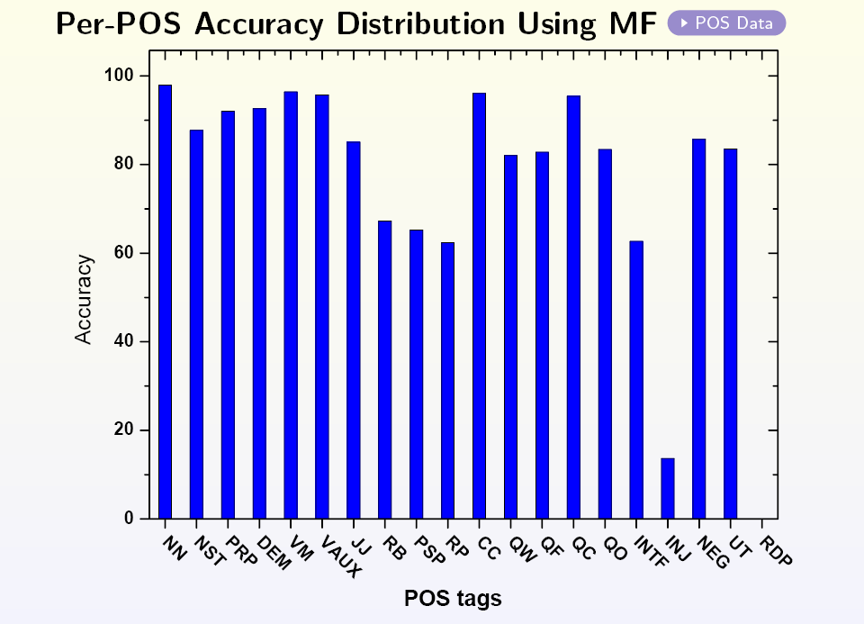
Standard Bar chart: Per Part of Speech Accuracy

Slide 23
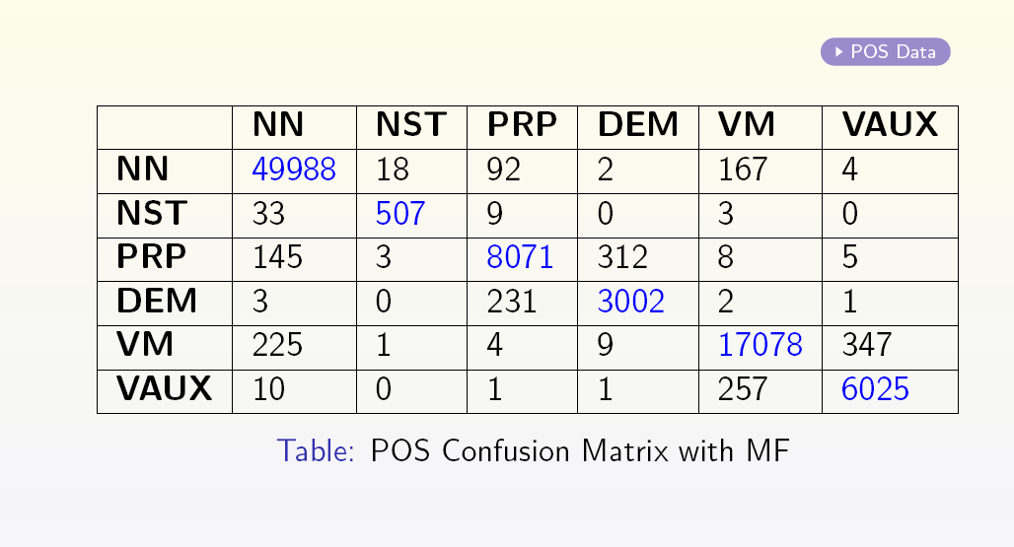
Standard Data: Confusion Matrix

Slide 24
How to check quality of tagging (P, R, F)
Three parameters
Precision P = |A ^ O|/|O|
Recall R = |A ^ O| / |A|
F-score = 2PR/(P+R)
Harmonic mean
Obtained(O)
Actual(A)
A ^ O

Slide 25
Relation between P & R
P is inversely related to R (unless additional knowledge is given)
Precision P
Recall R

Slide 26
Ambiguity problem in POS Tagging
To go – jaana – VNF (infinite verb)
Going – jaana – VN (Gerundial verb)
In general, their POS disambiguation is impossible.

Slide 27
Counting the probability

Slide 28
Context clues
Current word
Model
Look Ahead
Look Before
Generative
Discriminative
HMM
CRF
MEMM

Slide 29
Assignment on
Part of British National Corpus
We will also make available Hindi and Marathi POS tag corpus

Slide 30
Syncretism – Advantage of Hindi over English
Example:
For English: “will go”: both will and go may be noun or verb
For Indic languages: jaaunga word suffixes decides the tag
Marathi and Dravidian language have more word information

Slide 31
Concept of categorials
<category> → <category>al noun → nominal adjective → adjectival verb → verbal adverb → adverbial
Def: An entity that behaves like a <category>
{The boy} plays football
{The boy from Delhi} plays football
The part of the sentence in braces is nominal clause
These can be found using substitution test in linguistics
Distinguishing may be tricky - major cause of accuracy drop

Slide 32
HMM Training
Baum Welch or Forward Backward Algorithm

Slide 33
Key Intuition
a
a
b
a
q
r
b
a
b
b
Given: Training sequence
Initialization: Probability values
Compute: Pr (state seq | training seq)
get expected count of transition
compute rule probabilities
Approach: Initialize the probabilities and recompute them… EM like approach

Slide 34
Baum-Welch algorithm: counts
a, b
a,b
q
_{r}
a,b
a,b
String = abb aaa bbb aaa
Sequence of states with respect to input symbols
o/p seq
State seq

Slide 35
Calculating probabilities from table
Table of counts
T=#states
A=#alphabet symbols
Now if we have a non-deterministic transitions then multiple state seq possible for the given o/p seq (ref. to previous slide’s feature). Our aim is to find expected count through this.
Src | Dest | O/P | Count
q | r | a | 5
q | q | b | 3
r | q | a | 3
r | q | b | 2

Slide 36
Interplay Between Two Equations
w_{k}
No. of times the transitions s^{i}→s^{j} occurs in the string

Slide 37
Illustration
a:0.67
b:0.17
q
r
a:0.16
b:1.0
Actual (Desired) HMM
a:0.04
b:0.48
q
r
a:0.48
b:1.0
Initial guess

Slide 38
One run of Baum-Welch algorithm: string ababb
 |  |  |  |  |  | P(path)
q | r | q | r | q | q | 0.00077 | 0.00154 | 0.00154 | 0 | 0.00077
q | r | q | q | q | q | 0.00442 | 0.00442 | 0.00442 | 0.00442 | 0.00884
q | q | q | r | q | q | 0.00442 | 0.00442 | 0.00442 | 0.00442 | 0.00884
q | q | q | q | q | q | 0.02548 | 0.0 | 0.000 | 0.05096 | 0.07644
Rounded Total → |  |  |  |  |  | 0.035 | 0.01 | 0.01 | 0.06 | 0.095
New Probabilities (P) → |  |  |  |  |  |  | 0.06 =(0.01/(0.01+0.06+0.095) | 1.0 | 0.36 | 0.581
State sequences
* ε is considered as starting and ending symbol of the input sequence string.
Through multiple iterations the probability values will converge.

Slide 39
Computational part (1/2)
w₀ w₁ w₂ w_{k} w_{n-1} w_{n}
S0 → S1 → S1 → … Si → Sj … → Sn-1 → Sn → Sn+1

Slide 40
Computational part (2/2)
w₀ w₁ w₂ w_{k} w_{n-1} w_{n}
S0 → S1 → S1 → … Si → Sj … → Sn-1 → Sn → Sn+1

Slide 41
Discussions
1. Symmetry breaking:
Example: Symmetry leads to no change in initial values
2 Struck in Local maxima
3. Label bias problem
Probabilities have to sum to 1.
Values can rise at the cost of fall of values for others.
a:0.5
b:0.25
s
a:0.25
s
b:1.0
s
a:0.5
s
a:0.5
a:1.0
b:0.5
a:0.25
b:0.5
s
b:0.5
s
Desired
b:0.5
Initialized

