Slide 1
CS344: Introduction to Artificial Intelligence (associated lab: CS386)
Pushpak Bhattacharyya CSE Dept., IIT Bombay
Lecture 20: Neural Networks
28th Feb, 2011

Slide 2
A perspective of AI
Artificial Intelligence - Knowledge based computing
Disciplines which form the core of AI - inner circle
Fields which draw from these disciplines - outer circle.
Robotics
NLP
Search,
RSN,
LRN
Expert
Systems
Planning
CV

Slide 3
Symbolic AI
Connectionist AI is contrasted with Symbolic AI
Symbolic AI - Physical Symbol System Hypothesis
Every intelligent system can be constructed by storing and processing symbols and nothing more is necessary.
Symbolic AI has a bearing on models of computation such as
Turing Machine
Von Neumann Machine
Lambda calculus

Slide 4
Turing Machine & Von Neumann Machine

Slide 5
Challenges to Symbolic AI
Motivation for challenging Symbolic AI
A large number of computations and information process tasks that living beings are comfortable with, are not performed well by computers!
The Differences
Brain computation in living beings TM computation in computers
Pattern Recognition Numerical Processing
Learning oriented Programming oriented
Distributed & parallel processing Centralized & serial processing
Content addressable Location addressable

Slide 6
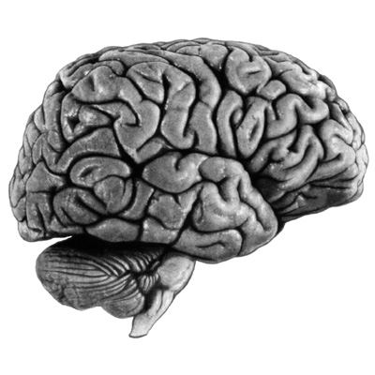
The human brain
Seat of consciousness and cognition
Perhaps the most complex information processing machine in nature

Slide 7
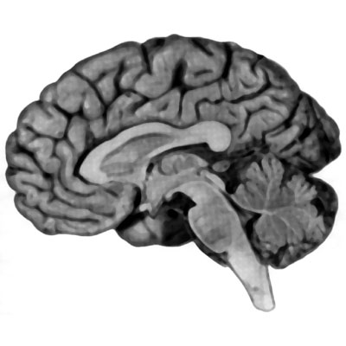
Beginner’s Brain Map
Forebrain (Cerebral Cortex): Language, maths, sensation, movement, cognition, emotion
Midbrain: Information Routing; involuntary controls
Cerebellum: Motor Control
Hindbrain: Control of breathing, heartbeat, blood circulation
Spinal cord: Reflexes, information highways between body & brain

Slide 8
Brain : a computational machine?
Information processing: brains vs computers
brains better at perception / cognition
slower at numerical calculations
parallel and distributed Processing
associative memory

Slide 9
Brain : a computational machine? (contd.)
Evolutionarily, brain has developed algorithms most suitable for survival
Algorithms unknown: the search is on
Brain astonishing in the amount of information it processes
Typical computers: 10⁹ operations/sec
Housefly brain: 10¹¹ operations/sec

Slide 10
Brain facts & figures
Basic building block of nervous system: nerve cell (neuron)
~ 10¹² neurons in brain
~ 10¹⁵ connections between them
Connections made at “synapses”
The speed: events on millisecond scale in neurons, nanosecond scale in silicon chips

Slide 11
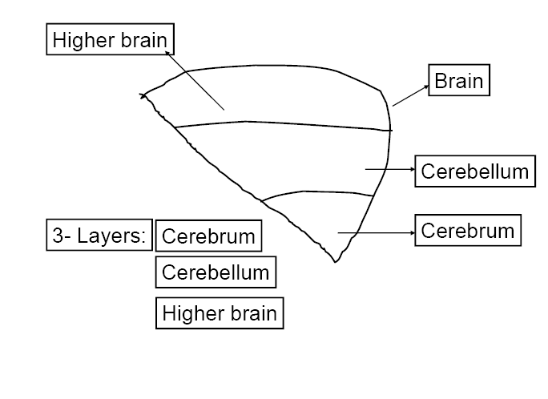

Slide 12
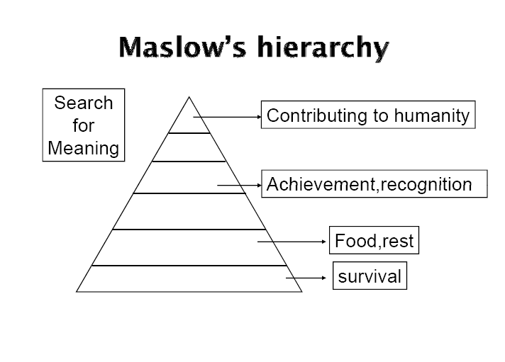

Slide 13
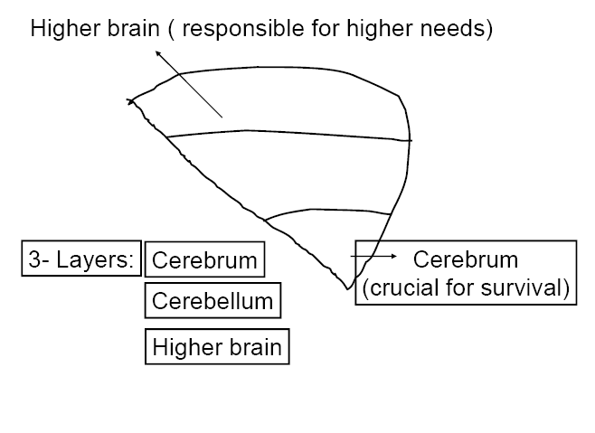

Slide 14
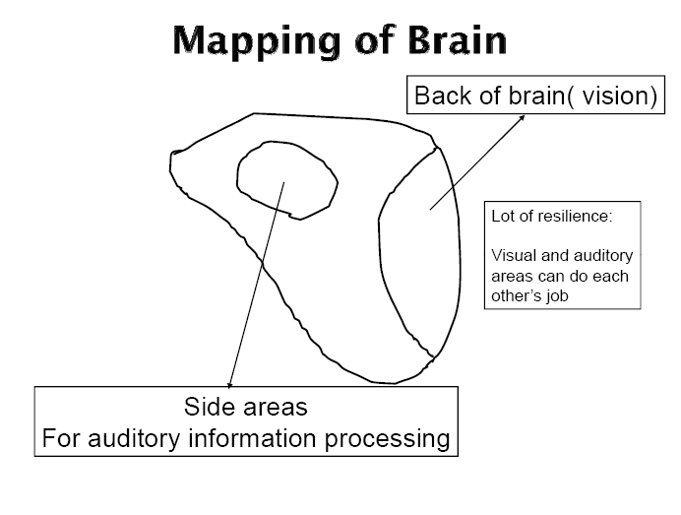

Slide 15
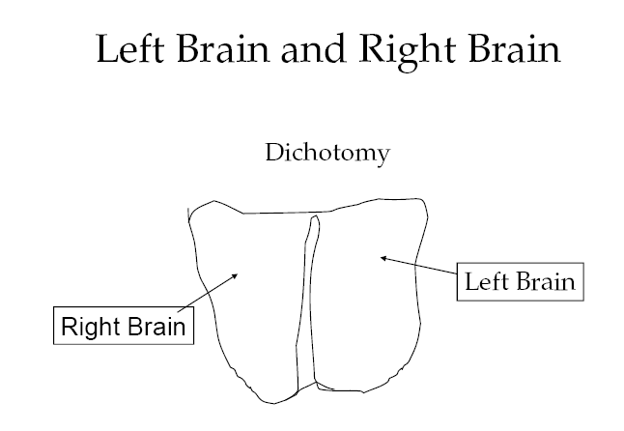

Slide 16
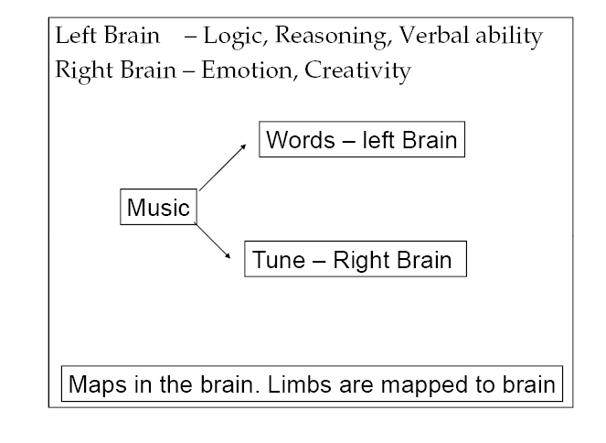

Slide 17
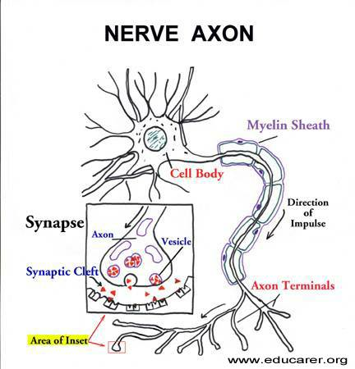
Neuron - “classical”
Dendrites
Receiving stations of neurons
Don't generate action potentials
Cell body
Site at which information
received is integrated
Axon
Generate and relay action
potential
Terminal
Relays information to
next neuron in the pathway
http://www.educarer.com/images/brain-nerve-axon.jpg

Slide 18
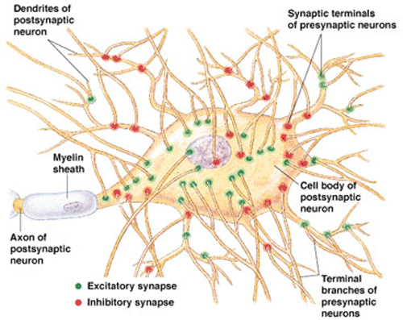
Computation in Biological Neuron
Incoming signals from synapses are summed up at the soma
, the biological “inner product”
On crossing a threshold, the cell “fires” generating an action potential in the axon hillock region
Synaptic inputs: Artist’s conception

Slide 19
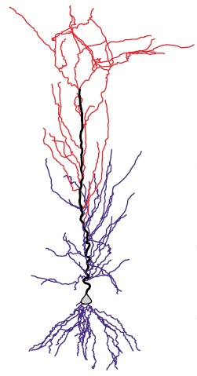
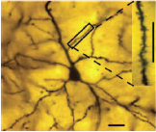
The biological neuron
Pyramidal neuron, from the amygdala (Rupshi et al. 2005)
A CA1 pyramidal neuron (Mel et al. 2004)

Slide 20
Perceptron

Slide 21
The Perceptron Model
A perceptron is a computing element with input lines having associated weights and the cell having a threshold value. The perceptron model is motivated by the biological neuron.
Output = y
Threshold = θ
w_{n}
w₁
W_{n-1}
x₁
X_{n-1}

Slide 22
y
1
θ
Σw_{i}x_{i}
Step function / Threshold function
y = 1 for Σw_{i}x_{i} >=θ
=0 otherwise

Slide 23
Features of Perceptron
Input output behavior is discontinuous and the derivative does not exist at Σw_{i}x_{i} = θ
Σw_{i}x_{i} - θ is the net input denoted as net
Referred to as a linear threshold element - linearity because of x appearing with power 1
y= f(net): Relation between y and net is non-linear

Slide 24
Computation of Boolean functions
AND of 2 inputs
X1 x2 y
0 0 0
0 1 0
1 0 0
1 1 1
The parameter values (weights & thresholds) need to be found.
y
θ
w₁
w₂
x₁
x₂

Slide 25
Computing parameter values
w1 * 0 + w2 * 0 <= θ ➔ θ >= 0; since y=0
w1 * 0 + w2 * 1 <= θ ➔ w2 <= θ; since y=0
w1 * 1 + w2 * 0 <= θ ➔ w1 <= θ; since y=0
w1 * 1 + w2 *1 > θ ➔ w1 + w2 > θ; since y=1
w1 = w2 = = 0.5
satisfy these inequalities and find parameters to be used for computing AND function.

Slide 26
Other Boolean functions
OR can be computed using values of w1 = w2 = 1 and = 0.5
XOR function gives rise to the following inequalities:
w1 * 0 + w2 * 0 <= θ ➔ θ >= 0
w1 * 0 + w2 * 1 > θ ➔ w2 > θ
w1 * 1 + w2 * 0 > θ ➔ w1 > θ
w1 * 1 + w2 *1 <= θ ➔ w1 + w2 <= θ
No set of parameter values satisfy these inequalities.

Slide 27
Threshold functions
n # Boolean functions (2^2^n) #Threshold Functions (2^{n2})
1 4 4
2 16 14
3 256 128
64K 1008
Functions computable by perceptrons - threshold functions
#TF becomes negligibly small for larger values of #BF.
For n=2, all functions except XOR and XNOR are computable.

