Slide 1
Consistency Rationing in the Cloud: Pay only when it matters
Tim Kraska, Martin Hentschel, Gustavo Alonso, Donald Kossmann
27.09.2009 Systems
Modified by
Raja Amadala - 08305078
Sandeep N - 08305063

Slide 2
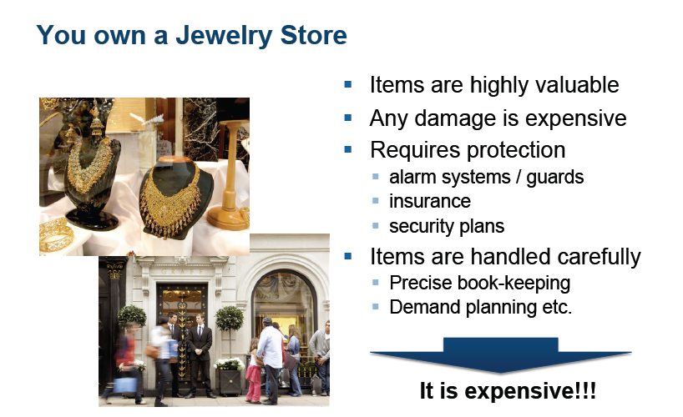

Slide 3
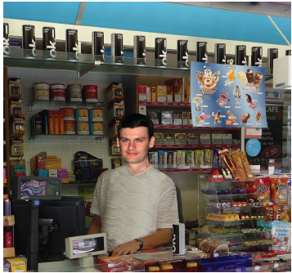
You own a Kiosk
Items are not as valuable
Strong protection is not required
It is easier to handle
Less expensive
It scales better
Of course,
more can go wrong!

Slide 4
Key Observation
Not all data needs to be treated at the same level consistency
Eg : Web shop : Credit card information
User Preferences – (who bought this item
also …)
Why :
Why we are looking at data divisions ?
Consistency
In cloud storage consistency not only determines correctness but also the actual cost per transaction.

Slide 5
Relation between cost, consistency and transaction
We are using cloud database services
For that we have to pay
In terms of transaction basis
How we are going to measure the transaction cost.
Number of service calls
For higher consistency – more number of service calls needed.
For lower consistency – less number of service calls enough.

Slide 6

Consistency Rationing - Idea
Strong consistency is expensive
ACID prevents scaling & availability
But not everything is worth gold!
Transaction Cost vs. Inconsistency Cost
Use ABC-analysis to categorize the data
Apply different consistency strategies per category

Slide 7
Outline
▪ Consistency Rationing
▪ Adaptive Guarantees
▪ Implementation & Experiments
▪ Conclusion and Future Work

Slide 8
Outline
▪ Consistency Rationing
▪ Adaptive Guarantees
▪ Implementation & Experiments
▪ Conclusion and Future Work

Slide 9
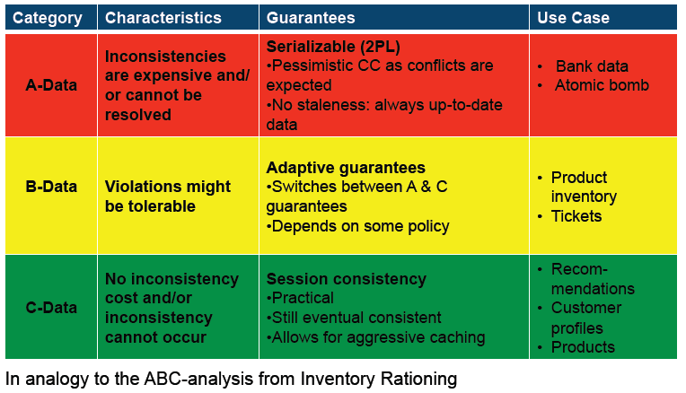
Consistency Rationing (Classification)

Slide 10
Consistency Rationing (Category A)
Serializability
Always stays consistent
In cloud – expensive
  transaction cost
  Performance issues
Complex protocols needed
Require more interaction with additional services (e.g., lock services, queuing services)
Higher cost
Lower performance(response time)
2PL protocol, serializability.

Slide 11
Consistency Rationing (Category C)
Session consistency
It is the minimum consistency level
Below this – application can’t see it’s own updates
Connects system in terms of Sessions
System guarantees read-your-own-writes monotonicity.
Session of different clients will not always see each other’s updates.
Only uses Eventual consistency
Conflict resolution in terms of type of updates
Non –commutative updates (overrides)
Commutative updates (numerical operations e.g., add)
It is very cheap
Permits extensive caching
Should always place data in C- category

Slide 12
Consistency Rationing (Category B)
Adaptive consistency
Switches between Serializability and Session consistency

Slide 13
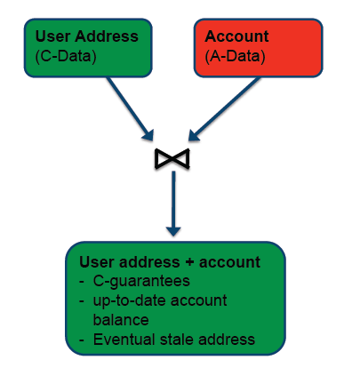
Consistency Rationing – Transactions on mixes
Consistency guarantees per category instead of transaction level
Different categories can mix in a single operation/transaction
For joins, unions, etc, the
lowest category wins
Issues: transactions may see different consistency levels

Slide 14
Outline
▪ Consistency Rationing
▪ Adaptive Guarantees
▪ Implementation & Experiments
▪ Conclusion and Future Work

Slide 15
Adaptive Guarantees for B-Data
▪ B-data: Inconsistency has a cost, but it might be tolerable
▪ Often the bottleneck in the system
▪ Here, we can make big improvements
▪ Let B-data automatically switch between A and C guarantees
▪ Use policy to optimize:
Transaction Cost vs. Inconsistency Cost

Slide 16
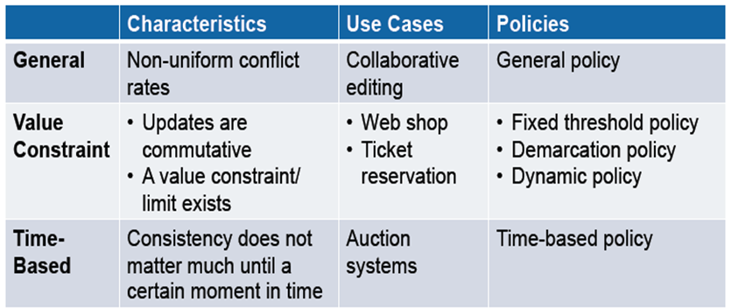
B-Data Consistency Classes

Slide 17
General Policy - Idea
Apply strong consistency protocols only if the likelihood of a conflict is high
1. Gather temporal statistics at runtime
2. Derive the likelihood of an conflict by means of a simple stochastic model
3. Use strong consistency if the likelihood of a conflict is higher than a certain threshold
Consistency becomes a probabilistic guarantee

Slide 18
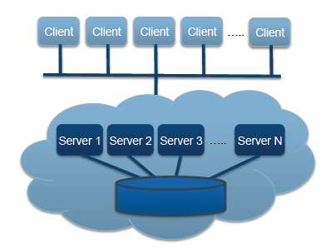
General Policy - Model
▪ n servers
▪ Servers cache data with
cache interval - CI
▪ Load equally distributed
▪ Two updates considered as
a conflict
▪ Conflicts for A and B data
can be detected and resolved after every CI
▪ Every server makes local
decisions
(no synchronization)

Slide 19
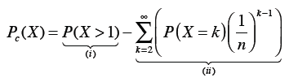
General Policy - Model
Likelihood of a conflict inside one CI
X is a stochastic variable corresponding to the number of updates to the same record within the cache interval.
P(X > 1) is the probability of more than one update over the same record in one cache interval.
the probability that the concurrent updates happen on the same server

Slide 20


General Policy - Model
Simplification of this equation using Poisson process
λ - arrival rate -

Slide 21
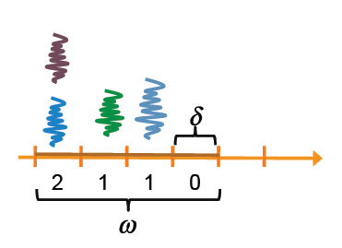
General Policy – Temporal Statistics
On every server: Collect update rate for a window ω with sliding factor per item
▪ Window size ω is a smoothing
factor
▪ Sliding factor and window size
influence adaptability and space
Requirement
▪ Sliding factor specifies the granularity which the window moves

Slide 22

General Policy – Temporal Statistics
All complete intervals of a window build a histogram of the updates.
Larger window size – better the statistics
Issues also present – like hot spot data
We can calculate arrival rate λ (useful at Model)
X – is arithmetic mean of the number of the updates to a record
n – number of servers
δ - Sliding factor
Issues: local statistics can easily mislead the statistics
So local statistics can combined into a centralized view. Broadcast statistics from time to time to all other servers.

Slide 23
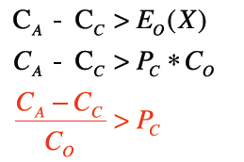
General Policy – Setting the Threshold
▪ Use strong consistency if the savings are bigger than the penalty cost
▪ Cost of A transaction
▪ Cost of C transaction
▪ Cost of inconsistency (O)

Slide 24
Numeric Data – Value Constraint
Most of the conflicting updates around numerical values.
Eg., : Stock of items in a store.
Available tickets in a reservation system
Often characterized by integrity constraint defined limit
Optimize the general policy by considering the actual update values to decide on which consistency level enforce

Slide 25

Numeric Data – Value Constraint
Fixed threshold policy
value is below a certain threshold, the record is handled under strong consistency
Current value – amount <= Threshold
Issues : Inconsistency can occur if the sum of all updates on different servers let the value under watch drop below the limit.
Finding the optimal Threshold - experimentally determine over time.
Static threshold.

Slide 26

Numeric Data – Value Constraint
Demarcation policy
The idea of the protocol is to assign a certain amount of the value (e.g., the stock) to every server with overall amount being distributed across the servers.
Servers may request additional shares from other servers
n – number of the servers
v – value
T - Threshold
Issues : Large number of servers n, so this policy will treat B data as A data. All most all transactions require locking

Slide 27
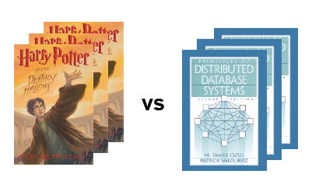
Value Constraint – Dynamic Policy
Apply strong consistency protocols only if the likelihood of violating a value constraint becomes high
▪ Commutative updates
▪ Without loss of generality
the limit is assumed to be “0”
▪ Assumptions as for the
general policy
▪ Statistics: Value change
over time

Slide 28

Numeric Data – Value Constraint
Dynamic policy:
It implements probablistic consistency guarantees by adjusting threshold.
Y is a stochastic variable corresponding to the sum of update values within the cache interval CI.

Slide 29



Dynamic policy:
Temporal statistics:
probability density function (PDF) f for the cache interval.

Slide 30


Dynamic policy:
Using central limit theorem- approximating the CDF

Slide 31
Outline
▪ Consistency Rationing
▪ Adaptive Guarantees
▪ Implementation & Experiments
▪ Conclusion and Future Work

Slide 32
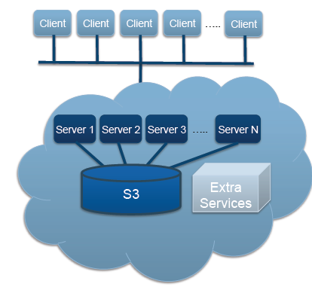
Implementation
▪ Architecture of “Building a
DB on S3” [Sigmod08]
▪ Extended protocols
▪ Additional services
▪ Locking Service
▪ Reliable Queues
▪ Counter Service
▪ Every call is priced
▪ Approach is not restricted
to this architecture
▪ PNUTS
▪ Distributed DB
▪ Traditional DB

Slide 33
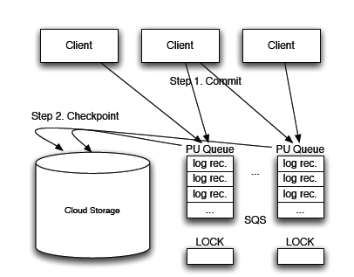
Implementation

Slide 34
Implementation
Session consistency
Serializability
Meta data
Implementation Alternative using PNUT

Slide 35
Experiments
Modified TPC-W
▪ No refilling of the stock
▪ Different demand distributions
▪ Stock is uniformly distributed between 10-100
▪ Order mix (up to 6 items per basket (80-20 rule)
▪ 10 app servers, 1000 products
▪ but up to 12,000 products are sold in 300sec
▪ Rationed consistency
Results represent just one possible scenario!!!

Slide 36
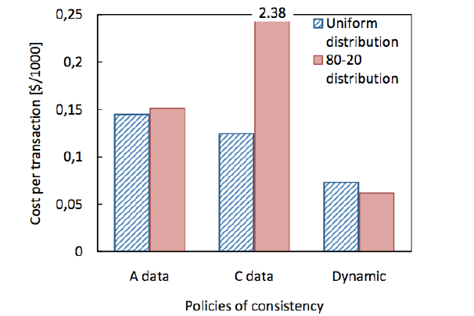
Overall Cost (including the penalty cost)
per TRX [$/1000]

Slide 37
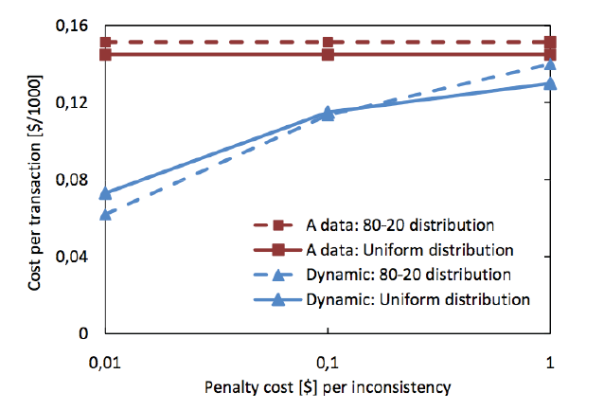
Overall Cost per TRX [$/1000], vary penalty costs

Slide 38
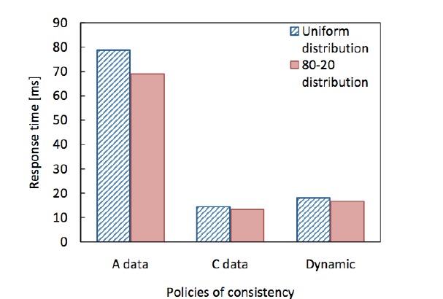
Response Time [ms]

Slide 39
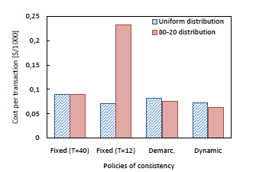
Cost per TRX [$/1000]

Slide 40
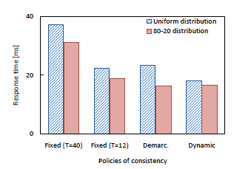
Response Time [ms]

Slide 41
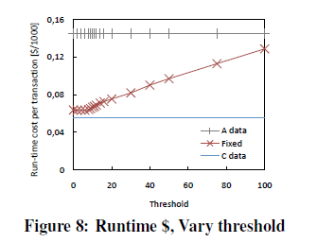

Slide 42
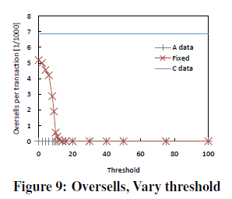

Slide 43
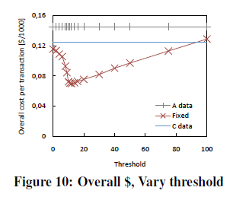

Slide 44
Conclusion and Future Work
▪ Rationing the consistency can provide big performance and cost benefits
▪ With consistency rationing we introduced the notion of probabilistic consistency guarantees
▪ Self-optimizing system – just the penalty cost is required
▪ Future work
▪ Applying it to other architectures
▪ Other optimization parameters (e.g. energy)
▪ Better and faster statistics

