Slide 1
MillWheel: Fault-Tolerant Stream Processing at Internet Scale
Tyler Akidau et all.
Google VLDB 2013
CS 632 Advanced Database Systems
13/03/2016

Slide 2
Outline
Motivation/Introduction
Running Example
System Overview and Concepts
MillWheel API
Fault Tolerance
Implementation And results

Slide 3
Motivation
Characteristics of Data Input:
Fast
Continuous
Real Time input and output
Example:
Google’s “Web Query Trend Tracker” called Zeitgeist

Slide 4
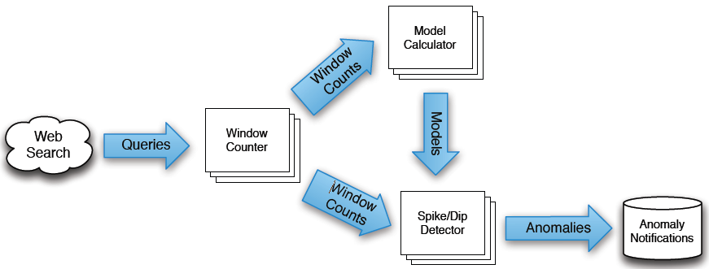
Google Zeitgeist

Slide 5
Requirements For MillWheel
Real time processing of data
Persistent State Abstraction to user
Out-of-order data handling
Monotonically increasing low-watermark
Low latency at high scalability
Guaranteed exactly once delivery

Slide 6
System Overview
At high level, MillWheel is graph of Computations
Computations parallelized over machines
User not concerned about specifying these low level details
User Specifies:
Directed Computations Graph
Application logic for each Computation Node
User can add/remove computations dynamically without restarting entire system.

Slide 7
System Overview
Delivery Guarantees:
Internal updates atomically checkpointed per key
Records delivered exactly once
Per key aggregation

Slide 8
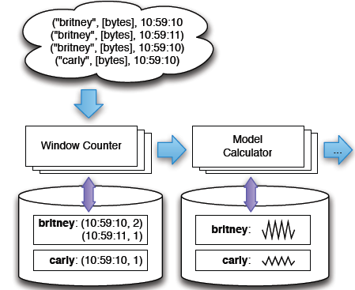
System Overview
Input to computation is represented as Triplet:
<Key, Value, TimeStamp>
Key: metadata field with semantic meaning
Value: Byte string for entire record
TimeStamp: assigned by users

Slide 9
Computation
Holds Application Logic
Invoked on receipt on incoming record or trigger timeout
Code operates in context of single key
Agnostic about distribution of keys on different machines

Slide 10
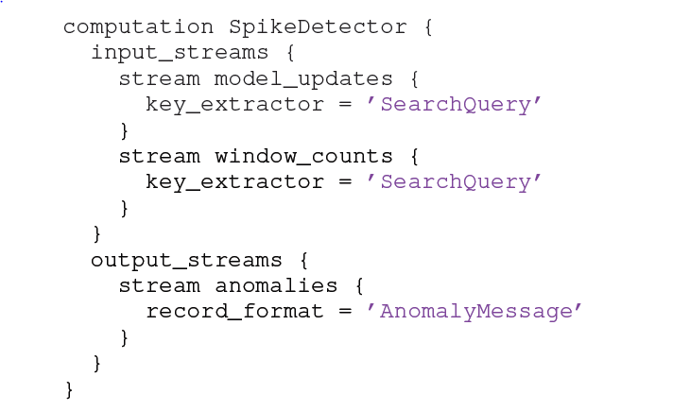
Computation

Slide 11
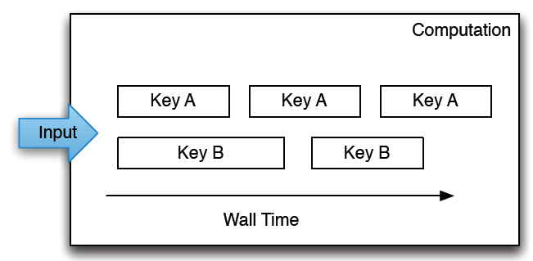
Computation
Processing serialized per key, but parallelized over different keys.

Slide 12
Key
Abstraction for aggregation and comparison between different records (Similar to map-reduce)
Key extraction function(specified by user) assigns a key to the record.
Computation code is run in the context of a specific key (accesses state for that specific key only)

Slide 13
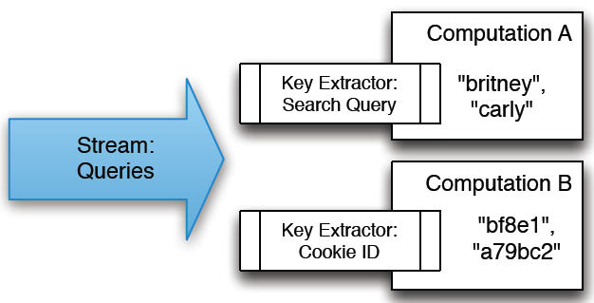
Streams
Pub-Sub System- Computations subscribe to streams as well as publish streams
Key extraction function specified for each incoming stream

Slide 14
Low watermark
Provides a bound on the timestamps of future records
Definition:
L.W(A) = min(oldest work of A, LW(C))
C are all input computations of A
3) Original Low watermarks are provided by Injectors

Slide 15
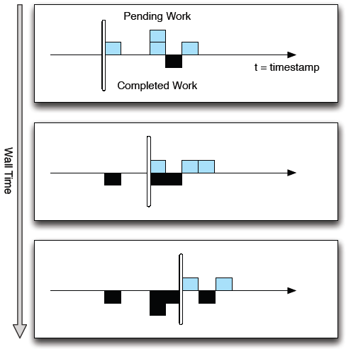
Low Watermark

Slide 16
Timers
Timers are per-key programmatic hooks that trigger at a specific wall time or low watermark value
Timers are journaled in persistent state and can survive process restarts and machine failures
Timer runs the specified user function (when fired) and provides same exactly-once guarantees

Slide 17
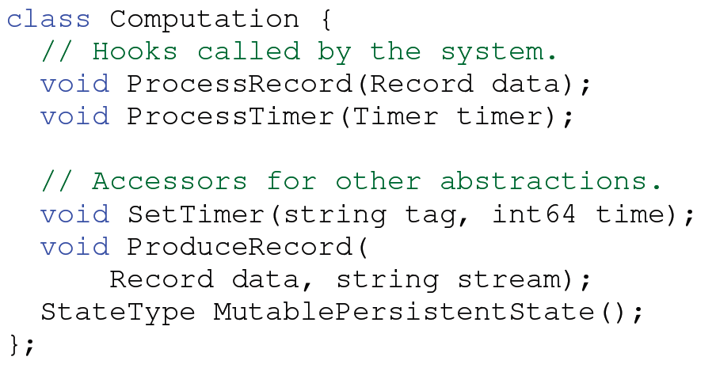
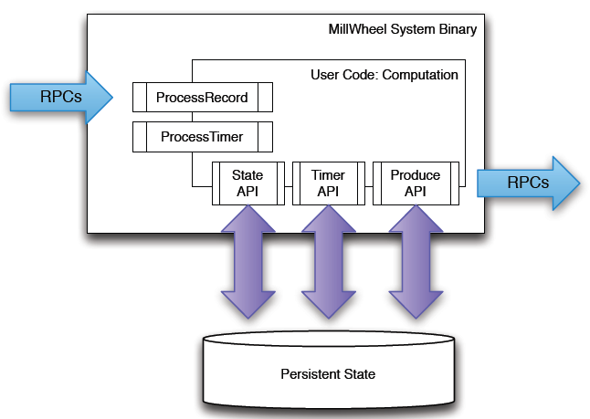
Computation API

Slide 18
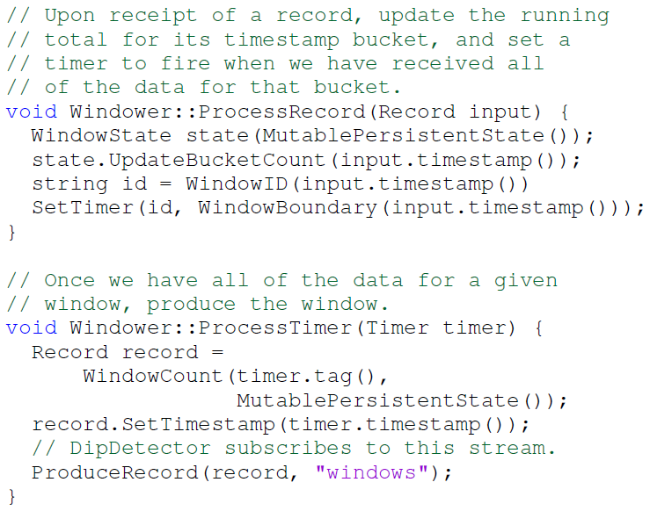
Example

Slide 19
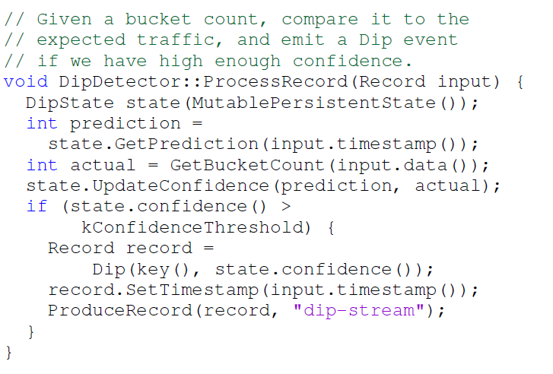
Example

Slide 20
Injector and Low Watermark API
Each computation calculates a low watermark value for all of its pending work
Users rarely deals with low watermarks
Users manipulate them indirectly by assigning timestamp to records
Injectors bring external data, seed low watermark values for the rest of the pipeline
If injector are distributed across multiple processes the least watermark among all processes is used

Slide 21
Fault Tolerance: Delivery Guarantees
Exactly-Once Delivery:
Steps performed on receipt of an input record for a computation are:
Checked for duplication
User code is run for the input
Pending changes are committed to the backing store.
Sender is ACKed
Pending productions are sent(retried until they are ACKed)
System assigns unique IDs to all records at production time, which are stored to identify duplicate records during retries
Optimization: Collect multiple records for checkpointing

Slide 22
Fault Tolerance: Delivery Guarantees
Strong Productions:
Produced records are checkpointed before delivery
Checkpointing is done in same atomic write as state modification
Checkpoints are scanned into memory and replayed, if a process restarts
Checkpoint data is deleted when productions are ACKed
Exactly-Once Delivery and Strong Productions ensures user logic is idempotent

Slide 23
Fault Tolerance: Delivery Guarantees
Weak Productions:
Broadcast downstream deliveries optimistically, prior to persisting state
Each stage waits for the downstream ACKs of records
Completion times of consecutive stages increases so chances of experiencing a failure increase
A small fraction of productions are checkpointed, allowing those stages to ACKs to their senders.

Slide 24
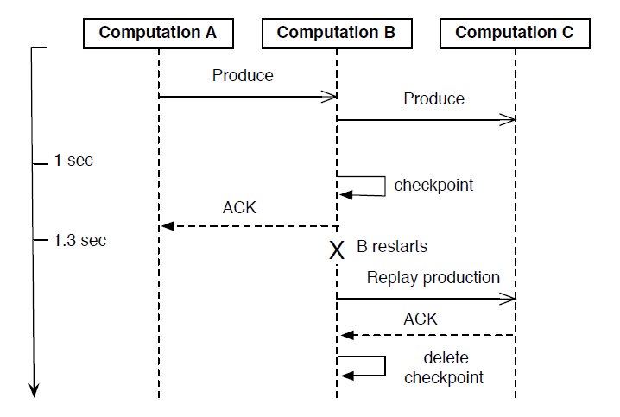
Fault Tolerance: Delivery Guarantees
Weak Productions:

Slide 25
State Manipulation
State: Persistent State, User state, and Timers
Following user-visible guarantees must satisfy:
No data loss
Updates must ensure exactly-once semantics
All persisted data must be consistent
Low watermarks must reflect all pending state in the system
Timers must fire in-order for a given key

Slide 26
State Manipulation
To avoid Inconsistencies in Persistent state
Per-key update are wrapped as single atomic operation
To avoid network remnant stale writes
Single writer per key at any given time
Sequencer is attached to each write
Mediator of backing store checks before allowing writes
New worker invalidates any extant sequencer

Slide 27
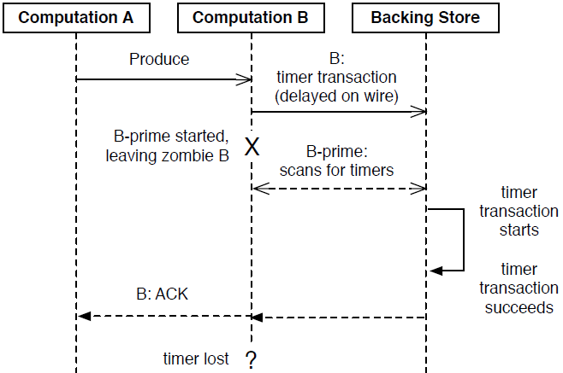
State Manipulation

Slide 28
System Implementation
Distributed systems with dynamic set of host servers
Each computation in a pipeline runs on one or more machines
Streams are delivered via RPC
On each machine, the MillWheel system
Marshals incoming work
Manages process-level metadata
Delegates data to the appropriate computation

Slide 29
System Implementation (cont.)
Load distribution and balancing is handled by a master
Each computation is divided into a set of lexicographic key intervals
Intervals are assigned to a set of machines
Depending on load intervals can be merged or splitted
Low Watermarks
Central authority tracks all low watermark values in the system and journals them to persistent state
Consumer computations subscribe low watermark from all the senders
Use minimum of all values
Central authority’s low watermark value is at most that of workers’

Slide 30
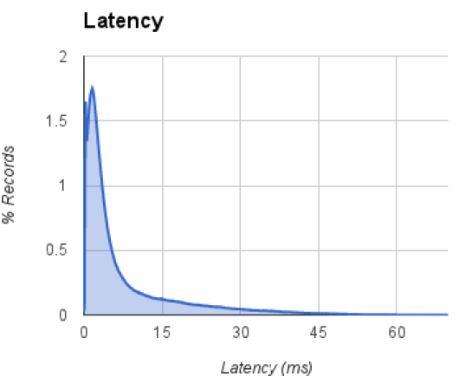
Experimentation
Latency distribution for records when running over 200 CPUs.
Median record delay is 3.6 milliseconds and 95th-percentile latency is 30 milliseconds
With strong productions and exactly-once guarantee both enabled Median Latency jumps to 33.7 milliseconds and 95th-percentile latency to 90 milliseconds

Slide 31
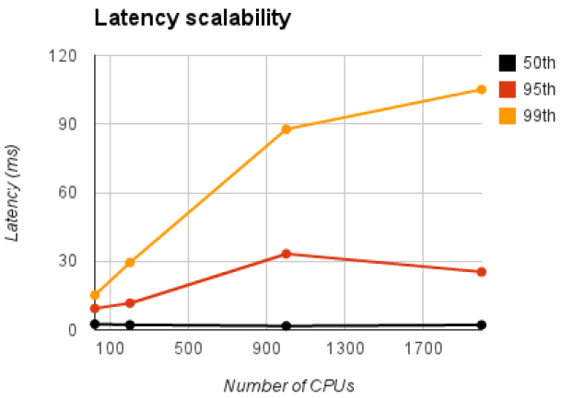
Experimentation
Median latency (50th percentile) stays roughly constant, regardless of system size
99th-percentile latency does get significantly worse with increase in system size.

Slide 32
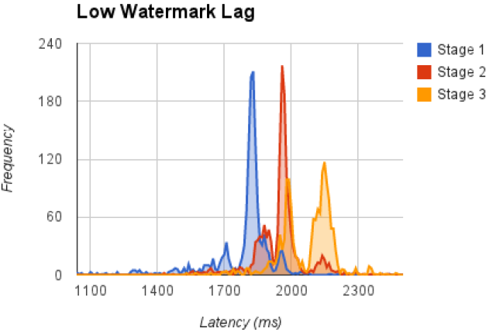
Experimentation
Simple three-stage MillWheel pipeline on 200 CPUs
Polled each computation’s low watermark value once per second
Latency values for stages are around 1795 ms, 1954 ms, 2081 ms

Slide 33
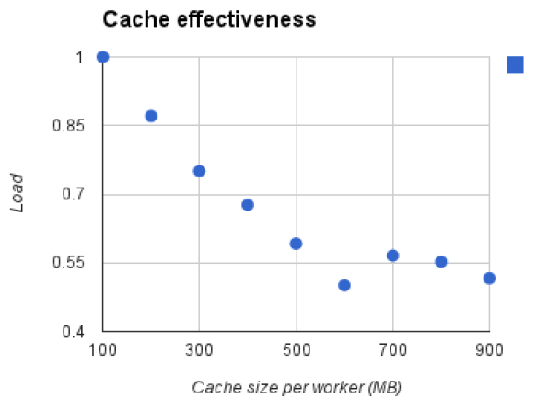
Experimentation
Load: aggregate CPU load of Millwheel and Storage System

Slide 34
Map-Update System
Event:
Four tuple <Stream ID, Time-Stamp, Key, Value>
Keys are non-unique and have global key space
Values are blob fields associated with key
Map:
Map(event) → event*
Update:
Functions with memory
Slate: S_{U,K}
Update(event, slate) → event*

Slide 35
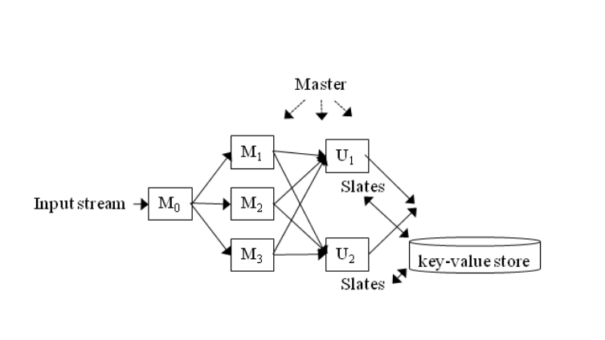
Muppet System
Distributed Map and Update functions
Hashing used to distribute events
Passing of events to next function

Slide 36
Muppet: Slate management
Persistent key-value store ‘Cassandra’ used to store Slates
K-V store is indexed by <key, Column>
Updated function is used as Column
Cache of key-value records
Flash memory storage for persistent state
Speeds up cache warm up
Higher Random I/O capacity to facilitate K-V store compaction
Configurations:
Flush rate
Quorum for Cassandra store
TTL for slates

Slide 37
Muppet: Failure Handling
Machine crash:
Detected By workers and reported to Master, unlike Map-Reduce
Hash-ring to find next worker
Event is lost, low latency is prime target
Updater: Unflushed changes to K-V store are lost
Input queue is also lost
Queue Overflow:
Drop incoming events
Special overflow queue processing
Slow down event passing

Slide 38
Muppet 2.0 Enhancements
Code Sharing among workers on same machine
No data passing among workers on same machine
Central cache of slates on each machine
Configure number of workers on a machine as per cores
Primary and secondary queues for Updaters on a machine
Reduced queue and slate lock contention
Better load balancing
Reduced hotspots

Slide 39
Muppet: extensions
Changing number of machines in the cluster on the fly
Handling Hotspots
Exploit Commutativity and associativity of computations
Slow down pace of events in the workflow for computations that do not need near-real time guarantees
Placing of mappers and updaters close to their data
Bulk-reading of slates
side effects?

Slide 40
Thank You

