Slide 1
RDF-3X: a RISC style Engine for RDF
Ref: Thomas Neumann and Gerhard Weikum [PVLDB’08 ]
Presented by: Pankaj Vanwari
Course: Advanced Databases (CS 632)

Slide 2
Motivation
RDF(Resource Description Framework ) is schema-free structured information.
Increasingly popular in context of
Knowledge bases
Semantic Web
Life-Sciences and Online communities.
Managing large-scale RDF data includes challenges for
Storage layout, indexing and querying

Slide 3
Overview
Introduction to RDF and SPARQL
Storage of RDF data
Query Translation and Processing
Query Optimization
Evaluation
Conclusion

Slide 4
Introduction to RDF
Standard model for data interchange on the Web.
Allows structured and semi-structured data to be mixed, exposed, and shared.
Conceptually a labeled graph
Linking structure forms a directed labeled graph where the edges represent the named link between two resources that are represented by the graph nodes.
Graph is stored as collection of facts. Each edge represents a fact (triple in RDF notation)
Triples have the form (subject; predicate; object)

Slide 5
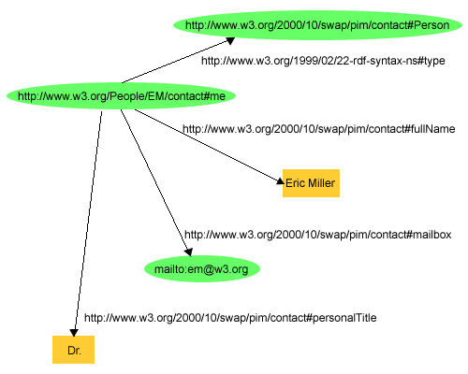
RDF as labeled graph
Extends the linking structure of the Web by using URIs for relationship.
Subjects and predicates are identified by URI values.
Object can be another URI or a value (literal).

Slide 6
RDF Example: Conceptual View
Slumdog Millionaire
2008
Danny Boyle
releaseYear
hasTitle
hasName
id1
id7
directedBy
hasCasting
roleName
Latika
id2
actor
hasName
id11
Freida Pinto

Slide 7
RDF Eample: Facts in triple form
(id1, hasTitle, " Slumdog Millionaire "),
(id1, releaseYear, "2009"),
(id1, directedBy,id7)
(id7,hasName,“Danny Boyle"),
(id1, hasCasting, id2),
(id2, roleName, “Latika"),
(id2, actor, id11),
(id11, hasName, " Freida Pinto"),and so on…
RDF data is a (potentially huge) set of triples
585 million triples – Size of data in Freebase
120 million facts of 10 million entities in YAGO2

Slide 8
Introduction to SPARQL
SPARQL is used to query over RDF data.
Result can be result sets or RDF graphs.
SPARQL query for “The titles of all movies having Freida Pinto“ can be:
Select ?title Where
{ ?p <hasTitle> ?title. ?p <hasCasting> ?s.
?s <actor> ?c. ?c<hasName>“Freida Pinto“ }
From the prevous example triples:
?c : id11 , ?s : id2, ?p : id1 and
?title : " Slumdog Millionaire "

Slide 9
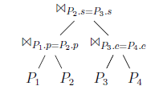
SPARQL- Join graph
Each SPARQL query can be represented by a join graph. A possible join tree for the previous query:
Where P₁ = (?p <hasTitle> ?title), P₂ = (?p <hasCasting> ?s), P₃ = (?s <actor> ?c) and P₄ =(?c <hasName> “Freida Pinto“ ) are triple patterns.

Slide 10
SPARQL: Query features
FROM clause to select a data set
PREFIX clause for Namespace Prefixes
WHERE clause supports
Star-shaped query
Long join path query
FILTER to restrict values by patterns/conditions
Union query
Optional query
For Result: ORDER BY, DISTINCT, CONSTRUCT, DESCRIBE and ASK clause

Slide 11
Problems in querying over RDF
RDF data storing, indexing and query processing is non-trivial:
Absence of global schema.
Very fine grained data items. instead of records or entities.
Execution plan optimization require statistics which is unsuitable for RDF due to no schema.
Physical design difficult as RDF triples form graph rather than a tree as in XML.

Slide 12
Solution Proposed
RDF-3X (RDF Triple eXpress), a RISC style execution engine based on three principles:
Physical design is workload independent. With exhaustive compressed indexes it eliminates need for physical-design tuning.
Query processor rely mostly on merge joins over sorted index lists.
Query optimizer focuses on join order in the execution plan.

Slide 13
Storage of RDF data- Raw
Raw RDF facts i.e set of triples are as shown
Literals can be very large and contains lot of redundancy
Facts
Subject | Predicate | Object
Object 214 | hasColor | Blue
Object 214 | belongsTo | Object 352
… | … | …

Slide 14
Storage of RDF data- Dictionary Compression
First step to reduce data is to provide ID to literals :Dictionary Compression
Facts
Subject | Predicate | Object
0 | 1 | 2
0 | 3 | 4
… | … | …
Strings
ID | Value
0 | Object 214
1 | hasColor
… | …

Slide 15
Storage of RDF data- RDF3X approach
Store everything in a clustered B⁺-Tree
Triples sorted in lexicographical order which allows SPARQL pattern into range scans.
Can be compressed well (delta encoding).
Efficient scan, fast lookup if prefix is known.
Structure of byte-level compressed triple is
Header value₁ value₂ value₃
Gap | Payload
1 Bit | 7 Bits
Delta
0-4 Bytes
Delta
0-4 Bytes
Delta
0-4 Bytes

Slide 16
Storage of RDF data- RDF3X approach
Header byte denotes number of bytes used by the three values. (5*5*5=125 size combinations)
Gap bit is used when only value₃ changes and delta is less than 128 (that fits in in header)
Which sort order to choose?
6 possible orderings, store all of them (SPO, SOP, OSP, OPS, PSO, POS)
Will make merge joins very convenient
Each SPARQL triple pattern can be answered by a single range scan.

Slide 17
Storage of RDF data- Aggregated Indices
Sometimes we do not need the full triple:
Are object₄ and object₁₃ related? (by any predicate).
Maintain aggregated indexes with 2 out of the three columns in triple.
Six additional indexes (SP, PS, SO, OS, PO, OP)
Count is necessary for the third. Example: How many author annotations does object₁₄ have?
Aggregated index stores (value₁, value₂, count)
Much smaller than full index

Slide 18
Storage of RDF data- Aggregated Indices (2)
Finally three one-value indexes (S, P, O)
Store (value₁, count) entries. Rare but size is very small.
Can afford another 6 two-value indexes and 3 one-value indexes as the full triple index is compressed.
Experimentally total size of all indexes is less than original data.
Smaller index provides faster scan and improves query performance significantly.

Slide 19
Query Translation and Processing
SPARQL query is transformed into calculus.
Each conjunctive query can be parsed into a set of triple patterns with each component either a literal (mapped to ids) or a variable.
Each triple pattern becomes an index scan.
With multiple triple patterns. Patterns with common variable induces joins.
All order indexes sorted in lexicographical order makes merge joins very attractive.

Slide 20
Query Translation and Processing (2)
Each triple corresponds to a node in query graph. Employ join ordering on query graph.
Cardinality of result is preserved (as per standard SPARQL semantics) using multiplicity as reported in aggregated index. Count=1 for unaggregated.
Disjunctive queries (UNION and OPTIONAL) are treated as nested subqueries and the results as base relation with special cost.

Slide 21
Query Optimization
Properties of SPARQL queries:
Star-shaped subqueries. (Star joins for an entity)
Star often occur at start and end of long join paths.
Key Issue : Join ordering. Two step process:
First, if a variable is unused, it can be projected away by using an aggregated index (preserving cardinality through count information).
In the second step the optimizer decides which of the applicable indexes to use. It focuses on optimizing join order in its query execution plans.

Slide 22
Query Optimization – Selectivity Estimates
Decision cost based, dynamic programming strategy.
A bit different from standard join ordering:
one big "relation", no schema
selectivity estimates are hard
Standard single attribute synopses are not very useful:
Only three attributes and one big relation
But (?a, ?b, ”Mumbai”) and (?a, ?b, ”1974-05-30”) produces vastly different values for ?a and ?b
Estimated cardinalities have huge impact on performance.
Two strategies proposed for selectivity estimation: Selectivity Histogram and Frequent Paths

Slide 23
Selectivity Estimates- Selectivity Histogram
Selectivity histogram (uses aggregated indexes): Generic but assumes predicates are independent.
Aggregate indexes until they fit into one page
Merge smallest buckets ( equi-depth)
For each bucket (i.e. triple range) compute statistics
6 indexes, pick the best for each triple pattern
Assumes uniformity and independence, but works quite well

Slide 24
Selectivity Estimates- Selectivity Histogram (2)
Example: bucket with (subject, predicate, object) statistics
Estimations:
(10,4,?a) => 1000 triples
(10,4,?a), (?a,?b,?c) => 2000 triples
range | (10,2,30) - (10,5,12000)
Length | 1 | 2 | 3
#prefixes of length | 1 | 3 | 3000
 | Subject | Predicat | Object
#subject joins with | 4000 | 0 | 200
#predicate joins with | 50 | 400000 | 200
#object joins with | 6000 | 0 | 9000

Slide 25
Selectivity Estimates- Frequent Paths
Still issues with (common) large correlated join patterns:
navigation: {(?a,[],?b),(?b,[],?c),(?c,[],?d)} (chain)
selection: {(?a,[],?b),(?a,[],?c),(?a,[],?d)} (star)
Frequent paths (pre-processed): Computes frequent join paths and gives accurate predictions for these long frequent joins.
Capture common correlations:
mine the most frequent paths (chains and stars) and count
exact prediction or an upper bound for these paths.
Not as easily applicable as histograms, but very accurate

Slide 26
Evaluation
RDF-3X is compared with:
MonetDB (column store approach)
PostgreSQL (triple store approach)
Three different data sets:
Yago, Wikipedia-based ontology: 1.8GB
LibraryThing : 3.1
Barton library data : 4.1GB
Same setup for all :
Same preprocessing
Same dictionary
Equivalent queries

Slide 27
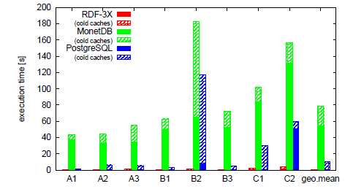
Evaluation - Yago
sample query(B2) : select ?n1 ?n2 where { ?p1 <isCalled> ?n1.
?p1 <bornInLocation> ?city. ?p1 <isMarriedTo> ?p2.
?p2 <isCalled> ?n2. ?p2 <bornInLocation> ?city }

Slide 28
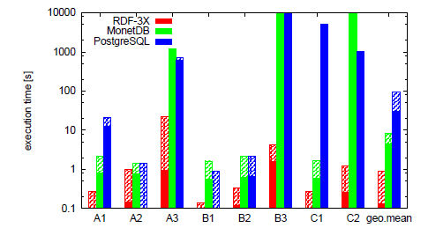
Evaluation – Library Thing
sample query(B3): select distinct ?u where { ?u [] ?b1.
?u [] ?b2.?u [] ?b3.?b1 [] <german> .?b2 [] <french> .
?b3 [] <english>}

Slide 29
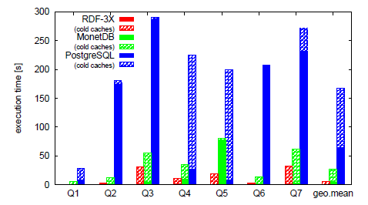
Evaluation – Barton Data Set [VLDB07]
sample query (Q5) select ?a ?c where
{ ?a <origin> <marcorg/DLC>. ?a <records> ?b.
?b <type >?c. filter (?c != <Text>) }

Slide 30
Conclusion
Avoids physical design tuning, generic storage of all orders and aggregated indexes.
Exhaustive triple indexes but due to compression overall cost is same as original database.
Estimation of cardinalities has a huge impact on query optimization.
Full paper includes managing updates: RDF and SPARQL standards do not include updates so far.
Optimization using SIP(Sideways Information Passing) and improved selectivity estimates in Newmann and Weikum[SIGMOD’09] “Scalable Join Processing on Very Large RDF Graphs”.

Slide 31
Questions?

Slide 32
Thank You

