Slide 1
Ajax-based Report Pages as Incrementally Rendered Views (Sigmod 2010)
By
Anjali Singhal (10305919)
Manisha Naik Gaonkar (10305302)

Slide 2
Pure Server-Side Application
In this when a user action leads to an http request to a server and server responds back.

Slide 3
Low-level code addressing frictions
of the web application architectures
pre-2005: Pure server-side programming
Plumbing code addressing language heterogeneities
post-2005: Ajax (also Flash, Silverlight)
Data coordination code between Ajax page
and server state (main memory + database)

Slide 4
Pre-2005: Pure server-side programming: Tedious code to integrate across three languages and computation hosts
Code with JDBC/SQL calls to combine database and server state
HTML
DOM
Code to combine database and server state into HTML
Browser
Server
Action
Page Computation
Request
Parameters
Java
Java
INSERT INTO reviews …
SELECT *
FROM proposals…
SELECT *
FROM reviews …
Session
Objects
Database
4

Slide 5

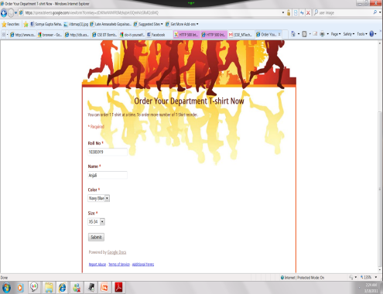


Pure Server-Side Programming
http request
Browser blanks out
Server processing
User waiting

Slide 6
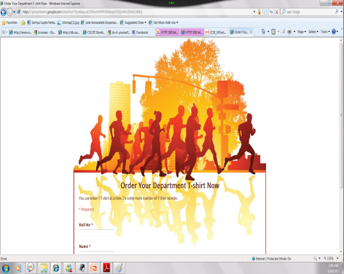
Continued..
results
Cursor & scroll position lost

Slide 7
AJAX (Asynchronous Javascript and XML)
It is a conglomerate of technologies and programming techniques for highly interactive web pages (Web 2.0)
Its programming model for producing web pages differs from Web 1.0 (purely sever side)
Relies on browser-side Javascript code and extensive use of Ajax library components (maps, calendars, etc)

Slide 8
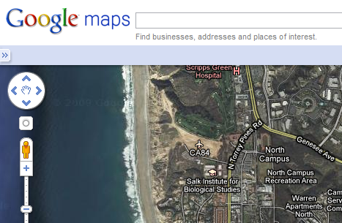
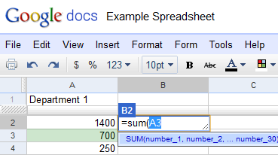
2005: Enter Ajax: A desktop feel to cloud-based applications
Asynchronous partial update of the page
Fancy JavaScript/Ajax components maps, calendars, tabbed windows

Slide 9
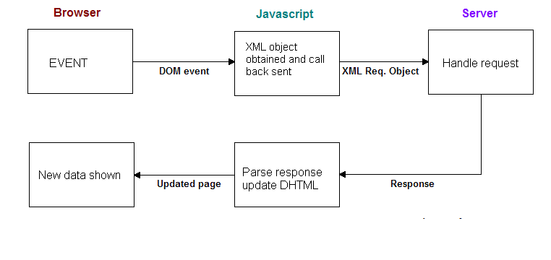
AJAX

Slide 10
AJAX Advantage
Partial Update Speed
Continuous action on browser
Javascript and AJAX libraries

Slide 11
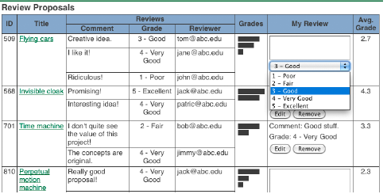

Slide 12
Ajax: Mundane data coordination between page state and server state (app server + database)
JavaScript/Java code
tuned to incrementally update HTML DOM & JavaScript components
HTML
DOM
JavaScript
Components
JavaScript components have different programmatic interfaces
JavaScript/Java code reflects page data & request parameters to the server
JavaScript
collect_args();
response_handler = function(){
partial_renderer(); }
send_request();
Diffs
Browser
Application Server
Action
Page Computation
Request
Parameters
Java
Java
INSERT INTO reviews …
SELECT *
FROM proposals…
SELECT *
FROM reviews …
Session
Objects
Database Server
Database
12

Slide 13
For each action, yet another incremental page computation code and partial renderer
Pure Server-side Model
Ajax Model
Partial update requires different logic and imperative programming for each user action
Partial Renderer 1
Partial Renderer 2
Partial Renderer 3
Browser
Application Server
Action 1
Page Computation
Action 1
Page Computation 1
INSERT …
INSERT …
Action 2
Action 2
Page Computation 2
UPDATE …
UPDATE …
Action 3
Action 3
Page Computation 3
DELETE …
DELETE …
13

Slide 14
AJAX Challenges
It leads to following programming challenges:
Developer has to program custom logic for each action that partially updates the page.
Developing AJAX pages requires distributed programming between browser and server, involves multiple languages and data models.

Slide 15
AJAX Challenges
The developer of AJAX also needs to understand DOM and component interfaces to write the code to refresh them.

Slide 16
FORWARD Framework
It simplifies the programming of data driven application pages by treating them as rendered views.
Its data is declared by developer using syntactical minor extension of SQL.
Rendering is delivered in page units.
These units maps to views by API.
It relieves the AJAX developer from having to write mundane data synchronization code.

Slide 17
Page
Has page data tree
Visual layer ( mapping of page unit tree to page data tree and includes javascript components )
Page data tree is populated by SQL statement, page query.
SQL is extended with SELECT clause nesting and variability of schemas.

Slide 18
FORWARD Contribution
Combination of page data tree and page unit tree enables developer to avoid multiple language programming.
We choose SQL because:
It has much larger programmer audience
Smaller feature set
FORWARD developer specifies unit state using page data tree (in terms of SQL) and thus avoids hassle of programming AJAX & Javascript components

Slide 19
FORWARD achieves performance & interface quality problems such as :
Instead of literally creating page data tree, unit tree and Javascript page from scratch, FORWARD incrementally recomputes them using their prior versions.
Enables the use of massive Javascript component libraries as page units into FORWARD’s framework

Slide 20
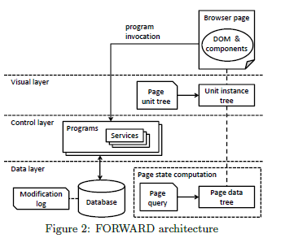
FORWARD Architecture

Slide 21
Data Layer
Captures page state at logical level with minimal extension of SQL’s data model with features that will facilitate mapping to the page’s data from unit tree.
Data tree has both sets and lists to indicate if the ordering of tuples matters.
Also has nested relations.
Heterogeneous schema

Slide 22
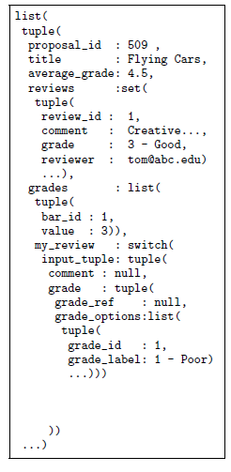
Page data tree

Slide 23
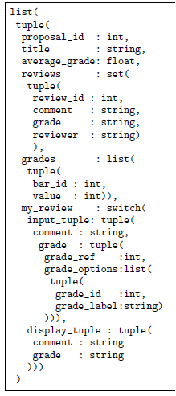
Page schema

Slide 24
Continued..
Each data node is mapped to schema and it may be 1 of the following:
Atomic value
A tuple
A collection
A switch value
A null value

Slide 25
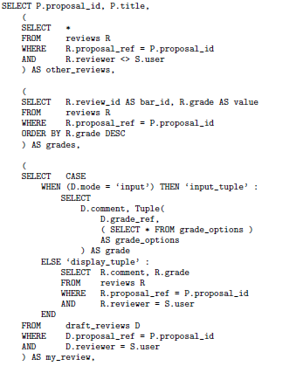
Page query

Slide 26
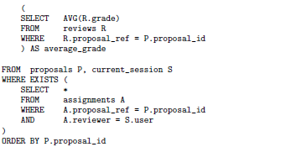
Page query

Slide 27
Visual Layer
Units capture logical structure of page and enable incorporation of components from javascript libraries.
Each page has a unit tree and each instance of a page has a corresponding unit instance tree.
Each unit has unit schema and mapping from unit schema attributes to nodes in page schema tree.
Provides a textual template syntax for configuring a unit tree.

Slide 28
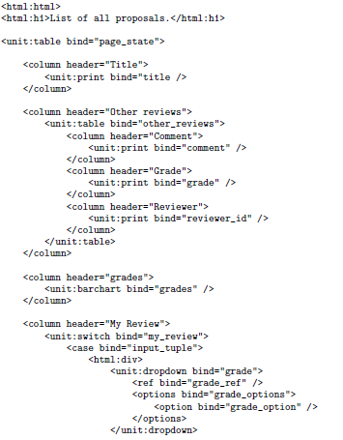
Page unit tree

Slide 29
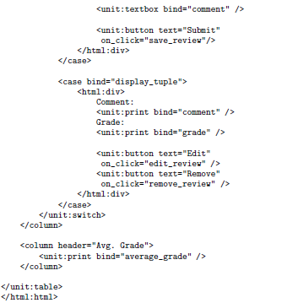
Page unit tree

Slide 30
Continued..
Each XML element encloses a unit configuration and contains:
XML elements for unit schema attributes
Nested unit configurations for children units
Template also allows HTML elements hence we can configure all visual aspects of a page
Bind attribute maps unit schema attributes to schema nodes.

Slide 31
Program invocation
It has access to
Data from text boxes and dropdowns
SQL database
Then issues UPDATE,DELETE & INSERT commands on database and are captured by modification log
After program invocation, the page is incrementally refreshed in an efficient manner.

Slide 32
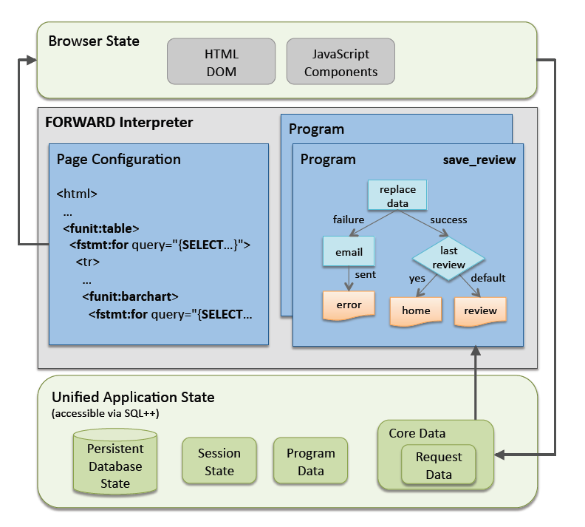
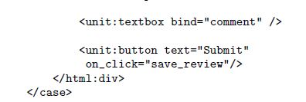
Continued..

Slide 33
INCREMENTAL PAGE REFRESH
Strawman Approach:
Uses Ajax to avoid blanking out
During refresh, makes asynchronous XHR JavaScript call that fetches the new page in its entirety
Response Handler replaces the old page DOM with the new one.
Browser needs to re-render the entire page.
Loss of focus, cursor position and data entered.
Notes:
Pure server side suffer from long refresh time, browser blanking out. Ajax solves these problems but complicates web programming

Slide 34
FORWARD
combines the best of both Ajax model and the pure server-side model
Like pure server side model developers need not specify any extra update logic.
Preservation of focus, scroll, cursor positions and form data.
Automates the incremental page refresh in both the data layer and the visual layer.

Slide 35
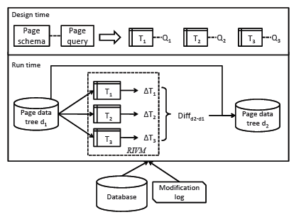
Page state computation module
Notes:
At design time PSC decomposes nested page schema into flat relational views

Slide 36
PSC
treats the page data tree as a view.
Uses modification log and the database for incremental maintenance
Design time: Decomposes the nested page schema into flat relational views and rewrites the page query into standalone SQL queries that define the flat views.
Run time: Old page data tree transformed to instances of the flat relational views.

Slide 37
Contd..
Uses Relational Incremental View Maintenance Algorithm(RIVM) on flat views.
RIVM in PSC –built on top of an off the shelf relational database.
All modifications in modification log.
Diff _{d2-d1} encoded as series of data modification commands(insert, remove and update).
Remove(t), update(t,N), insert_{s}(r,N), insert_{l}(r,N,t₀)

Slide 38
PSC benefits
Non-modification
Page state self sufficiency(fast computation)
Incremental maintenance

Slide 39
Incremental Maintenance
Consider V = q(R1,R2,…..,Rn) Where
V ---- materialized SQL view
q ---- SQL query
R1,R2,……Rn ---- base tables
PSC models data changes as differential tables.
For R_{i} , differential tables are ∆⁺R_{i} (tuples inserted into R_{i} ) and Δ⁻R_{i} ( tuples deleted from R_{i} )
Ex. V is join of R1 and R2
There is insert in R1 ie ∆⁺R₁ not empty
Then V=V U (∆⁺R₁ join R2)
Tuple update - insertion + deletion

Slide 40
Incremental Maintenance
RIVM runs two queries qΔ+ and qΔ- over {R₁,…..R_{n}, Δ⁺R₁,…,Δ⁺R_{n}, Δ⁻R₁,…,Δ⁻R_{n}} to produce Δ⁺V and Δ-V resp.
PSC uses deferred view maintenance.
Page view maintenance can be deferred for a user until the user requests for the page again.

Slide 41
Reduction of nested queries
PSC transforms nested page schema into flat relational viewsT₁ , ......, T_{n} and page query into SQL queries q₁,….., q_{n} such that each T_{i} is defined by q_{i} .
Outermost collection of Page schema is represented as a new relation(s1).
Each subquery in the SELECT clause mapped to a new relation.
Each case sub-query in CASE WHEN conditional statements mapped to a new relation.

Slide 42
Contd…
4. If P_{a} is parent (sub)query of p_{b}, then expand S_{b} to contain the foreign key attributes referencing tuples in S_{a} and call S_{a} parent of S_{b}.
5. Primary key of S_{i}= foreign key to its parent relation + primary key attributes of S_{i}

Slide 43
Incremetal Maintenance
PSC modifes S_{i} to get flat view T_{i} and creates p_{i} from q_{i}
Each T_{i} will have S_{i} ’s schema and also attributes referred by any descendent of p_{i}
q_{i} is modified from p_{i} by adding T_{i} as additional input table in p_{i}’s where clause where p_{j} is parent of pi
Original references to p_{j} are then changed to joined attributes from T_{j}
PSC traverses q_{i} from top down to incrementally maintain each T_{i}
Using RIVM PSC runs Δ⁺T_{1 and} Δ⁻T₁ for top level view T₁.

Slide 44
Ex.
Suppose there exists a form which displays the course info , the roll no and grade of students enrolled for that course and also the average grade for the course.
Course Grades
Course_id | Course_name | Students_enrolled |  | Avg_grade
 |  | Roll_No | Grade
CS632 | Advanced Database Systems | 10305001 | 10 | 9
 |  | 10305021 | 9
 |  | 10305901 | 8
CS635 | RDBMS | 10305012 | 9 | 9
 |  | 10305045 | 10
 |  | 10305061 | 8

Slide 45
Ex. Contd.
Corresponding page data tree
List(
tuple(
Course_id : CS632,
Course_name: Advanced Database Systems ,
students_enrolled:list(
tuple(
roll_no: 10305001,
grade : 10
),
tuple(
roll_no: 10305021,
grade : 9
)
…. ),
avg_grade : 9
))

Slide 46
Ex. Contd.
Include Foreign keys from parent sub query
Page Query:
SELECT C.course_id, C.course_name
( SELECT S.roll_no, S.grade
FROM students_enrolled S
WHERE S.course_id=C.course_id
ORDER BY S.roll_no
) as students_enrolled ,
( SELECT AVG(S.grade)
FROM students_enrolled S
WHERE S.course_id=C.course_id
) as Avg_grade
FROM courses C
ORDER BY C.course_id
Relation 1
SELECT C.course_id, C.course_name
FROM courses C
ORDER BY C.course_id
Relation 2
SELECT S.roll_no, S.grade
FROM students_enrolled S
WHERE
S.course_id=C.course_id
ORDER BY S.roll_no
Relation 3
SELECT AVG(S.grade)
FROM students_enrolled S
WHERE
S.course_id=C.course_id
Group by C.course_id
CREATE VIEW T1_courses AS
,T1_courses
CREATE VIEW T2_students AS
, C.course_id
, T1_courses
,T1_courses
,T1_courses
,T1_courses
CREATE VIEW T3_avg_grade AS
, C.course_id
,T1_courses

Slide 47
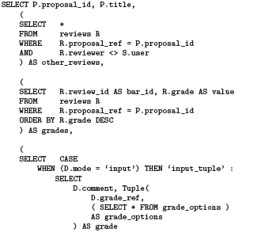

Slide 48
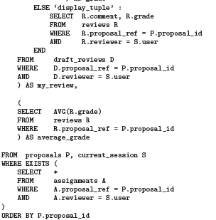

Slide 49
Relations in the view
CREATE VIEW T1_proposals AS
Outer Relation
SELECT P.proposal_id, P.title
FROM Proposals P,current_session S
WHERE EXISTS(
SELECT *
FROM assignments A
WHERE A.proposal_ref=P.proposal_id
AND A.reviewer=S.user
)
ORDER BY P.proposal_id
,S.user

Slide 50
CREATE VIEW T2_other_reviews AS
SELECT R.comment,R.grade,R.review_id
FROM Reviews R
WHERE R.proposal_ref=P.proposal_id
AND R.reviewer <> S.user
SELECT R.review_id AS bar_id, R.grade AS value
FROM Reviews R
WHERE R.proposal_ref=P.proposal_id
ORDER BY R.grade DESC
,T1.proposal_id
,T1_proposals t1
T1
T1

Slide 51
SELECT R.comment, R.grade
FROM Reviews R
WHERE R.proposal_ref=
P.proposal_id
AND R.reviewer = S.user
SELECT AVG(R.grade)
FROM Reviews r
WHERE R.proposal_ref=
P .proposal_id
GROUP BY P.proposal_id
CREATE VIEW T3_average_grade AS
,T1.proposal_id
T1_proposals T1
T1
T1

Slide 52
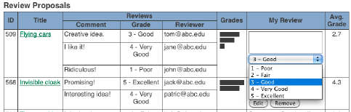
Example: reviews proposals page
Update grade and comment of review #2 of proposal 509
Modification log will include
Update comment & rating of (509,#2) tuple in the reviews table.

Slide 53
Ex. Contd..
b) An insertion of new review #4 for proposal 509.
c) An update of a review of another proposal 456.
d) An insertion of a recommendation on another page

Slide 54
Ex. Contd..
Given above modification PSC determines
Change (c) and (d) does not affect reviews(Non-modification).
Case (a) and (c ) corresponds to self sufficiency or incremental case.

Slide 55
Ex. Contd…
No change in proposals or current_session →No change in T1→ No change in Δ⁺T1 and Δ⁻T1.
Change (c) → non-empty Δ⁺R_{reviews}
As new review#4 for proposal 509 is inserted into the Reviews table.
RIVM computes Δ⁺T2 by joining Δ⁺R_{reviews} and T1 followed by selection.(All the new reviews inserted for the corresponding proposal)

Slide 56
Lists and reordering
PSC supports ordered lists.
For view maintenance, can embed order information as data inside order specifying attributes.
ex: {(1,tom),(2,ken)}
ORDER BY operator is handled by statically marking the order by attributes as the order specifying attributes.

Slide 57
Updating page data tree
After computing Δ⁺Ti and Δ⁻Ti for each Ti , Diff _{d2-d1} is computed as a series of data modification commands and then applied to d1 to obtain d2,new page data tree.
Changes to each Ti are applied in top-down order.
Easy to navigate the data tree to locate targets of each change in Δ⁺Ti and Δ⁻Ti .
Relation in data tree can be a list or set.
For a list ,tuples from Δ⁺Ti need to be translated into list version insert commands ,which requires adjacent tuples to be specified.

Slide 58
Contd…
Consider same example of students enrolled for a particular course.
Suppose a new student and its grade gets inserted.
T1 is the top level view defined over courses and thus Δ⁺T1 will be empty.
Δ⁺R _{students _enrolled} will include the new tuple inserted say (10305098,8).
Δ⁺T2 is computed by joining Δ⁺R _{students _enrolled} and T1.
Diff d2-d1 will include the insert(CS632,(10305098,8) ,(105021,8))
This is then applied to d1 to obtain d2,which will place this tuple adjacent to 105021 tuple.

Slide 59
Incremental maintenance of the visual layer
IMVL (Incremental Maintenance Visual Layer) refreshes the page through unit instances which translates data layer differences into updates of DOM elements and javascript components.
Browser page state can be divided into fragments where each fragment corresponds to rendering of a unit instance.

Slide 60
Incremental maintenance of unit instance tree
Each unit instance maintains pointers to its underlying DOM elements and JavaScript components.
From data layer difference ,IMVL uses the unit tree to produce unit instance differences.
Each insert command spanning multiple units will be fragmented into insert commands for the respective unit instances.(same for delete)
Unit instance differences are incrementally rendered.

Slide 61
Mediating between unit differences and JavaScript components
Consider the no of possible combinations for a unit instance difference
Any of the unit schema’s attributes can be the root of the data difference
Data diff can be encoded as any of the three insert , update or delete commands
For each (attribute, command) pair, a unit can be associated with a renderer.
Ex. (barchart id, update)
Given a unit difference ,if the most specific renderer for the (attribute , command)pair is not implemented framework will try to simulate it on a best effort basis with other available renderers.

Slide 62
Implementation and Evaluation
Implemented as a Java Servlet running in a Jetty servlet container.
PostgreSQL relational database
Database stores 20,000 proposals,each proposal has 6 reviews ,page displays 20 proposals and reviewer submits revision to his review for one displayed proposal.
Only 2 other db modifications, since last refresh
Review update(by other reviewer) for same proposal
Review update for a proposal not displayed on the current page
Measurements on Intel Core 2 Quad 2.7 Ghz desktop running Windows Vista 64-bit.
Server runs under Java VM 1.6 under server mode
Firefox 3.5 browser

Slide 63
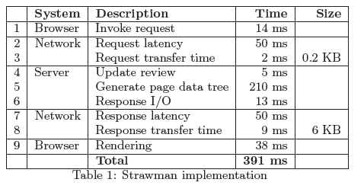
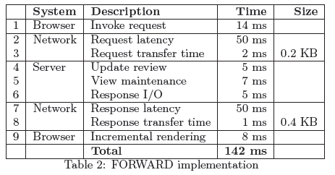
Implementation and Evaluation

Slide 64
Conclusions
Assumption: data driven page
Pages treated as incrementally rendered views
Increases productivity since the pages can be expressed with the combination of SQL and page unit

Slide 65
The FORWARD
SQL-Based Declarative Framework
for Ajax Applications
CIDR,2011
Yupeng Fu
Kian Win Ong
Kevin Zhao
YannisPapakonstantinou
Michalis Petropoulos

Slide 66
FORWARD INTERPRETER
Applications run in a continuous program/page cycle.
An HTTP request triggers the FORWARD interpreter to execute a program specification.
Programs reads/writes the applications unified state and invokes services.
Program determines which page will be displayed next
Interpreter creates new page according to the respective page configuration.
Page specification specifies programs invoked upon specified user events.
Invocation of program restarts the program/page cycle.

Slide 67
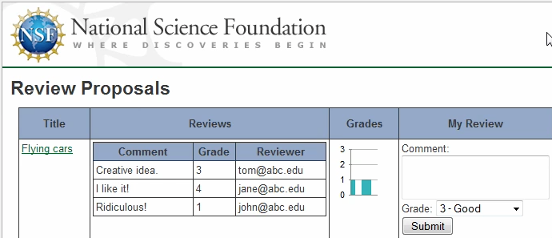
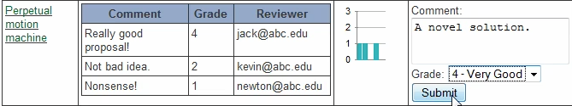
FORWARD Application: Operation
Browser-side FORWARD JavaScript libraries
HTML
DOM
JavaScript
Components
FORWARD Applicationnsf_reviewing
FORWARD Interpreter (e.g., http://forward.ucsd.edu )
Action Configuration
Page Configuration
Action Configurationsave_review
Page Configuration
review
Source Configurations & SQL++ Schema Definitions
Unified SQL++ Application State

Slide 68
Program configuration
Composition of synchronous services in a acyclic structure with a single starting service
Services input data from the unified application state
Outcome of service invocation
Generates a corresponding service output
Calls a consequent service or the end of the program
Special service called page to instruct interpreter which page to display

Slide 69
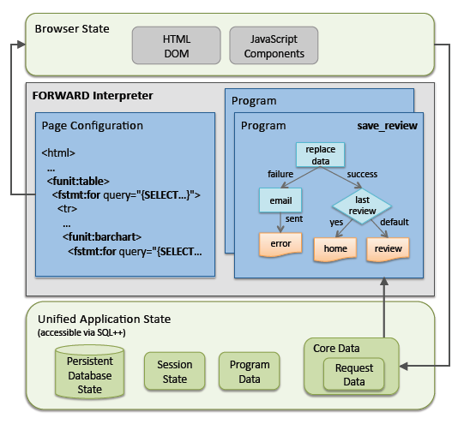
FORWARD INTERPRETER

Slide 70
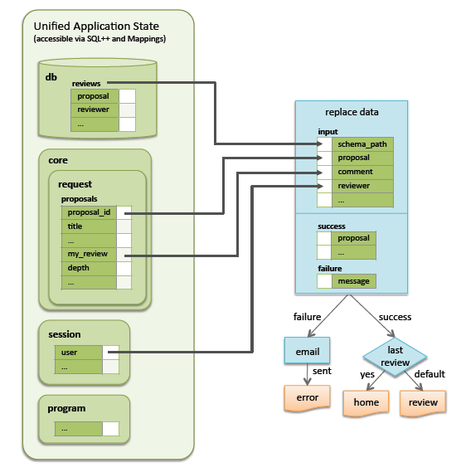
Save Review program configuration

Slide 71
Pages as Rendered SQL++ Views, with User Input Attributes
Browser-side FORWARD JavaScript libraries
HTML
DOM
JavaScript
Components
FORWARD Interpreter (e.g., http://forward.ucsd.edu )
FORWARD Applicationnsf_reviewing
Action Configuration
Page Configuration
Action Configurationsave_review
Page Configuration
review
Source Configurations & SQL++ Schema Definitions
Unified SQL++ Application State

Slide 72
Page configuration
Is an XHTML file with
FORWARD units specified as XML elements and rendered as maps ,calendars etc( JavaScript components).
SQL++ inline expressions and for and switch statements which are responsible for dynamic data generation.

Slide 73
Actions Access Unified Application State via SQL++
Browser-side FORWARD JavaScript libraries
HTML
DOM
JavaScript
Components
SQL++ includes:
Nesting
Variability
Identity
Ordering
FORWARD Interpreter (e.g., http://forward.ucsd.edu )
Core page &
request parameters: Abstraction of relevant part of browser state
FORWARD Applicationnsf_reviewing
Action Configuration
Page Configuration
Action Configurationsave_review
Page Configuration
review
Source Configurations & SQL++ Schema Definitions
Unified SQL++ Application State
Core Page
Database
Session
Objects
Action
Outputs
Request Parameters

Slide 74
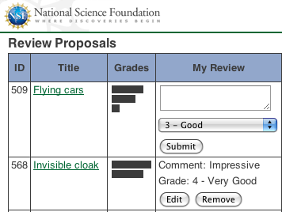
Page Configuration Follows Popular Frameworks: HTML + FORWARD statements & expressions, using SQL++
<fstmt:for query="
// proposals assigned to
// currently logged-in reviewer
SELECT p.id AS pid, p.title
FROMhosted.proposals AS p
WHERE EXISTS(
SELECT *
FROM hosted.assignments AS a
WHEREa.proposal = p.id
AND a.reviewer= session.user">
<tr>
...
<td>{pid}</td>
...
</tr>
</fstmt:for>
Overall structure reminiscent of XQuery and SQL/XML
74

Slide 75
Page Configuration: Ajax/JavaScript Components Simply by FORWARD Unit Tags
<fstmt:for query="
SELECT ...">
<tr>
...
<td>
<funit:bar_chart>
<bars>
<fstmt:for query="SELECT …">
<bar>
<id> {gid} </id>
<value>{score} </value>
</bar>
</fstmt:for>
</bars>
</funit:bar_chart>
</td>
...
After each action, the FORWARD interpreter automatically & incrementally updates
HTML and JavaScript components
75

Slide 76
Core Page and Request Parameters: Mirror of named page data
<fstmt:forname="proposals" query="
SELECT p.id AS pid, p.title
FROMhosted.proposals AS p
WHERE ...">
<tr>
...
<funit:editorname="myReview">
...
</funit:editor>
...
<funit:selectname="myRating">
...
</funit:select>
...
<funit:button
onclick="save_review"/>
</tr>
</fstmt:for>
Core Page
proposals
pid | my_review | rating
Automatically inferred

Slide 77
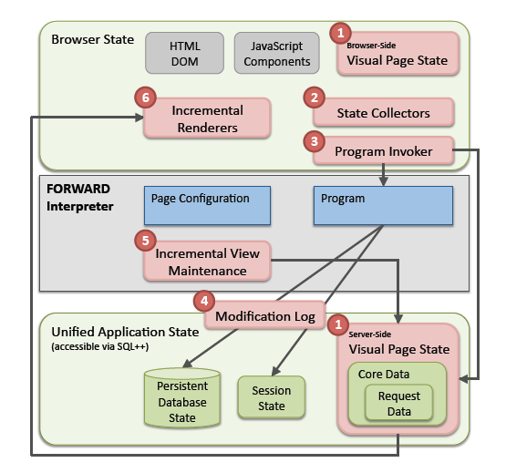
INTERNAL FORWARD ARCHITECTURE

Slide 78
REFERENCES
Ajax-based Report Pages as Incrementally Rendered Views
Yupeng Fu, Keith Kowalczykowski , Kian Win Ong
Yannis Papakonstantinou, Kevin Keliang Zhao, SIGMOD,2010
The SQL based All Declarative FORWARD Web Application Development Framework
Yupeng Fu, Kian Win Ong, Yannis Papakonstantinou
Michalis Petropoulos, CIDR 2011
Do-It-Yourself Database-Driven Web Applications
Keith Kowalzcykowski, Kian Win Ong, Kevin Keliang Zhao, Alin Deutsch, Yannis Papakonstantinou, Michalis Petropoulos, CIDR 2009

Slide 79


