Slide 1
PREGEL
A System for Large-Scale Graph Processing

Slide 2
The Problem
Large Graphs are often part of computations required in modern systems (Social networks and Web graphs etc.)
There are many graph computing problems like shortest path, clustering, page rank, minimum cut, connected components etc. but there exists no scalable general purpose system for implementing them.

Slide 3
Characteristics of the algorithms
They often exhibit poor locality of memory access.
Very little computation work required per vertex.
Changing degree of parallelism over the course of execution.
Refer [1, 2]

Slide 4
Possible solutions
Crafting a custom distributed framework for every new algorithm.
Existing distributed computing platforms like MapReduce.
These are sometimes used to mine large graphs^{[3, 4]}, but often give sub-optimal performance and have usability issues.
Single-computer graph algorithm libraries
Limiting the scale of the graph is necessary
BGL, LEDA, NetworkX, JDSL, Standford GraphBase or FGL
Existing parallel graph systems which do not handle fault tolerance and other issues
The Parallel BGL^{[5]} and CGMgraph^{[6]}

Slide 5
Pregel
Google, to overcome, these challenges came up with Pregel.
Provides scalability
Fault-tolerance
Flexibility to express arbitrary algorithms
The high level organization of Pregel programs is inspired by Valiant’s Bulk Synchronous Parallel model^{[7]}.
Notes:
The name Pregel honors Leonard Euler. The Bridges of of Konigsberg, which inspired his famous theorem, spanned the Pregel river.

Slide 6
Message passing model
A pure message passing model has been used, omitting remote reads and ways to emulate shared memory because:
Message passing model was found sufficient for all graph algorithms
Message passing model performs better than reading remote values because latency can be amortized by delivering larges batches of messages asynchronously.

Slide 7
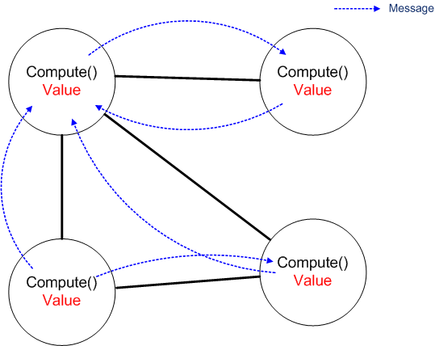
Message passing model

Slide 8
Example
Find the largest value of a vertex in a strongly connected graph

Slide 9
Finding the largest value in a graph
Blue Arrows
are messages
3
6
2
1
Blue vertices
have voted to halt
3
6
6
6
2
1
2
6
6
6
6
2
6
6
6
6
6
6
6
6

Slide 10
Basic Organization
Computations consist of a sequence of iterations called supersteps.
During a superstep, the framework invokes a user defined function for each vertex which specifies the behavior at a single vertex V and a single Superstep S. The function can:
Read messages sent to V in superstep S-1
Send messages to other vertices that will be received in superstep S+1
Modify the state of V and of the outgoing edges
Make topology changes (Introduce/Delete/Modify edges/vertices)
Notes:
The Vertex centric approach is inspired from MapReduce framework where the users focus on the local action, processing each item independently and the system composes these actions to lift computations to a large dataset.
The inherent synchronicity makes it easier to understand and implement algorithms. It also prevents deadlocks situations from occurring.
Since the typical numbers of vertices is far higher than the number of machines therefore load balancing is possible by redistribution, thus preventing latency.
Note that edges are not first class objects in Pregel; they have no associated computation.

Slide 11
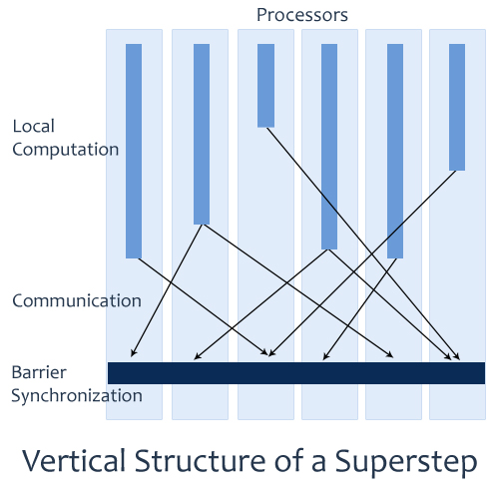
Basic Organization - Superstep
Notes:
The Vertex centric approach is inspired from MapReduce framework where the users focus on the local action, processing each item independently and the system composes these actions to lift computations to a large dataset.
The inherent synchronicity makes it easier to understand and implement algorithms. It also prevents deadlocks situations from occurring.
Since the typical numbers of vertices is far higher than the number of machines therefore load balancing is possible by redistribution, thus preventing latency.
Note that edges are not first class objects in Pregel; they have no associated computation.

Slide 12
Model Of Computation: Entities
VERTEX
Identified by a unique identifier.
Has a modifiable, user defined value.
EDGE
Source vertex and Target vertex identifiers.
Has a modifiable, user defined value.
Notes:
Identifier is a simple string.
Protocol Buffers
Typical Phases in Pregel Computation:
Input
Sequence of Supersteps
Termination and finishing with output.

Slide 13
Model Of Computation: Progress
In superstep 0, all vertices are active.
Only active vertices participate in a superstep.
They can go inactive by voting for halt.
They can be reactivated by an external message from another vertex.
The algorithm terminates when all vertices have voted for halt and there are no messages in transit.
Notes:
Only active vertices

Slide 14
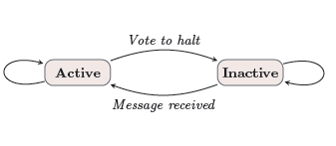
Model Of Computation: Vertex
State machine for a vertex
Notes:
Only active vertices

Slide 15
Comparison with MapReduce
Graph algorithms can be implemented as a series of MapReduce invocations but it requires passing of entire state of graph from one stage to the next, which is not the case with Pregel.
Also Pregel framework simplifies the programming complexity by using supersteps.

Slide 16
The C++ API
Creating a Pregel program typically involves subclassing the predefined Vertex class.
The user overrides the virtual Compute() method. This method is the function that is computed for every active vertex in supersteps.
Compute() can get the vertex’s associated value by GetValue() or modify it using MutableValue()
Values of edges can be inspected and modified using the out-edge iterator.
Notes:
The status updates are visible immediately. But since the visibility is confined to the modified vertex therefore there is no conflict.

Slide 17
The C++ API – Message Passing
Each message consists of a value and the name of the destination vertex.
The type of value is specified in the template parameter of the Vertex class.
Any number of messages can be sent in a superstep.
The framework guarantees delivery and non-duplication but not in-order delivery.
A message can be sent to any vertex if it’s identifier is known.
Notes:
User can specify handler for the case when destination vertex of the message doesn’t exist; it can create the vertex, destroy the dangling edge or dump the message.

Slide 18
The C++ API – Pregel Code
Pregel Code for finding the max value
Class MaxFindVertex
: public Vertex<double, void, double> {
public:
virtual void Compute(MessageIterator* msgs) {
int currMax = GetValue();
SendMessageToAllNeighbors(currMax);
for ( ; !msgs->Done(); msgs->Next()) {
if (msgs->Value() > currMax)
currMax = msgs->Value();
}
if (currMax > GetValue())
*MutableValue() = currMax;
else VoteToHalt();
}
};

Slide 19
The C++ API – Combiners
Sending a message to another vertex that exists on a different machine has some overhead. However if the algorithm doesn’t require each message explicitly but a function of it (example sum) then combiners can be used.
This can be done by overriding the Combine() method.
-It can be used only for associative and commutative operations.
Notes:
The combiner results in single message to the destination vertex that combines all the messages that were sent to that vertex in the previous superstep.

Slide 20
The C++ API – Combiners
Example:
Say we want to count the number of incoming links to all the pages in a set of interconnected pages.
In the first iteration, for each link from a vertex(page) we will send a message to the destination page.
Here, count function over the incoming messages can be used a combiner to optimize performance.
In the MaxValue Example, a Max combiner would reduce the communication load.
Notes:
The combiner results in single message to the destination vertex that combines all the messages that were sent to that vertex in the previous superstep.

Slide 21
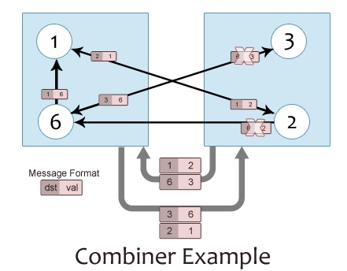
The C++ API – Combiners
Notes:
The combiner results in single message to the destination vertex that combines all the messages that were sent to that vertex in the previous superstep.

Slide 22
The C++ API – Aggregators
They are used for Global communication, monitoring and data.
Each vertex can produce a value in a superstep S for the Aggregator to use. The Aggregated value is available to all the vertices in superstep S+1.
Aggregators can be used for statistics and for global communication.
Can be implemented by subclassing the Aggregator Class
Commutativity and Assosiativity required
Notes:
Pregel provides a predefined set of aggregators like min, max or sum.
Statistics Example:
Sum operator applied to out-edge count of each vertex can be used to generate the total number of edges in the graph.
More complex reduction operators can even generate histograms.
Communication Example:
One branch of Compute() can be executed till an AND operator determines that all vertices satisfy a definite condition.
A min/max aggregator to a value concatenated to the vertex ID can also be used to select a vertex to play a distinguished role in an algorithm.
Sticky Aggregators:
Aggregators can also reduce values from multiple supersteps and not just the current superstep.

Slide 23
The C++ API – Aggregators
Example:
Sum operator applied to out-edge count of each vertex can be used to generate the total number of edges in the graph and communicate it to all the vertices.
- More complex reduction operators can even generate histograms.
In the MaxValue example, we can finish the entire program in a single superstep by using a Max aggregator.
Notes:
Pregel provides a predefined set of aggregators like min, max or sum.
Statistics Example:
Sum operator applied to out-edge count of each vertex can be used to generate the total number of edges in the graph.
More complex reduction operators can even generate histograms.
Communication Example:
One branch of Compute() can be executed till an AND operator determines that all vertices satisfy a definite condition.
A min/max aggregator to a value concatenated to the vertex ID can also be used to select a vertex to play a distinguished role in an algorithm.
Sticky Aggregators:
Aggregators can also reduce values from multiple supersteps and not just the current superstep.

Slide 24
The C++ API – Topology Mutations
The Compute() function can also be used to modify the structure of the graph.
Example: Hierarchical Clustering
Mutations take effect in the superstep after the requests were issued.
Ordering of mutations, with
deletions taking place before additions,
deletion of edges before vertices and
addition of vertices before edges
resolves most of the conflicts. Rest are handled by user-defined handlers.
Notes:
Example
Clusters can be reduced to a single node
In a minimum spanning tree algorithm, edges can be removed.
Requests for adding vertices and edges can also be made.

Slide 25
Implementation
Pregel is designed for the Google cluster architecture.
The architecture schedules jobs to optimize resource allocation, involving killing instances or moving them to different locations.
Persistent data is stored as files on a distributed storage system like GFS^{[8]} or BigTable.
Notes:
Google cluster architecture consists of thousands of commodity PCs organized into racks with high intra-rack bandwidth. Clusters are interconnected but distributed geographically.

Slide 26
Basic Architecture
The Pregel library divides a graph into partitions, based on the vertex ID, each consisting of a set of vertices and all of those vertices’ out-going edges.
The default function is hash(ID) mod N, where N is the number of partitions.
The next few slides describe the several stages of the execution of a Pregel program.
Notes:
Some applications work well with the default assignment, whereas some applications like a Web graph, benefit from defining custom assignment functions like colocating vertices representing pages of the same site.

Slide 27
Pregel Execution
Many copies of the user program begin executing on a cluster of machines. One of these copies acts as the master.
The master is not assigned any portion of the graph, but is responsible for coordinating worker activity.

Slide 28
Pregel Execution
2. The master determines how many partitions the graph will have and assigns one or more partitions to each worker machine.
Each worker is responsible for maintaining the state of its section of the graph, executing the user’s Compute() method on its vertices, and managing messages to and from other workers.
Notes:
Having more than one partition per worker allows parallelism among the partitions and better load balancing, and will usually improve performance.

Slide 29
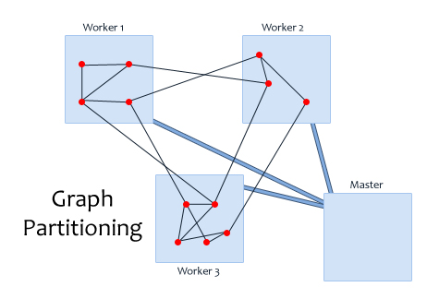
Pregel Execution
1
2
4
10
5
7
8
3
6
9
12
11
Notes:
Having more than one partition per worker allows parallelism among the partitions and better load balancing, and will usually improve performance.

Slide 30
Pregel Execution
3. The master assigns a portion of the user’s input to each worker.
The input is treated as a set of records, each of which contains an arbitrary number of vertices and edges.
After the input has finished loading, all vertices are marked are active.
Notes:
The division of inputs is orthogonal to the partitioning of the graph itself and is typically based on file boundaries.

Slide 31
Pregel Execution
4. The master instructs each worker to perform a superstep. The worker loops through its active vertices, and call Compute() for each active vertex. It also delivers messages that were sent in the previous superstep.
When the worker finishes it responds to the master with the number of vertices that will be active in the next superstep.
Notes:
Messages are sent asynchronously, to enable overlapping of computation, communication and batching.
This step is repeated as long as any vertices are active or any messages are in transit.
After the computation halts, the master may instruct each worker to save its portion of the graph.

Slide 32
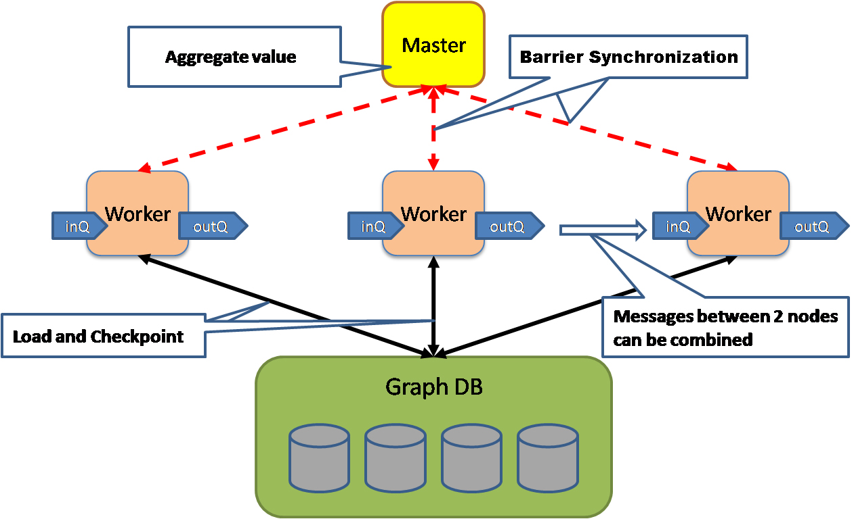
Pregel Execution
Notes:
Messages are sent asynchronously, to enable overlapping of computation, communication and batching.
This step is repeated as long as any vertices are active or any messages are in transit.
After the computation halts, the master may instruct each worker to save its portion of the graph.

Slide 33
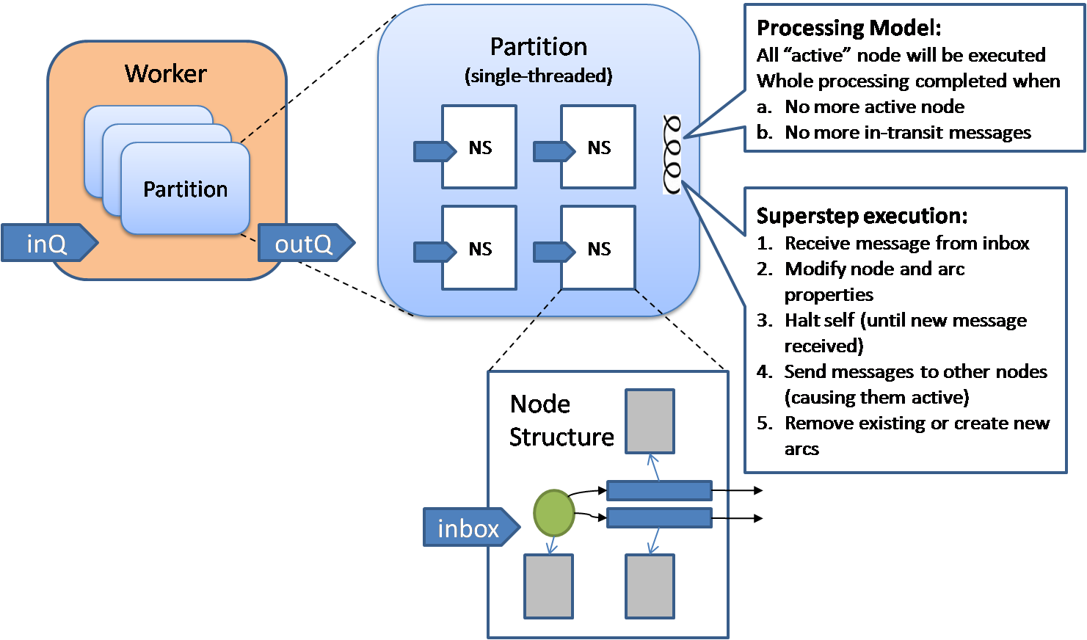
Pregel Execution
Notes:
Messages are sent asynchronously, to enable overlapping of computation, communication and batching.
This step is repeated as long as any vertices are active or any messages are in transit.
After the computation halts, the master may instruct each worker to save its portion of the graph.

Slide 34
Fault Tolerance
Checkpointing is used to implement fault tolerance.
At the start of every superstep the master may instruct the workers to save the state of their partitions in stable storage.
This includes vertex values, edge values and incoming messages.
Master uses “ping“ messages to detect worker failures.

Slide 35
Fault Tolerance
When one or more workers fail, their associated partitions’ current state is lost.
Master reassigns these partitions to available set of workers.
They reload their partition state from the most recent available checkpoint. This can be many steps old.
The entire system is restarted from this superstep.
Confined recovery can be used to reduce this load

Slide 36
Applications
PageRank

Slide 37
PageRank
PageRank is a link analysis algorithm that is used to determine the importance of a document based on the number of references to it and the importance of the source documents themselves.
[This was named after Larry Page (and not after rank of a webpage)]

Slide 38
PageRank
A = A given page
T₁ …. T_{n} = Pages that point to page A (citations)
d = Damping factor between 0 and 1 (usually kept as 0.85)
C(T) = number of links going out of T
PR(A) = the PageRank of page A
Notes:
Sum of all PageRanks = Number of pages

Slide 39
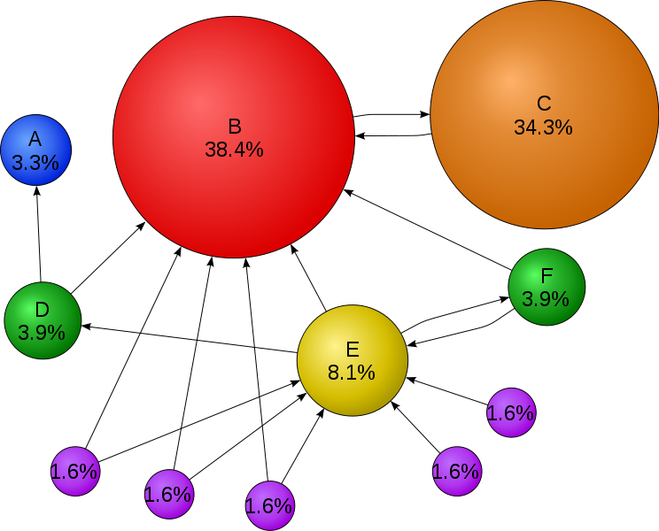
PageRank
Courtesy: Wikipedia
Notes:
Sum of all PageRanks = 1

Slide 40
PageRank
PageRank can be solved in 2 ways:
A system of linear equations
An iterative loop till convergence
We look at the pseudo code of iterative version
Initial value of PageRank of all pages = 1.0;
While ( sum of PageRank of all pages – numPages > epsilon) {
for each Page P_{i} in list {
PageRank(P_{i}) = (1-d);
for each page P_{j} linking to page P_{i} {
PageRank(P_{i}) += d × (PageRank(P_{j})/numOutLinks(P_{j}));
}
}
}
Notes:
Sum of all PageRanks = 1

Slide 41
PageRank in MapReduce – Phase I
Parsing HTML
Map task takes (URL, page content) pairs and maps them to (URL, (PR_{init}, list-of-urls))
PR_{init} is the “seed” PageRank for URL
list-of-urls contains all pages pointed to by URL
Reduce task is just the identity function

Slide 42
PageRank in MapReduce – Phase 2
PageRank Distribution
Map task takes (URL, (cur_rank, url_list))
For each u in url_list, emit (u, cur_rank/|url_list|)
Emit (URL, url_list) to carry the points-to list along through iterations
Reduce task gets (URL, url_list) and many (URL, val) values
Sum vals and fix up with d
Emit (URL, (new_rank, url_list))

Slide 43
PageRank in MapReduce - Finalize
A non-parallelizable component determines whether convergence has been achieved
If so, write out the PageRank lists - done
Otherwise, feed output of Phase 2 into another Phase 2 iteration

Slide 44
PageRank in Pregel
Class PageRankVertex
: public Vertex<double, void, double> {
public:
virtual void Compute(MessageIterator* msgs) {
if (superstep() >= 1) {
double sum = 0;
for (; !msgs->done(); msgs->Next())
sum += msgs->Value();
*MutableValue() = 0.15 + 0.85 * sum;
}
if (supersteps() < 30) {
const int64 n = GetOutEdgeIterator().size();
SendMessageToAllNeighbors(GetValue() / n);
} else {
VoteToHalt();
}}};

Slide 45
PageRank in Pregel
The pregel implementation contains the PageRankVertex, which inherits from the Vertex class.
The class has the vertex value type double to store tentative PageRank and message type double to carry PageRank fractions.
The graph is initialized so that in superstep 0, value of each vertex is 1.0 .

Slide 46
PageRank in Pregel
In each superstep, each vertex sends out along each outgoing edge its tentative PageRank divided by the number of outgoing edges.
Also, each vertex sums up the values arriving on messages into sum and sets its own tentative PageRank to
For convergence, either there is a limit on the number of supersteps or aggregators are used to detect convergence.

Slide 47
Applications
Shortest Paths

Slide 48
Shortest Path
There are several important variants of shortest paths like single-source shortest path, s-t shortest path and all-pairs shortest path.
We shall focus on single-source shortest path problem, which requires finding a shortest path between a single source vertex and every other vertex in the graph.

Slide 49
Shortest Path
Class ShortestPathVertex
: public Vertex<int, int, int> {
public:
virtual void Compute(MessageIterator* msgs) {
int minDist = IsSource((vertex_id()) ? 0 : INF;
for ( ; !msgs->Done(); msgs->Next())
minDist = min(minDist, msgs->Value());
if (minDist < GetValue()) {
*MutableValue() = minDist;
OutEdgeIterator iter = GetOutEdgeIterator();
for ( ; !iter.Done(); iter.Next())
SendMessageTo(iter.target(),
minDist + iter.GetValue());
}
VoteToHalt();
}
};

Slide 50
Shortest Path
In this algorithm, we assume the value associated with every vertex to be INF (a constant larger than any feasible distance).
In each superstep, each vertex first receives, as messages from its neighbors, updated potential minimum distances from the source vertex.
If the minimum of these updates is less than the value currently associated with the vertex, then this vertex updates its value and sends out potential updates to its neighbors, consisting of the weight of each outgoing edge added to the newly found minimum distance.

Slide 51
Shortest Path
In the 1st superstep, only the source vertex will update its value (from INF to zero) and send updates to its immediate neighbors.
These neighbors in turn will update their values and send messages, resulting in a wave front of updates through the graph.
The algorithm terminates when no more updates occur, after which the value associated with each vertex denotes the minimum distance from the source vertex to that vertex. The algorithm is guaranteed to terminate if there are no negative edges.

Slide 52
Shortest Path
Experiments:
Various experiments were conducted with the single-source shortest paths implementation on a cluster of 300 multicore commodity PCs. Runtimes are reported for
binary trees (to study scaling properties) and
lognormal random graphs (to study the performance in a more realistic setting)
using various graph sizes with the weights of all edges implicitly set to 1.

Slide 53
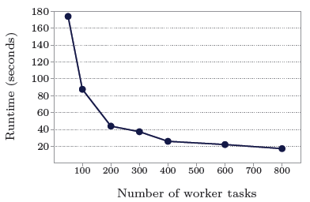
Shortest Path
1 billion vertex binary tree: varying number of worker tasks

Slide 54
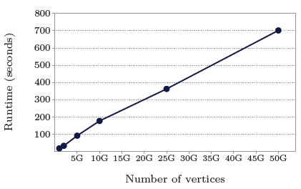
Shortest Path
binary trees: varying graph sizes on 800 worker tasks

Slide 55
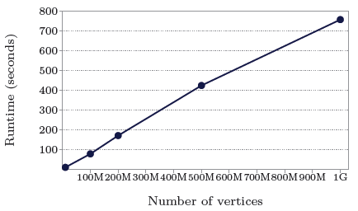
Shortest Path
log-normal random graphs, mean out-degree 127.1 (thus over 127 billion edges in the largest case): varying graph sizes on 800 worker tasks

Slide 56
Applications
Bipartite Matching

Slide 57
Bipartite Matching
The input to a bipartite matching algorithm consists of 2 distinct sets of vertices with edges only between the sets, and the output is a subset of edges with no common endpoints.
In the Pregel implementation, the algorithm is a randomized matching algorithm.
The vertex value is a tuple of 2 values: a flag indicating which set the vertex is in (L or R), and the name of its matched vertex once it is known.

Slide 58
Bipartite Matching
Class BipartiteMatchingVertex
: public Vertex<tuple<position, int>, void, boolean> {
public:
virtual void Compute(MessageIterator* msgs) {
switch (superstep() % 4) {
case 0: if (GetValue().first == ‘L’) {
SendMessageToAllNeighbors(1);
VoteToHalt();
}
case 1: if (GetValue().first == ‘R’) {
Rand myRand = new Rand(Time());
for ( ; !msgs->Done(); msgs->Next()) {
if (myRand.nextBoolean()) {
SendMessageTo(msgs->Source, 1);
break;
}
}
VoteToHalt(); }

Slide 59
Bipartite Matching
case 2:
if (GetValue().first == ‘L’) {
Rand myRand = new Rand(Time());
for ( ; !msgs->Done(); msgs->Next) {
if (myRand.nextBoolean()) {
*MutableValue().second = msgs->Source());
SendMessageTo(msgs->Source(), 1);
break;
}
}
VoteToHalt(); }
case 3:
if (GetValue().first == ‘R’) {
msgs->Next();
*MutableValue().second = msgs->Source();
}
VoteToHalt();
}}};

Slide 60
Bipartite Matching
The algorithm proceeds in cycles of 4 phases.
In phase 1, each left vertex not yet matched sends a message to each of its neighbors to request a match, and then unconditionally votes to halt.
In phase 2, each right vertex not yet matched randomly chooses one of the messages it receives, sends a message granting that request and sends messages to other requestors denying it. Then it unconditionally votes to halt.

Slide 61
Bipartite Matching
In phase 3, each left vertex not yet matched chooses one of the grants it receives and sends an acceptance message. Left vertices that are already will never execute this phase since they will not have sent any messages in phase 0.
In phase 4, an unmatched right vertex receives at most one acceptance message. It notes the matches node and unconditionally votes to halt.

Slide 62
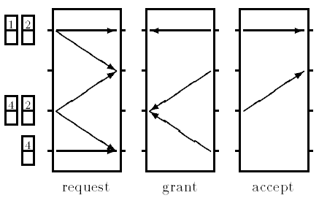
Bipartite Matching
Execution of a cycle (A cycle consists of 4 supersteps)

Slide 63
THANK YOU ANY QUESTIONS?

Slide 64
References
[1] Andrew Lumsdaine, Douglas Gregor, Bruce Hendrickson, and Jonathan W. Berry, Challenges in Parallel Graph Processing. Parallel Processing Letters 17, 2007, 5-20.
[2] Kameshwar Munagala and Abhiram Ranade, I/O-complexity of graph algorithms. in Proc. 10th Annual ACM-SIAM Symp. on Discrete Algorithms, 1999, 687-694.
[3] Joseph R. Crobak, Jonathan W. Berry, Kamesh Madduri, and David A. Bader, Advanced Shortest Paths Algorithms on a Massively-Multithreaded Architecture. in Proc. First Workshop on Multithreaded Architectures and Applications, 2007, 1-8.
[4] U Kung, Charalampos E. Tsourakakis, and Christos Faloutsos, Pegasus: A Peta-Scale Graph Mining System - Implementation and Observations. Proc. Intl. Conf. Data Mining, 2009, 229-238.

Slide 65
References
[5] Douglas Gregor and Andrew Lumsdaine, The Parallel BGL: A Generic Library for Distributed Graph Computations. Proc. of Parallel Object-Oriented Scientic Computing (POOSC), July 2005.
[6 ] Albert Chan and Frank Dehne, CGMGRAPH/CGMLIB: Implementing and Testing CGM Graph Algorithms on PC Clusters and Shared Memory Machines. Intl. J. of High Performance Computing Applications 19(1), 2005, 81-97.
[7] Leslie G. Valiant, A Bridging Model for Parallel Computation. Comm. ACM 33(8), 1990, 103-111.
[8] Sanjay Ghemawat, Howard Gobioff and Shun-Tak Leung, The Google File System. In Proc. 19th ACM Symp. On Operating Syst. Principles, 2003, 29-43.

Slide 66
Extra Slides

Slide 67
Applications
Semi-clustering

Slide 68
Semi-clustering
Vertices in a social graph typically represent people, and edges represent connections between them.
A semi-cluster in a social graph is a group of people who interact frequently with each other and less frequently with others. It is different from ordinary clustering in the sense that a vertex may belong to more than one semi-cluster.

Slide 69
Semi-clustering
The algorithm used is a greedy algorithm.
Its input is a weighted, undirected graph and its output is at most C_{max} semi-clusters, each containing at most V_{max} vertices, which are both user-defined parameters.

Slide 70
Semi-clustering
A semi-cluster is assigned a score,
Where,
I_{c} is the sum of the weights of all internal edges,
B_{c} is the sum of all boundary edges and
f_{B} is the boundary score factor, which is a user-defined parameter, between 0 and 1.
The score is normalized by dividing with the number of vertices in the clique, so that large clusters do not receive artificially high scores.

Slide 71
Semi-clustering
Each vertex V maintains a list containing at most C_{max} semi-clusters, sorted by score.
In superstep 0, V enters itself in that list as a semi-cluster of size 1 and score 1, and publishes itself to all of its neighbors.
In subsequent supersteps, V circulates over the semi-clusters sent to it in the previous superstep. If a semi-cluster c does not already contain V, V is added to c to form c’.

Slide 72
Semi-clustering
The semi-clusters are sorted by their scores and the best ones are sent to V’s neighbors.
Vertex V updates its list of semi-clusters with the semi-clusters that contain V.
The algorithm terminates either when the semi-clusters stop changing or the user may provide a limit. At that point, the list of best semi-cluster candidates for each vertex may be aggregated into a global list of best semi-clusters.

Slide 73
Model Of Computation: Output
Output of the vertices is a set of values explicitly output by the vertices
It can form a directed graph isomorphic to the input or different from it.
This can be because edges and vertices can be added/deleted while computation
Notes:
Example:
Clustering algorithm will generate a small set of disconnected vertices selected from a large graph
Graph mining algorithm might simply output aggregated statistics.

Slide 74
PageRank in MapReduce
Computing pagerank
R’(u) – New page rank of page u
R’(v) – New page rank of page v, where v links to u
N(v) – Number of outlinks from page v
The input that ‘reduce’ gets for each document v linking to u: [Key: “u”, Value: “v <PageRank of v> <number of outlinks from v>”.]
So we just sum over all the values passed to the reducer to compute the new PageRank.

Slide 75
PageRank in MapReduce
Parsing MapReduce
Map Phase
Input: For a document index.html <html><body>Blah blah blah... <a href=“2.html”> A link</a>....</html>
Output: For each link
[Key: “index.html”, value: “2.html”]
Reduce Phase
Input: [Key: “index.html”,
value: [“2.html”, “3.html”, “4.html”…]]
Output:[key: “index.html”, Value: “1.0 2.html 3.html ...” ]
Default PageRank

Slide 76
PageRank in MapReduce
Computation Iterations
Map Phase
Input: [ Key: “index.html”,
Value: “1.0, 1.html, 2.html, 3.html ...” ]
Output: For each outlink
[Key: “1.html”, value: “index.html <pagerank> <number of outlinks>” ...]
Reduce Phase
Input: [Key: “1.html”, value: “index.html <pagerank> <number of outlinks>” ...]
Output:[key: “1.html”, Value: “<new pagerank> index.html 3.html” ... ]
Iterate till convergence!
New PageRank

