Slide 1

Hyracks: A new partitioned-parallel platform for data-intensive computation
Vinayak Borkar
UC Irvine
(joint work with M. Carey, R. Grover, N. Onose, and R. Vernica)

Slide 2
Today’s Presentation
A new platform? Why?
How is Hyracks different from …?
The MapReduce Architecture
Hyracks Architecture
Hyracks User Model
Hyracks Data support
Experimental evaluation
Future Work

Slide 3
Motivation for Hyracks
Data sizes are growing exponentially
Social Networks (Facebook: 500M active users, >50M status updates/day)
Web : Trillions of URLs
Data is not necessarily flat
Semi-structured data
Unstructured data
Different data models (Arrays, for e.g.)
Non-traditional treatment of data
Need for processing data using custom logic

Slide 4
Motivation for Hyracks (contd.)
Large clusters of commodity hardware feasible
Google claims 10000s of cheap computers in their cluster
Fast networks are commodity
1G already available
10G available soon
Last but not least: Attention from industry
Plenty of new and interesting use-cases

Slide 5
A little bit of history (not so recent)
Parallel databases in the mid 90’s
The Gamma Database system (DeWitt et al)
True shared-nothing architecture
Operators process partitions
Split-tables perform data re-distribution
However: Could process only relational data using relational operators
Fault-tolerant execution was not a goal
Relatively fewer machines (~ 30 -50 nodes)

Slide 6
A little bit of history (recent)
Google proposed MapReduce in 2004
“Simple” user model
Write two/three sequential functions and let the infrastructure parallelize on the cluster
Hadoop built soon after that by Yahoo as an open-source project
High-level declarative languages compiled to MapReduce jobs
PIG from Yahoo
Hive from Facebook
Sawzall from Google
…

Slide 7
Hyracks vs. Other Alternatives
Vs. Parallel Databases
Extensible Data model
Fault tolerance
Vs. Hadoop
More flexible computational model
Generalized runtime processing model
Better support (transparency) for scheduling
Vs. Dryad
Data as a first class citizen
Commonly occurring data operators
Support common data communication patterns

Slide 8
The MapReduce Architecture
MapReduce
Job Tracker
Network
MapReduce
MapReduce
MapReduce
MapReduce
Distributed File System

Slide 9
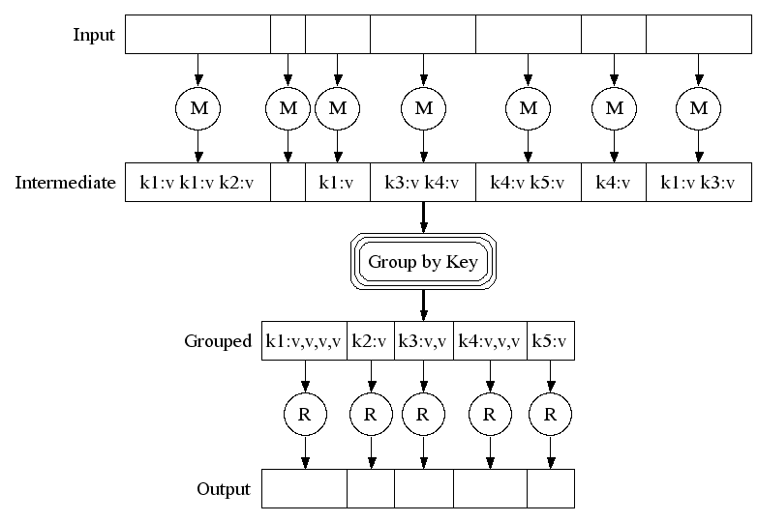
MapReduce in a Nutshell
Map (k1, v1) → list(k2, v2)
Processes one input key/value pair
Produces a set of intermediate
key/value pairs
Reduce (k2, list(v2))→ list(k3, v3)
Combines intermediate
values for one particular key
Produces a set of merged
output values (usually one)

Slide 10
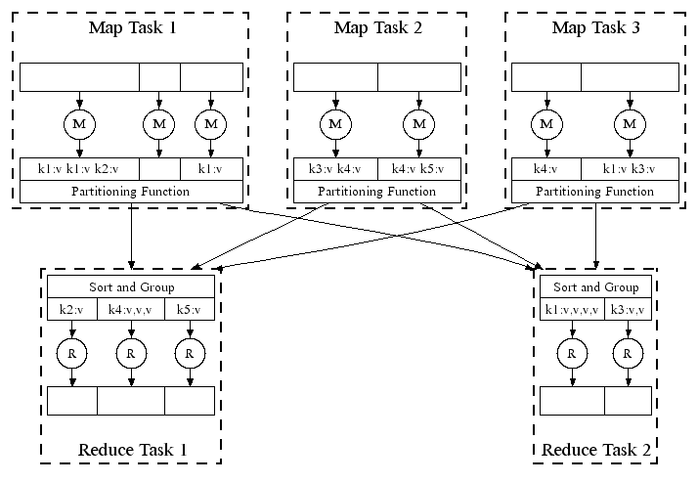
MapReduce Parallelism
← Hash Partitioning

Slide 11
The Hyracks Architecture
Cluster Controller
Network
Node Controller
Node Controller
Node Controller
Node Controller

Slide 12
Hyracks – Usage Scenarios
Designed with three possible uses in mind
High level data language compilation target
Compile directly to Native Hyracks Job
Compile to Hadoop jobs and run using compatibility layer
Run Hadoop jobs from existing Hadoop Clients
Run native Hyracks jobs

Slide 13

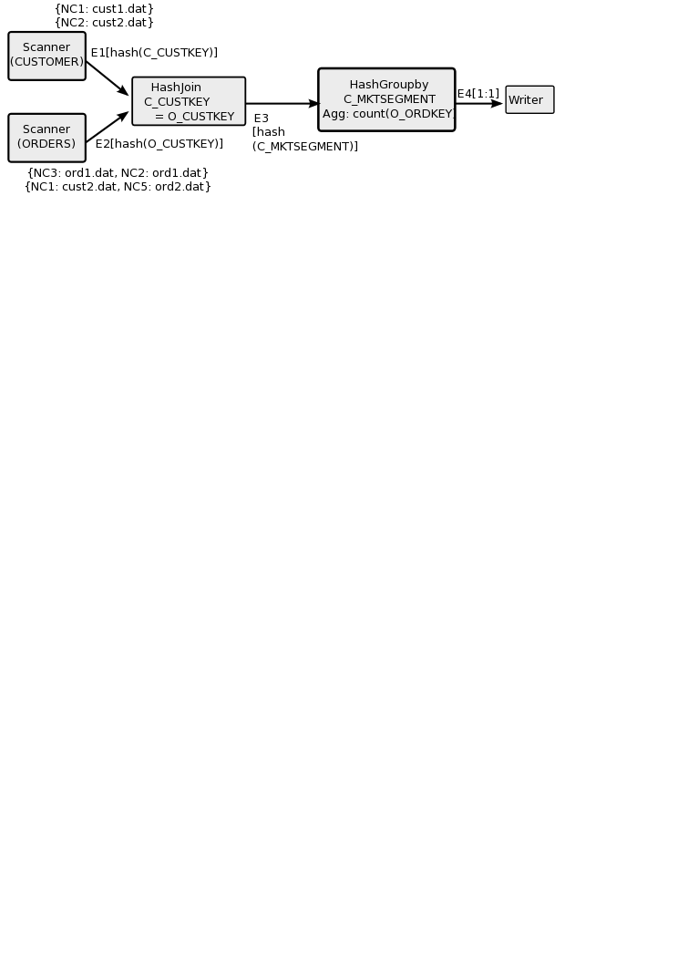
Hyracks Jobs
Job = Unit of work submitted by a Hyracks Client
Job = dataflow DAG of operators and connectors
Operators consume/produce partitions of data
Connectors repartition/route data between operators

Slide 14
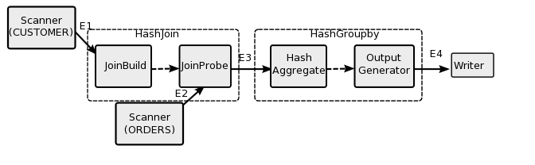
Hyracks: Operator Activities

Slide 15
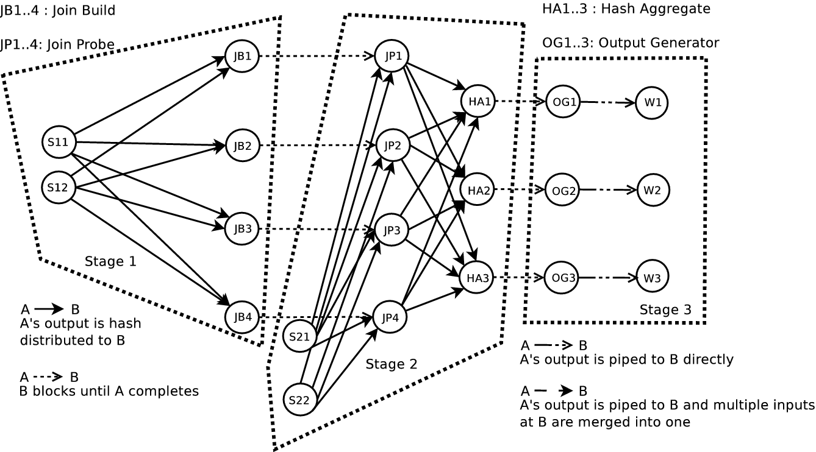
Hyracks: Runtime Task Graph

Slide 16
Hyracks Library (growing…)
Operators
File readers/writers: line files, delimited files, HDFS files
Mappers: native mapper, Hadoopmapper
Sorters: in-memory, external
Joiners: in-memory hash, hybrid hash
Aggregators: hash-based, preclustered
BTree Bulk Load, Search, Scan
Connectors
M:N hash-partitioner
M:N hash-partitioning merger
M:N range-partitioner
M:N replicator
1:1

Slide 17
Hyracks Data Movement
Fixed size memory blocks used to transport data
Cursors to iterate over serialized data
Common operations (comparison/hashing/ projection) can be performed directly on data in frames
Goal: Keep garbage collection to a minimum and minimize data copies
Anecdotally: Ran queries for ~60 mins, total GC time ~ 1.8 s.

Slide 18
Hyracks Operator/Connector Design
Operations on Collections of Abstract Data Types
Data model operations are provided during instantiation
For example:
Sort operator accepts a list of comparators
Hash-based groupby accepts a list of hash-functions and a list of comparators
Hash-Partitioning connector accepts a hash-function

Slide 19
Hyracks Operator/Connector Interface
Uniform push-style iterator interface that accept ByteBuffer objects
Operators can be connected to run in same or different threads.
public interface IFrameWriter {
public void open() …;
public void close() …;
public void nextFrame(ByteBuffer frame)…;
}

Slide 20
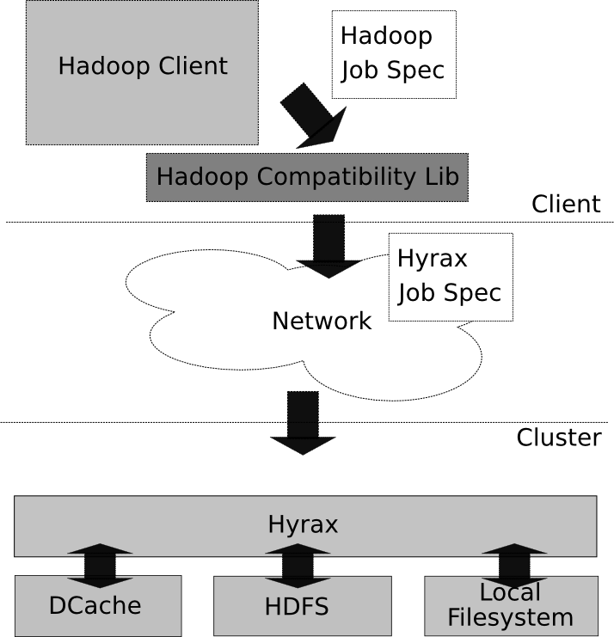
Hadoop Compatibility Layer
Goal:
Run Hadoop jobs unchanged on top of Hyracks
How:
Client-side library converts a Hadoop job spec into an equivalent Hyracks job spec
Hyracks has operators to interact with HDFS
Dcache provides distributed cache functionality

Slide 21

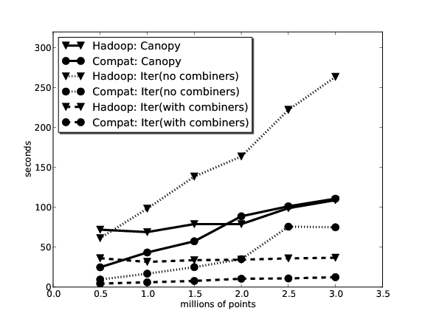
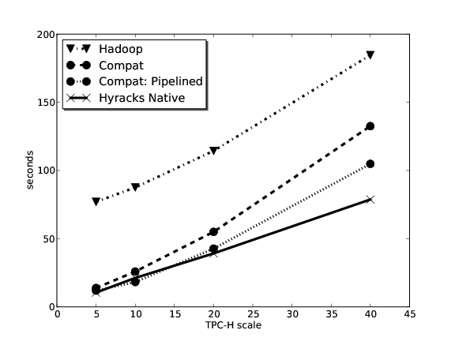
Hyracks Performance
K-means (on Hadoop Compatibility Layer)
DSS-style query execution (TPC-H based example)

Slide 22
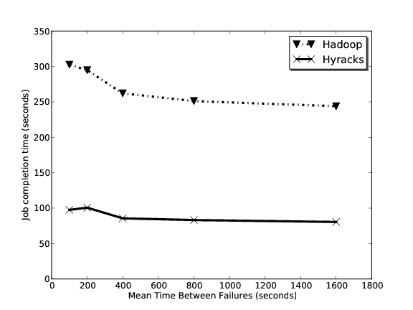
Hyracks Performance (contd.)
Fault-tolerant query execution (TPC-H based example)

Slide 23
Hyracks Performance Gains
K-Means
Push-based Job activation
Operations on serialized data representation
Not incurring extra disk I/O between Mapper and Reducer
Semantics of connector exploited at network level
TPC-H Query (In addition to the above)
Hash-based aggregation cheaper than sort based aggregation
Tagged joins sort |I1 + I2| amount of data
As an aside: Hash-join needs as much memory as the smaller input’s size to incur zero disk IO. Tagged join needs |I1 + I2| for an in-memory sort

Slide 24
Hyracks – Next steps
Fine-grained fault tolerance/recovery
Restart failed jobs in a more fine-grained manner
Exploit operator properties (natural blocking points) to get fault-tolerance at marginal (or no) extra cost
Automatic Scheduling
Use operator resource needs to decide sites for operator evaluation
Define protocol for interacting with HLL query planners

Slide 25
http://code.google.com/p/hyracks
More info at:

