Slide 1
Automated Selection of Materialized Views and Indexes for SQL Databases
Sanjay Agrawal Surajit Chaudhuri Vivek Narasayya
Hasan Kumar Reddy A (09005065)

Slide 2
Outline
Motivation
Introduction
Architecture
Algorithm
  Candidate Selection
  Configuration Enumeration
  Cost Estimation
Conclusion

Slide 3
Review : Materialized View
View: result of a stored query - logical
Materialized View: Physically stores the query result
Additionally: can be indexed !
Any change in underlying tables may give rise to change in materialized view – immediate, deferred
pros: Improve performance of queries
cons: Increase in size of database, update overhead, asynchrony
Notes:
A view is a virtual table derived from the real tables of a database. The views are not stored in the database, only a query definition is stored.
A Materialized view stores physically the data from the query defined by the view. Initially the data is stored from the base tables when the query is executed, and is then updated from the base tables.

Slide 4
Motivation
DBA have to administer manually – create indexes, materialized views, indexes on materialized views for performance tuning
Time consuming
prone to errors
Might not be able to handle continuously changing workload
Hence we need automatic DB tuning tools
Notes:
Read Keeping DBA in loop and improve the motivation slides

Slide 5
Introduction
Both indexes and materialized views are physical structures that can accelerate performance
A materialized view - richer in structure
- defined over multiple tables, and can have selections and GROUP BY over multiple columns.
An index can logically be considered as a special case of single table projection only materialized view
Notes:
Conceptually both indexes and materialized views are physical structures that can significantly accelerate performance
Most algorithms here are like heuristics which work well in practice

Slide 6
Problem
Determine an appropriate set of indexes, materialized views
  Identifying a set of traditional indexes, materialized views and indexes on materialized views for the given workload that are worthy of further exploration
  Picking attractive set from all potentially interesting mv set is practically not feasible
Notes:
Determine an appropriate set of indexes, materialized view for a given database and workload consisting of SQL queries and updates
Need to innovate techniques for dealing with large space of potentially interesting materialized views
Soln: a principled way to identify much smaller set of candidate materialized views s.t. search over reduced space preserves most of gains of searching entire space at a fraction of enumeration cost (more later)

Slide 7
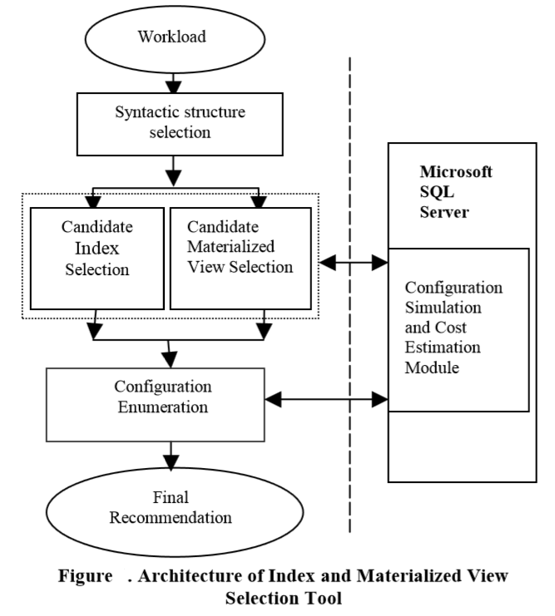
Architecture for Index and Materialized View Selection
Notes:
Workload
Consists of set of SQL statements
One way to obtain such a workload is to use the logging capability of modern database systems to capture a trace of queries and updates faced by the system. E.g.SQL Server Profiler
Alternatively, customer or organization specific benchmarks may be used.

Slide 8
Source: Automated Selection of Materialized Views and Indexes for SQL Databases [1]
Notes:
How to identify interesting set of tables such that we need to consider materialized views only over such set of tables
Finding relevant materialized views and further pruning of them based on cost
View merging technique that identifies candidate materialized views that while not optimal for any single query can be beneficial to multiple queries in the workload

Slide 9
Architecture for Index and Materialized View Selection
Assuming we are given a representative workload
Key components of Architecture
  Syntactic structure selection
  Candidate selection
  Configuration enumeration
  Configuration simulation and cost estimation
Notes:
Workload
One way to obtain such a workload is to use the logging capability of modern database systems to capture a trace of queries and updates faced by the system.
Alternatively, customer or organization specific benchmarks may be used.

Slide 10
Architecture: syntactic structure selection
Identify syntactically relevant indexes, mv and indexes on mv
query Q: SELECT Sum(Sales) FROM Sales_Data
WHERE City = 'Seattle’
Syntactically relevant materialized views (e.g.)
v1: SELECT Sum(Sales) FROM Sales_Data
WHERE City =‘Seattle’
Notes:
Given a workload, the first step is to identify syntactically relevant indexes, materialized views and indexes on materialized views
that can potentially be used to answer the query.

Slide 11
Architecture: syntactic structure selection
Identify syntactically relevant indexes, mv and indexes on mv
query Q: SELECT Sum(Sales) FROM Sales_Data
WHERE City = 'Seattle’
Syntactically relevant materialized views (e.g.)
v2: SELECT City, Sum(Sales) FROM Sales_Data GROUP BY City

Slide 12
Architecture: syntactic structure selection
Identify syntactically relevant indexes, mv and indexes on mv
query Q: SELECT Sum(Sales) FROM Sales_Data
WHERE City = 'Seattle’
Syntactically relevant materialized views (e.g.)
v3: SELECT City, Product, Sum(Sales)
FROM Sales_Data GROUP BY City, Product

Slide 13
Architecture: syntactic structure selection
Identify syntactically relevant indexes, mv and indexes on mv
query Q: SELECT Sum(Sales) FROM Sales_Data
WHERE City = 'Seattle’
Syntactically relevant materialized views (e.g.)
Optionally, we can consider additional indexes on the columns of the materialized view.

Slide 14
Architecture: Candidate Selection
Identifying a set of traditional indexes, materialized views and indexes on materialized views for the given workload which are worthy of further exploration
Note:
  This paper focuses only on efficient selection of candidate materialized views
  Assumes that candidate indexes have already been picked
Notes:
This is the focus of the paper and we will see it in detail later.
This module shotlists the indexes, mv for enumeration stage

Slide 15
Architecture : Configuration Enumeration
Determine ideal physical design – configuration
Search through the space in a naïve fashion is infeasible
over joint space of indexes and materialized views
Note:
  Paper doesn’t discuss issues related to selection of indexes on materialized views
Notes:
In our context, a configuration will consist of a set of traditional indexes, materialized views and indexes on materialized views
Despite remarkable pruning achieved by candidate selection module, searching through this space in a native fashion by enumerating all subsets of structures is infeasible

Slide 16
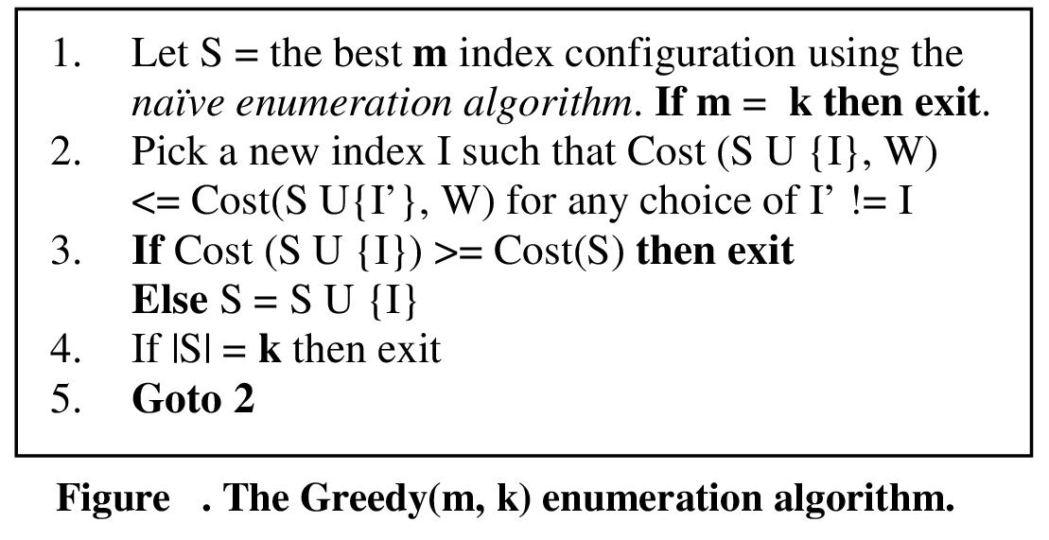
Greedy(m,k) algorithm for indexes
Source: An Efficient Cost-Driven Index Selection Tool for Microsoft SQL Server [3]
Extra: Ref - 3

Slide 17
Greedy(m,k) algorithm
Returns a configuration consisting of a total of k indexes and materialized views.
It first picks an optimal configuration of size up to m (≤ k) by exhaustively enumerating all configurations of size up to m. (seed)
It then picks the remaining (k-m) structures greedily or until no further cost reduction in cost is possible by adding a structure
Configuration simulation and cost estimation module is responsible for evaluation cost of configurations
Extra: Ref - 3
Notes:
If there are n candidate indexes, and the tool is asked to pick k indexes, a naïve enumeration algorithm would enumerate all subsets of the candidate indexes of size k or less, and pick the one with lowest total cost. The naïve enumeration algorithm guarantees an optimal solution; however, it is not practical, since for realistic values of n and k (e.g., n=40 and k=10) the number of configurations enumerated is too large to make exhaustive enumeration feasible.
The algorithm picks an optimal configuration of size m (where m <= k) as the “seed”. This seed is then expanded in a greedy fashion until all k indexes have been chosen, or no further reduction in cost is possible by adding an index.

Slide 18
Architecture: Configuration simulation and cost estimation
Supports other modules by providing cost estimation
Extension to database optimizer
- what-if - simulate presence of mat. views and indexes that do not exist to query optimizer
- cost(Q,C) - cost of query Q when the physical design is configuration C - optimizer costing module

Slide 19
“What-If” Indexes and Materialized Views
Provides interface to propose hypothetical (‘what-if’) indexes and mat views and
quantitatively analyze their impact on performance
Note: Details and implantation on reference[2]
Extra: Ref – 2
Notes:
Here Hypothetical configuration may include real physical db design and hypothetical indexes and mat views

Slide 20
Cost Evaluation (only indexes)
Naïve approach to evaluating a configuration:
cost-evaluator asks the optimizer for a cost estimate for each query in workload
Idea: cost of query Q in config C₂ may be same as in config C₁ which was computed earlier
  No need to recompute cost of Q in C₂
  How to identify such situations?
A configuration C is atomic if for some query there is a possible execution that uses all indexes and mat views in C
Sufficient to evaluate only M’ configurations among M as long as all atomic configurations are included in M’
(Identifying M’ – Reference[3])
Extra: Ref - 3

Slide 21
Cost of Configuration from Atomic Configurations
C : non-atomic configuration
Q : a select/update query
C_{i} : atomic configuration of Q & C_{i} is subset of C
Cost (Q,C) = Min_{i} {Cost (Q, C_{i} )}
without invoking optimizer for C, if Cost(Q, C_{i}) already computed
For a select query inclusion of index can only reduce the cost
  ➔ min cost over largest atomic configurations of Q
Extra: Ref - 3

Slide 22
Cost of Configuration from Atomic Configurations
Q : a insert/delete query
Cost of Q for non-atomic configuration C
  Cost of Selection
  Cost of updating table and indexes that may be used for selection
  Cost of updating indexes that don’t effect selection cost ( independent of each other and plan chosen for a & b )
Total cost = T + ∑_{j} (Cost(Q, {I_{j}}) – Cost(Q, {}))
Extra: Ref - 3
Notes:
Therefore, the optimizer will pick a plan that minimizes costs for (a) and (b).
As in a Select/Update query, we can derive T, the minimum of the costs over all atomic configurations of Q that are subsets of C to reflect the components (a) and (b) of
Cost (Q, C) .
To get the cost of updating an index I that is in (c), we look up (Cost (Q, (I]) - Cost (Q, { }).

Slide 23
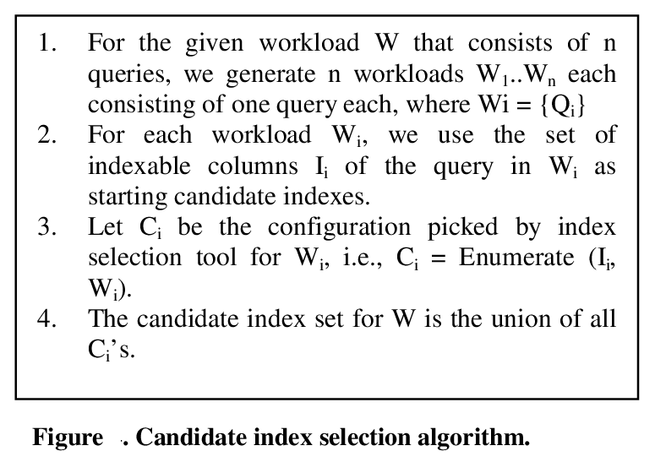
Candidate Index Selection
Source: An Efficient Cost-Driven Index Selection Tool for Microsoft SQL Server [3]
Extra: Ref - 3

Slide 24
Candidate Materialized View Selection
Given table-subset, no. of mat views arising from selection conditions and group by columns in the query is large
Goal: Quickly eliminate mat views that are syntactically relevant but are never used in answering any query
Obvious approach: Selecting one candidate materialized view per query that exactly matches each query in the workload
  does not work since in many database systems the language of materialized views may not match the language of queries
Notes:
a table-subset is a subset of tables referenced in a query in the workload
. For example, nested sub-queries can appear in the query but may not be part of the materialized view language
As said previously, we will only focus on candidate mv selection – candidate index selection is assumed to have been already done
Even for a given table-subset there is an explosion in the space of materialized views arising from selection conditions and group by columns in the query
The goal of candidate materialized view selection is to quickly eliminate materialized views that are syntactically relevant for one or more queries in the workload but are never used in answering any query from entering the configuration enumeration phase
For example, nested sub-queries can appear in the query but may not be part of the materialized view language.

Slide 25
Candidate selection: storage-constrained environments
Example 1: Consider a workload consisting of 1000 queries of the form:
SELECT l_returnflag, l_linestatus, SUM(l_quantity)
FROM lineitem
WHERE l_shipdate BETWEEN <Date1> and <Date2> GROUP BY l_returnflag, l_linestatus
  Assume different constants for <Date1> and <Date2>
Alternate mv:
SELECT l_shipdate, l_returnflag, l_linestatus, SUM(l_quantity)
FROM lineitem
GROUP BY l_shipdate, l_returnflag, l_linestatus
Notes:
Now lets go through a few example which better illustrate the role of candidate selection
Assume that each of the 1000 queries has different constants for <Date1> and <Date2>
Then, rather than recommending 1000 materialized views, the following materialized view that can service all 1000 queries may be more attractive for the entire workload:

Slide 26
Candidate selection: table-subsets with negligible impact
Table-subsets occur infrequently in the workload or they occur only in inexpensive queries
Example 2
Consider a workload of 100 queries whose total cost is 10,000 units. Let T be a table-subset that occurs in 25 queries whose combined cost is 50 units.
Then even if we considered all syntactically relevant materialized views on T, the maximum possible benefit of those materialized views for the workload is 0.5%
Notes:
This can happen because table-subsets occur infrequently in the workload or they occur only in inexpensive queries

Slide 27
Candidate selection: size of materialized view
Consider the TPC-H 1GB database and the workload specified in the benchmark.
There are several queries in which the tables lineitem, orders, nation, and region co-occur.
However, it is likely that materialized views proposed on the table-subset {lineitem, orders} are more useful than materialized views proposed on {nation, region}.
This is because the tables lineitem and orders have 6 million and 1.5 million rows respectively, but tables nation and region are very small (25 and 5 rows respectively).
The benefit of pre-computing the portion of the queries involving {nation, region} is insignificant compared to the benefit of pre-computing the portion of the query involving {lineitem, orders}.

Slide 28
Candidate materialized view selection
Arrive at a smaller set of interesting table-subsets
Propose a set of mat views for each query
We select a configuration that is best for that query, using cost-based analysis
Generate a set of merged mat views
merged mat views U mat views(2) enters configuration enumeration.
Notes:
1. From the large space of all possible table-subsets for the workload, we arrive at a smaller set of interesting table-subsets
2. Based on these interesting table-subsets, we propose a set of materialized views for each query in the workload, and from this set we select a configuration that is best for that query. This step uses a cost-based analysis for selecting the best configuration for a query
3. Starting with the views selected in (2), we generate an additional set of “merged” materialized views in a controlled manner such that the merged materialized views can service multiple queries in the workload

Slide 29
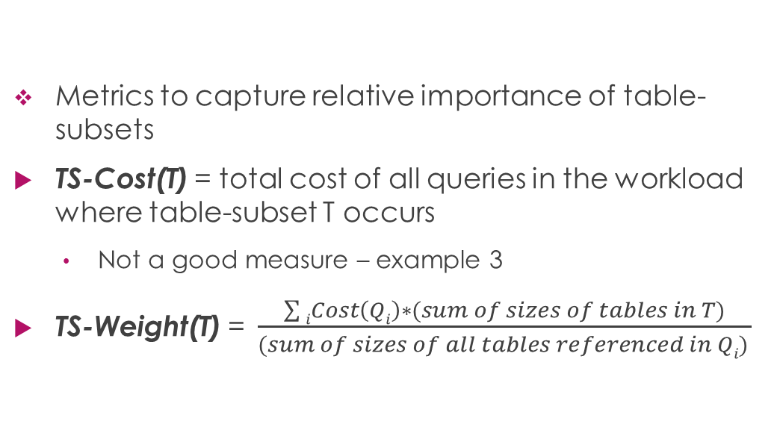
Finding Interesting
Table-Subsets
Metrics to capture relative importance of table-subsets
TS-Cost(T) = total cost of all queries in the workload where table-subset T occurs
  Not a good measure – example 3
TS-Weight(T) = $\frac{\sum{iCost\left(Qi\right)∗(sum of sizes of tables in T)}}{(sum of sizes of all tables referenced in Qi) }$
Notes:
Goal: find “interesting” table-subsets from among all possible table-subsets for the workload, and restrict the space of materialized views considered to only those table-subsets.
Intuitively, a table-subset T is interesting if materializing one or more views on T has the potential to reduce the cost of the workload significantly, i.e., above a given threshold.
Observe that TS-Weight is a simple function that can discriminate between table-subsets even if they occur in exactly the same queries in the workload

Slide 30
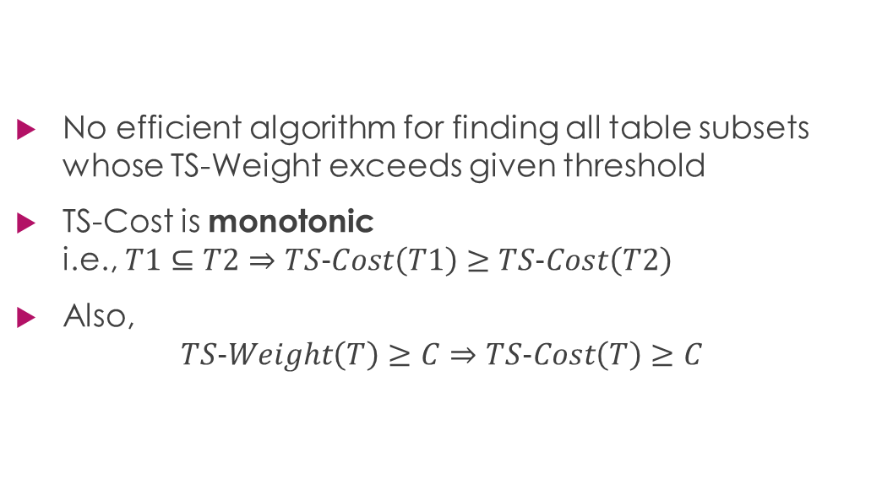
Finding Interesting
Table-Subsets
No efficient algorithm for finding all table subsets whose TS-Weight exceeds given threshold
TS-Cost is monotonic
i.e., $T1⊆T2⇒TS−Cost\left(T1\right)≥TS−Cost\left(T2\right)$
Also,
$TS−Weight\left(T\right)≥C⇒TS−Cost\left(T\right)≥C$
Notes:
There are a few properties of these two metrics which will help us in devising an efficient procedure

Slide 31
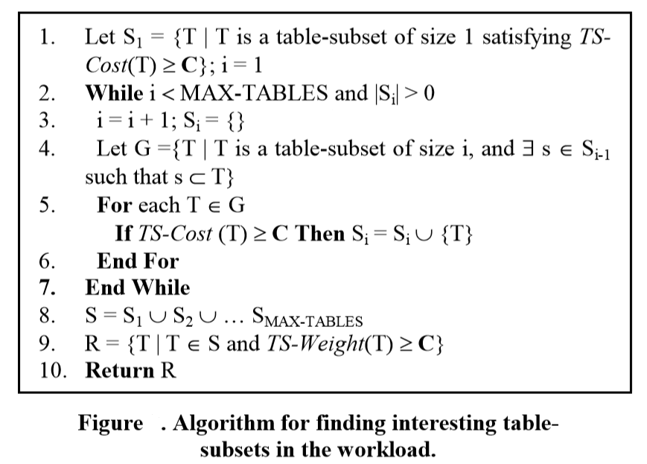
Finding Interesting
Table-Subsets
Source: Automated Selection of Materialized Views and Indexes for SQL Databases [1]
Notes:
The efficiency gained by the algorithm is due to reduced CPU and memory costs by not having to enumerate all table-subsets
We define the size of a table-subset T to be the number of tables in T.
MAX-TABLES is the maximum number of tables referenced in any query in the workload.
A lower threshold C leads to a larger space being considered and vice versa.
Based on experiments on various databases and workloads, we found that using C =10% of the total workload cost had a negligible negative impact on the solution compared to the case when there is no cut off (C = 0), but was significantly faster

Slide 32
Syntactically Relevant Materialized Views
Mat views only on the table-subset that exactly matches the tables references in Q_{i} – insufficient
  Language of mat views
  Algebraic transformation of queries by optimizer
  Exact match might not even be deemed interesting
Consider smaller interesting table subsets
  On all interesting table subsets that occur in Q_{i}
  - Effective pruning
Notes:
Once we got the table subsets, how do we derive syntactically relevant materialized views from it?
One reason for this is that the language of views may not match the language of queries,
e.g., the query may contain a nested sub-query whereas the view cannot.
Also, for complex queries the query optimizer performs algebraic transformations of the query to find a better execution plan.
In such cases, determining which of the interesting table-subsets to consider requires analysis of the structure of the query as well as knowledge of the transformations considered by the query optimizer.
We also note that due to the pruning of table-subsets in previous step, the table subset that exactly matches the tables referenced in the query may not even be deemed interesting.

Slide 33
Syntactically Relevant Materialized Views
For each interesting table-subset T
  A ‘pure-join’ mat view on T containing join and selection conditions in Q_{i} on tables in T
  If Q_{i} has grouping columns, also include GROUP BY columns and aggregate expressions from Q_{i} on tables in T
May also include only a subset of selection conditions
  But that is considered during view merging step
For each mat view, we propose a set of clustered and non-clustered indexes (details excluded)

Slide 34
Exploiting Query Optimizer to Prune Syntactically Relevant Materialized Views
Still many mat views may not be used in answering any query – decision made by query optimizer based on cost estimation
Intuition: If mat view is not part of best solution of any query in workload, its unlikely to be part of the best solution for entire workload
Notes:
Though table-subset pruning from previous algorithm itself significantly reduces the space of mat views, many of these views may still not be useful for answering any query in workload
This is because the decision of whether or not a materialized view is useful in answering a query is made by the query optimizer using cost estimation.
Therefore, our goal is to prevent syntactically relevant materialized views that are not used in answering any query from being considered during configuration enumeration.

Slide 35
Exploiting Query Optimizer to Prune Syntactically Relevant Materialized Views
For a given query Q, and a set S of materialized views (and indexes on them) proposed for Q, function Find-Best-Configuration(Q, S) returns the best configuration for Q from S
Cost-based - by optimizer
Any suitable search e.g. Greedy(m,k) can be used
Notes:
Find-Best-Configuration has the property that the choice of the best configuration for a query is cost based, i.e., it is the configuration that the optimizer estimates as having the lowest cost for Q.

Slide 36
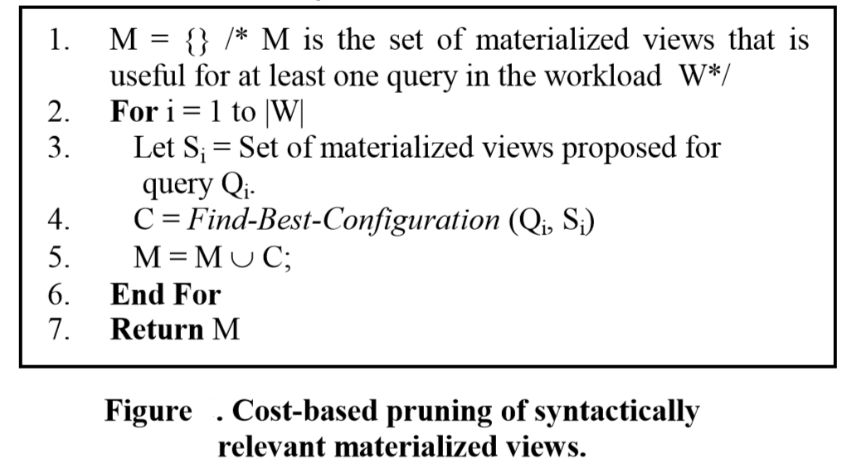
Exploiting Query Optimizer to Prune Syntactically Relevant Materialized Views
What if updates or storage constrains are present?
Source: Automated Selection of Materialized Views and Indexes for SQL Databases [1]
Notes:
In the presence of updates or storage constraints, we may need to pick more than one configuration for a query (e.g., the n best configurations) in Step 4 to maintain quality, at the expense of increased running time during configuration enumeration.

Slide 37
View Merging
Under storage constraints, sub-optimal recommendations (see example 1)
SELECT l_returnflag, l_linestatus, SUM(l_quantity) FROM lineitem WHERE l_shipdate BETWEEN <Date1> and <Date2>
GROUP BY l_returnflag, l_linestatus
SELECT l_shipdate, l_returnflag, l_linestatus, SUM(l_quantity) FROM lineitem
GROUP BY l_shipdate, l_returnflag, l_linestatus
Directly analyzing multiple queries at once – infeasible
Observation: Set of mat views returned, M are selected on cost-basis and are vey likely to be used by optimizer
Additional ‘merged’ mat views are derived from M
Notes:
If the materialized views that enter configuration enumeration are limited to the ones selected by the previous algorithm, then we can get sub-optimal recommendations for the workload when storage is constrained (see Example 1)
Consider the space of mat views that although are not optimal for any individual query, are useful for multiple queries, and therefore may be optimal for the workload

Slide 38
Merging a pair of views
Sequence of pair-wise merges
Parent view pair is merged to generate merged view
Criteria for merging
  All queries that can be answered using either of parent views should be answerable using merged view
  Cost of answering queries using merged view should not be significantly higher than the cost of answering queries using views in M
Notes:
An important issue in view merging is characterizing the space of merged views to be explored. In our approach, we have decided to explore this space using a sequence of pair-wise merges

Slide 39
View Merging – criteria
  All queries that can be answered using either of parent views should be answerable using merged view
    Syntactically modifying parent views as little as possible
    Retain common aspect and generalize only differences
  Cost of answering queries using merged view should not be significantly higher than the cost of answering queries using views in M
    Prevent a merged view(v) from being generated if it is much larger that views in Parent-Closure(v) – set of views in M from which v is derived

Slide 40
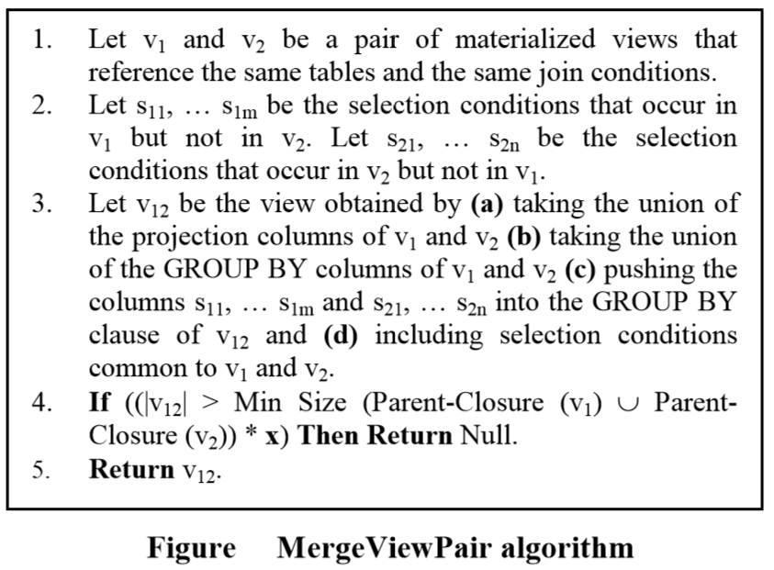
Merging Pair of Views
Source: Automated Selection of Materialized Views and Indexes for SQL Databases [1]
Notes:
For simplicity, we present the algorithm for SPJ views with grouping and aggregation, where the selection conditions are conjunctions of simple predicates. The algorithm can be generalized to handle complex selection conditions as well as account for differences in constants between conditions on the same column.
Its observed that setting x between 1 and 2 works well over a variety of databases and workloads.
In Step 4, MergeViewPair requires estimating the size of a materialized view. One way to achieve this is to obtain an estimate of the view size from the query optimizer.
The accuracy of such estimation depends on the availability of an appropriate set of statistics for query optimization

Slide 41
Algorithm for generating merged views
Merging merged mat views with mv from M or another merged mv
Much fewer than exponential of M merged mvs are explored – checks built into step 4
Set of merged mvs does not depend on sequence of merges
Notes:
This allows more than two views in M to be combined into one merged view even though the merging is done pair-wise

Slide 42
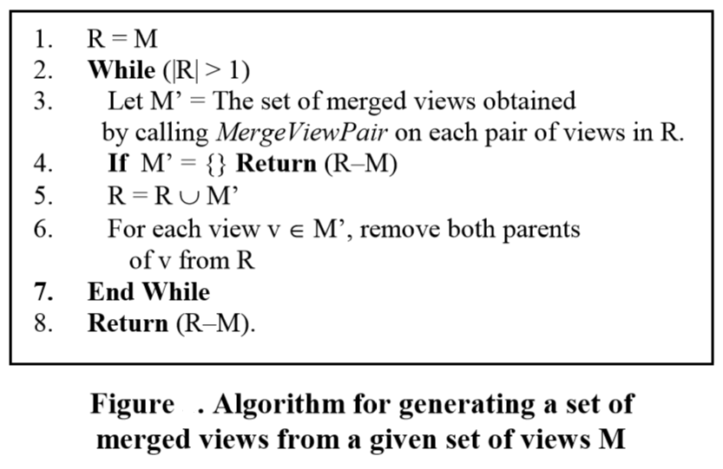
Algorithm for generating merged views
Source: Automated Selection of Materialized Views and Indexes for SQL Databases [1]
Notes:
Note however, that if views v1 and v2 cannot be merged to form v12, then no other merged view derived from v1 and v2 is possible, e.g., v123 is not possible. We can leverage this observation to increase efficiency by using techniques for finding frequent itemsets.
Finally, we can ensure that merged views generated by this algorithm are actually useful in answering queries in the workload, by performing a cost-based pruning using the query optimizer.

Slide 43
Key Techniques
How to identify interesting set of tables such that we need to consider materialized views only over such set of tables
Finding relevant materialized views and further pruning of them based on cost
View merging technique that identifies candidate materialized views that while not optimal for any single query can be beneficial to multiple queries in the workload
Notes:
The new set of merged materialized views, along with the materialized views selected in (2) is the set of candidate materialized views that enters configuration enumeration
Maintenance costs of mat. views and indexes are accounted for by the inclusion of updates/ inserts/ deletes statements in the workload

Slide 44
Role of interaction between indexes and materialized views
Together significantly improve performance
Impact more in presence of storage constraints and updates
Both are redundant structures that speed up query execution, compete for same resources – storage and incur maintenance overhead in presence of updates
Interact – presence of one may make other more attractive
Our approach - joint enumeration of space of candidate indexes and materialized views
Notes:
Now we will move to configuration enumeration
Which searches set of candidate mat views and indexes to determine the best configuration

Slide 45
Joint enumeration vs alternatives
Two alternatives to JOINTSEL
  MVFIRST – mv first and then ind
  INDFIRST – indexes first and then mv
Global storage bound is S, fraction f (0 ≤ f ≤ 1)
a storage constraint f*S is applied to selection of first feature
f depends on several attributes of workload
amount of updates, complexity of queries, absolute value of total storage bound
Even at optimal f, JOINTSEL is better in most cases
MVFIRST – adversely affect quality of indexes picked
Notes:
In both, if global storage bound is S, we need to determine fraction f (0 ≤ f ≤ 1), s.t. a storage constraint f*S is applied to selection of first feature and later remaining storage can be used when picking the second feature set
MVFIRST – adversely affect quality of indexes picked
Given a query, best materialized view is likely to be more beneficial than best index – since mv pre-computes part of query

Slide 46
Joint enumeration vs alternatives
JOINTSEL - two attractions
  A graceful adjustment to storage bounds
  Considering interactions between candidate indexes and candidate materialized views
e.g. a query Q for which I₁ and I₂, v are candidates
Assume I₁ alone reduces cost of Q by 25 units and I₂ by 30 units, but I₁ and v together reduce cost by 100 units.
Using INDFIRST I₂ would eliminate I₁ resulting in suboptimal recommendation
Greedy(m,k) – treats indexes, materialized views and indexes on materialized views on same footing

Slide 47
Experiments
Algorithms presented in this paper are implemented on Microsoft SQL Server 2000
Hypotheses set:
Selecting Candidate mat views
  Identifying interesting table-subsets substantially reduces mat views without eliminating useful ones
  View-merging algorithms significantly improves quality, especially under storage constraints
Architectural issues
  Candidate selection module reduces runtime maintaining quality recommendations
  Configuration enumeration module Greedy(m.k) gives results comparable to exhaustive algorithm
  JOINTSEL better than MVFIRST or INDFIRST

Slide 48
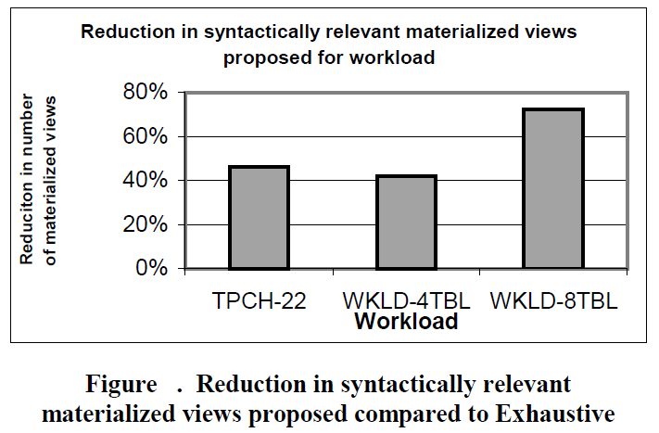
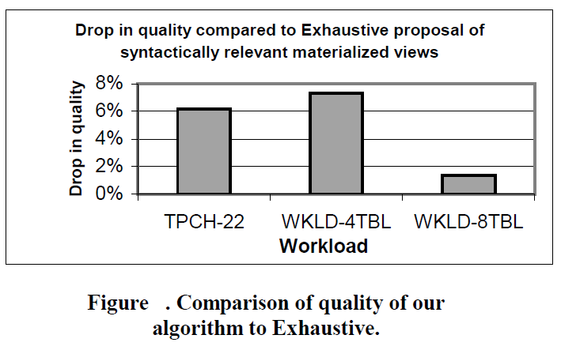
Identifying interesting table-subsets
Threshold C = 10%
Significant Pruning of space
With small drop in quality

Slide 49
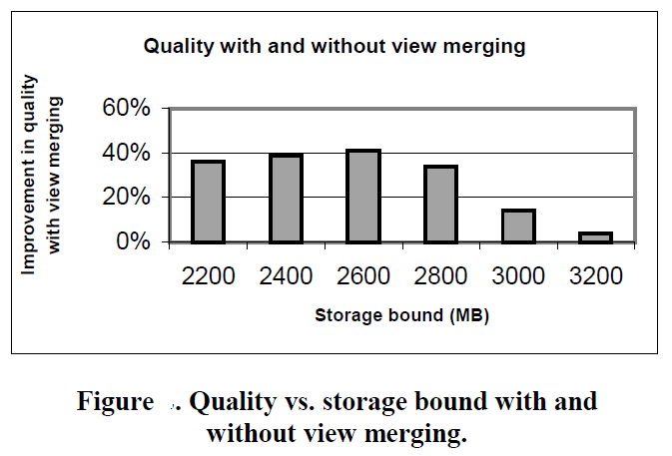
View Merging
With increase in storage, both converge
Add. Merged views: 19%
Increase in runtime: 9%

Slide 50
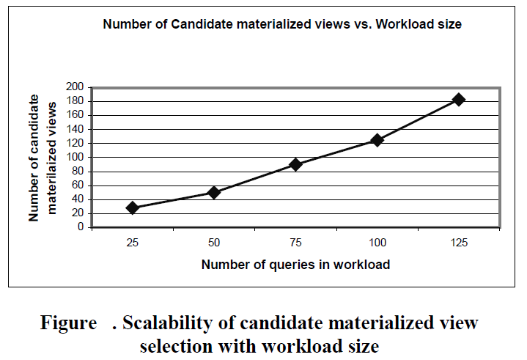
Candidate Selection
No. of mat views grows linearly with workload size – hence scalable

Slide 51
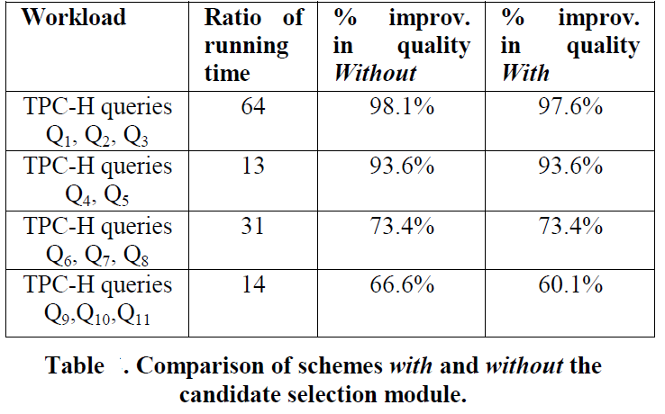
Candidate Selection
candidate selection not only reduces the running time by several orders of magnitude, but the drop in quality resulting from this pruning is very small

Slide 52
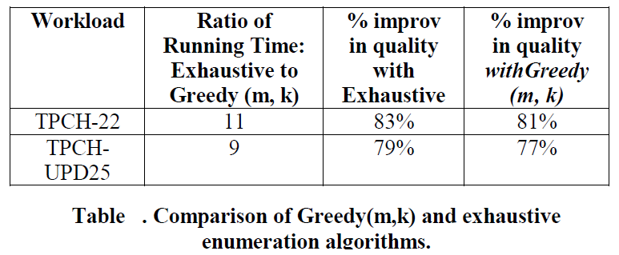
Configuration Enumeration
m=2
Greedy(m,k) gives a solution comparable in quality to exhaustive enumeration. Yet, in time magnitudes faster

Slide 53
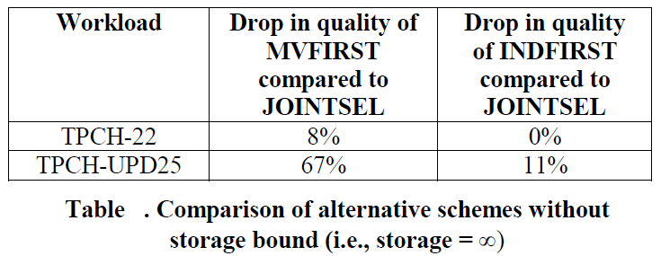
JOINTSEL vs MVFIRST vs INDFIRST
Even with no storage constraints JOINSEL is significantly better than MVFIRST or INDFIRST

Slide 54
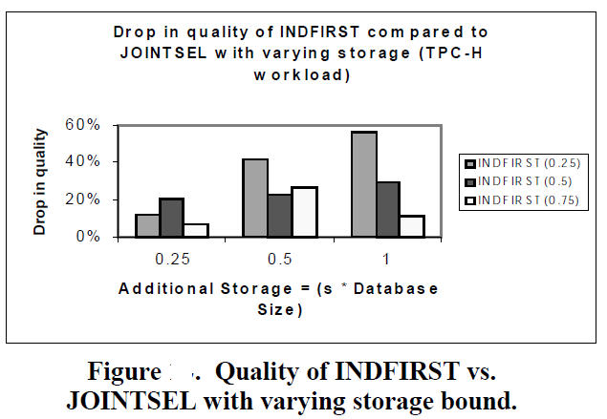
JOINTSEL vs MVFIRST vs INDFIRST
For a given database and workload optimal partitioning varies with storage constraint

Slide 55
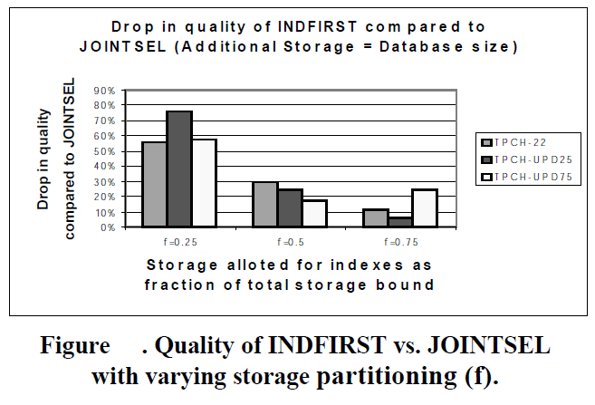
JOINTSEL vs MVFIRST vs INDFIRST
Best allocation fraction different for each workload
Consistent high quality of JOINTSEL, though the runtimes are comparable (+/- 10%)

Slide 56
Conclusions
Key take away from paper would be theoretical framework and appropriate abstractions from physical database design that is able to capture its complexities and compare properties of alternate algorithms
Though many assumptions are made while formulating, they are all later supported by experiments

Slide 57
References
Automated Selection of Materialized Views and Indexes for SQL Databases. Surajit Chaudhuri, Vivek Narasayya, and Sanjay Agrawal., VLDB 2000
AutoAdmin “What-If” Index Analysis Utility. Chaudhuri S., Narasayya V., ACM SIGMOD 1998.
An Efficient Cost-Driven Index Selection Tool for Microsoft SQL Server. Chaudhuri S., Narasayya V., VLDB 1997.

Slide 58
Thank you

