Slide 1
Scalability for Virtual Worlds
By Nitin Gupta, Alan Demers, Johannes Gehrke, Philipp Unterbrunner, Walker White
at ICDE 2009
Presented By,
Pratik Patre, Biplab Kar

Slide 2
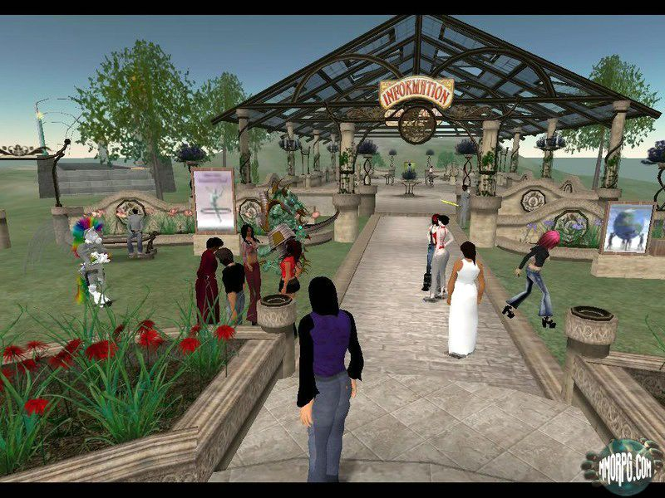
Net-VEs
Networked Virtual Environments
A virtual environment shared by many users connected over a network
Users can interact with each other in real time

Slide 3
Pushing the frontiers in Gaming
Low quality to highly immersive visuals
  Graphics Research Community
Simple button control to motion sensing control
  Interaction Design Community
Single Player to Multiplayer over LAN
  Networking Research Community
Massive Scalability over thousands of simultaneous users
  Distributed Database Research Community

Slide 4
What restricts Massive Scalability?
Computational Complexity
  Realistic graphics and physics based interaction
Consistency
  Consistent virtual world for all users. Required for realism.
Response Time
  Guaranteeing bounded response time to users thereby increasing action throughput. Required for real-time interaction.

Slide 5
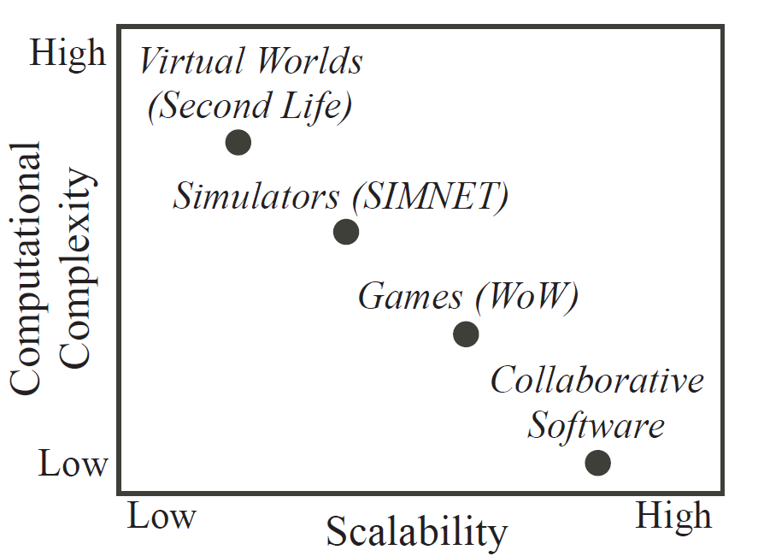
What restricts Massive Scalability?
Computational Complexity
Similarly we expect scalability to decrease with increasing consistency requirement and decreasing response time requirement

Slide 6
Tackling Massive Scalability Problem
Computation Complexity
  Pushing complex computation to client machines
Consistency
  Using application semantics to reduce consistency requirements
Response Time
  Reducing messages communicated for an action
Exploring the Trade-Offs in above requirements

Slide 7
But Wait…
First we investigate the current (as in 2008) approaches for improving scalability

Slide 8
Virtual World – A Database Perspective
The entire virtual world and all its components (World State) are stored in a database
  Tuples - Each object/player information
  Attributes - Characteristics like Health, position, speed, weapons of each object/player
Any interaction in the world is a database transaction
  Observations - Database Queries
  Change in state - Database Updates

Slide 9
A Gaming Example
A Shared Virtual Gotham City
Avatars - Batman and Joker
Event - Batman kicks Joker which reduces Joker’s health
A look from Database perspective
  Batman, Joker and their attributes including current health stored as tuples in the database in objects table
  The game engine reads from the database attacking power of Batman and health of Joker
  The game engine determines the effect of the action on Jokers health and other parameters
  The game engine updates the values of the new parameters in the database

Slide 10
An example consistency issue
Joker shoots at Robin while batman throws a batarang at Joker
What is the outcome?

Slide 11
Net-VE Architectures
Centralized VEs
  All computations are done at a centralized server
  World state updated only by server
  The clients only read this world state and show it to the users

Slide 12
Scaling Centralized VEs
Zoning
  Geographically partitioning virtual environments small enough for a server to handle
Sharding
  Different virtual environments for geographically distant users
Instancing
  Private zones meant a personal experiences to some players
Focus on partitioning user base
Some virtual worlds require users to pay for playing with real friends

Slide 13
Net-VE Architectures
Distributed Net-VEs
  Distribute computation to clients
  Advantage – Reducing load on server and leveraging capabilities of client
  Strongly consistent P2P architectures do not scale
  Companies want to exert control and monetize the virtual environment discouraging completely distributed models

Slide 14
Net-VE Architectures
Client Server Distributed Model
  Enforces centralized control at the server
  Distributes computation to clients
  Advantage – Reduced load on server
  Server needs to maintain consistency

Slide 15
Client Server Net-VEs
Clients connected to server
Client
  Clients contain virtual world logic
  Clients initiate and process action
    A sequence of atomic operations
    At first, observation of world state
    Followed by update of the state
Server
  Shoulders the responsibility of consistency of world state across clients

Slide 16
Ensuring consistency in Client Server Net-VEs
Lock Based Protocol
  Global Locks on objects
  Lock granted by server
  Client Requests locks
  Server multicasts it to detect conflicts
  Lock status reported to client
  Disadvantages
    Time required is 2 x RTT
    All consistency issues should be mapped to object access

Slide 17
Ensuring consistency in Client Server Net-VEs
Timestamp based Protocols
  Servers associates versions with objects and timestamp with transactions
  Clients execute actions
  Server integrates the actions into a global multi version history ensuring consistency in the world
  Disadvantages
    Server should understand game logic
    If server broadcasts global history then time required 2 x RTT

Slide 18
Ensuring consistency in Client Server Net-VEs
Object Ownership based protocols
  Each object owned and managed by single client
  Other clients manipulate locally cached copy and relay updates to the master copy
  Fairness in object ownership and object contention are issues

Slide 19
Back to the work in the paper…
Action based Protocols
  Consistency checked at the level of actions
  Allows using action semantics to provide levels of consistency
  Virtual World is a progression of world states updated by client actions
Assumptions
  Standard model of simulation engine
  World changes at simulation ticks
  Inter tick interval ‘T’

Slide 20
Basic Algorithms
First, some notations and definitions
  World State (WS)
  Client maintains two versions of world state
    Optimistic version Z_{CO}
    Stable version Z_{CS}
  Actions performed by clients a_{i}
  Effect of applying a_{i} to Z_{CO} is v_{i}

Slide 21
Basic Algorithms : A Bird’s eye view
Clients (when sending actions)
  Preform action on optimistic copy and sent result to server
Server
  Gets actions from all clients, timestamps and orders them and relays these actions to the clients
Clients (when receiving actions)
  Applies received actions on ZCS and compares the result with those of ZCO
  Reconciliation protocol is called in case of conflicts
    Resolves conflict considering the ordering imposed by the server
    Changes the action & its result and again sends it to the server

Slide 22
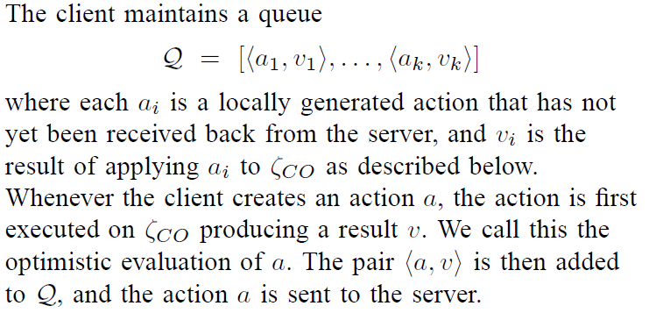
Basic Algorithms : Client

Slide 23
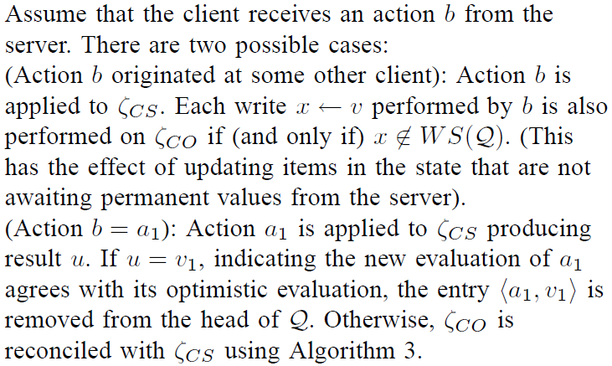
Basic Algorithm : Client

Slide 24
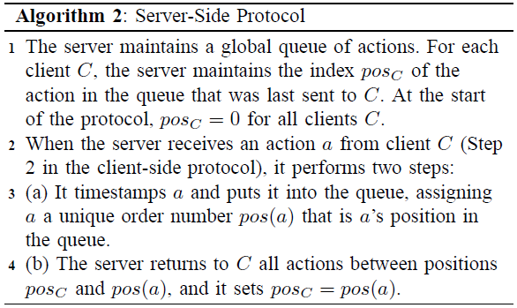
Basic Algorithms : Server

Slide 25
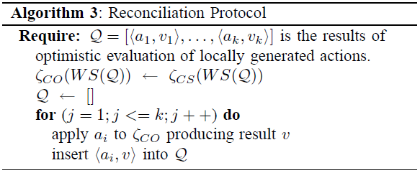
Basic Algorithms : Reconciliation

Slide 26
Is the proposed solution enough?
Response Time
  Good Enough. RTT for most actions (More for conflicting actions)
Consistency
  The server ensures consistency using timestamp ordering
Computational Load
  Clients need to process actions of all the clients in the world
  Incurs high computation load
  Is it necessary?

Slide 27
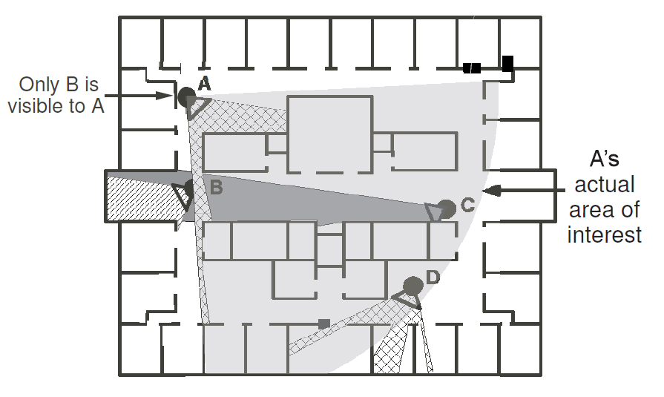
Leveraging Application Specific Information
Current optimizations focus on area-of-interest paradigm
  Restrict set of update messages by syntactic constraints like visibility
Problems with the approach
  Does not generalize to arbitrary actions like scrying spell
  Different obstructions for actions based on different senses
  Transitive propagation of effects of actions need to be taken into account

Slide 28
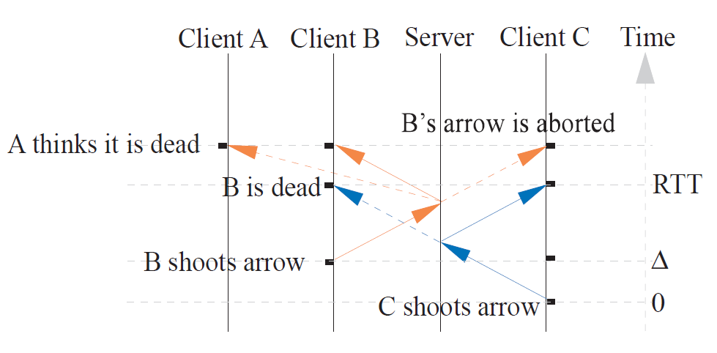
From application syntactic information to application semantic information
Transitive propagation of actions by users

Slide 29
Incomplete World Model
Clients maintain incomplete world state in their databases
  World State variables which concern them are updated
Now server has the responsibility to maintain a complete world state
  Also since we don’t want the server to evaluate game logic, the actions would still be evaluated by the clients
  Their result and a completion message is sent to the server
  The server then updates the authoritative state
Client sees an incomplete world while server sees a complete world

Slide 30
Incomplete World Model : Client
The client behaves similar as in the previous protocol
Now after application of each of its own action successfully, it sends a completion message to the server in both cases
  If Zco and Zcs match
  If not, then reconciled and new action added
Completion message indicates the successful application of an action

Slide 31
Incomplete World Model : Server
The server maintains
  Authoritative state Zs
  Global queue of ordered actions
  And for each action in the queue, the clients it was sent
Time stamping of actions is similar as in previous protocol
For every action, it computes the set previous actions that must be sent to each client (See Next Slide)
Upon receipt of an completion message of an action from a client, the action is removed from the global queue
Only completed actions are applied to the authoritative state

Slide 32

Which updates should be sent?
Which part of the world is client concerned with?
Application semantic information can be used to determine if an action affects another action
A bomb explosion in a area affects the health of an avatar if the avatar is within the maximum radius of explosion

Slide 33
Determining update set
An action has
  Read Set – The world state variables it reads
  Write Set – The world state variables it updates
An action a_{i} affects action a_{j} if,
  Read Set (a_{i}) ∩Write Set (a_{j}) ≠ ø
  Now compute which actions a_{k} affect a_{i}
  Continue transitively for all actions in the ready queue of actions
The determination of actions would go on but terminates when
  The action queue is finished since these actions have completed message sent
  The values for the remaining read set are read from the authoritative database since it as all actions with completed actions have been applied to authoritative database

Slide 34
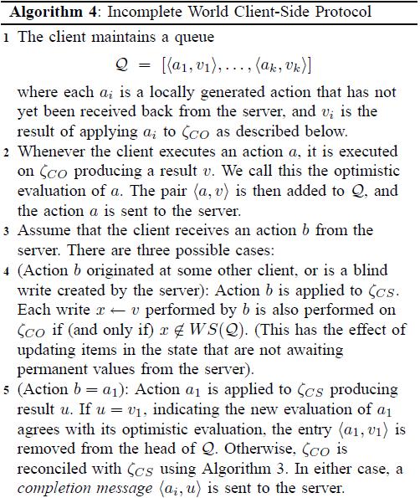
Incomplete World Protocol : In Detail

Slide 35
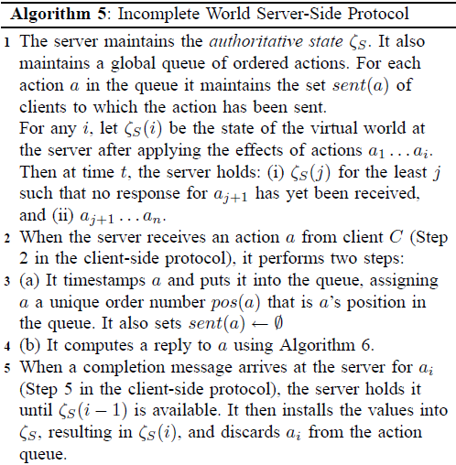
Incomplete World Protocol : In Detail

Slide 36
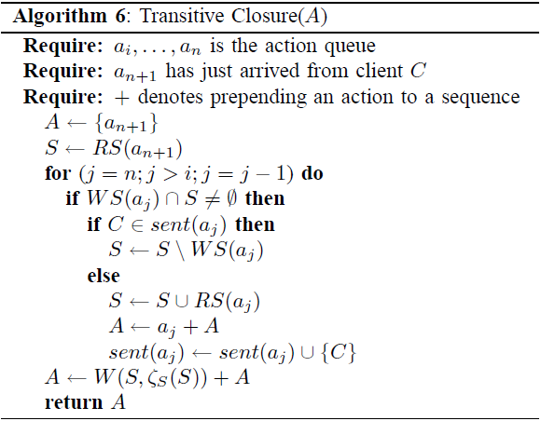
Incomplete World Protocol : In Detail

Slide 37
A Theorem
In a distributed snapshot of the system, Zcs at all clients is consistent with Zs at the server
  Observe that all clients and server apply the updates relevant to them in the same order

Slide 38
Analysis of the Protocol
Depends on the bound on the number of actions to be included in the update set which affects the computational complexity at the clients
Transitive closure
  Determines which previously unsent actions can affect the evaluation of current action
First Bound Model
  Considers the actions which might directly affect the current action using semantic constraints
Information Bound Model
  Considers transitive dependence of the actions

Slide 39
First Bound Model
FBM determines the set of actions that are sent to a client
Finds bound on the number of actions that might directly affect the future actions of the client

Slide 40
Which actions to consider?
Use application semantics to bound actions
Spatial attributes can change at most by maximum velocity
A player can damage other player at most by the maximum attacking power

Slide 41


First Bound Model : Intuition

Slide 42
First Bound Model
Computing Complexity
  Time for server to receive response for an action from client is RTT + Y (initial processing)
  Server needs to send all actions that it has seen in the previous (RTT + Y) / T ticks
  Later as actions increase Y increases proportionally increasing the bound geometrically
A little change in the protocol
  The server now proactively pushes action sets to clients at regular intervals of w RTT ( 0<w<1)
  The server receives a response for any action from the client in time (1+w) RTT of sending the action to the client

Slide 43
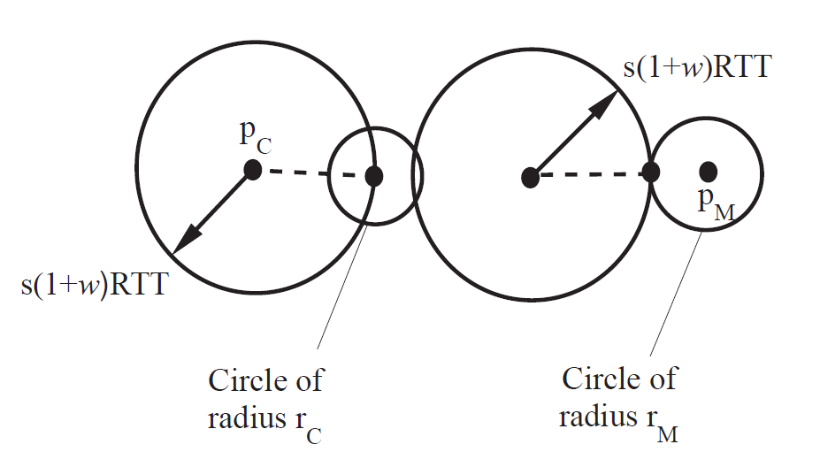
First Bound Model : The condition
Pa and Pc are positions of the users
S is the maximum velocity
Rc and Ra are radii of areas of influence

Slide 44

Information Bound Model
Transitive effects of actions can sometimes affect other actions through very long sequence of actions
Threshold

Slide 45
Information Bound Model
Transitive effects of actions can sometimes affect other actions through very long sequence of actions
Bound on the number of action to be considered for transitive effect
The bound is decided arbitrarily and actions are dropped and not considered
Raises some other issues like fairness but performance is good enough

Slide 46
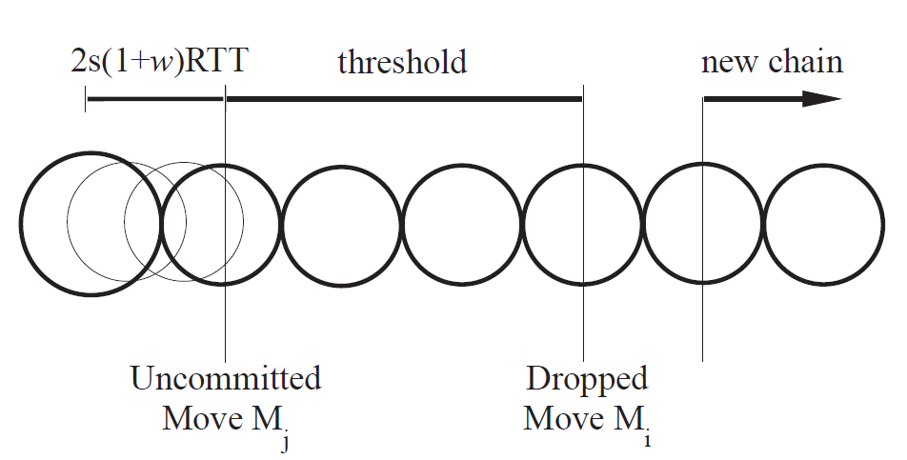
The complete bound
Using both the first bound and information bound

Slide 47
Other Optimizations
Inconsequential Action Elimination
  Some actions are inconsequential for other actions of objects
  Small changes in a area are significant for an insect while they may be insignificant for a large transformer robot
Area Culling
  Many actions do not have spherical area of influence like shooting of arrow
  Modify action influence accordingly
  An arrow shot by a player has a rectangular area of influence along with a velocity vector

Slide 48
Experimental Evaluation
Paper’s algorithm – SEVE (Scalable Engine for Virtual Environment)
The game - Manhattan People

Slide 49
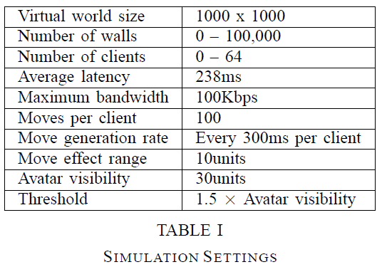
Experimental Evaluation

Slide 50
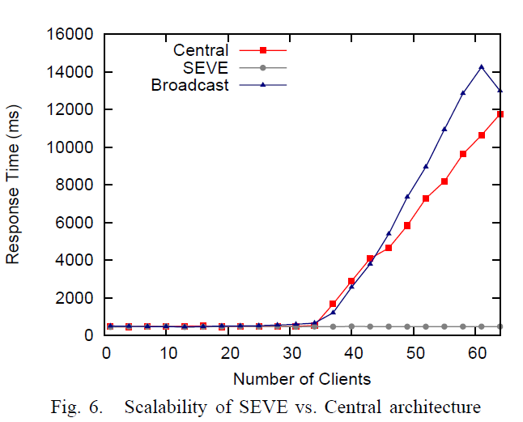
Response Time vs Scalability

Slide 51
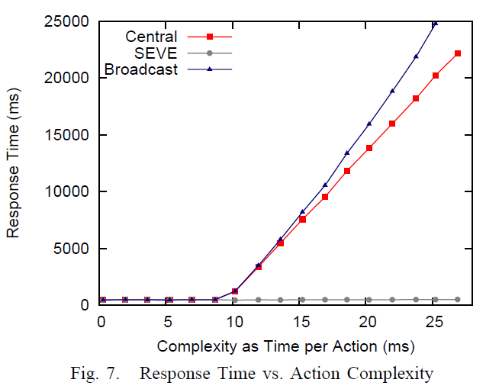
Response Time vs Complexity

Slide 52
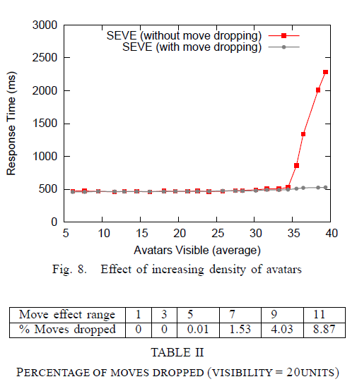
Response Time vs Density of Avatars

Slide 53
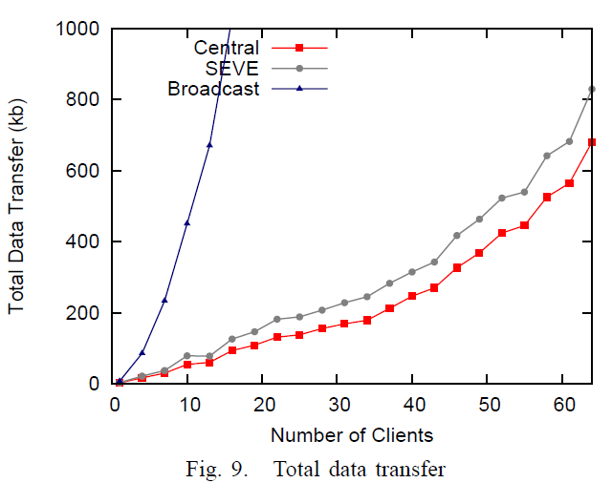
Data Transfer vs Number of Clients

Slide 54
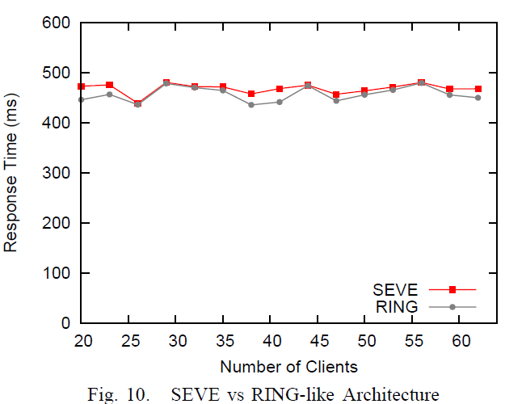
Response Time vs Number of Clients

Slide 55
Conclusion
  At the core of networked Virtual Environments, lie data-management problems.
Identified a novel solution to an interesting concurrency problem, using DBMS paradigms.
Applications ranging from collaborative problem solving to online games can benefit from the database community

Slide 56
References
[1] Scalability for Virtual Worlds
Nitin Gupta, Alan J. Demers, Johannes Gehrke, Philipp Unterbrunner, Walker M. White
ICDE 2009
[2] SEMMO: A Scalable Engine for Massively Multiplayer Online Games (Demonstration Paper) Nitin Gupta, Alan Demers, and Johannes Gehrke, SIGMOD 2008
[3] Database Research Opportunities in Computer Games Walker White, Christoph Koch, Nitin Gupta, Johannes Gehrke, and Alan Demers, In SIGMOD Record, September 2007

Slide 57
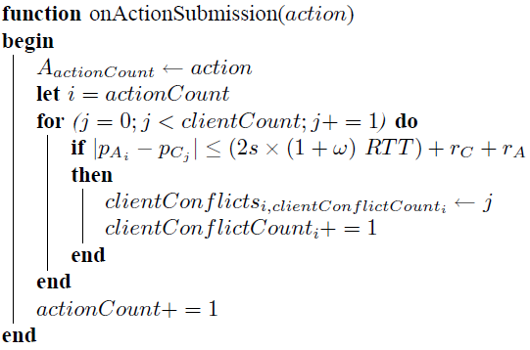
Considering relevant actions

Slide 58
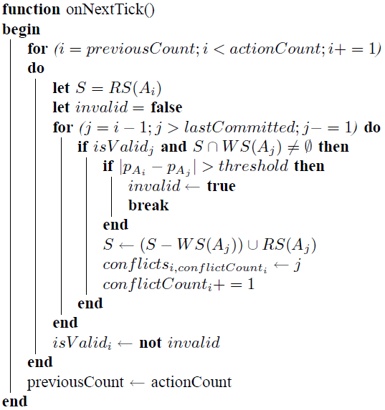
Computing Update set

