Slide 1
SCOPE
Easy and Efficient Parallel Processing of Massive Data Sets
Some slides taken from Jingren Zhou's talk on Scope :
isg.ics.uci.edu/slides/MicrosoftSCOPE.pptx
Adapted from a talk by: Sapna Jain & R. Gokilavani

Slide 2
Map-reduce framework
Good abstraction of group-by-aggregation operations
  Map function -> grouping
  Reduce function -> aggregation
Very rigid: Every computation has to be structured as a sequence of map-reduce pairs
Not completely transparent: users still have to use a parallel mindset
Lacks expressiveness of popular query language like SQL.
Notes:
For complex applications that require multiple stages of map-reduce, there are often many valid evaluation strategies and execution orders. Having users implement (potentially multiple) map and reduce functions is equivalent to asking users specify physical execution plans directly in database systems. The user plans may be suboptimal and lead to performance degradation by orders of magnitude.

Slide 3
Scope
Structured Computations Optimized for Parallel Execution
A declarative scripting language
  Easy to use: SQL-like syntax plus
  Provides interfaces for customized operations
Users focus on problem solving as if on a single machine
  System complexity and parallelism are hidden

Slide 4
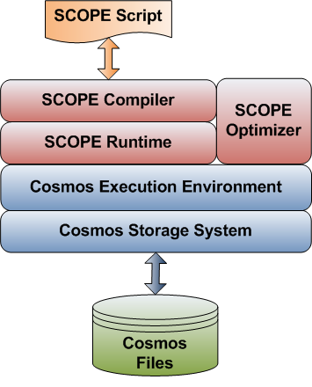
System Architecture

Slide 5
Cosmos Storage System
Append-only distributed file system (immutable data store).
Extent is unit of data replication (similar to tablets).
Append from an application is not broken across extents. To make sure records are not broken across extents, application has to ensure record is not broken into multiple appends.
A unit of computation generally consumes a small number of collocated extents.
/clickdata/search.log
Append block
Extent -0
Extent -1
Extent -2
Extent -3
Notes:
Similar to google file system & hadoop file system.
Extents is few hundred megabytes in size.
Append block is few megabytes in size.

Slide 6
Cosmos Execution Engine
A job is a DAG which consists of:
  Vertices – processes
  Edges – data flow between processes
  Job manager schedules & coordinates vertex execution, fault tolerance and resource management.
Map
Map
Map
Reduce
Reduce
Notes:
It can process more complicated DAG.

Slide 7
Scope query language
Compute the popular queries that have been requested at least 1000 times
Scenario 1:
SELECT query, COUNT(*) AS count
FROM “search.log” USING LogExtractor
GROUP BY query
HAVING count> 1000
ORDER BY count DESC;
OUTPUT TO “qcount.result”
Scenario 2:
e = EXTRACT query
FROM “search.log” USING LogExtractor;
s1 = SELECT query, COUNT(*) AS count
FROM e GROUP BY query;
s2 = SELECT query, count
FROM s1 WHERE count> 1000;
s3 = SELECT query, count
FROM s2 ORDER BY count DESC;
OUTPUT s3 TO “qcount.result”
Data model: a relational rowset (set of rows) with well-defined schema.

Slide 8
Input and Output
EXTRACT : Constructs row from input data block.
OUTPUT : Writes row into output data block.
Built-in extractors and outputters for commonly used formats like text data & binary data.
User can write customized extractors and outputters for data coming from different sources.
Presort is to tell system that rows on each vertex should be sorted before writing to disk.
OUTPUT [<input>
[PRESORT column [ASC|DESC] [, …]]]]
TO <output_stream>
[USING <Outputter> [(args)]]
EXTRACT column[:<type>] [, …]
FROM < input_stream(s) >
USING <Extractor> [(args)]
Defined schema of rows returned by extractor – used by compiler for type checking
RequestedColumns is the columns requested in EXTRACT command
public class LineitemExtractor : Extractor
{
public override Schema Produce(string[] requestedColumns, string[] args)
{ … }
public override IEnumerable<Row> Extract(StreamReader reader, Row outputRow, string[] args)
{ … }
}
It is called once for each extent.
Args is the arguments passed to extractor in EXTRACT statement.
Notes:
Extractor is similar to reader in hadoop.
Outputter is similar to writer in hadoop.

Slide 9
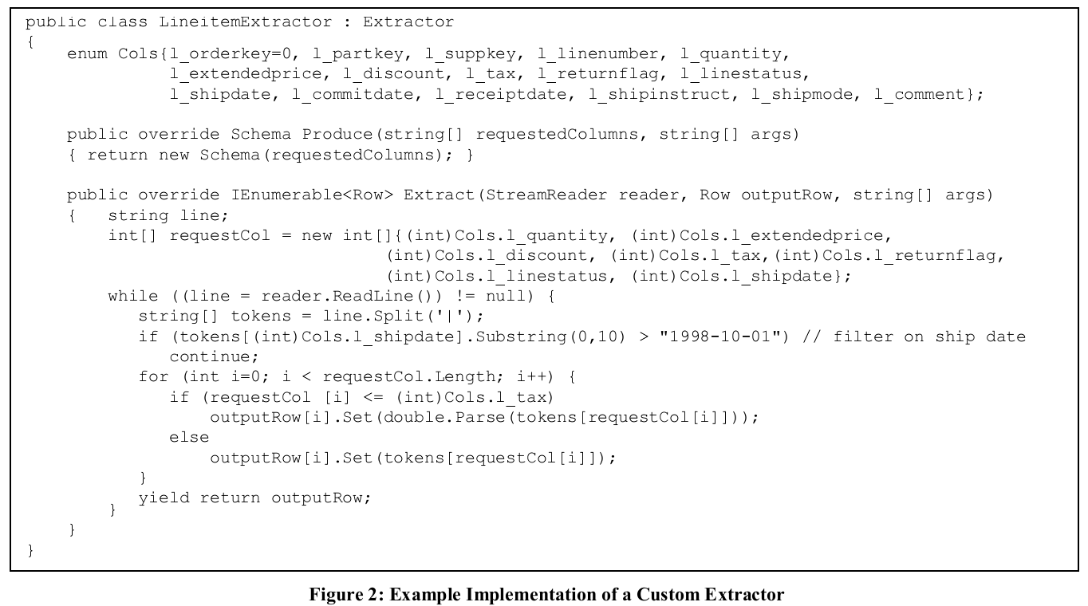
Extract: Iterators using Yield Returns
Greatly simplifies creation of iterators

Slide 10
SQL commands supported in Scope
SELECT [DISTINCT] [TOP count] select_expression [AS <name>] [, …]
FROM { <input stream(s)> USING <Extractor> |
{<input> [<joined input> […]]} [, …]
}
[WHERE <predicate>]
[GROUP BY <grouping_columns> [, …] ]
[HAVING <predicate>]
[ORDER BY <select_list_item> [ASC | DESC] [, …]]
joined input: <join_type> JOIN <input> [ON <equijoin>]
join_type: [INNER | {LEFT | RIGHT | FULL} OUTER]
Supports different Agg functions: COUNT, COUNTIF, MIN, MAX, SUM, AVG, STDEV, VAR, FIRST, LAST.
SQL commands not supported in Scope:
Sub-queries - but same functionality available because of outer join.
Non-equijoins : Non-equijoins require (n X m) replication of the two tables – which is very expensive (n & m is number of partitions of two tables).

Slide 11
Deep Integration with .NET (C#)
SCOPE supports C# expressions and built-in .NET functions/library
R1 = SELECT A+C AS ac, B.Trim() AS B1
FROM R
WHERE StringOccurs(C, “xyz”) > 2
#CS
public static int StringOccurs(string str, string ptrn)
{ … }
#ENDCS

Slide 12
User Defined Operators
Required to give more flexibility for advance users.
SCOPE supports three highly extensible commands:
  PROCESS,
  REDUCE,
  COMBINE

Slide 13
Process
PROCESS command takes a rowset as input, processes each row, and outputs a sequence of rows
It can be used to provide un-nesting capability.
Another example: User wants to find all bigrams in the input document & create a row per bigram.
PROCESS [<input>]
USING <Processor> [ (args) ]
[PRODUCE column [, …]]
url1 | “A B”
url1 | “B C”
url1 | “A B C”
public class MyProcessor : Processor
{
public override Schema Produce(string[] requestedColumns, string[] args, Schema inputSchema)
{ … }
public override IEnumerable<Row> Process(RowSet input, Row outRow, string[] args)
{ … }
}
Notes:
It is similar to map function in map reduce.

Slide 14
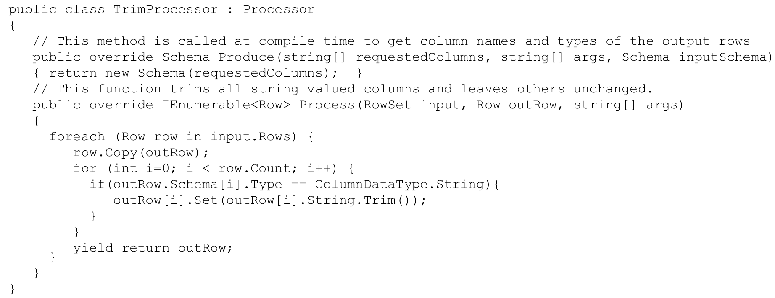
Example of Custom Processor

Slide 15
Reduce
REDUCE command takes a grouped rowset, processes each group, and outputs zero, one, or multiple rows per group
Map/Reduce can be easily expressed by Process/Reduce
Example: User want to compute complex aggregation from a user session log (reduce on SessionId) but his computation may require data to be sorted on time within a session.
REDUCE [<input>
[PRESORT column [ASC|DESC] [, …]]]
ON grouping_column [, …]
USING <Reducer> [ (args) ]
[PRODUCE column [, …]]
Sort rows within the group on specific column (may not be reduce col).
public class MyReducer : Reducer
{
public override Schema Produce(string[] requestedColumns, string[] args, Schema inputSchema)
{ … }
public override IEnumerable<Row> Reduce(RowSet input, Row outRow, string[] args)
{ … }
}
Notes:
Similar to reducer in map-reduce

Slide 16
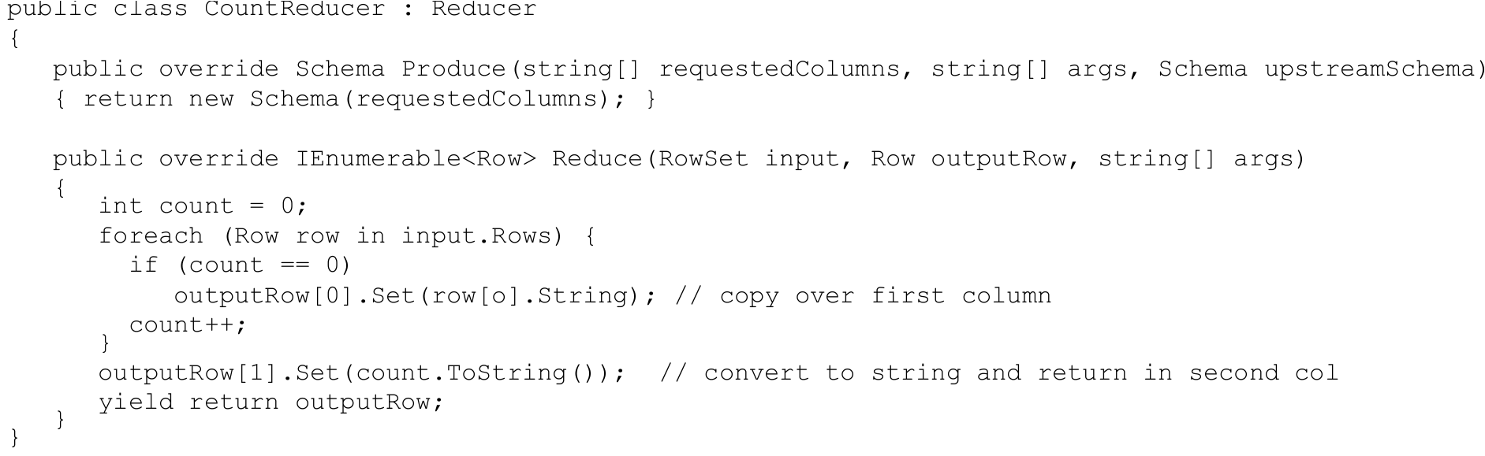
Example of Custom Reducer

Slide 17
Combine
COMBINE <input1> [AS <alias1>] [PRESORT …]
WITH <input2> [AS <alias2>] [PRESORT …]
ON <equality_predicate>
USING <Combiner> [ (args) ]
PRODUCE column [, …]
User define joiner
COMBINE command takes two matching input rowsets, combines them in some way, and outputs a sequence of rows
Example is multiset difference – compute the difference between 2 multisets (assume below S1 and S2 both have attributes A, B, C.
COMBINE S1 WITH S2
ON S1.A==S2.A AND S1.B==S2.B AND S1.C==S2.C
USING MultiSetDifference
PRODUCE A, B, C
public class MyCombiner : Combiner
{
public override Schema Produce(string[] requestedColumns, string[] args,
Schema leftSchema, string leftTable, Schema rightSchema, string rightTable)
{ … }
public override IEnumerable<Row> Combine(RowSet left, RowSet right, Row outputRow, string[] args)
{ … }
}

Slide 18
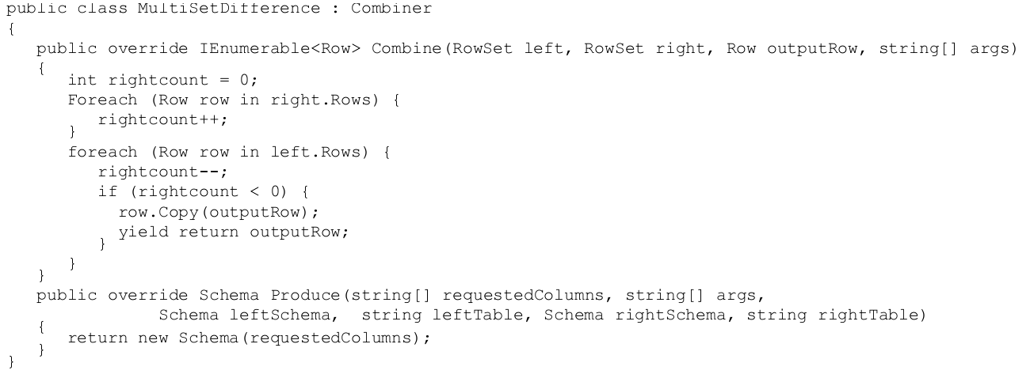
Example of Custom Combiner

Slide 19
Importing Scripts
Similar to SQL table function.
Improves reusability and allows parameterization
Provides a security mechanism
MyView.script:
E = EXTRACT query
FROM @@logfile@@
USING LogExtractor ;
EXPORT R = SELECT query, COUNT() AS count
FROM E
GROUP BY query
HAVING count > @@limit@@;
Query:
Q1 = IMPORT “MyView.script”
PARAMS logfile=”Queries_Jan.log”,
limit=1000;
Q2 = IMPORT “MyView.script”
PARAMS logfile=”Queries_Feb.log”,
limit=1000;
…

Slide 20
Life of a SCOPE Query
Scope Queries
Scope query
Query output
Parser / Compiler/ Security
Optimizer
Parse tree
Physical execution plan
. . .
…
…
…
Cosmos execution engine
. . .

Slide 21
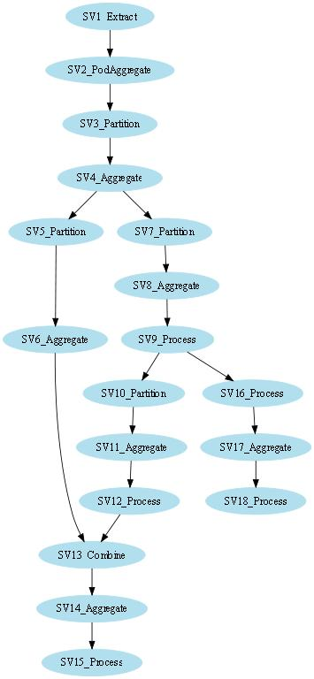
Optimizer and Runtime
Scope Queries
(Logical Operator Trees)
SCOPE optimizer
  Transformation-based optimizer
  Reasons about plan properties (partitioning, grouping, sorting, etc.)
  Chooses an optimal plan based on cost estimates
    Vertex DAG: each vertex contains a pipeline of operators
SCOPE Runtime
  Provides a rich class of composable physical operators
  Operators are implemented using the iterator model
  Executes a series of operators in a pipelined fashion
Logical Operators
Physical operators
Cardinality Estimation
Cost Estimation
Optimization Rules
Transformation Engine
Optimal Query Plans
(Vertex DAG)

Slide 22
Example – query count
Extent-0
Extent-5
Extent-3
Extent-1
Extent-6
Extent-4
Extent-2
Extract
Extract
Extract
Extract
hash agg
hash agg
hash agg
hash agg
SELECT
query, COUNT(*) AS count
FROM “search.log”
USING LogExtractor
GROUP BY query
HAVING count> 1000
ORDER BY count DESC;
OUTPUT TO “qcount.result”
Compute partial count(query) on each machine
Unlike Hyracks it does not execute vertices running on multiple machines in pipelined manner
hash agg
hash agg
Hash partition on query
partition
partition
Compute partial count(query) on a machine on a rack to reduce n/w traffic outside rack
hash agg
hash agg
hash agg
Filter rows with count > 1000
filter
filter
filter
sort
sort
sort
Sort merge for order by on count.
Runs on a single vertex in pipelined manner.
merge
output
Qcount.result

Slide 23
Scope optimizer
A transformation-based optimizer based on the Cascade framework (similar to volcano optimizer)
Generate all possible rewriting of query expression and chooses the one with lowest estimated cost.
Many of the traditional optimization rules from database systems are applicable, example: column pruning, predicate push down, pre-aggregation.
Need new rules to reason about partitioning and parallelism.
Goals:
  Seamless generate both serial and parallel plans
  Reasons about partitioning, sorting, grouping properties in a single uniform framework

Slide 24
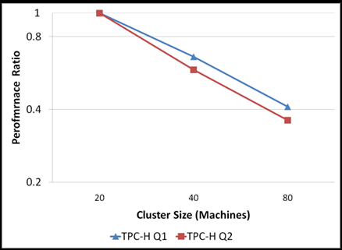
Experimental results
Linear speed up with increase in cluster size.
  Performance ratio = elapsed time / baseline
  Data size kept constant.
  Using log scale on performance ratio.

Slide 25
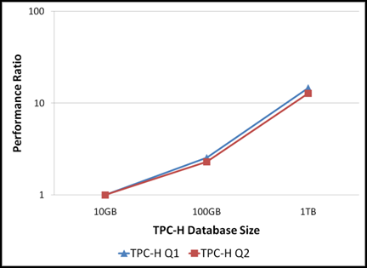
Experimental results
Linear scale up with data size.
  Performance ratio = elapsed time / baseline.
  Cluster size kept constant.
  Using log scale on performance ratio.

Slide 26
Conclusions
SCOPE: a new scripting language for large-scale analysis
  Strong resemblance to SQL: easy to learn and port existing applications
  High-level declarative language
    Implementation details (including parallelism, system complexity) are transparent to users
    Allows sophisticated optimization
Future work
  Multi-query optimization (with parallel properties, optimization opportunities have been increased).
  Columnar storage & more efficient data placement.

Slide 27
Scope Vs. Hive
Hive is SQL like scripting language designed by Facebook – which works on Hadoop.
From, language constructs it is similar to Scope with few differences:
  Hive does not allow user defined joiner (Combiner). Although it can be implemented as map & reduce extension by annotating row with tablename – but it is a bit hacky and non-efficient.
  Hive provides support for user defined types in columns whereas Scope doesn’t.
  Hive stores table serializer & de-serializer along with table metadata, user doesn’t have to specify Extractor in queries while reading the table (need to specify while creating the table).
  Hive also provides for column oriented data storage using RCInputFileFormat. It give better compression and improve performance of queries which access few columns.

Slide 28
Scope Vs. Hive
Hive provides a richer data model – It partitions the table into multiple partitions & then each partition into buckets.
ClickDataTable
Partition
ds=2010-02-02
Partition
ds=2010-02-28
Bucket - 0
Bucket - 0
Bucket - n
Bucket - n

Slide 29
Hive data model
Each bucket is a file in HDFS. The path of bucket will be:
  <hive.warehouse.root.dir>/<tablename>/<partition key>/<bucketid>
  <hive.warehouse.root.dir>/ClickDataTable/ds=2010-02-02/part-0000
Table might not be partitioned:
  <hive.warehouse.root.dir>/<tablename>/<bucketid>
Hierarchical partitionining is allowed:
  <hive.warehouse.root.dir>/ClickDataTable/ds=2010-02-02/hr-12/part-0000
Hive stores partition column with metadata, not with data. That means a separate partition is created foreach value of partition column.

Slide 30
Scope Vs. Hive : Metastore
Scope stores the output of query in unstructured data store.
Hive also stores the output in unstructured HDFS but, it also stores all the metadata of the output table in a separate service called metastore.
Metastore uses traditional RDBMS as its storage engine because of low latency requirements.
The information in metastore is backed up regularly using replication server.
To reduce load on metastore – only compiler access metastore & pass all the information required during runtime in a xml file.

Slide 31
References
SCOPE: Easy and Efficient Parallel Processing of Massive Data Sets
Ronnie Chaiken, Bob Jenkins, Per-Ã…ke Larson, Bill Ramsey, Darren Shakib, Simon Weaver, and Jingren Zhou, VLDB 2008
Hive - a petabyte scale data warehouse using Hadoop,
A. Thusoo, J. S. Sarma, N. Jain, Shao Zheng, P. Chakka, Zhang Ning, S. Antony, Liu Hao, and R. Murthy, ICDE 2010
Incorporating partitioning and parallel plans into the SCOPE optimizer. Jingren Zhou, Per-Ãke Larson, Ronnie Chaiken, ICDE 2010

Slide 32
The End!

Slide 33
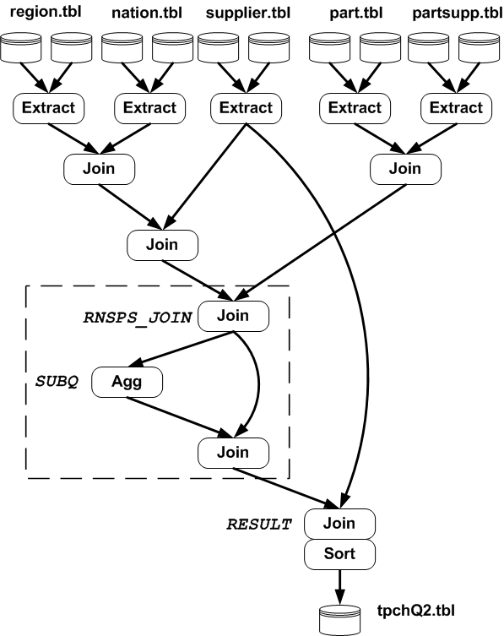
TPC-H Query 2
// Extract region, nation, supplier, partsupp, part …
RNS_JOIN =
SELECT s_suppkey, n_name FROM region, nation, supplier
WHERE r_regionkey == n_regionkey
AND n_nationkey == s_nationkey;
RNSPS_JOIN =
SELECT p_partkey, ps_supplycost, ps_suppkey, p_mfgr, n_name
FROM part, partsupp, rns_join
WHERE p_partkey == ps_partkey AND s_suppkey == ps_suppkey;
SUBQ =
SELECT p_partkey AS subq_partkey,
MIN(ps_supplycost) AS min_cost
FROM rnsps_join GROUP BY p_partkey;
RESULT =
SELECT s_acctbal, s_name, p_partkey,
p_mfgr, s_address, s_phone, s_comment
FROM rnsps_join AS lo, subq AS sq, supplier AS s
WHERE lo.p_partkey == sq.subq_partkey
AND lo.ps_supplycost == min_cost
AND lo.ps_suppkey == s.s_suppkey
ORDER BY acctbal DESC, n_name, s_name, partkey;
OUTPUT RESULT TO "tpchQ2.tbl";

Slide 34
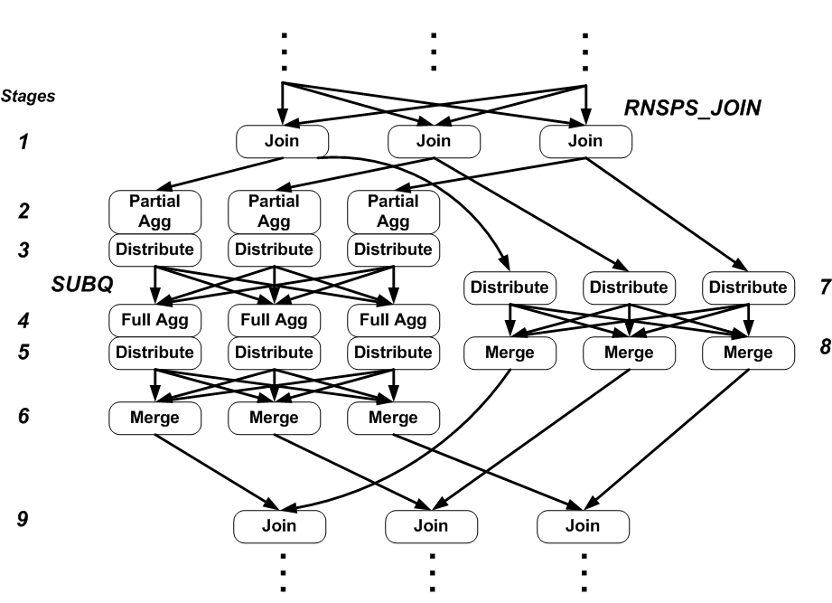
Sub Execution Plan to TPCH Q2
Join on suppkey
Partially aggregate at the rack level
Partition on group-by column
Fully aggregate
Partition on partkey
Merge corresponding partitions
Partition on partkey
Merge corresponding partitions
Perform join

Slide 35
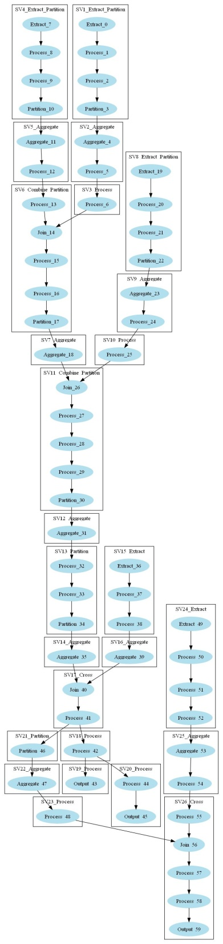
A Real Example

Slide 36

Large-scale Distributed Computing
Distributed storage system – can store 10s of terabytes of data.
I can find most frequent queries for a day:
Find location and name all fragment of my distributed data.
On each fragment, run my java program which will count number of occurrence of each query on that machine.
If a machine fail, find another healthy machine & run again.
Remote read all files written by my java program and compute total occurrence of all queries. And find top 100 queries.
Clean up all intermediate results.
. . .
…
…
…
. . .

Slide 37

Large-scale Distributed Computing
Distributed storage system – can store 10s of terabytes of data.
For every job:
How to parallelize the computation ?
How to distribute the data ?
How to handle machine failures ?
How to aggregate different values ?
. . .
…
…
…
. . .

Slide 38
Large-scale Distributed Computing
Distributed storage system – can store 10s of terabytes of data.
I am a machine learning person, whose job is to improve relevance.
But, most of the my time spend in writing jobs by copying & pasting code from previous jobs & modify it….
Need a deep understanding of distributed processing to run efficient jobs.
Error prone & boring…
. . .
…
…
…
. . .

Slide 39
Large-scale Distributed Computing
Distributed storage system – can store petabytes of data.
Mapreduce framework – Simplified data processing on large clusters.
No need to worry about vertex placement, failure handling etc.
Map (key, Value) {
queries[] = tokenize(value);
foreach (query in queries)
return <query, 1>;
}
Reduce(Key, Values[]) {
sum = 0;
foreach (value in values)
sum += value;
return <query, sum>;
}
Another map-reduce job to find most frequent query.
. . .
…
…
…
. . .

Slide 40
Large-scale Distributed Computing
Distributed storage system – can store petabytes of data.
Mapreduce framework – Simplified data processing on large clusters.
For every job:
How to parallelize it in map reduce framework ?
How to break my task in multiple map reduce jobs ?
What keys should I use at each step ?
How to do join, aggregation, and group by etc. efficiently for the computation ?
. . .
…
…
…
. . .

Slide 41
Large-scale Distributed Computing
Distributed storage system – can store petabytes of data.
Mapreduce framework – Simplified data processing on large clusters.
I am a machine learning person, whose job is to improve relevance.
But, most of the my time spend in writing jobs by copying & pasting code from previous map reduce jobs & modify it….
Need a good understanding of distributed processing & map reduce framework to run efficient jobs.
Error prone & boring…
. . .
…
…
…
. . .

Slide 42
Large-scale Distributed Computing
Distributed storage system – can store petabytes of data.
Mapreduce framework – Simplified data processing on large clusters.
Scope & Hive– A sql-like scripting language to specify distributed computation.
Finally no need to write any code…
SELECT TOP 100
Query, Count (*) AS QueryCount
FROM “queryLogs”
Using LogExtractor
ORDER BY QueryCount;
OUTPUT TO “mostFrequentQueries”;
Now, I can concentrate on my main relevance problem…
. . .
…
…
…
. . .

Slide 43
Outline
Limitations of map reduce framework.
Scope query language.
Scope Vs. Hive
Scope query execution.
Scope query optimization.
Experimental results.
Conclusion

