Slide 1
Monitoring streams: a new class of data management applications
Don Carney, Uğur Çetintemel, Mitch Cherniack, Christian Convey, Sangdon Lee, Greg Seidman, Michael Stonebraker, Nesime Tatbul, Stan Zdonik
VLDB 2002: 215-226
Includes some slides by:
Original authors (web.cs.wpi.edu/~cs561/s03/talks/aurora.ppt)
Joydip Datta
Debarghya Majumdar
YongChul Kwon (http://goo.gl/8K7Qa)
Jong-Won Roh (http://goo.gl/Fzc3e)
Presented by:
Vinit Deodhar
Ajay Gupta
Under the guidance of:
Prof. S. Sudarshan
Advanced Database Management System

Slide 2
Examples of monitoring systems
  Monitor continuous data streams, detect abnormal activity ,and alert users those situations
Patient monitoring
Aircraft Safety monitoring
Stock monitoring
Intrusion detection systems

Slide 3
Introduction
Characteristics of monitoring applications:
1.They operate on a stream of data.
2.Real time operation expected.

Slide 4
Monitoring Applications
Concept
  Monitor continuous data streams, detect abnormal activity, and alert users those situations
Data Stream
  Continuous,
  Unbounded,
  Rapid,
  May contain missing, out of order values
Occurs in a variety of modern applications

Slide 5
Comparison with traditional database sytems
Parameter | Traditional DBMS | Monitoring systems
DBMS Model | Human active DBMS passive | DBMS active human passive
Data state | Current data | Time series data
Triggers | Not scalable | Triggers must be scalable
Results | Exact | Approximate
Operation | Does not require real time service | Requires real time service

Slide 6

Aurora
This paper describes a new prototype system, Aurora, which is designed to better support monitoring applications
  Stream data
  Continuous Queries
  Historical Data requirements
  Imprecise data
  Real-time requirement

Slide 7
Outline of talk
Aurora system model
Query model
Optimizations

Slide 8
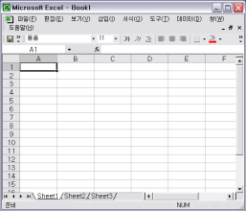
Aurora Overall System Model
8
User application
QoS spec
Query spec
Aurora
System
Historical
Storage
External
data source
Operator
boxes
data flow
(collection of stream)
Query spec
Application
administrator

Slide 9
Representation of Stream
Aurora stream tuple: (TS=ts, A₁=v₁, A₂=v₂ .. A_{n}=v_{n})

Slide 10
Types of operators
Continuous:-operate on single tuples
Windowed:- operate on a set of continuous tuples
1.) Slide
2.) Tumble
3.) Latch

Slide 11
Types of operators
Continuous:-operate on single tuples
Windowed:- operate on a set of continuous tuples
1.) Slide
2.) Tumble
3.) Latch

Slide 12
Operators
Filter
--Drop
Algebraic notation:
Filter(P1, . . . , Pm)(S)
Input stream
Price > 1000
Output stream

Slide 13
Operators
Map
Applies a function to every tuple in the stream
Map(TS = t.TS,B1 = F1(t), . . . , Bm = Fm(t))(S)

Slide 14
Operators
1.Union
Combine tuples from all input streams
Union (S1, . . . , Sn)
2.Resample

Slide 15
Operators
Group By
Partitioning of input stream into multiple output streams
Partitioning condition

Slide 16
Operators
Aggregate
Aggregate (F, Assuming O, Size s, Advance i) (S)
Bsort
Approximate sorting operator

Slide 17
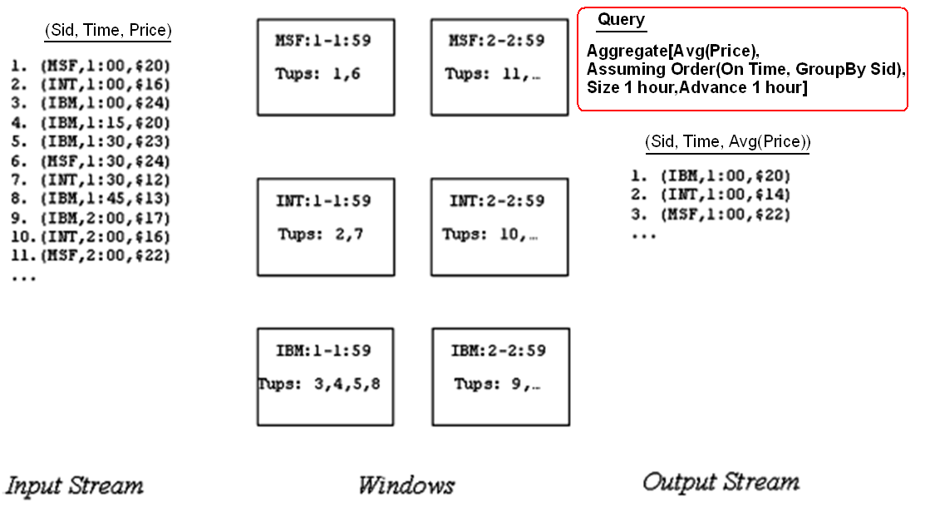
Aggregate

Slide 18
Join
Join is a binary join operator that takes the form
Join (P, Size s, Left Assuming O1, Right Assuming O2)(S1, S2)

Slide 19
Aurora Query model
Queries can be classified as:
1.Continuous queries
2.Views
3.Ad hoc queries

Slide 20
Aurora Query Model (cntd.)
Continuous queries: Continuously monitors input stream
QoS spec
data input
b1
b2
b3
app
continuous query
Connection
point
Picture Courtesy: Reference [2]

Slide 21
Aurora Query model: Views
QoS spec
data input
b1
b2
b3
app
continuous query
Connection
point
b4
QoS spec
b5
b6
view
Picture Courtesy: Reference [2]

Slide 22
Aurora Query model: Ad-hoc queries
QoS spec
data input
b1
b2
b3
app
continuous query
Connection
point
b4
QoS spec
b5
b6
view
3 days
ad-hoc query
b7
b8
b9
app
QoS spec
Picture Courtesy: Reference [2]

Slide 23
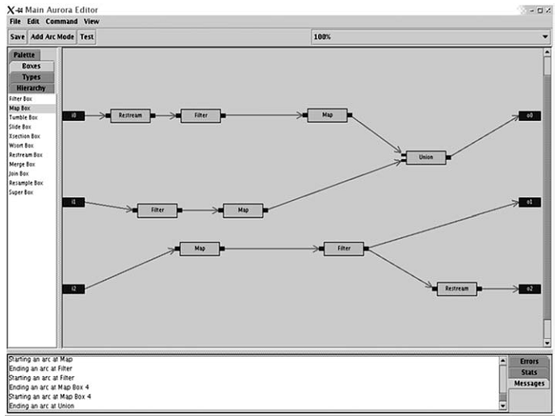
Aurora GUI
Operator Boxes

Slide 24
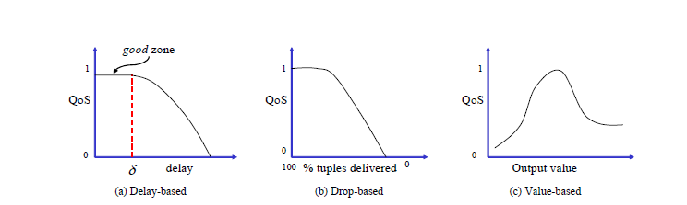
QoS specifications
Done by administrator
A multi dimensional function specified as a set of 2D functions

Slide 25
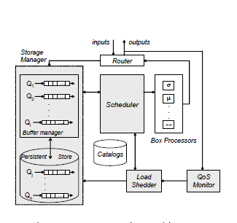
System Architecture

Slide 26
Optimization
Optimization issues
  Large no. of small box operations
  Dependencies among Box operations
  High Data rates
  Architecture changes to the system
Extra – Not taught during class lectures

Slide 27
Optimization
Optimizations
Dynamic Continuous
Query Optimization
  Inserting projections
  Combining Boxes
  Reordering Boxes
Scheduling related optimizations
Adhoc Query Optimization

Slide 28
Dynamic Continuous Query Optimizations
Optimize local sub-networks
  Inserting projections
  Combining Boxes:
    Combining reduces box execution overhead
    Eg : two filters into one etc
  Re-ordering boxes:
B1
B2
B2
B1
C(b) – time taken by b to
process 1 tuple
S(b) – Selectivity of box b
Total Cost(B1-B2) = TC1 =
C(B1) + S(B1) * C(B2)
Total Cost(B2-B1) = TC2 =
C(B2) + S(B2) * C(B1)

Slide 29
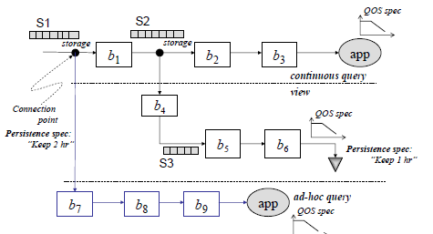
Optimizing Ad-hoc queries
Two separate copies of sub-networks for the ad-hoc query is created
  COPY#1: works on historical data
  COPY#2: works on current data
COPY#1
  is run first
  Storage has B+ Tree implementation
  Utilize B+ tree index if possible
  Index look-up for filter, appropriate join algorithms
  Subsequent steps optimized as before
COPY#2 is optimized as before

Slide 30
Real Time Scheduling(RTS)
Scheduler selects which box to execute next
Scheduling decision depends upon QoS information
End to End processing cost should also be considered (eg. Secondary storage accesses)
Aurora scheduling considers both
Extra – Not taught during class lectures

Slide 31
Real Time Scheduling(RTS)
Non-linearity :- Output tuple rate not always proportional to input tuple rate.
Inter-box non-linearity (Superbox scheduling)
  Less buffer space → thrashing
  Bypass storage manager with advanced scheduling
Intra-box non-linearity (Train scheduling)
  Tuple processing cost could decrease if more tuples are available for processing (similar to batch processing)
    Reduced context switches

Slide 32
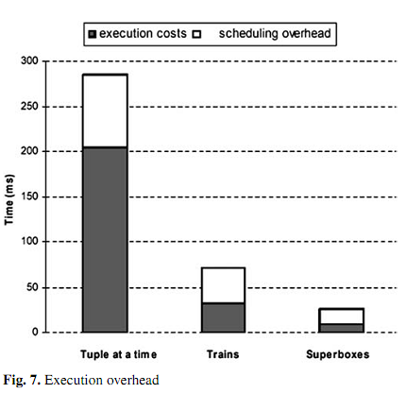
RTS by Optimizing overall processing cost(contd.)
Picture Courtesy: Reference [2]
Extra – Taken from journal version of the paper

Slide 33
RTS by Optimizing QoS: Priority Assignment
Latency = Processing delay + waiting delay
Train scheduling considers the Processing Delay
Waiting delay is a function of scheduling
Give priority to tuple while scheduling to improve QoS
Two approaches to assign priority
  a state-based approach
  feedback-based approach
Extra – Not taught during class lectures

Slide 34
Different priority assignment approach
High Priority → Less Waiting Delay
State-based approach (importance based)
  assigns priorities to outputs based on their expected utility
  Utility → How much QoS is sacrificed if execution is deferred
  Selects the output with max utility
Feedback-based approach (performance based)
  Monitor performance
  Increase priority of application which are not doing well
  Decrease priority of application in good zone

Slide 35
Load Shedding
Systems have a limit to how much fast data can be processed
Load shedding discards some data so that the system can flow
Drop box are used to discard data
Different from networking load shedding
  Data has semantic value in DSMS
  QoS can be used to find the best stream to drop
Application code can handle missing tuples

Slide 36
Load Shedding
Static → For detecting insufficient h/w resources
Dynamic → For detecting long spikes in input rates

Slide 37
Detecting Load Shedding: Static Analysis
Detects hardware insufficiencies
Condition for overload
  C X H < min_cap
    C=capacity of Aurora system
    H=Headroom factor, % of sys resources that can be used at a steady state
    min_cap=minimum aggregate computational capacity required
min_cap is calculated using input data rate and selectivity of the operator
Input data ( Rate r(B) )
B
s(B)
Output data ( 1/c(B))
Extra – Not explained during lecture

Slide 38
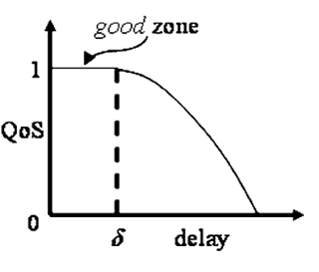
Detecting Load Shedding: Dynamic Analysis
The system can have sufficient resources but low QoS (eg. Due to long spikes in input rates)
Uses delay based QoS information
Timstamp tuples at input, check performance at output
If enough output is outside of good zone it indicates overload
Extra – Not explained during lecture

Slide 39
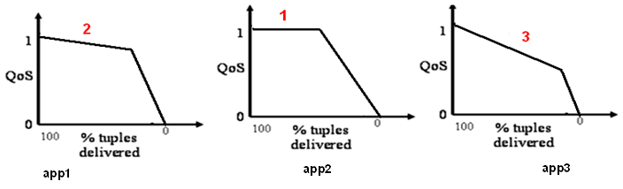
Static Load Shedding by dropping tuples
We will prefer to drop tuples that result in minimum compromise on QoS.
  Find output graph resulting in minimum QoS drop
  Drop tuples (Drop Box)
  Recalculate resources. If insufficient, repeat process
  Get rid of tuples as early as possible
  Move the drop-box as close to the data source or connection point

Slide 40
Static Load Shedding by dropping tuples
Considers the drop based QoS graph
Step1: Finds the output and amount of tuple drop which would results in minimum overall QoS drop
Step 2: Insert drop box in appropriate place and drop tuples randomly
Step3: Re-calculate the amount of system resources. If System resource is not sufficient repeat the process
Extra – Not explained during lecture

Slide 41
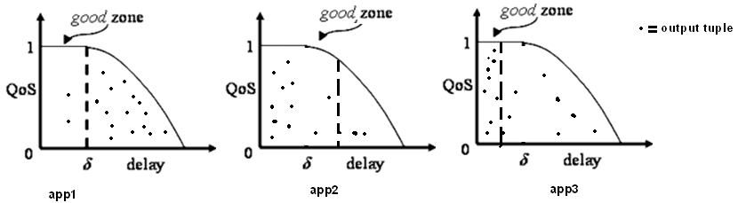
Dynamic Load Shedding by dropping tuples
Delay based QoS graph is considered
Drop tuples beyond delay thresholds
  Selects output which has QoS not in good zone
  Insert drop box
  Repeat if required
  Issues
    No consideration for tuple importance.
    Have to consider load at the queue while placing drop boxes.

Slide 42
Semantic Load shedding by filtering tuples
Previous method drops packet randomly at strategic point
Some tuple may be more important than other
Consult value based QoS information before dropping a tuple
Drop tuple based on QoS value and frequency of the value

Slide 43
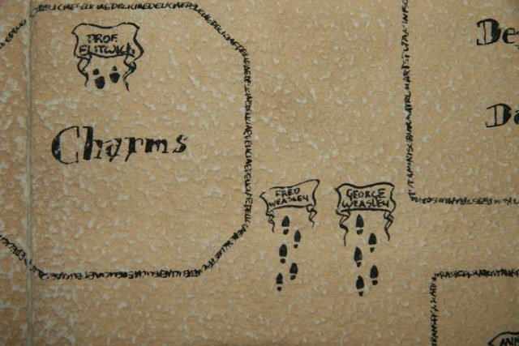
Semantic Load shedding example
Hospital - Network
  Stream of free doctors locations
  Stream of untreated patients locations, their condition (dyeing, critical, injured, barely injured)
  Output: match a patient with doctors within a certain distance
Patients
Join
Doctors who can work
on a patient
Doctors

Slide 44
Semantic Load shedding example
Load shedding based on condition
  Most critical patients get treated first
  Filter added before the Join
Patients
Drop barely
Injured tuples
Join
Doctors who can work
on a patient
Doctors
Too much Load

Slide 45
Conclusion
Aurora is a Data Stream Management System for Monitoring Systems. It provides:
  Continuous and Ad-hoc Queries on Data streams
  Historical Data of a predefined duration is stored
  Box and arrow style query specification
  Supports Imprecise data through Slack specification
  Real-time requirement is supported by Dynamic Load-shedding
Aurora runs on Single Computer
  Borealis^{[3]} is a distributed data stream management system

Slide 46
References
[1]
D. Carney et al., “Monitoring streams: a new class of data management applications,” Proceedings of the 28th international conference on Very Large Data Bases, p. 215–226, 2002.
[2]
D. J. Abadi et al., “Aurora: a new model and architecture for data stream management,” The VLDB Journal The International Journal on Very Large Data Bases, vol. 12, no. 2, pp. 120-139, 2003.
[3]
D. J. Abadi et al., others, “The design of the borealis stream processing engine,” in Second Biennial Conference on Innovative Data Systems Research (CIDR 2005), Asilomar, CA, 2005, p. 277–289.

Slide 47
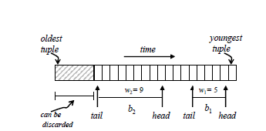
Storage manager
Extra – Taken from journal version of the paper
Queue management
Queue is present in main memory and disk. Storage manager implements a replacement policy to select which tuples to keep in memory

Slide 48
Storage manager
Extra – Taken from journal version of the paper
2. Connection point management
Connection point stores historical data
Data organized as a B Tree
Default key is time stamp
Insertions to B Tree are done in batched
Periodic passes deletes tuples older than the history requirement.

