Slide 1
Polybase: What, Why, How
David J. DeWitt
Microsoft Jim Gray Systems Lab
Madison, Wisconsin
graysystemslab.com

Slide 2
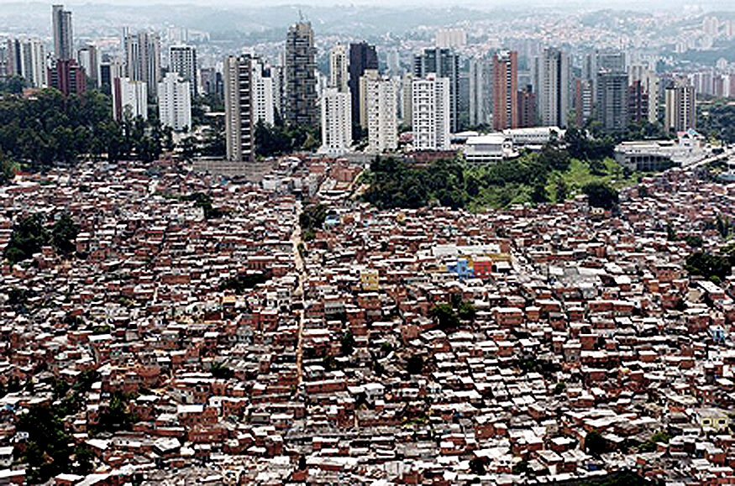

Gaining Insight in the Two Universe World
Many businesses now have data in both universes
Hadoop
RDBMS
What is the best solution for answering questions that span the two?
Combine
Insight
Polybase goal: make it easy to answer questions that require data from both universes

Slide 3






Disclaimer
DeWitt
Not a Keynote!!
Not a keynote talk. I thought you might enjoy having a deep dive into how Polybase works.
me
No Conclusions, please
Just because I am going to tell you about Phases 2 and 3 you should NOT reach any conclusions about what features might find their way into future products
Announcements
Ted announced “Phase 1” as a product
Quentin demoed the “Phase 2” prototype
  Don’t forget I am just a techie type and I have ZERO control over what will actually ship.
Productization
Future
The SQL PDW Team does all the hard work of productizing our prototypes.
Future Polybase versions continue to be designed, developed, and evaluated at the Microsoft Gray Systems Lab in Madison, WI.

Slide 4
Talk Outline
Review key components of the Hadoop ecosystem
Review SQL Server PDW
Alternatives for combining data from the unstructured and structured universes
Polybase
  Details on Phases 1, 2, and 3
  Some preliminary performance results
Wrap up

Slide 5

The Hadoop Ecosystem
HDFS – distributed, fault tolerant file system
MapReduce – framework for writing/executing distributed, fault- tolerant algorithms
Hive & Pig – SQL-like declarative languages
Sqoop – package for moving data between HDFS and relational DB systems
+ Others…
BI
Reporting
ETL
Tools
RDBMS
Hive & Pig
Sqoop
Map/
Reduce
Zookeeper
Avro (Serialization)
HBase
HDFS

Slide 6
HDFS – Hadoop Distributed File System
Underpinnings of the entire Hadoop ecosystem
HDFS:
  Scalable to 1000s of nodes
  Design assumes that failures (hardware and software) are common
  Targeted towards small numbers of very large files
  Write once, read multiple times
Limitations:
  Block locations and record placement is invisible to higher level components (e.g. MR, Hive, …)
  Makes it impossible to employ many optimizations successfully used by parallel DB systems
Hive
Sqoop
Map/
Reduce
HDFS

Slide 7
HDFS Node Types
NameNode – one instance per cluster
  Responsible for filesystem metadata operations on cluster, replication and locations of file blocks
Backup Node – responsible for backup of NameNode
DataNodes – one instance on each node of the cluster
  Responsible for storage of file blocks
  Serving actual file data to client
NameNode
Master
CheckpointNode
or
BackupNode
(backups)
DataNode
DataNode
DataNode
DataNode
Slaves

Slide 8
Hadoop MapReduce (MR)
Programming framework (library and runtime) for analyzing data sets stored in HDFS
MapReduce jobs are composed of user-supplied Map & Reduce functions:
MR framework provides all the “glue” and coordinates the execution of the Map and Reduce jobs on the cluster.
  Fault-tolerant
  Scalable
Hive
Sqoop
map() → reduce()
Map/
Reduce
sub-divide &
conquer
combine & reduce
cardinality
HDFS

Slide 9
MapReduce 101
Essentially, it’s…
Take a large problem and divide it into sub-problems
Perform the same function on all sub-problems
Combine the output from all sub-problems
…
MAP
…
DoWork()
DoWork()
DoWork()
REDUCE
…
Output

Slide 10
MapReduce Components
How Does This All Fit
With HDFS?
Master
- Manages job queues and scheduling
- Maintains and controls TaskTrackers
- Moves/restarts map/reduce tasks if needed
hadoop-namenode
JobTracker
MapReduce
Layer
NameNode
HDFS
Layer
JobTracker controls TaskTracker nodes
Execute individual map and reduce tasks as assigned by JobTracker
hadoop-
datanode1
hadoop-
datanode2
hadoop-
datanode3
hadoop-
datanode4
Slaves
TaskTracker
TaskTracker
TaskTracker
TaskTracker
MapReduce
Layer
HDFS
Layer
DataNode
DataNode
DataNode
DataNode

Slide 11
Hive
A warehouse solution for Hadoop
Supports SQL-like declarative language called HiveQL which gets compiled into MapReduce jobs executed on Hadoop
Data stored in HDFS
Since MapReduce used as a target language for execution
  Benefits from scalability and fault tolerance provided by the MR framework
  Limited statistics (file sizes only) make cost-based QO essentially impossible
Hive
Sqoop
Map/
Reduce
HDFS

Slide 12
Hadoop Summary So Far
HDFS – distributed, scalable fault tolerant file system
MapReduce – a framework for writing fault tolerant, scalable distributed applications
Hive – a relational DBMS that stores its tables in HDFS and uses MapReduce as its target execution language
Next, Sqoop – a library and framework for moving data between HDFS and a relational DBMS
Hive
Sqoop
Map/
Reduce
HDFS

Slide 13
Sqoop Use Case #1 – As a Load/Unload Utility
Control Node
Compute Node
Compute Node
Compute Node
Transfers data from Hadoop (in & out).
Gets serialized through both Sqoop process and PDW Control Node.
…
SQL Server
SQL Server
SQL Server
SQL Server
PDW Cluster
Sqoop
etc.
Namenode
(HDFS)
Instead transfers should:
  Take place in parallel.
  Go directly from Hadoop DataNodes to PDW Compute nodes.
DataNode
DataNode
DataNode
DataNode
DataNode
DataNode
Hadoop Cluster
DataNode
DataNode
DataNode
DataNode
DataNode
DataNode
13

Slide 14
Sqoop Use Case #2 - As a DB Connector
Map/
Reduce
Job
Sqoop
Query
Query
Results
Control Node
Compute Node
Compute Node
Compute Node
…
SQL Server
SQL Server
SQL Server
SQL Server
PDW Cluster

Slide 15

Sqoop’s Limitations as a DB Connector
Map tasks wants the results of the query:
Q: SELECT a,b,c FROM T WHERE P
X is different for each Map task.
Example, assume Cnt is 100 and
3 Map instances are to be used
For Map 1
For Map 2
For Map 3
X=0
L=33
X=33
Map 1
Map 2
Map 3
Each map() must see a distinct subset of the result
L=33
Sqoop
Sqoop
Sqoop
X=66
L=34
RDBMS
  Step (2): Sqoop generates unique query Q’
  for each Map task:
  SELECT a,b,c
  FROM T WHERE P
  ORDER BY a,b,c
  Limit L, Offset X
Performance is bound to be pretty bad as table T gets scanned 4 times!
T
Cnt
In general, with M Map tasks, table T would be scanned M + 1 times!!!!!!
  Step (1): Sqoop library runs
  SELECT count(*)
  FROM T WHERE P
  to obtain Cnt, the number of
  tuples Q will return
  Step (3): Each of the 3 Map tasks runs its query Q’

Slide 16
Hadoop Summary
HDFS – distributed, scalable fault tolerant file system
MapReduce – a framework for writing fault tolerant, scalable distributed applications
Hive – a relational DBMS that stores its tables in HDFS and uses MapReduce as its target execution language
Sqoop – a library and framework for moving data between HDFS and a relational DBMS
Hive
Sqoop
Map/
Reduce
HDFS

Slide 17
Gaining Insight in the Two Universe World
Assume that you have data in both universes
Hadoop
RDBMS
Combine
Insight
What is the best solution for answering
questions that span the two?

Slide 18
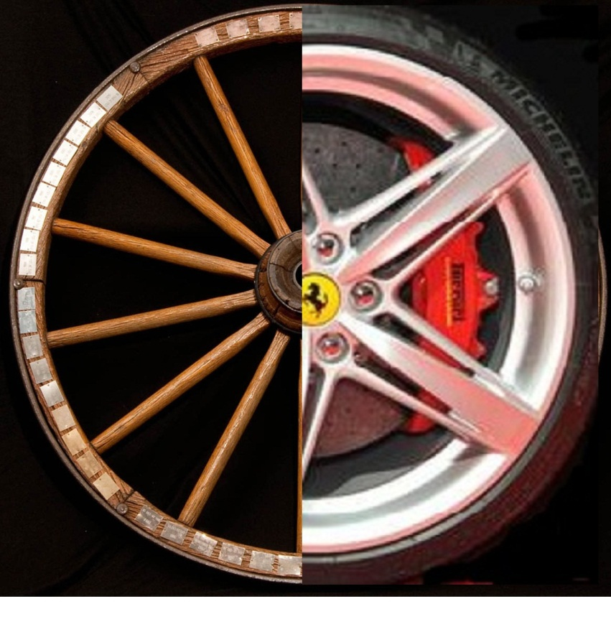
Sqoop
The Two Universe World:
1 Problem, 2 Alternative Solutions
Polybase
T-SQL Queries
Import
SQL SERVER PDW
MR
RDBMS
HDFS
SQL
HDFS
Export
Leverage PDW and Hadoop to run queries against RDBMS and HDFS

Slide 19
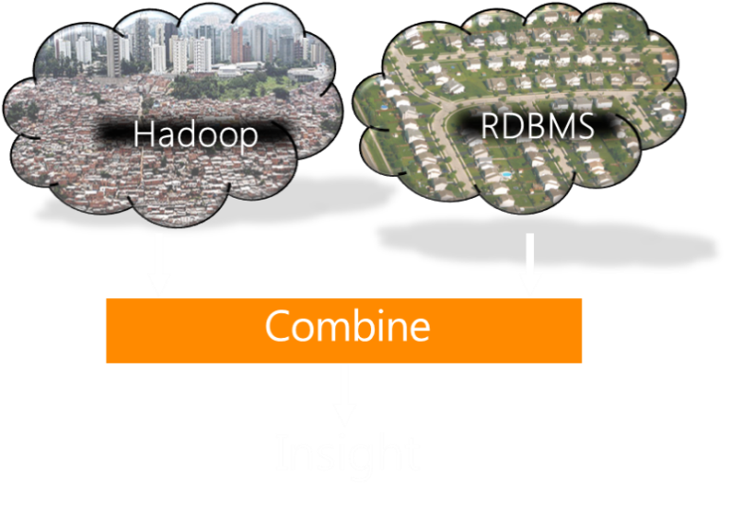
Alternative #1 - Sqoop
Import
MR
RDBMS
HDFS
Approach
Drawbacks
Do analysis using MapReduce
Sqoop used to pull data from RDBMS
Must be able to program MapReduce jobs
Sqoop as a DB connector has terrible performance
Export
Do analysis using the RDBMS
Sqoop used to export HDFS data into RDBMS
Data might not fit in RDBMS
Bad performance as load not parallelized

Slide 20
Polybase – A Superior Alternative
SQL
Results
Polybase = SQL Server PDW V2 querying HDFS data, in-situ
Polybase
SQL SERVER
PDW V2
Standard T-SQL query language. Eliminates need for writing MapReduce jobs
Polybase
Polybase
Polybase
Leverages PDW’s parallel query execution framework
DB
Data moves in parallel directly between Hadoop’s DataNodes and PDW’s compute nodes
HDFS
Exploits PDW’s parallel query optimizer to selectively push computations on HDFS data as MapReduce jobs (Phase 2 release)

Slide 21


Polybase Assumptions
Control Node
Compute Node
Compute Node
Compute Node
…
SQL Server
SQL Server
SQL Server
SQL Server
PDW Cluster
DataNode
DataNode
DataNode
PDW compute nodes can also be used as HDFS data nodes
Linux Cluster
Namenode
(HDFS)
Windows Cluster
HDFS data could be
on some other Hadoop cluster
Node
Node
Node
Node
Node
Node
Text
Format
Sequence
File
Format
RCFile
Format
Custom
Format
DN
DN
DN
DN
DN
DN
…
Node
Node
Node
Node
Node
Node
Hadoop Cluster
DN
DN
DN
DN
DN
DN
1. Polybase makes no assumptions about where HDFS data is
2. Nor any assumptions about the OS of data nodes
3. Nor the format of HDFS files (i.e. TextFile, RCFile, custom, …)
21

Slide 22
Polybase “Phases”
Phase 1
Phase 2
Phase 3
(shipping soon)
(working on)
(thinking about)

Slide 23
Polybase Phase 1
Query
Results
1
3
Key Technical Challenges:
Hadoop
PDW
Parallelizing transfers between HDFS data nodes and PDW compute nodes
Supporting all HDFS file formats
Imposing “structure” on the “unstructured” data in HDFS
2
HDFS blocks
HDFS
DB
SQL in, results out
Query
1
Hadoop
PDW
Results
2
HDFS blocks
HDFS
DB
SQL in, results stored in HDFS

Slide 24
Challenge #1 – Parallel Data Transfers
Control Node
Compute Node
Compute Node
Compute Node
…
SQL Server
SQL Server
SQL Server
SQL Server
PDW Cluster
But this:
Not this:
Sqoop
Namenode
(HDFS)
Node
Node
Node
Node
Node
Node
DN
DN
DN
DN
DN
DN
Node
Node
Node
Node
Node
Node
Hadoop Cluster
DN
DN
DN
DN
DN
DN
24

Slide 25
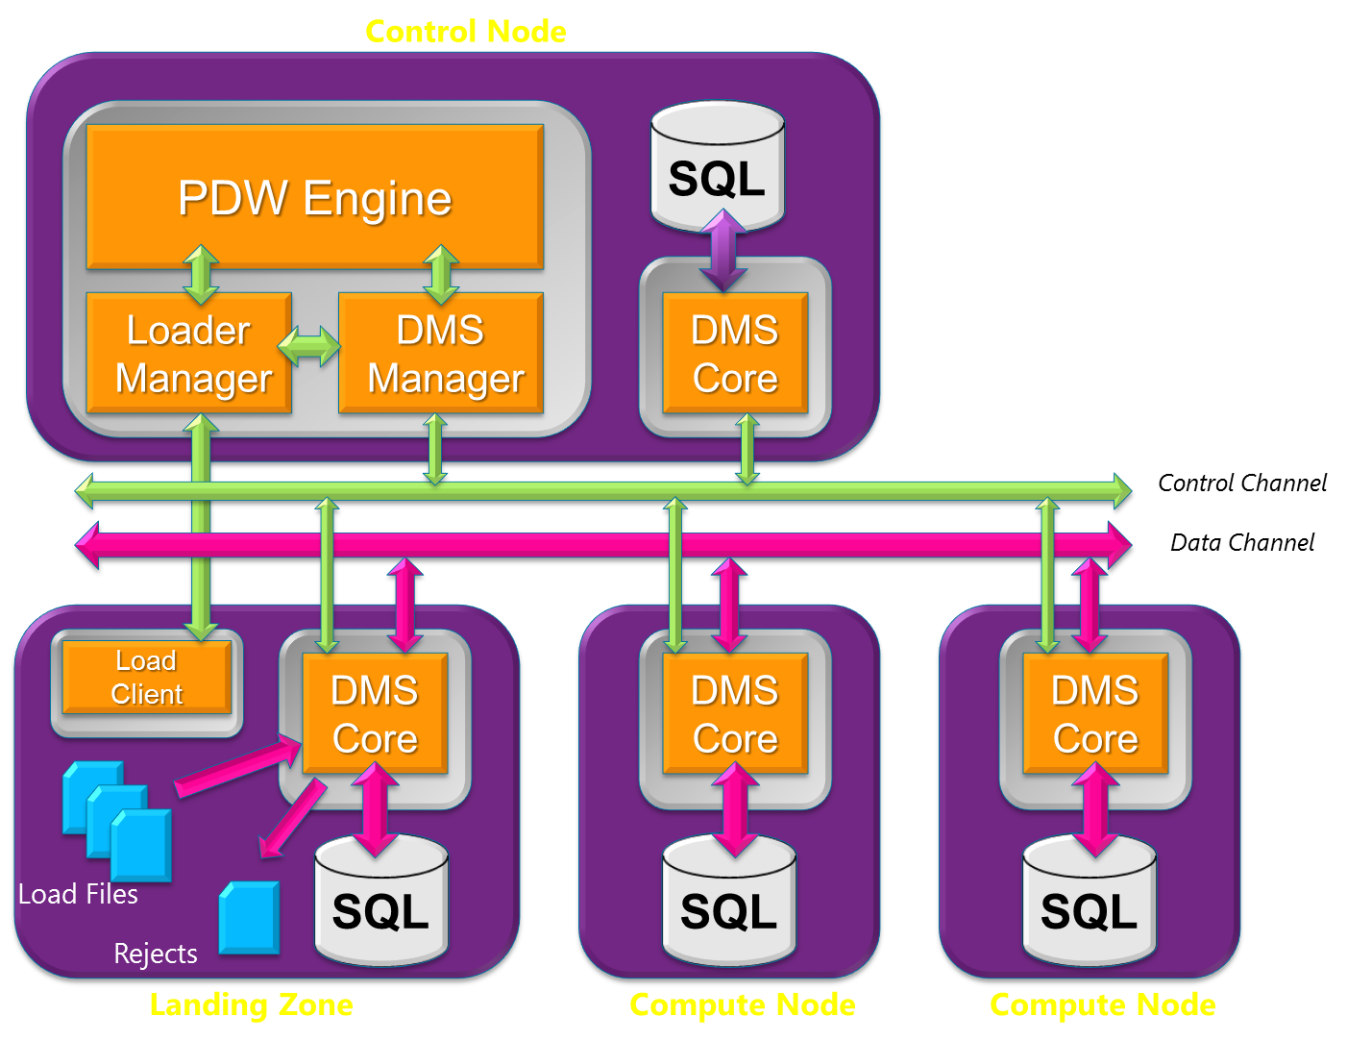
SQL Server PDW Architecture
DMS (Data Movement Service)
Two key PDW roles
“Redistributing/shuffling” rows of tables for some joins and aggregates
Loading tables
Additional Polybase role:
Reading (Writing) records stored in (to) HDFS files
25

Slide 26
DMS Role #1 - Shuffling
Node 1
Node 2
SQL Server
DMS
DMS
SQL Server
Node 3
Node 4
SQL Server
DMS
DMS
SQL Server
DMS instances will “shuffle” (redistribute) a table when:
  It is not hash partitioned on the column being used for a join
  =||= on the group-by column in an aggregate query
26

Slide 27
DMS Role #2 – Loading
DMS instances on compute nodes:
1. Convert records to binary format
2. Redistribute each record by hashing on partitioning
key of the table
Node 3
Node 4
SQL Server
DMS
DMS
SQL Server
SQL Server
DMS
DMS
SQL Server
Node 1
Node 2
DMS
DMS instance on landing zone distributes (RR) input records to DMS instances on compute nodes
PDW Landing Zone
Input File
27

Slide 28
HDFS Bridge in Polybase
PDW Node
PDW Node
SQL Server
HDFS Bridge
HDFS Bridge
DMS
DMS
SQL Server
HDFS
HDFS
Hadoop Cluster
HDFS
DMS instances (one per PDW compute node) extended to host an “HDFS Bridge”
HDFS Bridge hides complexity of HDFS.
DMS components reused for type conversions
All HDFS file types (text, sequence, RCFiles) supported through the use of appropriate RecordReaders by the HDFS Bridge
28

Slide 29
Reading HDFS Files in Parallel
Block buffers
After conversion, DMS instances redistribute each record by hashing on the partitioning key of the table – identical to what happens in a load
Node 1
Node 2
SQL Server
DMS
HDFS Bridge
HDFS Bridge
DMS
SQL Server
NameNode
returns locations
of blocks of file
PDW
Existing DMS components are leveraged, as necessary, for doing type conversions
HDFS Bridge employs Hadoop RecordReaders to obtain records from HDFS → enables all HDFS file types to be easily supported
Hadoop
HDFS
NameNode
HDFS
DataNode
HDFS
DataNode
HDFS
DataNode
29

Slide 30
Phase 1 Technical Challenges
Parallelizing transfers between HDFS data nodes and PDW compute nodes
Supporting all HDFS file
formats
Imposing “structure” on the “unstructured” data in HDFS
DMS processes extended with HDFS Bridge
HDFS Bridge uses standard RecordReaders (from InputFormats) and RecordWriters (from OutputFormats)

Slide 31

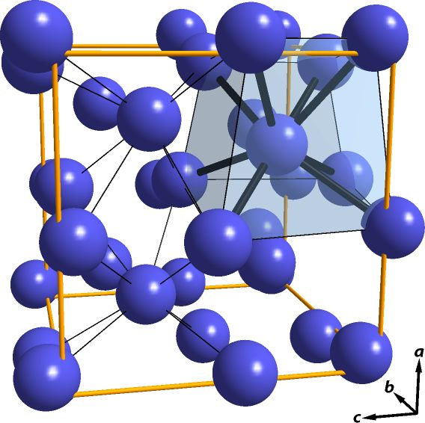
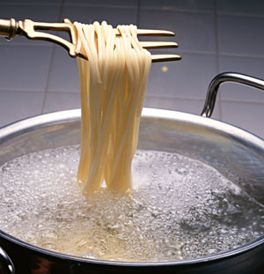

Challenge #3 – Imposing Structure
Unless pure text, all HDFS files consist of a set of records
These records must have some inherent structure to them if they are to be useful
    “structure” → each record consists of one or more fields of some known type
A MapReduce job typically uses a Java class to specify the structure of its input records
Polybase employs the notion of an “external table”

Slide 32
Phase 2 Syntax Example
Disclaimer:
for illustrative purposes only
CREATE HADOOP CLUSTER GSL_HDFS_CLUSTER
WITH (namenode=‘localhost’, nnport=9000
jobtracker=‘localhost’, jtport = 9010);
CREATE HADOOP FILEFORMAT TEXT_FORMAT
WITH (INPUTFORMAT = 'org.apache.hadoop.mapreduce.lib.input.TextInputFormat',
OUTPUTFORMAT = 'org.apache.hadoop.mapreduce.lib.output.TextOutputFormat',
ROW_DELIMITER = '0x7c0x0d0x0a',
COLUMN_DELIMITER = '0x7c‘);
CREATE EXTERNAL TABLE hdfsCustomer
( c_custkey bigint not null,
c_name varchar(25) not null,
c_address varchar(40) not null,
c_nationkey integer not null,
…
)
WITH (LOCATION =hdfs('/tpch1gb/customer.tbl’, GSL_HDFS_CLUSTER, TEXT_FORMAT);
HDFS file path
Notes:
Jobtracker specification

Slide 33
Polybase Phase 1 - Example #1
Selection on HDFS table
select * from hdfsCustomer
where c_nationkey = 3 and c_acctbal < 0
Execution plan generated by PDW query optimizer:
RETURN OPERATION
Select * from T where
T.c_nationkey =3 and T.c_acctbal < 0
3
DMS SHUFFLE
FROM HDFS
Hadoop file read into T
HDFS parameters passed into DMS
2
CREATE temp table T
1
On PDW compute nodes
33

Slide 34
Polybase Phase 1 - Example #2
Import HDFS data into a PDW table
create table pdwCustomer
with (distribution = hash(c_custkey))
as select * from hdfsCustomer;
Execution plan generated by query optimizer:
ON OPERATION
Insert into pdwCustomer
select * from T
4
DMS SHUFFLE
FROM HDFS
  Fully parallel load from HDFS into PDW!
3
From hdfsCustomer into T
HDFS parameters passed into DMS
CREATE table pdwCustomer
2
On PDW compute nodes
CREATE
temp table T
1
On PDW compute nodes
34

Slide 35
Polybase Phase 1 - Example #3
Query: Join between HDFS table and PDW table
select c.*, o.* from pdwCustomer c, hdfsOrders o
where c.c_custkey = o.o_custkey and c_nationkey = 3
and c_acctbal < 0
Execution plan generated by query optimizer:
RETURN OPERATION
Select c.*. o.* from Customer c, oTemp o where c.c_custkey = o.o_custkey and c_nationkey = 3 and c_acctbal < 0
3
DMS SHUFFLE FROM HDFS
on o_custkey
2
From hdfsOrders into oTemp
CREATE oTemp
distrib. on o_custkey
1
On PDW compute nodes
35

Slide 36
Polybase Phase 1 - Limitations
Data is always pulled into PDW to be processed
Does not exploit the computational resources of the Hadoop cluster
Query
Results
1
3
Hadoop
Hadoop
Hadoop
PDW
PDW
PDW
Results
2
HDFS blocks
DB
DB
HDFS
DB
HDFS
HDFS

Slide 37
Polybase “Phases”
Phase 1
Phase 2
Phase 3
(shipping soon)
(working on)
(thinking about)

Slide 38
Polybase Phase 2 Goals
SQL
Results
1
7
Hadoop
MR job
PDW
2
MapReduce
3
4
6
5
HDFS blocks
DB
HDFS
SQL operations on HDFS data
pushed into Hadoop as MapReduce jobs
Cost-based decision on how much computation to push

Slide 39




Polybase Phase 2 Query Execution
Query is parsed
“External tables” stored on HDFS are identified
Parallel QO is performed
Statistics on HDFS tables are used in the standard fashion
DSQL plan generator walks optimized query plan converting subtrees whose inputs are all HDFS files into sequence of MapReduce jobs
Java code generated uses a library of PDW-compatible type conversions routines to insure semantic capability
PDW Engine Service submits MapReduce jobs (as a JAR file) to Hadoop cluster.
Leverage computational capabilities of Hadoop cluster

Slide 40
Phase 2 Challenge – Semantic Equivalence
Alternative plans in Phase 2
Polybase Phase 2 splits query execution between Hadoop and PDW.
Java expression semantics differ from the SQL language in terms of types, nullability, etc.
Semantics (ie. results) should not depend on which alternative the query optimizer picks
Output
Output
PDW Query Execution
PDW Query Execution
DMS SHUFFLE FROM HDFS
DMS SHUFFLE FROM HDFS
Hadoop MR Execution
Only Phase 1 Plan
HDFS Data
Notes:
Split HDFS ?

Slide 41
Polybase Phase 2 - Example #1
Selection and aggregate on HDFS table
select avg(c_acctbal) from hdfsCustomer
where c_acctbal < 0 group by c_nationkey
Execution plan:
What really happens here?
Step 1) QO compiles predicate into Java and generates a MapReduce job
Step 2) QE submits MR job to Hadoop cluster
Apply filter and computes aggregate on hdfsCustomer. Output left in hdfsTemp
Run MR Job on Hadoop
1
41

Slide 42
MapReduce Review
PDW Query Executor
Key components:
1) Job tracker
  One per cluster
  Manages cluster resources
  Accepts & schedules MR jobs
2) Task Tracker
  One per node
  Runs Map and Reduce tasks
  Restarts failed tasks
In Polybase Phase 2, PDW Query Executor submits MR job to the Hadoop Job Tracker
Task Tracker
MR job
MR job
MapReduce
Job
Task Tracker
Job
Tracker
MR job
MR job
MapReduce Job Submission
Task Tracker
MapReduce Status
MR job
MR job
Hadoop Nodes

Slide 43
The MR Job in a Little More Detail
Query
select c_nationkey, avg(c_acctbal) from hdfsCustomer
where c_acctbal < 0 group by c_nationkey
<customer>
Mapper
C_ACCTBAL < 0
<US, $-1,233>
<FRA, $-52>
<UK, $-62>
…
DataNode
<US, list($-1,233, $-9,113, …)>
Reducer
Output is left in
hdfsTemp
<customer>
Mapper
<US, $-9,113>
<FRA, $-91>
<UK, $-5>
…
<US, $-975.21>
<UK, $-63.52>
DataNode
C_ACCTBAL < 0
<FRA, $-119.13>
Reducer
<customer>
Mapper
<US, $-3101>
<FRA, $-32>
<UK, $-45>
…
<FRA, list ($-52, $-91, …)>
C_ACCTBAL < 0
<UK, list($-62, $-5, $-45, …)>
DataNode

Slide 44
Polybase Phase 2 - Example #1
Aggregate on HDFS table
select avg(c_acctbal) from hdfsCustomer
where c_acctbal < 0 group by c_nationkey
Execution plan:
Predicate and aggregate pushed into Hadoop cluster as a MapReduce job
Query optimizer makes a cost-based decision on what operators to push
RETURN OPERATION
4
Select * from T
DMS SHUFFLE FROM HDFS
3
Read hdfsTemp into T
CREATE temp table T
2
On PDW compute nodes
hdfsTemp
Apply filter and computes aggregate on hdfsCustomer. Output left in hdfsTemp
Run MR Job on Hadoop
<US, $-975.21>
1
<UK, $-63.52>
<FRA, $-119.13>
44

Slide 45
Polybase Phase 2 - Example #2
Query: Join between HDFS table and PDW table
select c.*, o.* from pdwCustomer c, hdfsOrders o
where c.c_custkey = o.o_custkey and o_orderdate < ‘9/1/2010’
Execution plan :
Predicate on orders pushed into Hadoop cluster
DMS shuffle insures that the two tables are “like-partitioned” for the join
RETURN OPERATION
Select c.*. o.* from Customer c, oTemp o where c.c_custkey = o.o_custkey
4
DMS SHUFFLE
FROM HDFS on o_custkey
Read hdfsTemp into oTemp, partitioned on o_custkey
3
CREATE oTemp
distrib. on o_custkey
2
On PDW compute nodes
Run Map Job on Hadoop
Apply filter to hdfsOrders. Output left in hdfsTemp
1
45

Slide 46

Polybase Phase 2 - Wrap-Up
Extends capabilities of Polybase Phase 1 by pushing operations on HDFS files as MapReduce jobs
PDW statistics extended to provided detailed column-level stats on external tables stored in HDFS files
PDW query optimizer extended to make cost-based decision on what operators to push
Java code generated uses library of PDW-compatible type conversions to insure semantic capability
What are the performance benefits of pushing work?

Slide 47
Test Configuration
PDW Cluster:
16 Nodes
Commodity HP Servers
32GB memory
Ten 300GB SAS Drives
SQL Server 2008 running in a VM on Windows 2012
Control Node
Compute Node
Compute Node
Compute Node
…
SQL Server
SQL Server
SQL Server
SQL Server
PDW Cluster
Networking
1 Gigabit Ethernet to top of rack switches (Cisco 2350s)
10 Gigabit rack-to-rack
Nodes distributed across 6 racks
Hadoop Cluster
48 Nodes
Same hardware & OS
Isotope (HDInsight) Hadoop distribution
Namenode
(HDFS)
Node
Node
Node
Node
Node
Node
DN
DN
DN
DN
DN
DN
Hadoop Cluster
Node
Node
Node
Node
Node
Node
DN
DN
DN
DN
DN
DN
47

Slide 48
Test Database
  Two identical tables T1 and T2
    10 billion rows
    13 integer attributes and 3 string attributes (~200 bytes/row)
    About 2TB uncompressed
  One copy of each table in HDFS
    HDFS block size of 256 MB
    Stored as a compressed RCFile
    RCFiles store rows “column wise” inside a block
  One copy of each table in PDW
    Block-wise compression enabled
48

Slide 49
Selection on HDFS table
  SELECT u1, u2, u3, str1, str2, str4
  from T1 (in HDFS)
  where (u1 % 100) < sf
Crossover Point:
Above a selectivity factor of ~80%, PB Phase 2 is slower
Polybase
Phase 2
PB.2
PB.1
PB.1
PB.1
PB.1
PB.1
PB.1
Polybase
Phase 1
PB.2
PB.2
PB.2
PB.2
PB.2
49

Slide 50
Join HDFS Table with PDW Table
  SELECT * from T1 (HDFS), T2 (PDW)
  where T1.u1 = T2.u2 and
  (T1.u2 % 100) < sf and (T2.u2 % 100) < 50
Polybase
Phase 2
PB.2
Polybase
Phase 1
PB.1
PB.1
PB.1
PB.1
PB.2
PB.2
PB.2
50

Slide 51
Join Two HDFS Tables
  SELECT * from T1 (HDFS), T2 (HDFS)
  where T1.u1 = T2.u2 and
  (T1.u2 % 100) < SF and (T2.u2 % 100) < 10
PB.2P – Selections on T1 and T2 pushed to
Hadoop. Join performed on PDW
PB.1 – All operators on PDW
PB.2H – Selections & Join on Hadoop
PB.1
PB.1
PB.1
PB.2P
PB.1
PB.2P
PB.2H
PB.2H
PB.2P
PB.2H
PB.2H
PB.2P
51

Slide 52

Performance Wrap-up
Split query processing really works!
Up to 10X performance improvement!
A cost-based optimizer is clearly required to decide when an operator should be pushed
Optimizer must also incorporate relative cluster sizes in its decisions

Slide 53
Polybase “Phases”
Phase 1
Phase 2
Phase 3
(shipping soon)
(working on)
(thinking about)

Slide 54
Hadoop V2 (YARN)
YARN
Hadoop V1 – Job tracker can only
run MR jobs
Hadoop V2 (Yarn) – Job tracker has
been refactored into:
1) Resource manager
  One per cluster
  Manages cluster resources
2) Application Master
  One per job type
Hadoop V2 clusters capable of executing a variety of job types
  MPI
  MapReduce
  Trees of relational operators!
Node Manager
Client
Container
App Mstr
Node Manager
Resource Manager
App Mstr
Container
Client
Node Manager
Container
Container
Job Submission
MapReduce Status
Node Status
Resource Request

Slide 55
Polybase Phase 3
Query
Results
PDW YARN
Application Master
1
6
Key Ideas:
PDW generates relational operator trees instead of MapReduce jobs
How much and which part of query tree is executed in Hadoop vs. PDW is again decided by the PDW QO
Relational
Op. Tree
PDW
2
Relational
operators
3
4
5
HDFS
HDFS blocks
DB
Polybase Yarn Prototype

Slide 56

Some Polybase Phase 3 Musings
Nothing prevents extensions that would allow work to be offloaded from PDW or SQL Server to the Hadoop cluster
Lots
use Hadoop cluster to provide additional fault-tolerance for PDW. e.g. one could replicate all PDW tables on HDFS
of interesting query optimization challenges
One could
Phase 3
effort just beginning

Slide 57
Summary
MapReduce really is not the right tool
The world has truly changed.
Time to get ready!
Hadoop
RDBMS
Combine
Insight
T-SQL Queries
Polybase for PDW is a first step
  Allows use of T-SQL for both unstructured and structured data
  Scalable input/export between HDFS and PDW clusters
  Polybase Phase 2 is the first step towards exploiting computational resources of large Hadoop clusters
SQL SERVER PDW
SQL
HDFS

Slide 58
But, I am a “PC SQL Server”’
Don’t worry, Quentin has your back
He is definitely on my case about Polybase for both SQL Server and SQL Azure
T-SQL Queries
Needless to say don’t ask me how soon
SQL SERVER w. Polybase
HDFS
Notes:
Silhouette and quotation text with perspective
(Advanced)
To reproduce the effects on this slide, do the following:
On the Home tab, in the Slides group, click Layout, and then click Blank.
On the Insert tab, in the Text group, click Text Box, and then on the slide, drag to draw the text box.
Enter text in the text box, select the text, and then on the Home tab, in the Font group, select Candara from the Font list, select 44 from the Font Size list, click Italic, click the arrow next to Font Color, and then under Theme Colors click Dark Blue, Text 2, Lighter 80% (second row, fourth option from the left).
On the Home tab, in the Paragraph group, click Align Text Left to align the text left in the text box.
Select the text box. Under Drawing Tools, on the Format tab, in the WordArt Styles group, click Text Effects, point to 3-D Rotation, and then under Perspective click Perspective Left (first row, second option from the left).
Also under Drawing Tools, on the Format tab, in the WordArt Styles group, click Text Effects, point to 3-D Rotation, and then click 3-D Rotation Options. In the Format Text Effects dialog box, click 3-D Rotation in the left pane, and then in the right pane, under Rotation, do the following:
In the X box, enter 40°.
In the Perspective box, enter 60°.
On the Insert tab, in the Illustrations group, click Shapes, and then under Rectangles click Rectangle (first option from the left). On the slide, drag to draw a rectangle.
Select the rectangle. Under Drawing Tools, on the Format tab, in the Size group, do the following:
In the Shape Height box, enter 2.5”.
In the Shape Width box, enter 2”.
Under Drawing Tools, on the Format tab, in the Shape Styles group, click Shape Fill, point to Gradient, and then click More Gradients. In the Format Shape dialog box click Fill in the left pane, select Gradient fill in the Fill pane, and then do the following:
In the Type list, select Linear.
In the Angle box, enter 90.
Under Gradient stops, click Add gradient stops or Remove gradient stops until three stops appear in the slider.
Also under Gradient stops, customize the gradient stops as follows:
Select the first stop in the slider, and then do the following:
In the Position box, enter 0%.
Click the button next to Color, and then under Theme Colors click Dark Blue, Text 2 (first row, fourth option from the left).
In the Transparency box, enter 0%.
Select the second stop in the slider, and then do the following:
In the Position box, enter 50%.
Click the button next to Color, click More Colors, and then in the Colors dialog box, on the Custom tab, enter values for Red: 58, Green: 107, Blue: 165.
In the Transparency box, enter 0%.
Select the third stop in the slider, and then do the following:
In the Position box, enter 100%.
Click the button next to Color, and then under Theme Colors click Dark Blue, Text 2, Darker 25% (fifth row, fourth option from the left).In the Transparency box, enter 0%.
Also in the Format Shape dialog box, click Line Color in the left pane, and then select No line in the Line Color pane.
Also in the Format Shape dialog box, click Shadow in the left pane, and then do the following in the Shadow pane:
Click the button next to Presets, and then under Perspective click Perspective Diagonal Upper Left (first row, first option from the left).
In the Transparency box, enter 80%.
In the Blur box, enter 6 pt.
Also in the Format Shape dialog box, click 3-D Format in the left pane, and then do the following in the 3-D Format pane:
Under Bevel, click the button next to Top, and then under Bevel click Relaxed Inset (first row, second option from the left). Next to Top, in the Width box, enter 6 pt, and in the Height box, enter 6 pt.
Under Surface, click the button next to Material, and then under Standard click Warm Matte (second option from the left). Click the button next to Lighting, and then under Neutral click Three Point (first row, first option from the left).
On the Insert tab, in the Images group, click Clip Art.
In the Clip Art pane, in the Search for box, enter 00058924.wmf, select Include Office.com content, and then click Go. Select the clip art file and drag it onto the slide. (Note: If you choose another clip art file, the clip art must be in the Windows Metafile format [.wmf].)
On the slide, select the clip art. On the Home tab, in the Drawing group, click Arrange, and then click Ungroup. In the Microsoft Office PowerPoint dialog box, click Yes.
On the slide, select the converted clip art. On the Home tab, in the Editing group, click Select, and then click Selection Pane.
In the Selection and Visibility pane, select the top-level group. On the Home tab, in the Drawing group, click Arrange, and then click Ungroup.
Also in the Selection and Visibility pane, select the Autoshape object, and then press DELETE.
Also in the Selection and Visibility pane, select each object and drag it to one side of the slide, until the orange silhouette freeform shape is visible. (Note: The silhouette shape is directly on top of the dark brown rectangle in the back.) Delete all of the other freeform shapes except for the silhouette by selecting them in the Selection and Visibility pane and then pressing DELETE.
On the slide, select the silhouette shape. Under Drawing Tools, on the Format tab, in the Size group, do the following:
In the Shape Width box, enter 1.8”.
On the Home tab, in the bottom right corner of the Drawing group, click the Format Shape dialog box launcher. In the Format Shape dialog box, click Fill in the left pane, select Solid fill in the right pane, and then do the following:
Click the button next to Color, and then under Theme Colors click Black, Text 1 (first row, second option from the left).
In the Transparency box, enter 40%.
On the slide, drag the silhouette on top of the blue rectangle.
Select the silhouette shape. Press the UP ARROW and DOWN ARROW keys to position the silhouette so that the bottom edge is just above the rectangle bevel edge.
Press and hold SHIFT and select the silhouette shape and the rectangle. On the Home tab, in the Drawing group, click Arrange, and then do the following:
Point to Align, and then click Align Selected Objects.
Point to Align, and then click Align Center.
Click Group.
Select the group. On the Home tab, in the Drawing group, click Shape Effects, point to 3-D Rotation, and then under Perspective click Perspective Right (first row, third option from the left).
Drag the group and text box to position on the slide as needed.
To reproduce the background on this slide, do the following:
Right-click the slide background area, and then click Format Background. In the Format Background dialog box, click Fill in the left pane, select Gradient fill in the right pane, and then do the following:
In the Type list, select Linear.
Click the button next to Direction, and then click Linear Diagonal (first row, first option from the left).
In the Angle box, enter 225°.
Under Gradient stops, click Add gradient stops or Remove gradient stops until two stops appear in the drop-down list.
Also under Gradient stops, customize the gradient stops that you added as follows:
Select the first stop in the slider, and then do the following:
In the Position box, enter 48%.
Click the button next to Color, and then under Theme Colors click Black, Text 1, Lighter 5% (sixth row, second option from the left).
Select the last stop in the slider, and then do the following:
In the Position box, enter 94%.
Click the button next to Color, and then under Theme Colors click Dark Blue, Text 2, Lighter 40% (fourth row, fourth option from the left).

Slide 59



Acknowledgments
Alan Halverson
Srinath Shankar
Rimma Nehme
+ many more
Notes:
Silhouette and quotation text with perspective
(Advanced)
To reproduce the effects on this slide, do the following:
On the Home tab, in the Slides group, click Layout, and then click Blank.
On the Insert tab, in the Text group, click Text Box, and then on the slide, drag to draw the text box.
Enter text in the text box, select the text, and then on the Home tab, in the Font group, select Candara from the Font list, select 44 from the Font Size list, click Italic, click the arrow next to Font Color, and then under Theme Colors click Dark Blue, Text 2, Lighter 80% (second row, fourth option from the left).
On the Home tab, in the Paragraph group, click Align Text Left to align the text left in the text box.
Select the text box. Under Drawing Tools, on the Format tab, in the WordArt Styles group, click Text Effects, point to 3-D Rotation, and then under Perspective click Perspective Left (first row, second option from the left).
Also under Drawing Tools, on the Format tab, in the WordArt Styles group, click Text Effects, point to 3-D Rotation, and then click 3-D Rotation Options. In the Format Text Effects dialog box, click 3-D Rotation in the left pane, and then in the right pane, under Rotation, do the following:
In the X box, enter 40°.
In the Perspective box, enter 60°.
On the Insert tab, in the Illustrations group, click Shapes, and then under Rectangles click Rectangle (first option from the left). On the slide, drag to draw a rectangle.
Select the rectangle. Under Drawing Tools, on the Format tab, in the Size group, do the following:
In the Shape Height box, enter 2.5”.
In the Shape Width box, enter 2”.
Under Drawing Tools, on the Format tab, in the Shape Styles group, click Shape Fill, point to Gradient, and then click More Gradients. In the Format Shape dialog box click Fill in the left pane, select Gradient fill in the Fill pane, and then do the following:
In the Type list, select Linear.
In the Angle box, enter 90.
Under Gradient stops, click Add gradient stops or Remove gradient stops until three stops appear in the slider.
Also under Gradient stops, customize the gradient stops as follows:
Select the first stop in the slider, and then do the following:
In the Position box, enter 0%.
Click the button next to Color, and then under Theme Colors click Dark Blue, Text 2 (first row, fourth option from the left).
In the Transparency box, enter 0%.
Select the second stop in the slider, and then do the following:
In the Position box, enter 50%.
Click the button next to Color, click More Colors, and then in the Colors dialog box, on the Custom tab, enter values for Red: 58, Green: 107, Blue: 165.
In the Transparency box, enter 0%.
Select the third stop in the slider, and then do the following:
In the Position box, enter 100%.
Click the button next to Color, and then under Theme Colors click Dark Blue, Text 2, Darker 25% (fifth row, fourth option from the left).In the Transparency box, enter 0%.
Also in the Format Shape dialog box, click Line Color in the left pane, and then select No line in the Line Color pane.
Also in the Format Shape dialog box, click Shadow in the left pane, and then do the following in the Shadow pane:
Click the button next to Presets, and then under Perspective click Perspective Diagonal Upper Left (first row, first option from the left).
In the Transparency box, enter 80%.
In the Blur box, enter 6 pt.
Also in the Format Shape dialog box, click 3-D Format in the left pane, and then do the following in the 3-D Format pane:
Under Bevel, click the button next to Top, and then under Bevel click Relaxed Inset (first row, second option from the left). Next to Top, in the Width box, enter 6 pt, and in the Height box, enter 6 pt.
Under Surface, click the button next to Material, and then under Standard click Warm Matte (second option from the left). Click the button next to Lighting, and then under Neutral click Three Point (first row, first option from the left).
On the Insert tab, in the Images group, click Clip Art.
In the Clip Art pane, in the Search for box, enter 00058924.wmf, select Include Office.com content, and then click Go. Select the clip art file and drag it onto the slide. (Note: If you choose another clip art file, the clip art must be in the Windows Metafile format [.wmf].)
On the slide, select the clip art. On the Home tab, in the Drawing group, click Arrange, and then click Ungroup. In the Microsoft Office PowerPoint dialog box, click Yes.
On the slide, select the converted clip art. On the Home tab, in the Editing group, click Select, and then click Selection Pane.
In the Selection and Visibility pane, select the top-level group. On the Home tab, in the Drawing group, click Arrange, and then click Ungroup.
Also in the Selection and Visibility pane, select the Autoshape object, and then press DELETE.
Also in the Selection and Visibility pane, select each object and drag it to one side of the slide, until the orange silhouette freeform shape is visible. (Note: The silhouette shape is directly on top of the dark brown rectangle in the back.) Delete all of the other freeform shapes except for the silhouette by selecting them in the Selection and Visibility pane and then pressing DELETE.
On the slide, select the silhouette shape. Under Drawing Tools, on the Format tab, in the Size group, do the following:
In the Shape Width box, enter 1.8”.
On the Home tab, in the bottom right corner of the Drawing group, click the Format Shape dialog box launcher. In the Format Shape dialog box, click Fill in the left pane, select Solid fill in the right pane, and then do the following:
Click the button next to Color, and then under Theme Colors click Black, Text 1 (first row, second option from the left).
In the Transparency box, enter 40%.
On the slide, drag the silhouette on top of the blue rectangle.
Select the silhouette shape. Press the UP ARROW and DOWN ARROW keys to position the silhouette so that the bottom edge is just above the rectangle bevel edge.
Press and hold SHIFT and select the silhouette shape and the rectangle. On the Home tab, in the Drawing group, click Arrange, and then do the following:
Point to Align, and then click Align Selected Objects.
Point to Align, and then click Align Center.
Click Group.
Select the group. On the Home tab, in the Drawing group, click Shape Effects, point to 3-D Rotation, and then under Perspective click Perspective Right (first row, third option from the left).
Drag the group and text box to position on the slide as needed.
To reproduce the background on this slide, do the following:
Right-click the slide background area, and then click Format Background. In the Format Background dialog box, click Fill in the left pane, select Gradient fill in the right pane, and then do the following:
In the Type list, select Linear.
Click the button next to Direction, and then click Linear Diagonal (first row, first option from the left).
In the Angle box, enter 225°.
Under Gradient stops, click Add gradient stops or Remove gradient stops until two stops appear in the drop-down list.
Also under Gradient stops, customize the gradient stops that you added as follows:
Select the first stop in the slider, and then do the following:
In the Position box, enter 48%.
Click the button next to Color, and then under Theme Colors click Black, Text 1, Lighter 5% (sixth row, second option from the left).
Select the last stop in the slider, and then do the following:
In the Position box, enter 94%.
Click the button next to Color, and then under Theme Colors click Dark Blue, Text 2, Lighter 40% (fourth row, fourth option from the left).

Slide 60
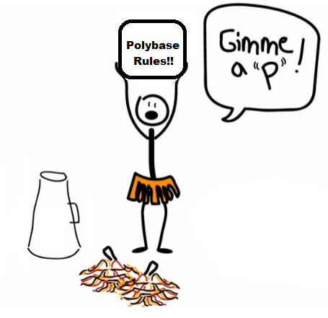

Thanks
Polybase

