Slide 1
OLAP over Uncertain and Imprecise Data
Doug Burdick, Prasad Deshpande, T. S. Jayram,
Raghu Ramakrishnan, Shivakumar Vaithyanathan
Presented by Raghav Sagar

Slide 2
OLAP Overview
Online Analytical Processing (OLAP)
  Interactive analysis of data, allowing data to be summarized and viewed in different ways in an online fashion
Databases configured for OLAP use a multidimensional data model:
  Measures
    Numerical facts which can be measured, aggregated upon
  Dimensions
    Measures are categorized by dimensions (each dimension defines a property of the measure)

Slide 3
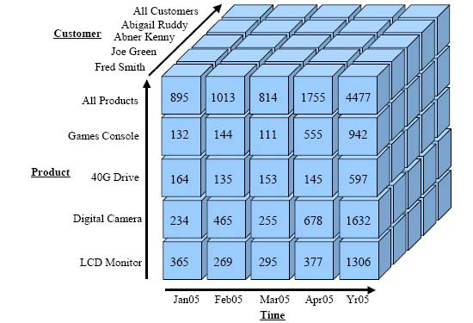
OLAP Data Hypercube (No. of Dimensions = 3)

Slide 4
Motivation
Generalization of the OLAP model to addresses imprecise dimension values and uncertain measure values
Answer aggregation queries over ambiguous data

Slide 5
Definitions
Uncertain Domains
  An uncertain domain U over base domain O is the set of all possible probability distribution functions over O
Imprecise Domains
  An imprecise domain I over a base domain B is a subset of the power set of B with ∅ ∉ I. (elements of I are called imprecise values)
Hierarchical Domains
  A hierarchical domain H over base domain B is defined to be an imprecise domain over B such that
    H contains every singleton set.
    For any pair of elements h1, h2 ∈ H, h1 ⊇ h2 or h1 ∩ h2 = ∅.

Slide 6
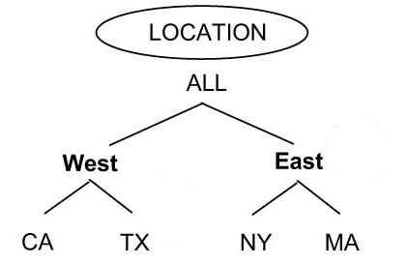
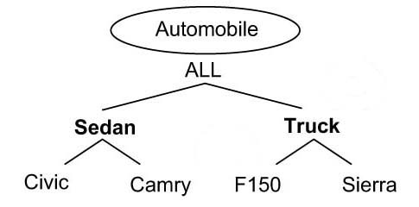
Hierarchy Domains

Slide 7
Definitions
Fact Table Schemas
  A fact table schema is <A₁, A₂, .. , A_{k}; M₁, .. , M_{n}> where
    A_{i} are dimension attributes, i ∈ {1, .. k}
    M_{j} are measure attributes, j ∈ {1, .. n}
Cells
  A vector <c₁, c₂, .. , c_{k}> is called a cell if every c_{i} is an element of the base domain of A_{i} , i ∈ {1, .. k}
Region
  Region of a dimension vector <a₁, a₂, .. , a_{k}> is the set of cells
  reg(r) denotes the region associated with a fact r

Slide 8
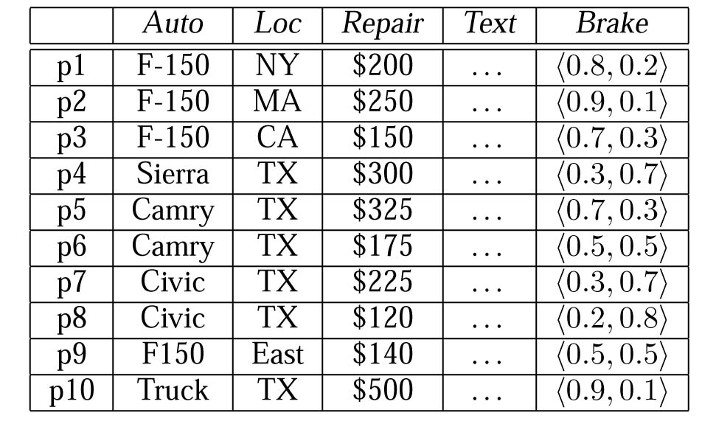
Example of a Fact Table

Slide 9
Definitions
Queries
  A query Q over a database D with schema <A₁, A₂, .. , A_{k}; M₁, .. , M_{n}> has the form Q(a₁, .. , a_{k}; M_{i}, A), where:
    a₁, .. , a_{k} describes the k-dimensional region being queried
    M_{i} describes the measure of interest
    A is an aggregation function
Query Results
  The result of Q is obtained by applying aggregation function A to a set of 'relevant' facts in D

Slide 10
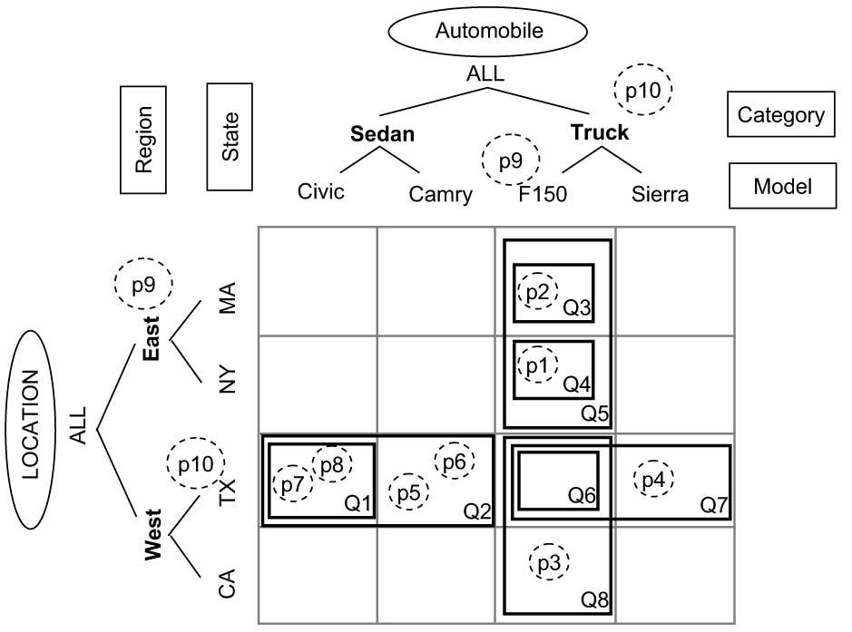
OLAP Data Hypercube (No. of Dimensions = 2)

Slide 11
Finding Relevant Facts
All precise facts within the query region are naturally included
Regarding imprecise facts, we have 3 options:
  None
    Ignore all imprecise facts
  Contains
    Include only those contained in the query region
  Overlaps
    Include all imprecise facts whose region overlaps

Slide 12
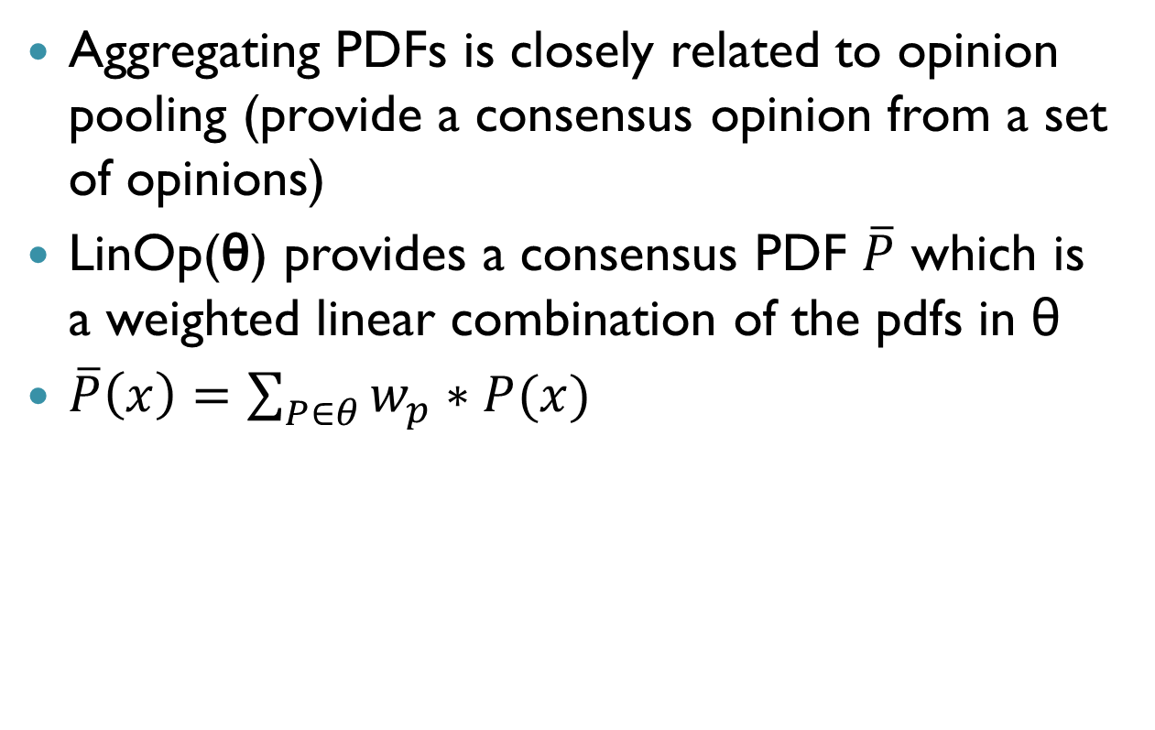
Aggregating Uncertain Measures
Aggregating PDFs is closely related to opinion pooling (provide a consensus opinion from a set of opinions)
LinOp(θ) provides a consensus PDF $\overline{P}$ which is a weighted linear combination of the pdfs in θ
$\overline{P}\left(x\right)=\sum_{P∈θ}{w_{p}∗P(x)}$

Slide 13
Consistency
α-consistency
  A query Q is partitioned into Q₁, .. Q_{p} s.t.
    reg(Q) = ∪_{i} reg(Q_{i})
    reg(Q_{i}) ∩ reg(Q_{j} ) = ∅ for every i ≠ j
  Satisfied w.r.t to A if predicate α(q, q₁, .. q_{p}) holds for every database D and for every such collection of queries Q, Q₁, .. Q_{p}

Slide 14
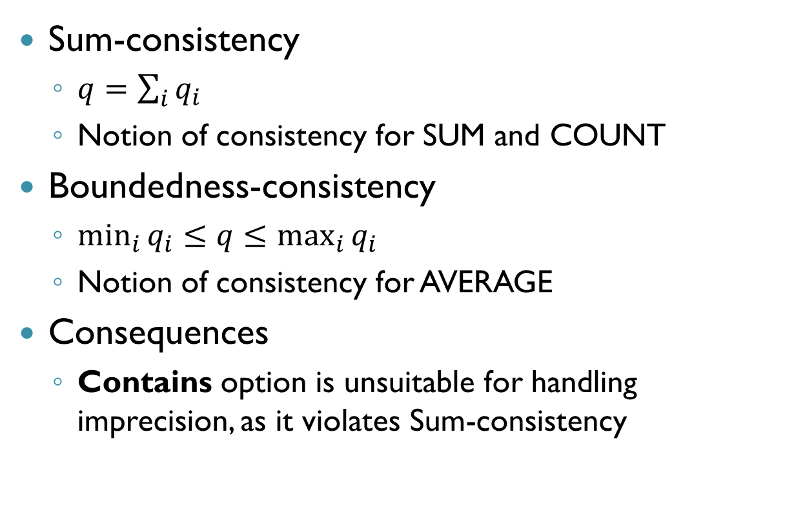
Consistency
Sum-consistency
  $q=\sum_{i}{q_{i}}$
  Notion of consistency for SUM and COUNT
Boundedness-consistency
  $\min_{i}{q_{i}≤q≤\max_{i}{q_{i}} }$
  Notion of consistency for AVERAGE
Consequences
  Contains option is unsuitable for handling imprecision, as it violates Sum-consistency

Slide 15
Faithfulness
Measure Similar Databases (D and D’)
  D’ is obtained from Database D by modifying (only) the dimension attribute values
Identically Precise Databases (D and D’)
  For a query Q, ∀ facts r ∈ D and r’ ∈ D’, either:
    Both reg(r) and reg(r’) are contained in reg(Q)
    Both reg(r) and reg(r’) are disjoint from reg(Q)
Basic faithfulness
  Identical answers for every pair of measure-similar databases D and D’ that are identically precise with respect to Q

Slide 16
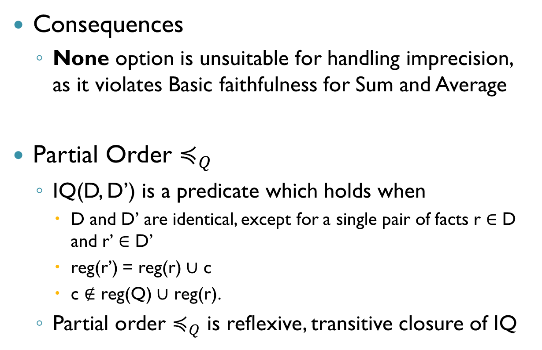
Faithfulness
Consequences
  None option is unsuitable for handling imprecision, as it violates Basic faithfulness for Sum and Average
Partial Order $≼_{Q}$
  IQ(D, D’) is a predicate which holds when
    D and D’ are identical, except for a single pair of facts r ∈ D and r’ ∈ D’
    reg(r’) = reg(r) ∪ c
    c ∉ reg(Q) ∪ reg(r).
  Partial order $≼_{Q}$ is reflexive, transitive closure of IQ

Slide 17
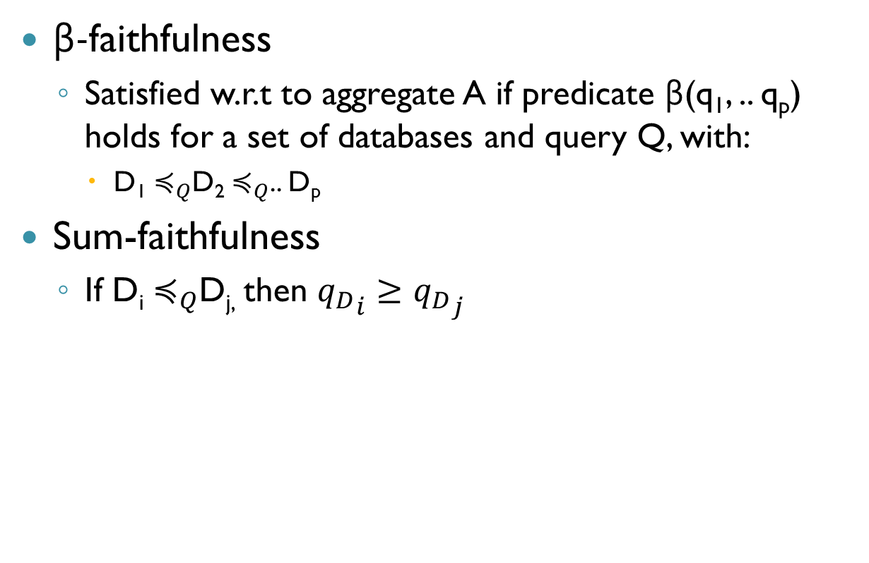
Faithfulness
β-faithfulness
  Satisfied w.r.t to aggregate A if predicate β(q₁, .. q_{p}) holds for a set of databases and query Q, with:
    D₁ $≼_{Q}$D₂ $≼_{Q}$.. D_{p}
Sum-faithfulness
  If D_{i} $≼_{Q}$D_{j,} then ${q_{D}}_{i}≥{q_{D}}_{j}$

Slide 18
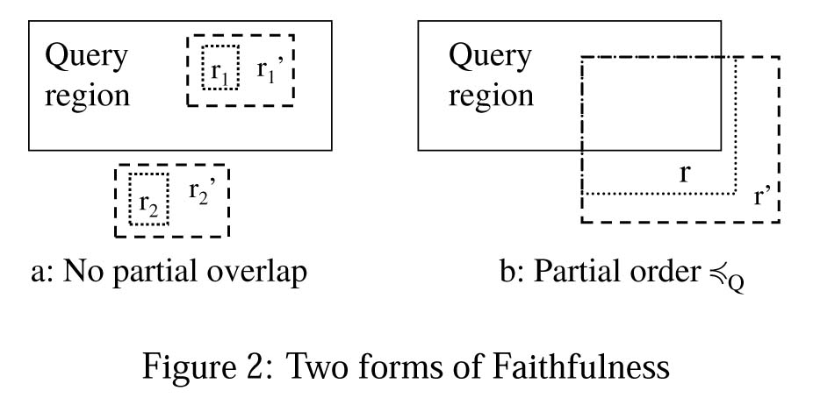

Slide 19
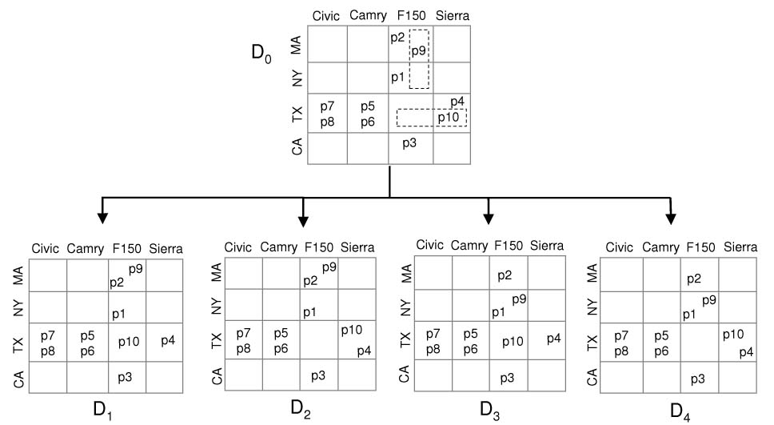
Possible Worlds
Possible Worlds of an imprecise Database D, is a set of true databases {D₁, D₂, .. D_{p}} derived by D

Slide 20
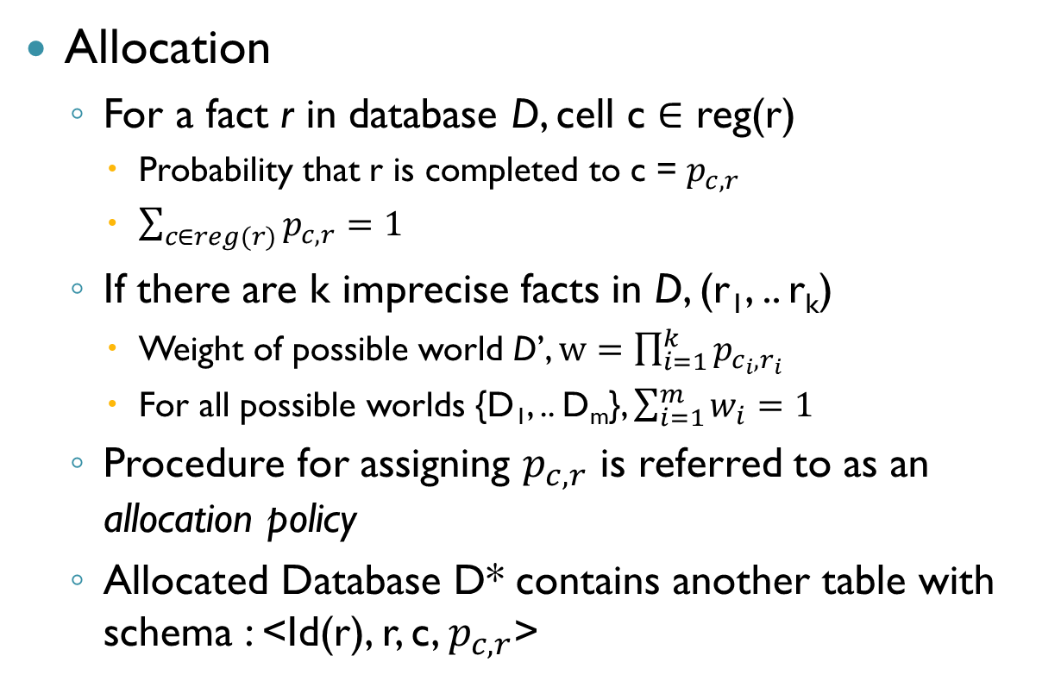
Extended Data Model
Allocation
  For a fact r in database D, cell c ∈ reg(r)
    Probability that r is completed to c = $p_{c,r}$
    $\sum_{c∈reg(r)}{p_{c,r}=1}$
  If there are k imprecise facts in D, (r₁, .. r_{k})
    Weight of possible world D’, $w=\prod_{i=1}^{k}{p_{c_{i},r_{i}}}$
    For all possible worlds {D₁, .. D_{m}}, $\sum_{i=1}^{m}{w_{i}=1}$
  Procedure for assigning $p_{c,r}$ is referred to as an allocation policy
  Allocated Database D* contains another table with schema : <Id(r), r, c, $p_{c,r}$>

Slide 21
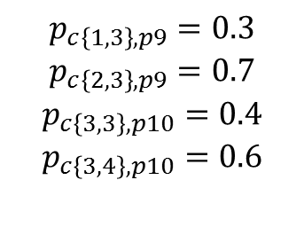
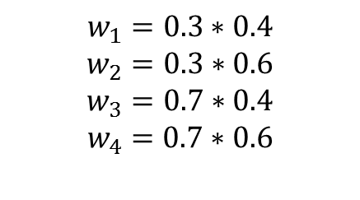
$$p_{c\left\{1,3\right\},p9}=0.3$$
$$p_{c\left\{2,3\right\},p9}=0.7$$
$$p_{c\left\{3,3\right\},p10}=0.4$$
$$p_{c\left\{3,4\right\},p10}=0.6$$
$$w_{1}=0.3∗0.4$$
$$w_{2}=0.3∗0.6$$
$$w_{3}=0.7∗0.4$$
$$w_{4}=0.7∗0.6$$

Slide 22
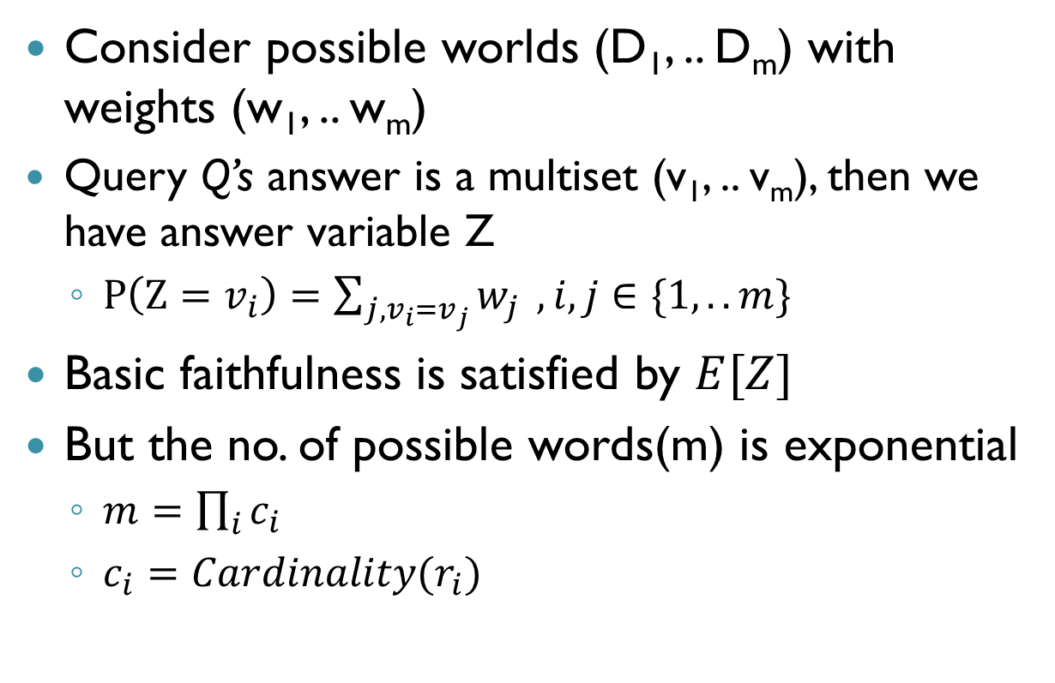
Summarizing Possible Worlds
Consider possible worlds (D₁, .. D_{m}) with weights (w₁, .. w_{m})
Query Q’s answer is a multiset (v₁, .. v_{m}), then we have answer variable Z
  $P\left(Z=v_{i}\right)=\sum_{j, v_{i}=v_{j}}{w_{j}} , i,j∈\{1, .. m\}$
Basic faithfulness is satisfied by $E[Z]$
But the no. of possible words(m) is exponential
  $m=\prod_{i}{c_{i}}$
  $c_{i}=Cardinality(r_{i})$

Slide 23
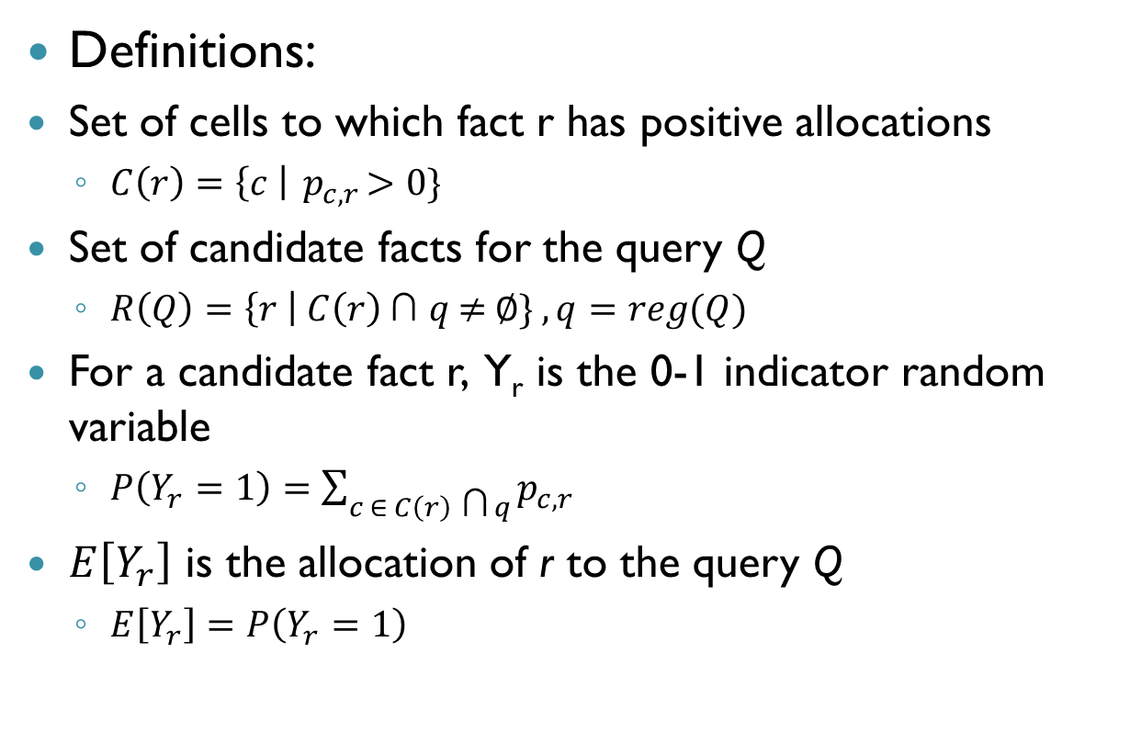
Summarizing Possible Worlds
Definitions:
Set of cells to which fact r has positive allocations
  $C\left(r\right)=\left\{c \right|{ p}_{c,r}>0\}$
Set of candidate facts for the query Q
  $R\left(Q\right)=\left\{r \right| C\left(r\right) \text{∩} q \text{≠} ∅\} , q=reg(Q)$
For a candidate fact r, Y_{r} is the 0-1 indicator random variable
  $P\left(Y_{r}=1\right)=\sum_{c ∈ C\left(r\right) \text{∩} q}{p_{c,r}}$
$E\left[Y_{r}\right]$ is the allocation of r to the query Q
  $E\left[Y_{r}\right]=P\left(Y_{r}=1\right)$

Slide 24
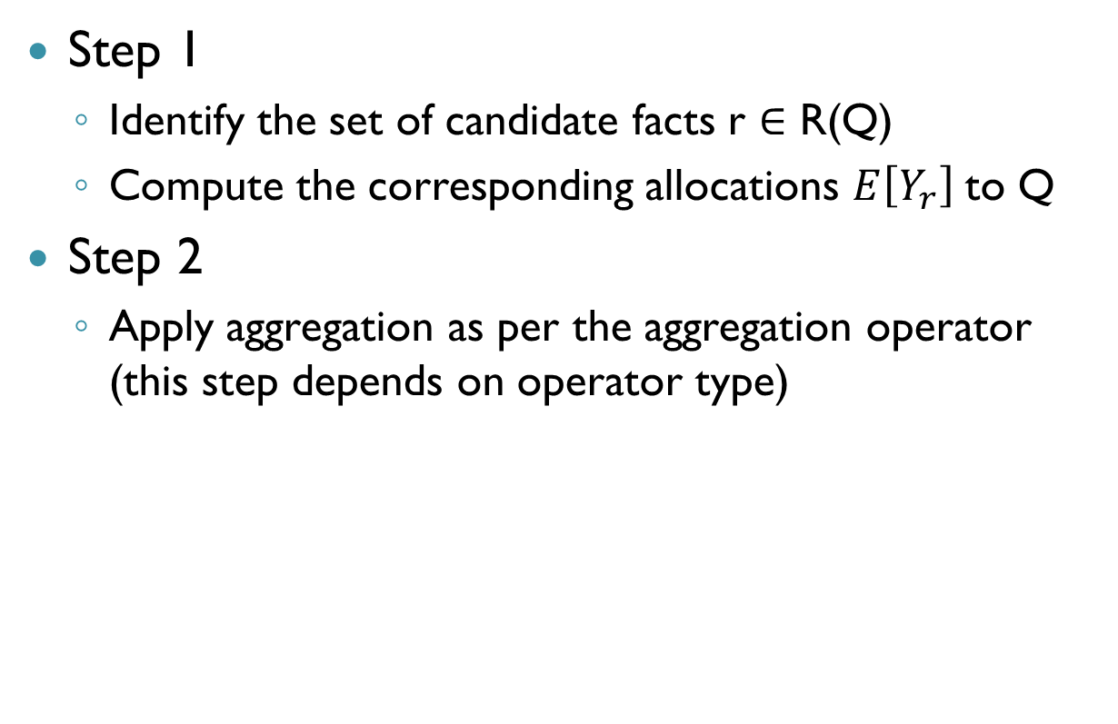
Summarizing Possible Worlds
Step 1
  Identify the set of candidate facts r ∈ R(Q)
  Compute the corresponding allocations $E\left[Y_{r}\right]$to Q
Step 2
  Apply aggregation as per the aggregation operator (this step depends on operator type)

Slide 25
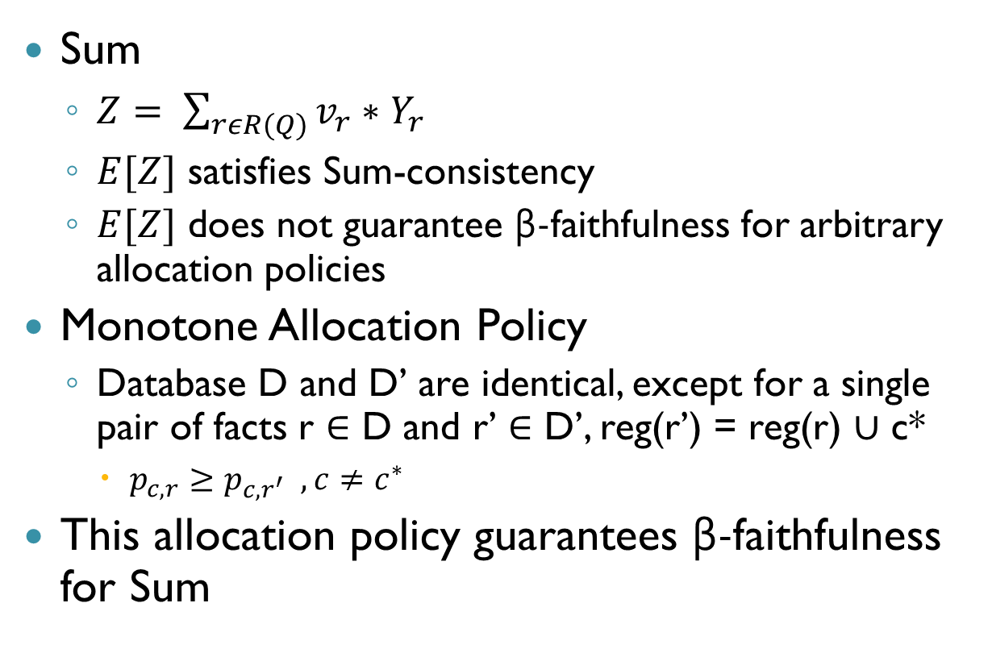
Summarizing Possible Worlds
Sum
  $Z= \sum_{rεR(Q)}{v_{r}∗Y_{r}}$
  $E[Z]$ satisfies Sum-consistency
  $E[Z]$ does not guarantee β-faithfulness for arbitrary allocation policies
Monotone Allocation Policy
  Database D and D’ are identical, except for a single pair of facts r ∈ D and r’ ∈ D’, reg(r’) = reg(r) ∪ c*
    $p_{c,r}≥p_{c,r^{′}} , c≠c^{∗}$
This allocation policy guarantees β-faithfulness for Sum

Slide 26
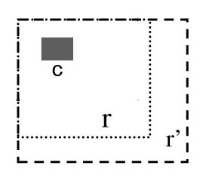

Monotone Allocation Policy:
$$p_{c,r}≥p_{c,r^{′}}$$

Slide 27
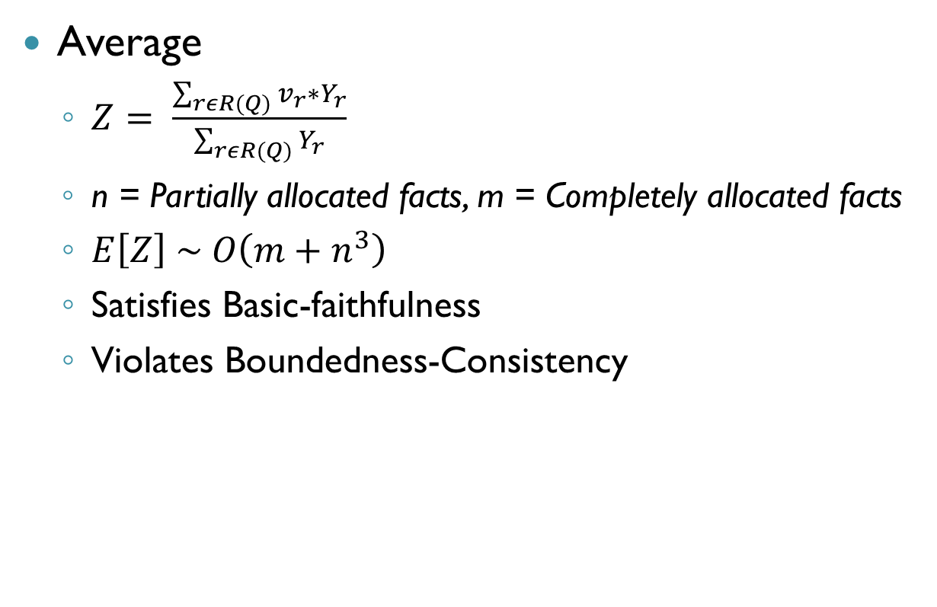
Summarizing Possible Worlds
Average
  $Z= \frac{\sum_{rεR(Q)}{v_{r}∗Y_{r}}}{\sum_{rεR(Q)}{Y_{r}}}$
  n = Partially allocated facts, m = Completely allocated facts
  $E\left[Z\right] \sim O\left(m+n^{3}\right)$
  Satisfies Basic-faithfulness
  Violates Boundedness-Consistency

Slide 28
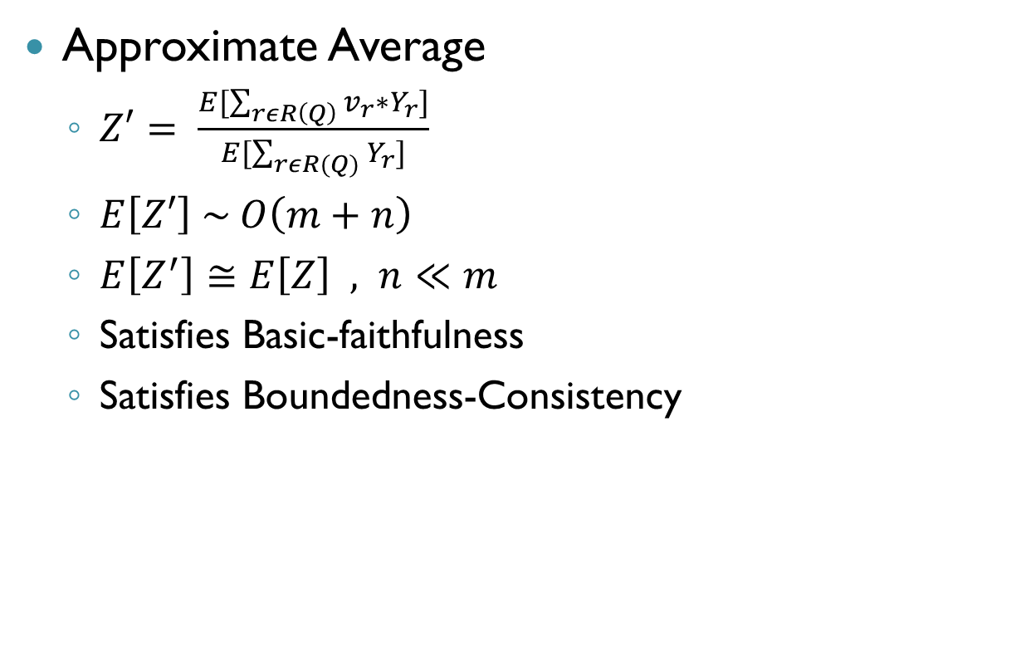
Summarizing Possible Worlds
Approximate Average
  $Z′= \frac{E[\sum_{rεR\left(Q\right)}{v_{r}∗Y_{r}}]}{E[\sum_{rεR(Q)}{Y_{r}]}}$
  $E\left[Z′\right] \sim O\left(m+n\right)$
  $E\left[Z^{′}\right]≅E\left[Z\right] , n≪m$
  Satisfies Basic-faithfulness
  Satisfies Boundedness-Consistency

Slide 29
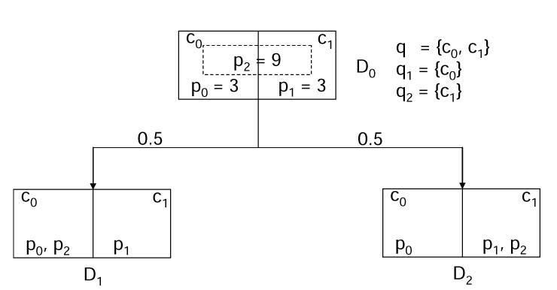
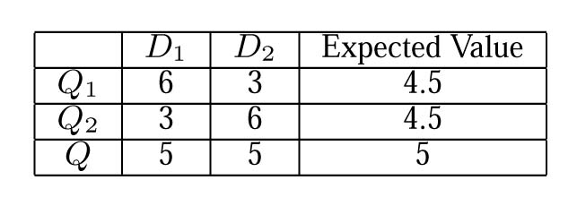
  Expectation of Average violates Boundedness-Consistency

Slide 30
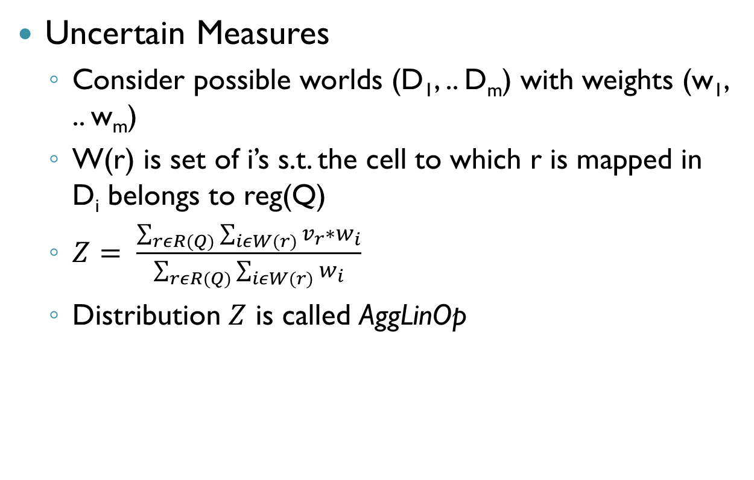
Summarizing Possible Worlds
Uncertain Measures
  Consider possible worlds (D₁, .. D_{m}) with weights (w₁, .. w_{m})
  W(r) is set of i’s s.t. the cell to which r is mapped in D_{i} belongs to reg(Q)
  $Z= \frac{\sum_{rεR(Q)}{\sum_{iεW(r)}{v_{r}∗w_{i}}}}{\sum_{rεR(Q)}{\sum_{iεW(r)}{w_{i}}}}$
  Distribution $Z$ is called AggLinOp

Slide 31
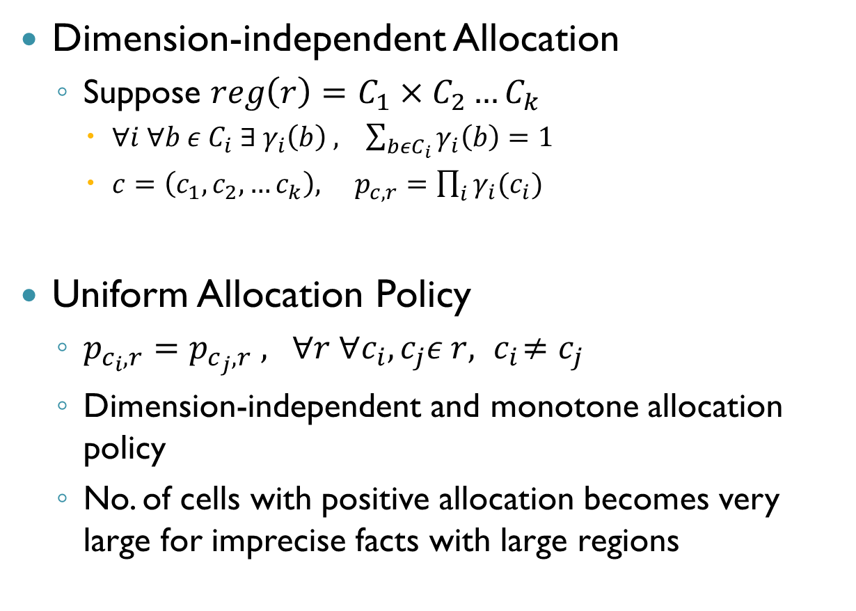
Allocation Policies
Dimension-independent Allocation
  Suppose $reg\left(r\right)=C_{1}×C_{2}…C_{k}$
    $∀i ∀b ε C_{i} ∃ γ_{i}\left(b\right) , \sum_{bεC_{i}}{γ_{i}\left(b\right)=1}$
    $c=\left(c_{1},c_{2}, …c_{k}\right), p_{c,r}=\prod_{i}{γ_{i}(c_{i})}$
Uniform Allocation Policy
  $p_{c_{i},r}=p_{c_{j},r} , ∀r ∀c_{i},c_{j}ε r,{ c}_{i}≠c_{j}$
  Dimension-independent and monotone allocation policy
  No. of cells with positive allocation becomes very large for imprecise facts with large regions

Slide 32
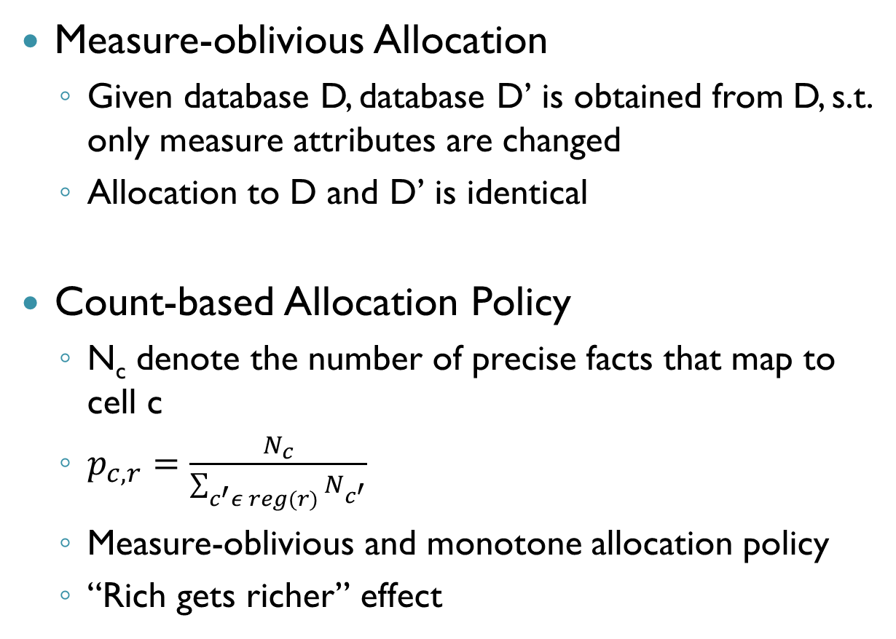
Allocation Policies
Measure-oblivious Allocation
  Given database D, database D’ is obtained from D, s.t. only measure attributes are changed
  Allocation to D and D’ is identical
Count-based Allocation Policy
  N_{c} denote the number of precise facts that map to cell c
  $p_{c,r}=\frac{N_{c}}{\sum_{c^{′}ε reg(r)}{N_{c^{′}}}}$
  Measure-oblivious and monotone allocation policy
  “Rich gets richer” effect

Slide 33
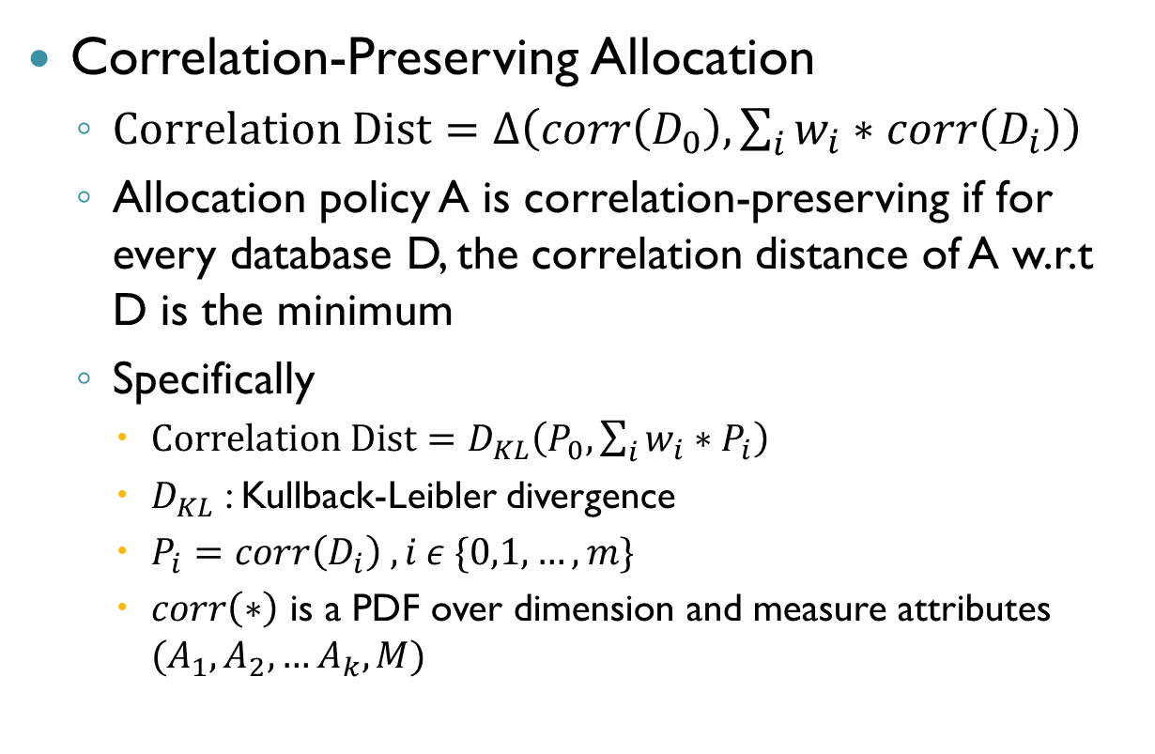
Allocation Policies
Correlation-Preserving Allocation
  $Correlation Dist=∆\left(corr\left(D_{0}\right),\sum_{i}{w_{i}∗corr\left(D_{i}\right)}\right)$
  Allocation policy A is correlation-preserving if for every database D, the correlation distance of A w.r.t D is the minimum
  Specifically
    $Correlation Dist=D_{KL}\left(P_{0},\sum_{i}{w_{i}∗P_{i}}\right)$
    $D_{KL}$ : Kullback-Leibler divergence
    $P_{i}=corr\left(D_{i}\right) , i ε \{0,1,…,m\}$
    $corr\left(∗\right)$ is a PDF over dimension and measure attributes $(A_{1},A_{2}, …A_{k},M)$

Slide 34
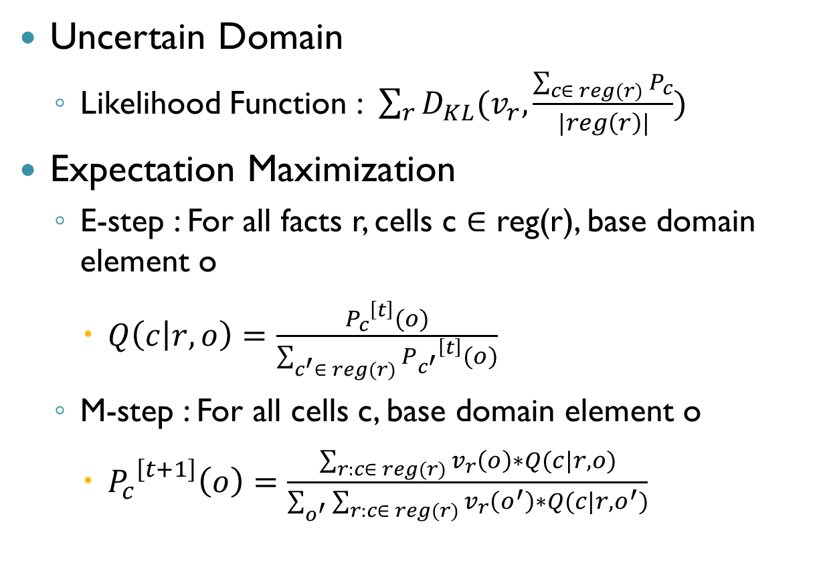
Allocation Policies
Uncertain Domain
  Likelihood Function : $\sum_{r}{D_{KL}(v_{r},\frac{\sum_{c∈ reg(r)}{P_{c}}}{|reg\left(r\right)|})}$
Expectation Maximization
  E-step : For all facts r, cells c ∈ reg(r), base domain element o
    $Q\left(c | r,o\right)=\frac{{P_{c}}^{\left[t\right]}(o)}{\sum_{c^{′}∈ reg(r)}{{P_{c^{′}}}^{\left[t\right]}(o)}}$
  M-step : For all cells c, base domain element o
    ${P_{c}}^{\left[t+1\right]}\left(o\right)=\frac{\sum_{r:c∈ reg(r)}{v_{r}\left(o\right)∗Q(c|r,o)}}{\sum_{o^{′}}{\sum_{r:c∈ reg(r)}{v_{r}\left(o^{′}\right)∗Q(c|r,o^{′})}}}$

Slide 35

Allocation Policies
Calculating parameters
  $p_{c,r}=Q\left(c | r\right)≔\sum_{o}{\frac{{P_{c}}^{\left[∞\right]}\left(o\right)}{\sum_{c^{′}}{{P_{c^{′}}}^{\left[∞\right]}\left(o\right)}}}∗v_{r}(o)$

Slide 36
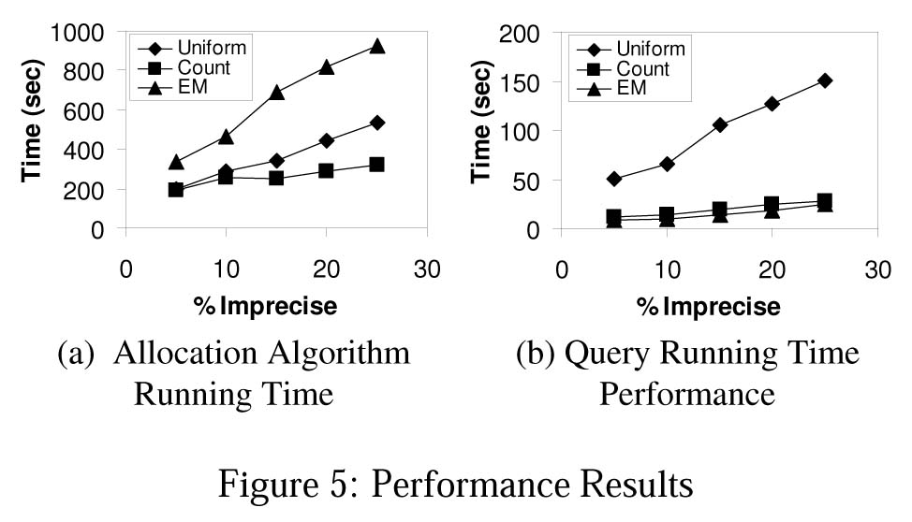
Experiments
Scalability of the Extended Data Model

Slide 37
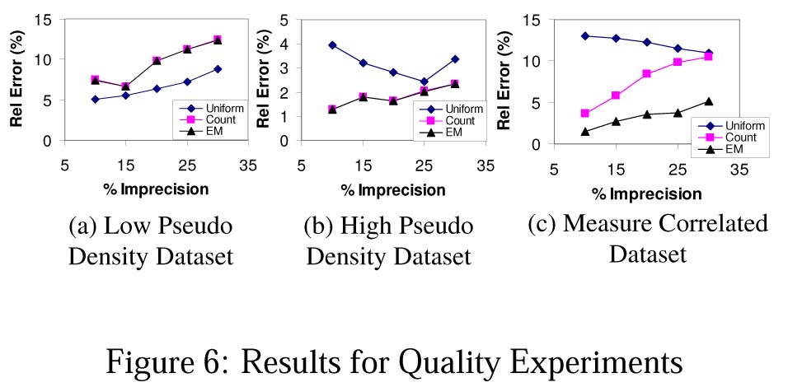
Experiments
Quality of the Allocation Policies

Slide 38
Conclusion
Handling of uncertain measures as probability distribution functions (PDFs)
Consistency requirements on aggregation operators for a relationship between queries on different hierarchy levels of imprecision
Faithfulness requirements for direct relationship between degree of precision with quality of query results
Correlation-Preserving requirements to make a strong, meaningful correlation between measures and dimensions
Studying scalability vs quality trade offs between different allocation techniques

