Slide 1
Monitoring streams:
a new class of data management applications
Don Carney, Uğur Çetintemel, Mitch Cherniack, Christian Convey, Sangdon Lee, Greg Seidman, Michael Stonebraker, Nesime Tatbul, Stan Zdonik
VLDB 2002: 215-226
Presented by:
Bharath Radhakrishnan
Under the guidance of:
Prof. S. Sudarshan
Includes some slides by:
YongChul Kwon (http://goo.gl/8K7Qa)
Jong-Won Roh (http://goo.gl/Fzc3e)
Advanced Database Management System

Slide 2
Outline
Motivation
  Monitoring Applications
  Special needs of monitoring applications
Aurora
  System and Query Model of Aurora
  Operators in Aurora
  Aurora System Architecture
Conclusion
Extras
  Borealis
  Physically Independent Stream Merging

Slide 3
Monitoring Applications
Concept
  Monitor continuous data streams, detect abnormal activity, and alert users those situations
Data Stream
  Continuous,
  Unbounded,
  Rapid,
  May contain missing, out of order values
Occurs in a variety of modern applications

Slide 4
Examples of Monitoring Applications
Patient monitoring
Aircraft Safety monitoring
Stock monitoring
Intrusion detection systems

Slide 5
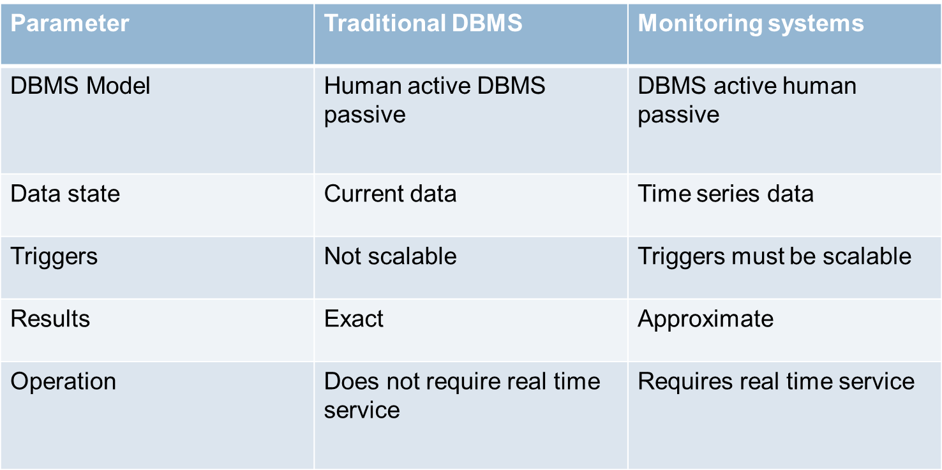
Motivation
Monitoring applications are difficult to implement in the traditional DBMS

Slide 6

Aurora
This paper describes a new prototype system, Aurora, which is designed to better support monitoring applications
  Stream data
  Continuous Queries
  Historical Data requirements
  Imprecise data
  Real-time requirement

Slide 7
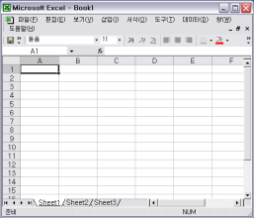
Aurora Overall System Model
7
User application
QoS spec
Query spec
Aurora
System
Historical
Storage
External
data source
Operator
boxes
data flow
(collection of stream)
Query spec
Application
administrator

Slide 8
Representation of Stream
Aurora stream tuple: (TS=ts, A₁=v₁, A₂=v₂ .. A_{n}=v_{n})
TS (Timestamp) information is used for QoS calculation

Slide 9
Types of operators
Continuous:-operate on single tuples
Windowed:- operate on a set of continuous tuples
1.) Slide
2.) Tumble
3.) Latch

Slide 10
Types of operators
Continuous:-operate on single tuples
Windowed:- operate on a set of continuous tuples
1.) Slide
2.) Tumble
3.) Latch

Slide 11
Operators
Filter
--Drop
Algebraic notation:
Filter(P1, . . . , Pm)(S)
Input stream
Price > 1000
Output stream

Slide 12
Operators
Map
Applies a function to every tuple in the stream
Map(A1 = F1, . . . , Am = Fm)(S)

Slide 13
Operators
Union
Combine tuples from all input streams
Union (S1, . . . , Sn)

Slide 14
Operators
Group By
Partitioning of input stream into multiple output streams
Partitioning condition

Slide 15
Operators
Aggregate
  Applies aggregate function on windows over input stream
  Syntax:
  Aggregate(Function, Assuming order, Size s, Advance I, Timeout t) (S)

Slide 16
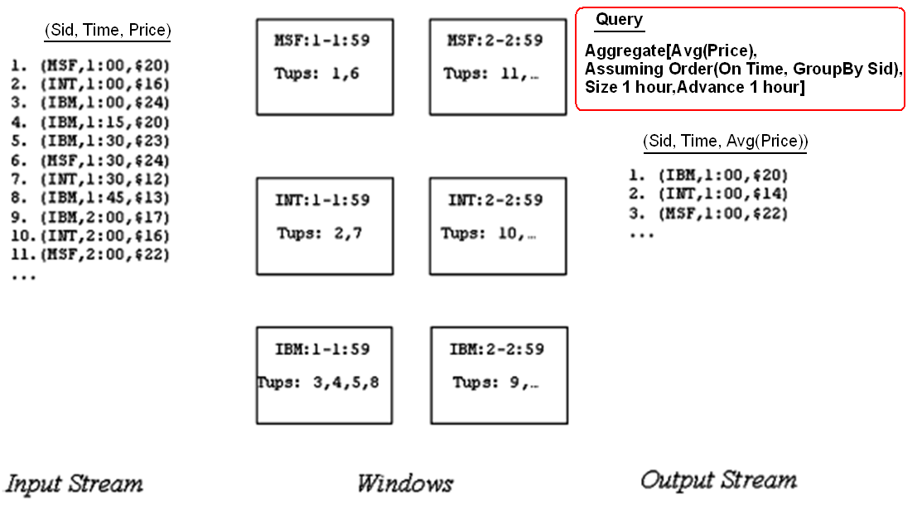
Aggregate Example Contd.

Slide 17
Join
Join is a binary join operator that takes the form
Join (P, Size s, Left Assuming O1, Right Assuming O2)(S1, S2)

Slide 18
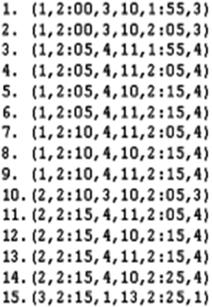
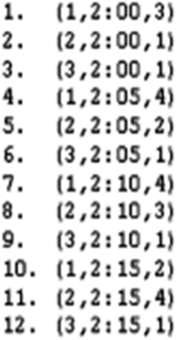
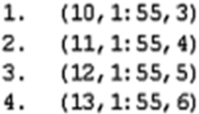
Join Example
Join( x.pos = y.pos, size = 10 min,
X ordered in time,
Y ordered in time) ( X,Y )
X(sid, time, pos)
Y(sid, time, pos)

Slide 19
Aurora Query model
Queries can be classified as:
1.Continuous queries
2.Views
3.Ad hoc queries

Slide 20
Aurora Query Model (cntd.)
Continuous queries: Continuously monitors input stream
QoS spec
data input
b1
b2
b3
app
continuous query
Connection
point
Picture Courtesy: Reference [2]

Slide 21
Aurora Query model: Views
QoS spec
data input
b1
b2
b3
app
continuous query
Connection
point
b4
QoS spec
b5
b6
view
Picture Courtesy: Reference [2]

Slide 22
Aurora Query model: Ad-hoc queries
QoS spec
data input
b1
b2
b3
app
continuous query
Connection
point
b4
QoS spec
b5
b6
view
3 days
ad-hoc query
b7
b8
b9
app
QoS spec
Picture Courtesy: Reference [2]

Slide 23
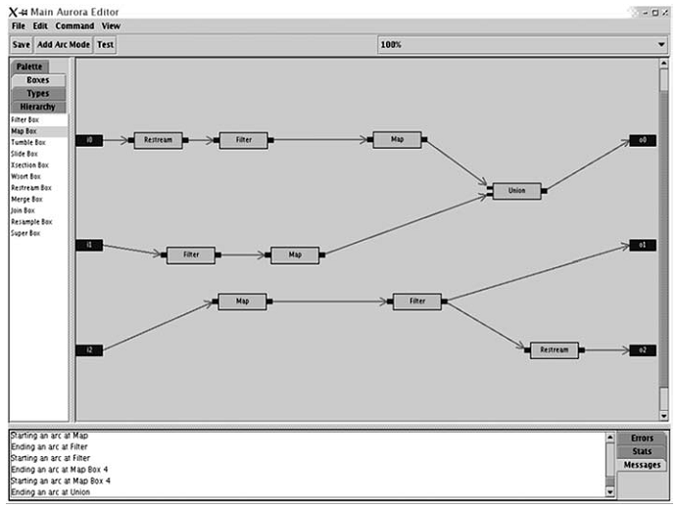
Aurora GUI
Operator Boxes

Slide 24
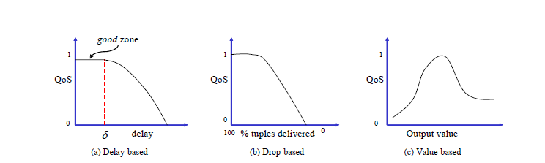
QoS specifications
Done by administrator
A multi dimensional function specified as a set of 2D functions

Slide 25
Run-time Architecture
inputs
outputs
Storage Manager
Router
Q₁
Scheduler
σ
μ
Q₂
Output
Data
Stream
Q_{m}
Buffer manager
Catalog
Box Processors
Persistent Store
Q₁
Load
Shedder
QoS
Monitor
Q₂
Q_{n}
Picture Courtesy: Reference [2]

Slide 26
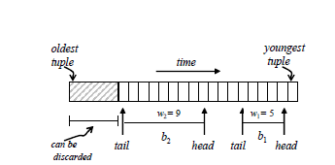
Storage manager
1. Queue management
Queue is present in main memory and disk. Storage manager implements a replacement policy to select which queue blocks to keep in memory

Slide 27
Storage manager
2. Connection point management
Connection point stores historical data
Data organized as a B Tree
Default key is time stamp
Insertions to B Tree are done in batched
Periodic passes deletes tuples older than the history requirement.

Slide 28
Optimization
Optimization issues
  Large no. of small box operations
  High Data rates
  Architecture changes to the system

Slide 29
Optimization
Optimizations
Dynamic Continuous
Query Optimization
  Inserting projections
  Combining Boxes
  Reordering Boxes
Scheduling related optimizations
Adhoc Query Optimization

Slide 30
Optimization
Courtesy: Slides by Yong Chul Kwon
Aggregate
Join
Map
Filter
pull data
Hold
Union
Continuous query
Filter
Hold
Ad hoc query
Filter
BSort
Map
Static storage
Aggregate
Join

Slide 31
Dynamic Continuous Query Optimizations
Optimize local sub-networks
  Inserting projections
  Combining Boxes:
    Combining reduces box execution overhead
    Eg : two filters into one etc
  Re-ordering boxes:
B1
B2
B2
B1
C(b) – time taken by b to
process 1 tuple
S(b) – Selectivity of box b
Total Cost(B1-B2) = TC1 =
C(B1) + S(B1) * C(B2)
Total Cost(B2-B1) = TC2 =
C(B2) + S(B2) * C(B1)

Slide 32
Optimizing Ad-hoc queries
Two separate copies sub-networks for the ad-hoc query is created
  COPY#1: works on historical data
  COPY#2: works on current data
COPY#1 is run first and utilizes the B-Tree structure of historical data for optimization
  Index look-up for filter, appropriate join algorithms
COPY#2 is optimized as before

Slide 33
Real Time Scheduling(RTS)
Scheduler selects which box to execute next
Scheduling decision depends upon QoS information
End to End processing cost should also be considered
Aurora scheduling considers both

Slide 34
Real Time Scheduling(RTS)
Non-linearity :- Output tuple rate not always proportional to input tuple rate.
Inter-box non-linearity (Superbox scheduling)
  Less buffer space → thrashing
  Bypass storage manager with advanced scheduling
Intra-box non-linearity (Train scheduling)
  Tuple processing cost could decrease if more tuples are available for processing (similar to batch processing)
    Reduced context switches

Slide 35
RTS by Optimizing QoS: Priority Assignment
Latency = Processing delay + waiting delay
Train scheduling considers the Processing Delay
Waiting delay is function of scheduling
Give priority to tuple while scheduling to improve QoS
Two approaches to assign priority
  a state-based approach
  feedback-based approach

Slide 36
Different priority assignment approach
State-based approach
  Assigns priorities to outputs based on their expected utility
    How much QoS is sacrificed if execution is deferred?
  Selects the output with max utility
Feedback-based approach
  Increase priority of application which are not doing well
  Decrease priority of application in good zone

Slide 37
Load Shedding
Systems have a limit to how much fast data can be processed
Load shedding discards some data so the system can flow
Drop box are used to discard data
Different from networking load shedding
  Data has semantic value in DSMS
  QoS can be used to find the best stream to drop

Slide 38
Detecting Load Shedding: Static Analysis
When input date rate is higher than processing speed queue will overflow
Condition for overload
  C X H < min_cap
    C=capacity of Aurora system
    H=Headroom factor, % of sys resources that can be used at a steady state
    min_cap=minimum aggregate computational capacity required
min_cap is calculated using input data rate and selectivity of the operator
Input data ( Rate r(B) )
B
s(B)
Output data ( 1/c(B))

Slide 39
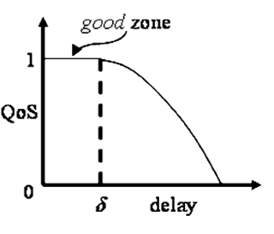
Detecting Load Shedding: Dynamic Analysis
The system have sufficient resource but low QoS
Uses delay based QoS information to detect load
If enough output is outside of good zone it indicates overload
Picture Courtesy: Reference [2]

Slide 40
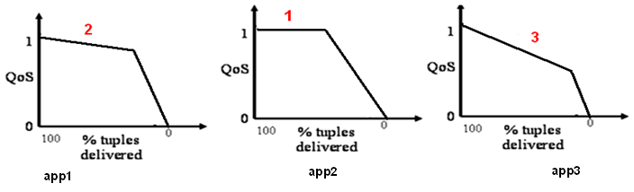
Static Load Shedding by dropping tuples
We will prefer to drop tuples that result in minimum compromise on QoS.
  Find output graph resulting in minimum QoS drop
  Drop tuples (Drop Box)
  Recalculate resources. If insufficient, repeat process
  Get rid of tuples as early as possible
  Move the drop-box as close to the data source or connection point

Slide 41
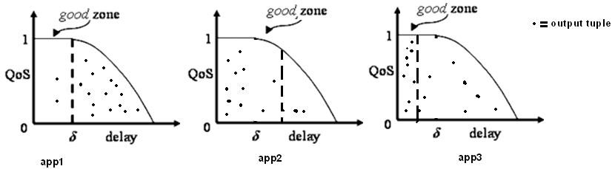
Dynamic Load Shedding by dropping tuples
Delay based Qos graph is considered
Selects output which has Qos lower than the threshold specified in the graph(not in good zone)
Insert drop box close to the source of the data or connection point
Repeat the process until the latency goal are met

Slide 42
Semantic Load shedding by filtering tuples
Previous method drops packet randomly at strategic point
Some tuple may be more important than other
Consult value based QoS information before dropping a tuple
Drop tuple based on QoS value and frequency of the value

Slide 43
Semantic Load shedding example
Load shedding based on condition
  Most critical patients get treated first
  Filter added before the Join
Patients
Drop barely
Injured tuples
Join
Doctors who can work
on a patient
Doctors
Too much Load

Slide 44
Conclusion
Aurora is a Data Stream Management System for Monitoring Systems. It provides:
  Continuous and Ad-hoc Queries on Data streams
  Historical Data of a predefined duration is stored
  Box and arrow style query specification
  Supports Imprecise data
  Real-time requirement is supported by Dynamic Load-shedding
Aurora runs on Single Computer
  Borealis^{[3]} is a distributed data stream management system

Slide 45
References
[1]
D. Carney et al., “Monitoring streams: a new class of data management applications,” Proceedings of the 28th international conference on Very Large Data Bases, p. 215–226, 2002.
[2]
D. J. Abadi et al., “Aurora: a new model and architecture for data stream management,” The VLDB Journal The International Journal on Very Large Data Bases, vol. 12, no. 2, pp. 120-139, 2003.
[3]
D. J. Abadi et al., others, “The design of the borealis stream processing engine,” in Second Biennial Conference on Innovative Data Systems Research (CIDR 2005), Asilomar, CA, 2005, p. 277–289.

Slide 46

Thank You!
Picture Courtesy: Good Financial Cents http://goo.gl/MaQC0

Slide 47
Extras

Slide 48
The Design of the Borealis Stream Processing Engine
Daniel J. Abadi, Yanif Ahmad, Magdalena Balazinska, Ug ̆ur C ̧ etintemel, Mitch Cherniack, Jeong-Hyon Hwang, Wolfgang Lindner, Anurag S. Maskey, Alexander Rasin, Esther Ryvkina, Nesime Tatbul, Ying Xing, and Stan Zdonik
Presented by:
Bharath Radhakrishnan
Under the guidance of:
Prof. S. Sudarshan
Advanced Database Management System

Slide 49
Second Generation SPE Requirements
Dynamic revision of query results
  Consider newly available updates
Dynamic query modification
  Automatic and fast modifications
Flexible and highly-scalable optimization

Slide 50
Borealis
Distributed stream processing engine
Extends the Aurora functionality
  Similar system architecture
Developed to meet the new SPE requirements

Slide 51
Data model
type: tuple type
  Insertion, deletion, replacement
id: unique identifier of tuple
Score function
  Returns the impact of the message on QoS
header
data
(time,type,id,a1,...,an)

Slide 52
Dynamic revision of results
Replay the past
  Using new or modified value
  Generates revision messages
Stateless operator (e.g. Filter)
  Affects only the revised messages
Stateful operators (e.g. Aggregation)
  Affects all messages involved in computation

Slide 53
Stateless revision
Stateless operator (e.g. Filter) only affects the revised message itself
Replace: 4
Delete: 6
1
6
8
x>5
6
8

Slide 54
Stateful revision
Stateful operator(e.g. Aggregation by window) revision require all messages involve in computation
REVISED
Aggregation

Slide 55
Dynamic modification of queries
Special control lines
  Revised box parameters
  Revised box functions
Control message : <attribute, value>
Handle timing problems
  Buffering
  Time travel

Slide 56
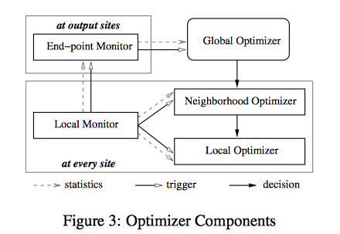
Optimization

Slide 57
Reference
[1]
D. J. Abadi et al., others, “The design of the borealis stream processing engine,” in Second Biennial Conference on Innovative Data Systems Research (CIDR 2005), Asilomar, CA, 2005, p. 277–289.

Slide 58
Physically Independent Stream Merging
Badrish Chandramouli, David Maier, Jonathan Goldstein
Presented by:
Bharath Radhakrishnan
Under the guidance of:
Prof. S. Sudarshan
Advanced Database Management System

Slide 59
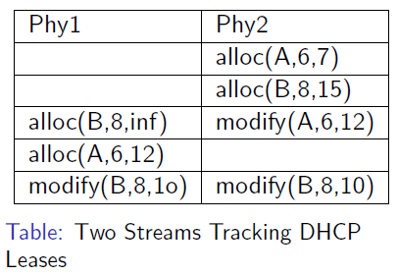
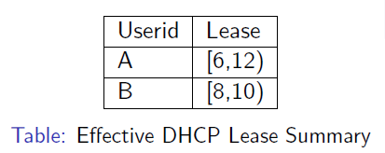
Physically Independent Stream Merging
Challenges
  Disorder
  Revisions
  Processing variations

Slide 60
Applications
High Availability
Fast Availability
Plan Fast-Forward
Query Cutover

Slide 61
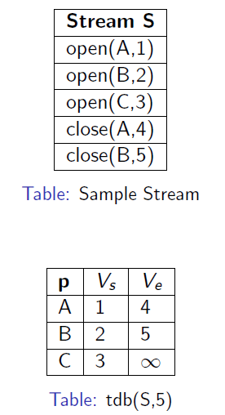
Theory of LMerge
Stream as Temporal Database
TDB schema : (p, [V_{s}, V_{e}))
Stream prefix
  S[i] = e₁, e₂ …, e_{i}
  Reconstitution function tdb(S, i)
Prefix equivalence S[i] = U[j]
Stream equivalence tdb(S) = tdb(U)

Slide 62
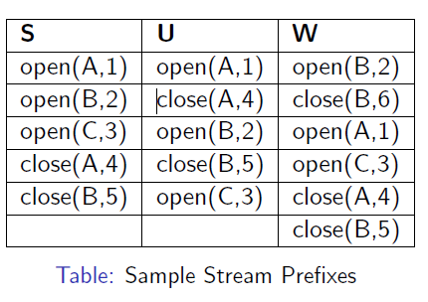
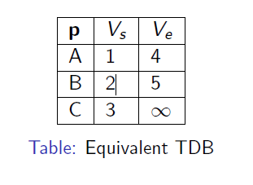
Prefix Equivalence

Slide 63
Reference
[1]
Badrish Chandramouli, David Maier, and Jonathan Goldstein. Physically Independent Stream Merging. In Proc. of the 28th IEEE International Conference on Data Engineering (ICDE ’12). IEEE, 2012.

