Slide 1
Spanner: Google’s
Globally-Distributed Database
James C. Corbett, Jeffrey Dean, Michael Epstein, Andrew Fikes, Christopher Frost, JJ Furman,Sanjay Ghemawat, Andrey Gubarev, Christopher Heiser, Peter Hochschild, Wilson Hsieh,Sebastian Kanthak, Eugene Kogan, Hongyi Li, Alexander Lloyd, Sergey Melnik, David Mwaura,David Nagle, Sean Quinlan, Rajesh Rao, Lindsay Rolig, Yasushi Saito, Michal Szymaniak,Christopher Taylor, Ruth Wang, Dale Woodford
OSDI 2012
Presented by: Sagar Chordia, CS 632-2012-2

Slide 2
Example: Social Network
Sao Paulo
Santiago
Buenos Aires
x1000
San Francisco
Seattle
Arizona
Brazil
User posts
Friend lists
User posts
Friend lists
User posts
Friend lists
User posts
Friend lists
User posts
Friend lists
x1000
US
London
Paris
Berlin
Madrid
Lisbon
Moscow
Berlin
Krakow
x1000
x1000
Russia
Spain

Slide 3
Motivation
Bigtable (2008):
  Difficult to use for complex, evolving schemas
  Can’t give strong consistency guarantees for geo-replicated sites
Megastore (2011):
  Evolved to support synchronous replication and provides semi-relational data model
  Full ACID semantics within partitions but lower consistency guarantees across partitions
  Poor write throughput

Slide 4
Spanner
  Distributed multiversion database
    General-purpose transactions (ACID)
    SQL query language
    Schematized tables
    Semi-relational data model
Focus: managing cross-datacenter replication
Features:
  Provides externally consistent reads and writes.
  Globally consistent reads across database
Running in production: Google’s Ad data

Slide 5
Outline
Structure of spanner implementation
Intuition
TrueTime API
Externally consistent transactions
  Read-only transactions
  Read-write transactions
  Schema-change transactions
Benchmarks

Slide 6
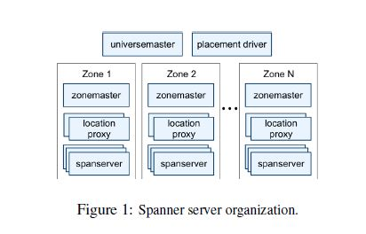
Span server organization
Universe : Spanner deployment
Zones :
  Analogues to deployment of bigtable servers
  Unit of physical isolation
  One zonemaster, thousands of spanservers

Slide 7
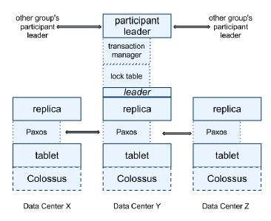
Structure-II
Each spanserver responsible for 100-1000 tablet instances
Tablet maintains following mapping: (key: string, timestamp:int64) -> string
Data and logs stored on colossus (successor of GFS)
Paxos - to get consensus; i.e. for all participants to agree on common value. We use Paxos for consistent replication
Transaction manager: to support distributed transactions

Slide 8
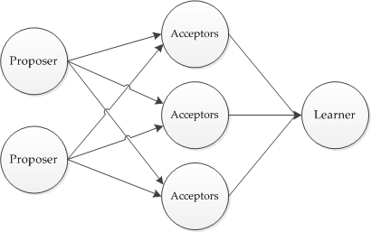
Paxos
Algorithm requires one of proposer(leader) to makes progress
Same server can act as proposer, acceptor and learner
During normal operation
  the leader receives a client's command
  assigns it a new command number i,
  Runs i th instance of the consensus algorithm
Paxos group: All machines involved in an instance of paxos
Within paxos group leader may fail and may need re-election, but safety properties are always guaranteed

Slide 9
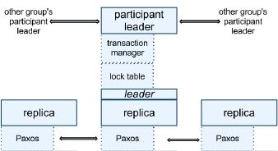
Transaction Manager
At every leader replica: transaction manager to support distributed transactions.
Participant leader and Participant slaves
One Paxos group transaction (common case) - bypass the TM
Multiple paxos group transaction:
  Group’s leaders coordinate to perform two phase commit.
  Coordinator: One of the participant groups is chosen as coordinator. Coordinator leader and coordinator slaves
The state of each TM is stored in the underlying Paxos group (and therefore is replicated)

Slide 10
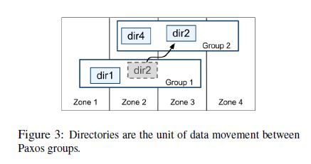
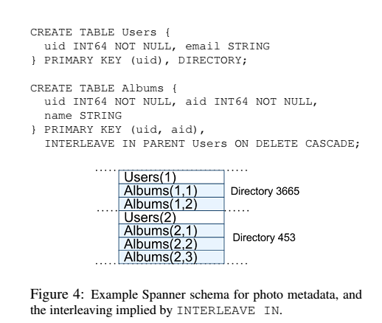
Data-model
Directory:
  Set of contiguous keys that share a common prefix
  Unit of data placement
  For load-balancing support for movedir operation

Slide 11
Overview
Feature: Lock-free distributed read transactions
Property: External consistency of distributed transactions
  First system at global scale
Implementation: Integration of concurrency control, replication, and 2Phase commit
  Correctness and performance
Enabling technology: TrueTime
  Interval-based global time

Slide 12
Read Transactions
Generate a page of friends’ recent posts
  Consistent view of friend list and their posts
Why consistency matters:
  Remove untrustworthy person X as friend
  Post P: “My government is repressive…”
Consistent view
  Synchronized snapshot read of database
  Effect of past transactions should be seen and effect of future transactions should not be seen across datacenters

Slide 13
Single Machine
Block writes
Generate my page
Friend1 post
User posts
Friend lists
User posts
Friend lists
Friend2 post
…
Friend999 post
Friend1000 post

Slide 14
Multiple Machines
Block writes
User posts
Friend lists
User posts
Friend lists
Friend1 post
Friend2 post
…
Generate my page
User posts
Friend lists
Friend999 post
User posts
Friend lists
Friend1000 post

Slide 15
Multiple Datacenters
User posts
Friend lists
Friend1 post
x1000
US
User posts
Friend lists
Friend2 post
x1000
Spain
…
Generate my page
User posts
Friend lists
Friend999 post
x1000
Brazil
User posts
Friend lists
Friend1000 post
x1000
Russia

Slide 16
Version Management
Transactions that write use strict 2PL
  Each transaction T is assigned a timestamp s
  Data written by T is timestamped with s
Time
<8
8
15
My friends
[X]
[]
My posts
[P]
X’s friends
[me]
[]

Slide 17
Synchronizing Snapshots
Global wall-clock time
==
External Consistency:
Commit order respects global wall-time order
==
Timestamp order respects global wall-time order
given
timestamp order == commit order

Slide 18
Timestamps, Global Clock
Strict two-phase locking for write transactions
Assign timestamp while locks are held
Acquired locks
Release locks
T
Pick s = now()

Slide 19
Timestamp Invariants
Timestamp order == commit order
Acquired locks
Release locks
T₁
T₂
Timestamp order respects global wall-time order
T₃
T₄
Notes:
Can be ensured by using Paxos write timestamp as spanner commit timestamp

Slide 20
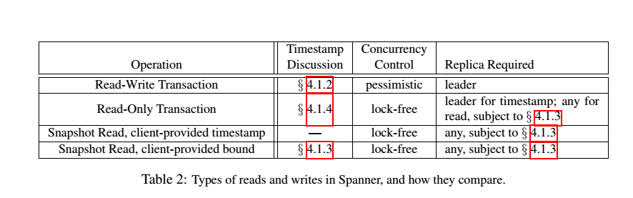
Types of Reads in Spanner

Slide 21
TrueTime
Ideally – perfect global clock to assign timestamps to transactions
Practical - “Global wall-clock time” with bounded uncertainty
TT.now()
earliest
2*ε
latest
time
API:
Method | Returns
TT.Now() | TTinterval: [earliest, latest]
TT.After(t) | True if t has definitely passed
TT.Before(t) | True if t has definitely not arrived
Guarantee:
  tt = TT.now() ,e_{now} is invocation event then
  tt.earliest <= t_{abs}(e_{now}) <= tt.latest

Slide 22
Timestamps and TrueTime
Two rules:
Start: s_{i} for T_{i} > TT.now.latest() computed after e_{i}^{server} (arrival event at leader)
Commit wait: Clients should not see data committed by T_{i} until TT.after(s_{i}) is correct
s_{i} < t_{abs}(e_{i}^{commit})
Acquired locks
Release locks
T
Wait until TT.now().earliest > s
Pick s = TT.now().latest
s
Commit wait
average ε
average ε

Slide 23
Assigning timestamps
Disjointness invariant:
  For each Paxos group, each Paxos leader ‘s lease interval is disjoint from others.
  Ensured by protocol based on TrueTime
Monotonicity invariant:
  Spanner assigns timestamps to Paxos writes in monotonically increasing order, even across leaders
  If leader assigns timestamps only when it has lease then disjoint invariant guarantees this
External consistency invariant:
  If start of transaction T2 occurs after commit of transaction T1 then commit timestamp of T2 must be greater than commit timestamp of T1
t_{abs}(e₁^{commit}) < t_{abs}(e₂^{start}) => s₁ < s₂

Slide 24
Reads in spanner
Snapshot reads
  Read in past without locking
  Client can specify timestamp for read or an upper bound of timestamp’s staleness
  Every
  Each replica tracks a value called safe time t_{safe} which is the maximum timestamp at which a replica is up-to-date.
  Replica can satisfy read at any t <= t_{safe}
Read-only transactions
  Assign timestamp s_{read} and do snapshot read at s_{read}
  s_{read} = TT.now().latest() guarantees external consistency
  Better? Should assign oldest timestamp preserving external consistency to avoid blocking
    For read at single paxos group:
      Let LastTS() = timestamp of the last committed write at the Paxos group.
      If there are no prepared transactions, the assignment s_{read} = LastTS() trivially satisfies external consistency: the transaction will see the result of the last write,
    Simpler choice of TT.now().latest() in general
Notes:
Without locking ensure that writes are not blocked
Spanner chooses timestamp if bound is specified

Slide 25
Read-write transactions

Slide 26
Read Write Transactions
Use read locks on all data items that are read
  Acquired at leader
  Read latest version, not based on timestamp
Writes are buffered, and acquire write locks at commit time (when prepare is done)
Wound-wait protocol to avoid deadlocks
Timestamp is assigned at commit time
  Data version written with commit timestamp

Slide 27
Transaction within paxos group
Start consensus
Achieve consensus
Notify slaves
Acquired locks
Release locks
T
Pick s
Commit wait done
Paxos algorithm is used for consensus

Slide 28
Transactions across Paxos groups
Writes in transaction are buffered at client until commit.
Read issued at leader replicas of appropriate groups -> acquires read locks -> reads most recent data.
On completion of all reads and buffering of all writes, client driven two-phase commit begins
Client chooses coordinating group and sends commit message to other participating groups

Slide 29
2-Phase Commit
Start logging
Done logging
Acquired locks
Release locks
T_{C}
Committed
Notify participants of s
Acquired locks
Release locks
T_{P1}
Acquired locks
Release locks
T_{P2}
Prepared
Send s
Compute s for each
Commit wait done
Compute overall s
Notes:
Non-coordinator acquires write locks
Chooses prepare timestamp preserving monotonicity
Logs prepare through paxos
Notifies coordinator of prepare timestamp
Chooses timestamp greater than all prepare timsetamps and TT.now() (Commit wait)
Waits for TT.after(s)
Coordinator logs commit record through paxos
After commit wait sends commit timestamp to client and all par. Leaders
Each par. Leader logs outcome through paxos .
All apply at same timestamp and then release locks

Slide 30
Example
Remove X from my friend list
Risky post P
T_{C}
T₂
s_{C}=6
s=8
s=15
Remove myself from X’s friend list
T_{P}
s_{P}=8
s=8
Time
<8
8
15
My friends
[X]
[]
My posts
[P]
X’s friends
[me]
[]

Slide 31
Serving Reads at a Timestamp
Every replica maintains safe time t_{safe} : maximum timestamp at which replica is up-to-date
Replica can satisfy read at any t <= t_{safe}
t_{safe} = min(t^{paxos}_{safe}, tTM_{safe})
t^{paxos}_{safe}: timestamp of highest applied paxos write
tTM_{safe :}
  Problematic for prepared phase in paxos
  s_{i,g}^{prepare} is lower bound on prepared transaction T_{i}’s timestamp for group g
  s_{i} >= s_{i,g}^{prepare} for all groups g
  tTM_{safe} = min_{i}(s_{i,g}^{prepare}) - 1 over all prepared transactions
    Is infinity if there are no prepared-but-not-committed transactions

Slide 32
Schema-change transaction
Spans millions of participants => standard transaction is infeasible
Non-blocking variant of standard transaction
Timestamp is assigned in future which is registered in prepare phase. Communication can overlap with other concurrent activity.
Reads-writes that depend on schema change if timestamps precede t they can proceed else blocked

Slide 33
TrueTime Architecture
GPS timemaster
GPS timemaster
GPS timemaster
GPS timemaster
Atomic-clock timemaster
GPS timemaster
Client
Datacenter 1
Datacenter 2
…
Datacenter n
Compute reference [earliest, latest] = now ± ε

Slide 34
TrueTime implementation
  now = reference now + local-clock offset
  ε = reference ε + worst-case local-clock drift
ε
+6ms
200 μs/sec
reference
uncertainty
time
0sec
30sec
60sec
90sec

Slide 35
What If a Clock Goes Rogue?
Timestamp assignment would violate external consistency
Empirically unlikely based on 1 year of data
  Bad CPUs 6 times more likely than bad clocks

Slide 36
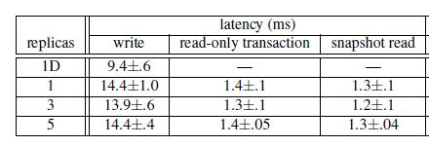
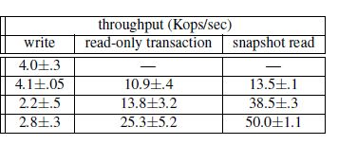
Performance
Mean and standard deviation over 10 runs

Slide 37
Conclusions
Concretize clock uncertainty in time APIs
  Known unknowns are better than unknown unknowns
  Rethink algorithms to make use of uncertainty
Stronger semantics are achievable
  Greater scale != weaker semantics
Notes:
Donald rumsfield

Slide 38
Thanks
Reference:
  Spanner: Google’s Globally-Distributed Database
  Slides on spanner by Google in OSDI 2012 talk
  http://research.google.com/archive/spanner.html
Questions?

