Slide 1
Reverse Query Processing Carsten Binnig, Donald Kossmann and Eric Lo ICDE 2007
Presented by
Ankit Shah
Bikash Chandra

Slide 2
Motivation
Testing database applications requires generating test databases
Test Database is required for
carrying out functional tests on the new application logic
testing the performance of a RDBMS for any user deﬁned benchmark queries
debugging SQL queries

Slide 3
Motivation
A number of commercial tools are available that automatically generate test databases.
However,
the databases generated by these tools are not adequate for testing a database application.
If an application query is executed against such a synthetic database, then the result of that application query is likely to be empty or contain weird results

Slide 4
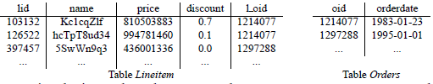
Motivation
Sample Query
SELECT orderdate, SUM(price*(1-discount))
FROM Lineitem, Orders WHERE l_oid=oid
GROUP BY orderdate
HAVING AVG(price*(1-discount))<=100
AND SUM(price*(1-discount))>=150;
Test Database generated by commercial tool

Slide 5
Motivation
Some tools allow the user to specify constraints for generating test databases (e.g., domain ), those constraints are defined on the base tables only. So, the query results can’t be controlled directly.
Therefore, those tools can hardly deal with the complexity of SQL and application programs.

Slide 6
Reverse Query Processing (RQP)
Given a Query Q and a Table R, the goal is to find a Database D (a set of tables) such that Q(D) = R.
Based on a reverse relational algebra (RRA).
Each operator of relation algebra has a corresponding operator in RRA
Unlike traditional query processing, iterators in RQP are push-based meaning data processing is started by scanning the query result and pushing each tuple down to the leaves of the query tree.

Slide 7
Problem Statement
Given,
SQL query Q
Schema S_{D} of relational database (including integrity constraints)
Table R
Required : Find a database instance D such that:
R = Q(D)
D is compliant with S_{D} and its integrity constraints

Slide 8
Problem Statement
There are many different database instances which can be generated for a given Q and R.
Depending on the application, some of these instances might be better than others.
For functional testing, RQP should generate a small D that satisfies the correctness criteria ( R=Q(D) ), so that the running time of tests is reduced.

Slide 9
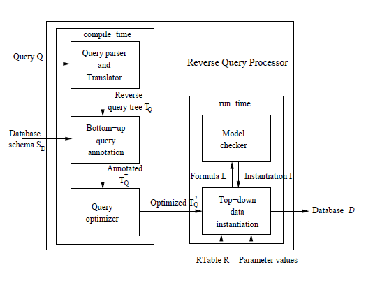
RQP Architecture

Slide 10
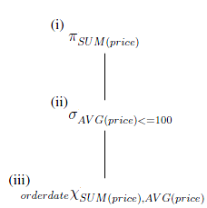
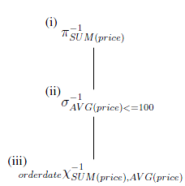
RQP Architecture …
Parser
Traditional query tree is translated into a reverse query tree.
In the reverse query tree, each operator of the relational algebra is translated into a corresponding reverse relational algebra operator.

Slide 11
RQP Architecture …
2.Bottom Up Query Annotation
annotates each operator of a reverse query tree with an input schema S^{IN} and an output schema S^{OUT} .
3. Query Optimization
Query optimization for RQP can be much more aggressive Traditional query optimization because it is acceptable to generate a different D for the same input as long as the criterion R = Q(D) is fulfilled.
not important to carry out join reordering because joins in RQP are mostly cheap.

Slide 12
RQP Architecture …
4. Top Down Data Instantiation
a physical implementation for each operator of the reverse relational algebra that is used for reverse query execution.
For parameterized query top-down data instantiation can use the same annotated reverse query tree for each set of parameter settings

Slide 13
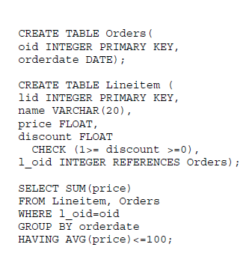
RQP Example
The database schema of the Lineitem and Orders tables with their integrity constraints
SQL query that asks for the sales (SUM(price)) by orderdate.

Slide 14
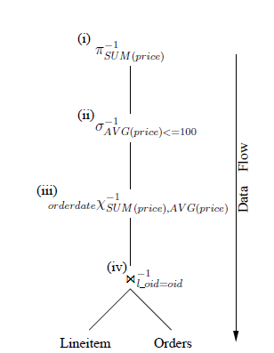
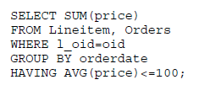
RQP Example

Slide 15
Reverse Relational Algebra
Each operator of the relational algebra has a corresponding operator in the reverse relational algebra.
the operators of the RRA are marked as op⁻¹ (e.g reverse of  is  ⁻¹ )
the following equation holds for all operators and all valid tables R:
op(op⁻¹(R)) = R

Slide 16
Reverse Relational Algebra
Reverse operators in RRA should not be confused with inverse operators because op⁻¹(op(S)) = S is not necessarily true for some valid tables S.
_{pid>50}
⁻¹_{pid>50}
Pid | pname
10 | ABC
60 | DEF
100 | GHI
Pid | Pname
60 | DEF
100 | GHI
Pid | pname
1 | XYZ
60 | DEF
100 | GHI

Slide 17
Reverse Relational Algebra …
An operator of the RRA has exactly one input and produces 0 or more output relations.
Basic Operators: The reverse variants of the basic operators of the (extended) relational algebra form the basis of the RRA. All other operators of the RRA can be expressed as compositions of these basic operators
Algebraic Laws: The relational algebra has laws on associativity, commutativity, etc. on many of its operators. Some laws are not applicable for the RRA (e.g., applying projections before joins).

Slide 18
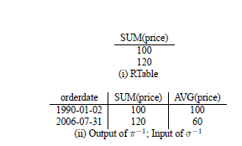

Reverse Projection (  ⁻¹)
The reverse projection operator (  ⁻¹) generates new columns according to its output schema.

Slide 19
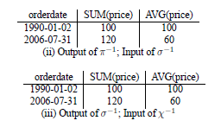

Reverse Selection (  ⁻¹)
Returns a superset of input.
Error is returned if input does not match the selection predicate.
If additional tuple are generated than they must satisfy the negation of the selection predicate.

Slide 20
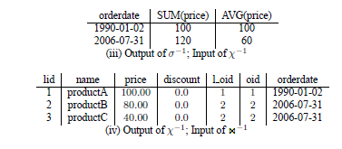

Reverse Aggregation ( x⁻¹)
The reverse aggregation operator (x⁻¹) generates
columns according to database schema.
The reverse aggregation operator generates additional rows in order to meet all constraints of its aggregate functions
Returns error if not able to ensure x(x⁻¹ (R)) = R

Slide 21

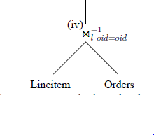
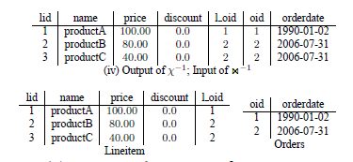
Reverse Join ( )
It takes one relation as input and generates two output relations.
The reverse join makes sure that its outputs meet the specified output schemas

Slide 22
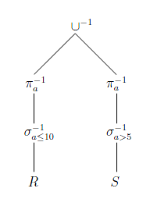
Reverse Union (U⁻¹)
The reverse union operator (∪−1) takes one relation as input and generates two output relations.
According to the constraints of the output schemas, the reverse union distributes the tuples of the input relation to the corresponding output relations.

Slide 23
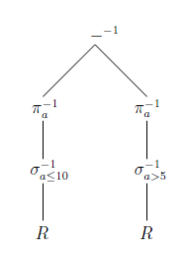
Reverse Minus ( ⁻¹)
Input tuples are always routed to the left branch or result in an error.
it is possible that the Reverse Minus operator ( − ⁻¹ ) generates new tuples for both branches in order to meet all its constraints

Slide 24
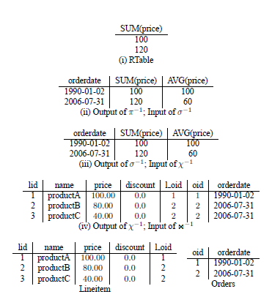
RQP Example

Slide 25
Bottom-up Query Annotation
The bottom-up query annotation phase annotates each operator (op⁻¹ ) of a reverse query tree with an output schema S^{OUT} and an input schema S^{IN}.
Each operator can check the correctness of the input and ensure that it generates valid output
Both schemas (input and output) are defined by
(1) the attributes A (names and data types)
(2) the integrity constraints C, and
(3) the functional dependencies F
(4) join dependencies J

Slide 26
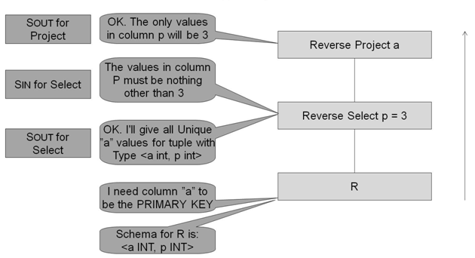
Bottom-up Query Annotation
Schema of R <a int primary key, p int>
Select a from R where p=3

Slide 27
Top-down Data Instantiation
The Top-down data instantiation component interprets the optimized reverse query execution plan using an RTable R and possibly query parameters as input.
The iterators are push-based.
The whole data instantiation is started by scanning the RTable and pushing each tupleof the RTable one at a time to the children operators
A push-based model is required because operators of the RRA can have multiple outputs

Slide 28
Top-down Data Instantiation
All iterators have the same interface which contains the following three methods:
open(): prepare the iterator for producing data as in traditional query processing;
pushNext(Tuple t): (a) receive a tuple t (b) check if t satisfies the input schema SIN of the operator, (c) produce zero or more output tuples, and (d) for each output tuple, call the pushNext method of the relevant children operators;
close(): clean up everything as in traditional query processing.

Slide 29
Model Checker*
Given a model of a system, tests automatically whether this model meets a given specification.
Mathematical formulation of the constraints and the system – Predicate Logic.
Often generate a model that satisfy or does not satisfy a given formula.
Examples
CVC3
Alloy
Not in the paper

Slide 30
CVC3 Example*
Input file for cvc3
% Possible Values for person data type
DATATYPE
PERSON = P1|P2|P3|P4|P5
END;
%Possible values for CAR data type
DATATYPE
CAR= C1|C2|C3|C4|C5
Not in the paper

Slide 31
CVC3 Example*
Query
CHECKSAT R[1].0=P1 AND R[1].1=C1;
Response
Unsatisfiable
Query
Query R[1].0=P1 AND R[1].1=C1;
Countermodel;
Response
ASSERT (R[1]=(P2,C1));
ASSERT (R[1]=(P1,C2));
ASSERT (R[1]=(P3,C3));
ASSERT (R[1]=(P4,C4));
ASSERT (R[1]=(P5,C5)); Not in the paper

Slide 32
Top-down Data Instantiation
SPQR is a RQP prototype for functional testing.
The physical algebra of SPQR tries to keep the generated database as small as possible.
In order to generate values for new columns, the reverse operators calls the decision procedure of a model checker
The model checker is treated as a black box. It takes a constraint formula as input and returns one of the possible data instantiations on all variables as output

Slide 33
SQPR example
Example:
Query: select A from R where A + B < 30
Consider the reverse projection operator.
Input schema
Call Model Checker with
the formula A=3 & A+B<30
Instantiated data
A
3
Reverse Projection
Reverse Select A+B<30
A | B
3 | 20
R

Slide 34
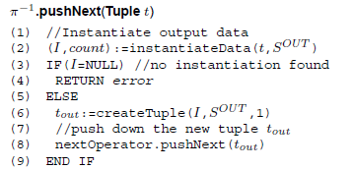
Reverse Projection in SPQR

Slide 35
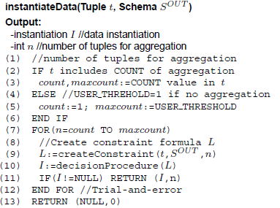
Instantiate Data in SQPR

Slide 36
An example
For the tuple of the RTable (SUM(price) = 120), thefollowing formula is generated for n = 1,where n is number of tuples to be generated.
sum_price=120 &
avg_price<=100 &
sum_price=price1 &
avg_price=sum_price/1
This formula is given to the decision procedure of the model checker. The model checker cannot find values for the variables price1 and avg price that meet all constraints.
price
price1

Slide 37
Example contd..
In the second attempt for n = 2, the following formula is passed to the decision procedure:
sum_price=120 &
avg_price<=100 &
sum_price=price1+price2 &
avg_price=sum price/2
The decision procedure can now find an instantiation:
sum_price=120, avg_price=60,
price1=80, price2=40,
price
price1
price2
price
80
40

Slide 38
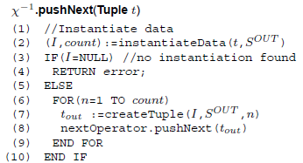
Reverse Aggregation in SPQR

Slide 39
Processing Nested Queries for SQPR
SPQR uses the concept of nested iterations in a reverse way
The inner subquery can be thought of as a reverse query tree whose input is parameterized on values generated for correlation variables of the outer query
Reverse processing of nested queries is expensive having quadratic complexity with the size of the RTable

Slide 40
Optimization of Data Instantiation
Reverse query processing heavily relies on calls to a model checker. These calls are expensive. In the worst case, the cost is exponential to the size of the formula.
Independent attribute: An attribute a is independent with regard to an output schema S^{OUT} of an operator iff S^{OUT} has no integrity constraints limiting the domain of a and a is not correlated with another attribute a′ (e.g. by a> a′ ) which is not independent.
For e.g. S^{OUT} (A,B,C)
A=3 & A+B < 20 then C can be considered as a independent attribute

Slide 41
Optimization of Data Instantiation
Constrictive independent attribute: An attribute a is constrictive independent, if it is independent with regard to an output schema S^{OUT} disregarding certain optimization dependent integrity constraints.
For e.g. S^{OUT} (A,B,C)
A=3 & A+B < 20 & C is unique, then C can be considered as a constrictive independent attribute.

Slide 42
Optimization of Data Instantiation
Default-value Optimization: Assigns a default (fixed) value to an independent attribute a depending on the type of the attribute.
Unique-value Optimization: Assigns a unique increment counter value to a constrictive independent attribute a, which is only bound by unique or primary key constraints.
Attributes which use this optimization are not included in the constraint formula.

Slide 43
Optimization of Data Instantiation
Single-value Optimization:
Can be applied to a constrictive independent attribute a which is only bound by CHECK constraints.
Only included in a constraint formula, the first time the top-down phase needs to instantiate a value for them. The instantiated value is then reused.

Slide 44
Optimization of Data Instantiation
Aggregation-value Optimization: Can be applied to constrictive independent attributes a which are involved in an aggregation.
If SUM(a:float) is an attribute in the operator’s input schema, MIN(a) and MAX(a) are not in the operator’s input schema. Instantiate a value for a by solving a=SUM(a)/n.
If MIN(a) or MAX(a) are in the operator’s input schema, and n ≥ 3. Use values for MIN(a) or MAX(a) once to instantiate a. Instantiate the other values for a by solving a=(SUM(a)-MIN(a)-MAX(a))/(n-2).
a is of data type integer. We can directly compute a by solving SUM(a)=n1×a1+n2 × a2, where a1=⌊sum(a)/n⌋, a2=⌈sum(a)/n⌉,n1=n − n2 and n2=(SUM(a) modulo n).
If only COUNT(a) is in the operator’s input schema,a can be set using the default-value optimization.

Slide 45
Optimization of Data Instantiation
Count heuristics: Does not find instantiations. But reduces the number of attempts for guessing the number of tuples to reverse process an aggregation by constraining the value of n.
Heuristics used are:
If SUM(a) and AVG(a) are attributes of the operator’s input schema, then n=SUM(a)/AVG(a).
If SUM(a) and MAX(a) are attributes of the operator’s input schema, then n ≥ SUM(a)/MAX(a) (if SUM(a) and MAX(a) ≥ 0; if SUM(a) and MAX(a) ≤ 0 use n ≤ SUM(a)/MAX(a)).
If SUM(a) and MIN(a) are attributes of the operator’s input schema, then n ≤ SUM(a)/MIN(a) (if SUM(a) and MIN(a) ≥ 0; if SUM(a) and MIN(a) ≤ 0 use n ≥ SUM(a)/MIN(a)).

Slide 46
Optimization of Data Instantiation
Tolerance on precision: Tolerances can be exploited in order to speed up model checking. Rather than, say, specifying a= 100, a more flexible constraint 90 ≤ a ≤ 110 can be used.
Only legal for certain applications.
Set to 0 percent by default.
Memoization: Cache calls to the model checker. Useful for reverse operator that often solve similar constraints and carry out the same kind of guessing.
The results of guessing for the  ⁻¹ operator can be re-used by the x⁻¹ operator

Slide 47
Performance Experiments and Results
The SPQR system was implemented in
Java 1.4
installed on Linux AMD Opteron 2.2 GHz Server
4 GB of main memory
As a backend database system PostgreSQL 7.4.8 was used.
Cogent as a decision procedure was used.
SPQR was configured to allow 0 percent tolerance

Slide 48
Performance Experiments and Results
Table 1 shows the size of the databases generated by SPQR for all queries on the three scaling factors ( 100M , 1G, 10G).

Slide 49
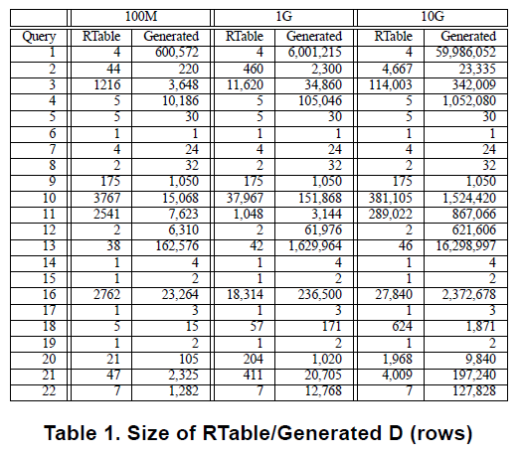
Performance Experiments and Results

Slide 50
Performance Experiments and Results
Queries which include an explicit or implicit COUNT value in R, the size of the generated database depends on that COUNT value.
For those queries which do not define a COUNT value, only a small number of tuples are generated

Slide 51
Performance Experiments and Results
Table 2 shows the running times of SPQR for the TPC-H benchmark for three scaling factors (0.1,1,10).
#M-Inv - number of times the decision procedure is invoked.
MC- time spent by the decision procedure of the model checker.
QP - time spent processing tuples in SPQR.
DB - time that is spent by PostgreSQL in order to generate new tuples.

Slide 52
Performance Experiments and Results
For SF=0.1, the Total running time is up to one hour in worst case but most queries can be reverse processed in a few seconds.
Count heuristic optimization was very useful as none of the 22 queries required any trial-and-error.
For all those queries which have higher running times for a larger scaling factor, the running time increased linearly

Slide 53
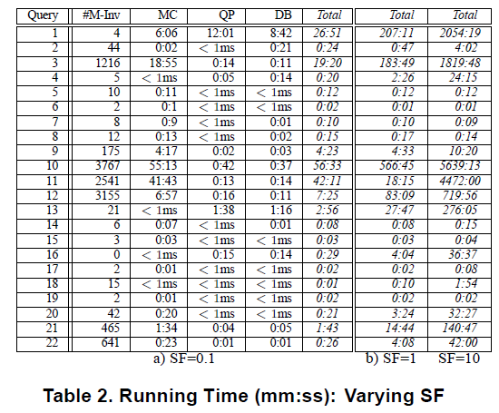
Performance Experiments and Results

Slide 54
Conclusion
This work presented a new technique called reverse query processing or RQP.
SPQR is a fullfledged RQP system for SQL for generating test databases for functional testing of database applications.
SPQR scales linearly with the size of the database that is generated for the TPC-H benchmark.

Slide 55
Massive Stochastic Testing of SQL Don Slutz Microsoft Research

Slide 56
Motivation
Deterministic testing of SQL database systems is human intensive.
The input domain, all SQL statements, from any number of users, with all states of the database, is gigantic.
These test libraries cover an important, but tiny, fraction of the SQL input domain.
Large increases in test coverage must come from automating the generation of tests.

Slide 57
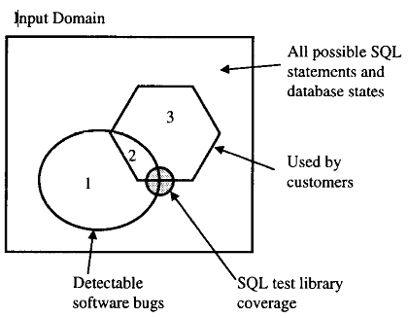
Test Coverage Problem

Slide 58
Random Generation of SQL (RAGS)
RAGS is an experiment in massive stochastic testing of SQL systems.
Its main contribution is to generate entire SQL statements stochastically
The problem of validating outputs remains a tough issue. Output comparisons for different vendor’s database systems proved to be extremely useful, but only for the small set of common SQL.
RAGS could steadily generate errors in released SQL products.

Slide 59
Generating Databases for Query Workloads Eric Lo Nick Cheng Wing-Kai Hon

Slide 60
QAGen vs MyBenchmark
QAGen - ofﬂine test database generator designed for purpose of generation of test databases.
QAGen every time takes only one test case as input and generates an independent test database that is speciﬁc for that test case. So we need to maintain separate test databases for each query.
MyBenchmark takes a set of annotated parameterized queries as input, and generates a minimal set of database instances with the same query cardinality and data distribution assurance as QAGen does.
Tests on DBMSs can be carried out more space efﬁciently.

Slide 61
MyBenchmark Applications
Stress testing database applications :-MyBenchmark can be used to generate a variety of synthetic workloads to stress the application.
A developer may use MyBenchmark to generate a 1GB database that guarantees all the application queries return millions of rows. This Allows the developers to test the functional and performance limits of their applications.

Slide 62
MyBenchmark Applications
Benchmarking requires the generation of benchmark databases.
Existing benchmarks such as TPC benchmarks may not 100% reﬂect the performance of a DBMS with respect to an enterprise’s environment because of the differences in the schemas between TPC benchmarks and the enterprise’s DB applications.
By using MyBenchmark, an enterprise is able to study the performance of a DBMS with respect to its own DB applications

Slide 63
References
Reverse Query Processing Carsten Binnig, Donald Kossmann and Eric Lo, ICDE 2007.
Reverse Query Processing (Technical Report) Carsten Binnig, Donald Kossmann and Eric Lo, ETH Zurich, 2007
QAGen: Generating Query-Aware Test Databases Carsten Binnig, Donald Kossmann, Eric Lo and M. Tamer. Ozsu, SIGMOD 2007
Massive Stochastic Testing of SQL Donald, R. Slutz, VLDB 1998: 618-622
Generating Databases for Query Workloads, Eric Lo, Nick Cheng, Wing-Kai Hon, VLDB Endowment 2010

