Slide 1
Plan Bouquets: A Fragrant Approach to Robust Query Processing
Plan 1
Plan 2
Plan 5
Plan 3
Plan 4
Jayant R. Haritsa
Database Systems Lab
Indian Institute of Science, Bangalore

Slide 2
Talk Theme
Declarative query processing with performance guarantees has been a highly desirable but equally elusive goal for the database community over the last three decades. I will present a conceptually new approach, called “plan bouquets”, to address this classical problem.
(Joint work with Anshuman Dutt, IISc PhD student)

Slide 3
Sample Relational Database: Manufacturing
Supplier
Region
PartSupp
Nation
Orders
Part
Customer
Lineitem
Declarative
select *
from lineitem, orders, part
where p_partkey = l_partkey and
l_orderkey = o_orderkey and
p_retailprice < 1000
SQL query for
Complete details of orders for cheap parts
Algebraic equivalent: σ_{p_retailprice < 1000} (part ⨝_{partkey} lineitem ⨝ _{orderkey} orders)

Slide 4
Query Execution Plan
Ordered (imperative) sequence of steps to process the data
Enormous number of semantically equivalent alternative plans
for a query with N relations, there are at least N! join orders
multiple algorithmic choices at each node in the plan (e.g. Join operator: Nested Loops, Sort Merge, Hash, Index, …)
⨝ (l_orderkey = o_orderkey)
⨝ (p_partkey = l_partkey)
⨝ (p_partkey = l_partkey)
orders
⨝ (l_orderkey = o_orderkey)
part
σ (p_retailprice < 1000)
part
lineitem
orders
lineitem
σ (p_retailprice < 1000)

Slide 5
Cost-based Query Optimization
Determining the most efficient plan to execute an SQL query
Huge performance difference between good and bad plans
Only a few good plans
Compare all alternative plans with a performance framework consisting of
operator cardinality model
estimate the quantity of data processing at each operator
expected to accurately estimate the number of tuples at each operator
summary statistics through histograms
operator cost model
estimate the time taken to perform the required data processing
expected to accurately estimate the
time taken to bring a relational page from disk to memory
time taken to process filter condition on a given tuple, etc.

Slide 6
Cardinality Estimation
RDBMS
(EQ)
select *
from lineitem, orders, part
where p_partkey = l_partkey and
l_orderkey = o_orderkey and
p_retailprice < 1000
Statistical Metadata
Query Optimizer
Estimated Join
Cardinality
1.2 x 10⁶
Hash Join
Estimated Join
Cardinality
1.5 x 10⁵
RelScan
1.2 x 10⁶
Hash Join
1.5 x 10⁵
orders
6 x 10⁶
RelScan
4 x 10³
RelScan
Estimated Selection Cardinality
Base Relation Cardinality
6 x 10⁶
lineitem
2 x 10⁴
part

Slide 7
Canonical Query Optimization Framework
Query Optimizer
Optimal [Min Cost] Plan P(Q)
Declarative Query (Q)
Operator Execution Cost
Estimation Model
function of (Hardware, DB Engine)
e.g. NL Join
= |R_{outer}| + |R_{outer}| x |R_{inner}|
Operator Result Cardinality Estimation Model function of (Data Distributions, Data Correlations)
e.g. Output Cardinality of Join = $\left|t_{outer}\right|×\left|t_{inner}\right| ×$ join filter factor

Slide 8
Run-time Sub-optimality
The supposedly optimal plan-choice from the query optimizer may actually turn out to be highly sub-optimal when the query is executed with this plan. This adverse effect is due to errors in:
(a) cost model → limited impact, < 30 %
(b) cardinality model → huge impact, orders of magnitude
Coarse statistics, attribute value independence (AVI) assumption, multiplicative error propagation, outdated statistics, query construction, …

Slide 9
Proof by Authority [Guy Lohman, IBM Almaden]
Snippet from his recent Sigmod blog post on
“Is Query Optimization a “Solved” Problem?”

Slide 10
Selectivity Estimation Error (EQ)
(EQ)
select *
from lineitem, orders, part
where p_partkey = l_partkey and
l_orderkey = o_orderkey and
p_retailprice < 1000
Compile time estimate
1.2 * 10⁶
Optimizer assumes orders are equally likely for all prices
4 x 10³
lineitem
6 x 10⁶
part
2 x 10⁴
Run time situations
There are no orders for cheap parts
All the orders correspond to cheap parts
0
6 x 10⁶
Huge overestimate
4 x 10³
lineitem
6 x 10⁶
4 x 10³
lineitem
6 x 10⁶
Huge
underestimate
part
2 x 10⁴
part
2 x 10⁴

Slide 11
Prior Research (lots!)
Sophisticated estimation techniques
SIGMOD 1999, VLDB 2001, VLDB 2009, SIGMOD 2010, VLDB 2011, …
Selection of Robust Plans
SIGMOD 1994, PODS 2002, SIGMOD 2005, VLDB 2008, SIGMOD 2010, …
Runtime Re-optimization techniques
SIGMOD 1998, SIGMOD 2000, SIGMOD 2004, SIGMOD 2005, …
Several novel ideas and formulations, but lacked performance guarantees

Slide 12
Talk Summary
We present “plan bouquets”, a query processing technique that completely eschews making estimates for error-prone selectivities (normalized cardinalities [0% to 100%])
Plan Bouquet Approach: run-time discovery of selectivities using a compile-time selected bouquet of plans
provides worst case performance guarantees wrt omniscient oracle that knows the correct selectivities
e.g. for a single error-prone selectivity, relative guarantee of 4
empirical performance well within guaranteed bounds on industrial-strength environments

Slide 13
Problem Framework

Slide 14
Selectivity Dimensions
100%
Example Query: EQ
select *
from lineitem, orders, part
where p_partkey = l_partkey and
l_orderkey = o_orderkey and
p_price < 1000
sel (part ⨝ lineitem)
SS – Selectivity Space
0%
sel (σ (part))
100%
sel (lineitem ⨝ orders)
100%

Slide 15
Performance Metrics
100%
sel (part ⨝ lineitem)
q_{e} – estimated selectivity location in SS
q_{a} – actual run-time location in SS
P_{oe} – optimal plan for q_{e}
P_{oa} – optimal plan for q_{a}
q_{a}(75%, 62%, 85%)
q_{e}(5%, 2%, 8%)
0%
sel (σ (part))
100%
$$SubOpt\left(q_{e}, q_{a}\right)= \frac{cost(P_{oe}, q_{a})}{cost(P_{oa}, q_{a})} [1, ∞)$$
100%
sel (lineitem ⨝ orders)
$$MaxSubOpt \left(MSO\right)=MAX\left[SubOpt\left(q_{e}, q_{a}\right)\right] ∀q_{e}, q_{a}∈SS$$
$$AvgSubOpt \left(ASO\right)=AVG\left[SubOpt\left(q_{e}, q_{a}\right)\right] ∀q_{e}, q_{a}∈SS$$

Slide 16
Main Assumptions
Plan Cost Monotonicity (Mandatory)
Perfect Cost Model (relaxed at end of talk)
Independent SS Dimensions (ongoing work)
PCM:
For any plan P and distinct selectivity locations q₁ and q₂
cost (P, q₁) < cost (P, q₂) if q₁ $≺$ q₂ (q₁ is dominated by q₂ in SS)
Cost(P, q₂) =100
q₂
cost(P, q_{i}) < 100

Slide 17
Current Optimizer Behavior on One-dimensional SS

Slide 18
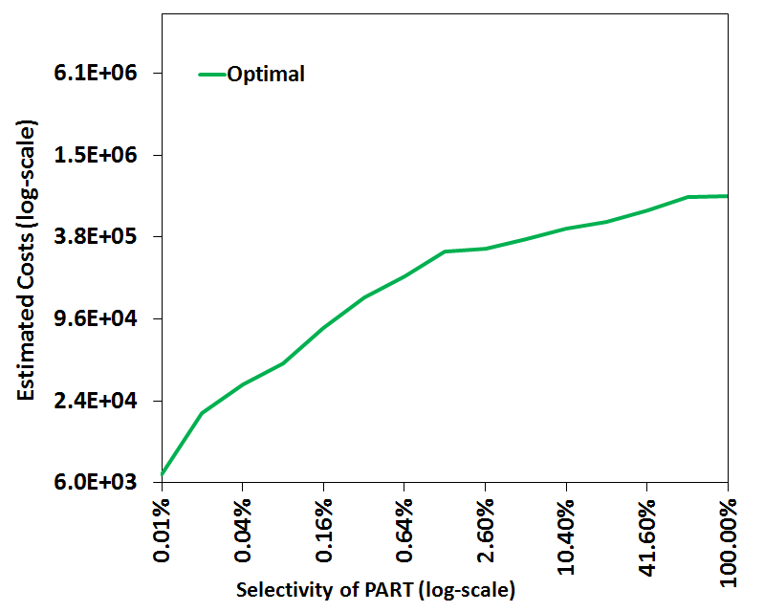
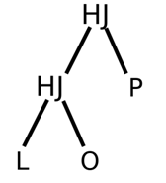
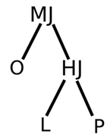
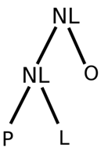
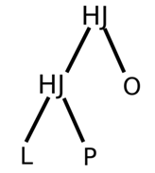
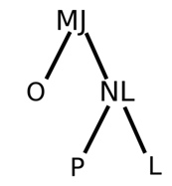
Parametric Optimal Set of Plans (POSP)
( Parametric version of EQ)
select *
from lineitem, orders, part
where p_partkey = l_partkey and
l_orderkey = o_orderkey and
SEL (PART) = $1
log-scale
P5
P4
P3
P2
Using Selectivity Injection
P1
NL: Nested Loop Join
MJ: Merge Join
HJ: Hash Join
L: Lineitem
O: Orders
P: Part
log-scale
Notes:
JH: Keep single predicate
Bring plan also one by one : done

Slide 19
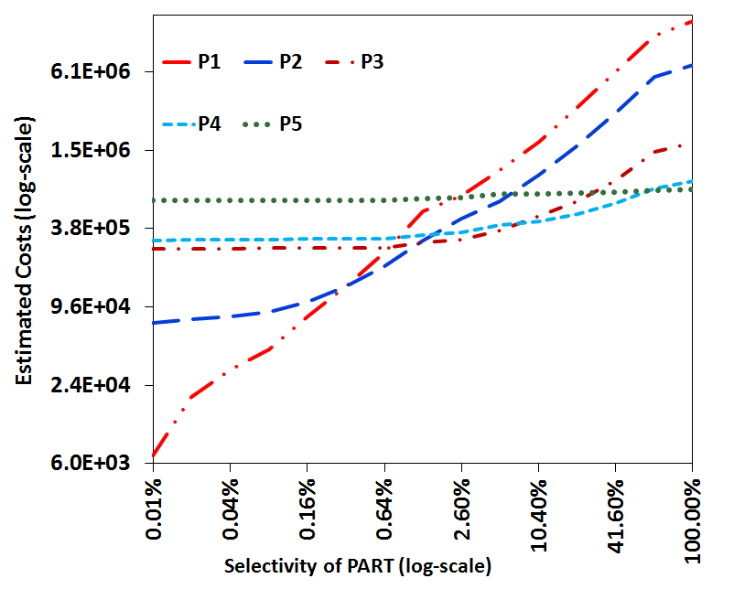
POSP Performance Profile (across SS)
P5
P4
P3
P2
P1

Slide 20
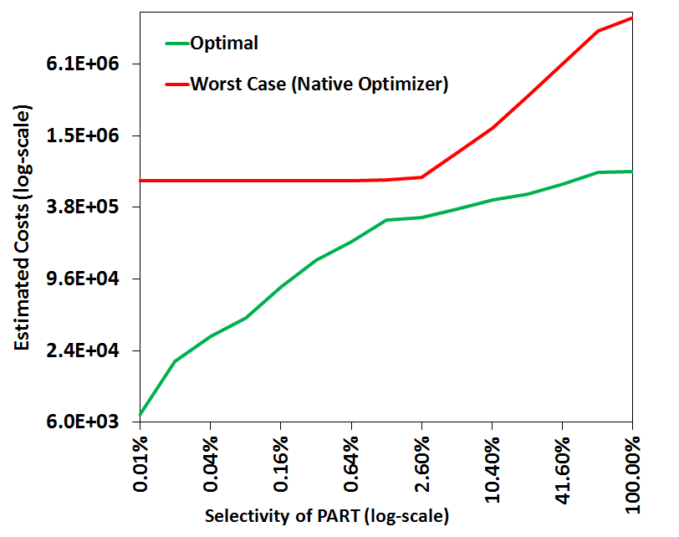
Sub-optimality Profile (across SS)
P1
SubOpt
(1%, 99%)
= 20
P5
P5
SubOpt
(80%, 0.01%)
= 100
P4
P3
P2
MaxSubOpt = 100
AvgSubOpt = 1.8
P1

Slide 21
Bouquet Approach in 1D SS

Slide 22
Bouquet Identification
Step 1: Draw cost steps with cost-ratio r=2 (geometric progression).
Step 2: Find plans at intersection of optimal profile with cost steps
IC7
IC6
IC5
IC4
IC3
IC2
IC1
P5
P3
P2
P1
P1
P1
P1
Bouquet = {P1, P2, P3, P5}

Slide 23
Bouquet Execution
Let q_{a} = 5%
(1) Execute P1
with budget IC1(1.2E4)
(2) Throw away results of P1
Execute P1
with budget IC2(2.4E4)
(3) Throw away results of P1
Execute P1
with budget IC3(4.8E4)
(4) Throw away results of P1
Execute P1
with budget IC2(9.6E4)
(5) Throw away results of P1
Execute P2
with budget IC5(1.9E5)
(6) Throw away results of P2
Execute P3
with budget IC6(3.8E5)
P3 completes with cost 3.4E5
IC7
IC6
IC5
IC4
IC3
IC2
IC1
P5
P3
P2
P1
q_{a} = 5%

Slide 24
Stupid Idea ?
Yes! Very stupid!
We are expending lots and lots of wasted effort at both planning time (producing PIC) and at execution time (throwing away work) ! Certainly a recipe for disaster …
But, with careful engineering, can actually be made to work surprisingly well → rest of talk

Slide 25
Bouquet Execution
Let q_{a} = 5%
(1) Execute P1
with budget IC1(1.2E4)
(2) Throw away results of P1
Execute P1
with budget IC2(2.4E4)
(3) Throw away results of P1
Execute P1
with budget IC3(4.8E4)
(4) Throw away results of P1
Execute P1
with budget IC2(9.6E4)
(5) Throw away results of P1
Execute P2
with budget IC5(1.9E5)
(6) Throw away results of P2
Execute P3
with budget IC6(3.8E5)
P3 completes with cost 3.4E5
Bouquet Cost = 3.4 E5 (P3) +
1.92 E5 (P2) +
0.96 E5 (P1) +
0.48 E5 (P1) +
0.24 E5 (P1) +
0.12 E5 (P1)
= 7.1 E5
SubOpt (*, 5%) = 7.1/3.4 = 2.1
With obvious optimization
SubOpt(*, 5%) = 6.3/3.4 = 1.8
IC7
IC6
IC5
IC4
IC3
IC2
IC1
P5
P3
P2
P1
q_{a} = 5%

Slide 26
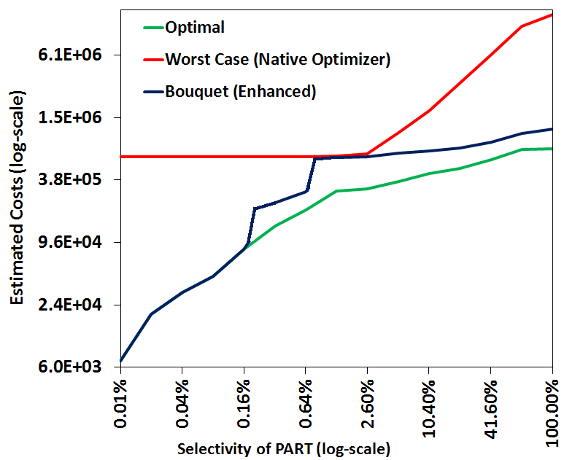
Bouquet Performance (EQ)
Native Optimizer
MaxSubOpt = 100
AvgSubOpt = 1.8
Bouquet (Enhanced)
MaxSubOpt = 3.1
AvgSubOpt = 1.7

Slide 27
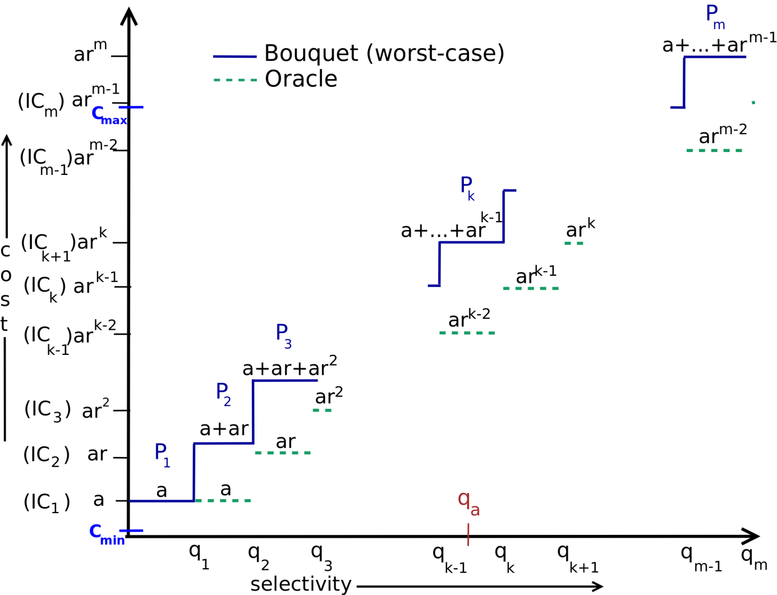
Worst Case Cost Analysis
Bouquet (upper bound)
Optimal (lower bound)
P_{k} would complete within its budget when q_{a} ϵ (q_{k-1}, q_{k}]

Slide 28
1D Performance Bound
$$C_{bouquet}\left(q_{k−1}, q_{k}\right]=cost\left(IC_{1}\right)+cost\left(IC_{2}\right)+ …+cost\left(IC_{k−1}\right)+cost(IC_{k})$$
$$= a + ar + …+ ar^{k−2 } + ar^{k−1}$$
$$= \frac{ a(r^{k} −1)}{(r−1)}$$
$$C_{optimal}\left(q_{k−1}, q_{k}\right] ≥ar^{k−2}$$
(Implication of PCM)
Reaches minima at r = 2
➔ MSO = 4
Best performance achievable by any deterministic online algorithm!
Notes:
JH: Formatting is poor : done

Slide 29
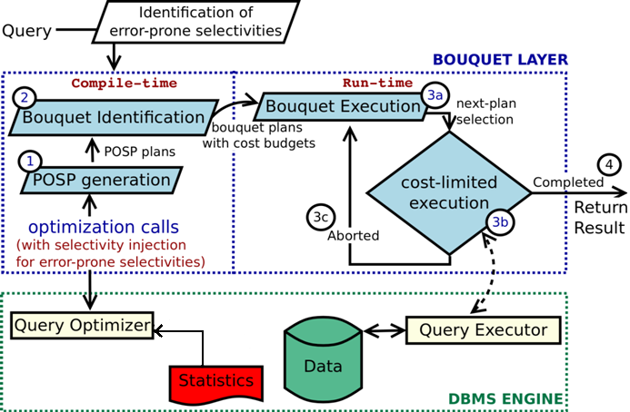
Bouquet Architecture

Slide 30
Connection to Online Bidding Problem
There is an object D with hidden value V in range (1, 100)
Your task is to bid for D until you acquire it under the following rules:
If the bid B < V, then you forfeit B, and bid again
If the bid B ≥ V, then you pay B and acquire D
Your goal is to minimize the worst-case ratio of your total payment to the object value, i.e. min ( (B₁ + B₂ + … + B_{k}) / V)
Bid doubling algorithm is best possible choice
Notes:
JH: Formatting is poor : done

Slide 31
Bouquet Approach in 2D SS

Slide 32
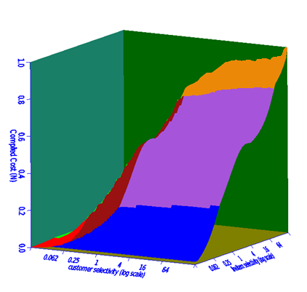
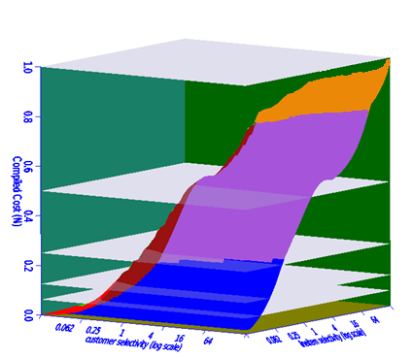
2D Bouquet Identification
Cost
(normalized)
Isocost Contours
Plans
Isocost Planes
Cost
Plans
Multiple Plans per contour
sel-X
sel-Y
Notes:
Fix PCM violation in these pics using paint : done

Slide 33
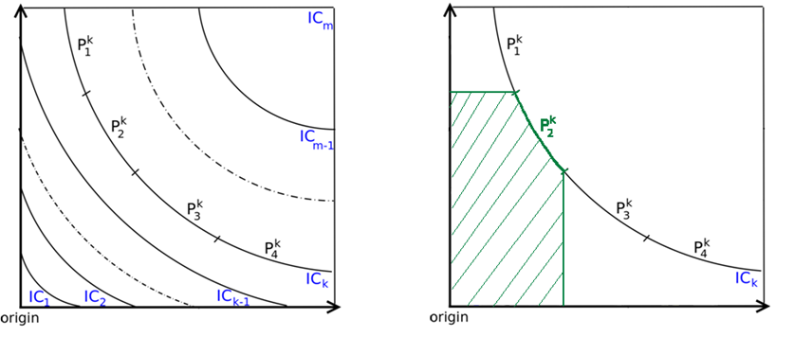
Characteristics of 2D Contours
s
e
l
-
Y
s
e
l
-
Y
sel - X
sel - X
2D contours
Hyperbolic curves
Multiple plans per contour
Third quadrant coverage (due to PCM)
P₂^{k} can complete any query with actual selectivities(q_{a}) in the shaded region within cost(IC_{k})
Notes:
Mention Cmax and Cmin
Make the bottom thing a callout : done

Slide 34
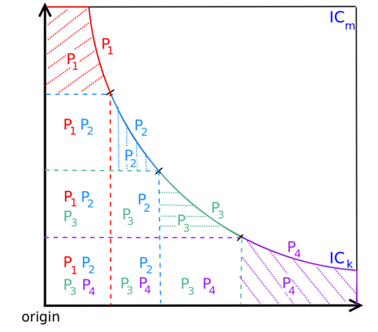
Crossing 2D Contours
Covered by only one plan in contour
Covered by all plans in contour
s
e
l
-
Y
sel - X
⇒ Entire set of contour plans must be executed to fully cover all locations under IC_{k}
Notes:
Highlight the region being covered : done

Slide 35
2D Performance Analysis
When q_{a} ϵ (IC_{k-1}, IC_{k}]
Number of plans on i^{th} contour
$$C_{bouquet}\left(q_{a}\right)= \sum_{i=1}^{k}{[n_{i} ×cost\left(IC_{i}\right)]}$$
ρ = max(n_{i})
$$C_{bouquet}\left(q_{a}\right) ≤ ρ ×\sum_{i=1}^{k}{cost\left(IC_{i}\right)}$$
$${SubOpt}_{bouquet}\left(q_{a}\right)=4ρ$$
(Using 1D Analysis)
Bound for N-dimensions:
$${SubOpt}_{bouquet}\left(q_{a}\right)=4 × ρ_{ _{ICsurface} }$$
Notes:
JH: Need to make colors consistent across slides! Keep font to be Arial throughout. : see
JH: Give nD analysis at bottom

Slide 36
Dealing with large ρ
In practice, ρ can often be large, even in 100s, making the performance guarantee of 4ρ impractically weak
Reducing ρ
Compile Time:
Anorexic POSP reduction [VLDB 2007]
Run Time:
Explicit Monitoring of Selectivity Lower Bounds
Spilling-based Execution

Slide 37
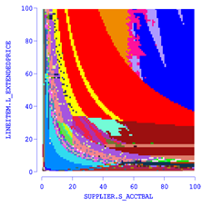
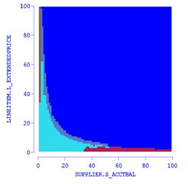
1) Reducing ρ with Anorexic Reduction
Collapse a large set of POSP plans on a selectivity space into a reduced cover that provides performance within a (1+ λ) factor of the optimal at all locations in the ESS. With λ = 0.2, invariably obtain a small-sized (< 10) cover.
Reduced to 5 plans
76 plans
Notes:
JH: Increase sizes of pictures
76 in left figure - try
Put contours to

Slide 38
MSO guarantees (compile time)
Query (dim) | ρ_{POSP} | MSO Bound (POSP) = 4ρ_{POSP} | ρ_{reduced} (λ=0.2) | MSO Bound (reduced) = 4ρ_{reduced}(1+λ)
Q5 (3D) | 11 | 44 | 3 | 14.4
Q7 (3D) | 13 | 52 | 3 | 14.4
Q8 (4D) | 88 | 352 | 7 | 33.6
Q7 (5D) | 111 | 444 | 9 | 43.2
Q15 (3D) | 7 | 28 | 3 | 14.4
Q96 (3D) | 6 | 24 | 3 | 14.4
Q7 (4D) | 29 | 116 | 4 | 19.2
Q19 (5D) | 159 | 636 | 8 | 38.4
Q26 (4D) | 25 | 100 | 5 | 24.0
Q91 (4D) | 94 | 376 | 9 | 43.2
TPC-H
TPC-DS
Notes:
Costgreedy with FPC was used

Slide 39
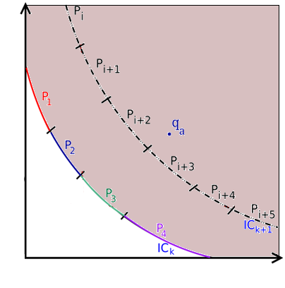
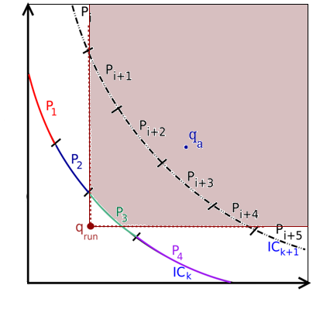
2) Reducing ρ with Selectivity Monitoring
When (cost-limited) execution of plans on IC_{k} does not complete the query, we know that q_{a} does not lie under IC_{k}
but q_{a} could lie anywhere beyond IC_{k}
By monitoring lower bounds on selectivities during execution (q_{run})
q_{a} can only be in first quadrant of q_{run}
(# of tuples at a node can only be greater
than what has already been seen)
➔(P_{i}, P_{i+5} need not be executed)
➔lesser effective value of ρ
s
e
l
-
Y
sel - X

Slide 40
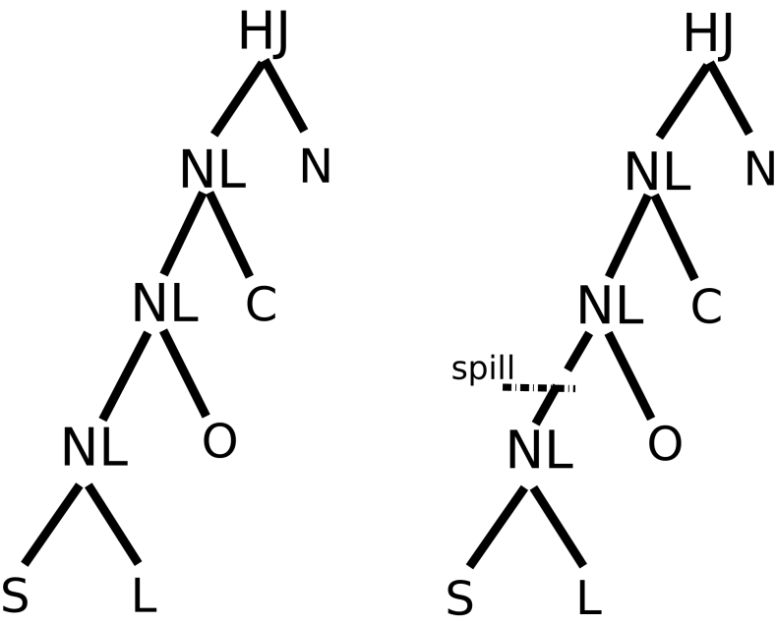
3) Maximizing selectivity movement
The selectivity movement at a node N in the plan tree is increased by “spilling” (dropping without forwarding) the output of N, thereby focusing the entire execution budget on the sub-tree rooted at N.
Spill modification to a plan
To enhance movement of join selectivity SL, the join output tuples are spilled, instead of being forwarded to the upstream nodes.

Slide 41
Empirical Evaluation

Slide 42
Experimental Testbed
Database Systems: PostgreSQL and COM (commercial engine)
Databases: TPC-H and TPC-DS
Physical Schema: Indexes on all attributes present in query predicates
Workload: 10 complex queries from TPC-H and TPC-DS
with SS having upto 5 error dimensions
Metrics: Computed MSO and ASO using Abstract Plan Costing over SS

Slide 43
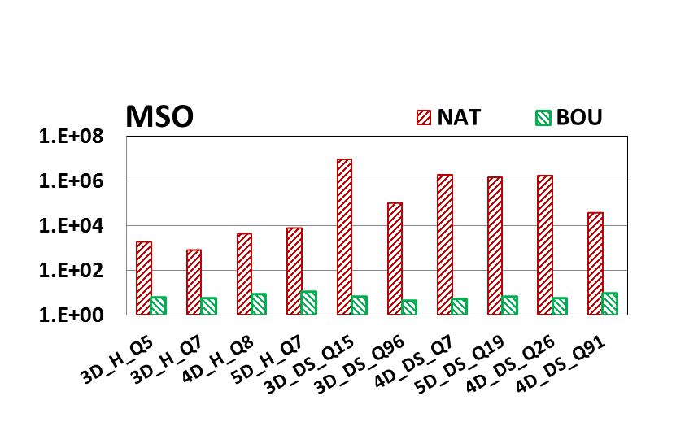
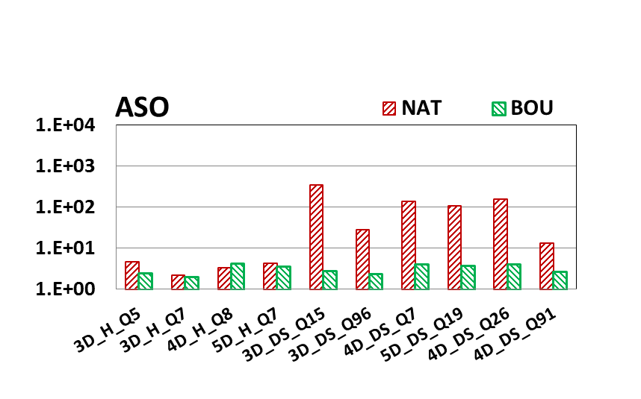
Performance on PostgreSQL
Log-scale
Native Optimizer
Bouquet
MSO
bounds
For many DS queries
MSO improves from ≈10⁶ to ≈10
ASO improves from ≈10² to ≈ 5
ASO not compromised
to reduce MSO!
Notes:
Showing Enhanced bouquet

Slide 44
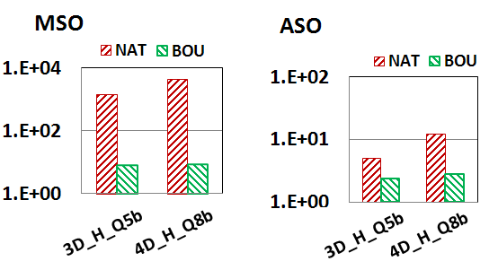
Performance with COM
⇒Robustness improvements not artifact of a specific engine

Slide 45
Sample Savings in Wall-clock Time
Performance Summary | NAT (PostgreSQL) | Enhanced Bouquet | Optimal
 | 600 sec | 69 sec | 16.1 sec
Contour ID | Avg. Execution Time (in sec) | # Executions (Enhanced Bouquet) | Time (in sec) (Enhanced Bouquet)
1 | 0.6 | 2 | 1.2
2 | 3.1 | 2 | 6.2
3 | 4.8 | 3 | 14.4
4 | 6.2 | 3 | 18.6
5 | 12.2 | 1 | 12.2
6 | 16.1 | 1 | 16.1
Total |  | 12 | 68.7
In spite of uncalibrated cost model
Query based on TPC-H Q8

Slide 46
Summary
Plan bouquet approach achieves
bounded performance sub-optimality
using a (cost-limited) plan execution sequence guided by isocost contours defined over the optimal performance curve
robust to changes in data distribution
only q_{a} changes – bouquet remains same
easy to deploy
bouquet layer on top of the database engine
repeatability in execution strategy (important for industry)
q_{e} is always zero, depends only on q_{a}
independent of metadata contents
Important distinction from re-optimization techniques
Notes:
Say that for us – q_e is always 0 and hence we have repeatability

Slide 47
Limitations
Bouquet identification overheads are exponential in the ESS dimensionality
unsuitable for on-the-fly queries
Not suitable for latency sensitive applications
need to wait for final execution to complete
Not suitable for update queries
each partial execution needs to be “garbage-cleaned” on termination
Not suitable for “hinted” queries
multiple plans used
Database scaling requires bouquet re-computation
but robust to changes in data distribution

Slide 48
Incorporating Cost Model Error
If cost model error is bounded by $δ$ , that is
$\frac{cost_{estimated}}{cost_{actual}} ∈ \left[\frac{1}{1+δ}, 1+δ\right]$
then $MSO_{bounded} ≤MSO_{perfect} ∗{\left(1+δ\right)}^{2}$
for δ = 0.4 ➔ MSO_{bounded} ≤ 2 MSO_{perfect}

Slide 49
For more details, visit project website:
dsl.serc.iisc.ernet.in/projects/QUEST
Concepts paper: ACM Sigmod 2014
Demo paper: VLDB 2014

Slide 50
Take Away
Plan 1
Near
Plan 2
Optimal
Query
Execution
Performance
Plan 5
Plan 3
SQL
Query
Plan 4
Do you know the correct selectivities ?

Slide 51
FAQs
Can we use knowledge about selectivities to reduce exploration overheads?
lower bound and upper bound on selectivities can be utilized to limit the selectivity space to be explored
Overheads for high cost query instances?
Current work provides worst case relative guarantees much better than worst-case overheads for native optimizer
we have promising results towards providing absolute guarantees (upcoming)
Update queries
incur additional overheads as partial executions need to be “garbage-cleaned” on termination
Notes:
Replacing relative guarantees with absolute guarantees for high cost queries
-- promising results

Slide 52
Assumptions Revisited
Impact of error in cost model (bounded error)
If $\frac{cost_{estimated}}{cost_{actual}} ∈ \left[\frac{1}{1+δ}, 1+δ\right]$ then $MSO_{bounded} ≤MSO_{perfect} ∗{\left(1+δ\right)}^{2}$
for δ = 0.4 ➔ MSO_{bounded} ≤ 2 MSO_{perfect}
Bouquet identification overheads -- exponential in the SS dimensionality
Current work presented initial ideas for overhead reduction
Ongoing work (bouquet discovery)
Handling dependence among selectivity dimensions
Current work handled dependence among intra-relational predicates
Ongoing work (identify all dependent scenarios)
Perfect Cost model assumption
Canned queries assumption
Independent dimensions assumption
Notes:
JH: Include cost model here

Slide 53
Assumptions Revisited
Impact of error in cost model (bounded error)
If $\frac{cost_{estimated}}{cost_{actual}} ∈ \left[\frac{1}{1+δ}, 1+δ\right]$ then $MSO_{bounded} ≤MSO_{perfect} ∗{\left(1+δ\right)}^{2}$
for δ = 0.4 ➔ MSO_{bounded} ≤ 2 MSO_{perfect}
Bouquet identification overheads -- exponential in the SS dimensionality
Current work presented initial ideas for overhead reduction
Ongoing work (bouquet discovery)
Handling dependence among selectivity dimensions
Current work handled dependence among intra-relational predicates
Ongoing work (identify all dependent scenarios)
Perfect Cost model assumption
Canned queries assumption
Independent dimensions assumption

