Slide 1

Leveraging Re-costing for
Online Optimization of Parameterized Queries
Anshuman Dutt
Joint work with
Vivek Narasayya, Surajit Chaudhuri
Microsoft Research

Slide 2
Sample Relational Database: Manufacturing
Data is stored in a set of relations (i.e. tables) in the form of attributes with constraints and relationships among them
PART
p_partkey | p_type | p_price
ORDERS
o_orderkey | o_totalprice | o_orderdate | o_orderpriority
LINEITEM
l_partkey | l orderkey | l_shipdate

Slide 3

Query Interface
DECLARATIVE ACCESS
  state what you want, not how to get it
  unlike standard (imperative) programming, where you specify every step
Declarative
select *
from lineitem, orders, part
where p_partkey = l_partkey and
o_orderkey = l_orderkey and
p_price < 1000 and
o_orderpriority = ‘HIGH’
Example Query (EQ):
Enumerate high priority orders for cheap parts
  Unspecified:
  Join order [((O L) P) or ((P L) O) …]
  Join technique [Nested-Loops or HashJoin …]

Slide 4
Query Optimization
select *
from lineitem, orders, part
where p_partkey = l_partkey and
o_orderkey = l_orderkey and
p_price < 1000 and
o_orderpriority = ‘HIGH’
Statistical Metadata
RDBMS
Query Optimizer
Card: 1.2 x 10⁶
Hash Join
Card: 1.5 x 10⁵
TableScan + Filter
Card: 1.2 x 10⁶
Hash Join
Card: 1.5 x 10⁵
orders
Card: 4 x 10³
TableScan + Filter
Card: 6 x 10⁶
TableScan
This execution plan is executed over
the data to get the results
Card: 2 x 10⁴
part
Card: 6 x 10⁶
lineitem

Slide 5
Query as seen by optimizer
Query optimizer cares about predicate selectivities (not parameter values) to determine optimal plan
Selectivity = fraction of input tuples that satisfy the predicate
q_{i} (x_{i}, y_{i})
Sel₂
Selectivity (p_price < 1000) = x_{i} ϵ [0,1]
Selectivity ( o_orderpriority = ‘HIGH’) = y_{i} ϵ [0,1]
Sel₁

Slide 6
Parameterized queries
Example parameterized query
select *
from lineitem, orders, part
where p_partkey = l_partkey and
o_orderkey = l_orderkey and
p_price < @Param1 and
o_orderpriority = @Param2
Query instance 1
@Param1 = 100
@Param2 = ’LOW’
Query instance 2
@Param1 = 10000
@Param2 = ’MEDIUM’
Query instance 3
@Param1 = 3000
@Param2 = ’HIGH’
Notes:
We all know that parameterized queries are quite common in database applications. Here I show an example parameterized query over the TPC-DS schema with 2 parameters. We also call this a query template and when the placeholders are replaced with specific values , we call it a ‘query instance’.
Usually query instances are optimized as they arrive to find their best execution plan, but in case of parameterized queries there are interesting trade offs – this is because after optimization we may find that different instances lead to same optimal plan and this looks like an opportunity to avoid the time spent in optimization.
This becomes specifically important for the queries where optimization time is comparable to execution time.
1. Find out the connection between cs_sales_price and i_current_price and what does this query mean?

Slide 7
Query Workload
20
19
Selectivity₂
18
Parametric Query Optimization
(term coined in early 1990s)
5
3
10
13
17
12
14
15
6
4
8
2
16
1
11
7
9
Selectivity₁

Slide 8
Simple approaches
MS SQL Server approach
Sequence
q₁
q₂
q₃
q₄
q₅
q₆
q₇
…
OptAlways | Plan used
Optimize | P₁
Optimize | P₂
Optimize | P₂
Optimize | P₁
Optimize | P₃
Optimize | P₂
Optimize | P₄
…
OptOnce | Plan used
Optimize and store | P₁
Skip optimize | P₁
Skip optimize | P₁
Skip optimize | P₁
Skip optimize | P₁
Skip optimize | P₁
Skip optimize | P₁
…
Issue: Huge optimizer overhead
Risk: Bad plan quality
Many different query instances may lead to same optimal execution plan
Notes:
Here, we see two extreme approaches for optimizing parameterized queries.
The first one is the naïve approach where fresh optimization is done for each individual query instance.
While this ensures that the plan quality is best possible, the optimizer overhead is huge.
The approach used by SQL Server is on the other extreme. Here, the plan is constructed only once and it is stored in the plan cache. Then, the same plan is used for every new query instance. While this ensures maximum saving in optimizer overhead, the savings may be easily nullified if the plan quality turns out to be bad for new instances.
So, we can say that an interesting goal is to strike a balance between these two extreme approaches.

Slide 9
Prior work (upfront identification of plans i.e. offline PQO)
Paper from IIT-B at VLDB 2003

Slide 10
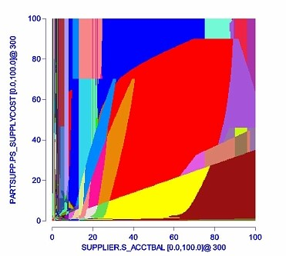
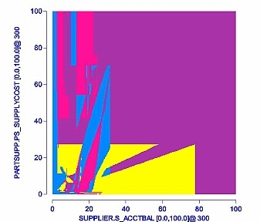
Prior work (upfront identification of plans i.e. offline PQO)
VLDB 2005
VLDB 2007

Slide 11
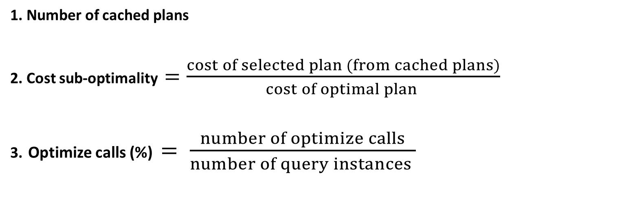
Performance Metrics (online PQO)
1. Number of cached plans
2. Cost sub-optimality $=\frac{cost of selected plan (from cached plans)}{cost of optimal plan }$
3. Optimize calls (%) $= \frac{number of optimize calls}{number of query instances }$
Notes:
Let us formalize the above notions in terms of metrics that can be used to compare various middle-ground techniques.
The most important aspect of plan quality is captured by the cost sub-optimality metric which is defined as the optimizer estimated cost of the selected plan compared to the optimal plan.
Next, optimizer overheads are measured in terms of fraction of instances that are optimized compared to OptAlways.
Finally, the number of stored plans.
Our formulation of the problem is to minimize optimizer overhead while ensuring a tight bound on cost sub-optimality. We also study a variant where an additional constraint on number of plans can be specified – of course, such restriction can lead to increase in optimizer overhead but we do not want to compromise the bounded sub-optimality.

Slide 12
Competing factors and Goal
Worst
Best
OptAlways
Goal: plan quality comparable to OptAlways
with significantly fewer optimize calls
Paper provides ways to keep number of plans under control
(briefly hinted at the end of the talk)
Notes:
Here, we see two extreme approaches for optimizing parameterized queries.
The first one is the naïve approach where fresh optimization is done for each individual query instance.
While this ensures that the plan quality is best possible, the optimizer overhead is huge.
OptOnce is on the other extreme. Here, the plan is constructed only once and it is stored in the plan cache. Then, the same plan is used for every new query instance. While this ensures maximum saving in optimizer overhead, the savings may easily be nullified if the plan quality turns out to be bad for new instances.
So, we can say that an interesting goal is to strike a balance between these two extreme approaches.

Slide 13
Prior work 1: online PQO [VLDB 2008]
Merging Ranges
Assumption
  plan is close-to-optimal in a hypercube shaped selectivity region
Same plan found again
  merge the selectivity ranges
Advantage
  skip many optimizer calls
Limitations
  may choose sub-optimal plan
  cannot discard a new plan in principled manner
P₁
P₂
Sel₂
P₁
P₁
P₁
P₃
P₄
Sel₁

Slide 14
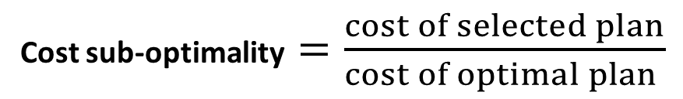
Prior work 2: online PQO [TKDE 2009]
Basis: Plan Cost Monotonicity
  Plan cost increases with increase in selectivities
Ensures bounded sub-optimality of selected plan
Cost sub-optimality $=\frac{cost of selected plan}{cost of optimal plan }$
P₁, 500
q₁
Sel₂
new
Candidate for selection : P₁
Cost sub-optimality : < 5 (500/100)
P₃, 100
q₃
Sel₁

Slide 15
Prior techniques: online PQO
 | Merging-Ranges [VLDB’08] Ellipse-PPQO [TKDE’09] Density based clustering [ICDE’12] | Bounded-PPQO [TKDE’09]
Bounded cost sub-optimality | ✗ | ✓
Low optimizer overhead | ✓ | ✗
(using assumption on
plan cost behavior)
Merging Ranges
Bounded-PPQO
OptAlways

Slide 16
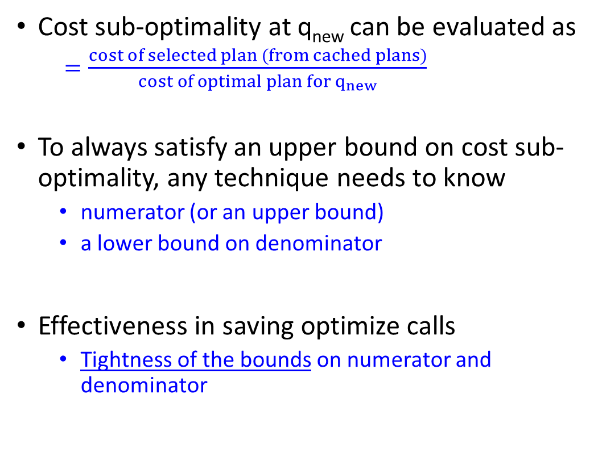
Generic argument for online PQO
Cost sub-optimality at q_{new} can be evaluated as
  $=\frac{cost of selected plan (from cached plans)}{cost of optimal plan for q_{new}}$
To always satisfy an upper bound on cost sub-optimality, any technique needs to know
  numerator (or an upper bound)
  a lower bound on denominator
Effectiveness in saving optimize calls
  Tightness of the bounds on numerator and denominator
Needs optimize call
P₁, 500
q₁
new
Sel₂
P₃, 100
q₃
Sel₁

Slide 17
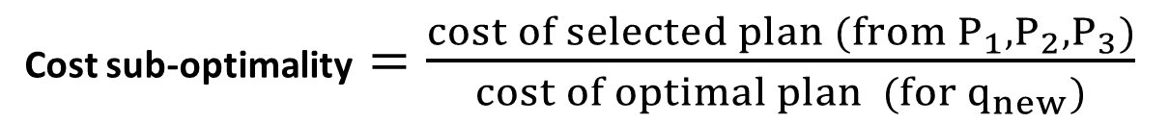
Contributions
Cost sub-optimality $=\frac{cost of selected plan (from P_{1},P_{2}, P_{3})}{cost of optimal plan (for q_{new})}$
(C1) Tighter upper bound on numerator using plan re-cost
(C2)
(C1) Bounded-PPQO
OptAlways
(C2) Tighter lower bound on denominator using an assumption on plan cost behavior

Slide 18
Plan re-cost in online PQO
Query instance (q)
Optimize
Optimal plan (P)
P₁, 500
q₁
vs
Sel₂
new
Plan (P)
Re-cost
Cost of P for q’
P₃, 100
q₃
Query instance (q’ )
Re-cost is much cheaper than Optimize
Optimize: find minimum cost plan among millions of plans
Recost: compute the cost of specified plan
(USE PLAN hint by Microsoft SQL Server)
Sel₁
Exact value of numerator:
select the cached plan with minimum cost for q_{new}
Notes:
But this still does not give any guarantee and a single bad plan can be so sub-optimal that it can nullify the saving that we have been doing by skipping optimizer calls. Also, recost is not so cheap that we can do 100s of them
Because we may want guarantees and re-cost is not so cheap

Slide 19
Advantages of plan re-costing in online PQO
Plan re-cost
  can help significantly in terms of plan selection
  can help any prior technique
This approach is very efficient when
  number of plans is small
  Re-cost itself helps to ensure small number of plans (shown in paper)

Slide 20
Bounded-PPQO with plan re-cost
Cost(P₁, q_{new}) = 300
Cost(P₃, q_{new}) = 150 (exact numerator)
Tighter upper bound on cost sub-optimality
  500/100 ➔ 150/100
  Can skip more optimize calls
P₁, 500
q₁
Sel₂
new
Selected plan: P₃
Cost sub-optimality: < 1.5 (150/100)
P₃, 100
q₃
Sel₁

Slide 21
Contribution 2
Tighter lower bound on optimal cost (denominator)

Slide 22
Existing PCM assumption is conservative
  Let
    Cost(P₁, q_{new}) = 480
    Cost(P₃, q_{new}) = 800
  Bounded PPQO with re-cost
    will check for the cost ratio (480/100 ~ 5 is too high)
    Make an optimize call to get P₁ itself
Sel₂
new
P₁, 500
q₁
P₃, 100
q₃
Sel₁
Lower bound on optimal cost:
depends only on instances in 3rd quadrant
No other neighboring instance can be utilized by PCM assumption

Slide 23
This work: Bounded Cost Growth (BCG) assumption
  If selectivity increase by factor α , cost increase is upper bounded by a known factor f(α)
cost(P₁, q₃) < f(α)f(β) x C₁
q₃ (αx₁, βy₁)
Sel₂
P₁, C₁
cost(P₁, q₂) < f(α) x C₁
q₄ (x₁/ α, y₁)
q₁ (x₁, y₁)
q₂ (αx₁, y₁)
cost(P₁, q₄) > C₁ / f(α)
Sel₁
Assumption is not new, used in different contexts earlier
L. Krishnan, Improving Worst-case Bounds for Plan Bouquet based techniques, M.E. Thesis, IISc, 2015
I. Trummer, C.Koch, Probably Approximately Optimal Query Optimization, Arxiv, 2015

Slide 24
With BCG
lower bound on optimal cost for q_{new}
  using optimal cost for a close-by instance q₁
  Only x-selectivity greater by factor (α = 1.1)
Observation:
  standard relational operators have less than quadratic complexity
  [for single input]
> 413
Sel₂
new
P₁, 500
(0.7, 0.5)
q₁ (0.77, 0.5)
Let optimal cost for q_{new} is C (unknown plan P*)
Cost(P*, q₁) ≤ C x (1.1)² (assuming quadratic cost growth)
Optimal cost for q₁ ≤ C x (1.1)² ➔ C ≥ 500/(1.1)² ≈ 413
P₃, 100
q₃
Sel₁

Slide 25
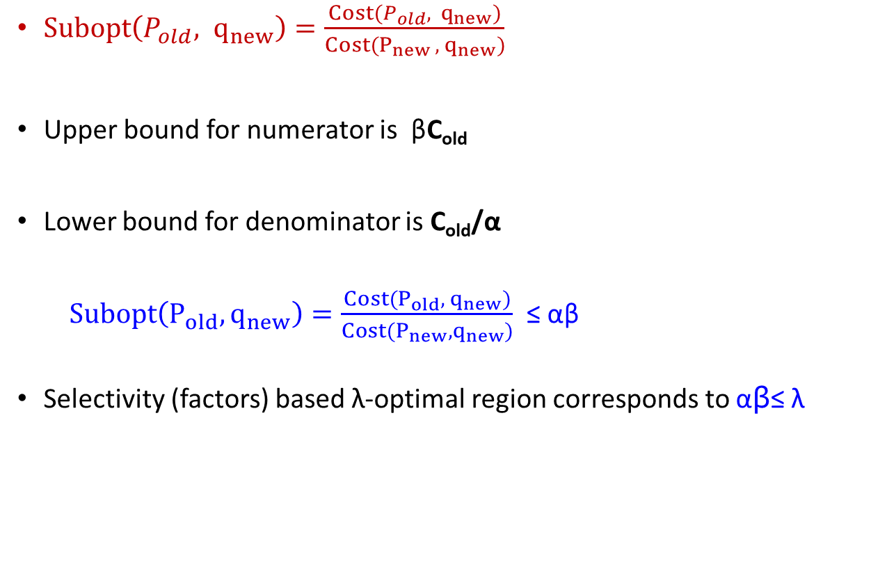
“Selectivity Check” to select a cached plan
$Subopt\left(P_{old}, q_{new}\right)=\frac{Cost(P_{old}, q_{new})}{Cost(P_{new }, q_{new})}$
Upper bound for numerator is βC_{old}
Lower bound for denominator is C_{old}/α
  $Subopt\left(P_{old}, q_{new}\right)=\frac{Cost(P_{old}, q_{new})}{Cost(P_{new}, q_{new})}$ ≤ αβ
Selectivity (factors) based λ-optimal region corresponds to αβ≤ λ
q_{new} (x₁/α, β y₁)
Sel₂
q_{old}
(x₁, y₁)
P_{old} , C_{old}
Sel₁
We can successfully check for λ-optimality of cached plans using only selectivity information

Slide 26

“Cost Check” to select a cached plan
$Subopt\left(P_{old}, q_{new}\right)=\frac{Cost(P_{old}, q_{new})}{Cost(P_{new }, q_{new})}$
Re-cost helps in replacing upper bound on numerator with exact value
Continue to use lower bound for denominator
q_{new} (x₁/α, β y₁)
Sel₂
q_{old}
(x₁, y₁)
P_{old} , C_{old}
αβ ≤ λ changes to αR ≤ λ with R ≤ β
Sel₁
More chances of finding λ-optimal plan due to Re-cost
– especially in high dimensional spaces

Slide 27
Algorithm
1. do Selectivity check
2. if it fails to find a plan, do Cost check
3. if cost check fails, do optimize call
For every new plan,
do the Redundancy check

Slide 28
Selectivity Check
Using selectivities
Merging Ranges
P₂
P₁
P₂
P₁
Sel₂
Sel₂
P₁
P₁
P₁
P₁
P₃
P₄
Sel₁
Sel₁

Slide 29
Cost check
Merging Ranges
P₂
P₁
P₁
P₂
Sel₂
Sel₂
P₁
P₃
P₁
P₁
P₃
P₃
P₁
P₄
Sel₁
Sel₁

Slide 30
Redundancy check
Merging Ranges
P₂
P₁
P₁
P₂
Sel₂
Sel₂
P₁
P₃
P₁
P₃
P₁
P₁
P₄
P₃
P₃
P₄
Sel₁
Sel₁

Slide 31
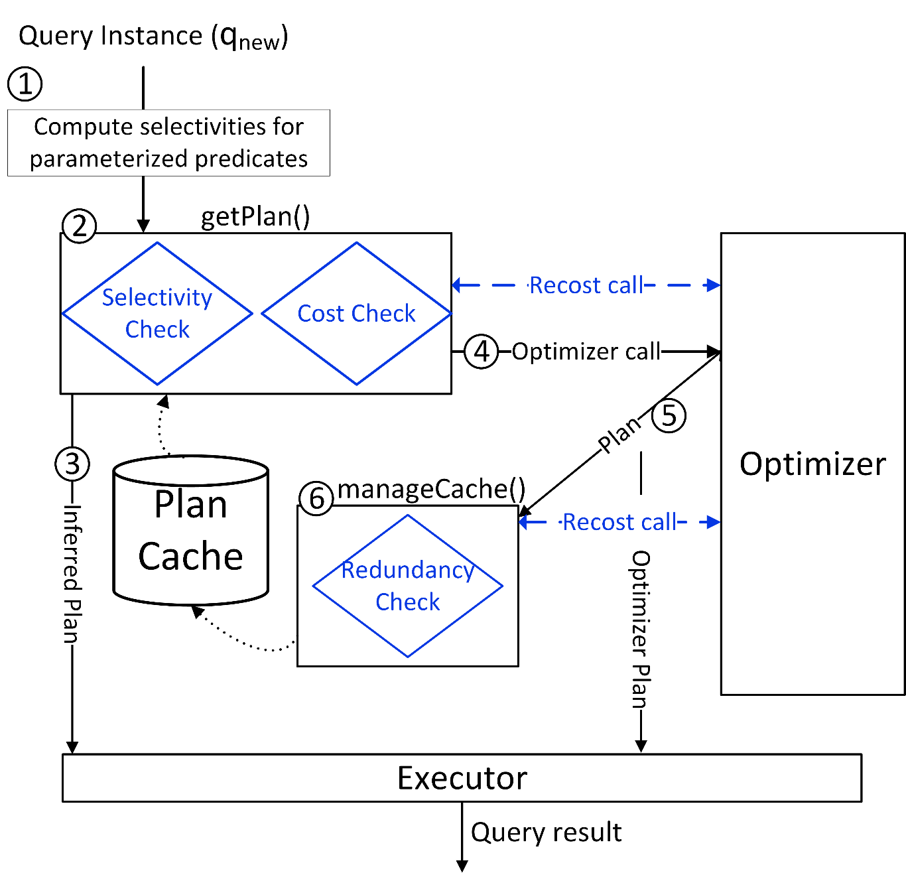
Architecture (SCR)

Slide 32
Experimental Results

Slide 33
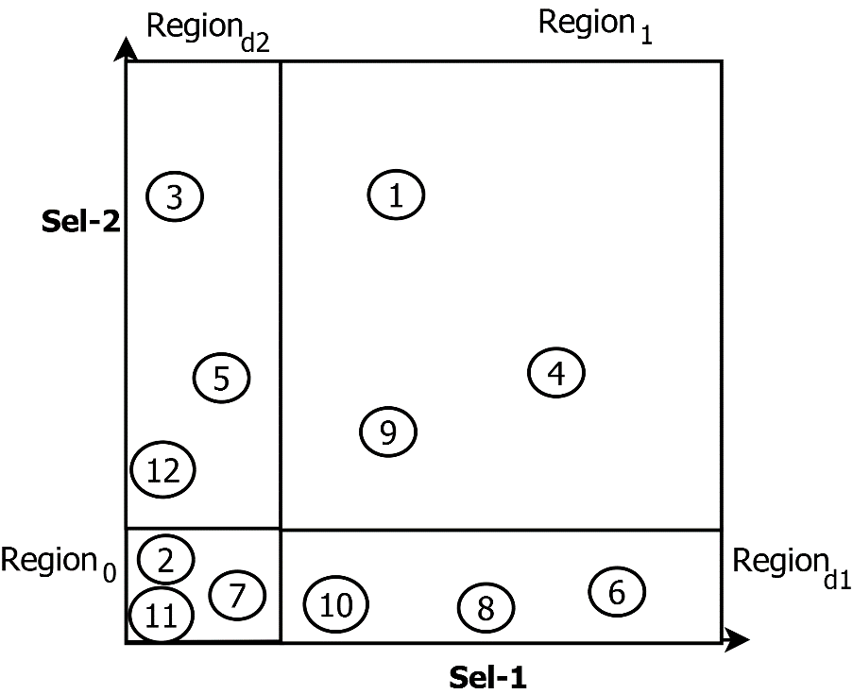
Experimental Setup
90 query templates based on TPC-H/TPC-DS/REAL-1/REAL-2 queries
  #parameters: from 2 to 10
Each workload having 1000 instances
  Instances with significant variation in selectivities
  Arranged in random order
Algorithms compared
  OptOnce, OptAlways
  (Merging-)Ranges, Ellipse-PPQO, Density
  PCM-PPQO, SCR (with λ=2)
Notes:
Cost and plan changes in selectivity regions near the axes tend to be quite different than in other regions. Hence, we ensure generation of instances from different regions. The number of regions increases in higher-dimensions.
MSO: maximum sub optimality over all instances – compared to optimizing each instance to get its best plan (OptAlways).

Slide 34
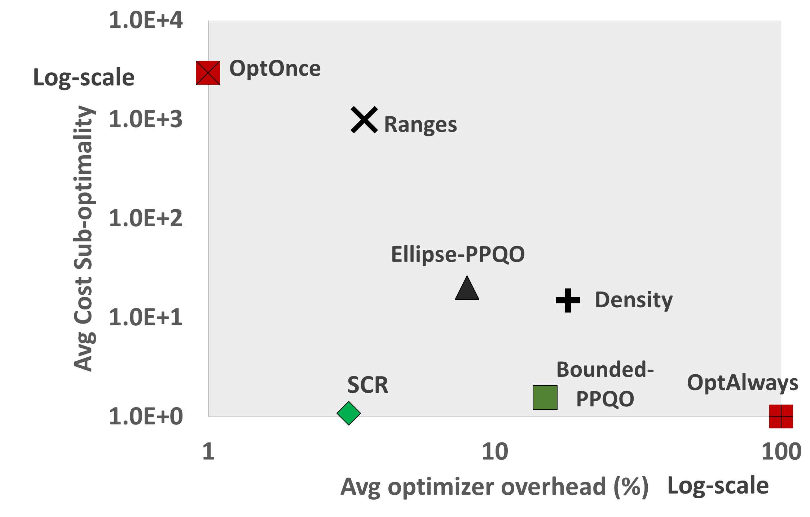
Cost sub-optimality and optimizer overheads

Slide 35
Number of stored plans

Slide 36
Summary
Proposed a new approach for optimization of parameterized queries
  Matches/beats the performance of best techniques for different metrics
    Optimizer calls ≈3% and Number of plans < 5 (average)
Use of Re-cost feature in online PQO
  Selects best plan from cache
  also helps in discarding redundant plans [small number of stored plans]
Bounded cost growth (BCG) assumption
  Provide lower bound on optimal cost using any other query instance
  Supports selectivity check
    More efficient to ensure bounded sub-optimality

Slide 37
Thanks!
Questions?

Slide 38
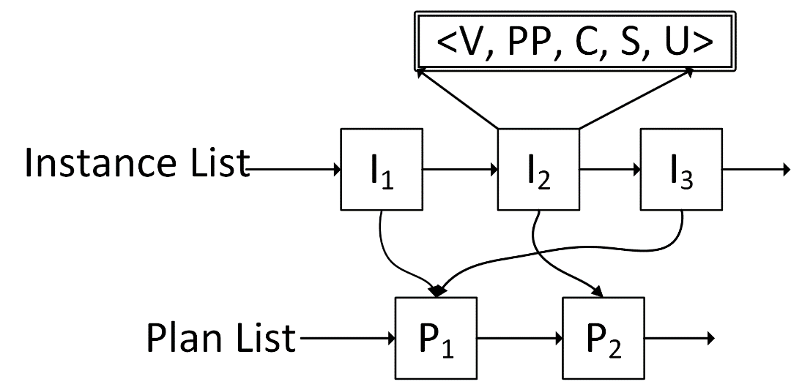
Inside Plan Cache
For each optimized instance, we add the following to instance list:
  Selectivity vector
  Pointer to a plan in cache
  Optimal cost
  Sub-optimality of associated plan
  Usage count: how many times getPlan() used this instance
Selectivity Check
Cost Check
Redundancy Check
To enforce constraint on number of stored plans
~ 12 bytes extra per instance
compared to PCM technique
λ-optimal region for blue plan
One to many mapping from Plans to Query Instances
At any time plan cache contains a list of plans,
and λ-optimality region of each stored plan is captured
using a set of optimized query instances
Sel₂
Sel₁

Slide 39
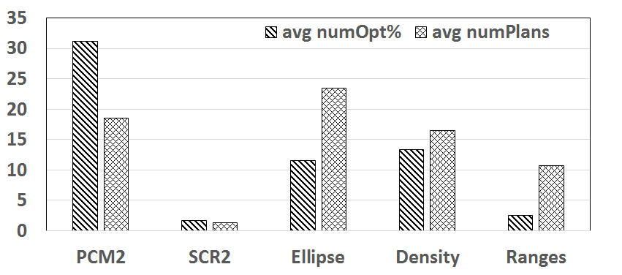
When OptOnce gave MSO < 2

Slide 40
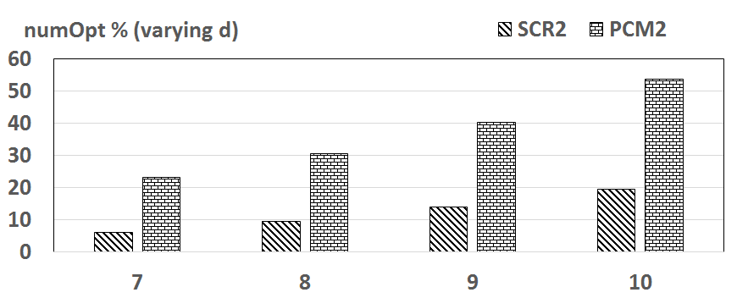
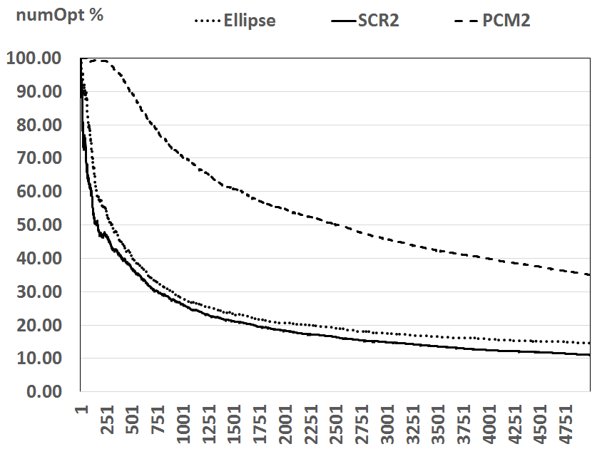
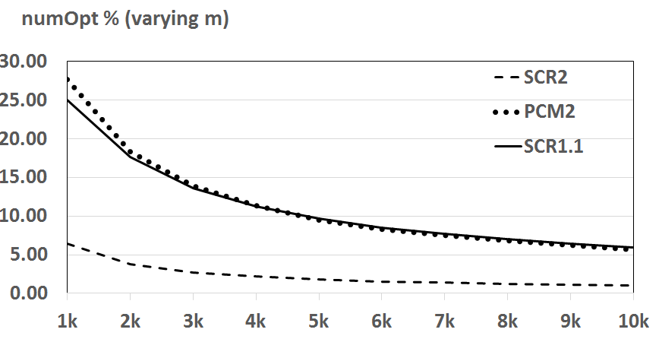
Variation with dimension and length of workload
10-d
4-d

Slide 41
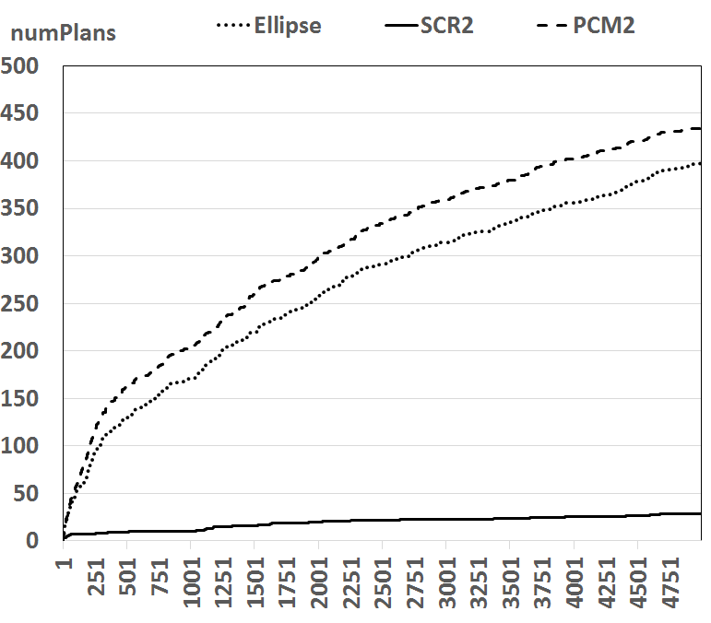
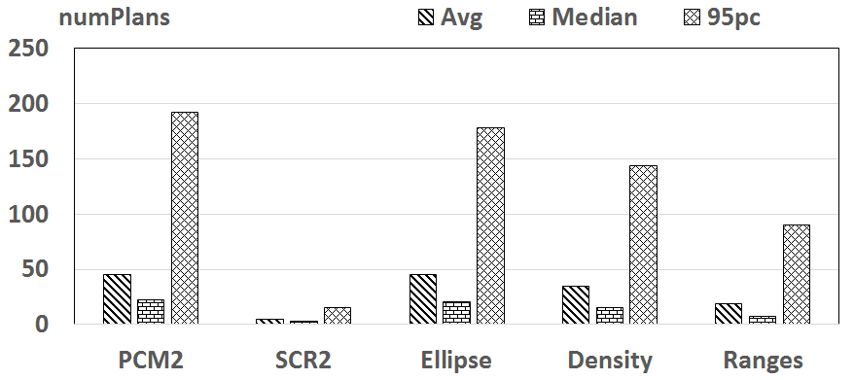
#Plans compared to other techniques and variation with λ and workload length

Slide 42
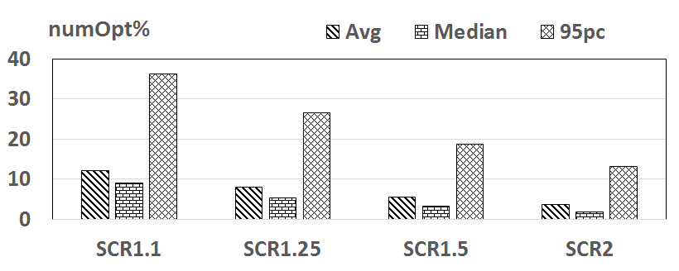
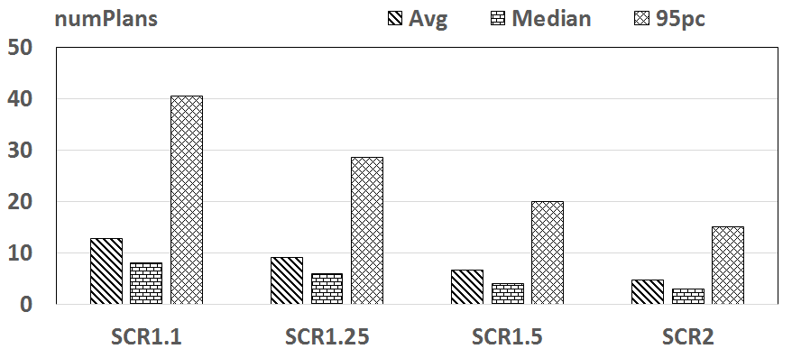
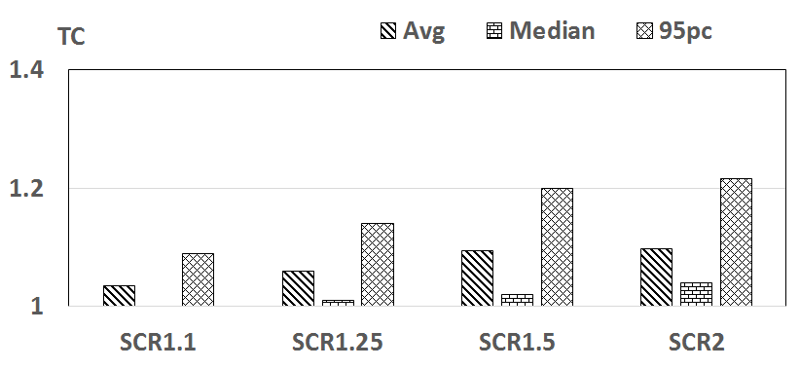
Impact of λ

