Slide 1
CrowdDB: Answering Queries using Crowdsourcing
Michael J. Franklin, Donald Kossmann, Tim Kraska, Sukriti Ramesh, Reynold Xin

Slide 2
Outline
Crowdsourcing
Motivation
Design Considerations
Overview of CrowdDB
CrowdSQL
User Interface Generation
Query Processing
Experimental Results

Slide 3
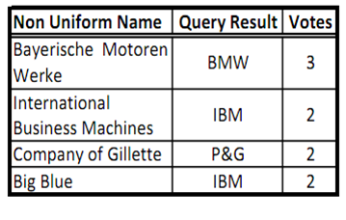
Crowdsourcing : Introduction
Consider the following examples :
Converting online tutorials into various Indian languages.
Proof reading of the converted documents
Given a set of photographs of people from a disaster, and pictures submitted by family members of lost individuals to find them
Given a university and department name, find the link to department webpage
Creating the list of all religious places (any size) in India

Slide 4

Crowdsourcing : Introduction
A large undefined group of peoples via a group invitation
Application of open sourcing principles to outside the software development

Slide 5
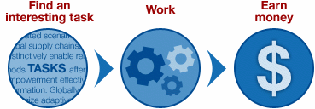
Crowdsourcing : Platforms
What is Crowdsourcing ?
Crowdsourcing is the practice of engaging a 'crowd' or group for a common goal—often for innovation, problem solving, or efficiency.
Crowdsourcing Platform:
A crowdsourcing platform creates a marketplace on which requesters offer tasks and workers accept and work on the tasks

Slide 6
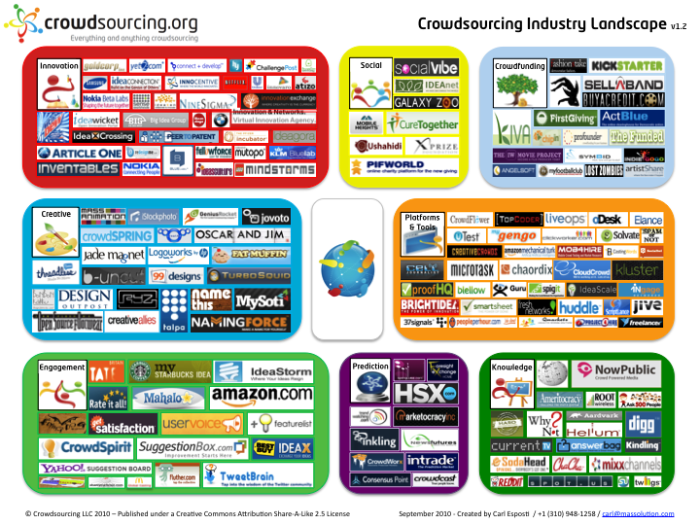
Crowdsourcing : Platforms

Slide 7

Crowdsourcing : Platforms
Some popular platforms are
Freelancer
DesignCrowd
OneSpace
Innocentive
Amazon Mechanical Turk
One of the largest among these is Amazon Mechanical Turk (AMT)
Platform had 500,000 workers in 2011 and continuously growing.

Slide 8
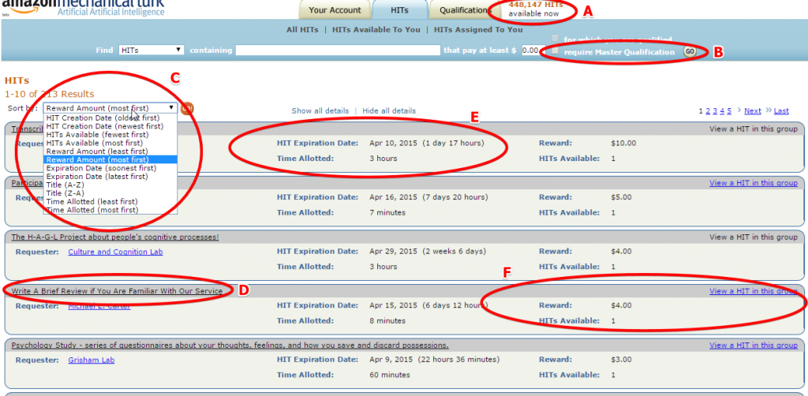
AMT Interface

Slide 9
AMT Terminologies
HIT : A Human Intelligent Task, or HIT, is the smallest entity of work a worker can accept to do. HITs contain one or more jobs. Hits are like micro tasks , which typically takes less than a minute
Eg : In the novel , one page may act as a HIT.
Assignment : Every HIT can be replicated into multiple assignments. Odd number of assignments enables majority voting,
HIT Group : Group of similar HITs. Grouped for convenience of 'turkers‘
Eg : We can pages of the same novel may form a hit group.

Slide 10
AMT-Workflow
Package the jobs comprising of information into HITs, determines the number of assignments required for each HIT and posts the HITs
Optionally specify requirements that workers must meet in order to be able to accept the HIT
AMT Groups compatible HITs into HIT Groups and posts them so that they are searchable by workers
A worker accepts and processes assignments
Requesters then collect all the completed assignments for their HITs and apply whatever quality control methods they deem necessary and provide payment that enable hundreds of thousands of people to perform paid work

Slide 11
Design Considerations
Performance and variability
Ambiguity
Affinity
Relatively small worker pool
Open and Close world assumption

Slide 12
Motivation : CrowdDB
Hybrid Human-Machine DBMS
Hard Database Problems
Missing Data: Generally because of left out or wrongly entered. Key limitation of relational technology stems from the Closed World Assumption. People, aided by tools such as search engines and reference sources, are quite capable of finding information that they do not have readily at hand.
Fuzzy Comparisons : People are skilled at making comparisons that are difficult or impossible to encode in a computer algorithm like “I.B.M” and “Big Blue” are refers to same entities
Need data that is cleaned , validated and free from inconsistencies
Harness Human Computation for solving problems that are impossible or too expensive to answer correctly using computers.
SELECT image FROM picture WHERE topic = "Business Success“ ORDER BY relevance LIMIT 1;

Slide 13
Overview of CrowdDB
In addition to functionality of traditional databases , CrowdDB consists
Turker Relationship Management:
Facilitates the important duties of a requester, such as approving/rejecting assignments, paying and granting bonuses, etc.
User Interface Management:
HITs require user interfaces and human-readable instructions. At runtime, Generates user interfaces for HITs based on these annotations ,standard type definitions and constraints appear in the schema.
HIT Manager:
Manages the interactions between CrowdDB and the crowdsourcing platform
Note : CrowdDB provides physical data independence

Slide 14
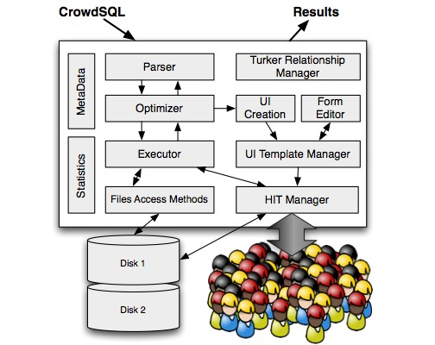
Overview of CrowdDB
Left side of the figure are traditional QO parts: parsing, optimization and execution. Right side contain components used to extend the traditional DB system to get human generated input.

Slide 15
CrowdSQL
CrowdSQL is a SQL extension that supports crowdsourcing.
Supports two main use cases:
allow crowdsourcing missing data
support subjective comparisons

Slide 16
CrowdSQL : SQL DDL Extensions
With Incomplete data : Two scenarios
  Specific attributes could be crowdsourced
  Entire tuples could be crowdsourced
ID | Dept. | URL
1 | CSE
2 | IOR
.
.
.
.
.
Attribute missing
Entire tuple missing

Slide 17
CrowdSQL : SQL DDL Extensions
Introduces a CROWD keyword to solve both.
Let us revisit example of finding the department webpage URL. In CrowdSQL it translates into
CREATE TABLE Department ( university STRING,
name STRING,
url CROWD STRING,
phone STRING,
PRIMARY KEY (university, name) );
The crowd keyword indicates that the url attribute will be got using crowdsourcing.
Let's go one step further. We want to get the details of all the professors in a department. This translates into:
CREATE CROWD TABLE Professor ( name STRING PRIMARY KEY, email STRING UNIQUE,
university STRING,
department STRING,
FOREIGN KEY (university, department) REF Department(university, name) );

Slide 18
CrowdSQL : SQL DDL Extensions
There are no constraints placed and tables both crowd / non-crowd treated same way w.r.t referential integrity constraints.
CROWD tables must have a primary key so that CROWDDB can infer if two workers input same tuple.
A special CNULL value indicates data in CROWD columns that should be crowd-sourced when needed as part of processing a query.
During INSERT/UPDATE, crowd columns can also be initialized. All non-initialized crowd columns are set to CNULL.
Consider example below, it sets URL to CNULL
INSERT INTO Department(university, name) VALUES ("UC Berkeley", "EECS");

Slide 19
Query Semantics
CrowdDB supports any kind of SQL query on CROWD tables and columns
CrowdSQL specifies that tables are updated as a side-effect of crowdsourcing
Let us take two examples based on the tables created previously:
In this, the url column would be implicitly updated with the crowdsourced URL.
In this query missing values in the email column would be implicitly populated and new professors of math department would be implicitly inserted as a side-effect of processing.
SELECT url FROM Department WHERE name = "Math";
SELECT * FROM Professor WHERE email LIKE "%berkeley%" AND dept = "Math";

Slide 20
Subjective Comparisons
Beyond finding missing data, subjective comparisons is important use of CrowdDB
Two new operators:
1. CROWDEQUAL
2. CROWDORDER
CROWDEQUAL(~=) takes two parameters and asks the crowd to decide whether the two values are equal
Here the query writer asks the crowd to do entity resolution with the possibly different names given for Computer Science in the database like 'Computer Science', 'CSE', etc.
SELECT * FROM department WHERE name ~= "CS";

Slide 21
Subjective Comparisons
CROWDORDER is used whenever the help of the crowd is needed to rank or order results
The CrowdSQL query below asks for a ranking of pictures with regard to how well these pictures depict the Golden Gate Bridge
As with missing data, CrowdDB stores the results of CROWDEQUAL and CROWDORDER calls so that the crowd is only asked once for each comparison. This caching is equivalent to the caching of expensive functions in traditional SQL databases
CREATE TABLE picture ( p IMAGE,
subject STRING
);
SELECT p FROM picture
WHERE subject = "Golden Gate Bridge" ORDER BY CROWDORDER(p,
"Which picture visualizes better %subject");

Slide 22
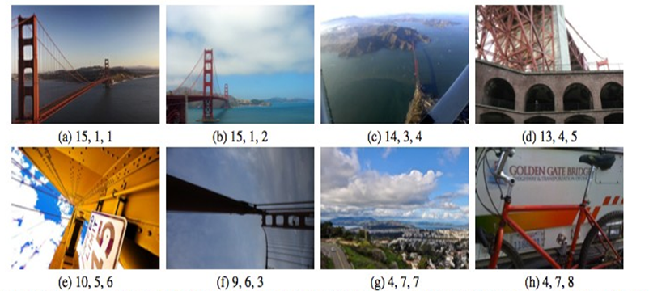
Subjective Comparisons
As with missing data, CrowdDB stores the results of CROWDEQUAL and CROWDORDER calls so that the crowd is only asked once for each comparison. This caching is equivalent to the caching of expensive functions in traditional SQL databases

Slide 23
UI Generation
UI is important, because clear, unambiguous user interface helps greatly in improving accuracy.
Two step process:
  Compile-time: CrowdDB creates templates to crowd-source missing information from all CROWD tables and all regular tables which have CROWD columns. JS is generated in addition to HTML to do type checking
  Runtime: These templates are instantiated at runtime in order to provide a user interface for a concrete tuple or a set of tuples.

Slide 24
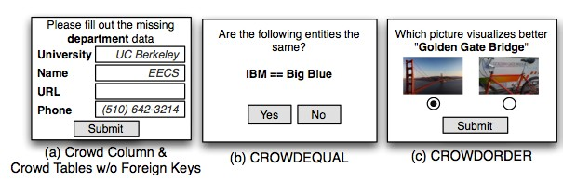
Basic - UI
(a) is our earlier example where we want to crowdsource URL
(b) does entity resolution using CROWDEQUAL
(c) is our earlier example to rank a set of images based on how well they visualize subject (here Golden Gate Bridge)

Slide 25
Basic - UI
Optimizations:
Prefetching: Crowdsourcing all the missing value of tuples at a time , eg: both the department and email of a professor are unknown, but only the email of that professor is required to process a query, it might make sense to get the department
  Batching: Get information of several tuples at once (eg: URL of Elec, CS, EP of UC-Berkeley). Assumption: cheaper to input two pieces of information of the same kind in a single form rather than separate forms
  Note: Trade off is there in case of prefetching. It may take time and hurt the performance but optimizes the requests

Slide 26
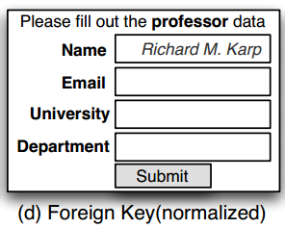
Foreign Key - UI
Foreign Key relations:
Crowdsourcing relations with foreign keys require special considerations
  If foreign key references non-CROWD table, the generated user interface shows a select box and for larger lists a ajax based suggest method
  If foreign key references CROWD table, there are two types of interfaces which are used
  1. Normalized Interface : The worker inputs the value of foreign key but no other attributes of referenced tuple

Slide 27
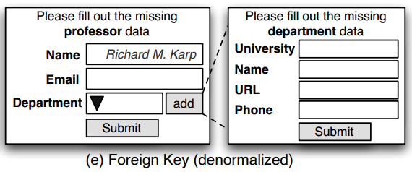
Foreign Key - UI
De-normalized Interface : There is a select box and an add button which allows the worker to input a new department
Note : To fill entirely new tuples, the non-key attributes can be preset via WHERE clause, autosuggest while typing and an option to say no new professor entry present. If many workers say no new professor entry present, we can stop

Slide 28
Query Processing
The traditional database model extended:
SQL extended to CrowdSQL
Crowd Operators for crowdsourcing
Optimizer that handles crowd operators.
CPU time taken << time taken by crowd to answer i.e. goal of optimizer is to find plan which results in least number of queries to Crowd.

Slide 29
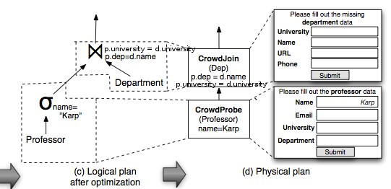
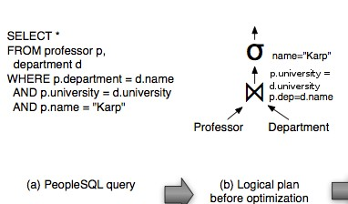
Query Processing

Slide 30
Query Processing
CROWDPROBE:
Crowdsources missing information of CROWD columns (i.e., CNULL values) and new tuples
Quality control carried by majority vote. If not majority achieved at max hits, choose randomly from most frequent ones
In the case of new tuples, finding majority impossible. The DB reposts the tasks with only primary key filled in.

Slide 31
Query Processing
CROWD JOIN :
Implements a nested-loop join where at least one of the tables is a CROWD table
For every tuple of outer relation, creates HIT's to find the inner tuples
CROWD COMPARE:
Implements the CROWDEQUAL and CROWDCOMPARE functions
Typically used inside a traditional operator like sorting

Slide 32
Query Processing
The basic functionality of all Crowd operators is the same.
  Initialized with a user interface template and the standard HIT parameters
  At runtime, they consume a set of tuples
  Depending on the Crowd operator, crowdsourcing can be used to source missing values of a tuple or to source new tuples.
  Batch HITs. Create HIT Groups.
  Consume tuples from crowd and do quality control
Quality control is currently carried out by a majority vote. The number of workers assigned to each HIT is controlled by an Assignments parameter.

Slide 33
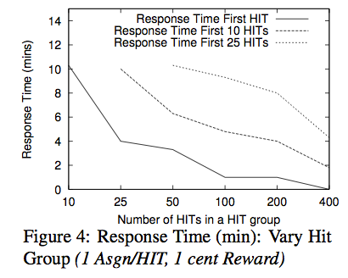
Experiments and Results
As the HIT group size increases, the time to get first x responses decreases. Larger HIT groups mean more tasks to attempt. HITs are repetitive tasks and there is an initial overhead of learning how to do the task. Hence larger HIT groups give higher payoffs and attract more turkers.

Slide 34
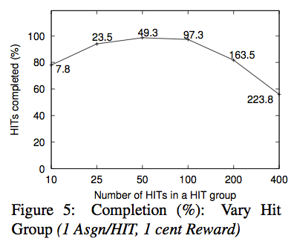
Experiments and Results
However the percentage of HIT's completed in the 30 minutes increases and then decreases. Exhibits tradeoff between throughput and completion %.

Slide 35
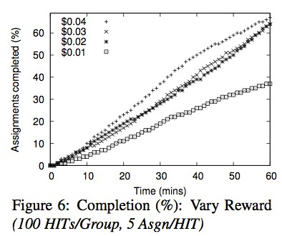
Experiments and Results
Paying more than 1 cent per task attracts more workers. However beyond 2 cents, there is barely any difference.

Slide 36
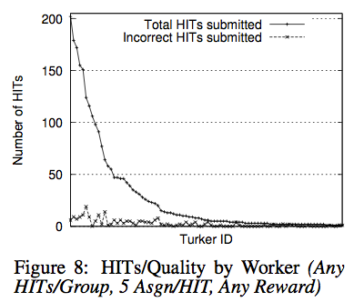
Experiments and Results
The graph below shows the work distribution. It is highly skewed. Total 750 workers.
Tasks acquire a community
The authors thought the ones doing more hits will have lesser error but this behavior not seen in experiments.

Slide 37
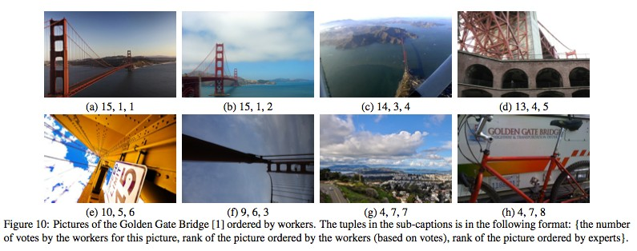
Complex Queries
Query is to sort the pictures for Golden Gate bridge. They rankings are close to ranking by experts.

Slide 38
Thank You

