Slide 1
Declarative Networking
Boon Thau Loo, Tyson Condie, Minos Garofalakis, David E. Gay, Joseph M. Hellerstein, Petros Maniatis, Raghu Ramakrishnan, Timothy Roscoe, and Ion Stoica
CACM 52(11), Nov 2009
Presented by: Kuldeep Punjabi
04/04/2016
1

Slide 2
Agenda
Datalog and Recursive Query Processing
Motivation to Declarative Networking
NDLog : Extensions to Datalog
Language Extensions
Execution Plan generation
Incremental Maintenance
Use cases
Conclusion and References
<number>

Slide 3
Datalog
Introduction to datalog and recursive query processing
<number>

Slide 4
Datalog : Query language for relational databases
Declarative Paradigm
  Give only what, and not how
  Used extensively in SQL, functional programming
  Easy and more natural to state
Non-procedural query language, based on the logic-programming language Prolog
Syntax of Datalog resembles to that of Prolog
Meaning of Datalog programs defined in a purely declarative manner
Datalog simplifies writing simple queries and makes query optimization easier
more convenient for analysis
equivalent in power to relational algebra
<number>

Slide 5
Basic Structure
A Datalog rule has the form -
p :-q1, q2, ..., qn,
which can be read informally as “q1 and q2 and ... and qn implies p.
  v1 ( A , B ):– account ( A , “ Perryridge ” , B ), B > 700
    P is the head of the rule, and q1, q2 , ..., qn is a list of literals that constitutes the body of the rule.
    Literals are either predicates over fields (variables and constants), or functions (formally, function symbols) applied to field.
    Rules can refer to each other in cyclic fashion to express recursion.
<number>

Slide 6
Rule Semantics
v1 ( A , B ):– account ( A , “ Perryridge ” , B ), B > 700
defines a view v1 with attributes A and B using the relation account
:– is read as “ if, ”
comma separating the “ account ( A , “ Perryridge ” , B ) ” from “ B > 700 ” is read as “ and. ”
Intuitively, the rule is understood as follows:
for all A , B if ( A , “ Perryridge ” , B ) ∈ account and B > 700 then ( A , B ) ∈ v1
<number>

Slide 7
Syntax of Datalog Rules
Same conventions as in the relational algebra
A positive literal has the form : p ( t1, t2,..., tn ) where p is the name of a relation with n attributes, and t1 , t2 ,..., tn are either constants or variables.
A negative literal has the form not p ( t1, t2,..., tn ) where relation p has n attributes.
Literals involving arithmetic operations are treated specially
A fact is written in the form p ( v1 ,v2 ,...,vn ) and denotes that the tuple( v1 ,v2 ,..., vn ) is in relation p .
<number>

Slide 8
Problems caused by Negative literals
Use of negation can lead to infinite results :
E.g. not_in_loan( L , B , A ) :– not loan( L , B , A )
-> if the set of possible loan numbers, branch names, and balances is infinite, the relation not in loan would be infinite as well.
We will see : Recursive Datalog programs should not contain negative literals it will create problems in Fixpoint procedure
<number>

Slide 9
Safe Datalog Rules
By safe rule we mean one that prevents infinite results
A Datalog rule p :- q1, ..., qn. is safe if :
Every variable that appears in the head of the rule also appears in a non-arithmetic positive literal in the body of the rule.
Every variable appearing in a negative literal in the body of the rule also appears in some positive literal in the body of the rule.
Each of the following is unsafe and not allowed: s(X) :- r(Y).
s(X) :- r(Y), not r(X).
s(X) :- r(Y), X < Y.
In each case, too many x ’s can satisfy the rule, in the first two rules all constants occurring in the program. Meaningless!
<number>

Slide 10
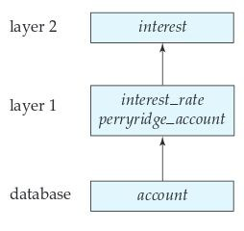
Datalog Programs
A Datalog Program is a collection of declarative rules and an optional query
Example: following Datalog program that defines interest on Perryridge accounts.
interest(A, I):– account(A, “Perryridge”, B),
interest_rate( A , R ), I = B ∗ R / 100
interest_rate(A, 5) :– account (A, N, B), B<10000
interest_rate(A, 6) :– account (A ,N , B), B>= 10000
The order in which the rules are presented in a program
is semantically immaterial.
10

Slide 11
Relational Operations in Datalog
Nonrecursive Datalog expressions without arithmetic operations are equivalent in expressive power to expressions using the basic operations in relational algebra ( ∪ , − , × , select, project ,and rename ) :-
Selection : ?v1 ( “ A-217 ” , B )
Projection : To project attribute account name from account, we use query ( A ):– account ( A , N , B )
Cartesian Product :
query ( X1 , X2 ,..., Xn , Y1 , Y2 ,..., Ym ):– r 1 ( X1 , X2 ,..., Xn ) , r 2 ( Y1 , Y2 ,..., Ym )
where r1 is of arity n ,and r2 is of arity m ,and the X1 , X2 ,..., Xn , Y1 , Y2 ,..., Ym are all distinct variable names.
11

Slide 12
Relational Operations in Datalog
Union : the union of two relations r1 and r2 (both of arity n )in this way :
query ( X1 , X2 ,..., Xn ):– r1 ( X1 , X2 ,..., Xn ) query ( X1 , X2 ,..., Xn ):– r2 ( X1 , X2 ,..., Xn )
Set Difference : the set difference of two relations r1 and r2 in this way: query ( X1 , X2 ,..., Xn ):– r1 ( X1 , X2 ,..., Xn ) , not r2 ( X1 , X2 ,..., Xn )
Insertion and Deletion : we can move all accounts at the Perryridge branch to the Johnstown branch by executing :
+ account ( A , “ Johnstown ” , B ):– account ( A , “ Perryridge ” , B )
− account ( A , “ Perryridge ” , B ):– account ( A , “ Perryridge ” , B )
12

Slide 13
Recursive Datalog Program
Recursive datalog program
Consider a program to give all paths between nodes of a graph
  path(src,Dest,path,Cost) :- link(src,Dest,Cost), path=f_init(src,Dest).
  path(src,Dest,path,Cost) :- link(src,nxt,Cost1), path(nxt,Dest,path2,Cost2), Cost=Cost1+Cost2, path=f_concatpath(src,path2)
Note : the above Datalog program considers the graph to be acyclic
Recursive programs use fixpoint evaluation
Tuples produced in each iteration are added to the relation
Duplicate tuples are removed
Repeated until no new tuples are produced, i.e. “fixpoint” is reached
<number>

Slide 14
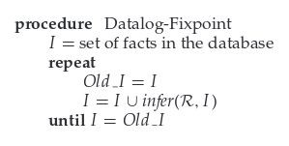
Datalog-Fixpoint Procedure :
Suppose given a relation schema:
Manager_schema =(employee_name,
manager_name)
“Find out which employees are supervised,
directly or indirectly by a given manager
—say,Jones”
a recursive Datalog view, called empl_jones :
empl_jones(X):– manager(X ,“Jones”)
empl_jones(X):– manager(X,Y), empl_jones(Y)
Note:
infer (R , I) ={ p ( t1 ,..., tni ) | there is an instantiation R’ of R , where p ( t1 ,..., tni ) is the head of R ,and the body of R is satisfied in I }
<number>

Slide 15
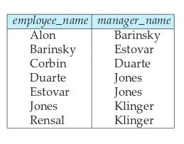
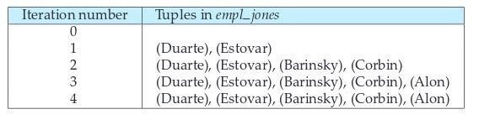
the program defining empl_jones , with the relation manager , shown in right figure.
The set of facts computed for the view relation empl jones in each iteration appears in below figure.
In each iteration, the program computes one more level of employees under Jones and adds it to the set empl_jones.
The procedure terminates when there is no change to the set empl_jones , which the system detects by finding
I = Old_I .
Fig. The manager relation
Fig. Employee of Jones in iterations of procedure Datalog-Fixpoint
<number>

Slide 16
Non-recursive vs Recursive Datalog
Datalog with recursion has more expressive power than Datalog without recursion.
e.g. we cannot express transitive closure in Datalog without using recursion
    The expressive power provided by recursion must be used with care : may generate infinite result:
      number(0)
      number(A) :– number(B), A = B + 1
    a recursive program should not contain negative literals
    Monotonic Views: if, given any two sets of facts I1 and I2 such that I1 ⊆ I2 , then Ev ( I1 ) ⊆ Ev( I2 ), where Ev is the expression used to define V
I1 ⊆ I2 ⇒ infer ( R , I1 ) ⊆ infer ( R , I2 )
The fixed-point technique does not work on recursive views defined with non-monotonic expressions.
16

Slide 17
Expressive Power of Datalog
Without recursion, Datalog can express all and only the queries of core relational algebra.
  The same as SQL select-from-where, without aggregation and grouping.
But with recursion, Datalog can express more than these languages.
Yet still not Turing-complete
17

Slide 18
Motivation to Declarative Networking
<number>

Slide 19
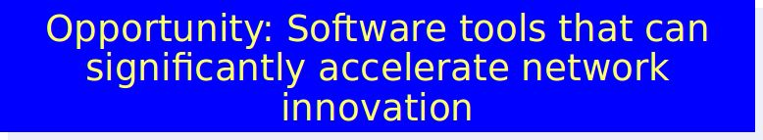
Motivation of Declarative Networking
Internet faces many challenges today:
  Proliferation of new applications and services -high throughput and resilience
  Internet’s core routing infrastructure difficult to evolve to meet the needs of these new apps.
  In order to upgrade a deployed routing protocols- require change of each router’s software
Efforts at improving the Internet:
  Evolutionary: App-level “Overlay” networks
  Revolutionary: Clean-slate designs
    NSF GENI initiative, FIND program
19

Slide 20
Motivation
Routing Protocols to accommodate to the needs of new applications- more tedious and error prone using conventional query languages
Routing?
  Gathering local network state : Base Data
  Deriving forwarding tables : Derived Data
  Enforcing constraints : Constraints
Recursive Query processing- natural fit for expressing the relationship between base data, derived data, and the associated constraints
Using derived data again in query processing
20

Slide 21
Overlay Networks
Overlay network
A network built on top of one or more existing networks
adds an additional layer of indirection/virtualization
changes properties in one or more areas of underlying network basic
Idea :
“Treat multiple hops through IP network as one hop in “virtual” overlay network”
Run routing protocol on overlay nodes
21

Slide 22
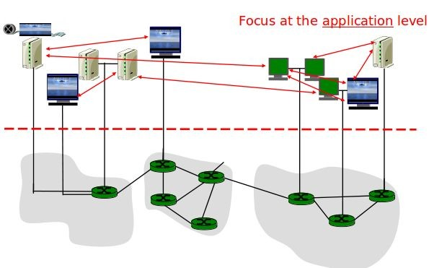
22

Slide 23
Declarative Networking
an application of database query language and processing techniques to the domain of networking
Declarative Networking enables declarative specification and deployment of distributed protocols and algorithms via distributed recursive queries over network graphs
High level goal- provide a software environment that accelerate the process of specifying, implementing, experimenting with and evolving designs for network architectures.
23

Slide 24
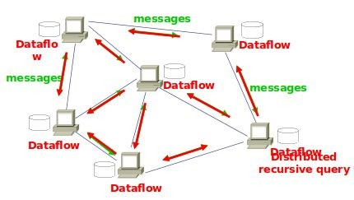
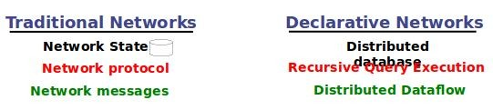
A Declarative Network
24

Slide 25
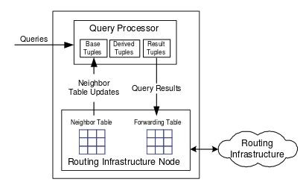
The Case for Declarative Networking
Ease of programming:
  Compact and high-level representation of protocols
  Orders of magnitude reduction in code size
  Declarative Chord DHT is 47 lines instead of 10,000.
  Easy customization
Safety:
  Queries are “sandboxed” within query processor
  Potential for static analysis of safety
What about efficiency?
  No fundamental overhead when executing standard routing protocols
  Application of well-studied query optimizations
  Note: Same question was asked of relational databases in the 70’s.
25

Slide 26
NDlog:Extension to Datalog
Network Datalog language for Declarative Networking
<number>

Slide 27
NDlog
Ndlog is a subset of Datalog that makes explicit the link graph of the network and the partitioning of data across nodes.
enables a variety of routing protocols and overlay networks to be specifi ed in a natural and concise manner.
Integration of networking and logic is unique :
  As a network protocol language : notable for the absence of any communication primitives like “send” and “receive”;
  In comparison to traditional logic languages, enhanced to capture typical network realities including distribution, link-layer constraints on communication (and hence deduction), and soft-state semantics.
27

Slide 28
NDlog by Example
Implementation the path-vector protocol, which computes in a distributed fashion, for every node, the shortest paths to all other nodes in a network
Sp1 - path(@Src,Dest,Path,Cost) :- link(@Src,Dest,Cost), Path= f_init(Src,Dest)
Sp2 - path(@Src,Dest,Path,Cost) :- link(@Src,Nxt,Cost1), path(@Nxt, Dest,Path2,Cost2), Cost=Cost1+Cost2, Path= f_concatPath(Src,Path2).
Sp3 - spCost(@Src,Dest,min<Cost>) :- path(@Src,Dest,Path,Cost).
Sp4 - shortestPath(@Src,Dest,Path,Cost) :-spCost(@Src, Dest,Cost), path(@Src,Dest, Path,Cost).
Query - shortestPath(@Src,Dest,Path,Cost).
Each tuple generated is stored at the address determined by its location specifier.
28

Slide 29
Supporting Distributed Computations
NDlog builds upon traditional Datalog by providing control over the storage location of tuples explicitly in the syntax via location specifiers.
Location Specifiers (@) :
  a field within a predicate that dictates the partitioning of the table.
  Extension to datalog for networking
  Specifies the location of data
  Captures data partitioning
  Enables distributed computations necessary for network protocols
  Hides low level dataflow details
<number>

Slide 30
NDlog Program
A Network Datalog (NDlog) program is a Datalog program that satisfies the following syntactic constraints:
1.) Location specificity: Each predicate has a location specifier as its first attribute
2.) Address type safety: A variable that appears once in a rule as an address type must not appear elsewhere in the rule as a non-address type.
3.) Stored link relations: Link relations never appear in the head of a rule with a non-empty body (i.e., they are stored, not derived).
4.) Link-restriction: Any non-local rules in the program are link-restricted by some link relation.Since NDlog is a subset of Datalog, the semantics of a valid NDlog
program are exactly those of Datalog.
<number>

Slide 31
Execution of the Shortest Path NDlog Program
Communication can be described in synchronized iterations.
at each iteration, network node generates paths of increasing hop count, and then propagates these paths to neighbor nodes along links.
derived paths communicated along the solid lines.
All communication - implicitly generated during rule execution as a result of data placement specifications.
<number>

Slide 32
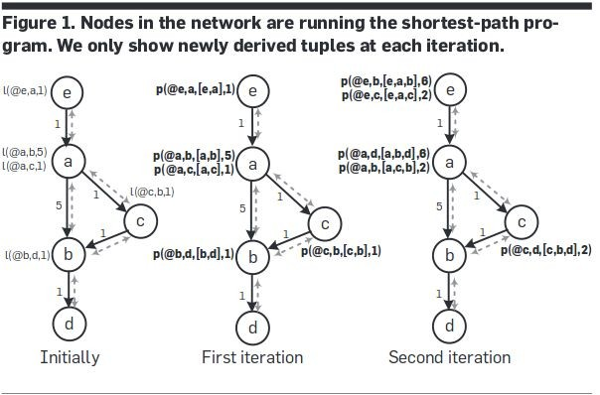
First iteration, all nodes initialize their local path tables to 1-hop paths using rule sp1
Second iteration, using rule sp2, each node takes the input paths generated in the previous iteration, and computes 2-hop paths, which are then propagated to its neighbors.
As paths are computed, the shortest one is incrementally updated.
<number>

Slide 33
Language Extensions
Link Restricted Rules and Soft-state Model
<number>

Slide 34
Link Restricted Rules
NDlog provides restrictions ensuring that rule execution results in comm-unication only among nodes that are physically connected with a bidirectional link.
A link-restricted rule is either a local rule (having the same location specifier variable in each predicate), or a rule with the following properties:
1.) There is exactly one link predicate in the body.
2.) All other predicates (including the head predicate) have their location specifier set to either the first (source) or second (destination) field of the link predicate
Example of a link-restricted rule:
p(@Dest,...) :- link(@src, Dest...),p1(@src, ...), p2(@src, ...),..., pn(@src, ...).
34

Slide 35
Soft-state storage model
stored data have an associated lifetime or time-to-live (TTL).
A soft-state datum needs to be periodically refreshed;
  if more than a TTL passes, the datum is deleted
Soft state favoured in networking implementations- provides well defined eventual consistency semantics
Eventual values are obtained in case of transient errors such as reordered messages, node disconnection.
In case of persistent failure no coordination is required, since any data provided by failed node would be forgotten.
<number>

Slide 36
Overlog- Extension to NDlog
Provides Soft-state feature
availability of a materialized keyword at the beginning of each program to specify the TTL of predicates.
  E.g. materialized(link, {1,2}, 10)
Overlog soft-state storage semantics:
When a tuple is derived, if there exists another tuple with the same primary key but differences on other fields, an update occurs, in which the new tuple replaces the previous one.
if the two tuples are identical, a refresh occurs, in which the existing tuple is extended by its TTL
Periodic Event predicate: transient tables that has no materialized declaration
ping(@Y, X) :- periodic(@X, 10), link(@X, Y).
<number>

Slide 37
Execution Plan generation
<number>

Slide 38
Execution Plan generation
Network Protocols : State machines
NDlog : Runtime systems developed as Distributed dataflow execution engines
Recursive flows and the asynchronous communication difficult to handle
Two types : Centralized / Distributed
<number>

Slide 39
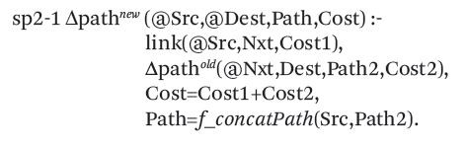
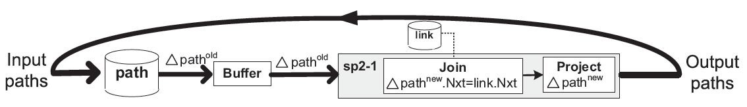
Centralized Evaluation
Semi-naive fixpoint-Datalog Evaluation mechanism that ensures no redundant evaluations
<number>

Slide 40

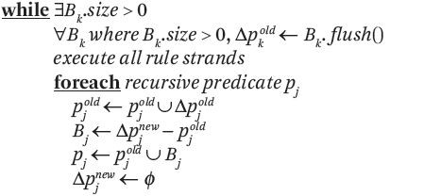
Centralized Evaluation
Pseudo code for Semi-naive(SN) Evaluation in P2
<number>

Slide 41
Distributed Plan Generation
<number>

Slide 42



Localization Rewrite
Rules may have body predicates at different locations:
42

Slide 43
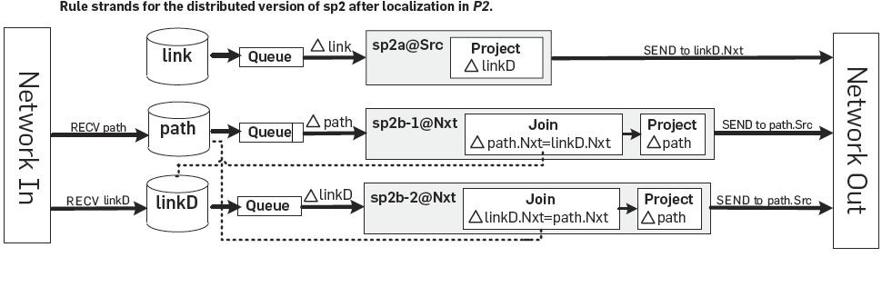
Distributed Plan Generation
Rule sp2a@Src sends links to dest. add with as linkD tuples.
Rule sp2b-2@Nxt takes linkD and performs join with path tuple.
43

Slide 44
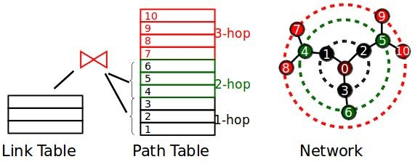
Recursive Query Evaluation
Semi-naïve evaluation:
  Iterations (rounds) of synchronous computation
  Results from iteration ith used in (i+1)th
44

Slide 45
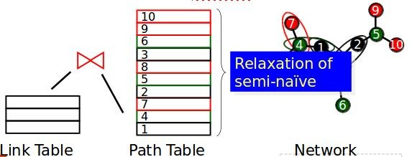

Pipelined Semi-naïve (PSN)
Fully-asynchronous evaluation:
  Computed tuples in any iteration pipelined to next iteration
  Natural for distributed dataflows
45

Slide 46
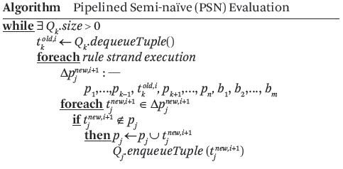
Pipelined Semi-naïve (PSN)
Node receiving new tuple can immediately process the tuple without waiting for local iteration to complete.
46

Slide 47
Incremental Maintenance
<number>

Slide 48
Semantics in Dynamic Network
Underlying Network Changes.
Use Bursty update model for re-computations
Three types of changes:
  Insertion : Tuple can be inserted at any stage , handled by pipelined Evaluation.
  Deletion : Deletion of base tuple leads to deletion of tuples derived from base tuple.
  Update : Treated as deletion followed by insertion. Updating base tuple leads to more updates propagated further.
48

Slide 49
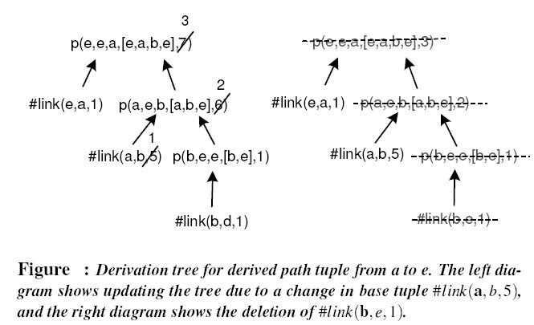
Semantics in Dynamic Network
49

Slide 50
Semantics in Dynamic Network
Use of Count Algorithm for multiple derivations
Standard view maintenance technique for aggregates
Ensures that tuples no longer derivable are deleted on deletes/updates.
Example : Calculate 2 hop paths for given link set
Link={(a,b),(b,c),(b,e),(a,d),(d,c)}
Evaluates to {[(a,c)-2],[(a,e)-1]}
We keep count with both paths
If link (a,b) is deleted, algo uses stored count to reevaluate hop to {(a,c)}
50

Slide 51
Use Cases of Declarative Networking
<number>

Slide 52
Declarative Routing
Routing Protocol is implemented by writing query in Ndlog
Queries executed in distributed fashion on nodes
Static analysis tests for termination of query in Ndlog
NDlog can express variety of routing protocols such as distance vector, path vector, dynamic source routing easily
52

Slide 53
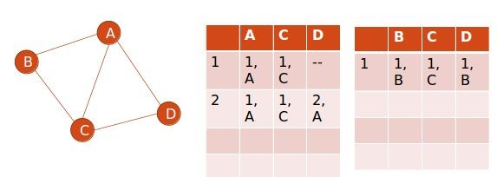
Distance Vector Routing
At each node, save next hop each destination with the cost
Nodes exchange this information to get knowledge about complete network state
53

Slide 54
Distance Vector Routing
DV1:
DV2:
DV3:
DV4:
Query:
path(@S,D,D,C) :- link(@S,D,C).
path(@S,D,Z,C) :- link(@S,Z,C1), path(@Z,D,W,C2),C=C1+C2
shortestCost(@S,D,min<C>) :- path(@S,D,Z,C).
nextHop(@S,D,Z,C) :- path(@S,D,Z,C), shortestCost(@S,D,C).
nextHop(S,D,Z,C).
Count to Infinity problem?
○ DV2: path(@S,D,Z,C) :- link(@S,Z,C1), path(@Z,D,W,C2), C=C1+C2, W != S
○ DV5: path(@S,D,Z,∞) :- link(@S,Z,C1), path(@Z,D,S,C2)
54

Slide 55
Policy Based Routing
Some of the policies
  Node Utilization
  Link Utilization
  Security issues
  Transit- Peer relationships
PBR1: invalidPath(@S,D,P,C) :- path(@S,D,P,C),
f_inPath(P,W) = true.
PBR2: permitPath(@S,D,P,C) :- path(@S,D,P,C), not
Query: permitPath(@S,D,P,C).
excludeNode(@S,W),
invalidPath(@S,D,P,C)
excludeNode(@S,W) : this says that node W can not carry any traffic for node S
55

Slide 56
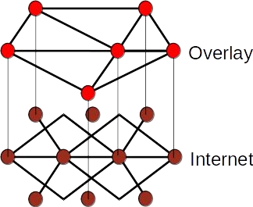
Declarative Overlays
Overlay network : Virtual nodes built on top of internet
To provide services that are not available in existing network.
Overlog declarative language an extension on NDlog.
Soft-state is introduced on Overlog
56

Slide 57
Conclusion
Declarative Networking has gone a really long way in the domain of Network
protocol implementation
On multiple occasions-seen at least two times reduction in code size -producing qualitative results
e.g.Chord - a 10,000 lines C++ library rewritten as a 48 line declarative program
Open up opportunties for automatic protocol optimization and hybridization,
program checking, and debugging
a wired protocol (distance-vector protocol) can be translated to a wireless protocol (dynamic source routing) by applying the standard database optimizations of
magic sets rewrite and predicate reordering
increasing evidence that declarative, data-centric programming has much broader applicability.
Recent works : Secure Distributed Systems and Datacenter programming
<number>

Slide 58
References
Declarative Networking, Boon Thau Loo, Tyson Condie, Minos Garofalakis, David E. Gay, Joseph M. Hellerstein, Petros Maniatis, Raghu Ramakrishnan, Timothy Roscoe, and Ion Stoica CACM 52(11), Nov 2009
Declarative Networking: Language, Execution and Optimization Boon Thau Loo , Tyson Condie , Minos Garofalakis , David E. Gay , Joseph M. Hellerstein , Petros Maniatis , Raghu Ramakrishnan , Timothy Roscoe , Ion Stoica, SIGMOD-2006
Declarative Routing:Extensible Routing with Declarative Queries, Boon Thau Loo, Joseph M. Hellerstein, Ion Stoica, Raghu Ramakrishnan, SIGCOMM-2005
Database Systems and Concepts, Avi Silberschatz, Henry F. Korth, S. Sudarshan, 4th Edition Appendix ( for Datalog and also, Prolog)
Design and Implementaion of Declarative Networks, Boon Thau Loo, powerpoint presentation, available online, URL : www.cis.upenn.edu/~boonloo/research/talks/dn- sigmod07.ppt
<number>

Slide 59
Thanks
<number>

