Slide 1
Declarative Networking:
Language, Execution and Optimization
Boon Thau Loo, Tyson Condie, Minos Garofalakis, David E. Gay, Joseph M. Hellerstein, Petros Maniatis, Raghu Ramakrishnan, Timothy Roscoe and Ion Stoica
SIGMOD 2006
Presented By : Upendra Jeliya
03/04/2017
1

Slide 2
Motivation to Declarative Networking
2

Slide 3
Motivation of Declarative Networking
Internet faces many challenges today:
Proliferation of new applications and services
Demand of high throughput and resilience with robustness and efficiency
Network Protocols deal with computing and maintaining distributed state locally at each node
Upgrading single router is hard, making the whole network hard to upgrade
19

Slide 4
Motivation of Declarative Networking
Routing Protocols to accommodate to the needs of new applications- more tedious and error prone using conventional query languages
Routing?
Gathering local network state : Base Data
Deriving forwarding tables : Derived Data
Enforcing constraints : Constraints
Recursive Query processing- natural fit for expressing the relationship between base data, derived data, and the associated constraints
Opportunity for automated protocol optimization, program checking and debugging
20

Slide 5
Agenda
Introduction to Datalog
Ndlog : An extension to Datalog
Language Extensions
Execution Plan generation
Use cases
Conclusion and References
5

Slide 6
Datalog
Introduction to datalog and recursive query processing
6

Slide 7
Datalog : Query language for relational databases
Declarative Logic Paradigm
Give only what, and not how
Used extensively in SQL, functional programming
Easy and more natural to state
Subset of Prolog
Used as a query language for deductive databases
7

Slide 8
Basic Structure of a Datalog Rule
A Datalog rule has the form -
p :- q1 , q2 , ..., qn which can be read informally as “q1 and q2 and ... and qn implies p.
P is the head of the rule, and q1, q2 , ..., qn is a list of literals that constitutes the body of the rule.
Literals are either predicates over fields (variables and constants), or functions (formally, function symbols) applied to field.
Rules can refer to each other in cyclic fashion to express recursion
Semantically Immaterial
8

Slide 9
Rule Semantics
two_hop_path(X,Z) :- edge( X , Y ) , edge ( Y , Z )
defines a two hop path using the relation edge
:– is read as “ if ”
comma separating the “edge( X , Y ) ” from “edge ( Y , Z ) ” is read as “ and ”
Intuitively, the rule is understood as follows: If there is a link from X to Y, AND Y to Z then X can reach Z and is a two hop path.
9

Slide 10
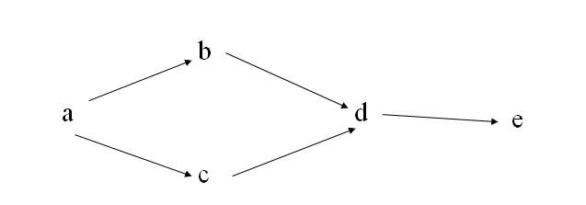
Recursive Datalog Program
Suppose we are representing a graph by a relation edge(X,Y):
edge(a,b), edge (a,c), edge(b,d), edge(c,d), edge(d,e)
path( X, Y ) :- edge( X, Y )
path( X, Y ) :- path( X, Z ), edge( Z, Y )
Recursive programs use fixpoint evaluation
Tuples produced in each iteration are added to the relation
Duplicate tuples are removed
Repeated until no new tuples are produced, i.e. “fixpoint” is reached

Slide 11
Recursive Datalog Program
Query : Find all nodes reachable from a
Semantics : We’ll continue to iterate until a fixed point is reached
Initial: edge: {(a,b), (a,c), (b,d), (c,d), (d,e)}
path: {}
Iteration #1: path: {(a,b), (a,c), (b,d), (c,d), (d,e)}
Iteration #2: path gets the new tuples:
(a,d), (b,e), (c,e)
Iteration #3: path gets the new tuple:
(a,e)
Iteration #4: Nothing changes -> We stop

Slide 12
Shortest Path Program in Datalog
The program recursively calculates shortest path between all pairs of nodes of the graph :
R1: path(S,D,P,C) :- link(S,D,C), P = f_concatPath(link(S,D,C), nil).
R2: path(S,D,P,C) :- link(S,Z,C1), path(Z,D,P2,C2), C = C1 + C2,
P = f_concatPath(link(S,Z,C1),P2).
R3: spCost(S,D,min<C>) :- path(S,D,P,C).
R4: shortestPath(S,D,P,C) :- spCost(S,D,C), path(S,D,P,C).
Query: shortestPath(S,D,P,C).

Slide 13
Shortest Path Program in Datalog
(e, a,[e, a], 1)
(a, b,[a, b], 5)
(a, c,[a, c], 1)
(c, b, [c, b], 1)
(b, d,[b, d],1)
(e, a,1)
e
1st Iteration
1
(a, b, 5)
(a, c, 1)
a
1
(e, b, [e, a, b], 6)
(e, c, [e, a, c], 2)
(a, d, [a, b, d], 6)
(a, b, [a, c, b], 2)
(c, d, [c, b, d],2)
5
c
1
2nd Iteration
(b,d,1)
b
(c,b,1)
1
(e, d, [e, a, b, d], 7)
(e, b, [e, a, c, b], 3)
(a, d, [a, c, b, d], 3)
d
3rd Iteration
Initial Stage
4th Iteration
(e, d, [e, a, c, b, d], 4)

Slide 14
Aggregate Selection
AggregateSelection(path(S,D,P,C), [S,D],min(C))
Aggregate selections are necessary for the termination of some queries.
For e.g. with aggregate selections, even if paths with cycles are permitted, the shortest-path query will terminate, avoiding cyclic paths of increasing lengths.
Those paths that do not contribute to the eventual shortest paths are pruned.

Slide 15
Aggregate Selection
(e, a,[e, a], 1)
(a, b,[a, b], 5)
(a, c,[a, c], 1)
(c, b, [c, b], 1)
(b, d,[b, d],1)
(e, a,1)
e
1st Iteration
1
(a, b, 5)
(a, c, 1)
a
1
(e, b, [e, a, b], 6)
(e, c, [e, a, c], 2)
(a, d, [a, b, d], 6)
(a, b, [a, c, b], 2)
(c, d, [c, b, d],2)
5
c
1
2nd Iteration
(b,d,1)
b
(c,b,1)
1
(e, d, [e, a, b, d], 7)
(e, b, [e, a, c, b], 3)
(a, d, [a, c, b, d], 3)
d
3rd Iteration
Initial Stage
4th Iteration
(e, d, [e, a, c, b, d], 4)

Slide 16
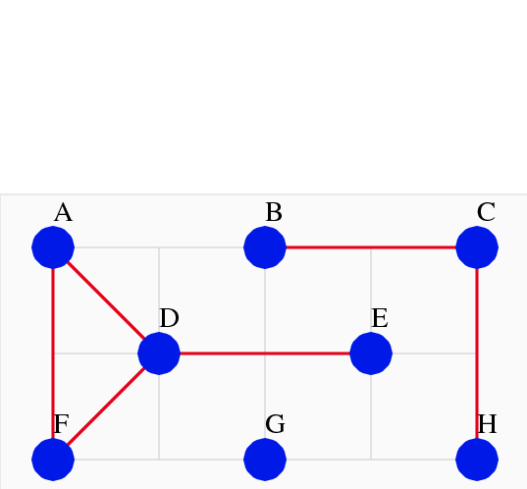
Magic Sets Shortest Paths From Given Source
MR1: reachable(src1) :- query(src1) /* Want paths with src1 as source */ MR2: reachable(Z) :- reachable (D), link(D, Z, _);
R1: path(S,D,P,C) :- reachable(S), link(S,D,C), P = f_concatPath(link(S,D,C), nil).
R2: path(S,D,P,C) :- reachable(S), link(S,Z,C1), path(Z,D,P2,C2), C = C1 + C2,
P = f_concatPath(link(S,Z,C1),P2).
R3: spCost(S,D,min<C>) :- path(S,D,Z,P,C).
R4: shortestPath(S,D,P,C) :- spCost(S,D,C), path(S,D,P,C).
Query: shortestPath(S,D,P,C).

Slide 17
Magic Sets Shortest Path with Reordering
MR1: reachable(D) :- query(D) /* Want paths with D as source */ R1: path(S,D,P,C) :- reachable(S), link(S,D,C), P = f_concatPath(link(S,D,C), nil).
R2: path(S,D,P,C) :- reachable(S), path(S,Z,P2,C2), link(Z,D,C1), C = C1 + C2,
P = f_concatPath(link(S,Z,C1),P2).
R3: spCost(S,D,min<C>) :- path(S,D,Z,P,C).
R4: shortestPath(S,D,P,C) :- spCost(S,D,C), path(S,D,P,C).
Query: shortestPath(S,D,P,C).

Slide 18
Shortest Path With Next Hop (as in paper)
R1: path(S,D,D,P,C) :- link(S,D,C), P = f_concatPath(link(S,D,C), nil).
R2: path(S,D,Z,P,C) :- link(S,Z,C1), path(Z,D,Z2,P2,C2),C = C1 + C2,
P = f_concatPath(link(S,Z,C1),P2).
R3: spCost(S,D,min<C>) :- path(S,D,Z,P,C).
R4: shortestPath(S,D,P,C) :- spCost(S,D,C), path(S,D,Z,P,C).
Query: shortestPath(S,D,P,C).

Slide 19
What is Declarative Networking
It is a programming methodology that enables developers to concisely specify network protocols and services, which are directly compiled to a dataflow framework that executes the specification

Slide 20
Declarative Networking
An application of database query language and processing techniques to the domain of networking
Declarative Networking enables declarative specification and deployment of distributed protocols and algorithms via distributed recursive queries over network graphs
High level goal- provide a software environment that accelerate the process of specifying, implementing, experimenting with and evolving designs for network architectures.
23

Slide 21
A Declarative Network
24

Slide 22
The Case for Declarative Networking
Ease of programming:
Compact and high-level representation of protocols
Orders of magnitude reduction in code size
Declarative Chord DHT is 47 lines instead of 10,000.
Easy customization
Safety:
Queries are “sandboxed” within query processor
Potential for static analysis of safety
What about efficiency?
No fundamental overhead when executing standard routing protocols
Application of well-studied query optimization.
25

Slide 23
Ndlog : Extension to Datalog
Network Datalog language for Declarative Networking
23

Slide 24
NDlog
Ndlog is an extension to Datalog that makes explicit the link graph of the network and the partitioning of data across nodes.
Enables a variety of routing protocols and overlay networks to be specified in a natural and concise manner.
Integration of networking and logic is unique :
As a network protocol language :
notable for the absence of any communication primitives like “send” and “receive”;
In comparison to traditional logic languages:
enhanced to capture typical network realities including distribution, link-layer constraints on communication (and hence deduction), and soft-state semantics.
27

Slide 25
Supporting Distributed Computations
NDlog builds upon traditional Datalog by providing control over the storage location of tuples explicitly in the syntax via location specifiers.
Each tuple generated is stored at the address determined by its location specifier.
Location Specifiers (@) :
a field within a predicate that specifies the location of data
Enables distributed computations necessary for network protocols
Hides low level dataflow details
25

Slide 26
NDlog by Example
path-vector protocol, which computes in a distributed fashion, for every node, the shortest paths to all other nodes in a network
Sp1 - path(@Src,Dest,path,Cost) :- link(@Src,Dest,Cost), path= f_init(Src,Dest)
Sp2 - path(@Src,Dest,path,Cost) :- link(@Src,Nxt,Cost1), path(@Nxt, Dest,path2,Cost2), Cost=Cost1+Cost2, path= f_concatpath(Src,path2).
Sp3 - spCost(@Src,Dest,min<Cost>) :- path(@Src,Dest,path,Cost).
Sp4 - shortestpath(@Src,Dest,path,Cost) :-spCost(@Src, Dest,Cost), path(@Src,Dest, path,Cost).
Query - shortestpath(@Src,Dest,path,Cost).
28

Slide 27
Shortest path with next hop from SIGMOD paper
SP1: path(@S,@D,@D,P,C) :- #link (@S,@D,C), P = f concatPath(link(@S,@D,C), nil).
SP2: path(@S,@D,@Z,P,C) :- #link (@S,@Z,C1), path(@Z,@D,@Z2,P2,C2), C = C1 + C2, P = f concatPath(link(@S,@Z,C1),P2).
SP3: spCost(@S,@D,min<C>) :- path(@S,@D,@Z,P,C).
SP4: shortestPath(@S,@D,P,C) :- spCost(@S,@D,C), path(@S,@D,@Z,P,C).
Query: shortestPath(@S,@D,P,C).
As a matter of notation, we require the location specifier to be the first field in all predicates, and we highlight it in bold for clarity. For eg. the location specifier of link(@S,@D,C) is @S.

Slide 28
Execution of the Shortest path NDlog Program
Communication is described in synchronized iterations
At each iteration, network node generates paths of increasing hop count
Then propagates these paths to neighbour nodes along links.
Derived paths communicated along the solid lines
All communication - implicitly generated during rule execution as a result of data placement specifications.
28

Slide 29
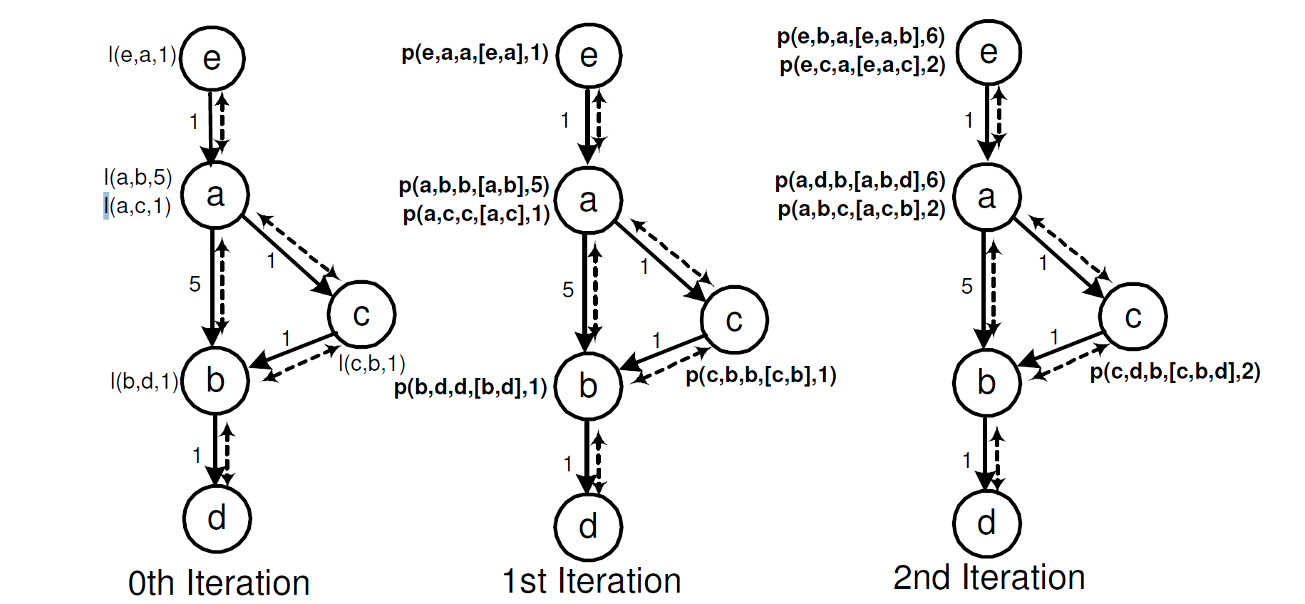
Nodes in the network are running the shortest-path program
29

Slide 30
NDlog Program
A Network Datalog (NDlog) program is a Datalog program that satisfies the following syntactic constraints:
1.) Location specificity: Each predicate has a location specifier as its first attribute
2.) Address type safety: A variable that appears once in a rule as an address type must not appear elsewhere in the rule as a non-address type.
3.) Stored link relations: Link relations never appear in the head of a rule with a non-empty body (i.e., they are stored, not derived).
4.) Link-restriction: next slide.
30

Slide 31
Link Restricted Rules
Link restriction: ensures that rule execution results in communication only among nodes that are physically connected with a bidirectional link.
A link-restricted rule is either a local rule (having the same location specifier variable in each predicate), or a rule with the following properties: 1. There is exactly one link predicate in the body. 2.) All other predicates (including the head predicate) have their location specifier set to either the first (source) or second (destination) field of the link predicate
Example of a link-restricted rule: p(@Dest,...) :- link(@src, Dest...),p1(@src, ...), p2(@src, ...),..., pn(@src, ...)
NOTE : In a fully connected network, an Ndlog parser can be configured to bypass the requirement for link restricted rules
34

Slide 32
Soft-state storage model
Stored data have an associated lifetime or time-to-live (TTL).
A soft-state datum needs to be periodically refreshed;
if more than a TTL passes, the datum is deleted
Eventual values are obtained in case of transient errors such as reordered messages, node disconnection.
In case of persistent failure no coordination is required, since any data provided by failed node would be forgotten.
32

Slide 33
Overlog – An Extension to NDlog
(Not in SIGMOD 2006 paper)
Provides Soft-state feature
availability of a materialized keyword at the beginning of each program to specify the TTL of predicates.
E.g. materialized(link, {1,2}, 10)
Overlog soft-state storage semantics:
When a tuple is derived, if there exists another tuple with the same primary key but differences on other fields, an update occurs, in which the new tuple replaces the previous one.
if the two tuples are identical, a refresh occurs, in which the existing tuple is extended by its TTL
Periodic Event predicate: transient tables that has no materialized declaration
ping(@Y, X) :- periodic(@X, 10), link(@X, Y).
33

Slide 34
Execution Plan generation
34

Slide 35
Execution Plan generation
Network Protocols : State machines
NDlog : Runtime systems developed as Distributed dataflow execution engines
Recursive flows and the asynchronous communication difficult to handle
Two types : Centralized / Distributed
35

Slide 36
Centralized Plan Generation
Semi-naive fixpoint Datalog Evaluation mechanism that ensures no redundant evaluations
Input tuples computed in the previous iteration of the recursive rule are used as input in the current iteration
The first time produced tuples only are used as input for the next iteration
It repeats until a fixpoint is reached ( All buffers are empty and no new tuples produced)
36

Slide 37
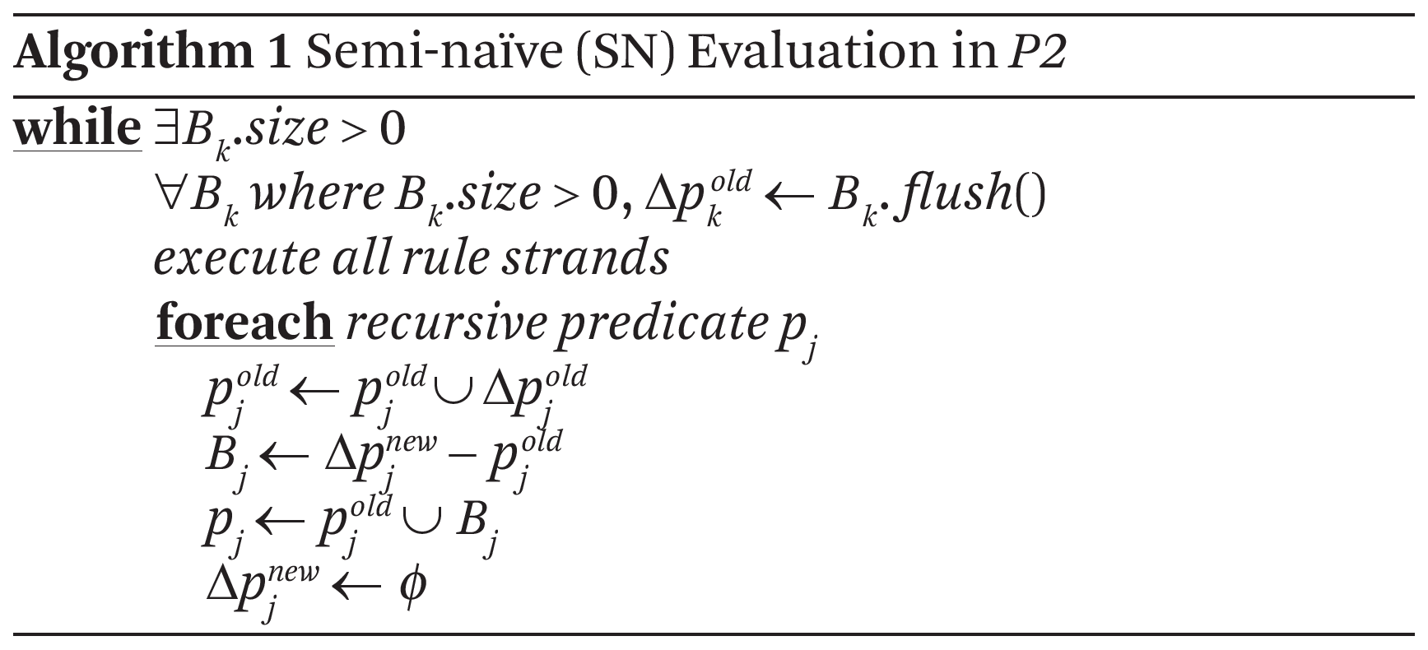
Centralized Plan Generation
37

Slide 38
Distributed Plan Generation
38

Slide 39
Localization Rewrite
Rules may have body predicates at different locations:
A rule localization rewrite step ensured that all tuples to be joined are at the same node
42

Slide 40
Distributed Plan Generation
Rule sp2a@Src sends links to destination address with as linkD tuples.
Rule sp2b-2@Nxt takes linkD via the network and performs join with local path tuple.
43

Slide 41
Recursive Query Evaluation
Semi-naïve evaluation:
Iterations (rounds) of synchronous computation
Results from iteration ith used in (i+1)th
44

Slide 42
Pipelined Semi-naïve (PSN)
Fully-asynchronous distributed evaluation:
Computed tuples in any iteration are immediately pipelined to next iteration
Natural for distributed dataflow
Timestamps are added to each tuple locally to ensure no repeated inferences
45

Slide 43
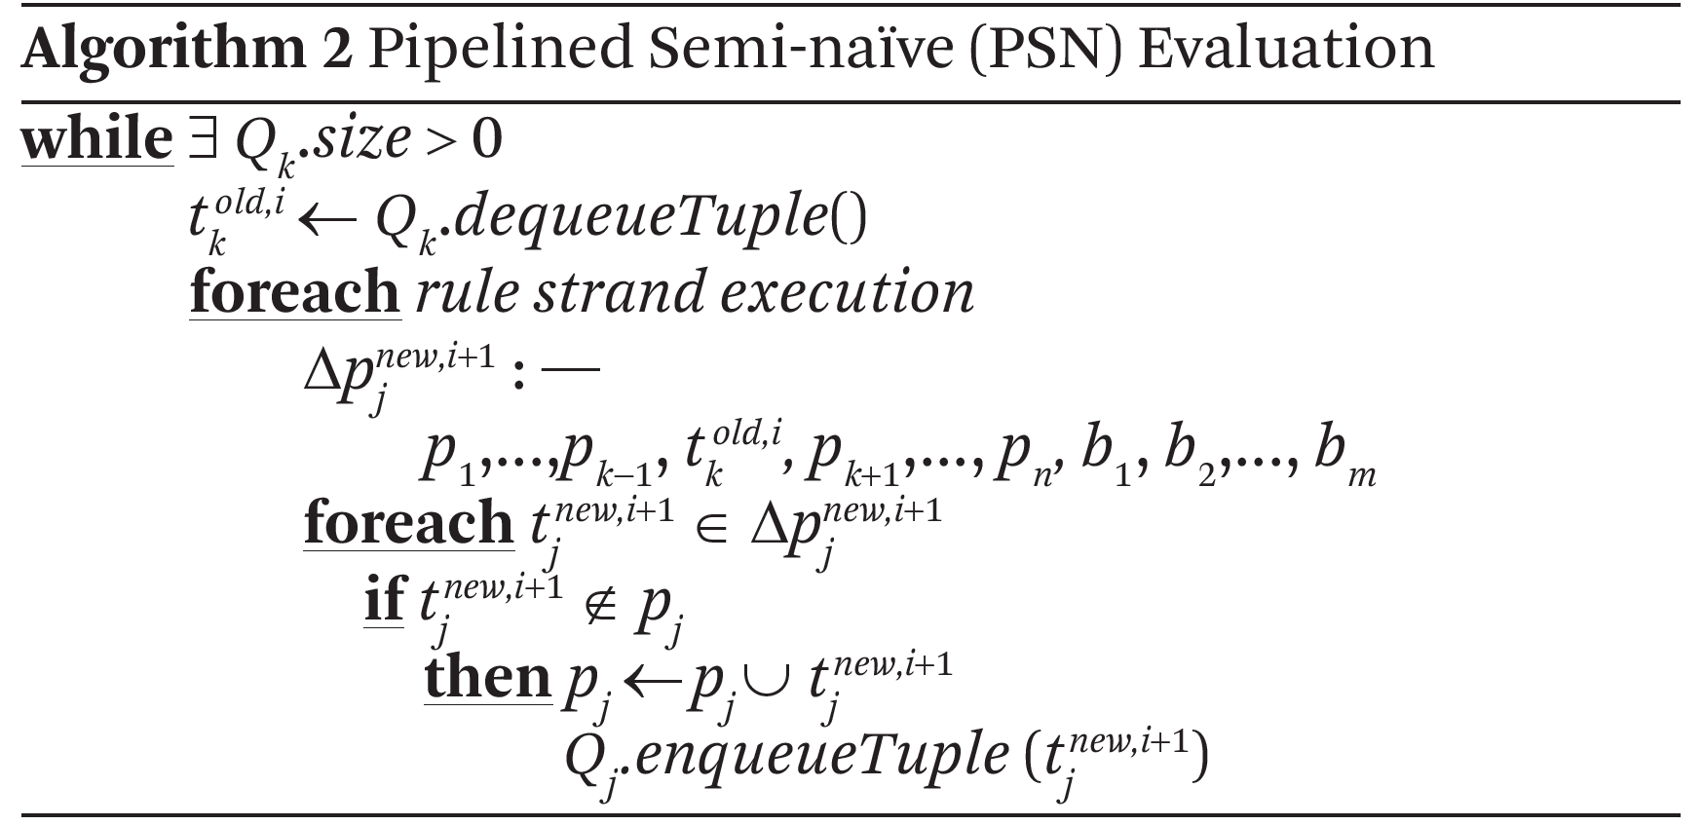
Pipelined Semi-naïve (PSN)
Node receiving new tuple can immediately process the tuple without waiting for local iteration to complete
As long as Ndlog program is monotonic & messages arrive in FIFO between nodes, PSN acts same as SN
46

Slide 44
Incremental Maintenance
44

Slide 45
Semantics in Dynamic Network
Underlying Network Changes.
Use Bursty update model :
Updates are allowed during query processing
Assumption that network eventually quiesces for a long time enough to reach a fixpoint
Three types of changes:
Insertion : Tuple can be inserted at any stage , handled by pipelined Evaluation.
Deletion : Deletion of base tuple leads to deletion of tuples derived from base tuple.
Update : Treated as deletion followed by insertion. Updating base tuple leads to more updates propagated further.
48

Slide 46
Semantics in Dynamic Network
Use of Count Algorithm for multiple derivations ensures that tuples no longer derivable are deleted on deletes/updates
Standard view maintenance technique for aggregates
Example : Calculate 2 hop paths for given link set
Link={(a,b),(b,c),(b,e),(a,d),(d,c)}
Evaluates to {[(a,c)-2],[(a,e)-1]}
We keep count with both paths
If link (a,b) is deleted, algo uses stored count to re-evaluate hop to {(a,c)}
50

Slide 47
Use Cases of Declarative Networking
47

Slide 48
Declarative Routing
Routing Protocol is implemented by writing query in Ndlog
Queries executed in distributed fashion on nodes
Static analysis tests for termination of query in Ndlog
NDlog can express variety of routing protocols such as distance vector, path vector, dynamic source routing easily
To limit query computation to the relevant portion of the network, a query rewrite technique called Magic Sets Rewriting is used
52

Slide 49
Declarative Overlays
Overlay network : Virtual nodes built on top of internet
To provide services that are not available in existing network
Overlog declarative language an extension on NDlog.
Soft-state is introduced on Overlog
In declarative overlays, application submit P2 a concise Overlog program that describes an overlay network and the system maintains routing tables, perform neighbor discovery etc.
Declarative programs are compact , easier to understand, debug & extend than thousands of lines of imperative code.
56

Slide 50
Datalog Optimizations

Slide 51
Aggregate Selections in NDLog Distributed Evaluation
For e.g. in shortest-path query, each node only needs to propagate the most current shortest paths for each destination to neighbors.
This propagation can be done whenever a shorter path is derived.
Can be done periodically called as Periodic Aggregation Scheme

Slide 52
Aggregate Selection
Pruned by AggSelection since we found a cost
2 which is < 5.
(e, a,1)
e
(e, a,[e, a], 1)
e
(e, a, [e, a, b], 1)
e
1
1
1
(a, d, [a, b, d], 6)
(a, b, [a, c, b], 2)
(a, b, 5)
(a, c, 1)
(a, b,[a, b], 5)
(a, c,[a, c], 1)
a
1
a
a
1
1
5
c
5
c
5
c
1
1
1
(b,d,1)
b
(b, d,[b, d],1)
b
(c, b, [c, b], 1)
b
(c,b,1)
(c, d, [c, b, d],2)
1
1
1
d
d
d
Initial Stage
1 Hop paths
2 Hop paths

Slide 53
Magic Sets
To limit query computation to the relevant portion of the network
For e.g. by modifying SP1 from the shortest-path query, the following computes only paths limited to destinations in the magicDst table :
SP1-D: path(@S,@D,@D,P,C) :- magicDst(@D),#link(@S,@D,C), P = f_concatPath(link(@S,@D,C), nil).
Rule SP1-D initializes 1-hop paths for destinations whose magicDst(@D) is present in the magicDst table

Slide 54
Predicate Reordering
The use of magic sets in the previous query is not useful for pruning paths from sources
Switching the search strategy can be done simply by reordering the path and #link predicates
This has the effect of turning SP2 from a right-recursive to a left-recursive rule.
Together with the use of magic sets, the following magic-shortest-path query allows filtering on both sources and destinations

Slide 55
Predicate Reordering
Shortest path with next hop :
SP1: path(@S,@D,@D,P,C) :- #link (@S,@D,C), P = f_concatPath(link(@S,@D,C), nil).
SP2: path(@S,@D,@Z,P,C) :- #link (@S,@Z,C1), path(@Z,@D,@Z2,P2,C2), C = C1 + C2, P = f_concatPath(link(@S,@Z,C1),P2).
SP3: spCost(@S,@D,min<C>) :- path(@S,@D,@Z,P,C).
SP4: shortestPath(@S,@D,P,C) :- spCost(@S,@D,C), path(@S,@D,@Z,P,C).
Query: shortestPath(@S,@D,P,C).
Shortest path after Magic Sets & Partial Reordering :
SP1-SD: pathDst(@D,@S,@D,P,C) :- magicSrc(@S), #link (@S,@D,C),
P = f_concatPath(link(@S,@D,C), nil).
SP2-SD: pathDst(@D,@S,@Z,P,C) :- pathDst(@Z,@S,@Z1,P1,C1), #link (@Z,@D,C2), C := C1 + C2,
P = f_concatPath(P1,link(@Z,@D,C2)).
SP3-SD: spCost(@D,@S,min<C>) :- magicDst(@D),pathDst(@D,@S,@Z,P,C).
SP4-SD: shortestPath(@D,@S,P,C) :- spCost(@D,@S,C), pathDst(@D,@S,@Z,P,C).

Slide 56
Conclusion
On multiple occasions-seen at least two times reduction in code size -producing qualitative results
e.g. Chord - a 10,000 lines C++ library rewritten as a 48 line declarative program
Open up opportunities for automatic protocol optimization and hybridization, program checking, and debugging
a wired protocol (distance-vector protocol) can be translated to a wireless protocol (dynamic source routing) by applying the standard database optimizations of
Increasing evidence that declarative, data-centric programming has much broader applicability.
Recent works : Secure Distributed Systems and Datacentre programming
56

Slide 57
References
Declarative Networking, Boon Thau Loo, Tyson Condie, Minos Garofalakis, David E. Gay, Joseph M. Hellerstein, Petros Maniatis, Raghu Ramakrishnan, Timothy Roscoe, and Ion Stoica CACM 52(11), Nov 2009
Declarative Networking: Language, Execution and Optimization Boon Thau Loo , Tyson Condie , Minos Garofalakis , David E. Gay , Joseph M. Hellerstein , Petros Maniatis , Raghu Ramakrishnan , Timothy Roscoe , Ion Stoica, SIGMOD-2006
Declarative Routing:Extensible Routing with Declarative Queries, Boon Thau Loo, Joseph M. Hellerstein, Ion Stoica, Raghu Ramakrishnan, SIGCOMM-2005
Database Systems and Concepts, Avi Silberschatz, Henry F. Korth, S. Sudarshan, 4th Edition Appendix ( for Datalog and also, Prolog)
Design and Implementaion of Declarative Networks, Boon Thau Loo, powerpoint presentation, available online, URL : www.cis.upenn.edu/~boonloo/research/talks/dn- sigmod07.ppt
Datalog Presentation, URL :http://courses.cs.washington.edu/courses/cse544/00sp/lectures/ppt/l8.ppt
57

Slide 58
Thanks
58

