Slide 1
Holistic Optimization of Database Applications
S. Sudarshan, IIT Bombay
Joint work with:
Ravindra Guravannavar,
Karthik Ramachandra, and
Mahendra Chavan,
and several other students
Project URL: http://www.cse.iitb.ac.in/infolab/dbridge
September 2014

Slide 2
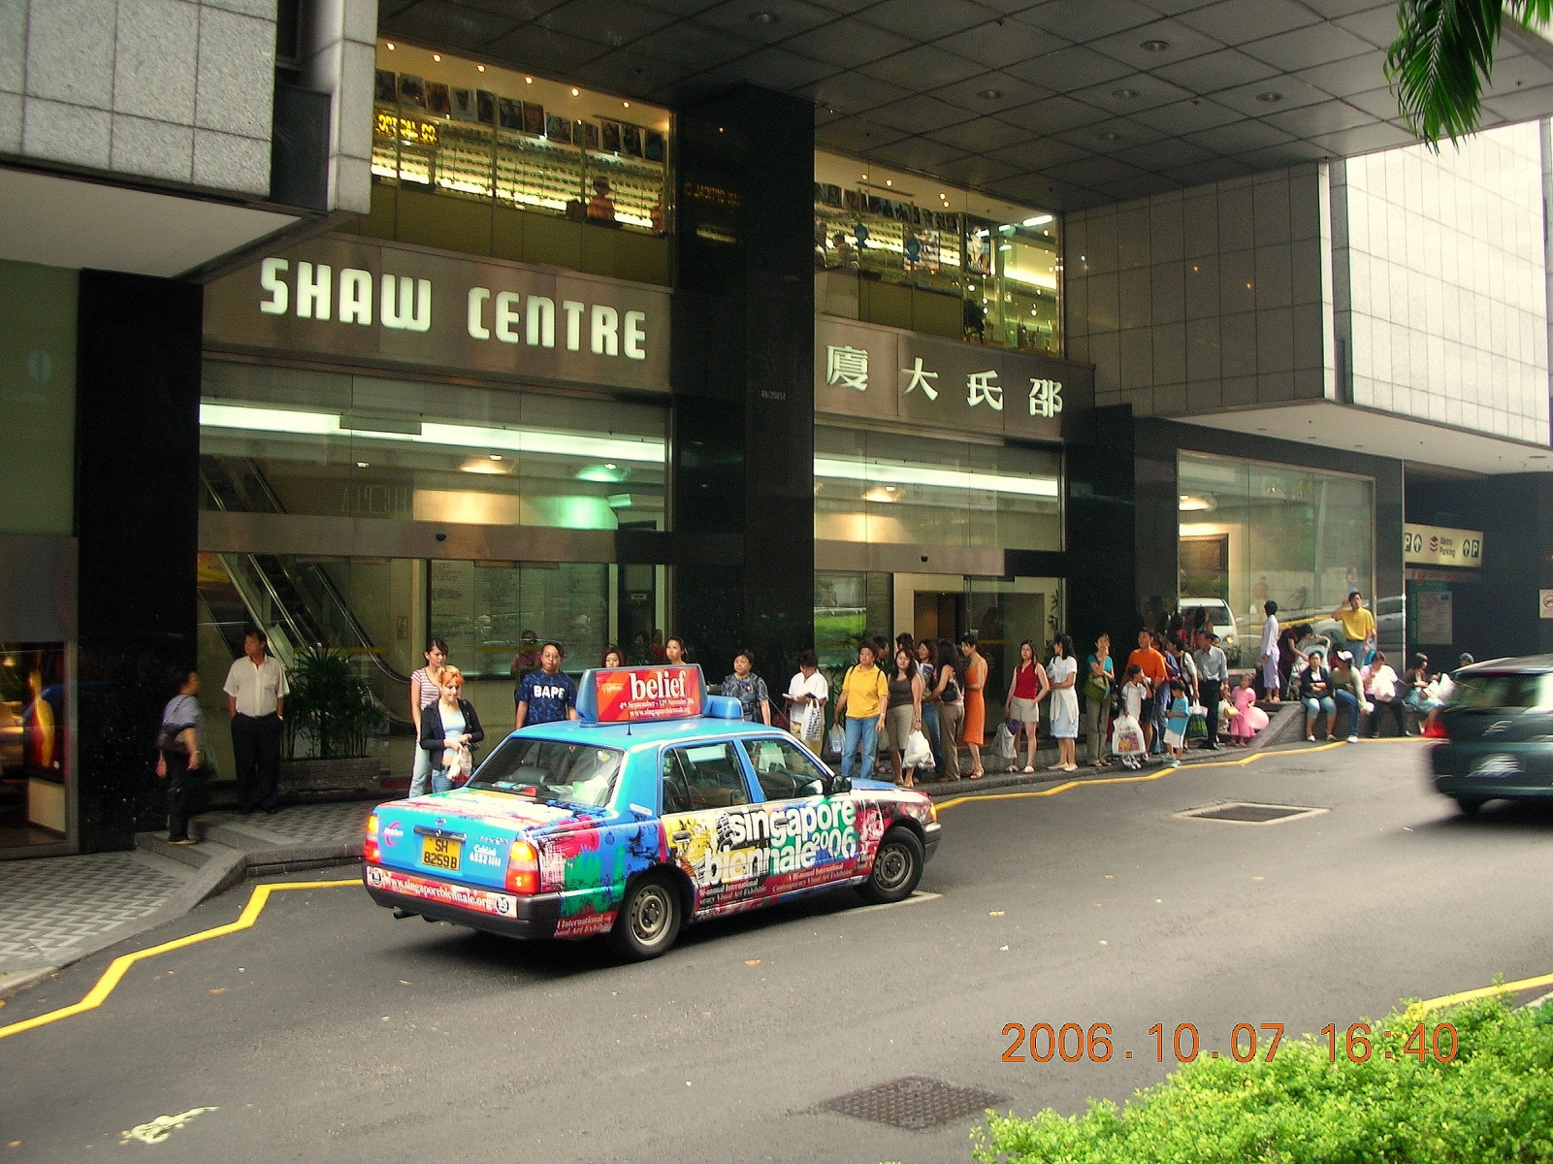
The Problem
And what if there is only one taxi?

Slide 3


The Latency problem
Database applications experience lot of latency due to
  Network round trips to the database
  Disk IO at the database
Query
Disk IO and
query execution
Network time
Application
Database
Result
“Bandwidth problems can be cured with money. Latency problems are harder because the speed of light is fixed—you can't bribe God.”
—Anonymous
(courtesy: “Latency lags Bandwidth”, David A Patterson, Commun. ACM, October 2004 )

Slide 4

The Problem
Applications often invoke Database queries/Web Service requests
  repeatedly (with different parameters)
  synchronously (blocking on every request)
Naive iterative execution of such queries is inefficient
  No sharing of work (eg. Disk IO)
  Network round-trip delays
The problem is not within the database engine. The problem is the way queries are invoked from the application.
Query optimization:
time to think out of the box

Slide 5
holistic optimization
Traditional database query optimization
  Focus is within the database engine
Optimizing compilers
  Focus is the application code
Our focus: optimizing database access in the application
  Above techniques insufficient to achieve this goal
  Requires a holistic approach spanning the boundaries of the DB and application code.
Holistic optimization: Combining query optimization, compiler optimization and program analysis ideas to optimize database access in applications.

Slide 6
Talk/Solution Overview
Rewriting Procedures for Batch Bindings
[VLDB 08]
Asynchronous Query Submission
[ICDE 11]
Prefetching Query Results
[SIGMOD 12]

Slide 7

Solution 1: Use a BUS!

Slide 8
Rewriting Procedures For Batched Bindings
Guravannavar and Sudarshan [VLDB 2008]
Repeated invocation of a query automatically replaced by a single invocation of its batched form.
  Enables use of efficient set-oriented query execution plans
  Sharing of work (eg. Disk IO) etc.
  Avoids network round-trip delays
Approach
  Transform imperative programs using equivalence rules
  Rewrite queries using decorrelation, APPLY operator etc.

Slide 9
Program Transformation for Batched Bindings
qt = con.Prepare(
"SELECT count(partkey) " +
"FROM part " +
"WHERE p_category=?");
while(!categoryList.isEmpty()) {
category = categoryList.next();
qt.bind(1, category);
qt.addBatch();
}
qt.executeBatch();
while(qt.hasMoreResults()) {
count = qt.getNextResult();
sum += count;
}
qt = con.prepare(
"SELECT count(partkey) " +
"FROM part " +
"WHERE p_category=?");
while(!categoryList.isEmpty()) {
category = categoryList.next();
qt.bind(1, category);
count = qt.executeQuery();
sum += count;
}
**
** Conditions apply.

Slide 10
Query Rewriting For Batching
SELECT COUNT(p_partkey) AS itemCount
FROM part
WHERE p_category = ?
Original Query
CREATE TABLE ParamBatch(
paramcolumn1 INTEGER,
loopKey1 INTEGER)
INSERT INTO ParamBatch VALUES(..., …)
SELECT PB.*, qry.*
FROM ParamBatch PB OUTER APPLY (
SELECT COUNT(p_partkey) AS itemCount
FROM part
WHERE p_category = PB.paramcolumn1) qry
ORDER BY loopkey1
Temp table to store
Parameter batch
Batch Inserts into
Temp table.
Cam use JDBC
addBatch
Set-oriented Query
Outer Apply: MS SQLServer == Lateral Left Outer Join .. On (true): SQL:99

Slide 11
Challenges in Generating Batched Forms of Procedures
Must deal with control-flow, looping and variable assignments
Inter-statement dependencies may not permit batching of desired operations
Presence of “non batch-safe” (order sensitive) operations along with queries to batch
Approach:
Equivalence rules for program transformation
Static analysis of program to decide rule applicability

Slide 12
Batch Safe Operations
Batched forms – no guaranteed order of parameter processing
Can be a problem for operations having
side-effects
Batch-Safe operations
All operations that have no side effects
Also a few operations with side effects
  E.g.: INSERT on a table with no constraints
  Operations inside unordered loops (e.g., cursor loops with no order-by)

Slide 13
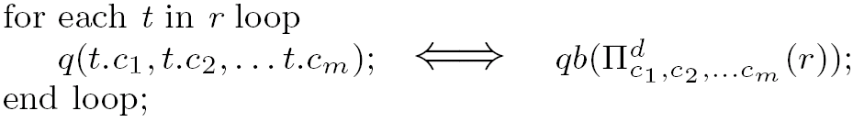
Rule 1A: Rewriting a Simple Set Iteration Loop
where q is any batch-safe operation with qb as its batched form
for each t in r loop
insert into orders values (t.order-key, t.order-date,…);
end loop;
insert into orders select … from r;
Several other such rules; see paper for details
DBridge system implements transformation rules on Java bytecode, using SOOT framework for static analysis of programs

Slide 14
Rule 2: Splitting a Loop
Table(T) t;
while(p) {
ss1 modified to save local variables as a tuple in t
}
while (p) {
ss1;
s_{q};
ss2;
}
Collect the
parameters
for each r in t {
s_{q} modified to use attributes of r;
}
Can apply Rule 1A-1C
and batch.
for each r in t {
ss2 modified to use attributes of r;
}
Process the
results
* Conditions Apply

Slide 15
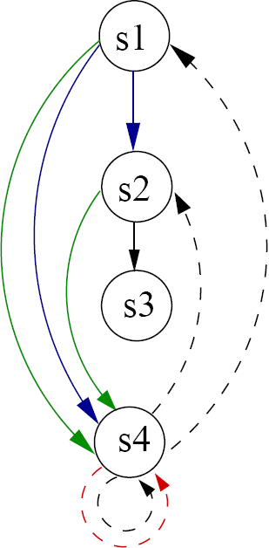
Data Dependency Graph
Data Dependencies
(s1) while (category != null) {
(s2) item-count = q1(category);
(s3) sum = sum + item-count;
(s4) category = getParent(category);
}
W→R
Flow Dependence
R→W
Anti Dependence
W→W
Output Dependence
Control Dependence
Loop-Carried
Pre-conditions for Rule-2 (Loop splitting)
  No loop-carried flow dependencies cross the points at which the loop is split
  No loop-carried dependencies through external data (e.g., DB)

Slide 16
Other Rules
Further rules for
  Separating batch safe operations from other operations (Rule 3)
  Converting control dependencies into data dependencies (Rule 4)
    i.e. converting if-then-else to guarded statemsnts
  Reordering of statements to make rules applicable (Rule 5)
  Handling doubly nested loops (Rule 6)

Slide 17
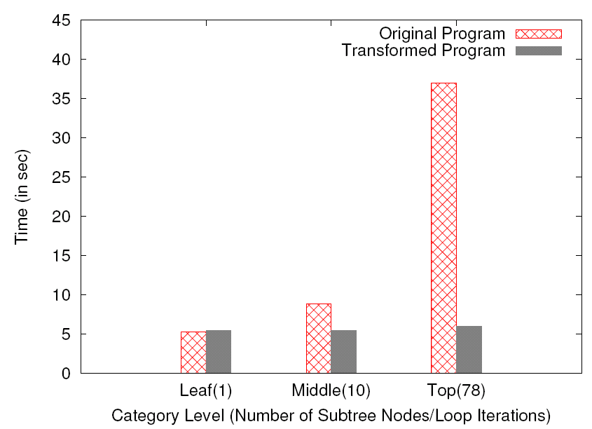
Application 2: Category Traversal
Find the maximum size of
any part in a given category
and its sub-categories.
Clustered Index
CATEGORY (category-id)
Secondary Index
PART (category-id)
Original Program
Repeatedly executed a query
that performed selection
followed by grouping.
Rewritten Program
Group-By followed by Join

Slide 18
Beyond Batching
Limitations of batching (Opportunities?)
  Some data sources e.g. Web Services may not provide a set oriented interface
  Queries may vary across iterations
  Arbitrary inter-statement data dependencies may limit applicability of transformation rules
Our Approach 2: Asynchronous Query Submission (ICDE11)
Our Approach 3: Prefetching (SIGMOD12)

Slide 19
Automatic Program Transformation for asynchronous submission
Rewriting Procedures for Batched Bindings
Prefetching Query Results Across Procedure Boundaries
System design and experimental evaluation

Slide 20
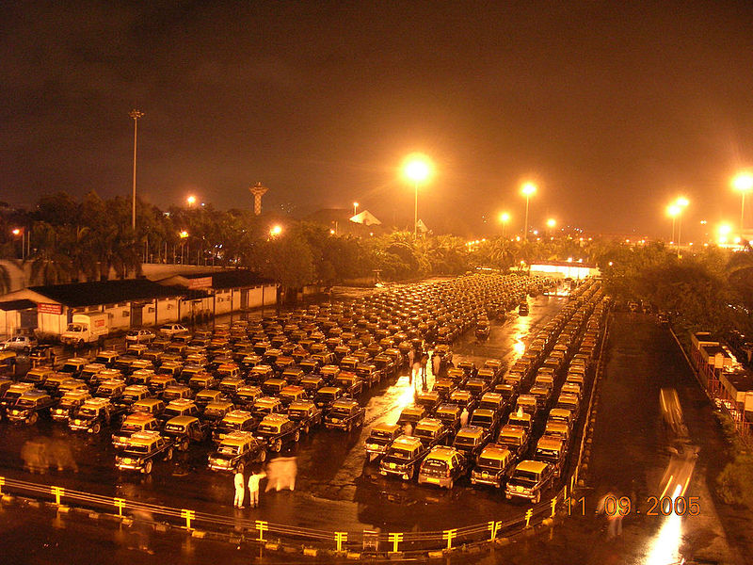

Solution 2: Asynchronous Execution: More Taxis!!

Slide 21
Motivation
Fact 1: Performance of applications can be significantly improved by asynchronous submission of queries.
Multiple queries could be issued concurrently
Application can perform other processing while query is executing
Allows the query execution engine to share work across multiple queries
Reduces the impact of network round-trip latency
Fact 2: Manually writing applications to exploit asynchronous query submission is HARD!!

Slide 22
Program Transformation Example
qt = con.Prepare(
"SELECT count(partkey) " +
"FROM part " +
"WHERE p_category=?");
int handle[SIZE], n = 0;
while(!categoryList.isEmpty()) {
category = categoryList.next();
qt.bind(1, category);
handle[n++] = submitQuery(qt);
}
for(int i = 0; i < n; i++) {
count = fetchResult(handle[i]);
sum += count;
}
qt = con.prepare(
"SELECT count(partkey) " +
"FROM part " +
"WHERE p_category=?");
while(!categoryList.isEmpty()) {
category = categoryList.next();
qt.bind(1, category);
count = executeQuery(qt);
sum += count;
}
Conceptual API for asynchronous execution
  executeQuery() – blocking call
  submitQuery() – initiates query and returns immediately
  fetchResult() – blocking wait

Slide 23
Asynchronous query submission model
Thread
qt = con.prepare(
"SELECT count(partkey) " +
"FROM part " +
"WHERE p_category=?");
int handle[SIZE], n = 0;
while(!categoryList.isEmpty()) {
category = categoryList.next();
qt.bind(1, category);
handle[n++] = submitQuery(qt);
}
for(int i = 0; i < n; i++) {
count = fetchResult(handle[i]);
sum += count;
}
Submit Q
DB
Result array
submitQuery() – returns immediately
fetchResult() – blocking call

Slide 24
Program Transformation
Can rewrite manually to add asynchronous fetch
  Supported by our library, but tedious.
Challenge:
  Complex programs with arbitrary control flow
  Arbitrary inter-statement data dependencies
  Loop splitting requires variable values to be stored and restored
Our contribution 1: Automatically rewrite to enable asynchronous fetch.
int handle[SIZE], n = 0;
while(!categoryList.isEmpty()) {
category = categoryList.next();
qt.bind(1, category);
handle[n++] = submitQuery(qt);
}
for(int i = 0; i < n; i++) {
count = fetchResult(handle[i]);
sum += count;
}
while(!categoryList.isEmpty()) {
category = categoryList.next();
qt.bind(1, category);
count = executeQuery(qt);
sum += count;
}
Notes:
Remove image, expand why it is tedious

Slide 25
Program transformation rules
Transformation rules which simplify and generalize the transformation rules of our VLDB08 paper
  Rule A: Equivalence rule for splitting a loop
    Minimal pre-conditions
    Simplified handling of nested loops
  Rule B: Converting control dependencies to flow dependencies
    Enables handling conditional branching(if-then-else) structures
  Rule C1, C2, C3: Rules to facilitate reordering of statements
Statement reordering algorithm
  Guarantees success in absence of true dependency cycle
For details, refer to ICDE 11 paper

Slide 26
The Statement Reordering Algorithm
Goal: Reorder statements such that no loop-carried flow dependencies cross the desired split boundary.
Input:
  The blocking query execution statement Sq
  The basic block b representing the loop
Output: Where possible, a reordering of b such that:
  No LCFD edges cross the split boundary Sq
  Program equivalence is preserved
Theorem: If a query execution statement doesn’t lie on a true-dependence cycle in the DDG, then algorithm reorder always reorders the statements such that the loop can be split.

Slide 27
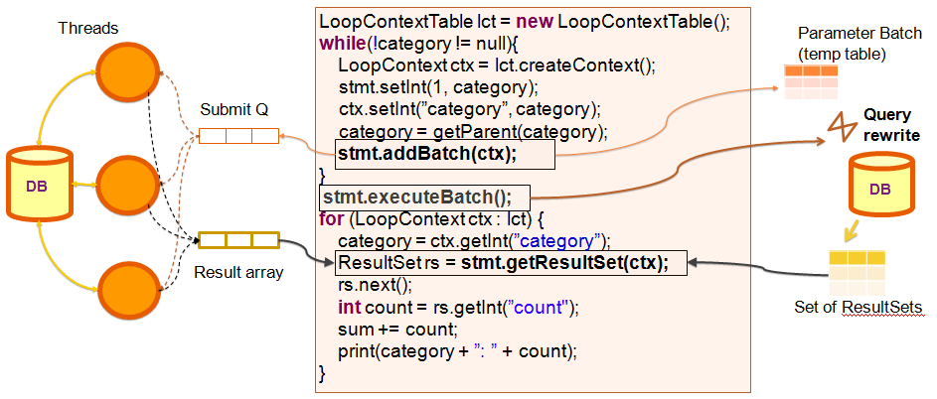
Batching and Asynchronous submission api
Asynchronous submission
Batching
Batching: rewrites multiple query invocations into one
Asynchronous submission: overlaps execution of multiple queries
Identical API interface

Slide 28
Overlapping the generation and consumption of asynchronous requests
Producer Loop
LoopContextTable lct = new LoopContextTable();
while(!categoryList.isEmpty()){
LoopContext ctx = lct.createContext();
category = categoryList.next();
stmt.setInt(1, category);
ctx.setInt(”category”, category);
stmt.addBatch(ctx);
}
stmt.executeBatch();
for (LoopContext ctx : lct) {
category = ctx.getInt(”category”);
ResultSet rs = stmt.getResultSet(ctx);
rs.next();
int count = rs.getInt(”count");
sum += count;
print(category + ”: ” + count);
}
Thread
Submit Q
DB
Result array
Consumer Loop
Consumer loop starts only after all requests are produced - unnecessary delay

Slide 29
Overlapping the generation and consumption of asynchronous requests
LoopContextTable lct = new LoopContextTable();
runInNewThread (
while(!categoryList.isEmpty()){
  LoopContext ctx = lct.createContext();
  category = categoryList.next();
  stmt.setInt(1, category);
  ctx.setInt(”category”, category);
  stmt.addBatch(ctx);
  }
)
for (LoopContext ctx : lct) {
category = ctx.getInt(”category”);
ResultSet rs = stmt.getResultSet(ctx);
rs.next();
int count = rs.getInt(”count");
sum += count;
print(category + ”: ” + count);
}
Thread
Submit Q
DB
Result array
Consumer loop starts only after all requests are produced - unnecessary delay
Idea: Run the producer loop in a separate thread and initiate the consumer loop in parallel
Note: This transformation is not yet automated

Slide 30
Asynchronous submission of batched queries
Executes a set oriented query
LoopContextTable lct = new LoopContextTable();
while(!categoryList.isEmpty()){
LoopContext ctx = lct.createContext();
category = categoryList.next();
stmt.setInt(1, category);
ctx.setInt(”category”, category);
stmt.addBatch(ctx);
}
stmt.executeBatch();
for (LoopContext ctx : lct) {
category = ctx.getInt(”category”);
ResultSet rs = stmt.getResultSet(ctx);
rs.next();
int count = rs.getInt(”count");
sum += count;
print(category + ”: ” + count);
}
Thread picks up multiple requests
Submit Q
DB
Result array
Instead of submitting individual asynchronous requests, submit batches by rewriting the query as done in batching
Benefits:
  Achieves the advantages of both batching and asynchronous submission
  Batch size can be tuned at runtime (eg. growing threshold)

Slide 31
System Design
DBridge
Tool to optimize Java applications using JDBC
A source-to-source transformer using SOOT framework for Java program analysis
DBridge API
Java API that extends the JDBC interface, and can wrap any JDBC driver
Can be used with manual/automatic rewriting
Hides details of thread scheduling and management
Same API for both batching and asynchronous submission
Experiments conducted on real world/benchmark
applications show significant gains

Slide 32
Auction Application: Impact of thread count, with 40K iterations
Database SYS1, warm cache
Time taken reduces drastically as thread count increases
No improvement after some point (30 in this example)

Slide 33
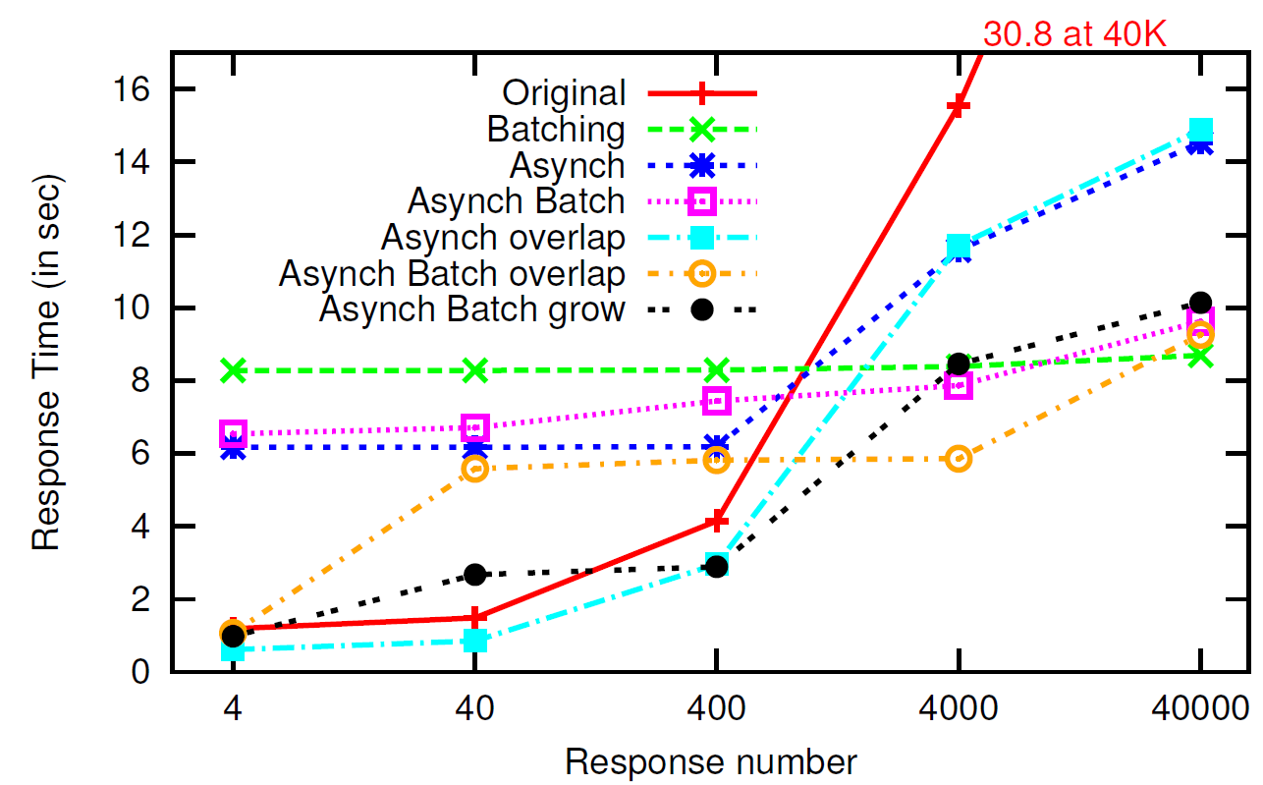
Comparison of approaches
Observe “Asynch Batch Grow” (black)
  stays close to the original program (red) at smaller iterations
  stays close to batching (green) at larger number of iterations.

Slide 34
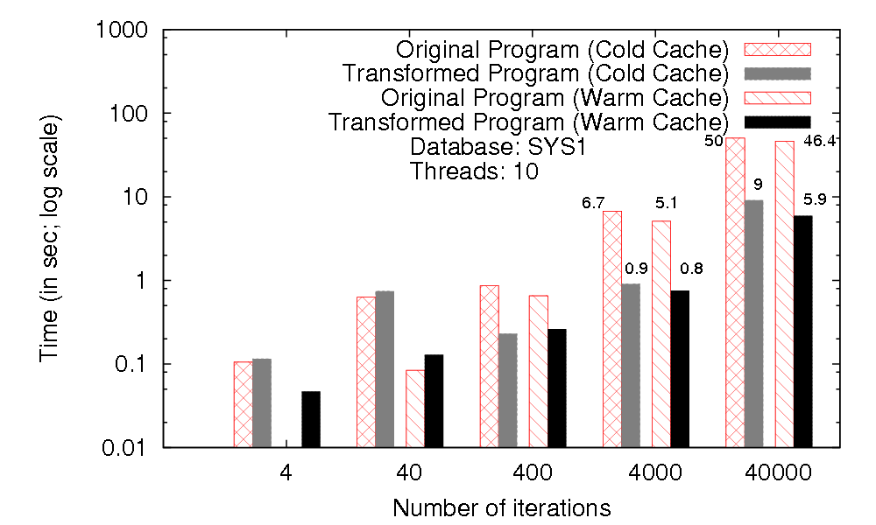
Auction Application: Impact of Iteration count, with 10 threads
Time
In seconds
Log Scale!
For small no. (4-40) iterations, transformed program slower
At 400-40000 iterations, factor of 4-8 improvement
Similar for warm and cold cache
Notes:
Highlight log scale and factor of 8

Slide 35
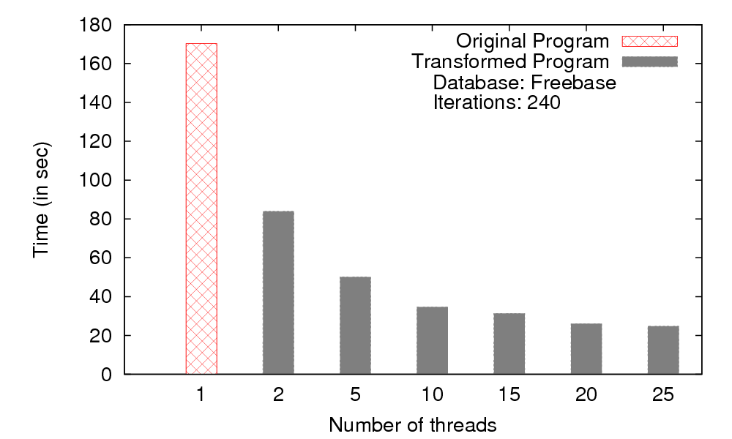
WebService: Impact of thread count
HTTP requests with JSON content
Impact similar to earlier SQL example
Note: Our system does not automatically rewrite web service programs, this example manually rewritten using our transformation rules
Notes:
Slide on batch vs async

Slide 36
Comparison:
Batching vs. Asynchronous submission
Auction system benchmark application
Asynchronous execution with 10 threads
Batching works best when applicable but asynchronous is close behind
  Currently implementing new optimizations that significantly speed up asynchronous submission

Slide 37
Prefetching Query Results Across Procedures
Automatic Program Transformation for asynchronous submission
System design and experimental evaluation

Slide 38


Solution 3: Advance Booking of Taxis

Slide 39
Prefetching Query Results
Intra-Procedural
Inter-Procedural
Enhancements
Automatic Program Transformation for asynchronous submission
System design and experimental evaluation

Slide 40
Intraprocedural prefetching
Approach:
  Identify valid points of prefetch
  insertion within a procedure
  Place prefetch request
  submitQuery(q, p) at the
  earliest point
Valid points of insertion of prefetch
  All the parameters of the query
  should be available, with no intervening assignments
  No intervening updates to the database
  Should be guaranteed that the query will be executed subsequently
Systematically found using Query Anticipability analysis
  extension of a dataflow analysis technique called anticipable expressions analysis
void report(int cId,String city){
city = …
while (…){
…
}
c = executeQuery(q1, cId);
d = executeQuery(q2, city);
…
}
Notes:
----- Meeting Notes (19/05/12 19:31) -----
drop if in earlier program

Slide 41
Query anticipability analysis
Definition 3.1. A query execution statement q is anticipable at a program point u if every path in the CFG from u to End contains an execution of q which is not preceded by any statement that modifies the parameters of q or affects the results of q.
CFG: Control flow graph
  Nodes: statements
  Edges: control transfers between statements
Data flow information
  Stored as bit vectors (1 bit per query)
  Propagated against the direction of control flow
  (Backward Dataflow Analysis)
  Captured by a system of data flow equations
  Solve equations iteratively till a fixpoint is reached
  Details with example in the paper
u
q
End

Slide 42

Query anticipability analysis
start
n1
n2
n3
n4
n5
void report(int cId,String city){
city = …
while (…){
…
}
rs1 = executeQuery(q1, cId);
rs2 = executeQuery(q2, city);
…
}
n1
n3
n2
Bit vector = (q1,q2)
= anticipable (valid)
= not anticipable (invalid)
n4
n5
end
Notes:
Map stmts to nodes?

Slide 43


Query anticipability analysis results
start
( , )
n1
n2
n3
n4
n5
void report(int cId,String city){
city = …
while (…){
…
}
rs1 = executeQuery(q1, cId);
rs2 = executeQuery(q2, city);
…
}
( , )
n1
( , )
( , )
( , )
n3
n2
( , )
( , )
( , )
n4
Bit vector = (q1,q2)
= anticipable (valid)
= not anticipable (invalid)
( , )
( , )
n5
( , )
end
( , )

Slide 44
Intraprocedural prefetch insertion
  Analysis identifies all points in the program where q is anticipable; we are interested in earliest points
n1: x =…
n1: if(…)
submit(q,x)
submit(q,x)
n2
n2
nq: executeQuery(q,x)
n3
nq: executeQuery(q,x)
  Data dependence barriers
    Due to assignment to query parameters or UPDATEs
    Append prefetch to the barrier statement
  Control dependence barriers
    Due to conditional branching
    (if-else or loops)
    Prepend prefetch to the
    barrier statement

Slide 45
Intraprocedural prefetch insertion
void report(int cId,String city){
city = …
while (…){
…
}
rs1 = executeQuery(q1, cId);
rs2 = executeQuery(q2, city);
…
}
void report(int cId,String city){
submitQuery(q1, cId);
city = …
submitQuery(q2, city);
while (…){
…
}
rs1 = executeQuery(q1, cId);
rs2 = executeQuery(q2, city);
…
}
q2 only achieves overlap with the loop
q1 can be prefetched at the beginning of the method
Note: fetchResult() replaced by executeQuery() in our new API

Slide 46
Intraprocedural prefetch insertion
void report(int cId,String city){
city = …
while (…){
…
}
rs1 = executeQuery(q1, cId);
rs2 = executeQuery(q2, city);
…
}
void report(int cId,String city){
submitQuery(q1, cId);
city = …
submitQuery(q2, city);
while (…){
…
}
rs1 = executeQuery(q1, cId);
rs2 = executeQuery(q2, city);
…
}
q2 only achieves overlap with the loop
q1 can be prefetched at the beginning of the method
  Can be moved to the method that invokes report()

Slide 47
InterProcedural Prefetching
for (…) {
…
genReport(custId, city);
}
void genReport(int cId, String city) {
if (…)
city = …
while (…){
…
}
rs1 = executeQuery(q1, cId);
rs2 = executeQuery(q2, city);
…
}
for (…) {
…
genReport(custId, city);
}
void genReport(int cId, String city) {
submitQuery(q1, cId);
if (…)
city = …
submitQuery(q2, city);
while (…){
…
}
rs1 = executeQuery(q1, cId);
rs2 = executeQuery(q2, city);
…
}
If first statement of procedure is submitQuery, move it to all call points of procedure.

Slide 48
InterProcedural Prefetching
for (…) {
…
genReport(custId, city);
}
void genReport(int cId, String city) {
if (…)
city = …
while (…){
…
}
rs1 = executeQuery(q1, cId);
rs2 = executeQuery(q2, city);
…
}
for (…) {
submitQuery(q1, custId);
…
genReport(custId, city);
}
void genReport(int cId, String city) {
if (…)
city = …
submitQuery(q2, city);
while (…){
…
}
rs1 = executeQuery(q1, cId);
rs2 = executeQuery(q2, city);
…
}
If first statement of procedure is submitQuery, move it to all call points of procedure.

Slide 49
Prefetching Algorithm: Summary
Our algorithms ensure that:
  The resulting program preserves equivalence with the original program.
  All existing statements of the program remain unchanged.
  No prefetch request is wasted.
Equivalence preserving program and query
transformations (details in paper)
Barriers to prefetching
  Enhancements to enable
  prefetching
  Code motion and query chaining
void proc(int cId){
int x = …;
while (…){
…
}
if (x > 10)
c = executeQuery(q1, cId);
…
}

Slide 50
Enhancement: Transitive code motion
(Strong anticipability)
Increase prefetching benefits in presence of barriers:
  Control dependence barrier:
    Transform it into a data dependence barrier by rewriting it as a guarded statement
  Data dependence barrier:
    Apply anticipability analysis on the barrier statements
    Move the barrier to its earliest point followed by the prefetch
void genReport(int cId){
int x = …;
while (…){
…
}
if (x > 10)
rs1 = executeQuery(q1, cId);
…
}
void genReport(int cId){
int x = …;
boolean b = (x > 10);
if (b) submit(q1, cId);
while (…){
…
}
if (b)
rs1 = executeQuery(q1, cId);
…
}

Slide 51
Enhancement: Chaining prefetch requests
Output of a query forms a parameter to another – commonly encountered
Prefetch of query 2 can be issued immediately after results of query 1 are available.
submitChain similar to submitQuery ; details in paper
void report(int cId,String city){
…
c = executeQuery(q1, cId);
while (c.next()){
accId = c.getString(“accId”);
d = executeQuery(q2, accId);
}
}
void report(int cId,String city){
submitChain({q1, q2’}, {{cId}, {}});
…
c = executeQuery(q1, cId);
while (c.next()){
accId = c.getString(“accId”);
d = executeQuery(q2, accId);
}
}
q2 cannot be beneficially prefetched
as it depends on accId which comes
from q1
q2’ is q2 with its ? replaced by q1.accId

Slide 52
Rewriting Chained prefetch requests
Chained SQL queries have correlating parameters between them (q1.accId)
Can be used to rewrite them into one query using known techniques such as OUTER APPLY or LEFT OUTER LATERAL operators
Results are split into individual result sets in cache
Reduces network round trips, aids in selection of set oriented query plans
submitChain({“SELECT * FROM accounts WHERE custid=?”,
“SELECT * FROM transactions WHERE accId=:q1.accId”}, {{cId}, {}});
SELECT ∗
FROM (SELECT ∗ FROM accounts WHERE custId = ?)
OUTER APPLY
(SELECT ∗ FROM transactions
WHERE transactions.accId = account.accId)

Slide 53
Integration with loop fission
Loop fission (splitting) intrusive and complex for loops invoking procedures that execute queries
Prefetching can be used as a preprocessing step
Increases applicability of batching and
asynchronous submission
for (…) {
…
addBatch(q, cId);
}
submitBatch(q);
for (…) {
genReport(custId);
}
void genReport(int cId) {
…
r=executeQuery(q, cId);
…
}
for (…) {
…
submit(q,cId);
genReport(custId);
}
void genReport(int cId) {
…
r=executeQuery(q, cId);
…
}
for (…) {
…
genReport(custId);
}
void genReport(int cId) {
…
r=executeQuery(q, cId);
…
}
Original program
Interprocedural prefetch
Loop Fission

Slide 54
Hibernate and web services
Lot of enterprise and web applications
  Are backed by O/R mappers like Hibernate
    They use the Hibernate API which internally generate SQL
  Are built on Web Services
    Typically accessed using APIs that wrap HTTP requests and responses
To apply our techniques here,
  Transformation algorithm has to be aware of the underlying data access API
  Runtime support to issue asynchronous prefetches
Our implementation currently provides runtime support for JDBC, a subset of Hibernate, and a subset of the Twitter API

Slide 55
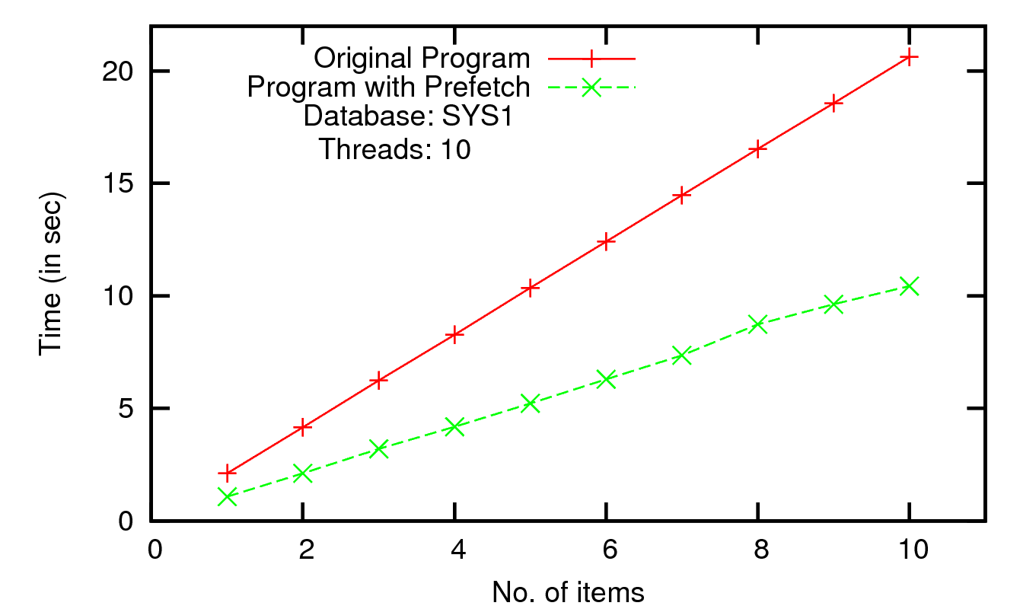
Auction application (Java/JDBC): Intraprocedural prefetching
for(…) {
for(…) {
…
}
exec(q);
}
for(…) {
submit(q);
for(…) {
…
}
exec(q);
}
Single procedure with nested loop
Overlap of loop achieved; varying iterations of outer loop
Consistent 50% improvement

Slide 56
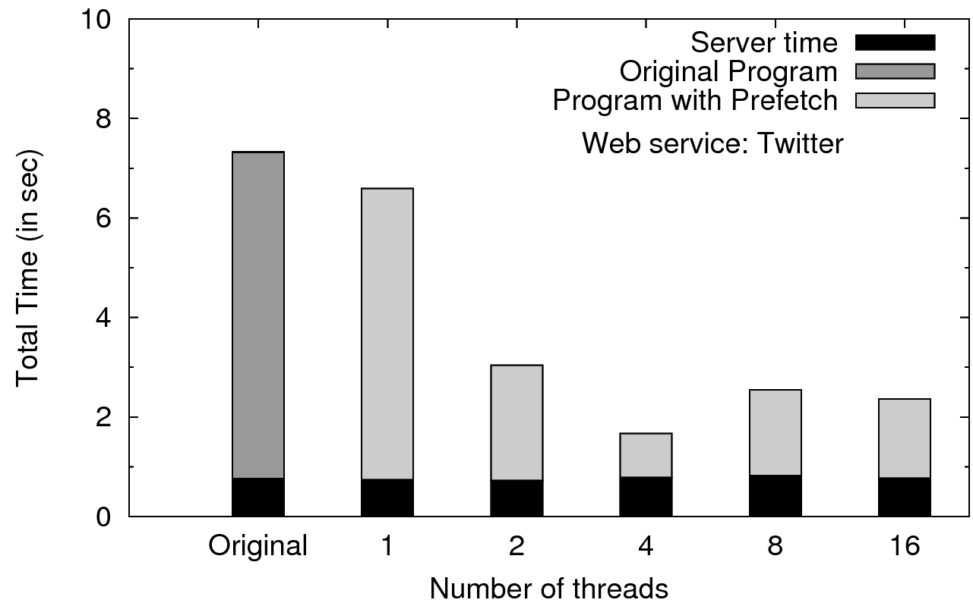
Web service (HTTP/JSON):
Interprocedural prefetching
Twitter dashboard: monitors 4 keywords for new tweets
(uses Twitter4j library)
Interprocedural prefetching; no rewrite possible
75% improvement at 4 threads
Server time constant; network overlap leads to significant gain
Note: Our system does not automatically rewrite web service programs, this example was manually rewritten using our algorithms

Slide 57
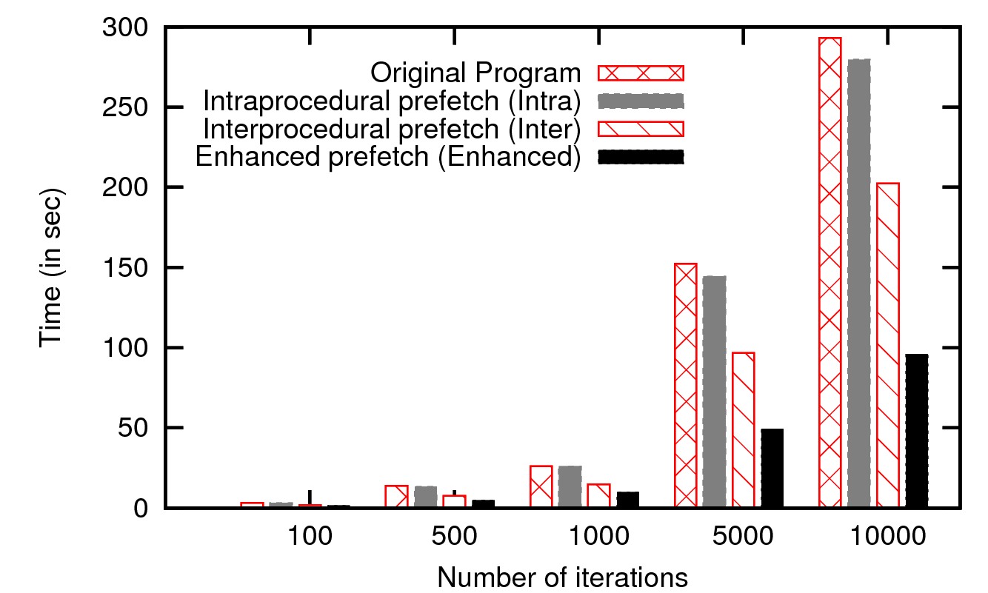
ERP Application: Impact of our techniques
Intraprocedural: moderate gains
Interprocedural: substantial gains (25-30%)
Enhanced (with rewrite): significant gain(50% over Inter)
Shows how these techniques work together

Slide 58
Related Work
Query result prefetching based on request patterns
    Fido (Palmer et.al 1991), AutoFetch (Ibrahim et.al ECOOP 2006),
    Scalpel (Bowman et.al. ICDE 2007), etc.
  Predict future queries using traces, traversal profiling, logs
  Missed opportunities due to limited applicability
  Potential for wasted prefetches
Imperative code to SQL in OODBs
  Lieuwen and DeWitt, SIGMOD 1992

Slide 59
Related Work
getAllReports() {
for (custId in …) {
…
genReport(custId);
}
}
void genReport(int cId) {
…
r = executeQuery(q, cId);
…
}
Manjhi et. al. 2009 – insert
prefetches based on static analysis
  No details of how to automate
  Only consider straight line
  intraprocedural code
  Prefetches may go waste
Recent (Later) Work:
  StatusQuo: Automatically Refactoring Database Applications for Performance (MIT+Cornell projact)
    Cheung et al. VLDB 2012, Automated Partition of Applications
    Cheung et al. CIDR 2013
  Understanding the Behavior of Database Operations under Program Control, Tamayo et al. OOPSLA 2012
    Batching (of inserts), asynchronous submission, …

Slide 60
The DBridge System
Prefetch insertion algorithm
Enhancements
Increasing applicability

Slide 61
System design: DBridge
Our techniques have been incorporated into the DBridge holistic optimization tool
Two components:
  Java source-to-source program Transformer
    Uses SOOT framework for static analysis and transformation (http://www.sable.mcgill.ca/soot/)
    Minimal changes to code – mostly only inserts prefetch instructions (readability is preserved)
  Prefetch API (Runtime library)
    Thread and cache management
    Can be used with manual writing/rewriting or automatic rewriting by DBridge transformer
Currently works for JDBC API; being extended for Hibernate and Web services

Slide 62
System Design: DBridge

Slide 63
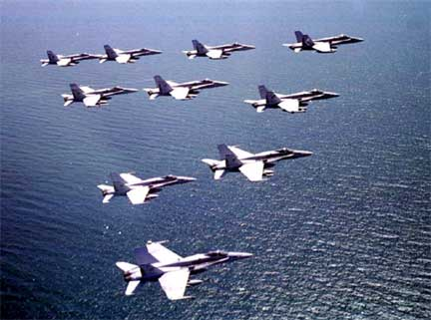
Future Directions?
Technical:
  Which calls to prefetch
    where to place prefetch
  Cost-based speculative prefetching
  Updates and transactions
  Cross thread transaction support
  Cache management
Complete support for Hibernate
Support other languages/systems
  (working with ERP major)
Acknowledgements
Work of Karthik Ramachandra supported by a Microsoft India PhD fellowship, and a Yahoo! Key Scientific Challenges Grant
Work of Ravindra Guravannavar partly supported by a grant from Bell Labs India
Project website: http://www.cse.iitb.ac.in/infolab/dbridge

Slide 64
References
Ravindra Guravannavar and S. Sudarshan, Rewriting Procedures for Batched Bindings, VLDB 2008
Mahendra Chavan, Ravindra Guravannavar, Karthik Ramachandra and S. Sudarshan,
Program Transformations for Asynchronous Query Submission, ICDE 2011
Mahendra Chavan, Ravindra Guravannavar, Karthik Ramachandra and S Sudarshan
DBridge: A program rewrite tool for set oriented query execution, (demo paper) ICDE 2011
Karthik Ramachandra and S. Sudarshan
Holistic Optimization by Prefetching Query Results, SIGMOD 2012
Karthik Ramachandra, Ravindra Guravanavar and S. Sudarshan
Program Analysis and Transformation for Holistic Optimization of Database Applications, SIGPLAN Workshop on State of the Art in Program Analysis (SOAP) 2012
Karthik Ramachandra, Mahendra Chavan, Ravindra Guravannavar, S. Sudarshan, Program Transformation for Asynchronous and Batched Query Submission, IEEE TKDE 2014 (to appear).

Slide 65
Thank You!

