Slide 1
Plan Bouquets
Final Draft

Slide 2
Motivation
Cost-based database query optimizers estimate a host of selectivities while identifying the ideal execution plan for declarative OLAP queries.
Eg:
SELECT * FROM lineitem,orders,part
WHERE p_partkey = l_partkey and I_orderkey = o_orderkey and p_retailprice <1000
In this example the optimizer estimates the selectivities of a selection predicate and two join predicates.

Slide 3
Sample Relational Database: Manufacturing
Supplier
Region
PartSupp
Nation
Orders
Part
Customer
Lineitem
Declarative
select *
from lineitem, orders, part
where p_partkey = l_partkey and
l_orderkey = o_orderkey and
p_retailprice < 1000
SQL query for
  Complete details of orders for cheap parts
  Algebraic equivalent: σ_{p_retailprice < 1000} (part ⨝_{partkey} lineitem ⨝ _{orderkey} orders)

Slide 4
Query Execution Plan
Ordered (imperative) sequence of steps to process the data
Enormous number of semantically equivalent alternative plans
  for a query with N relations, there are at least N! join orders
  multiple algorithmic choices at each node in the plan
  (e.g. Join operator: Nested Loops, Sort Merge, Hash, Index, …)
⨝ (l_orderkey = o_orderkey)
⨝ (p_partkey = l_partkey)
⨝ (p_partkey = l_partkey)
orders
⨝ (l_orderkey = o_orderkey)
part
σ (p_retailprice < 1000)
part
lineitem
orders
lineitem
σ (p_retailprice < 1000)

Slide 5
Cost-based Query Optimization
Determining the most efficient plan to execute an SQL query
  Depends a lot on the data distribution even with the same query.
Compare all alternative plans based on the following criteria:
  operator cardinality model
    estimate the quantity of data processing at each operator
    expected to accurately estimate the number of tuples at each operator
      summary statistics through histograms
  operator cost model
    estimate the time taken to perform the required data processing
    expected to accurately estimate the
      time taken to bring a relational page from disk to memory
      time taken to process filter condition on a given tuple, etc.

Slide 6
Cardinality Estimation
RDBMS
(EQ)
select *
from lineitem, orders, part
where p_partkey = l_partkey and
l_orderkey = o_orderkey and
p_retailprice < 1000
Statistical Metadata
Query Optimizer
Estimated Join
Cardinality
1.2 x 10⁶
Hash Join
Estimated Join
Cardinality
1.5 x 10⁵
RelScan
1.2 x 10⁶
Hash Join
1.5 x 10⁵
orders
6 x 10⁶
RelScan
4 x 10³
RelScan
Estimated Selection Cardinality
Base Relation
Cardinality
6 x 10⁶
lineitem
2 x 10⁴
part

Slide 7
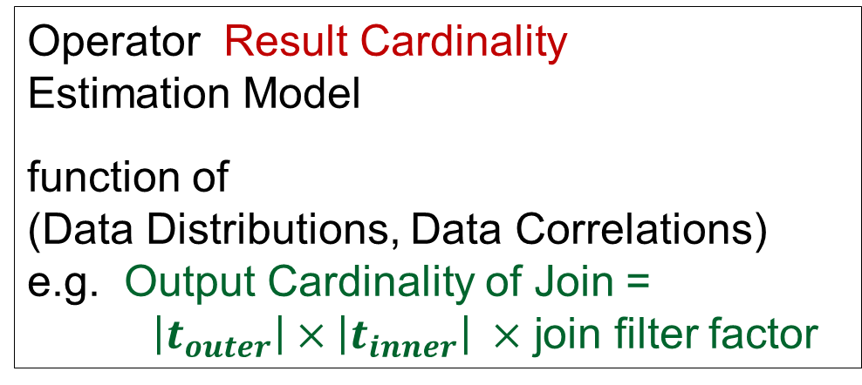
Canonical Query Optimization Framework
Query Optimizer
Optimal [Min Cost]
Plan P(Q)
Declarative
Query (Q)
Operator Execution Cost
Estimation Model
function of
(Hardware, DB Engine)
e.g. NL Join
= |R_{outer}| + |R_{outer}| x |R_{inner}|
Operator Result Cardinality
Estimation Model
function of
(Data Distributions, Data Correlations)
e.g. Output Cardinality of Join = $\left|t_{outer}\right|×\left|t_{inner}\right| ×$ join filter factor

Slide 8
Run-time sub-optimality
In practice there are errors in estimations which are executed during query execution.
A supposedly optimal plan may actually turn out to be sub-optimal, in some cases very significantly when used on the actual data.
This is mainly due to:
(a) cost model → limited impact, < 30 %
(b) cardinality model → huge impact, orders of magnitude
These are due to coarse statistics, attribute value independence assumption, multiplicative error propagation, outdated statistics, query construction, etc.

Slide 9

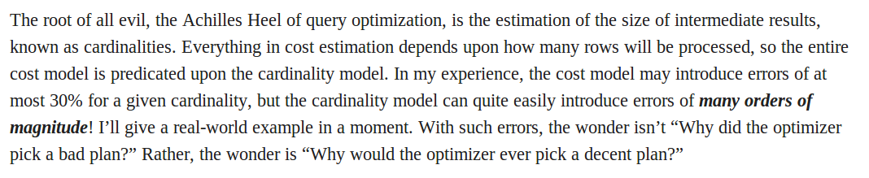
Proof by Authority [Guy Lohman, IBM Almaden]
Snippet from his recent Sigmod blog post on
“Is Query Optimization a “Solved” Problem?”

Slide 10
Selectivity Estimation Error (EQ)
(EQ)
select *
from lineitem, orders, part
where p_partkey = l_partkey and
l_orderkey = o_orderkey and
p_retailprice < 1000
Compile time estimate
1.2 * 10⁶
Optimizer assumes orders are equally likely for all prices
4 x 10³
lineitem
6 x 10⁶
part
2 x 10⁴
Run time situations
There are no orders for cheap parts
All the orders correspond to cheap parts
0
6 x 10⁶
Huge
overestimate
4 x 10³
lineitem
6 x 10⁶
4 x 10³
lineitem
6 x 10⁶
Huge
underestimate
part
2 x 10⁴
part
2 x 10⁴

Slide 11
Prior Research (lots!)
Sophisticated estimation techniques
  SIGMOD 1999, VLDB 2001, VLDB 2009, SIGMOD 2010, VLDB 2011, …
Selection of Robust Plans
  SIGMOD 1994, PODS 2002, SIGMOD 2005, VLDB 2008, SIGMOD 2010, …
Runtime Re-optimization techniques
  SIGMOD 1998, SIGMOD 2000, SIGMOD 2004, SIGMOD 2005, …
Several novel ideas and formulations,
but lacked performance guarantees

Slide 12
Introduction to Plan Bouquets
Plan Bouquets is a conceptually new approach, wherein the compile-time estimation process is completely eschewed for error-prone selectivities.
These selectivities are discovered systematically at run-time through a calibrated sequence of cost-limited plan executions.
Plan bouquets provide worst case performance guarantees with respect to omniscient oracle that knows the correct selectives.
Empirical performance well within guaranteed bounds on industrial strength environments.

Slide 13
Parametric Query Optimization(PQO)
The cost of a query plan depends on various database and system parameters.
The exact values of these parameters may not be known at compile time.
Parametric query optimization (PQO) optimizes a query into a number of candidate plans, each optimal for some region of the parameter space.

Slide 14
PQO diagrams in Picasso

Slide 15
Problem Framework

Slide 16
Selectivity Dimensions
100%
Example Query: EQ
select *
from lineitem, orders, part
where p_partkey = l_partkey and
l_orderkey = o_orderkey and
p_price < 1000
sel (part ⨝ lineitem)
SS – Selectivity Space
0%
sel (σ (part))
100%
sel (lineitem ⨝ orders)
100%

Slide 17
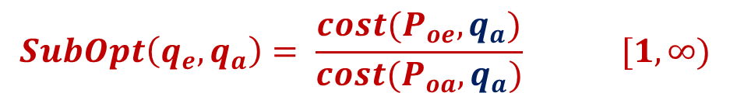
Performance Metrics
100%
sel (part ⨝ lineitem)
q_{e} – estimated selectivity location in SS
q_{a} – actual run-time location in SS
P_{oe} – optimal plan for q_{e}
P_{oa} – optimal plan for q_{a}
q_{a}(75%, 62%, 85%)
q_{e}(5%, 2%, 8%)
0%
sel (σ (part))
100%
$$SubOpt\left(q_{e}, q_{a}\right)= \frac{cost(P_{oe}, q_{a})}{cost(P_{oa}, q_{a})} [1, ∞)$$
100%
sel (lineitem ⨝ orders)
$$MaxSubOpt \left(MSO\right)=MAX\left[SubOpt\left(q_{e}, q_{a}\right)\right] ∀q_{e}, q_{a}∈SS$$
$$AvgSubOpt \left(ASO\right)=AVG\left[SubOpt\left(q_{e}, q_{a}\right)\right] ∀q_{e}, q_{a}∈SS$$

Slide 18
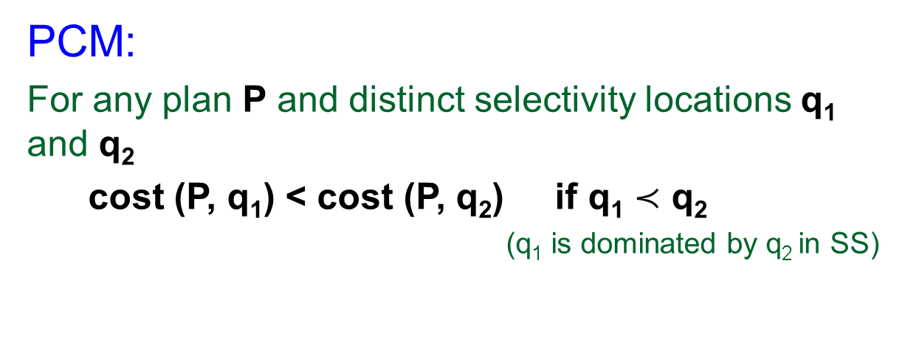
Main Assumptions
Plan Cost Monotonicity (Mandatory)
Perfect Cost Model (relaxed at end of talk)
Independent SS Dimensions (ongoing work)
PCM:
For any plan P and distinct selectivity locations q₁ and q₂
cost (P, q₁) < cost (P, q₂) if q₁ $≺$ q₂
(q₁ is dominated by q₂ in SS)
Cost(P, q₂) =100
q₂
cost(P, q_{i}) < 100

Slide 19
Current Optimizer Behavior on
One-dimensional SS

Slide 20
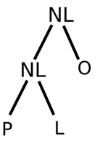
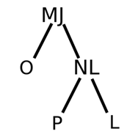
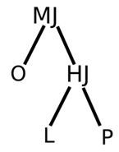
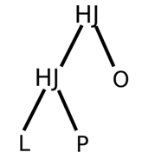
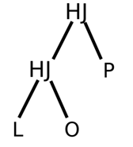
POSP (Parametric Optimal Set of Plans)
1D example:
Let us assume that only the p_retailprice selection predicate is error-prone.
Through repeated invocations of the optimizer, we identify the parametric optimal set of plans (POSP).
These cover the entire selectivity range of the predicate.
P1(0,0.3]
P2(0.3,1.0]
P3(1.0,7.5]
P4(7.5,63.0)
P5(63.0,100.0]

Slide 21
POSP Infimum Curve (PIC)
  PIC is the trajectory of the minimum cost from among the POSP plans.
  The dotted lines represent thr geometric progression of the isocost steps.
  The intersection with IC with PIC represents an associated selectivity along with the best plan among POSP.
  Plan bouquets are the subsets of POSP that are associated with the intersection of PIC and IC.
  Here plan bouquet is {P1,P2,P3,P5}.
  This will turn into:

Slide 22
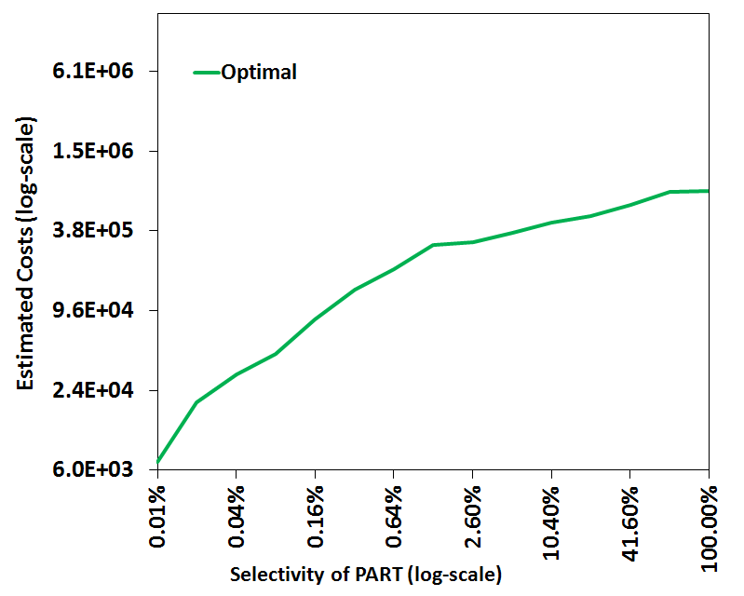
Parametric Optimal Set of Plans (POSP)
( Parametric version of EQ)
select *
from lineitem, orders, part
where p_partkey = l_partkey and
l_orderkey = o_orderkey and
SEL (PART) = $1
log-scale
P5
P4
P3
P2
Using Selectivity Injection
P1
NL: Nested Loop Join
MJ: Merge Join
HJ: Hash Join
L: Lineitem
O: Orders
P: Part
log-scale
Notes:
JH: Keep single predicate
Bring plan also one by one : done

Slide 23
How It Works
From the Plan Bouquets, in the increasing order of PIC, take a plan and execute it.
If the query execution is complete before the cost reaches the corresponding isocost line then return the result.
If not delete all the result e obtained and go to the next isocost line and the corresponding plan in the same order as above.
Do this until the second condition satisfies.

Slide 24
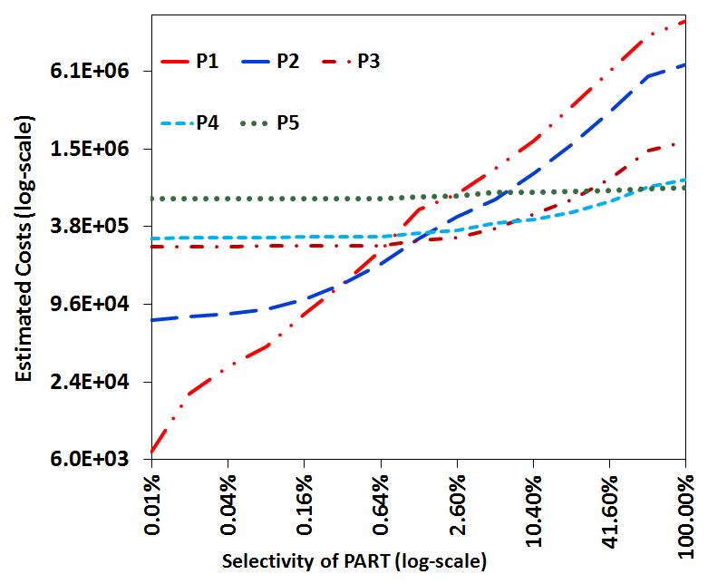
Bouquet Execution
Let q_{a} = 5%
(1) Execute P1
with budget IC1(1.2E4)
(2) Throw away results of P1
Execute P1
with budget IC2(2.4E4)
(3) Throw away results of P1
Execute P1
with budget IC3(4.8E4)
(4) Throw away results of P1
Execute P1
with budget IC2(9.6E4)
(5) Throw away results of P1
Execute P2
with budget IC5(1.9E5)
(6) Throw away results of P2
Execute P3
with budget IC6(3.8E5)
P3 completes with cost 3.4E5
IC7
IC6
IC5
IC4
IC3
IC2
IC1
P5
P3
P2
P1
q_{a} = 5%

Slide 25
Performance Characteristics
May seem absurd and self-defeating because
  At compile time considerable preprocessing may be required to identify the POSP plan set and the associated PIC.
  At run time overheads may be hugel expensive since there are multiple plan executions for the same query.
But through careful design we can have plan bouquets efficiently provide robustness profiles that are markedly superior to the native optimizer’s profile.

Slide 26
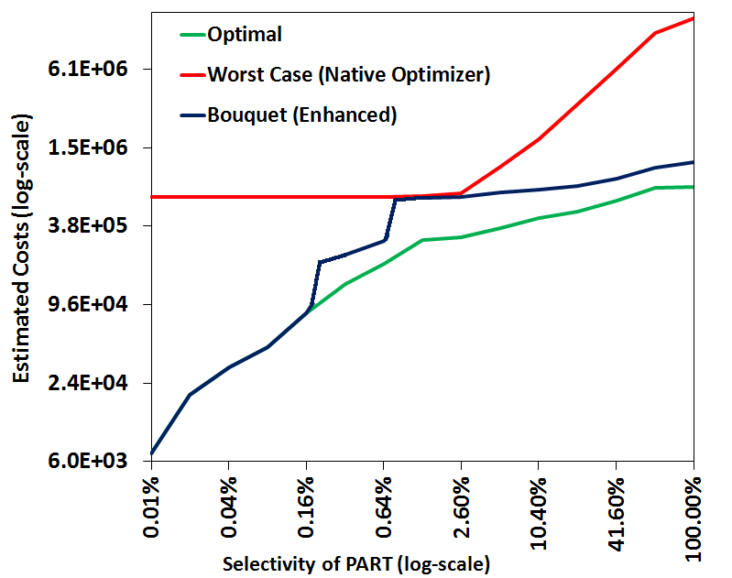
Bouquet Performance (EQ)
Native Optimizer
MaxSubOpt = 100
AvgSubOpt = 1.8
Bouquet (Enhanced)
MaxSubOpt = 3.1
AvgSubOpt = 1.7

Slide 27
Performance Characteristics
There is a guarantee on the guarantee on the MSO.
Also the ASO is not sacrificed.
To show the worst case guarantee, we need the following lemma:
If q resides in the range (qk-1,qk], 1<=k<=m. then plan Pk executes it to the completion of the algorithm.

Slide 28
Theorem:
Given any query Q on a 1D error-prone selectivity space and the associated PIC discretized with a geometric progression having common ratio r, the bouquet execution algorithm ensures that:
MSO <= r*r/(r-1)
To prove this, we need to construct the graph with isocost obeying the following rules:
PIC is sliced with m=logr[Cmax/Cmin] cuts, satisfying the boundary conditions a/r < Cmin <= IC1 and Icm-1<Cmax=Icm.

Slide 29
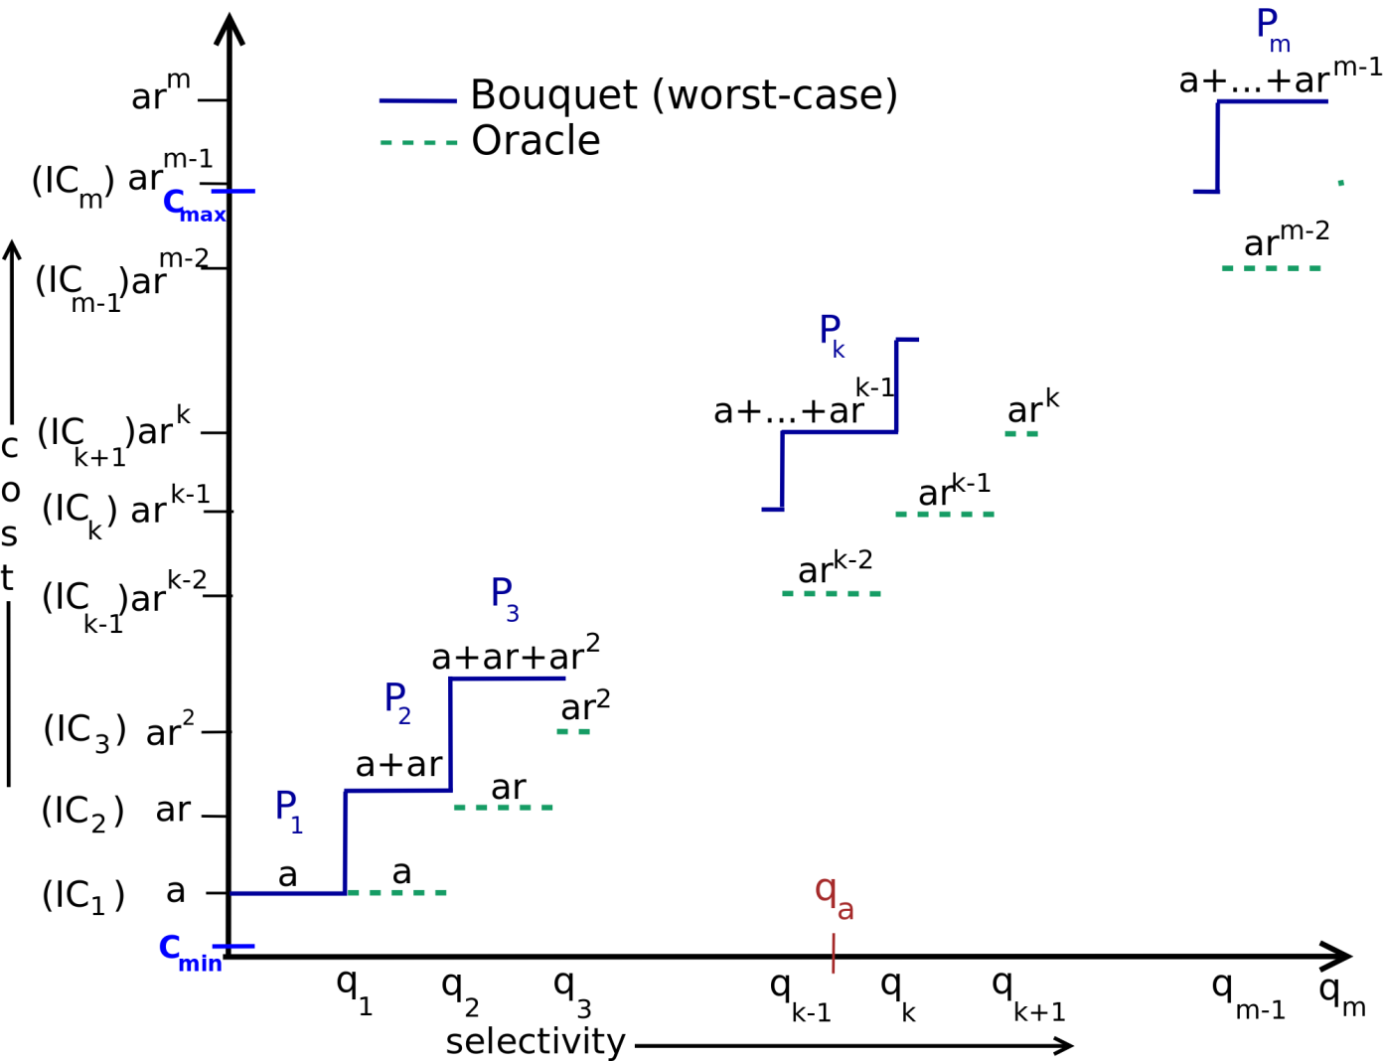
Worst Case Cost Analysis
Bouquet (upper bound)
Optimal (lower bound)
P_{k} would complete within its budget when q_{a} ϵ (q_{k-1}, q_{k}]

Slide 30
MSO Bound
Now for the worst case, if the query is in (k-1,k] we have:
Cost(qa) = cost(IC1) + cost(IC2) + ….. + cost(ICk)
= a + ar + ar*r + ………
Now let us assume there is a corresponding oracle algorithm that apriori knows the correct location of qa is lower bounded by k.
Then subopt <= r*r/(r-1)
So the minimum value of MSO is 4.
We can also show that there exists no online deterministic algorithm with MSO guarantee lower than 4 in the 1D scenario.

Slide 31

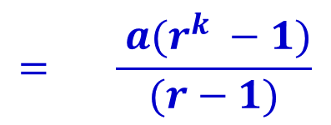
1D Performance Bound
$$C_{bouquet}\left(q_{k−1}, q_{k}\right]=cost\left(IC_{1}\right)+cost\left(IC_{2}\right)+ …+cost\left(IC_{k−1}\right)+cost(IC_{k})$$
$$= a + ar + …+ ar^{k−2 } + ar^{k−1}$$
$$= \frac{ a(r^{k} −1)}{(r−1)}$$
$$C_{optimal}\left(q_{k−1}, q_{k}\right] ≥ar^{k−2}$$
(Implication of PCM)
Reaches minima at r = 2
➔ MSO = 4
Best performance achievable by any deterministic online algorithm!
Notes:
JH: Formatting is poor : done

Slide 32
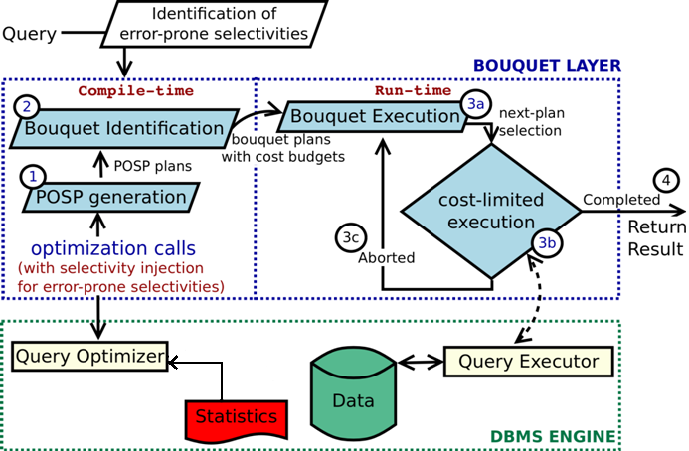
Bouquet Architecture

Slide 33
Bouquet Approach in Multidimensional SS

Slide 34
Multi-dimensional Selectivity Space
Let us look at 2D scenario and generalize it to multi-dimensional scenario.
Here the isocost surfaces ICk are represented by countours that represent a continuous sequence of selectivity locations.
Multiple bouquet plans may be present on each individual contour.
To decide whether the actual query localtion (qa) lies below or beyond the contour in principle every plan that is present in the contour must be executed. Only if none of them is complete, we can decide that the actual location of the query is definitely beyond the contour.

Slide 35
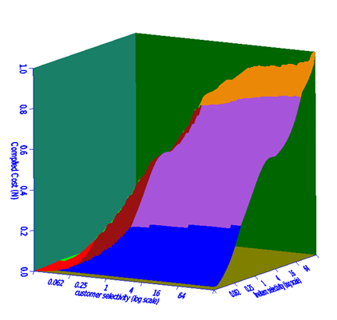
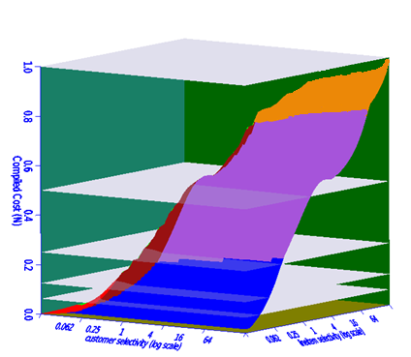
2D Bouquet Identification
Cost
(normalized)
Isocost Contours
Plans
Isocost Planes
Cost
Plans
Multiple Plans per contour
sel-X
sel-Y
Notes:
Fix PCM violation in these pics using paint : done

Slide 36
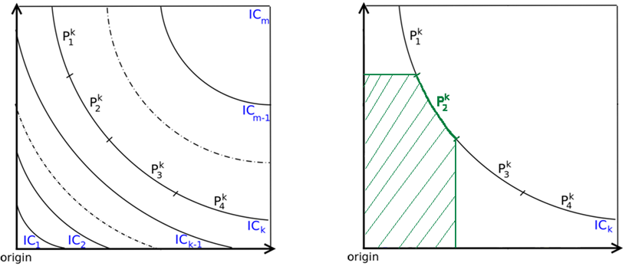
Characteristics of 2D Contours
s
e
l
-
Y
s
e
l
-
Y
sel - X
sel - X
Third quadrant coverage (due to PCM)
P₂^{k} can complete any query with actual selectivities(q_{a}) in the shaded region within cost(IC_{k})
2D contours
Hyperbolic curves
Multiple plans per contour
Notes:
Mention Cmax and Cmin
Make the bottom thing a callout : done

Slide 37
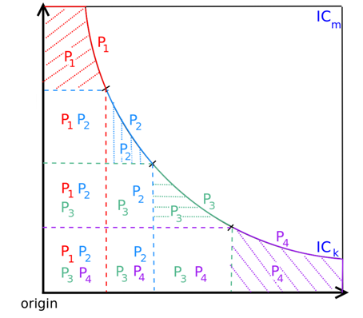
Crossing 2D Contours
Covered by only one plan in contour
Covered by all plans in contour
s
e
l
-
Y
These can be proved using PCM
sel - X
⇒ Entire set of contour plans must be executed to fully cover all locations under IC_{k}
Notes:
Highlight the region being covered : done

Slide 38
Algorithm for multi-dimensional SS
for cid = 1 to m do //for each cost-contour cid
for I = 1 to ncid do //for each plan on cid
Start executing Pi
while running-cost(Pi) <= cost-budget(ICcid) do
execute plan Pi //cost limited execution
if Pi finishes execution then
return query result
stop executing Pi

Slide 39
Performance Analysis
Even in the multidimensional scenario MSO is calculated just as it is done in 1D scenario.
For each contour line we have to execute all the plans corresponding to it.
But we clearly see that the maximum cost corresponding to each plan is the same as the cost of the contour line.
So the cost will be:

Slide 40
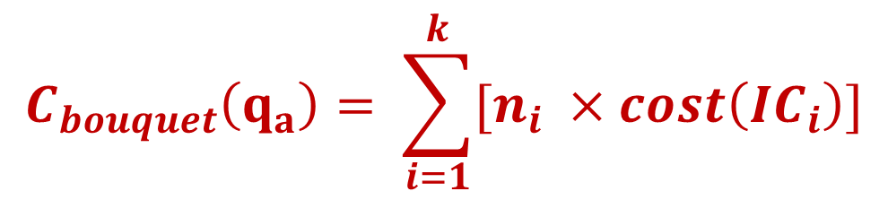


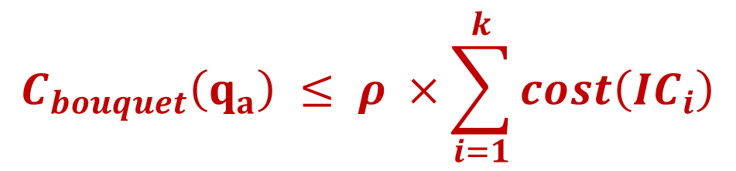
2D Performance Analysis
Number of plans on i^{th} contour
When q_{a} ϵ (IC_{k-1}, IC_{k}]
$$C_{bouquet}\left(q_{a}\right)= \sum_{i=1}^{k}{[n_{i} ×cost\left(IC_{i}\right)]}$$
ρ = max(n_{i})
$$C_{bouquet}\left(q_{a}\right) ≤ ρ ×\sum_{i=1}^{k}{cost\left(IC_{i}\right)}$$
$${SubOpt}_{bouquet}\left(q_{a}\right)=4ρ$$
(Using 1D Analysis)
Bound for N-dimensions:
$${SubOpt}_{bouquet}\left(q_{a}\right)=4 × ρ_{ _{ICsurface} }$$
Notes:
JH: Need to make colors consistent across slides! Keep font to be Arial throughout. : see
JH: Give nD analysis at bottom

Slide 41
Dependency on ρ
From the above result we can clearly see that MSO is dependent on ρ.
In practice, ρ can be very large, (even in the magnitude of 100s) making the performance guarantee of 4ρ impractically weak.
So we have to reduce the value of ρ.
This optimization can be done during:
  Compile Time:
    Anorexic POSP reduction [VLDB 2007]
  Run Time:
    Explicit Monitoring of Selectivity Lower Bounds
    Spilling-based Execution.

Slide 42
Anorexic Reduction
This is used to reduce the number of plans that are present during compile time.
In this method, one plan occupies the other plan’s region in the ESS space, if the sub-optimality introduced due to these occupations can be bounded to a user defined threshold λ.
It was shown that even for complex OLAP queries, a λ value of 20% was typically sufficient to bring the number of POSP plans down to a small number around or within 10.
In this case instead of 4 ρ, we will have (1+λ) ρ but here ρ is considerably reduced.

Slide 43
MSO guarantees (compile time)
Query (dim) | ρ_{POSP} | MSO Bound (POSP) = 4ρ_{POSP} | ρ_{reduced} (λ=0.2) | MSO Bound (reduced) = 4ρ_{reduced}(1+λ)
Q5 (3D) | 11 | 44 | 3 | 14.4
Q7 (3D) | 13 | 52 | 3 | 14.4
Q8 (4D) | 88 | 352 | 7 | 33.6
Q7 (5D) | 111 | 444 | 9 | 43.2
Q15 (3D) | 7 | 28 | 3 | 14.4
Q96 (3D) | 6 | 24 | 3 | 14.4
Q7 (4D) | 29 | 116 | 4 | 19.2
Q19 (5D) | 159 | 636 | 8 | 38.4
Q26 (4D) | 25 | 100 | 5 | 24.0
Q91 (4D) | 94 | 376 | 9 | 43.2
TPC-H
TPC-DS
Notes:
Costgreedy with FPC was used

Slide 44
Anorexic reduction

Slide 45
Run time Optimizations
In a basic plan bouquet execution no explicit monitoring of selectivities is required since the execution statuses serve as implication indicators of whether we have reached qa or not.
Consciously tracking selectivities can aid in substantively curtailing the discovery overheads.
Tracking can help to:
  Reduce the number of plan executions incurred in crossing contours; and
  Develop techniques for increasing the selectivity movement obtained through each cost-limited plan execution.

Slide 46
Reducing Contour Crossing Executions
During processing of a contour the location of qrun is incrementally updated after each (partial) plan execution to reflect the additional knowledge gained through the execution.
This is based on the principle that at all times the only plans that need to be executed are those that lie in the first quadrant.
So we move the origin every time we run the execution of the partial plans and then we execute the plans which were present in the first quadrant with respect to the now moved origin.
At each qrun location, we first identify AxisPlans, the set of bouquet plans present at the intersection of isocost contour with the dimensional axes corresponding to qrun as the origin.
From these plans we heuristically pick the plan which causes the maximum movement of the origin towards qa.

Slide 47
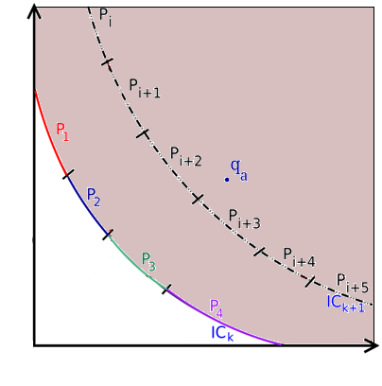
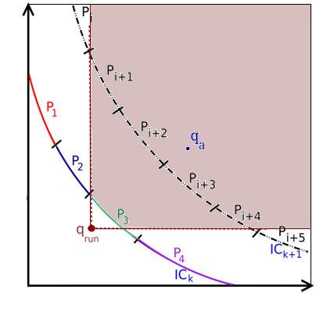
2) Reducing ρ with Selectivity Monitoring
When (cost-limited) execution of plans on IC_{k} does not complete the query, we know that q_{a} does not lie under IC_{k}
  but q_{a} could lie anywhere beyond IC_{k}
By monitoring lower bounds on
selectivities during execution (q_{run})
  q_{a} can only be in first quadrant of q_{run}
  (# of tuples at a node can only be greater
  than what has already been seen)
  ➔(P_{i}, P_{i+5} need not be executed)
  ➔lesser effective value of ρ
s
e
l
-
Y
sel - X

Slide 48
Maximizing Selectivity Movement
In executing a budgeted plan to determine error-prone selectivities, we would ideally like to learn as much as possible from the least amount of resources spent.
That is, we would like to move to the actual query location in the least executions possible.
So there is no need to completely execute the plans which are error prone to find if they are exceeding the cost contour.
So we use spilling, in which we deliberately break the pipeline immediately after the first error node and spilling it’s output, which ensures that the downstream nodes do not get any data to process.
This change helps to maximize the effort spent on executing the error-prone nodes, and thereby increase the selectivity movement with a given cost budget.

Slide 49
Maximizing Selectivity Movement (Spilling)
P1
HJ
P2
HJ
P3
HJ
P4
HJ
HJ
HJ
N
N
HJ
NL
NL
HJ
C
L
NL
L
HJ
HJ
S
O
C
NL
o
S
N
L
NL
O
C
HJ
S
L
P1,P2 are along selectivity-x
C
O
P3,P4 are along selectivity-y

Slide 50
Maximizing Selectivity Movement
S
E
L
E
C
T
I
V
I
T
Y
Y
P1
P2
qrun
P3
P4
qrun
S E L E C T I V I T Y X

Slide 51
Optimized Bouquet Algorithm
qrun = (0,0, ...,0); cid = 1 //initialization
loop
Pcur = AxisPlanRoutine(qrun, cid) //next plan selection
while running-cost(Pcur ) ≤ cost-budget(ICcid) do
execute Pcur //cost limited execution
if Pcur finishes execution then
return query result
update qrun //selectivity updation
if optimal-cost(qrun) ≥ cost-budget(ICcid) then
cid ++ //early contour change

Slide 52
Empirical Evaluation

Slide 53
Experimental Testbed
Database Systems: PostgreSQL and COM (commercial engine)
Databases: TPC-H and TPC-DS
Physical Schema: Indexes on all attributes present in
query predicates
Workload: 10 complex queries from TPC-H and TPC-DS
  with SS having upto 5 error dimensions
Metrics: Computed MSO and ASO using Abstract Plan Costing
over SS

Slide 54
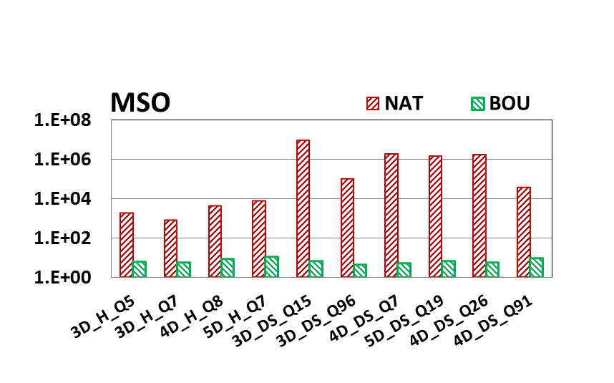
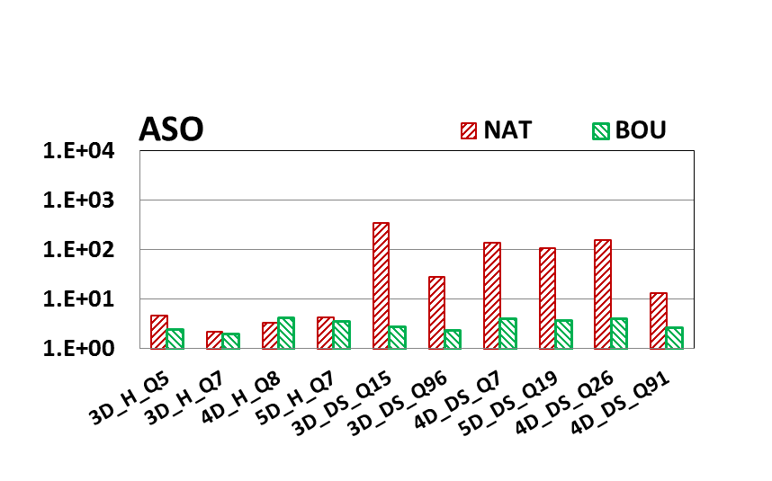
Performance on PostgreSQL
Log-scale
Native Optimizer
Bouquet
MSO
bounds
For many DS queries
  MSO improves from ≈10⁶ to ≈10
  ASO improves from ≈10² to ≈ 5
ASO not compromised
to reduce MSO!
Notes:
Showing Enhanced bouquet

Slide 55
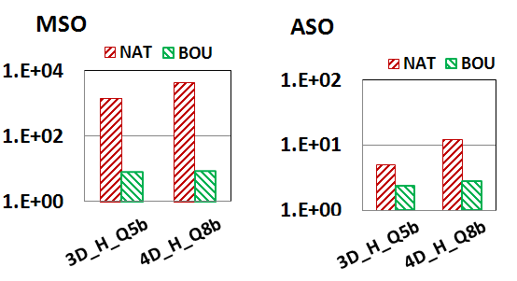
Performance with COM
⇒Robustness improvements not artifact of a specific engine

Slide 56
Sample Savings in Wall-clock Time
Performance Summary | NAT (PostgreSQL) | Enhanced Bouquet | Optimal
 | 600 sec | 69 sec | 16.1 sec
Contour ID | Avg. Execution Time (in sec) | # Executions (Enhanced Bouquet) | Time (in sec) (Enhanced Bouquet)
1 | 0.6 | 2 | 1.2
2 | 3.1 | 2 | 6.2
3 | 4.8 | 3 | 14.4
4 | 6.2 | 3 | 18.6
5 | 12.2 | 1 | 12.2
6 | 16.1 | 1 | 16.1
Total |  | 12 | 68.7
In spite of uncalibrated cost model
Query based on TPC-H Q8

Slide 57
Summary
Plan bouquet approach achieves
  bounded performance sub-optimality
    using a (cost-limited) plan execution sequence guided by isocost contours defined over the optimal performance curve
  robust to changes in data distribution
    only q_{a} changes – bouquet remains same
  easy to deploy
    bouquet layer on top of the database engine
  repeatability in execution strategy (important for industry)
    q_{e} is always zero, depends only on q_{a}
    independent of metadata contents
Important distinction from re-optimization techniques
Notes:
Say that for us – q_e is always 0 and hence we have repeatability

Slide 58
Limitations
Bouquet identification overheads are exponential in the ESS dimensionality
  unsuitable for on-the-fly queries
  Not suitable for latency sensitive applications
    need to wait for final execution to complete
  Not suitable for update queries
    each partial execution needs to be “garbage-cleaned” on termination
  Not suitable for “hinted” queries
    multiple plans used
  Database scaling requires bouquet re-computation
    but robust to changes in data distribution

Slide 59
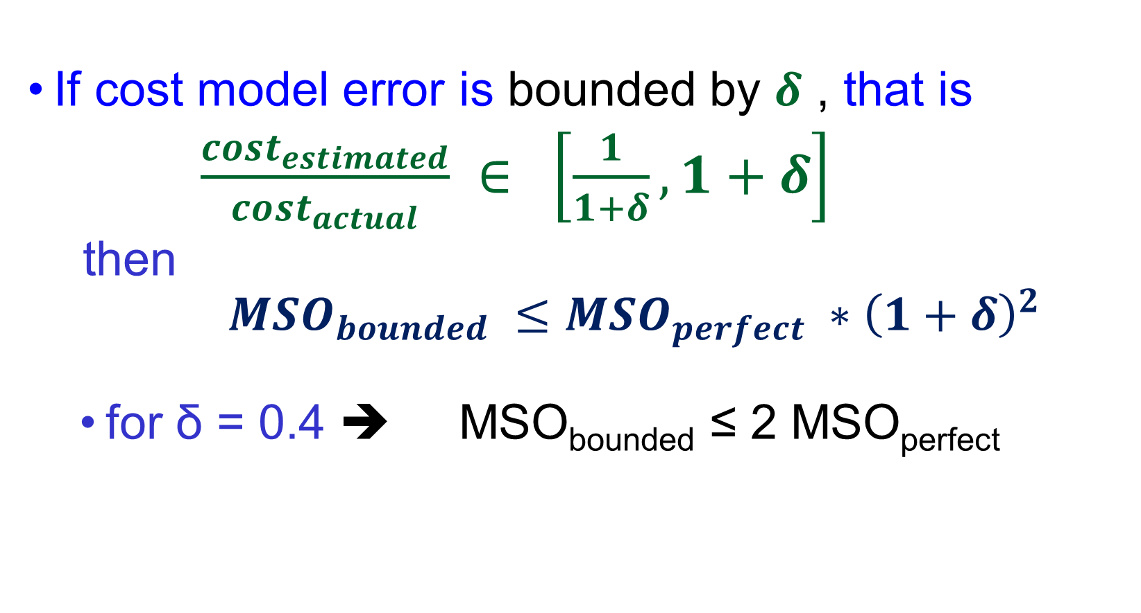
Incorporating Cost Model Error
If cost model error is bounded by $δ$ , that is
$\frac{cost_{estimated}}{cost_{actual}} ∈ \left[\frac{1}{1+δ}, 1+δ\right]$
  then
  $MSO_{bounded} ≤MSO_{perfect} ∗{\left(1+δ\right)}^{2}$
  for δ = 0.4 ➔ MSO_{bounded} ≤ 2 MSO_{perfect}

Slide 60
For more details, visit project website:
dsl.serc.iisc.ernet.in/projects/QUEST
Concepts paper: ACM Sigmod 2014
Demo paper: VLDB 2014
VLDB 2017
ANIPQO
Parametric Query Optimization for Linear and Piecewise Linear Cost Functions
Analysing Plan Diagrams Of Database Query Optimizations
VLDB 2007(anorexic reductions)

