Slide 1
Generating Test Data for Killing SQL Mutants
: A Constraint based Approach
Shetal Shah, S. Sudarshan, Suhas Kajbaje, Sandeep Patidar, Bhanu Pratap Gupta, Devang Vira
Slides Updated and Presented by Sai Prasad Kousika
Guided by Prof. S. Sudarshan

Slide 2
Outline
Motivation
Mutation Testing
Related Work
Contributions
Implementation[XDa-TA]
Experiments
Extensions
Future Work

Slide 3
Testing SQL Queries : A Challenge
Complex SQL queries hard to get right
Question: How to check if an SQL query is correct?
  Formal verification is not applicable since we do not have a separate specification and an implementation
  State of the art solution: manually generate test databases and check if the query gives the intended result
    Often misses errors

Slide 4
Generating Test Data: Prior Work
Automated Test Data generation
  Based on database constraints, and SQL query
    Agenda [Chays et al., STVR04]
  Reverse Query Processing [Binning et al., ICDE07]
    takes desired query output and generates relation instances
    Handle a subset of Select/Project/Join/GroupBy queries
  Extensions of RQP for performance testing
    guarantees cardinality requirements on relations and intermediate query results
None of the above guarantee anything about detecting errors in SQL queries
Question: How do you model SQL errors? Answer: Query Mutation

Slide 5
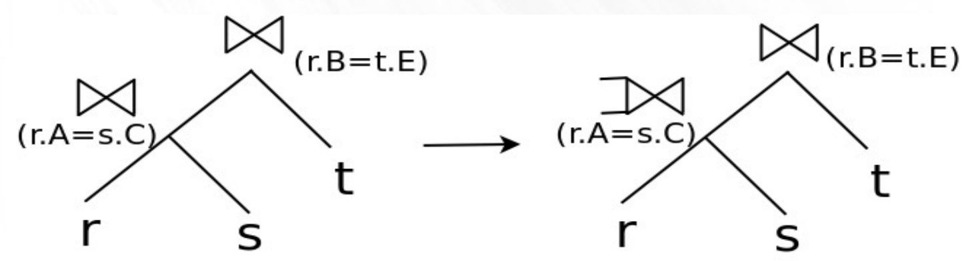
Mutation Testing
Mutant: Variation of the given query
Mutations model common programming errors, like
  Join used instead of outerjoin (or vice versa)
  Join/selection condition errors
    < vs. <=, missing or extra condition
  Wrong aggregate (min vs. max)
Mutant may be the intended query

Slide 6
Mutation Testing of SQL Queries
Traditional use of mutation testing has been to check coverage of dataset
  Generate mutants of the original program by modifying the program in a controlled manner
  A dataset kills a mutant if query and the mutant give different results on the dataset
  A dataset is considered complete if it can kill all non-equivalent mutants of the given query
Our goal: generating dataset for testing query
  Test dataset and query result on the dataset are shown to human, who verifies that the query result is what is expected given this dataset
  Note that we do not need to actually generate and execute mutants

Slide 7
Related Work
Tuya and Suarez-Cabal [IST07], Chan et al. [QSIC05] defined a class of SQL query mutations
  Shortcoming: do not address test data generation
More recently (and independent of our work) de la Riva et al [AST10] address data generation using constraints, with the Alloy solver
  Do not consider alternative join orders
  No completeness results
  Limitations on constraints

Slide 8
Contributions
Principled approach to test data generation for given query
Define class of mutations:
  Join/outerjoin
  Selection condition
  Aggregate function
Algorithm for test data generation that kills all non-equivalent mutants in above class for a (fairly large) subset of SQL.
  Under some simplifying assumptions
  With the guarantee that generated datasets are small and realistic, to aid in human verification of results

Slide 9


NP Hardness of Data Generation Problem
Data Generation Problem : Is there an assignment of tuples to each relation in query , Q such that the result of Q and its mutation Q’ differ?
Query Containment Problem: Given two SQL queries Q1 and Q2, is Q2 contained in Q1 ? (Already known to be NP-complete)
Reduction: Consider Q2 Q1 and Q2 Q1.
  If Data Generation Problem assigns tuples to the relation in Q1 and Q2 such that the results of above two trees differ than Q2 is not contained in Q1.
  If there is no such assignment, Q2 is contained in Q1.

Slide 10
SAT Solvers and Constraints​
Boolean formula satisfiability (SAT) problem​
E.g. ( (A and B) or (not B and C)) and (B and not A) ..​
Quintessential NP hard problem​
In theory, totally impractical beyond say 30 or so variables/constraints​
In practice: most important cases are not really that hard once you throw in techniques to handle common special cases​
SAT solvers: developed over the last few decades, can handle formulas with even hundreds of thousands of variables/constraints​

Slide 11
Satisfiability Modulo Theory (SMT) Solvers
From Boolean variables to variables of other types
  Integers, rationals, ..
  "Theory": arithmetic, comparison (<, <=, ..), etc
Check satisfiability taking theory into account
In general undecidable!
In practice, techniques to exploit common special cases work very well
  Can handle tens of thousands of variables/constraints in matter of seconds
  Output assignments of values to variables such that given constraints are satisfied
    Unless unsatisfiable, or system times out/fails

Slide 12
SMT Solvers (Cont.)
Practical SMT solvers
  E.g. Z3, CVC3/CVC4, Alloy, …
  Provide a language to express constraints
    Types, tuples of variables, arrays of variables/tuples, ..
Applications
  Program verification
    Verify if program satisfies specifications
  Program synthesis
    Given specifications, synthesize (create) programs that satisfy specifications
    E.g. flashfill feature of Microsoft Excel creates Excel macros from given examples
  Test data generation

Slide 13
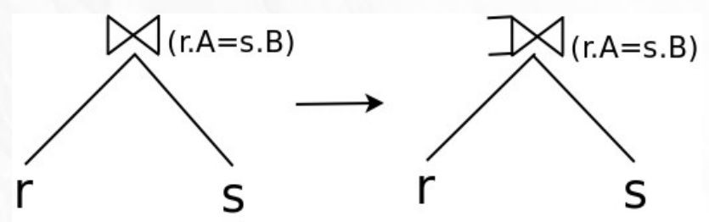
Killing Join Mutants : Example 1
Example 1: Without foreign key constraints
Schema: r(A), s(B)
To kill this mutant: ensure that for some r tuple there is no matching s tuple
Generated test case: r(A)={(1)}; s(B)={}
Basic idea, version 1 [ICDE 2010]
  run query on given database
  from result extract matching tuples for r and s
  delete s tuple to ensure no matching tuple for r
Limitation: foreign keys, repeated relations

Slide 14
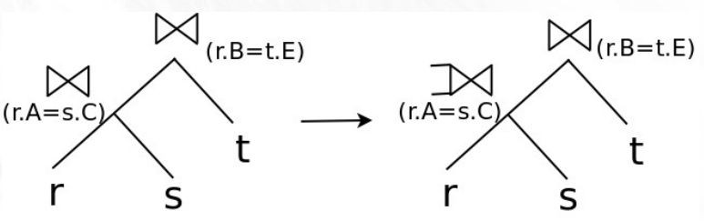
Killing Join Mutants : Example 2
Example 2: Extra join above mutated node
Schema: r(A,B), s(C,D), t(E)
To kill this mutant we must ensure that for an r tuple there is no matching s
tuple, but there is a matching t tuple
Generated test case: r(A,B)={(1,2)}; s(C,D)={}; t(E)={(2)}

Slide 15
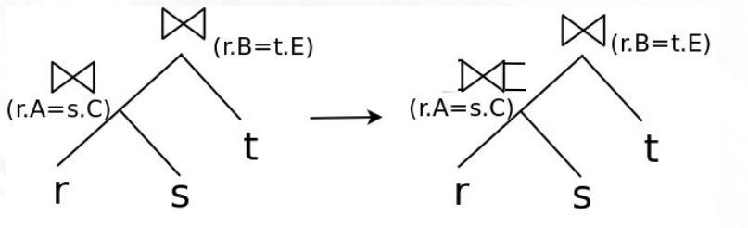
Killing Join Mutants : Example 3
Example 3: Equivalent mutation due to join
Schema: r(A,B), s(C,D), t(E)
Note: right outer join this time
Any result with a r.B being null will be removed by join with t
Similarly equivalence can result due to selections

Slide 16
Killing Join Mutants : Example 4
teaches instructor is equivalent to teaches
instructor if there is a
foreign key from teaches.ID to instructor.ID
The two expressions are no longer equivalent if instructor is replaced with
Key idea: have a teaches tuple with an instructor not from CS
Selections and joins can be used to kill mutations

Slide 17
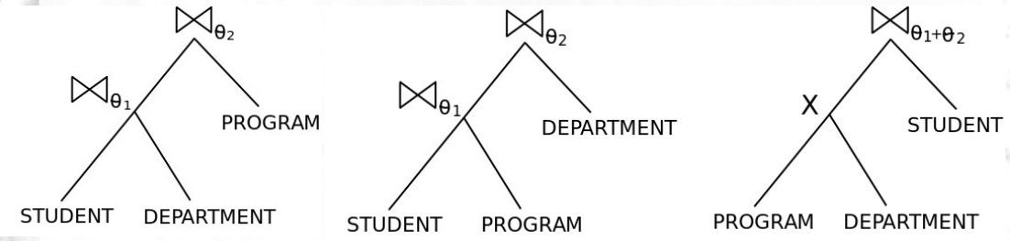
Killing Join Mutants: Equivalent Trees
Space of join-type mutants: includes mutations of join operator of a single node for all trees equivalent to given query tree
Datasets should kill mutants across all such trees

Slide 18
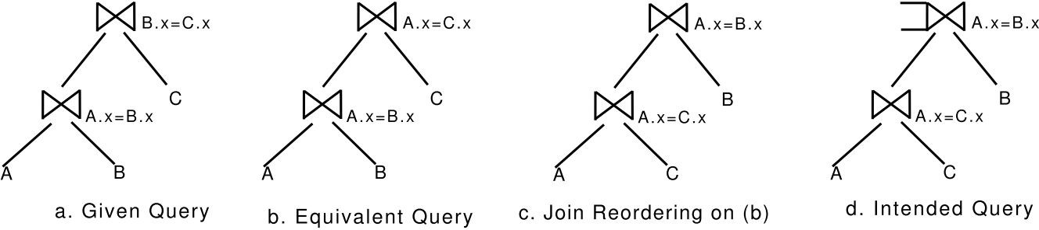
Killing Join Mutants: Equivalent Trees
Whether a query is written in the form A.x = B.x AND B.x = C.x, or A.x = B.x AND A.x = C.x should not affect set of mutants generated
Solution: Equivalence classes of attributes

Slide 19
Assumptions
A1, A2: Only primary and foreign key constraints; foreign key columns not nullable
A3: Single block SQL queries; no nested subqueries
A4: Expr/functions: Only arithmetic expressions
A5: Join/selection predicates : conjunctions of {expr relop expr}
A6: Queries do not explicitly check for null values using IS NULL
A7: In the presence of full outer join, at least one attribute from each of its inputs present in the select clause
A8: In the presence of full outer join, at least one attribute other than common attributes from each of its inputs present in the select clause

Slide 20


Generating Constraints to kill Join Mutations
There exists a tuple in A for which there does not exist any matching tuple in B.
There exists a tuple in B for which there does not exist any matching tuple in A.

Slide 21
Problems
Translate high level requirements into constraints on individual tuples
Ensure the difference exposed at an internal node is propagated to root
Exponential number of join trees
Repeated relation occurrences

Slide 22
Data Generation in 2 Steps
Step 1: Generation of constraints
  Constraints due to the schema
  Constraints due to the query
  Constraints to kill a specific mutant
Step 2: Generation of data from constraints Using solver, currently CVC3

Slide 23
Example of Constraints
Tuple types​
STUDENT_TupleType: TYPE = [ID, NAME, DEPT_NAME, TOT_CRED];​
O_STUDENT: ARRAY INT OF STUDENT_TupleType;​
Foreign Key constraints (unfolded)​
ASSERT ((O_STUDENT[1].2 = O_DEPARTMENT[1].0)) OR (ISNULL_DEPT_NAME(O_STUDENT[1].2));​
ASSERT ((O_STUDENT[2].2 = O_DEPARTMENT[2].0)) OR (ISNULL_DEPT_NAME(O_STUDENT[2].2));​

Slide 24
Example of Constraints (Cont.)
Primary key constraints​
ASSERT (O_STUDENT[1].0 = O_STUDENT[2].0 ) => (O_STUDENT[1].1 = O_STUDENT[2].1) AND (O_STUDENT[1].2 = O_STUDENT[2].2) AND (O_STUDENT[1].3 = O_STUDENT[2].3) ;​
Query constraints
For non empty result​
ASSERT (O_TAKES[1].0=O_STUDENT[1].0);​
For killing mutants (STUDENT[1] has no matching tuple in TAKES)
​ASSERT (O_TAKES[1].0 /= O_STUDENT[1].0 AND ​
O_TAKES[2].0 /= O_STUDENT[1].0) ;​

Slide 25
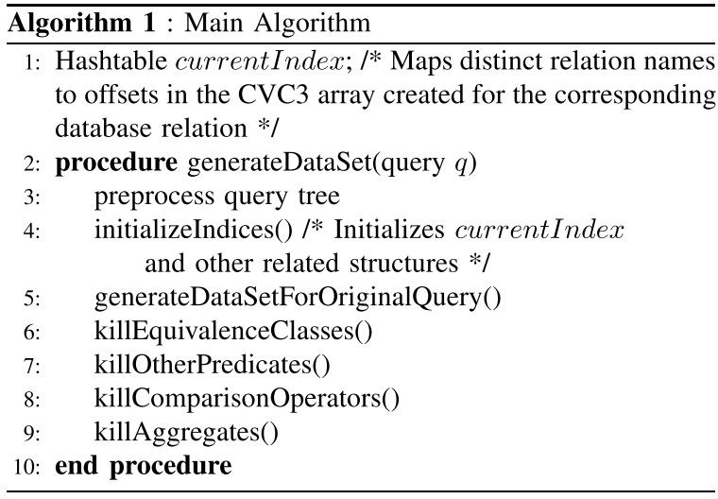
Data Generation Algorithm : Overview

Slide 26
Preprocess Query Tree
Build Equivalence Classes from join conditions
  A.x = B.y and B.y = C.z
  Equivalence class: A.x, B.y and C.z
Foreign Key Closure –
  A.x -> B.y and B.y -> C.z then A.x -> C.z
Retain all join/selection predicates other than equijoin predicates

Slide 27
Helper Functions
CvcMap(rel.attr)
  Takes a rel and attr and returns r[i].pos where
    r is base relation of rel
    pos is the position of attribute attr
    i is an index in the tuple array *
GenerateEqConds(P)
  Generates equality constraints amongst all elements of an equivalence class P

Slide 28
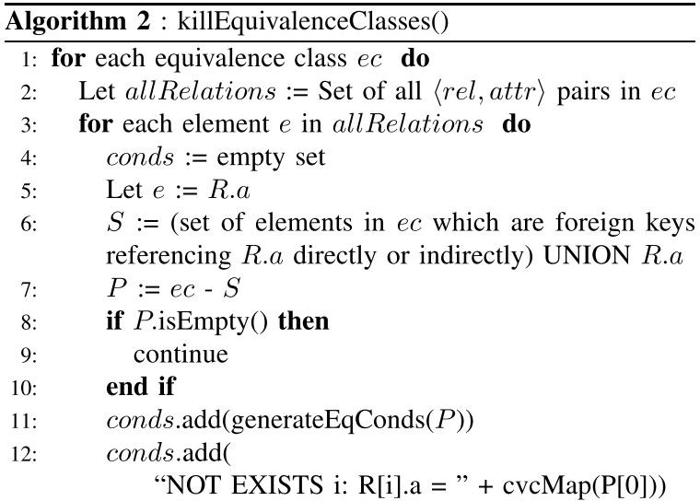
Killing Equi Join Condition Mutations

Slide 29
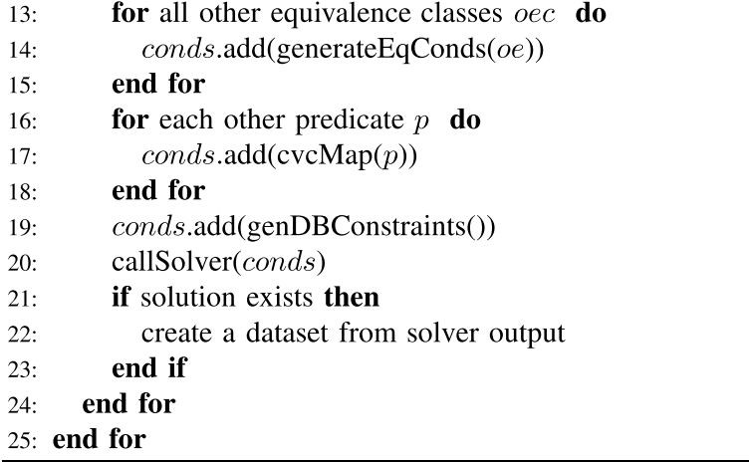
Killing Equi Join Condition Mutations (contd.)

Slide 30
Example of killEquivalenceClasses()
Equivalence Class containing A.x, B.x and C.x
Foreign Key relationship from A.x to B.x
  It is not possible create a dataset where A.x has no matching B.x
  So, whenever we need to nullify B.x we will also nullify referencing foreign keys (here A.x)
  Now split equivalence class into two parts
    Q.x and and all its referencing foreign keys in one part (S) ---> A.x and B.x
    Remaining keys in another part (P:= es - S) ---> C.x

Slide 31
Killing Other Predicates
Create separate dataset for each attribute in predicate
Example genNotExist(predicate p, relation r)
For Join condition B.x = C.x + 10
  Dataset 1 (nullifying B:x):
ASSERT NOT EXISTS (i : B_INT) : (B[i].x = C[1].x + 10);
  Dataset 2 (nullifying C:x):
ASSERT NOT EXISTS (i : C_INT) : (B[1].x = C[i].x + 10);

Slide 32
Killing Comparison Operator Mutations
Example of comparison operation mutations:
  A < 5 vs. A <= 5 vs. A > 5 vs A >= 5 vs. A=5, vs A <> 5
Idea: generate separate dataset for three cases (leaving rest of query unchanged):
  A < 5
  A = 5
  A > 5
This set will kill all above mutations

Slide 33


Killing Unconstrained Aggregation Mutations
Aggregation operations
  count(A) vs. count(distinct A)
  sum(A) vs sum(distinct A)
  avg(A) vs avg(distinct A)
  min(A) vs max(A)
  and mutations amongst all above operations
Idea: given relation r(G, O, A) and query
Tuples (g1, o1, a1), (g1, o2, a1), (g1, o3, a2) , with a1 <> 0 will kill above pairs of mutations
Additional constraints to ensure killing mutations across pairs

Slide 34
Aggregation Operation Mutation
Issues:
  Database/query constraints forcing A to be unique for a given G
  Database/query constraints forcing A to be a key
  Database/query constraints forcing G to be a key
Carefully crafted set of constraints, which are relaxed to handle such cases

Slide 35
Completeness Results
Theorem: For the class of queries, with the space of join-type and selection mutations defined as per paper, the suite of datasets generated by our algorithm is complete. That is, the datasets kill all non-equivalent mutations of a given query

Slide 36
Experimental Results
x86 machines, 1.86 GHz processor, 2 GB main memory
Schema: University database from Database System COncepts (6th ed.)
Queries with joins with varying number of foreign keys imposed
Queries with comparison, aggregation and inner joins

Slide 37
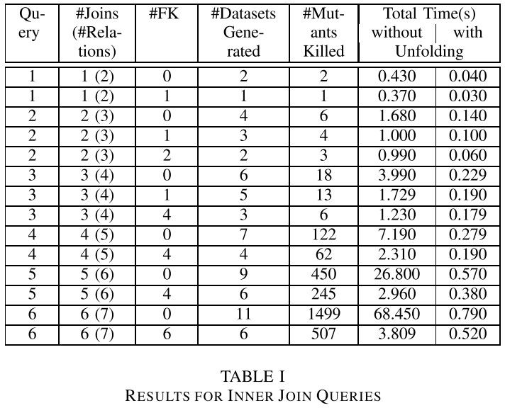
Inner Join Queries

Slide 38
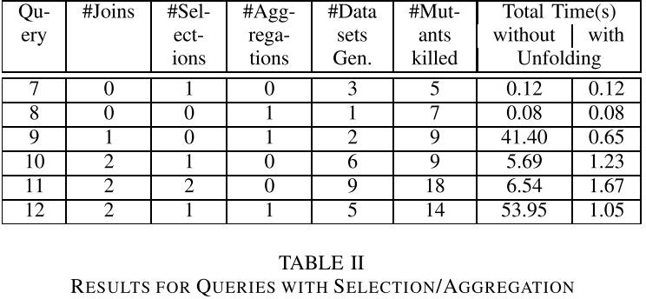
Selection/Aggregation Queries

Slide 39
Thank You!
Questions?
42

Slide 40
Extensions
Handling Nulls
String Constraints
Constrained Aggregation
Source :
Extending XData to kill SQL query mutants in the wild

Slide 41
Handling Nulls
For text attributes, enumerate a few more values in the enumerated type and designate them NULLs.
  Example : for an attribute course_id, we enumerate values NULL_course_id_1, NULL_course_id_2, etc.
For numeric values, we model NULLs as any integer in a range of negative values that we define to be not part of the allowable domain of that numeric value.
Add constraints forcing those attribute values to take on one of the above mentioned special values representing NULL.
Add constraints to force all other values to be non null
Enables handling of nullable foreign keys, and explicit IS NULL checks

Slide 42
String Constraints
String Constraints
  S1 likeop pattern
  S1 relop constant
  strlen(S) relop constant
  S1 relop S2
where
S1 and S2 are string variables,
likeop is one of LIKE, ILIKE (case insensitive like),NOT LIKE and NOT ILIKE
relop operators are =, <, ≤, >, ≥, <>, and case-insensitive equality denoted by =.

Slide 43
String Constraints
String solver
String constraint mutation: {=, <>, <, >, ≤, ≥}
  S1 = S2
  S1 > S2
  S1 < S2
LIKE predicate mutation: {LIKE, ILIKE,NOT LIKE, NOT ILIKE }
  Dataset 1 satisfying the condition S1 LIKE pattern.
  Dataset 2 satisfying condition S1 ILIKE pattern, but not S1 LIKE pattern
  Dataset 3 failing both the LIKE and ILIKE conditions

Slide 44
Constrained Aggregation Operation
Aggregation Constraints: Example : SUM (r.a) > 20
CVC3 requires us to specify how many tuples r has.
Hence, before generating CVC3 constraints we must
  estimate the number of tuples n, required to satisfy an aggregation constraint
  translate this number n to appropriate number of tuples for each base relation so that the input of the aggregation contains exactly n tuples.

Slide 45
XDa-TA System
For each query in an assignment, a correct SQL query is given to the tool, which generates datasets for killing mutants of that query.
Modes:
  admin mode
  student mode.
Assignment can be marked as :
  learning assignment
  graded assignment.
Source:
XDa-TA : Automating Grading of SQL Query Assignments

Slide 46
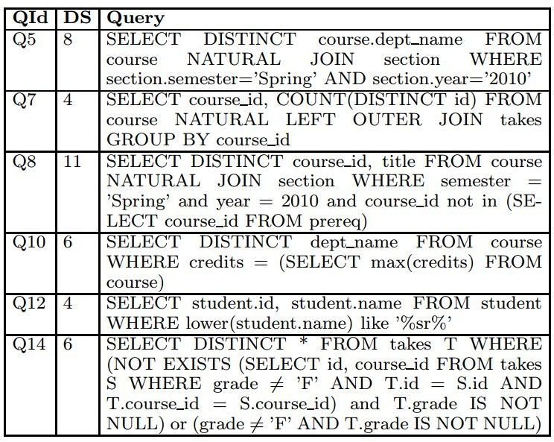
Sample Query Set

Slide 47
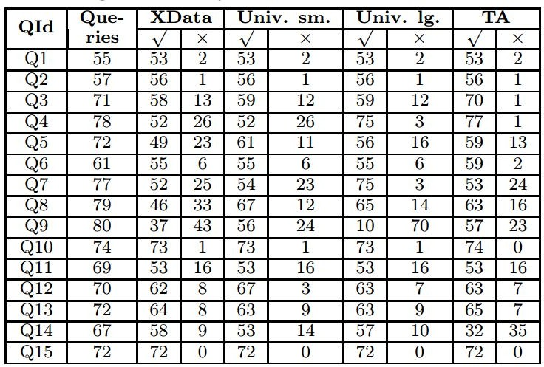
Results

Slide 48
Future Work
Integration with course management systems such as Moodle or Blackboard using the Learning Tools Interoperability (LTI) standard (complete)
Partial Marking Scheme implementation (ongoing)
Future work:
  Handling SQL features not supported currently
  Multiple queries
  Form parameters

