Slide 1
Human-powered Sorts and Joins
Adam Marcus Samuel Madden
Eugene Wu Robert Miller
David Karger
Proceedings of the VLDB Endowment,2011
Presented by: Ashwini Pale
Notes:
Today’s topic is human powered sorts and joins.
This paper makes use of crowdsourcing model, so we will see crowdsourcing in brief

Slide 2


Example of Crowdsourcing
Yes
No
Is the cat above smiling?
Yes
No
Is the cat above smiling?
Notes:
this is example of crowdsourcing.
Used to perform tasks which are hard to automate.
like ..labeling or filtering the images,translating and editing text.
This is one example of crowdsourcing..recognizing smiling cat image

Slide 3

Crowdsourcing
Getting work done from a group of people
To get information missing from database
Examples
- Given an image containing text, get the text from it (aka CAPTCHA)
- Given a university and department name, find the link to department webpage
The largest crowdsourcing platform - Amazon Mechanical Turk

Slide 4
CrowdSourcing Definitions
HIT ( Human Intelligent Task)
The smallest entity of work a worker can accept to do. HITs contain one or more jobs.
Eg: Given a university and department name, find the url of department webpage
Assignment
Every HIT can be replicated into multiple assignments.
HIT Group
Group of similar HITs.
Eg: We can post 1000 HITS to get the URL of 1000 different departments spread across universities

Slide 5
What paper focuses on?
How to use humans for sorting and joining
User interfaces
Optimisations
  Task batching
  Pre-filtering
  Numerical rating
  On one example, reduced joining cost from $67 to $3
Describes the Qurk system
Notes:
Task batching in one HIT
Filtering Table before joining

Slide 6
Qurk
Declarative query processing system designed to run queries using a crowd of workers to carry out certain tasks that are hard to automate
Selects the best user interface
Translates parts of queries into HITs
Collect the results in tabular form
Notes:
Different UIs for different operations
HITs that can be given to crowdsourcing platform

Slide 7
Data model & Query language
Basic Data model is relational with UDFs (User Defined functions)
UDFs are used to retrieve data from crowd
UDFs implemented using predefined task templates.

Slide 8
Qurk filter
photos(id PRIMARY KEY, picture IMAGE)
Query =SELECT * FROM photos WHERE
isSmiling(photos.picture);
UDF
First paper to represent crowd calls as UDF invocations!
Notes:
Let we want to find smiling cat images
There is a relation photos
The query will be…
isSmiling is a UDF in this case.Photos.picture is the argument.

Slide 9
UDFs as Tasks
Instead of writing code for UDFs, can be described at a high level using Tasks
Tasks = High level-templates for commonly occurring crowd-operations and or algorithms
Task templates: Filter, Generative, Rank, EquiJoin

Slide 10
TASK isSmiling(picture)
Prompt: "<table><tr> \
<td><img src=’%s’></td> \
<td>Is the cat above smiling?” </td> \
</tr></table>", tuple[field]
YesText: "Yes"
NoText: "No"
Combiner: MajorityVote
TYPE Filter:
Generative
Rank
EquiJoin
…
Notes:
Prompt is a HTML block in which fields from tuple are substituted
Tuple-variable to access tuples
YesText:to specify titles of answer buttons
Combiner:how to combine multiple responses
MajorityVote:most popular answer

Slide 11
Is the cat above smiling?
Yes
No
Is the cat above smiling?
Yes
No
Notes:
So filter task template given in previous slide will look like this.

Slide 12
Template: Generative
Goal: To generate unconstrained input like labels,finding phone no.
Eg. We have table of animals’ photos
animals(id integer, img url)
SELECT id, animalInfo(img).common,
animalInfo(img).species
FROM animals
animalInfo is a UDF
Notes:
There may be requirement for unconstrained input.
We want to find common name and species of animal in each photo

Slide 13
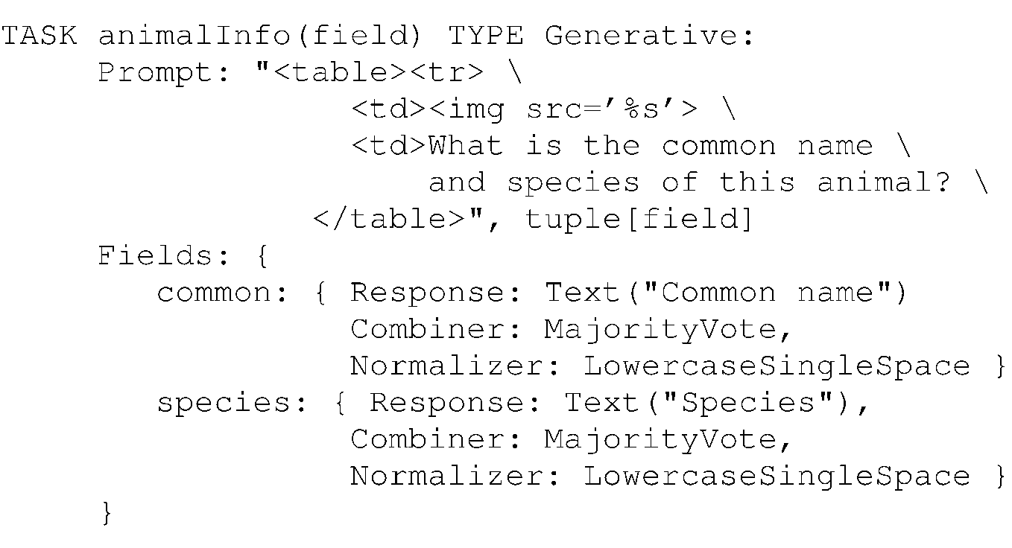
Task template
Notes:
There are 2 fields
commonName and Species
The response combind by MajorityVote
and it is Normalised to LowercaseSingleSpace

Slide 14
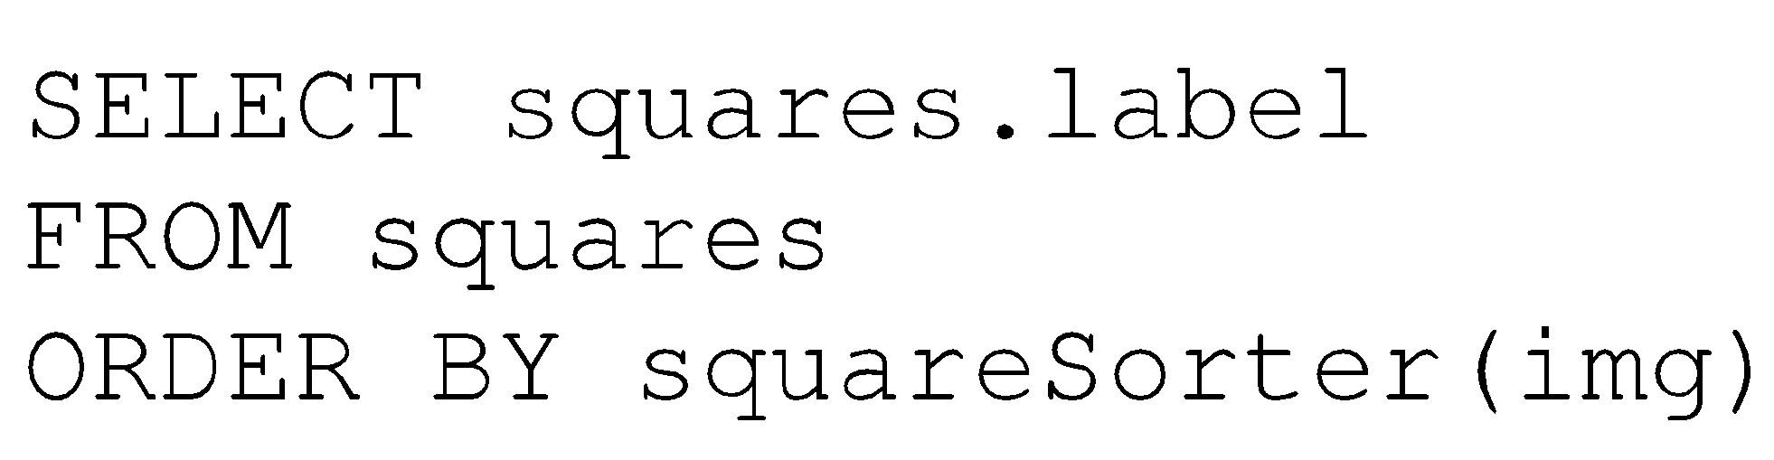
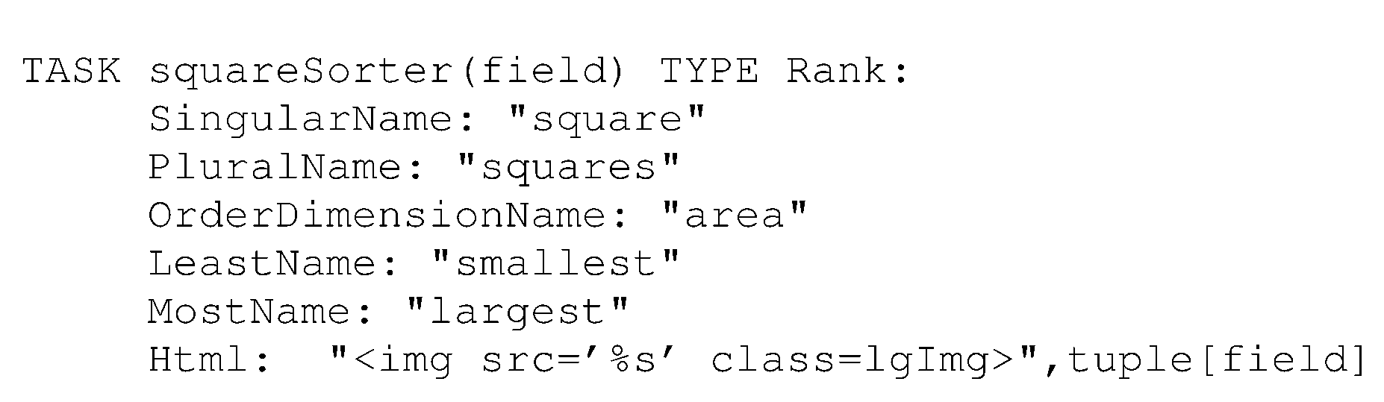
SORTS
squareSorter is UDF
Notes:
We will see task templates for sorts
Suppose task is to sort squares by size.
Task type is Rank

Slide 15
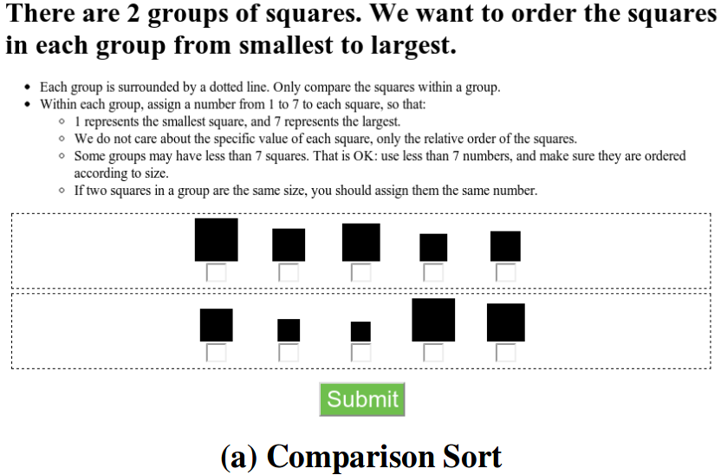
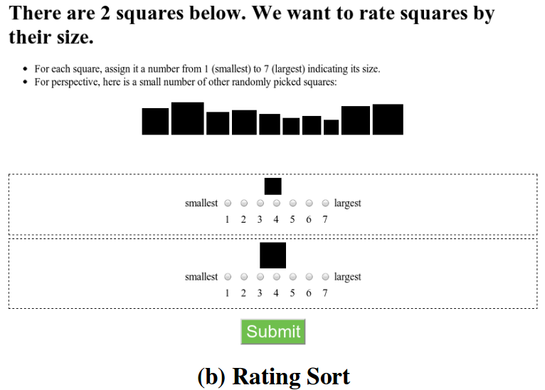
Two ways:
Order small subset
Numerical rating
Batch:
Comparing several records in a HIT
Top-k
MIN/MAX
Notes:
To give idea to user about the data, there are some random items picked and displayed at the top.

Slide 16
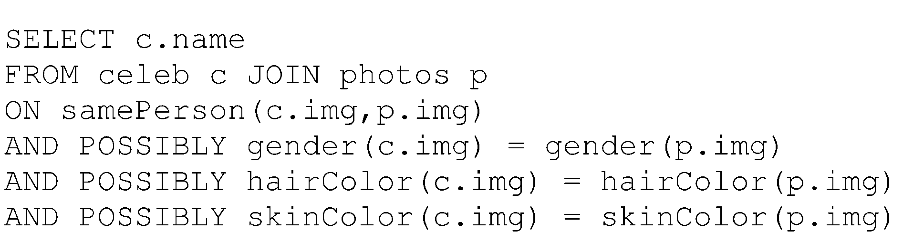
Joins and Feature Extraction
samePerson,gender,hairColor,skinColor are UDFs
POSSIBLY clause indicate such features that help filter items
Number of join candidates reduced
Linear scan of tables to apply these predicates
Notes:
There are two tables celeb and photos .We want to find photos of same person from both table.Query will be
Suppose some filters are applied to reduce number of join canadidates

Slide 17
eg:UDF for gender
TASK gender(field) TYPE Generative:
Prompt: "<table><tr> \
<td><img src=’%s’> \
<td>What this person’s gender? \
</table>", tuple[field]
Response: Radio("Gender",
["Male","Female",UNKNOWN])
Combiner: MajorityVote
TASK gender(field) TYPE Generative:
Prompt: "<table><tr> \
<td><img src=’%s’> \
<td>What this person’s gender? \
</table>", tuple[field]
Response: Radio("Gender",
["Male","Female",UNKNOWN])
Combiner: MajorityVote
Notes:
response can be indicated using radio button with label gender.having options as male female and unknown.

Slide 18
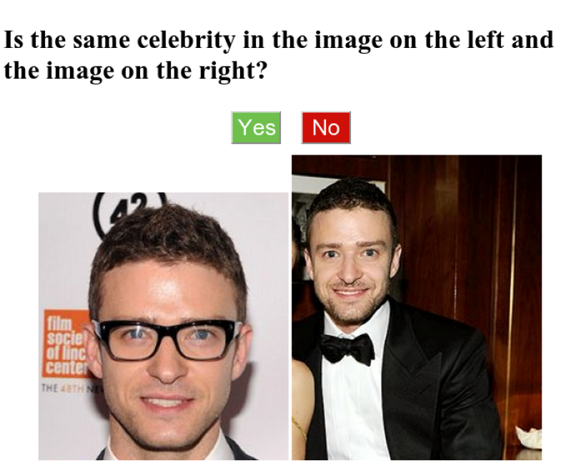
Simple join
Notes:
one photo from first table and other from second table

Slide 19
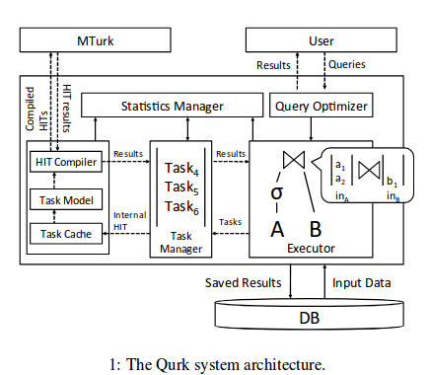
Qurk Architecture
Notes:
Query optimiser generates the logical plan for query issued by user.
Executor runs the plan , generates the tasks.
Task are sent to task manager.Task manager applies batching and other optimisations.

Slide 20

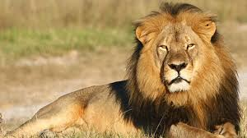
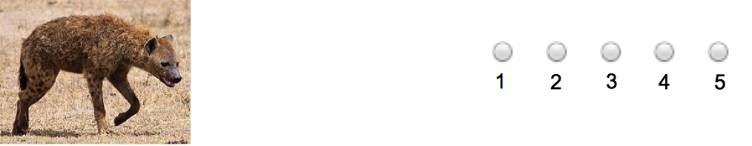
Sort Interfaces
Multiple interfaces to get similar data!
Comparison
more
dangerous?
Rating
how
dangerous?

Slide 21
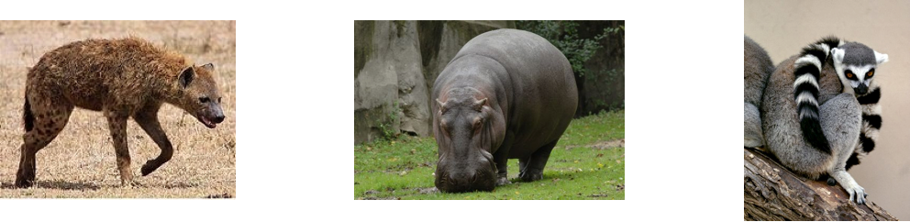
Batching
<
<
Notes:
Multiple tuples data in same HIT(screen)

Slide 22
Comparison-Based
Compute number of HITs in which each item is ranked higher than other items
^{n}C₂ HITs
Grouping
(group of s items)
  ^{n}C₂ / ^{s}C₂ HITs
  Tau ≈ 1 (accurate)
Batching (size b)
Q: Can we use Quick sort or merge sort to reduce #HITs?
No.
Human makes errors.
Paper argues that cycles may be present and hence quicksort-like algorithms will not work.
Notes:
In comparison , each item compared with other so nC2 HITs, if group of s items is formed then HITs reduces to ^{n}C₂ / ^{s}C₂.And #HITs can be further reduce by batching tasks.HITs reduced by factor of b , if batch size of b is used.

Slide 23
2.Rating based
Rate each item on the scale and then sort based on rating
O(n) HITs
Batching(size b)
Reduced by factor of b
But results are not accurate
Tau ≈ 0.8 (accurate)

Slide 24
Hybrid Schemes
First, gather a bunch of ratings
Order based on average ratings
Then, use comparisons, in one of three flavors:
  Random: pick S items, compare
  Confidence-based: pick most confusing “window”, compare that first, repeat
  Sliding-window: for all windows, compare

Slide 25
Confidence-based
w_{i} = {l_{i} …..l_{i+s}}
(contains s consecutive items)
∀ a,b ϵ w_{i ,} Rating summary statistics -(μ_{a},𝝈_{a}) ,(μ_{b},𝝈_{b}) is defined
For μ_{a}< μ_{b} , Δ_{a,b}= max{μ_{a}+ 𝝈_{a} - μ_{b}+𝝈_{b} , 0}
∀ w_{i} , R_{i} =∑_{(a,b )ϵ wi} Δ_{a,b}
μ_{b} μ_{b}
μ_{a}+ 𝝈_{a}
μ_{a}+ 𝝈_{a} μ_{b}- 𝝈_{b}
μ_{a} μ_{b}- 𝝈_{b} μ_{a}
Overlap Non Overlap
Give to crowd to reorder Not given to crowd
μ_{a}+ 𝝈_{a} - μ_{b}+𝝈_{b}>0
so Δ_{a,b}> 0
μ_{a}+ 𝝈_{a} - μ_{b}+𝝈_{b}< 0
so Δ_{a,b}= 0

Slide 26
Confidence-based
Order all windows in decreasing order of R_{i}
Windows with most standard deviation overlap
So least confidence in their rating are reorder first

Slide 27
Measuring Quality of Results
Fleiss’ Kappa (Comparison based)
inter-rater agreement(how consistent rating is)
Range: [0, 1]
Higher number greater agreement
Notes:
1-P = degree of agreement that is attainable above chance
p-p_{e} = degree of agreement actually achieved above chance

Slide 28
2. Kendall’s Tau rank correlation(Rating based)
Range: [-1, 1]
(x_{1,}y₁) , (x_{2,}y₂) ,...(x_{n,}y_{n}) observations
concordant pair: if (x_{i} > x_{j} and y_{i}>y_{j} ) or ( x_{i} < x_{j} and y_{i}<y_{j} )
discordant pairs: if (x_{i} > x_{j} and y_{i}<y_{j} ) or ( x_{i} < x_{j} and y_{i}>y_{j} )
  -1 : inverse correlation
0 : no correlation
1 : perfect correlation
a b c d
d c b a
a b c d
a b c d
-1
1

Slide 29
Query ambiguity Sort vs Rank
Q1 : Sort squares by size
Q2 : Sort animals by “Adult size”
Q3 : Sort animals by “Dangerousness”
Q4 : Sort animals by “How much this animal belongs on Saturn”
Q5 : (Artificially) generate random Compare and Rate responses
Notes:
How increasing ambiguity affects accuracy of sort by rate and compare methods

Slide 30
Ambiguity of Sort Order
less ambiguous
more ambiguous
adult size
dangerousness
likelihood to
be on saturn

Slide 31
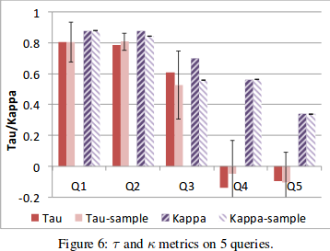
Query ambiguity Sort vs Rank
K (worker agreement) decreases with increasing ambiguity
Notes:
T-rating(interRater agreement)
K-compare(rankCorrelation)
For Q1,2,3 rate agrees with compare and because it is cheaper than compare, we can use it.

Slide 32
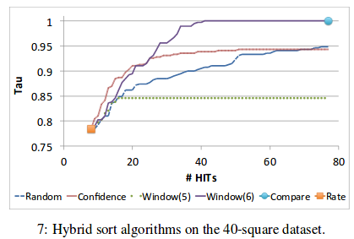
Hybrid sort performance
Sliding Window > Confidence > Random
Notes:
Here # HITs is plotted against Tau values for different methods of sorting.
Rate in nearly 8 HITs achieve 80% accuracy. Compare achieve 100% accuracy but nearly 80 HITs
So we can see Hybrid sort with sliding window achieve >95% in 36 HITs.
Compare window(5) and 6

Slide 33
Summary for Sorts
Two approaches for sorting:
comparison based,rating based
Batching reduces no. of tasks in both cases
Rating is cheaper while comparison is more accurate
Hybrid-window based approach performs best (𝜏 > .95)

Slide 34
Joins

Slide 35
Join Operator
Qurk uses block nested loop join
Simple Join:
single pair of item in each HIT
|R||S| HITs
2.Naive Batching:
Display several pairs
For batch of b pairs in a HIT
|R||S| HITs
b
3.Smart batching:
Display in 2 columns(r in first , s in second)
|R||S| HITs
r* s

Slide 36
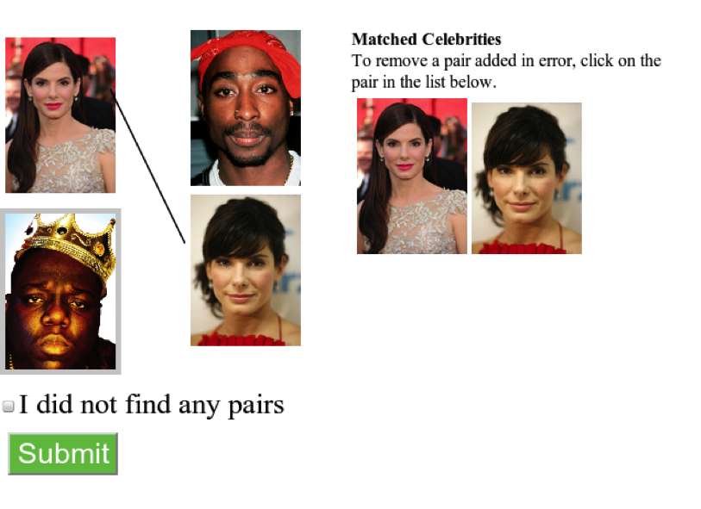
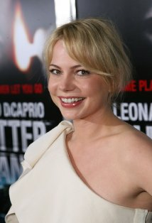
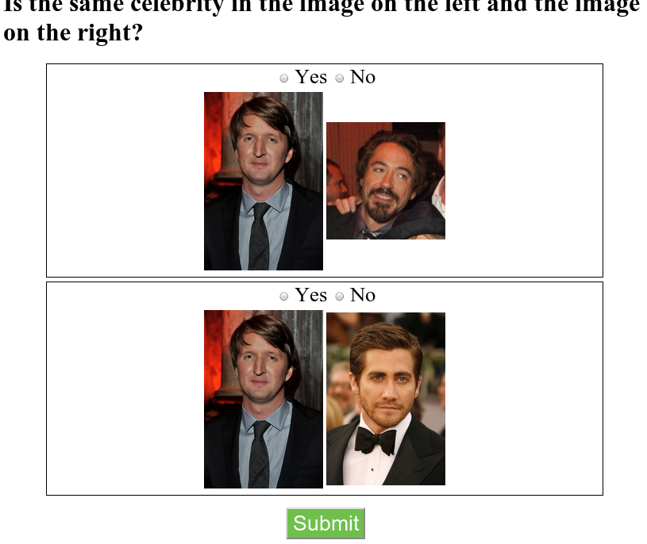
Matching celebrities
Notes:
Suppose there are some pictures of celebrities in 2 tables celeb and award and we want to find picture of same person from two tables.

Slide 37
Simple join O(nm)

Slide 38
Naïve batching join O(nm/b)

Slide 39
Smart batching O(nm/b²)
reduction in cost by factor of 4

Slide 40
Join heuristics
gender
hair color
skin color
50-66% reduction in cost
Notes:
We can use different feature filters to reduce #HITs.In this example,if we use these features then cost reduces by 50-66%.

Slide 41
Could go wrong!
If there are cases where
  Feature is ambiguous
- Fleiss’ k (agreement) is below some threshold
  Feature equality does not imply join/not join
- |j_{f-} - j_{f+}| j_{f-/f+} :Join result excluding/including feature f
|j_{f-} |
  Selectivity is not helpful
- Run feature over small sample
Notes:
Which are problems while selecting these features
-less agreement for ambigous features
- jf below some threshold -exclude
-if all people have brown hair

Slide 42
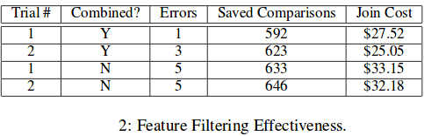
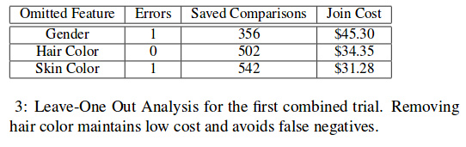
Feature Filtering
Combining features reduces both errors and cost
Cost without feature filtering is $67.50
Notes:
Feature filtering Effectivenes:
Asked about all 3 attributes at once more accuracy,else workers may over analyse task and more errors
Omitting HaiColor reduces error

Slide 43
Experiments
Dataset: 2 tables (30 images)
1. celeb - table with profile photo from IMDB
2. photos - table with photos from 2011 Oscar awards
2 trials to measure variance in latency at different times : 11AM and 7PM
5 assignments for each comparison
Combiners:
  MajorityVote - choose the most popular
  QualityAdjust - considers quality of workers

Slide 44
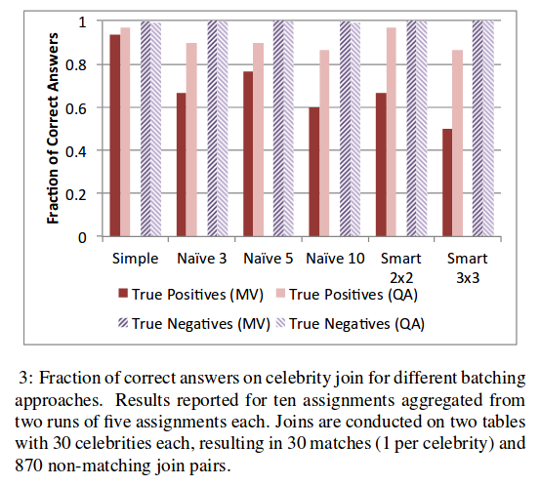
Join algorithm comparisons
Notes:
Different batching approaches for joining compared wrt accuracy.
Simple -best but #HITs are large
smart- 3x3 less accuracy but least #HITs reduces HITs by factor of 9
so best in this case:naive 5x5 reduces HITs by factor of 5 and good accuracy

Slide 45
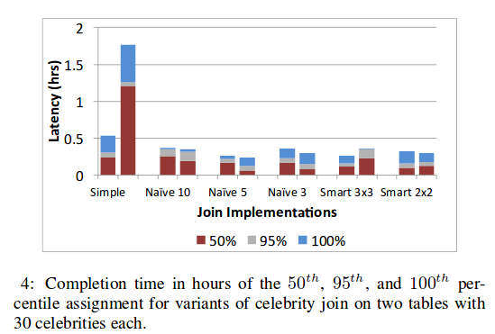
Join algorithm comparisons
Notes:
Different Batching compared based on time required.
ore HITs more time-simple
But worker choose naive 5 over smart3x3(more time even less HIT)
Last 5% assignments take neary 50% time because worker prefer long batches of work.

Slide 46
Experient with Complex query
SELECT name, scene.img
FROM actors JOIN scenes
ON inScene(actors.img, scenes.img)
AND POSSIBLY numInScene(scenes.img) >= 1
ORDER BY name, quality(scenes.img)
dataset: 211 photos taken from movie (scenes)and actor profile photos(actors) came from web
inScene, numInScene, quality are UDFs
Notes:
we will see ex of complex query where both join and sort are used.
Query:for each actor find frames where actor is the main focus of frame and orders the frame by how flattering they are.

Slide 47
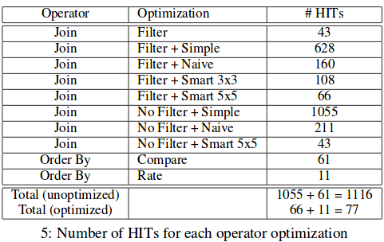
Comparison by #HITs
Number of HITs reduced by a factor of 14.5
Only Filter
operation
Larger Value
expected
Notes:
Number of Hits for diff batching approaches

Slide 48
Summary for Joins
Batching is a effective technique
QA filters spammers and sloppy workers, so improves result quality
Feature filtering reduces join cost from $67.50 to $27.00
Adding batching for final cost for celebrity join reduced to $2.70

