Slide 1
Question/Answering System
&
Watson
Naveen Bansal
Soumyajit De
Sanober Nishat
Under the guidance of
Dr. Pushpak Bhattacharyya

Slide 2
Outline
Motivation
Search V/S Expert QA
Roots Of QA
  Information Retrieval
  Information Extraction
QA System
  Question Analysis
  Parsing And Semantic Analysis
  Knowledge Extraction
IBM Watson
Watson Architecture
  Understanding Clue
  Hypothesis Generation
  Candidate Generation
  Scoring And Ranking
QA Applications & Future Work
References

Slide 3

Motivation
Understanding a text and answering questions
A fundamental problem in Natural Language Processing and Linguistics
May have many applications like in healthcare, customer care services etc
Imagine if computers could understand text

Slide 4
Motivation(cont..)
Problem:
I’m having trouble installing program.
I got error message 1. How do I solve it?
User text about
the problem
Text Understanding
System
Commonsense
Reasoning
Yes, you will get error message 1 if there is another program installed.
Solutions
You must first uninstall other programs.
Then, when you run setup you will
get your program installed

Slide 5
Search vs. Expert Q&A
Decision Maker
Has Question
Search Engine
Distills to 2-3 Keywords
Finds Documents containing Keywords
Reads Documents, Finds Answers
Delivers Documents based on Popularity
Finds & Analyzes Evidence

Slide 6
Search vs. Expert Q&A
Decision Maker
Has Question
Search Engine
Distills to 2-3 Keywords
Finds Documents containing Keywords
Reads Documents, Finds Answers
Delivers Documents based on Popularity
Finds & Analyzes Evidence
Expert
Decision Maker
Understands Question
Asks NL Question
Produces Possible Answers & Evidence
Considers Answer & Evidence
Analyzes Evidence, Computes Confidence
Delivers Response, Evidence & Confidence

Slide 7
Roots of Question Answering
Information Retrieval (IR)
Information Extraction (IE)

Slide 8
Information Retrieval
Goal = find documents relevant to an information need from a large document set
Info. need
Query
Document
collection
IR system
Retrieval
Answer or document list

Slide 9
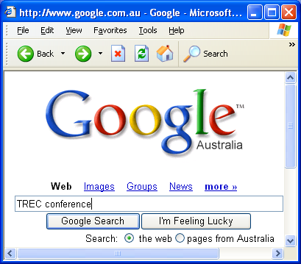
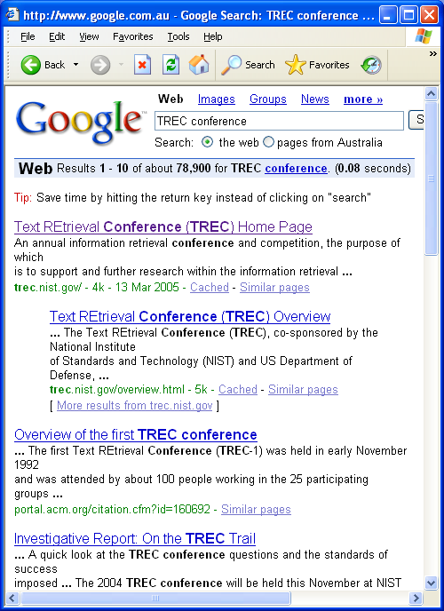
Example
Example
Google
Web

Slide 10
Information Retrieval
Question ?
Query
Formulation
Query
Search
Ranked List
Selection
Documents
Examination
Documents
Delivery

Slide 11
IR Limitations
Can only substitute “document” for “information”
Answers questions indirectly
Does not attempt to understand the “meaning” of user’s query or documents in the collection
Notes:
An informational retrieval system merely informs the existence of documents relating to the request
Do not confuse with Data Retrieval
Data retreival is the xact match while information retrival is the best match or partial match.
Query specificationn is complete in data retrieval but incomplete in information retrieval

Slide 12
Information Extraction (IE)
IE systems
  Identify documents of a specific type
  Extract information according to pre-defined templates
  Place the information into frame-like database records
Templates = pre-defined questions
Extracted information = answers
Limitations
  Templates are domain dependent and not easily portable
  One size does not fit all!
Weather disaster:
Type
Date
Location
Damage
Deaths
...

Slide 13
An Example
Who won the Nobel Peace Prize in 1991?
But many foreign investors remain sceptical, and western governments are withholding aid because of the Slorc's dismal human rights record and the continued detention of Ms Aung San Suu Kyi, the opposition leader who won the Nobel Peace Prize in 1991.
The military junta took power in 1988 as pro-democracy demonstrations were sweeping the country. It held elections in 1990, but has ignored their result. It has kept the 1991 Nobel peace prize winner, Aung San Suu Kyi - leader of the opposition party which won a landslide victory in the poll - under house arrest since July 1989.
The regime, which is also engaged in a battle with insurgents near its eastern border with Thailand, ignored a 1990 election victory by an opposition party and is detaining its leader, Ms Aung San Suu Kyi, who was awarded the 1991 Nobel Peace Prize. According to the British Red Cross, 5,000 or more refugees, mainly the elderly and women and children, are crossing into Bangladesh each day.

Slide 14
Question Answering System
QA systems can pull answers from
  structured database of knowledge or information
    Example: FAQ, How-to
  an unstructured collection of natural language documents
    Example: Wikipedia articles, reference books, encyclopedia, www etc
QA System Domain
  Closed-domain question answering
    only a limited type of questions are accepted.
    Example: medicine or automotive maintenance
  Open-domain question answering
    deals with questions about nearly anything
    extract the answer from large amount of data
    Example : Watson model

Slide 15
Generic QA Architecture
NL question
Question Analyzer
IR Query
Document Retriever
Answer Type
Documents
Passage Retriever
Passages
Answer Extractor
Answers

Slide 16

Question Analysis
Mistake @ this step => P(wrong answer) 1
Elements of Question analysis are:
  Focus detection
    Part of the question that is the reference to the answer.
  Lexical Answer Types (LATs)
    Strings in the clue that indicate what type of entity is being asked for
  Question Classification
    Logical categorization of question in definite class to narrow down the scope of search.
    Example: Why, Definition, Fact
  Question decomposition
    Breaking question in the logical sub parts
Notes:
first stage of processing in the IBM Watson system is to perform a detailed analysis of the question in order to determine what it is asking for and how best to approach answering it
3 - Fact List Definition How Why Hypothetical
4 -Breaking a question down into logical subparts, so that the subparts may be independently explored and the results combined to produce the answer.
Parsing and semantic analysis is used to achieve above two goals.

Slide 17
Question Analysis
POETS & POETRY: He was a bank clerk in the Yukon before he published Songs of a Sourdough in 1907.
Lexical Analysis Type (LAT)
Focus
Category : Fact
FICTIONAL ANIMALS: The name of this character, introduced in 1894, comes from the Hindi for bear. (Answer: Baloo).
Sub-question 1: Find the characters introduced in 1894.
Sub-question 2: Find the words that come from hindi for bear.
Evidence for both of the sub-questions are combined for Scoring.
Notes:
Focus = he
LAT = poet, he, clerk
Category = Factoid

Slide 18
Foundation of Question Analysis
3. Co-reference Resolution Component
  Provides an analytical structure of questions posed and textual knowledge.
1. Slot Grammar parser ESG (English Slot Grammar)
4 .Relation Extraction
Component
Parsing And Semantic Analysis
5. Named Entity Recognizer (NER)
2. Predicate-argument Structure (PAS)
Notes:
Percy placed the penguin on the podium
argument predicate argument argument
https://docs.google.com/viewer?a=v&q=cache:US9smdxFxj8J:www.cs.stonybrook.edu/~pfodor/courses/HON111/DeepParsing.pdf+&hl=en&gl=in&pid=bl&srcid=ADGEESi98e3HMPa5ptzUfSE_Q5kAW8a1RVRogMD80VT0Peb_aW-H7PtmG19s7eGujac0hmvGhtgjcIOsuPDB1OK0pSPJdWfsLHQBVwuO8gVWz2as9GZ-i9FMR-wY4Vg4ORARxJFjvaxG&sig=AHIEtbQRm3zSAf5hdaLl8H6CPWkfl9irPQ

Slide 19
1- English Slot Grammar (ESG) parser
Deep parser which explores the syntactic and logical structure to generate semantic clues
Fig: Slot filling for John sold a fish Fig: Slot Grammer Analysis Structure
Slots WS(arg) features
Subj(n) John(1) noun pron
Top sold(2,1,4) verb
Ndet a(3) det indef
Obj(n) fish(4) noun
John sold a fish
obj
subj
ndet
Notes:
○ English Slot Grammar
grammatical parse of a sentence , identifies parts of speech and syntactic roles such as subject, predicate, and object, as well as modification relations between sentence segments.
▪ Seeks to generate semantic clues based on a network of syntactic relationships.

Slide 20
2- Predicate-Argument Structure (PAS) builder
  Modifies the output of the ESG parse.
  Example:
  “John sold a fish” and “A fish was sold by John” yield different parse trees via ESG but reduce to the same PAS.
        Figure: PAS Builder
John(1)
Sold(2, subj:1, obj:4)
a(3)
fish(4,ndet:3) [determiner : a]
Notes:
○ Predicate- Argument Structure
▪ Builder reduces the complexity of results given by the ESG.
▪ Result is more general form and is logically approximate to the result of the original parse.
▪ E.g. “John sold a fish” and “A fish was sold by John” yield different parse trees via ESG but reduce to the same PAS.
▪ Seeks to expand the space of textual evidence which would match well to the question.

Slide 21
2- Predicate-Argument Structure (PAS) builder (Cont..)
  PAS Builder:
    publish(e1, he, ‘‘Songs of a Sourdough’’)
    in(e2, e1, 1907)
POETS & POETRY: He was a bank clerk in the Yukon before he published “Songs of a Sourdough” in 1907.
Notes:
2 - publishing event e1 occurred in 1907

Slide 22
Parsing And Semantic Analysis (Cont..)
Example
POETS & POETRY: He was a bank clerk in the Yukon before he published “Songs of a Sourdough” in 1907.
3. Co-reference Resolution Component
  the two occurrences of “he” and “clerk”
4. Relation Extraction Component
  identify semantic relationships among entities
  authorOf(focus, ‘‘Songs of a Sourdough’’)
5. Named Entity Recognizer (NER)
  Person: Mr. Hubert J. Smith, Adm. McInnes, Grace Chan
  Title: Chairman, Vice President of Technology, Secretary of State
  Country: USSR, France, Haiti, Haitian Republic
  People: He

Slide 23
Watson adaptations
Question are in Uppercase
Apply statistical
True caser component
this/these/he/she/it in palce of wh questions
Modified parser to handle noun phrases
  often include an unbound pronoun as an indicator of the focus
  Eg. “Astronaut Dave Bowman is brought back to life in his recent novel 3001: The Final Odyssey”
  “his” refers to the answer (Arthur C. Clarke), not Dave Bowman
Notes:
Our existing parsing and semantic analysis capabilities were developed for mixed case and heavily relied on these cues. To address this problem, we apply a statistical true-caser component that has been trained on many thousands of correctly cased example phrases

Slide 24
Knowledge Extraction
A large amount of digital information is on WWW.
Artequakt project: The ability to extract certain types of knowledge from multiple documents and to maintain it in the structured KB for further inference forms the basis of Artequakt project.
Artequakt project has implemented a system that searches web and extract knowledge about artists and stores in KB to be used for automatically producing personalised biographies of artists.

Slide 25
Knowledge extraction by Artequakt
The aim of the knowledge extraction tool of Artequakt is to identify and extract knowledge triplets (concept – relation – concept) from text documents and to provide it as XML files for entry into the KB.
Major steps to achieve above goal are:
  Document Retrieval
  Entity Recognition
  Syntactical Analysis.
  Semantic Analysis
  Relation Extraction
Example sentence:
"Pierre-Auguste Renoir was born in Limoges on February 25, 1841."

Slide 26
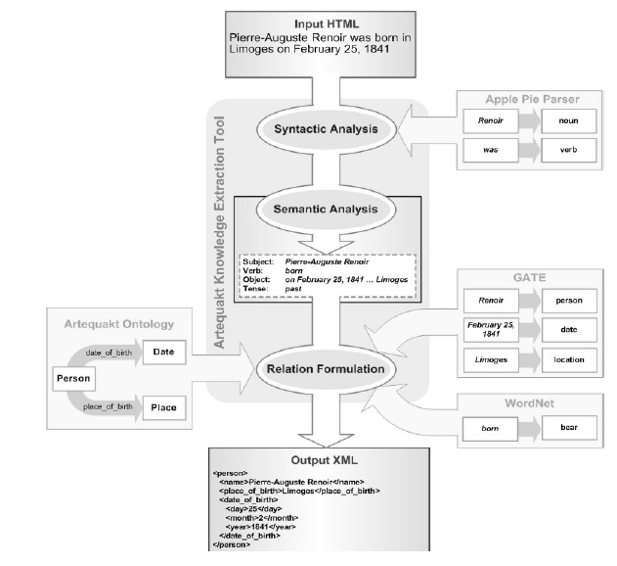

Slide 27
Does it work ?
Where do lobsters like to live?
  on a Canadian airline
Where do hyenas live?
  in Saudi Arabia
  in the back of pick-up trucks
Where are zebras most likely found?
  near dumps
  in the dictionary
Why can't ostriches fly?
  Because of American economic sanctions
What’s the population of Maryland?
  three

Slide 28
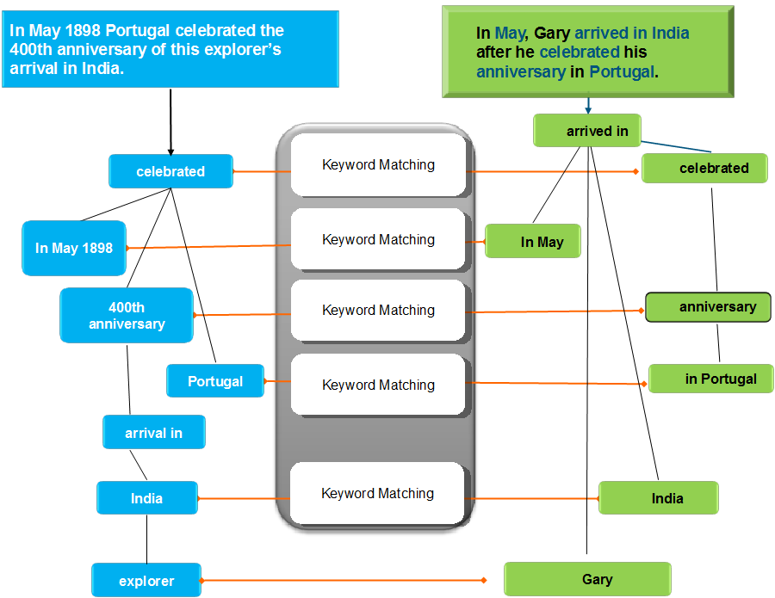
Notes:
Evidence suggests “Gary” is the answer BUT the system must learn that keyword matching may be weak relative to other types of evidence

Slide 29

































In May 1898 Portugal celebrated the 400th anniversary of this explorer’s arrival in India.
On 27th May 1498, Vasco da Gama landed in Kappad Beach
On 27th May 1498, Vasco da Gama landed in Kappad Beach
On 27th May 1498, Vasco da Gama landed in Kappad Beach
On the 27th of May 1498, Vasco da Gama landed in Kappad Beach
Search Far and Wide
Explore many hypotheses
Find Judge Evidence
Many inference algorithms
celebrated
landed in
Portugal
Temporal Reasoning
May 1898
400th anniversary
27th May 1498
Statistical Paraphrasing
Date
Math
arrival in
GeoSpatial Reasoning
Para-phrases
India
Kappad Beach
Geo-KB
explorer
Vasco da Gama

Slide 30
IBM WATSON

Slide 31
Watson
Project started by IBM in 2007.
Goal was to make an expert system which can process natural language faster then human in real time.
Being above goal and question answering in mind, an american TV quiz show, Jeopardy was chosen because of its pattern.
Notes:
For competing with human champions, the system should be capable of answering 70 percent of the questions with accuracy of more than 80 percent in a time frame of less than three seconds.

Slide 32
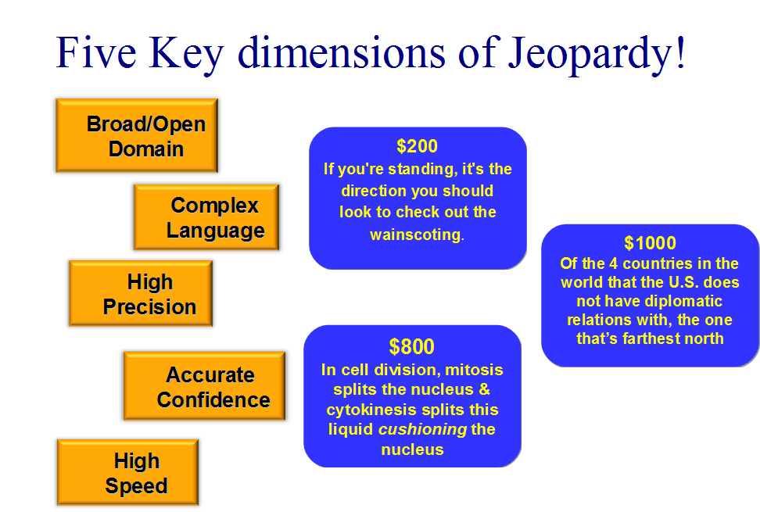

Slide 33
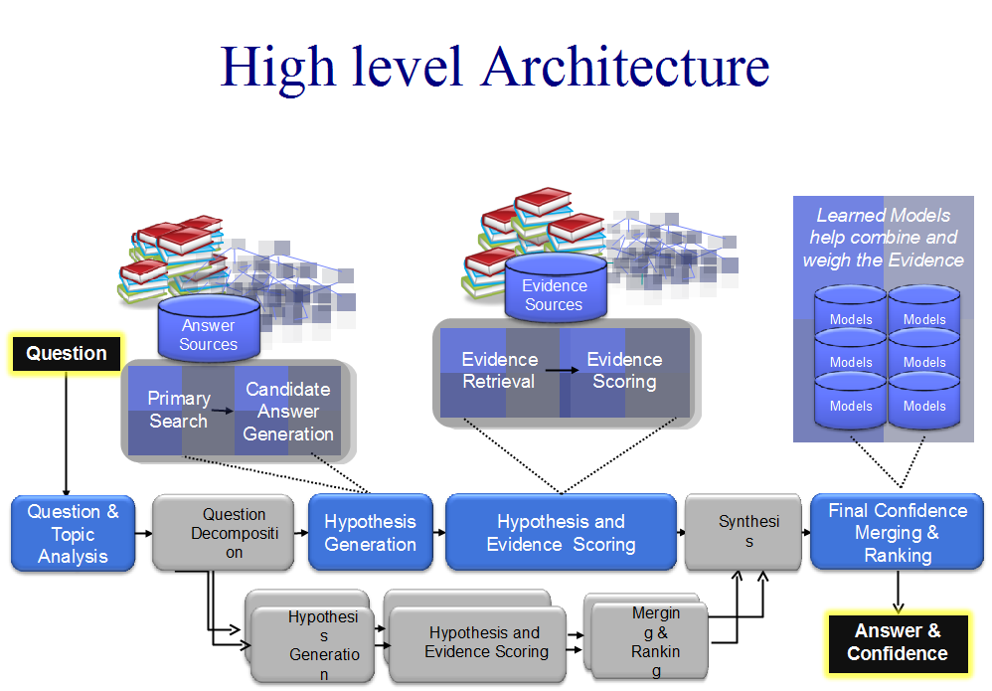

Slide 34
How Watson Works

Slide 35
Understanding by Example
“Who is the 44th president of United states”

Slide 36
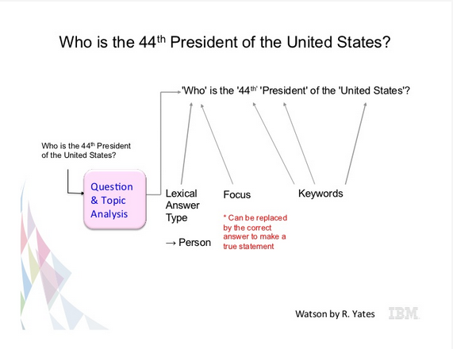
Notes:
http://h30565.www3.hp.com/t5/Feature-Articles/How-Watson-Won-at-Jeopardy/ba-p/7752

Slide 37
Understanding Clue
Watson tokenizes and parse clue to identify relationship among important words and find the focus of the clue.
“Wisden ranked him the second greatest ODI batsman”
ranked
mod
batsman
subj
madj
obj
Wisden
him
nadj
nadj
ODI
second
greatest

Slide 38
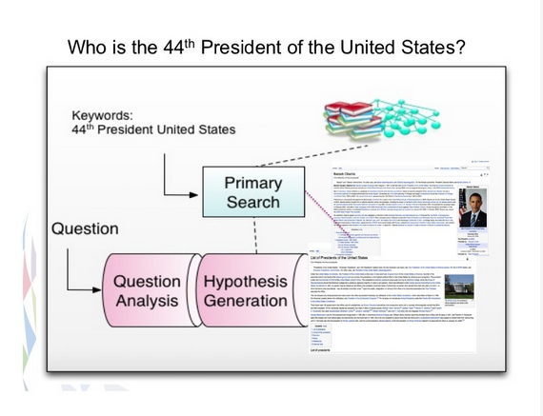

Slide 39
Hypothesis generation
Process of producing possible answers to a given question.
These candidate answers are scored by the Evidence gathering and Hypothesis scoring components and ranked by final merging component.
Two main components :
  Search
    Retrieve relevant content from its diverse knowledge source
  Candidate generation
    Identifies the potential answers

Slide 40
Searching
Searching unstructured resources
  Title oriented search
    Correct answer is the title of the document itself
    Ex- “This country singer was imprisoned for robbery and in 1972 was pardoned by Ronald Reagan” (answer : Merle Haggard)
    Title of the document is the question itself
Ex- “Aleksander became the president of this country in 1995”
    [ The first sentence of the Wikipedia article on Aleksander states, Aleksander is a Polish socialist politician who served as the President of Poland from 1995 to 2005 ]
Notes:
1. Watson’s text corpora contain both title-oriented documents,
such as encyclopedia documents, and non-title-oriented
sources, such as newswire articles
2. In the first case, the correct answer is the title of the
document that answers the question. For example,
consider the Jeopardy! question This country singer
was imprisoned for robbery and in 1972 was
pardoned by Ronald Reagan.[ The Wikipedia** article for
Merle Haggard, the correct answer, mentions him as a
country singer, his imprisonment for robbery, and his pardon
by Reagan and is therefore an excellent match for the
question. Jeopardy!
3. In the second case, the title of a document that answers the
question is in the question itself. For instance, consider the
question Aleksander Kwasniewski became the president of
this country in 1995.[ The first sentence of the Wikipedia
article on Aleksander Kwasniewski states, BAleksander
Kwasniewski is a Polish socialist politician who served as
the President of Poland from 1995 to 2005.[

Slide 41
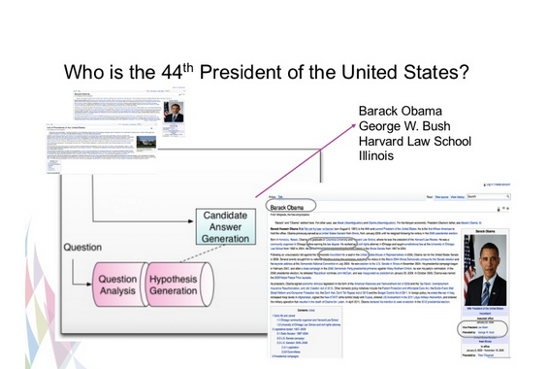
Candidate Generation

Slide 42

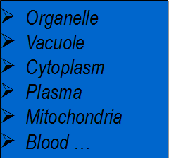







Candidate Generation
Responsible for finding CAs and giving them relative probability estimate using Word net.
“In cell division, mitosis splits the nucleus & cytokinesis splits this liquid cushioning the nucleus”
Notes:
Many candidate answers (CAs) are generated from many different searches
Each possibility is evaluated according to different dimensions of evidence.
Just One piece of evidence is if the CA is of the right type. In this case a “liquid”.

Slide 43
Missing Links
Buttons
Category: Common Bonds
Shirts,
TV remote controls,
Telephones
Mt Everest
Edmund
Hillary
He was first
On hearing of the discovery of George Mallory's body, he told reporters he still thinks he was first.
Notes:
Realizing and resolving implicit relationships and using
them to interpret language and to answer questions is
generally useful and appears in different forms in Jeopardy!
clues. Although these examples are fun and may seem of
unique interest to Jeopardy!, the ability to find what different
concepts have in common can help in many areas, including
relating symptoms to diseases or generating hypotheses
that a chemical might be effective at treating a disease. For
example, a hypothesis of using fish oil as a treatment for
Raynaud’s disease was made after text analytics discovered
that both had a relationship to blood viscosity [34].
In COMMON BONDS clues, the task of finding the
missing link is directly suggested by the well-known
Jeopardy! category. However, this is not always the case.
Final Jeopardy! questions, in particular, were uniquely
difficult, partly because they made implicit references to
unnamed entities or missing links. The missing link had to be
correctly resolved in order to evidence the right answer.
Consider the following Final Jeopardy! clue:
EXPLORERS: On hearing of the discovery of George
Mallory’s body, he told reporters he still thinks he was
first. (Answer: BSir Edmund Hillary[)
To answer this question accurately, Watson had to first
make the connection to Mount Everest and realize that,
although not the answer, it is essential to confidently
getting the correct answerVin this case, Edmund Hillary, the
first person to reach the top of Mount Everest. Implicit
relationships and other types of tacit context that help in
interpreting language are certainly not unique to Jeopardy!
but are commonplace in ordinary language. In the next paper
in this journal issue, BIdentifying Implicit Relationships,[
Chu-Carroll et al. [35] discuss the algorithmic techniques
used to solve BCOMMON BONDS[ questions, as well as
other questions, such as the Final Jeopardy! question above,
which require the discovery of missing links and implicit
relationships.

Slide 44
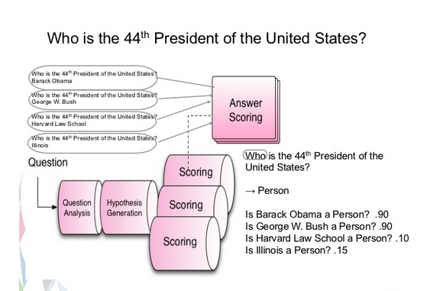

Slide 45
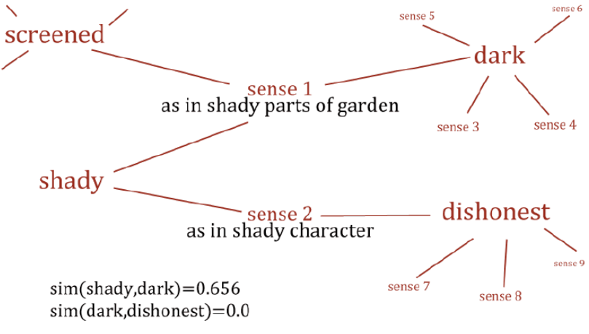
Word Net - Synsets

Slide 46
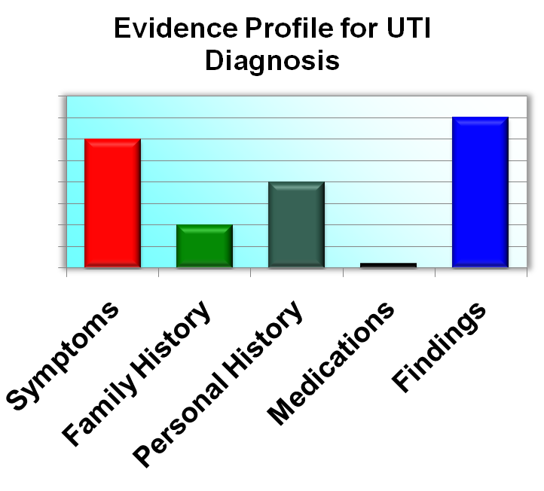
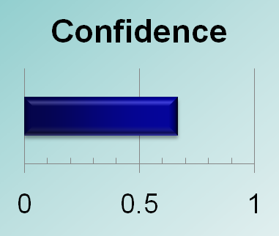
Final Scoring and Summarizing
Each dimension contributes to supporting or refuting hypotheses based on
  Strength of evidence and
  Importance of dimension for diagnosis (learned from training data)
Evidence dimensions are combined to produce an overall confidences
  Overall Confidence
Positive Evidence
Negative Evidence

Slide 47

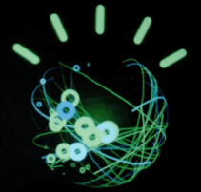



Real-Time Game Configuration
Used in Sparring and Exhibition Games
Clue Grid
Insulated and Self-Contained
Human Player
1
Watson’s
QA Engine
2,880
IBM Power750
Compute
Cores
15 TB of
Memory
Jeopardy! Game Control
System
Decisions to
Buzz and Bet
Strategy
Clue &
Category
Watson’s
Game Controller
Text-to-Speech
Answers & Confidences
Human Player
2
Clues, Scores & Other Game Data
Analyzes content equivalent to 1 Million Books

Slide 48
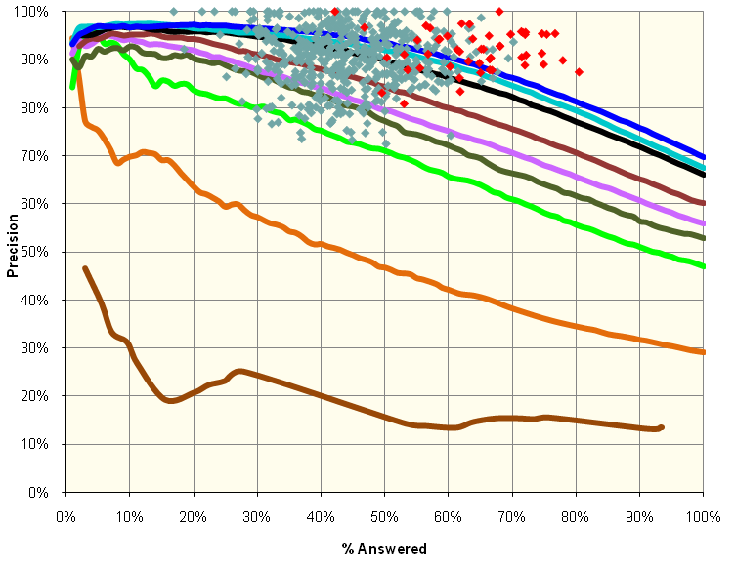
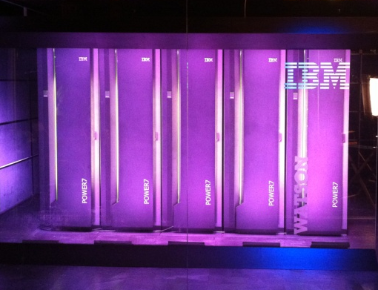
Conclusion
Watson: Precision, Confidence & Speed
Deep Analytics – Watson achieved champion-levels of Precision and Confidence over a huge variety of expression
Speed – By optimizing Watson’s computation for Jeopardy! on 2,880 POWER7 processing cores watson went from 2 hours per question on a single CPU to an average of just 3 seconds – fast enough to compete with the best.
Results – in 55 real-time sparring against former Tournament of Champion Players last year, Watson put on a very competitive performance, winning 71%. In the final Exhibition Match against Ken Jennings and Brad Rutter, Watson won!

Slide 49


Potential Business Applications
&
Future Work
Healthcare / Life Sciences: Diagnostic Assistance, Evidence-Based, Collaborative Medicine
Tech Support: Help-desk, Contact Centers
Enterprise Knowledge Management and Business Intelligence
Government: Improved Information Sharing and Education

Slide 50
References
Ferrucci, David, Eric Brown, Jennifer Chu-Carroll, James Fan, David Gondek, Aditya A. Kalyanpur, Adam Lally et al. "Building Watson: An overview of the DeepQA project." AI Magazine 31, no. 3 (2010): 59-79.
Harith Alani, Sanghee Kim, David E. Millard, Mark J. Weal, Paul H. Lewis, Wendy Hall, Nigel Shadbolt, “Automatic Extraction of Knowledge from Web Documents .” In Workshop of Human Language Technology for the Semantic Web and Web Services, 2nd International Semantic Web Conference, Sanibel Island, Florida, USA, 2003.
J. Chu-Carroll J. Fan , B. K. Boguraev, D. Carmel, D. Sheinwald, C. Welty, “Finding needles in the haystack: Search and candidate generation.” In IBM Journal of Research and Development 56.3.4 (2012): 6-1.
J. Chu-Carroll , E.W. Brown, Lally, J.W. Murdock, “Identifying Implicit Relationships.” IBM Journal of Research and Development 56, no. 3.4 (2012): 12-1.
B. L. Lewis, “In the game: The interface between Watson and Jeopardy!.” In IBM Journal of Research and Development 56.3.4 (2012): 17-1.
D. A. Ferrucci, “Introduction to “This is Watson”.” In IBM Journal of Research and Development 56.3.4 (2012): 1-1.

Slide 51
References
7. A. Lally, J. M. Prager, M. C. McCord, B. K. Boguraev, S. Patwardhan, J. Fan, P. Fodor, J. Chu-Carroll, “Question analysis: How Watson reads a clue.” In IBM Journal of Research and Development 56.3.4 (2012): 2-1.
8. Jeopardy! IBM Watson Day 1 (Feb 14, 2011) http://www.youtube.com/watch?v=seNkjYyG3gI&feature=related
9. What Is Watson? – http://www-03.ibm.com/innovation/us/watson/what-is-watson/index.html

Slide 52
Thank You

