Slide 1
Provable Non-convex Optimization for ML
Prateek Jain
Microsoft Research India

Slide 2

Overview
$$\min_{X}{f(X)} \\ s.t. rank\left(X\right)≤r$$
Projected gradient descent
Alternating Minimization

Slide 3
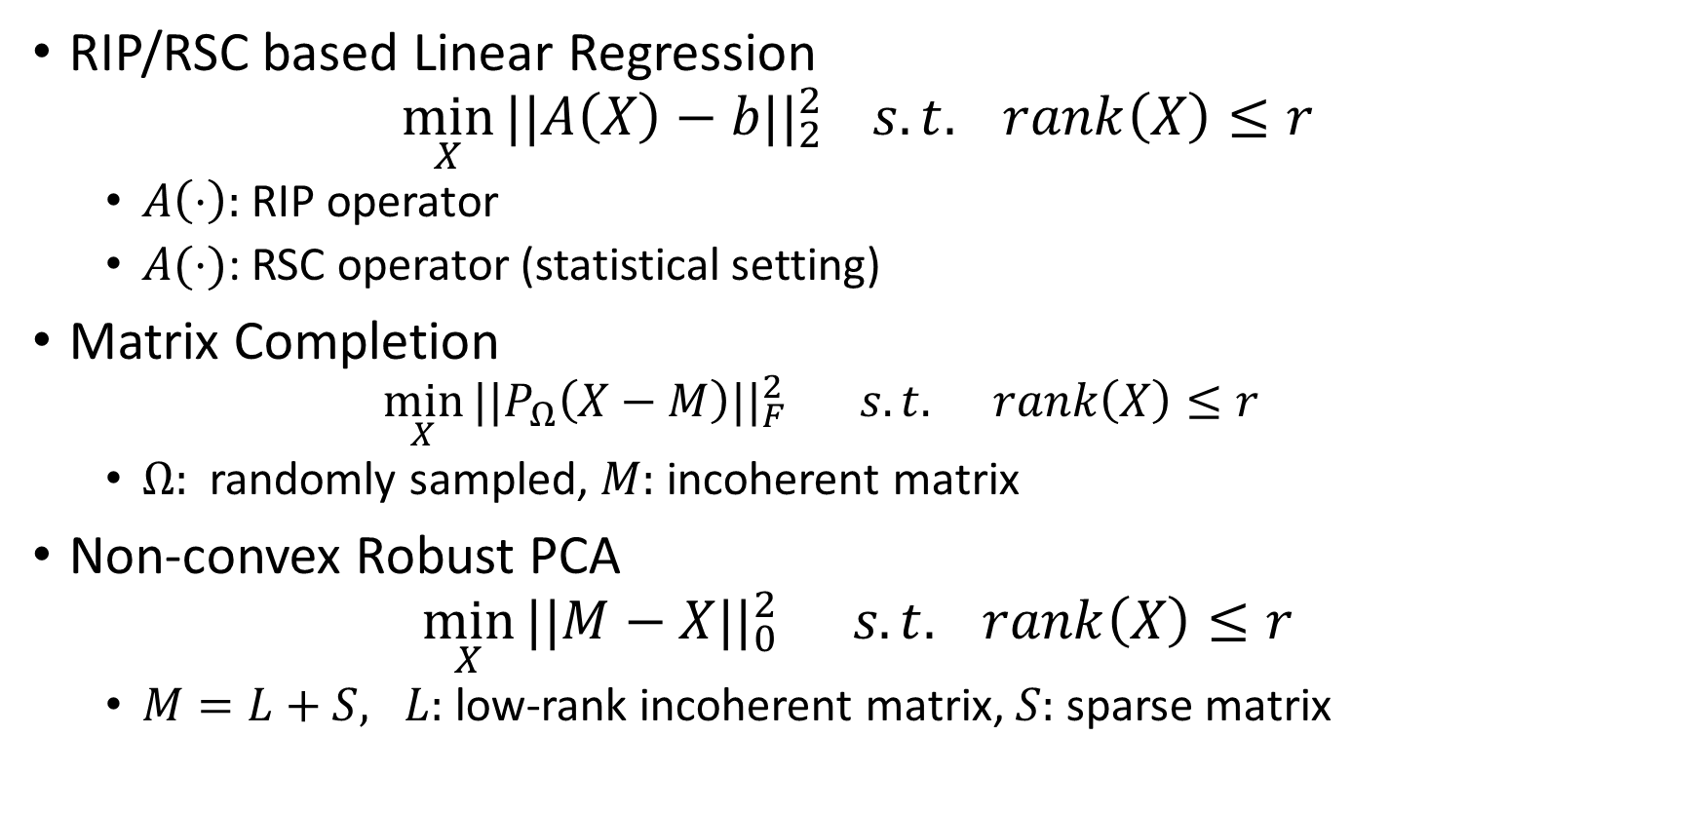
Our Results
RIP/RSC based Linear Regression
$$\min_{X}{||A\left(X\right)−b||_{2}^{2}} s.t. rank\left(X\right)≤r$$
  $A\left(⋅\right):$ RIP operator
  $A(⋅)$: RSC operator (statistical setting)
Matrix Completion
  $$\min_{X}{||P_{Ω}\left(X−M\right)||_{F}^{2}} s.t. rank\left(X\right)≤r$$
  $Ω:$ randomly sampled, $M:$ incoherent matrix
Non-convex Robust PCA
$$\min_{X}{||M−X||_{0}^{2}} s.t. rank\left(X\right)≤r$$
  $M=L+S, L:$low-rank incoherent matrix, $S:$ sparse matrix

Slide 4
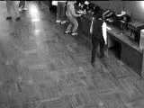
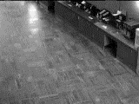
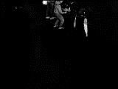
Foreground/Background Separation
=
+

Slide 5
Non-convexity of Low-rank manifold
1 | 0 | 0
0 | 0 | 0
0 | 0 | 0
0 | 0 | 0
0 | 1 | 0
0 | 0 | 0
0.5 | 0 | 0
0 | 0.5 | 0
0 | 0 | 0
0.5
+ 0.5
=

Slide 6









Projection onto set of Low-rank Matrices
Non-convex projections: NP-hard in general
But $P_{r}(Z)$ can be computed efficiently:
$$Z=UΣV^{T}$$
$P_{r}\left(Z\right)=U_{r}Σ_{r}V_{r}^{T}$
=
x
x
$$Z$$
$$U$$
$$Σ$$
$$V^{T}$$
$$P_{1}(Z)$$
=
x
x
$$U_{1}$$
$$Σ_{1}$$
$$V^{T}$$

Slide 10
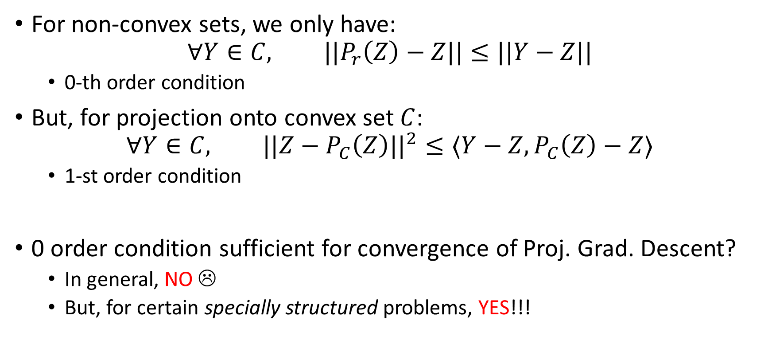
Convex-projections vs Non-convex Projections
For non-convex sets, we only have:
$$∀Y∈C, ||P_{r}\left(Z\right)−Z||≤||Y−Z||$$
  0-th order condition
But, for projection onto convex set $C$:
$$∀Y∈C, ||Z−P_{C}\left(Z\right)||^{2}≤〈Y−Z, P_{C}\left(Z\right)−Z〉$$
  1-st order condition
0 order condition sufficient for convergence of Proj. Grad. Descent?
  In general, NO ☹
  But, for certain specially structured problems, YES!!!

Slide 11








Low-rank Matrix Regression
$$⇒$$
$$,$$
$$⇒$$
$$…$$
$$,$$
Recovered Matrix ($M$)
Hidden matrix ($M$)
Observed Measurements (A($M$))

Slide 12
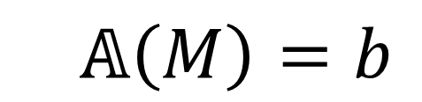

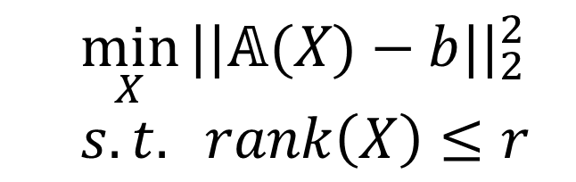
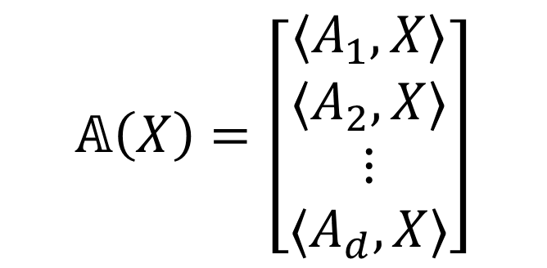
Matrix Linear Regression
  $$𝔸\left(M\right)=b$$
$𝔸:R^{n×n}→R^{d}$
  Linear operator
  $𝔸=\{A_{1}, A_{2}, …, A_{d}\}$
Optimization Version:
$$𝔸\left(X\right)=\left[\begin{matrix}〈A_{1}, X〉 \\ 〈A_{2}, X〉 \\ \begin{aligned}⋮ \\ 〈A_{d}, X〉\end{aligned}\end{matrix}\right]$$
  $$\min_{X}{||𝔸(X)−b||_{2}^{2}}$$
  $s.t. rank\left(X\right)≤r$

Slide 13
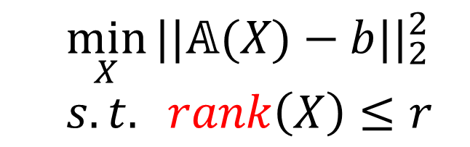
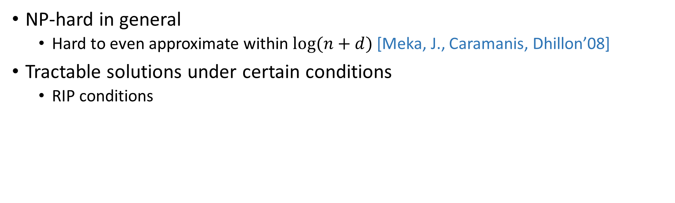
Low-rank Matrix Estimation
  $$\min_{X}{||𝔸(X)−b||_{2}^{2}}$$
  $s.t. rank\left(X\right)≤r$
NP-hard in general
  Hard to even approximate within $log⁡(n+d)$ [Meka, J., Caramanis, Dhillon’08]
Tractable solutions under certain conditions
  RIP conditions

Slide 14

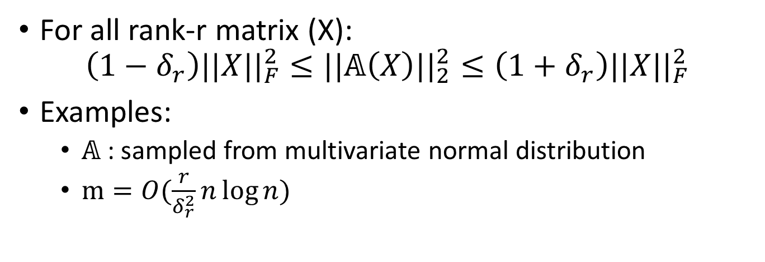


Restricted Isometry Property
$$𝔸$$
$$X$$
$$𝔸(X)$$
For all rank-r matrix (X):
$$\left(1−δ_{r}\right)||X||_{F}^{2}≤||𝔸\left(X\right)||_{2}^{2}≤\left(1+δ_{r}\right)||X||_{F}^{2}$$
Examples:
  $𝔸$: sampled from multivariate normal distribution
  $m=O(\frac{r}{δ_{r}^{2}}n\log{n})$

Slide 15
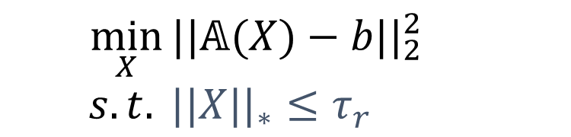
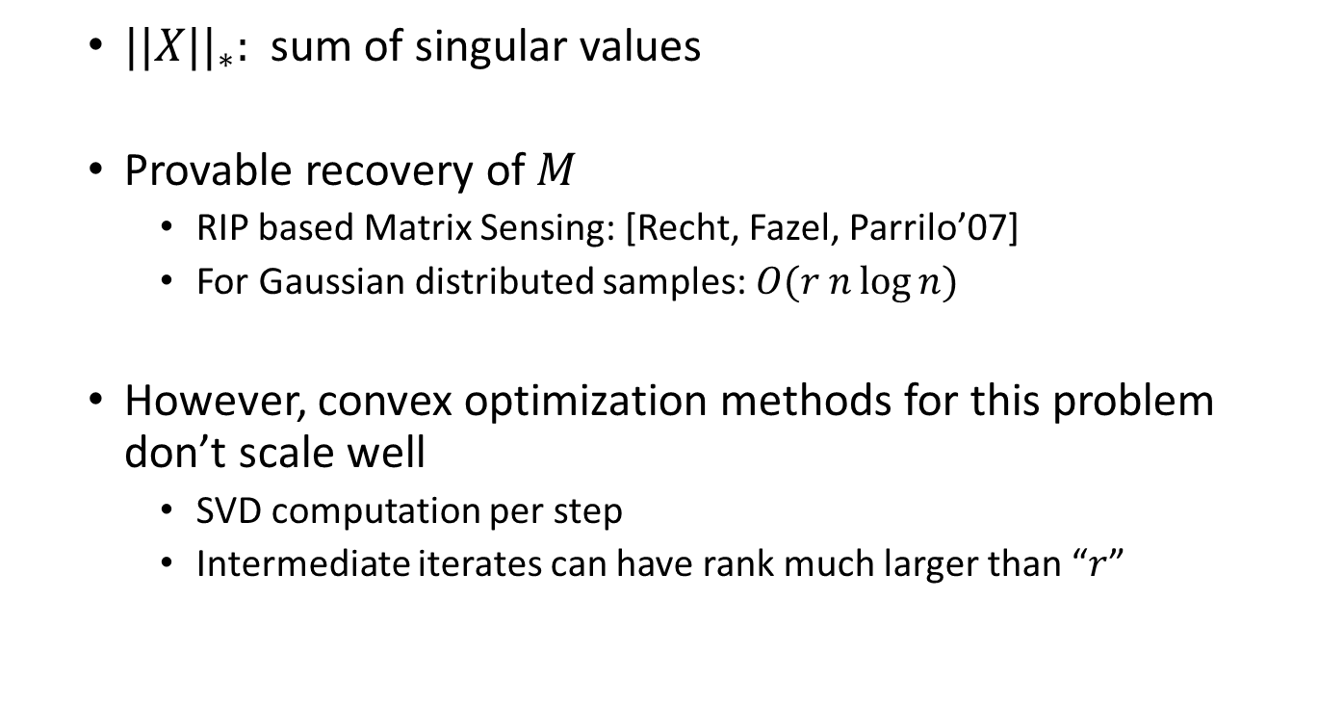
Approach 1: Trace-norm minimization
  $$\min_{X}{||𝔸(X)−b||_{2}^{2}}$$
  $s.t. ||X||_{∗}≤τ_{r}$
  $||X||_{∗}:$ sum of singular values
  Provable recovery of $M$
    RIP based Matrix Sensing: [Recht, Fazel, Parrilo’07]
    For Gaussian distributed samples: $O(r n\log{n})$
  However, convex optimization methods for this problem don’t scale well
    SVD computation per step
    Intermediate iterates can have rank much larger than “$r$”

Slide 18
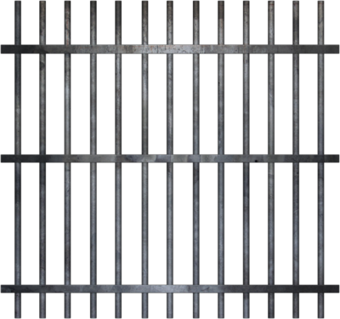









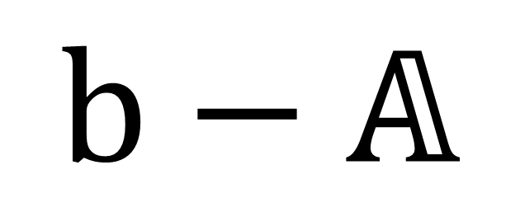
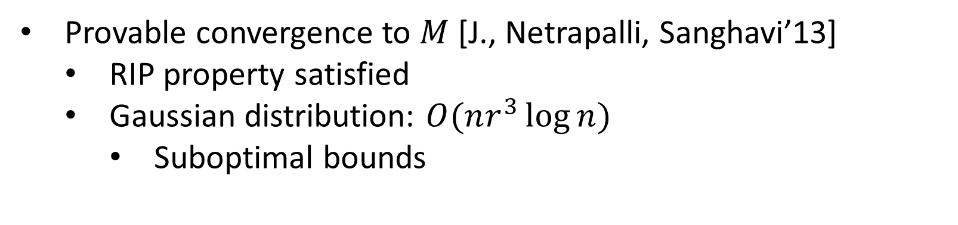
Approach 2: Alternating Minimization
$$($$
$$)$$
2
$$b−𝔸$$
$$×$$
F
$$M$$
$$≅$$
$$U$$
$$×$$
$$V^{T}$$
$$V^{t+1}=\min_{V}{||b−A(U^{t}V^{T})}||_{2}^{2}$$
$$U^{t+1}=\min_{U}{||b−A\left(U{\left(V^{t+1}\right)}^{T}\right)||_{2}^{2}}$$
Provable convergence to $M$ [J., Netrapalli, Sanghavi’13]
  RIP property satisfied
  Gaussian distribution: $O(nr^{3}\log{n})$
    Suboptimal bounds

Slide 19
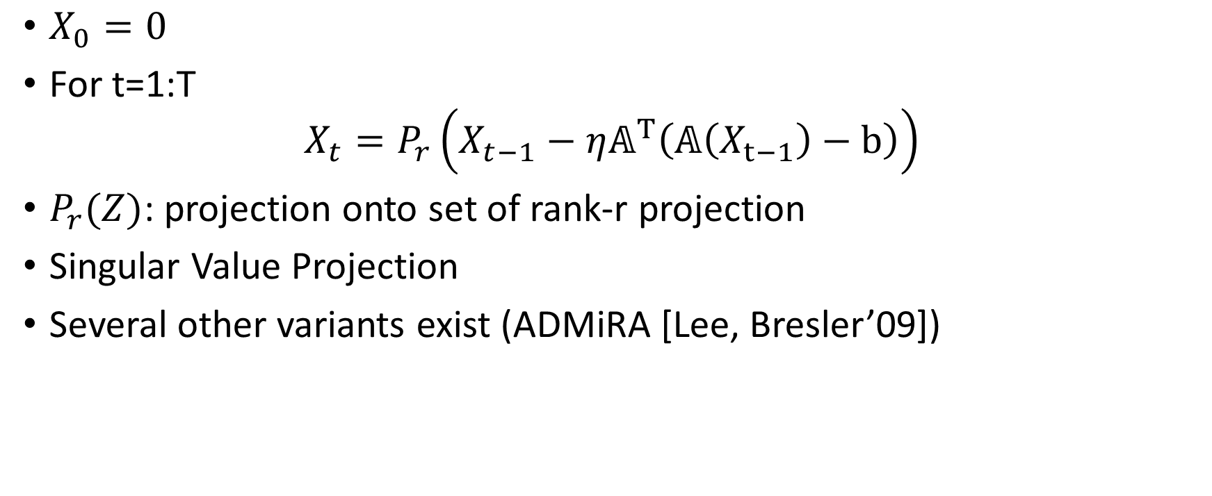
Approach 3: Projected Gradient based Methods
$X_{0}=0$
For t=1:T
$$X_{t}=P_{r}\left(X_{t−1}−η𝔸^{T}\left(𝔸\left(X_{t−1}\right)−b\right)\right)$$
$P_{r}(Z)$: projection onto set of rank-r projection
Singular Value Projection
Several other variants exist (ADMiRA [Lee, Bresler’09])

Slide 20
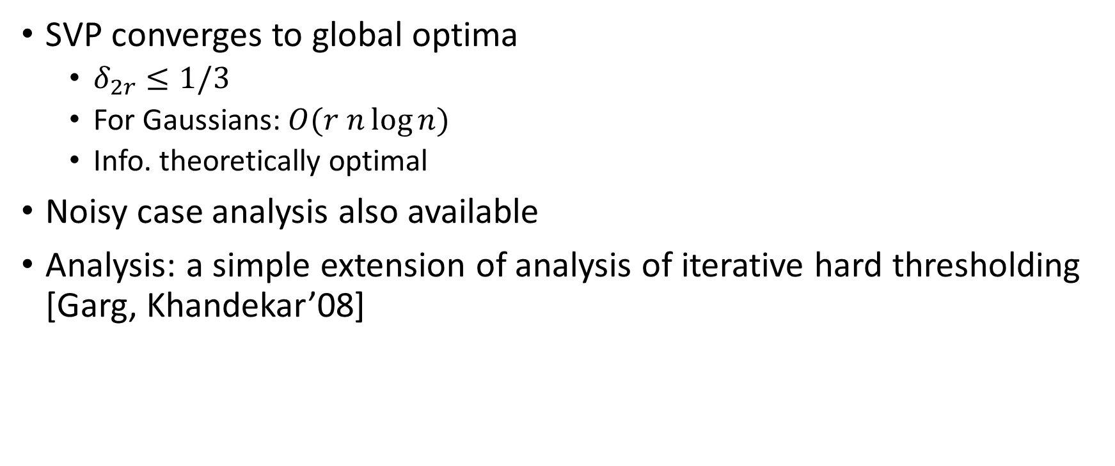
Guarantees
SVP converges to global optima
  $δ_{2r}≤1/3$
  For Gaussians: $O(r n\log{n})$
  Info. theoretically optimal
Noisy case analysis also available
Analysis: a simple extension of analysis of iterative hard thresholding [Garg, Khandekar’08]
[J., Meka, Dhillon 2009]

Slide 21
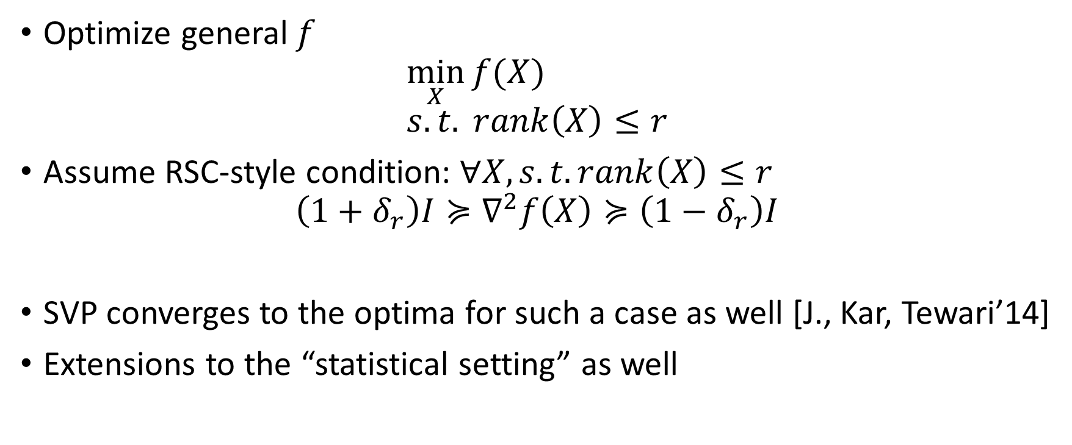
Extensions
Optimize general $f$
$$\min_{X}{f(X)} \\ s.t. rank\left(X\right)≤r$$
Assume RSC-style condition: $∀X, s.t. rank\left(X\right)≤r$
$$\left(1+δ_{r}\right)I≽∇^{2}f\left(X\right)≽\left(1−δ_{r}\right)I$$
SVP converges to the optima for such a case as well [J., Kar, Tewari’14]
Extensions to the “statistical setting” as well

Slide 22
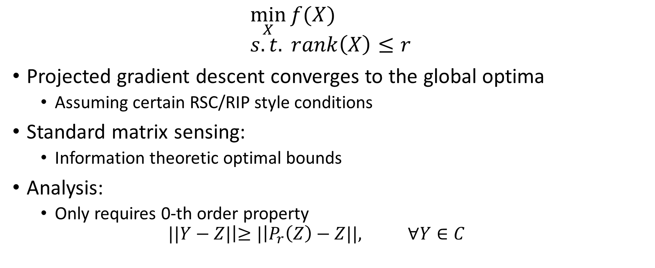
Summary
$$\min_{X}{f(X)} \\ s.t. rank\left(X\right)≤r$$
Projected gradient descent converges to the global optima
  Assuming certain RSC/RIP style conditions
Standard matrix sensing:
  Information theoretic optimal bounds
Analysis:
  Only requires 0-th order property
  $$||Y−Z|\left|≥|\right|P_{r}\left(Z\right)−Z||, ∀Y∈C$$

Slide 23
Low-rank Matrix Completion

Slide 24
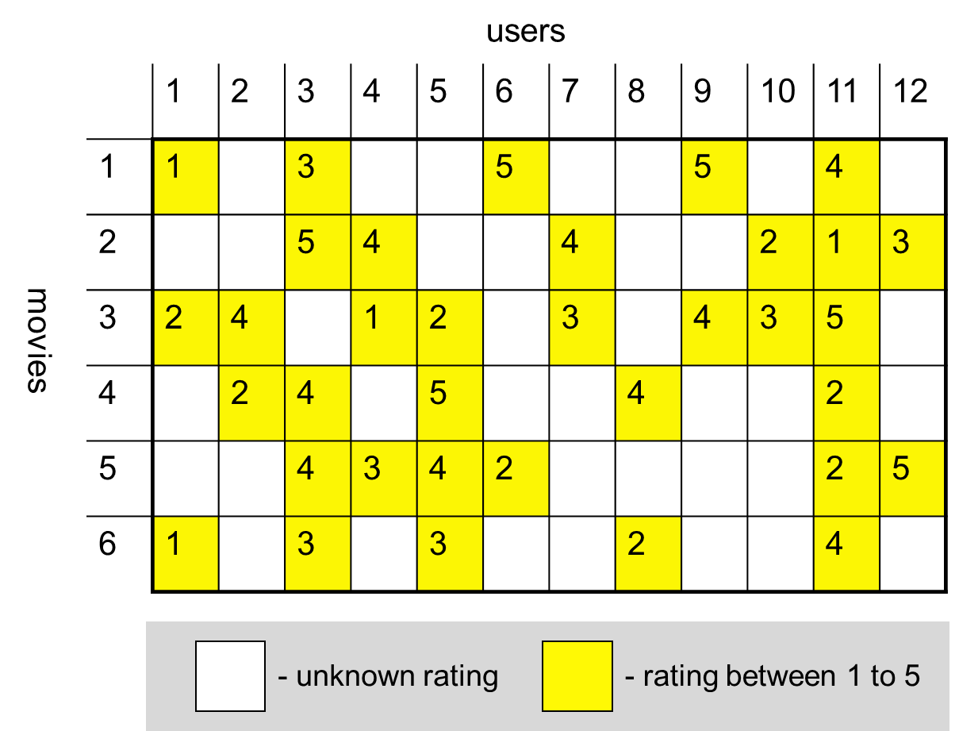
Low-rank Matrix Completion
Task: Complete ratings matrix
Applications: recommendation systems, PCA with missing entries

Slide 25


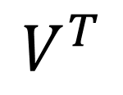
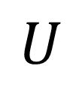
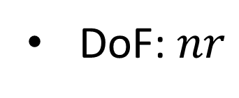

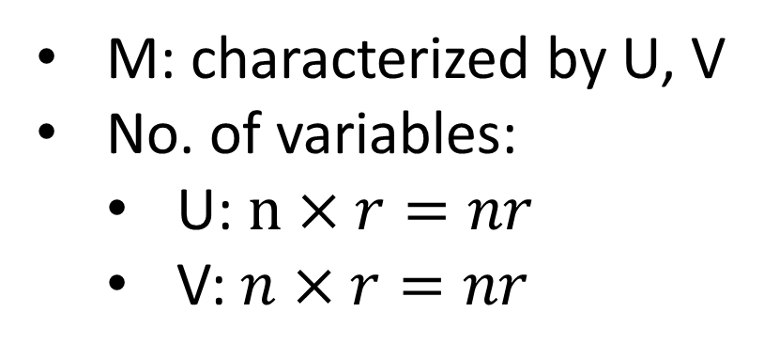


Low-rank
$$≅$$
$$×$$
$$M$$
$$≅$$
$$U$$
$$×$$
$$V^{T}$$
M: characterized by U, V
No. of variables:
  U: $n×r=nr$
  V: $n×r=nr$
DoF: $nr$

Slide 26




Low-rank Matrix Completion
$${\min_{X}{ Error_{Ω}\left(X\right)=\sum_{\left(i,j\right)∈Ω }{{\left(X_{ij}−M_{ij}\right)}^{2}}}}_{}=||P_{Ω}\left(X−M\right)||_{F}^{2} \\ s.t rank\left(X\right)≤r$$
$Ω:$set of known entries
$P_{Ω}{\left(X\right)}_{ij}=X_{ij}, \left(i,j\right)∈Ω$
  $0$ otherwise
1
 |  | 2
 |  | 1
 | 4
1 | 0 | 0 | 0
0 | 0 | 2 | 0
0 | 0 | 1 | 0
0 | 4 | 0 | 0
$$⇒$$
$$M$$
$$P_{Ω}(M)$$

Slide 27
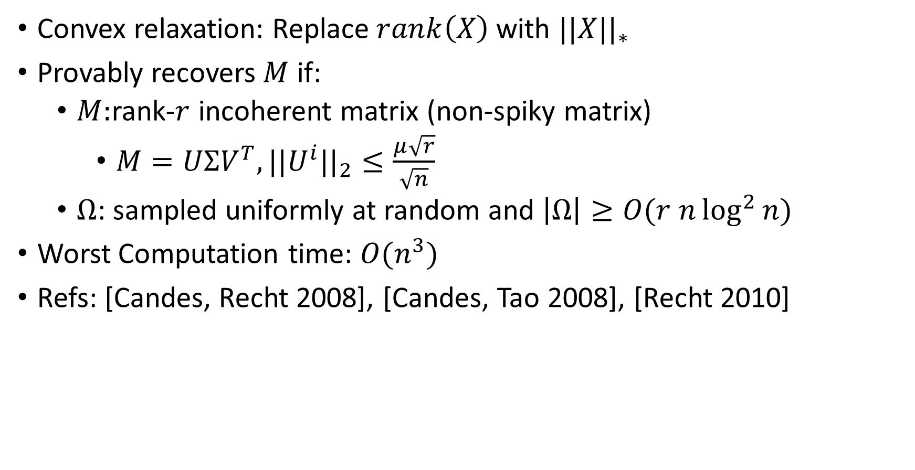
Approach 1
Convex relaxation: Replace $rank\left(X\right)$ with $||X||_{∗}$
Provably recovers $M$ if:
  $M:$rank-$r$ incoherent matrix (non-spiky matrix)
    $M=UΣV^{T}, ||U^{i}||_{2}≤\frac{μ\sqrt{r}}{\sqrt{n}}$
  $Ω$: sampled uniformly at random and $\left|Ω\right|≥O(r n\log^{2}{n})$
Worst Computation time: $O(n^{3})$
Refs: [Candes, Recht 2008], [Candes, Tao 2008], [Recht 2010]

Slide 28
Incoherence?

Slide 30

Alternating Minimization
$${\min_{X}{ Error_{Ω}\left(X\right)=\sum_{\left(i,j\right)∈Ω }{{\left(X_{ij}−M_{ij}\right)}^{2}}}}_{} \\ s.t rank\left(X\right)≤r$$
If X has rank-k:
n
k
k
m
$$=$$
$$×$$
$$V^{T}$$
X
U
$$V^{t+1}=\min_{V}{Error_{Ω}(U^{t}, V)} \\ U^{t+1}=\min_{U}{Error_{Ω}(U, V^{t+1})}$$

Slide 31

Initialization [JNS’13]
Initialization:
  SVD($P_{Ω}\left(M\right), r)$
0
3
0
2
5
0
0
0
2
$$P_{Ω}\left(M\right)$$

Slide 32
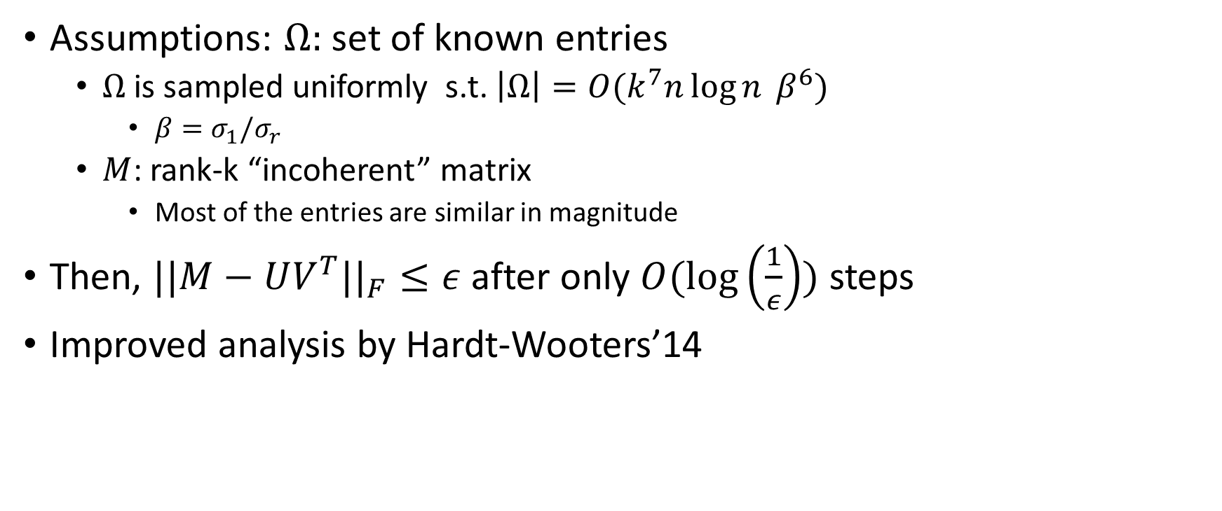
Results [JNS’13]
Assumptions: $Ω:$set of known entries
  $Ω$ is sampled uniformly s.t. $\left|Ω\right|=O(k^{7}n\log{n }β^{6})$
    $β=σ_{1}/σ_{r}$
  $M$: rank-k “incoherent” matrix
    Most of the entries are similar in magnitude
Then, $||M−UV^{T}||_{F}≤ε$ after only $O(\log\left(\frac{1}{ε}\right))$ steps
Improved analysis by Hardt-Wooters’14

Slide 33
Proof Sketch
Assume Rank-1 case, i.e., $M=u^{∗}v^{∗^{T}}$
Fixing $u$, update for $v$ is given by:
$$v=\arg{\min_{v}{\sum_{\left(i,j\right)∈Ω}{{\left(u_{i}v_{j}−u_{i}^{∗}v_{j}^{∗}\right)}^{2}} }} \\ v_{j}=\frac{\sum_{\left(i,j\right)∈Ω}{u_{i}u_{i}^{∗}}}{\sum_{\left(i,j\right)∈Ω}{u_{i}^{2}}}⋅v_{j}^{∗}$$
If $Ω=\left[m\right]x\left[n\right],$
$$v_{j}=〈u, u^{∗}〉v_{j}^{∗}$$
Power method update!

Slide 34
Proof Sketch
$$v=\underbrace{{ M}^{T}u }−\underbrace{{ B}^{−1}\left(B<u,u^{∗}>−C\right)v^{∗} }$$
Power
Method Term
Error Term
Problems:
Show error term decreases with iterations
Also, need to show “incoherence” of each $v$
Tools:
Spectral gap of random graphs
Bernstein-type concentration bounds

Slide 35
Bernstein?

Slide 36
Power Method?

Slide 38
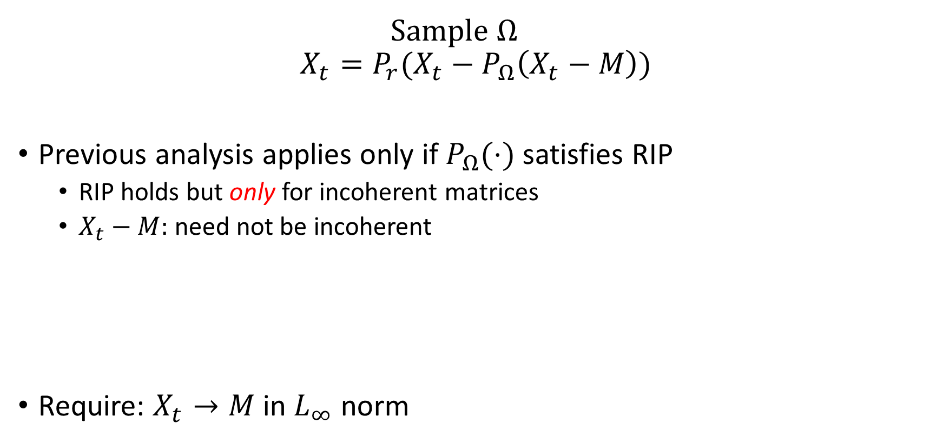
Approach 3: Singular Value Projection
Sample $Ω$
$$X_{t}=P_{r}(X_{t}−P_{Ω}\left(X_{t}−M\right))$$
Previous analysis applies only if $P_{Ω}(⋅)$ satisfies RIP
  RIP holds but only for incoherent matrices
  $X_{t}−M:$ need not be incoherent
Require: $X_{t}→M$ in $L_{∞}$ norm
1 | 1 | 1
1 | 1 | 1
1 | 1 | 1
1 | 1 | 1
1 | 1 | 1
.5 | .5 | .5
0 | 0 | 0
0 | 0 | 0
.5 | .5 | .5
-
=

Slide 39
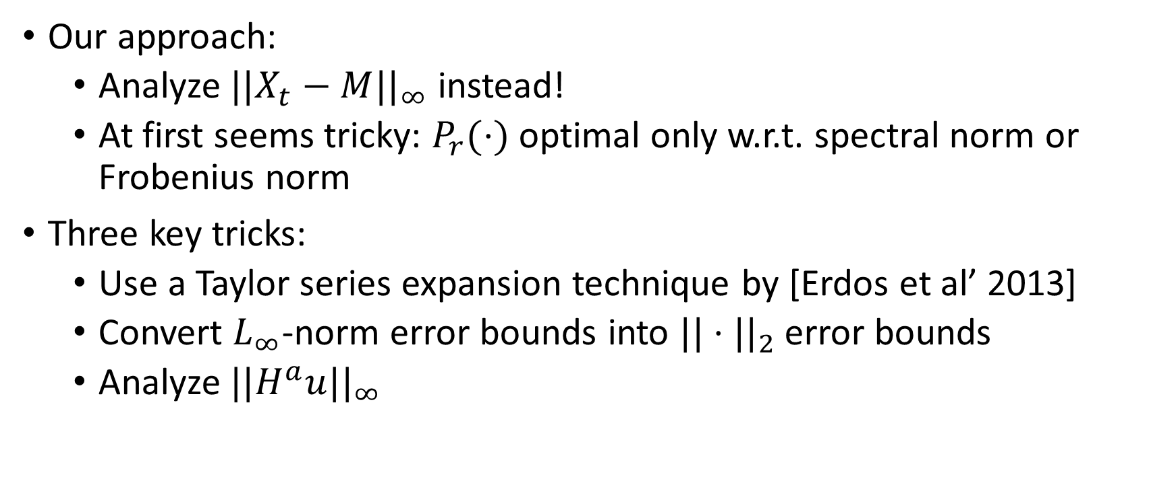
Guarantees
Our approach:
  Analyze $||X_{t}−M||_{∞}$ instead!
  At first seems tricky: $P_{r}(⋅)$ optimal only w.r.t. spectral norm or Frobenius norm
Three key tricks:
  Use a Taylor series expansion technique by [Erdos et al’ 2013]
  Convert $L_{∞}$-norm error bounds into $||⋅||_{2}$ error bounds
  Analyze $||H^{a}u||_{∞}$

Slide 40
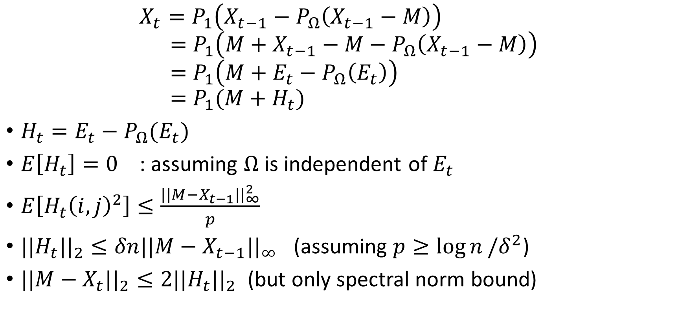
Setting up the proof (Rank-one Case)
$$X_{t}=P_{1}\left(X_{t−1}−P_{Ω}\left(X_{t−1}−M\right)\right) \\ =P_{1}\left(M+X_{t−1}−M−P_{Ω}\left(X_{t−1}−M\right)\right) \\ =P_{1}\left(M+E_{t}−P_{Ω}\left(E_{t}\right)\right) \\ =P_{1}(M+H_{t})$$
$H_{t}=E_{t}−P_{Ω}(E_{t})$
$E\left[H_{t}\right]=0$ : assuming $Ω$ is independent of $E_{t}$
$E\left[H_{t}{\left(i,j\right)}^{2}\right]≤\frac{||M−X_{t−1}||_{∞}^{2}}{p}$
$||H_{t}||_{2}≤δn||M−X_{t−1}||_{∞}$ (assuming $p≥\log{n}/δ^{2}$)
$||M−X_{t}||_{2}≤2||H_{t}||_{2}$ (but only spectral norm bound)

Slide 41
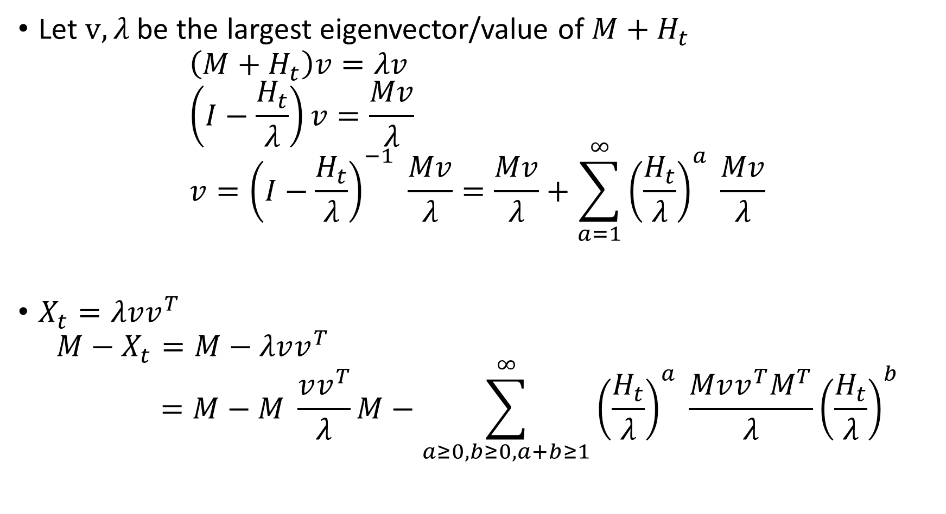
Key Step 1
Let $v,λ$ be the largest eigenvector/value of $M+H_{t}$
$$\left(M+H_{t}\right)v=λv \\ \left(I−\frac{H_{t}}{λ}\right)v=\frac{Mv}{λ} \\ v={\left(I−\frac{H_{t}}{λ}\right)}^{−1} \frac{Mv}{λ}=\frac{Mv}{λ}+\sum_{a=1}^{∞}{{\left(\frac{H_{t}}{λ}\right)}^{a} \frac{Mv}{λ}}$$
$X_{t}=λvv^{T}$
$$M−X_{t}=M−λvv^{T} \\ =M−M \frac{vv^{T}}{λ}M−\sum_{a≥0, b≥0, a+b≥1}^{∞}{{\left(\frac{H_{t}}{λ}\right)}^{a} \frac{Mvv^{T}M^{T}}{λ}{\left(\frac{H_{t}}{λ}\right)}^{b}}$$

Slide 42
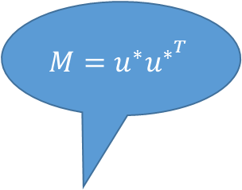
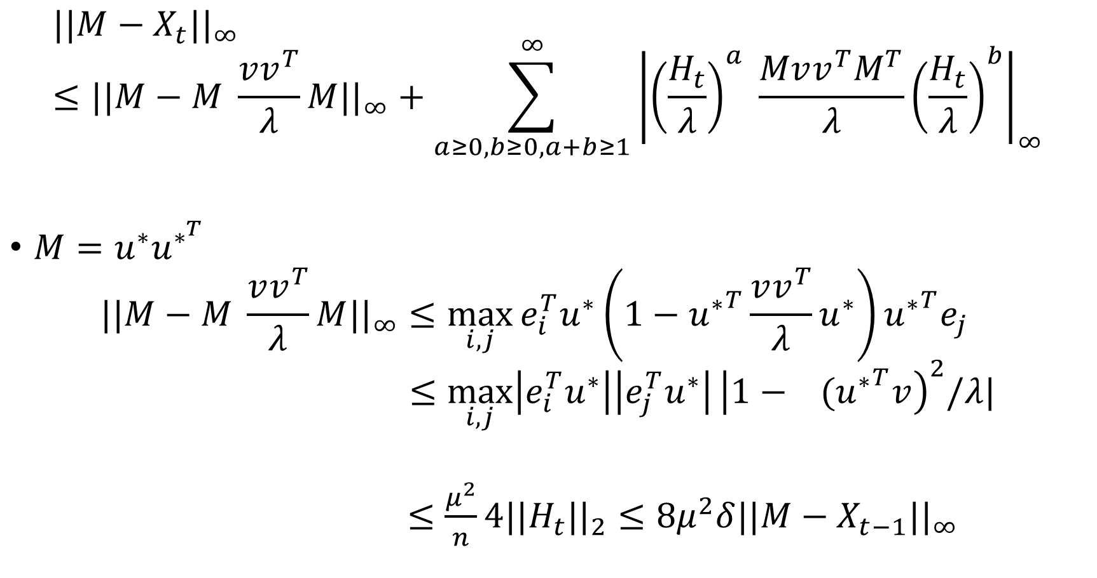
Key Step 2
$$M=u^{∗}u^{∗^{T}}$$
$$||M−X_{t}||_{∞}≤||M−M \frac{vv^{T}}{λ}M||_{∞}+\sum_{a≥0, b≥0, a+b≥1}^{∞}{{\left|{\left(\frac{H_{t}}{λ}\right)}^{a} \frac{Mvv^{T}M^{T}}{λ}{\left(\frac{H_{t}}{λ}\right)}^{b}\right|}_{∞}}$$
$M=u^{∗}u^{∗^{T}}$
$$||M−M \frac{vv^{T}}{λ}M||_{∞}≤\max_{i,j}{e_{i}^{T}u^{∗}\left(1−{u^{∗}}^{T}\frac{vv^{T}}{λ}u^{∗}\right){u^{∗}}^{T}e_{j} } \\ ≤\max_{i,j}\left|e_{i}^{T}u^{∗}\right|\left|e_{j}^{T}u^{∗}\right|{\left|1− {(u^{∗}}^{T}v\right)}^{2}/λ|$$
$≤\frac{μ^{2}}{n}4||H_{t}||_{2}≤8μ^{2}δ||M−X_{t−1}||_{∞}$

Slide 43
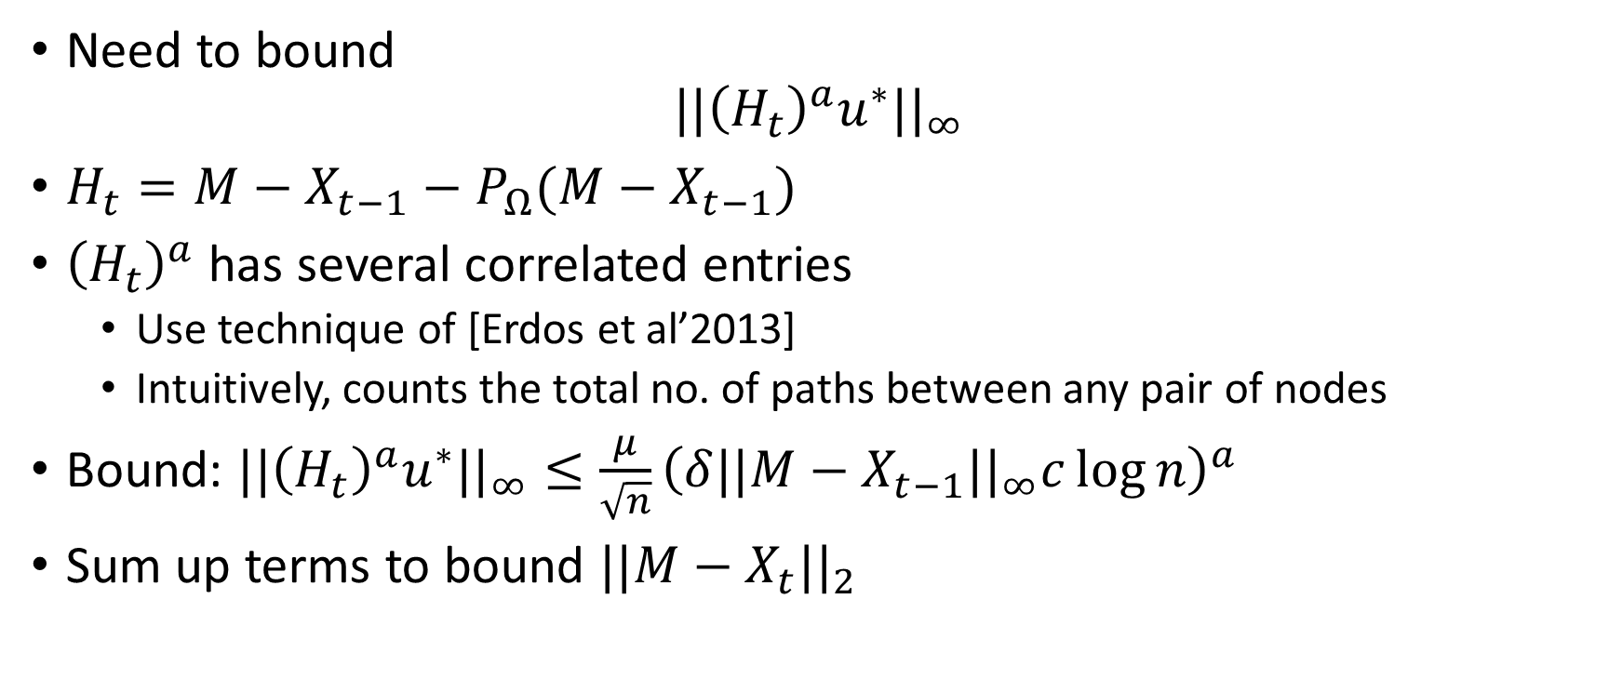
Key Step 3
Need to bound
$$||{\left(H_{t}\right)}^{a}u^{∗}||_{∞}$$
$H_{t}=M−X_{t−1}−P_{Ω}(M−X_{t−1})$
${\left(H_{t}\right)}^{a}$ has several correlated entries
  Use technique of [Erdos et al’2013]
  Intuitively, counts the total no. of paths between any pair of nodes
Bound: $||{\left(H_{t}\right)}^{a}u^{∗}||_{∞}≤\frac{μ}{\sqrt{n}}{\left(δ||M−X_{t−1}||_{∞}c\log{n}\right)}^{a}$
Sum up terms to bound $||M−X_{t}||_{2}$

Slide 44
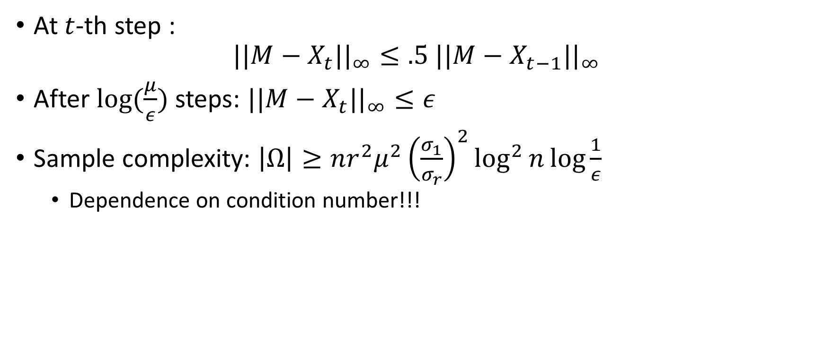
Guarantee for SVP
At $t$-th step :
$$||M−X_{t}||_{∞}≤.5 ||M−X_{t−1}||_{∞}$$
After $log⁡(\frac{μ}{ε})$ steps: $||M−X_{t}||_{∞}≤ε$
Sample complexity: $\left|Ω\right|≥nr^{2}μ^{2}{\left(\frac{σ_{1}}{σ_{r}}\right)}^{2}\log^{2}{n}\log{\frac{1}{ε}}$
  Dependence on condition number!!!
[Netrapalli, J.’14]

Slide 45

Stagewise-SVP
$X_{0}=0$
For k=1…r
  For t=1:T
    $X_{t}=P_r(X_{t−1}−P_{Ω}\left(X_{t−1}−M\right))$
  End For
  $X_{0}=X_{T}$
End For

Slide 46
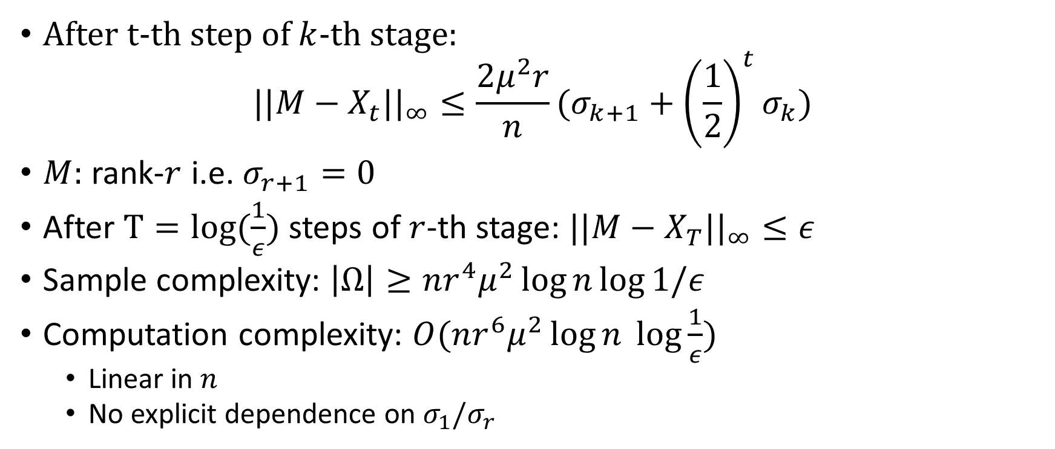
Guarantees
After t-th step of $k$-th stage:
$$||M−X_{t}||_{∞}≤\frac{2μ^{2}r}{n}(σ_{k+1}+{\left(\frac{1}{2}\right)}^{t}σ_{k})$$
$M:$ rank-$r$ i.e. $σ_{r+1}=0$
After $T=log(\frac{1}{ε})$ steps of $r$-th stage: $||M−X_{T}||_{∞}≤ε$
Sample complexity: $\left|Ω\right|≥nr^{4}μ^{2}\log{n}\log{1/ε}$
Computation complexity: $O(nr^{6}μ^{2}\log{n }\log{\frac{1}{ε}})$
  Linear in $n$
  No explicit dependence on $σ_{1}/σ_{r}$
[Netrapalli, J.’14]

Slide 47
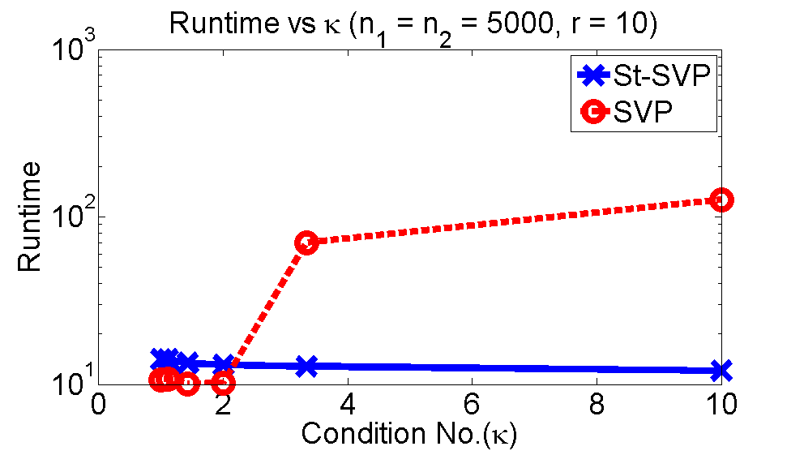
Simulations

Slide 48
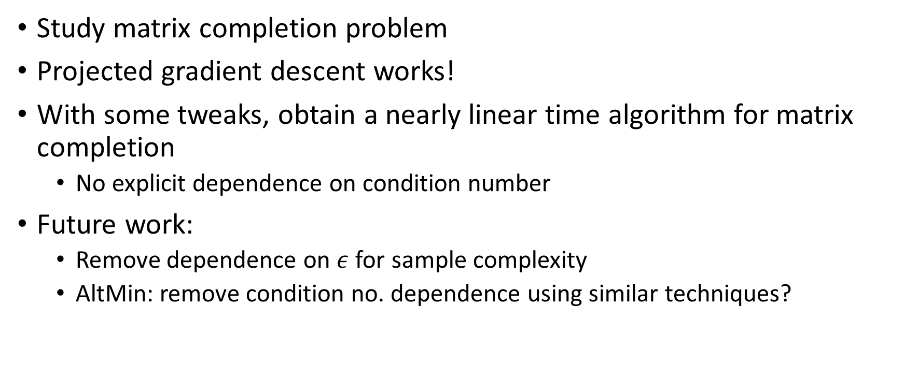
Summary
Study matrix completion problem
Projected gradient descent works!
With some tweaks, obtain a nearly linear time algorithm for matrix completion
  No explicit dependence on condition number
Future work:
  Remove dependence on $ε$ for sample complexity
  AltMin: remove condition no. dependence using similar techniques?

Slide 49
Robust Principal Component Analysis
$$M = L + S$$

Slide 50
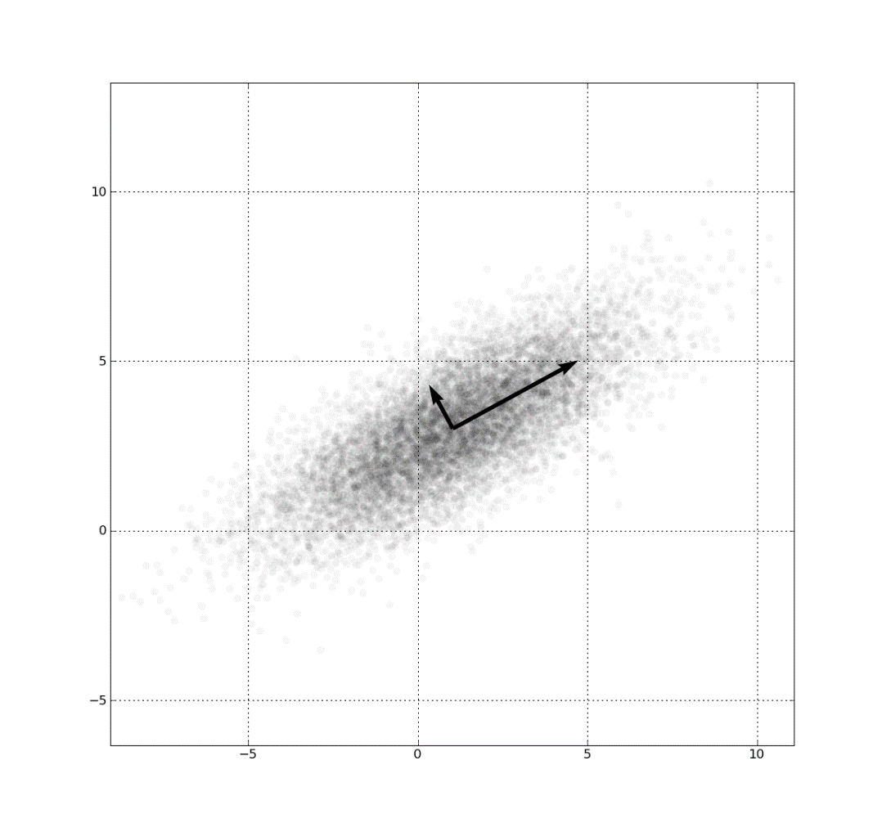
Principal Component Analysis
$X=[x_{1} x_{2}…x_{n}]$
PCA: find best rank-$r$ approx. of $X$
  Top $r−$singular components of $X$
  $X_{r}=P_{r}(X)$
$||X−X_{r}||_{2}=σ_{r+1}$
  Frobenius norm guarantees

Slide 51
PCA with Corruption?
$X=\left[x_{1} x_{2}…x_{n}\right]+E$
$||X−P_{r}(X+E)||_{2}≤σ_{r+1}+2||E||_{2}$

Slide 52
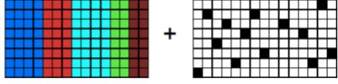
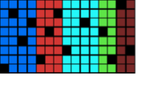
Sparse Corruptions?
Can we do better?
  If $E$ is sparse?
E.g.
  Each point can be corrupted in a few random co-ordinates

Slide 53
Robust PCA
$M:$ given matrix
  $L:$ low-rank matrix
  $S:$ sparse matrix
$$M = L + S$$

Slide 54
Foreground + Background Separation
=
+
Original Video
Background
Foreground
=
+

Slide 55
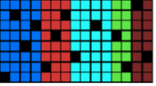
Foreground + Background Separation
Each $64×64$ frame: $4096$-dimensional vector

Slide 56
Robust PCA
$M∈R^{n×n}:$ given matrix
  $L:$ low-rank matrix
  $S:$ sparse matrix
NP-hard problem in general
$$M = L + S$$

Slide 57
Identifiability?
1 | 0 | 0
0 | 0 | 1
0 | 0 | 0
1 | 0 | 0
0 | 0 | 0
0 | 0 | 0
0 | 0 | 0
0 | 0 | 1
0 | 0 | 0
=
+
$$M = L + S$$
Assumptions:
  $L$ is incoherent--- $L_{ij}≤μ||L|{\left.​\right|}_{F}/n$
  $S$ is row and column sparse

Slide 58
Existing Method
$$\min_{\hat{L}, \hat{S}}{rank(\hat{L})+λ||\hat{S}||_{0}} \\ s.t. M=\hat{L}+\hat{S}$$
$$\min_{\hat{L}, \hat{S}}{||\hat{L}||_{∗}+λ||\hat{S}||_{1}} \\ s.t. M=\hat{L}+\hat{S}$$
$||\hat{L}||_{∗}=\sum_{i}{σ_{i}(\hat{L})}$
Convex program, Running time: $O(n^{3})$
Assumption:
  $M=L+S$, $L:$ incoherent, $S:$row-column sparse
  $s≤\frac{n}{μ^{2}r}$
Recover $L, S$ [Chandrasekharan et al’2009, Candes et al’2009]
Question: PCA time complexity for Robust PCA?
That is, $O(n^{2}r)$ algorithm?

Slide 59




Our Approach: Alternating Projections
Goal: $M=L+S$
  $L:$ low-rank matrix
  $S:$ sparse matrix
M=$L_{t}+S_{t}$
$$M−L_{t}$$
$$L_{t}$$
$$S_{t}$$
$$M−S_{t}$$
$$L_{t+1}$$
$$S_{t+1}$$
$$M−L_{t+1}$$
Low-rank Matrices
Sparse Matrices

Slide 60
Projection onto Low-rank Matrices
Non-convex projections: NP-hard in general
But $P_{r}(Z)$ can be computed efficiently:
$$Z=UΣV^{T}$$
$P_{r}\left(Z\right)=U_{r}Σ_{r}V_{r}^{T}$
Time complexity: $O(n^{2}r)$
=
x
x
$$Z$$
$$U$$
$$Σ$$
$$V^{T}$$
$$P_{1}(Z)$$
=
x
x
$$U_{1}$$
$$Σ_{1}$$
$$V^{T}$$

Slide 61
Projection onto Sparse Matrices
Non-convex projection
$HT_{ζ}\left(Z\right):$ removes all elements with magnitude smaller than $ζ$
1 | 0.1 | 0.22
0.1 | 0.01 | .9
0.11 | 0.02 | 0.12
1 | 0 | 0
0 | 0 | .9
0 | 0 | 0
$$HT_{0.5}$$

Slide 62
Non-convex RPCA
$L_{0}→0$
$ζ=μ^{2}r/n$
For t=1, 2, … T
  $ζ=\frac{1}{4}⋅ζ$
  $S_{t}=HT_{ζ}(M−L_{t})$
  $L_{t+1}=P_{r}(M−S_{t})$
Output, $L_{T}, S_{T}$

Slide 63

Computation Time
Each round: 1 SVD + 1 Hard Thresholding
Time complexity per round: $O(n^{2}r)$
No. of rounds?

Slide 64
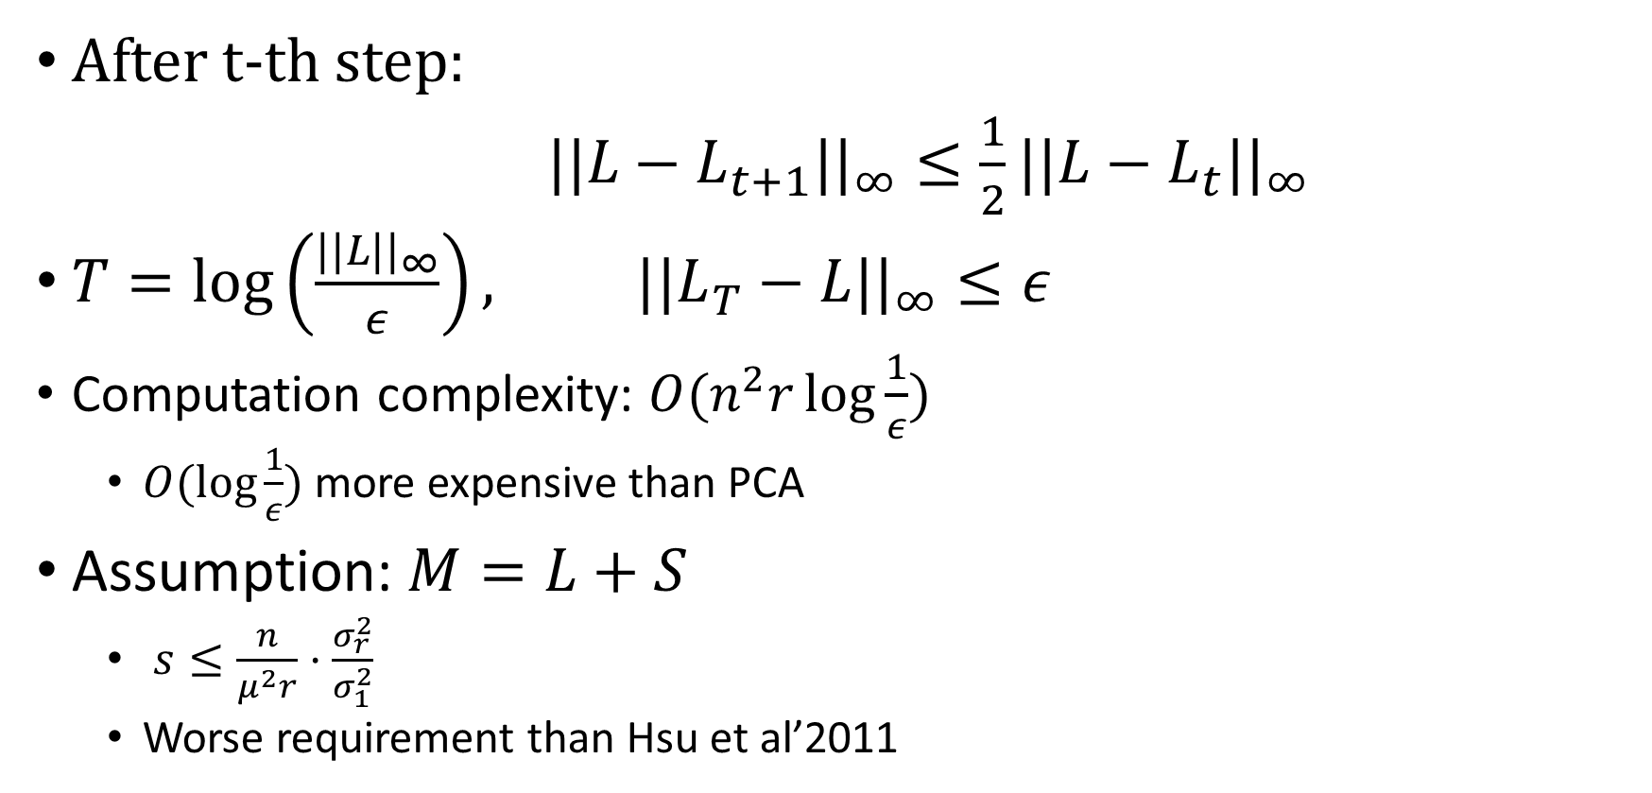
Results
After t-th step:
$||L−L_{t+1}||_{∞}≤\frac{1}{2}||L−L_{t}||_{∞}$
$T=\log\left(\frac{||L||_{∞}}{ε}\right), ||L_{T}−L||_{∞}≤ε$
Computation complexity: $O(n^{2}r\log{\frac{1}{ε}})$
  $O(\log{\frac{1}{ε}})$ more expensive than PCA
Assumption: $M=L+S$
  $s≤\frac{n}{μ^{2}r}⋅\frac{σ_{r}^{2}}{σ_{1}^{2}}$
  Worse requirement than Hsu et al’2011
[NUSAJ’14]

Slide 65






Remove Condition No. Dependence?
Stagewise procedure
  k-th stage projects onto rank-$k$ matrices
  $1≤k≤r$
1st Stage
2nd Stage
$$M−L_{t}$$
$$L_{t}$$
$$S_{t}$$
$$M−S_{t}$$
$$L_{t+1}$$
$$S_{t+1}$$
$$M−L_{t+1}$$
Rank-2 Matrices
Rank-1 Matrices
Sparse Matrices

Slide 66

Result
$T=log⁡(\frac{1}{ε})$
$$||L_{T}−L||_{2}≤ε$$
Assumption: $s≤\frac{n}{μ^{2}r}$
  $s:$ number of corrupted entries in any row or column
  Same as convex relaxation approach (Hsu et al’2011)
Running time: $O(n^{2}r^{2}\log{\frac{1}{ε}})$
[NUSAJ’14]

Slide 67

Missing Entries?
Assuming missing entries are corrupted entries
Allows for $O(\frac{n^{2}}{r})$ missing entries

Slide 68

Proof Technique
$L_{t+1}=P_{r}\left(M−S_{t}\right)=P_{r}\left(L+S−S_{t}\right)=P_{r}(L+E_{t})$
Standard SVD guarantees:
  $||L_{t+1}−L||_{2}≤||E_{t}||_{2}∼O(1)$
  $supp\left(S_{t+1}\right)≠supp(S)$
  Hence, $E_{t+1}=S−S_{t+1}$ can be dense
Goal: ensure
  $supp\left(S_{t+1}\right)⊆supp\left(S\right)$
  $||S−S_{t+1}||_{∞}≤.5 ||S−S_{t}||_{∞}$
But for this, we need $||L_{t+1}−L||_{∞}≤.5 ||E_{t}||_{∞}$

Slide 69
A Novel Perturbation Lemma
$$||P_{r}\left(L+E_{t}\right)−L||_{∞}≤.5 ||E_{t}||_{∞}$$
If:
  $E_{t}:$ sparse
  $L:$ incoherent
Much tighter than the standard matrix perturbation results
  $||P_{r}\left(L+E_{t}\right)−L||_{2}≤2||E_{t}||_{2}$

Slide 70
Proof Sketch (Rank-1 case)
$L=uu^{T}$
$L_{t+1}=P_{1}\left(L+E_{t}\right), L_{t+1}=vv^{T}$
$$\left(L+E_{t}\right)v=v \\ \left(I−E_{t}\right)v=Lv$$
$$v={\left(I−E_{t}\right)}^{−1} Lv=Lv+\sum_{a=1}^{∞}{{\left(E_{t}\right)}^{a} Lv}$$
$$L−L_{t+1}=L−vv^{T} \\ =L−Lvv^{T}L−\sum_{a≥0, b≥0, a+b≥1}^{∞}{{\left(E_{t}\right)}^{a} Lvv^{T}L^{T}{\left(E_{t}\right)}^{b}}$$

Slide 71

Proof Sketch
Using $L=uu^{T}$
$$L−L_{t}=\left(1−{〈u, v〉}^{2}\right)L+{〈u,v〉}^{2}\sum_{a≥0, b≥0, a+b≥1}^{∞}{{\left(E_{t}\right)}^{a} uu^{T}{\left(E_{t}\right)}^{b}}$$
$||{\left(E_{t}\right)}^{a}u||_{∞}$: small
  $E_{t}:$ sparse
  $u:$ incoherent ($||u||_{∞}≤μ/\sqrt{n})$
Bound $||⋅||_{∞}$ of each term

Slide 72
Empirical Results (Synthetic Datasets)

Slide 73


Empirical Results
Convex Method. Runtime: 1700 sec
=
+
Non-Convex Method. Runtime: 70 sec
=
+

Slide 74
Summary
Robust PCA
  Low-rank+Sparse Decomposition
Alternating Projection Method
Under standard assumptions
  Linear rate of convergence
  Computation time: Recovery in O(PCA), for constant rank matrices
Key analysis tool: a strong perturbation bound for SVD

Slide 75
Future Work
RIP/RSC based Matrix sensing:
  Necessity of the required RIP/RSC conditions?
Matrix completion:
  Remove dependence of $|Ω|$ on error $ε$
  Optimal dependence of $|Ω|$ on $r$
Robust PCA:
  Extension to [Candes et al’09] style conditions
  Can handle $O(\frac{n}{μ^{2}})$ corruptions per row (currently, $O(\frac{n}{μ^{2}r})$)
Develop a more generic framework to jointly analyze these problems
  Similar to unified M-estimator technique of [Negahban et al’09]

Slide 76
Thanks!

