Slide 1


Supervised
Class-Ratio Estimation
Joint Work by: Arun Iyer, J. Saketha Nath, Sunita Sarawagi

Slide 2
Motivation & Definition

Slide 3
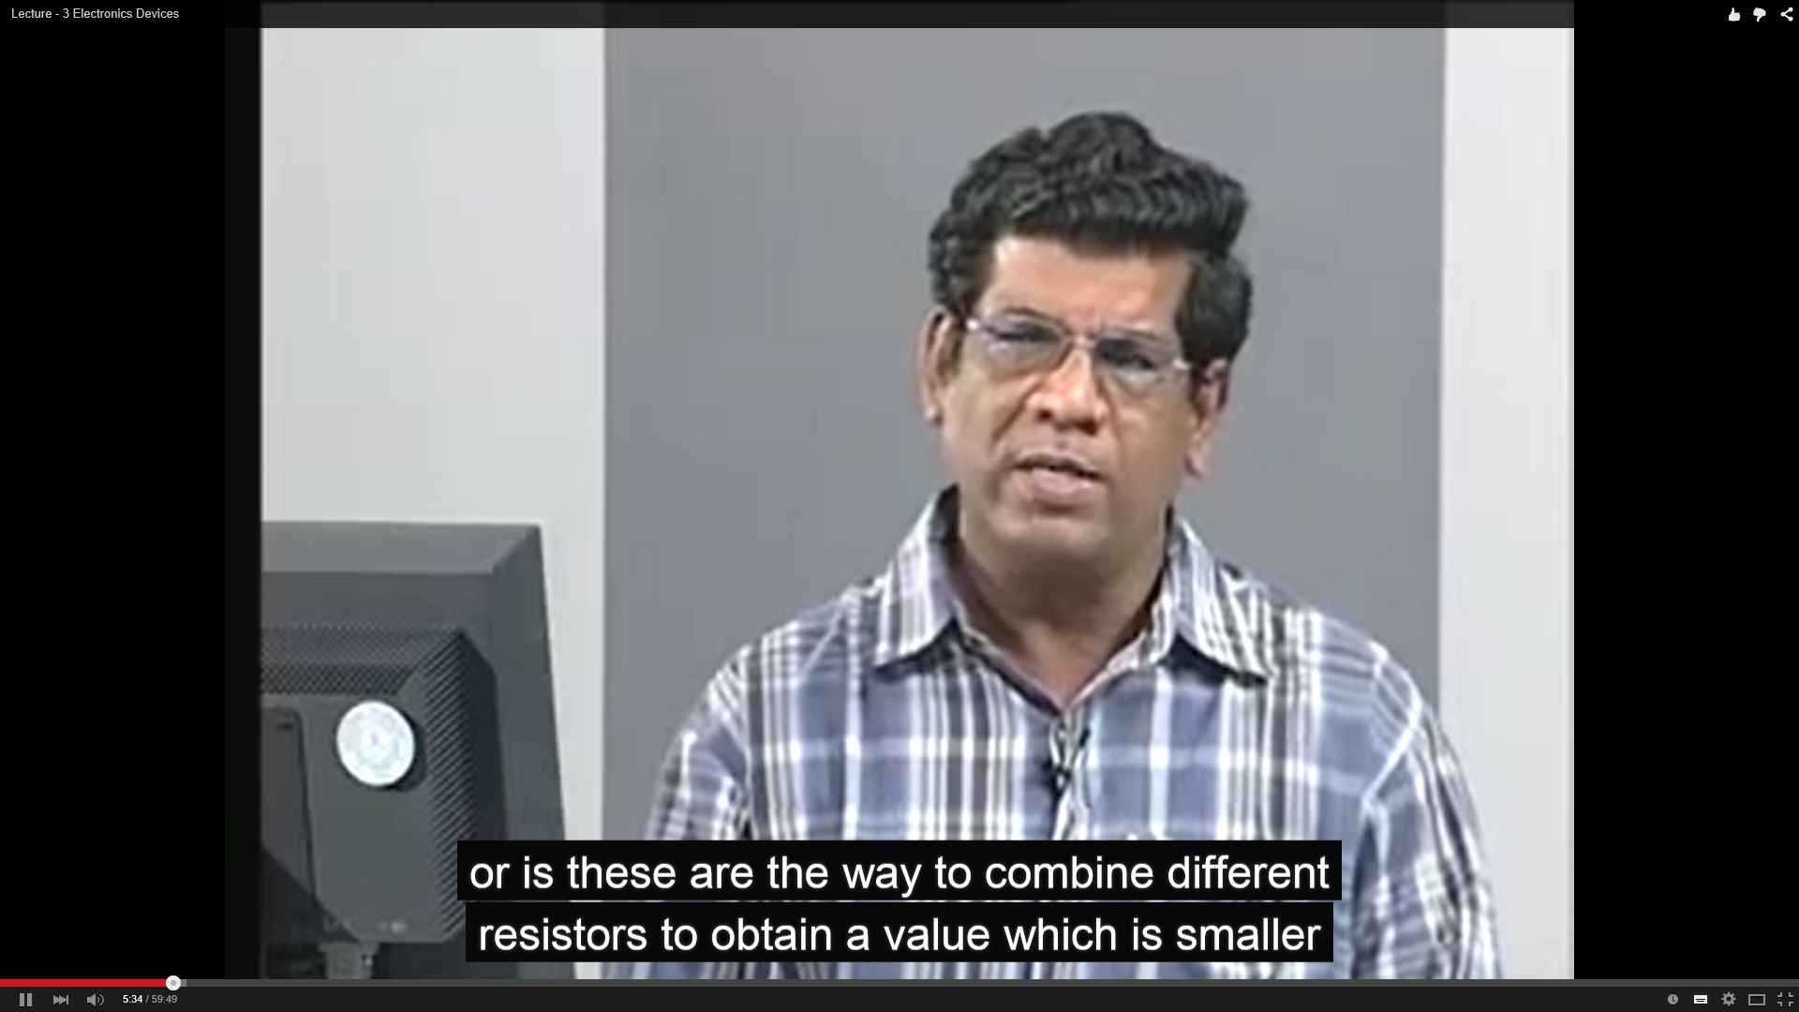
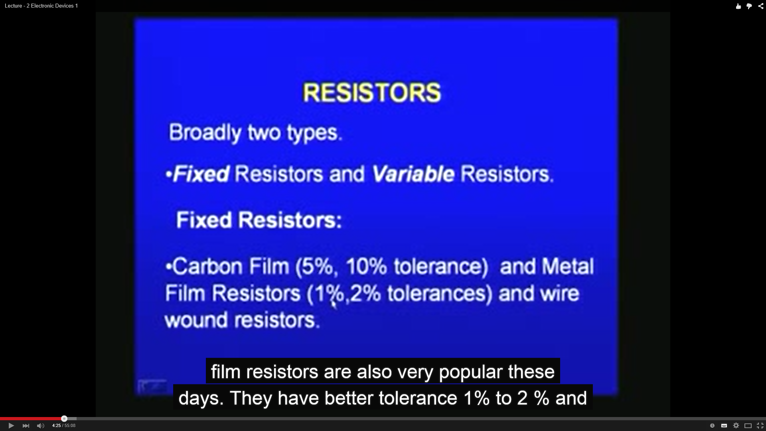

Motivating Example

Slide 4
Motivating Example
k roninson
10 months ago (edited)
This Man is brilliant! Every American teacher could learn from this man!!!

Slide 5

Motivating Example
k roninson
10 months ago (edited)
This Man is brilliant! Every American teacher could learn from this man!!!
Ramapriya D
1 year ago
Sorry but the first 9-odd minutes are utter nonsense

Slide 6

Motivating Example
k roninson
10 months ago (edited)
This Man is brilliant! Every American teacher could learn from this man!!!
Ramapriya D
1 year ago
Sorry but the first 9-odd minutes are utter nonsense
Pallavi Eshwaran
8 months ago
Sir, I have a doubt. In the last part(dual supply voltage measurement demonstration).. what will the multimeter show if we connect the positive and negative terminals of the multimeter to the corresponding +ve and -ve terminals of the dual supply of RPS

Slide 7

Motivating Example
k roninson
10 months ago (edited)
This Man is brilliant! Every American teacher could learn from this man!!!
Ramapriya D
1 year ago
Sorry but the first 9-odd minutes are utter nonsense
Pallavi Eshwaran
8 months ago
Sir, I have a doubt. In the last part(dual supply voltage measurement demonstration).. what will the multimeter show if we connect the positive and negative terminals of the multimeter to the corresponding +ve and -ve terminals of the dual supply of RPS

Slide 8

Motivating Example
% +ve comments
80%
% neutral
5%
% -ve comments
15%

Slide 9
Comments vs. Star Rating
Not all comments have rating
Perspective of end-user
Comments themselves imply emphasis

Slide 10
Motivating Example
% +ve comments
80%
Each comment need NOT be labelled
From ML perspective:
  Direct estimation is simpler problem
  Leads to better confidence in estimates
% neutral
5%
% -ve comments
15%

Slide 11
Class-Ratio (CR) estimation
Definition
Given an unlabeled set of objects sampled from an unknown distribution, the task is to estimate the true probabilities of the labels (viz., Class-Ratios).

Slide 12
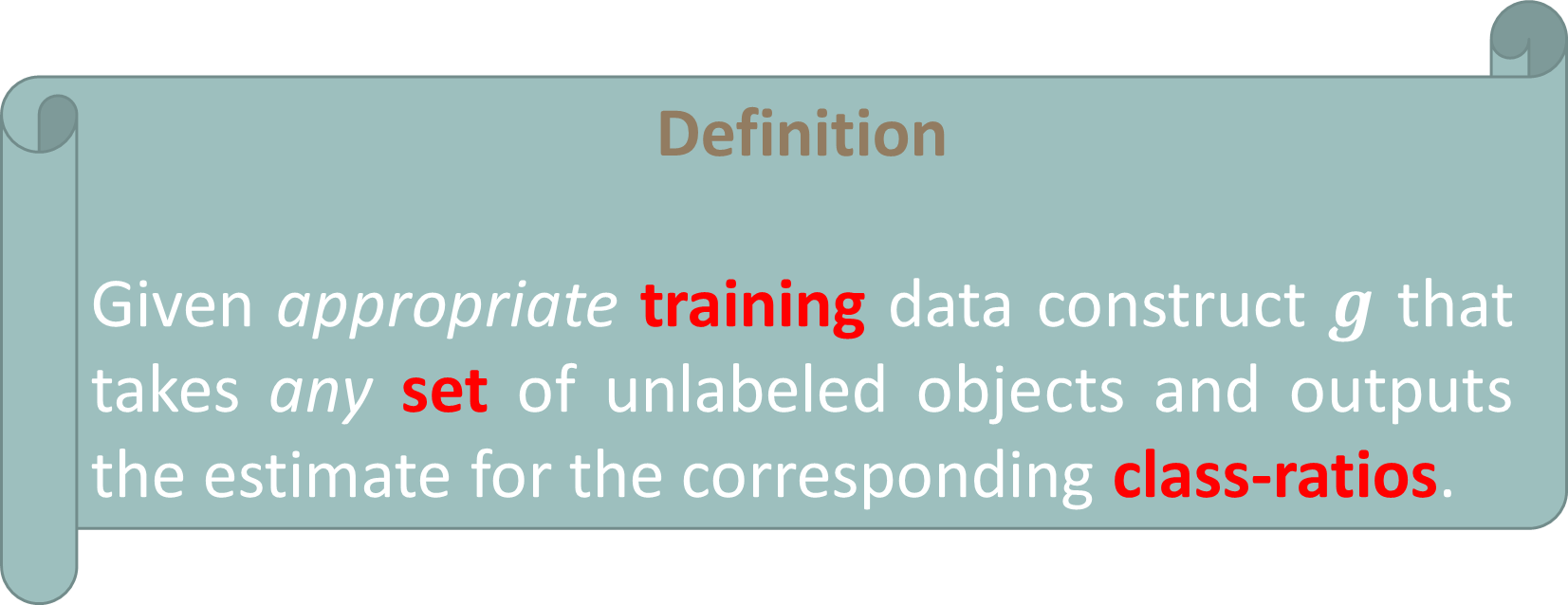
Supervised Class-Ratio (CR) estimation
Definition
Given appropriate training data construct $g$ that takes any set of unlabeled objects and outputs the estimate for the corresponding class-ratios.

Slide 13
Supervised Class-Ratio (CR) estimation
Definition
Given appropriate training data construct $g$ that takes any set of unlabeled objects and outputs the estimate for the corresponding class-ratios.
Fraction of objects with a label is a good estimate
(but unknown)

Slide 14
Baseline & Beyond

Slide 15




Baseline ML Set-up
Training data
$$z_{1}$$
$$z_{2}$$
$$z_{m−1}$$
$$z_{m}$$
+
Training Algorithm
Comment Classifier
Classifier
Classifier
Classifier
Classifier
-
Model
Training Phase
CR
Inference Phase

Slide 16
Direct Estimator (Strong Supervision)
Training data
$$z_{1}$$
$$z_{2}$$
$$z_{m−1}$$
$$z_{m}$$
+
Training Algorithm
CR Estimator
CR Estimator
-
Model
Training Phase
CR
Inference Phase

Slide 17
Key observations …
Learning requires Training and Test data to be related

Slide 18

Key observations …
Learning requires Training and Test data to be related
Traditional ML algos insist $Tr$ and $Te$ come from same distribution
  Renders CR estimation meaningless

Slide 19
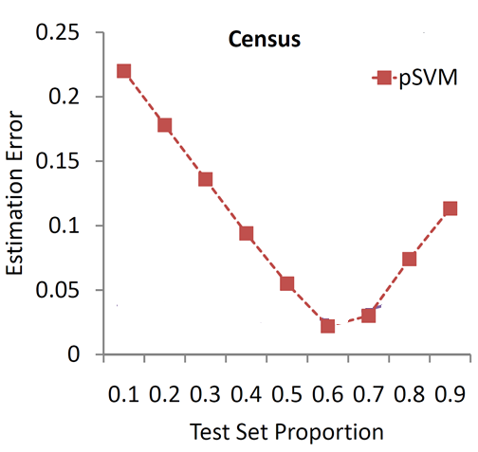
Key observations …
Learning requires Training and Test data to be related
Traditional ML algos insist $Tr$ and $Te$ come from same distribution
  Renders CR estimation meaningless
Baseline predicts well ONLY with iid data

Slide 20

Key observations …
Learning requires Training and Test data to be related
Traditional ML algos insist $Tr$ and $Te$ come from same distribution
  Renders CR estimation meaningless
Invent better `relatedness’ assumption

Slide 21
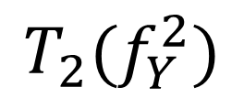
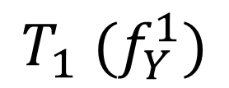

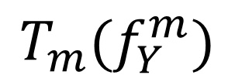
Our assumption … “Target-Shift”
$$f_{XY}=f_{X/Y}f_{Y}$$
Interesting
Boring
decent
$$T_{1} (f_{Y}^{1})$$
$$T_{2}(f_{Y}^{2})$$
$$T_{m}(f_{Y}^{m})$$

Slide 22
Our assumption … “Target-Shift”
Distribution of all possible comments and labels
$$f_{XY}=f_{X/Y}f_{Y}$$
Interesting
Boring
decent
$$T_{1} (f_{Y}^{1})$$
$$T_{2}(f_{Y}^{2})$$
$$T_{m}(f_{Y}^{m})$$

Slide 23
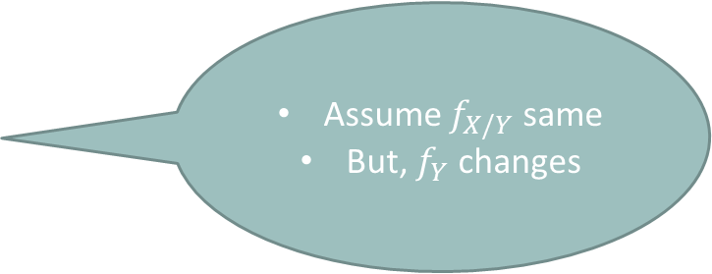
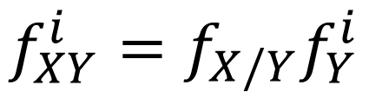
Our assumption … “Target-Shift”
$$f_{XY}=f_{X/Y}f_{Y}$$
Interesting
Boring
decent
$$T_{1} (f_{Y}^{1})$$
$$T_{2}(f_{Y}^{2})$$
$$T_{m}(f_{Y}^{m})$$
Assume $f_{X/Y}$ same
But, $f_{Y}$ changes
$$f_{XY}^{i}=f_{X/Y}f_{Y}^{i}$$

Slide 24
Proposed CR Estimator

Slide 25



Key Idea
$$\left[\begin{matrix}1 \\ 0 \\ 0\end{matrix}\right]$$
$$\left[\begin{matrix}0 \\ 0 \\ 1\end{matrix}\right]$$
$$\left[\begin{matrix}0 \\ 1 \\ 0\end{matrix}\right]$$

Slide 26
Key Idea
Space of all possible CRs with three classes
$$\left[\begin{matrix}1 \\ 0 \\ 0\end{matrix}\right]$$
$$\left[\begin{matrix}0 \\ 0 \\ 1\end{matrix}\right]$$
$$\left[\begin{matrix}0 \\ 1 \\ 0\end{matrix}\right]$$

Slide 27
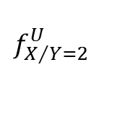
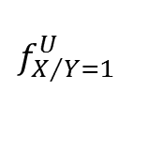
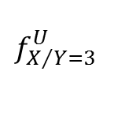
Key Idea
$$\left[\begin{matrix}1 \\ 0 \\ 0\end{matrix}\right]$$
$$\left[\begin{matrix}0 \\ 0 \\ 1\end{matrix}\right]$$
$$\left[\begin{matrix}0 \\ 1 \\ 0\end{matrix}\right]$$
$$f_{X/Y=1}^{U}$$
$$f_{X/Y=3}^{U}$$
$$f_{X/Y=2}^{U}$$

Slide 28
Key Idea
$$\left[\begin{matrix}1 \\ 0 \\ 0\end{matrix}\right]$$
$$\left[\begin{matrix}0 \\ 0 \\ 1\end{matrix}\right]$$
$$\left[\begin{matrix}0 \\ 1 \\ 0\end{matrix}\right]$$
RKHS embeddings for distributions are well-known
$$f_{X/Y=1}^{U}$$
$$f_{X/Y=3}^{U}$$
$$f_{X/Y=2}^{U}$$

Slide 29
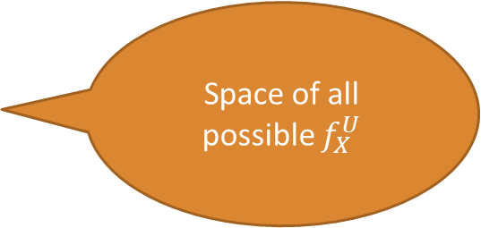
Key Idea
$$\left[\begin{matrix}1 \\ 0 \\ 0\end{matrix}\right]$$
$$\left[\begin{matrix}0 \\ 0 \\ 1\end{matrix}\right]$$
$$\left[\begin{matrix}0 \\ 1 \\ 0\end{matrix}\right]$$
Space of all possible $f_{X}^{U}$
$$f_{X/Y=1}^{U}$$
$$f_{X/Y=3}^{U}$$
$$f_{X/Y=2}^{U}$$

Slide 30


Key Idea
$$\left[\begin{matrix}1 \\ 0 \\ 0\end{matrix}\right]$$
$$\left[\begin{matrix}0 \\ 0 \\ 1\end{matrix}\right]$$
$$f_{Y}^{U}$$
$$\left[\begin{matrix}0 \\ 1 \\ 0\end{matrix}\right]$$
$$f_{X/Y=1}^{U}$$
$$f_{X/Y=3}^{U}$$
$$?$$
$$f_{X/Y=2}^{U}$$

Slide 31
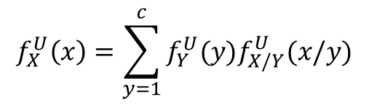

Key Idea
$$\left[\begin{matrix}1 \\ 0 \\ 0\end{matrix}\right]$$
$$\left[\begin{matrix}0 \\ 0 \\ 1\end{matrix}\right]$$
$$f_{Y}^{U}$$
$$\left[\begin{matrix}0 \\ 1 \\ 0\end{matrix}\right]$$
Total Probability Rule
$$f_{X}^{U}\left(x\right)=\sum_{y=1}^{c}{f_{Y}^{U}(y)f_{X/Y}^{U}(x/y)}$$
$$f_{X/Y=1}^{U}$$
$$f_{X/Y=3}^{U}$$
$$f_{X}^{U}$$
$$f_{X/Y=2}^{U}$$

Slide 32
Key Idea
$$\left[\begin{matrix}1 \\ 0 \\ 0\end{matrix}\right]$$
$$\left[\begin{matrix}0 \\ 0 \\ 1\end{matrix}\right]$$
$$f_{Y}^{U}$$
$$\left[\begin{matrix}0 \\ 1 \\ 0\end{matrix}\right]$$
Total Probability Rule
Mild conditions¹
$$f_{X/Y=1}^{U}$$
$$f_{X/Y=3}^{U}$$
$$f_{X}^{U}$$
$$f_{X/Y=2}^{U}$$

Slide 33
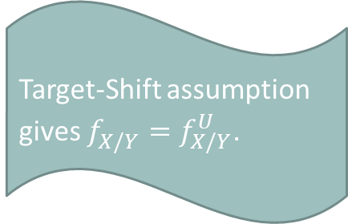
Key Idea
$$\left[\begin{matrix}1 \\ 0 \\ 0\end{matrix}\right]$$
$$\left[\begin{matrix}0 \\ 0 \\ 1\end{matrix}\right]$$
$$f_{Y}^{U}$$
$$\left[\begin{matrix}0 \\ 1 \\ 0\end{matrix}\right]$$
Total Probability Rule
Mild conditions
$$f_{X/Y=1}^{U}$$
$$f_{X/Y=3}^{U}$$
Target-Shift assumption gives $f_{X/Y}^{}=f_{X/Y}^{U}$.
$$f_{X}^{U}$$
$$f_{X/Y=2}^{U}$$

Slide 34
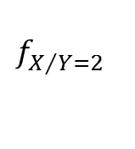
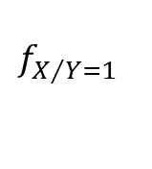
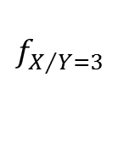
Key Idea
$$\left[\begin{matrix}1 \\ 0 \\ 0\end{matrix}\right]$$
$$\left[\begin{matrix}0 \\ 0 \\ 1\end{matrix}\right]$$
$$f_{Y}^{U}$$
$$\left[\begin{matrix}0 \\ 1 \\ 0\end{matrix}\right]$$
Total Probability Rule
Mild conditions
$$f_{X/Y=1}^{}$$
$$f_{X/Y=3}^{}$$
$$f_{X}^{U}$$
$$f_{X/Y=2}^{}$$

Slide 35
Key Idea
$$\left[\begin{matrix}1 \\ 0 \\ 0\end{matrix}\right]$$
$$\left[\begin{matrix}0 \\ 0 \\ 1\end{matrix}\right]$$
$$f_{Y}^{U}$$
$$\left[\begin{matrix}0 \\ 1 \\ 0\end{matrix}\right]$$
Total Probability Rule
Mild conditions
$$f_{X/Y=1}^{}$$
$$f_{X/Y=3}^{}$$
$$f_{X}^{U}$$
Can we approximately embed distributions using samples?
$$f_{X/Y=2}^{}$$

Slide 36

Kernel Embedding
Given $χ$, set of objects, and kernel $k:χ×χ↦ℝ$ (similarity function)

Slide 37


Kernel Embedding
Given $χ$, set of objects, and kernel $k:χ×χ↦ℝ$ (similarity function)
$$X$$
Space of random variables over $χ$

Slide 38


Kernel Embedding
Given $χ$, set of objects, and kernel $k:χ×χ↦ℝ$ (similarity function)
$$φ_{k}\left(X\right)$$
$$X$$
Space of random variables over $χ$
RKHS of real valued functions over $χ$

Slide 39

Kernel Embedding
Given $χ$, set of objects, and kernel $k:χ×χ↦ℝ$ (similarity function)
$$φ_{k}\left(X\right)\left(⋅\right)≡𝔼\left[k(X,⋅)\right]$$
$$φ_{k}\left(X\right)$$
$$X$$
Space of random variables over $χ$
RKHS of real valued functions over $χ$

Slide 40
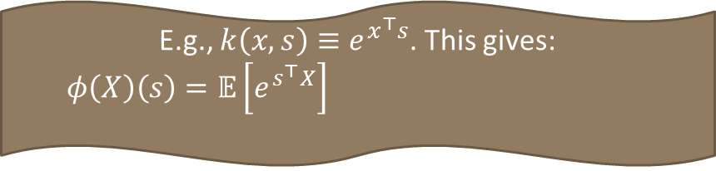

Kernel Embedding
Given $χ$, set of objects, and kernel $k:χ×χ↦ℝ$ (similarity function)
$$φ_{k}\left(X\right)\left(⋅\right)≡𝔼\left[k(X,⋅)\right]$$
E.g., $k\left(x,s\right)≡e^{x^{⊤}s}$. This gives:
$φ\left(X\right)\left(s\right)=𝔼\left[e^{s^{⊤}X}\right]$, the moment-generating function
$$φ_{k}\left(X\right)$$
$$X$$
Space of random variables over $χ$
RKHS of real valued functions over $χ$

Slide 41
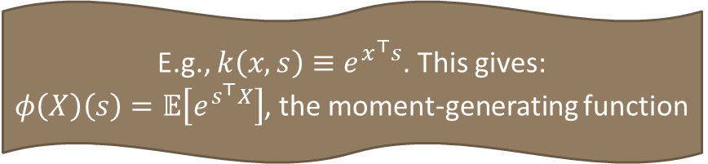
Kernel Embedding
Given $χ$, set of objects, and kernel $k:χ×χ↦ℝ$ (similarity function)
$$φ_{k}\left(X\right)\left(⋅\right)≡𝔼\left[k(X,⋅)\right]$$
E.g., $k\left(x,s\right)≡e^{x^{⊤}s}$. This gives:
$φ\left(X\right)\left(s\right)=𝔼\left[e^{s^{⊤}X}\right]$, the moment-generating function
$$φ_{k}\left(X\right)$$
$$X$$
Space of random variables over $χ$
RKHS of real valued functions over $χ$

Slide 42


Kernel Embedding – Sample approx.
Given $χ$, set of objects, and kernel $k:χ×χ↦ℝ$ (similarity function)
$$φ_{k}\left(X\right)\left(⋅\right)≡𝔼\left[k(X,⋅)\right]$$
$$≈\frac{\sum_{i=1}^{m}{k\left(x_{i},⋅\right)}}{m}$$
$${\hat{φ}}_{k}\left(X\right)\left(⋅\right)$$
$$X$$
Space of random variables over $χ$
RKHS of real valued functions over $χ$

Slide 43

Kernel Embedding – Sample approx.
Given $χ$, set of objects, and kernel $k:χ×χ↦ℝ$ (similarity function)
$$φ_{k}\left(X\right)\left(⋅\right)≡𝔼\left[k(X,⋅)\right]$$
$$≈\frac{\sum_{i=1}^{m}{k\left(x_{i},⋅\right)}}{m}$$
$${\hat{φ}}_{k}\left(X\right)\left(⋅\right)$$
$$X$$
Space of random variables over $χ$
RKHS of real valued functions over $χ$

Slide 44
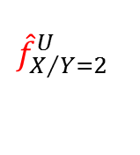




Key Idea
$$\left[\begin{matrix}1 \\ 0 \\ 0\end{matrix}\right]$$
$$\left[\begin{matrix}0 \\ 0 \\ 1\end{matrix}\right]$$
$${\hat{f}}_{Y}^{U}$$
$$\left[\begin{matrix}0 \\ 1 \\ 0\end{matrix}\right]$$
Mild conditions
$${\hat{f}}_{X/Y=1}^{U}$$
$${\hat{f}}_{X/Y=3}^{U}$$
$${\hat{f}}_{X}^{U}$$
$${\hat{f}}_{X/Y=2}^{U}$$

Slide 45
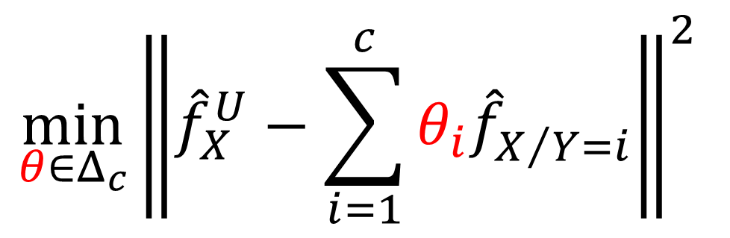
Formulation for CR Estimation
$${\min_{θ∈Δ_{c}}\left\|{\hat{f}}_{X}^{U}−\sum_{i=1}^{c}{θ_{i}{\hat{f}}_{X/{Y=i}}^{}}\right\|}^{2}$$

Slide 46
Strong -> Regular Supervision
$$z_{1}$$
$$z_{2}$$
$$z_{m−1}$$
$$z_{m}$$
+
Training Algorithm
CR Estimator
CR Estimator
-
Model
Training Phase
pmf
Inference Phase

Slide 47
Strong -> Regular Supervision
$$z_{1}$$
$$z_{2}$$
$$z_{m−1}$$
$$z_{m}$$
+
Training Algorithm
CR Estimator
CR Estimator
-
Model
Training Phase
pmf
E.g. Demography based Voter Analysis
Inference Phase

Slide 48
Strong -> Regular Supervision
%
$$z_{1}$$
$$z_{2}$$
$$z_{m−1}$$
$$z_{m}$$
Training Algorithm
CR Estimator
CR Estimator
%
Model
Training Phase
pmf
Inference Phase

Slide 49






Key Idea
$$\left[\begin{matrix}1 \\ 0 \\ 0\end{matrix}\right]$$
$$f_{Y}^{2}$$
$$f_{Y}^{1}$$
$$\left[\begin{matrix}0 \\ 0 \\ 1\end{matrix}\right]$$
$$\left[\begin{matrix}0 \\ 1 \\ 0\end{matrix}\right]$$
$$f_{Y}^{3}$$

Slide 50

Key Idea
$$\left[\begin{matrix}1 \\ 0 \\ 0\end{matrix}\right]$$
$$f_{Y}^{2}$$
$$f_{Y}^{1}$$
$$\left[\begin{matrix}0 \\ 0 \\ 1\end{matrix}\right]$$
$$f_{Y}^{U}$$
$$\left[\begin{matrix}0 \\ 1 \\ 0\end{matrix}\right]$$
$$f_{Y}^{3}$$

Slide 51
Key Idea
Affine hull of training-set CRs has the simplex
$$\left[\begin{matrix}1 \\ 0 \\ 0\end{matrix}\right]$$
$$f_{Y}^{2}$$
$$f_{Y}^{1}$$
$$\left[\begin{matrix}0 \\ 0 \\ 1\end{matrix}\right]$$
$$f_{Y}^{U}$$
$$\left[\begin{matrix}0 \\ 1 \\ 0\end{matrix}\right]$$
$$f_{Y}^{3}$$

Slide 52

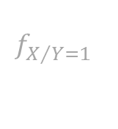



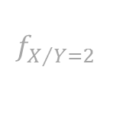
Key Idea
$$\left[\begin{matrix}1 \\ 0 \\ 0\end{matrix}\right]$$
$$f_{Y}^{2}$$
$$f_{Y}^{1}$$
$$\left[\begin{matrix}0 \\ 0 \\ 1\end{matrix}\right]$$
$$f_{Y}^{U}$$
$$\left[\begin{matrix}0 \\ 1 \\ 0\end{matrix}\right]$$
$$f_{Y}^{3}$$
$$f_{X/Y=1}^{}$$
$$f_{X}^{1}$$
$$f_{X}^{2}$$
$$f_{X/Y=3}^{}$$
$$f_{X}^{3}$$
$$f_{X/Y=2}^{}$$

Slide 53

Key Idea
$$\left[\begin{matrix}1 \\ 0 \\ 0\end{matrix}\right]$$
$$f_{Y}^{2}$$
$$f_{Y}^{1}$$
$$\left[\begin{matrix}0 \\ 0 \\ 1\end{matrix}\right]$$
$$f_{Y}^{U}$$
$$\left[\begin{matrix}0 \\ 1 \\ 0\end{matrix}\right]$$
$$f_{Y}^{3}$$
$$f_{X/Y=1}^{}$$
$$f_{X}^{1}$$
$$f_{X}^{2}$$
$$?$$
$$f_{X/Y=3}^{}$$
$$f_{X}^{3}$$
$$f_{X/Y=2}^{}$$

Slide 54

Key Idea
$$\left[\begin{matrix}1 \\ 0 \\ 0\end{matrix}\right]$$
$$f_{Y}^{2}$$
$$f_{Y}^{1}$$
$$\left[\begin{matrix}0 \\ 0 \\ 1\end{matrix}\right]$$
$$f_{Y}^{U}$$
$$\left[\begin{matrix}0 \\ 1 \\ 0\end{matrix}\right]$$
$$f_{Y}^{3}$$
Total Probability Rule
$$f_{X/Y=1}^{}$$
$$f_{X}^{1}$$
$$f_{X}^{2}$$
$$f_{X}^{U}$$
$$f_{X/Y=3}^{}$$
$$f_{X}^{3}$$
$$f_{X/Y=2}^{}$$

Slide 55
Key Idea
$$\left[\begin{matrix}1 \\ 0 \\ 0\end{matrix}\right]$$
$$f_{Y}^{2}$$
$$f_{Y}^{1}$$
$$\left[\begin{matrix}0 \\ 0 \\ 1\end{matrix}\right]$$
$$f_{Y}^{U}$$
$$\left[\begin{matrix}0 \\ 1 \\ 0\end{matrix}\right]$$
$$f_{Y}^{3}$$
Mild conditions²
$$f_{X/Y=1}^{}$$
$$f_{X}^{1}$$
$$f_{X}^{2}$$
$$f_{X}^{U}$$
$$f_{X/Y=3}^{}$$
$$f_{X}^{3}$$
$$f_{X/Y=2}^{}$$

Slide 56
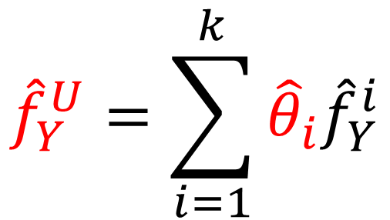
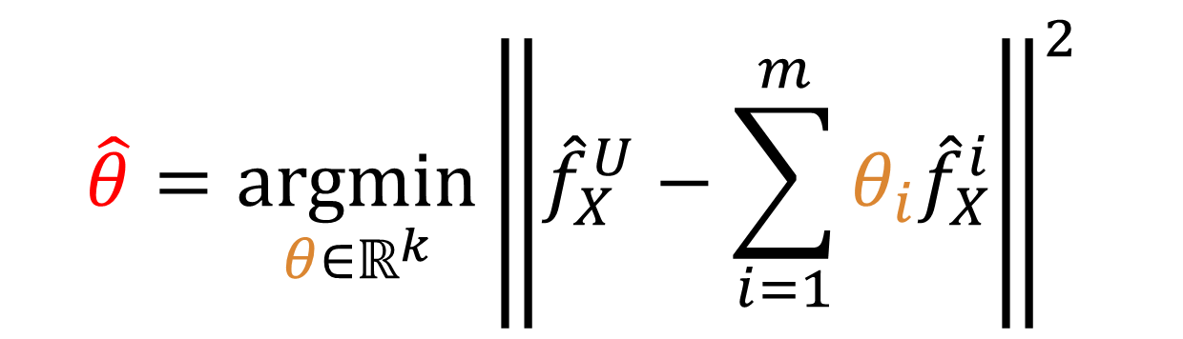
Formulation for CR Estimation
$$\hat{θ}={\underset{θ∈ℝ^{k}}{argmin}\left\|{\hat{f}}_{X}^{U}−\sum_{i=1}^{m}{θ_{i}{\hat{f}}_{X}^{i}}\right\|}^{2}$$
$${\hat{f}}_{Y}^{U}=\sum_{i=1}^{k}{{\hat{θ}}_{i}{\hat{f}}_{Y}^{i}}$$

Slide 57
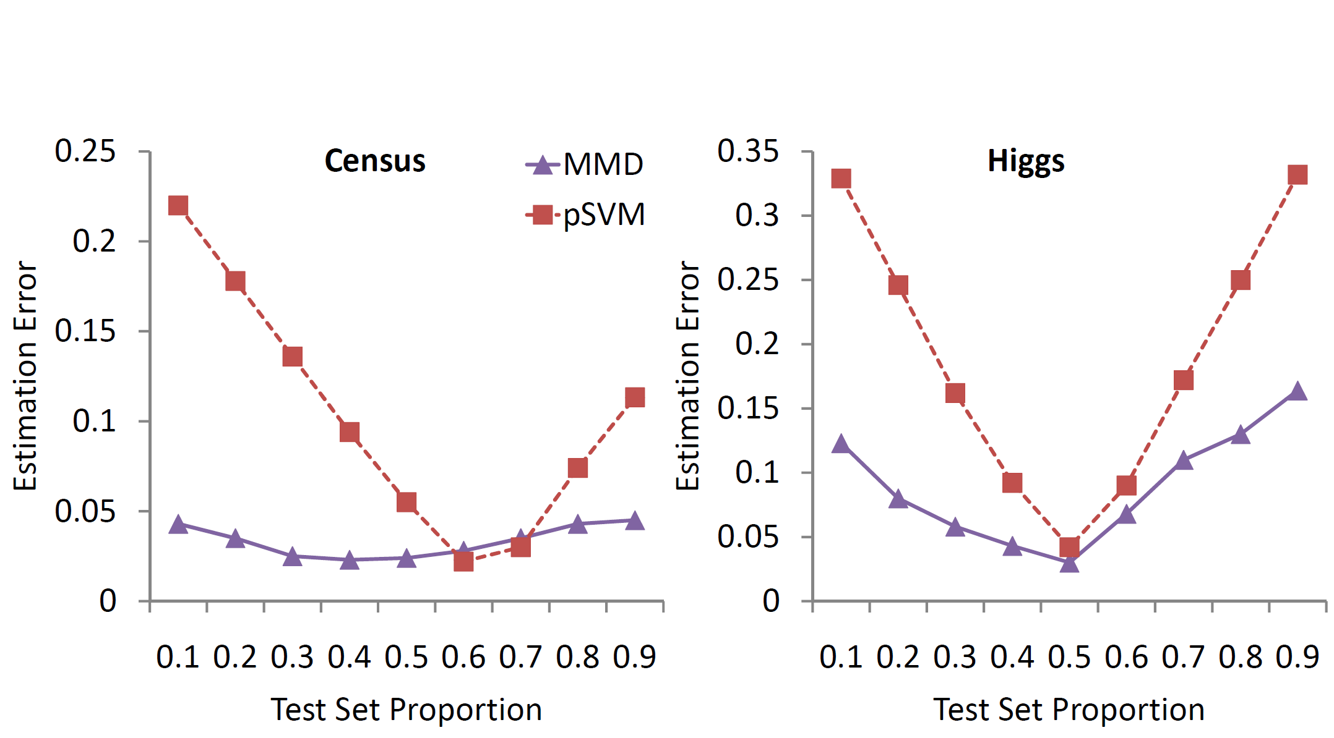
Proposed method adapts, compares well in best case

Slide 58
Learning Bounds

Slide 59
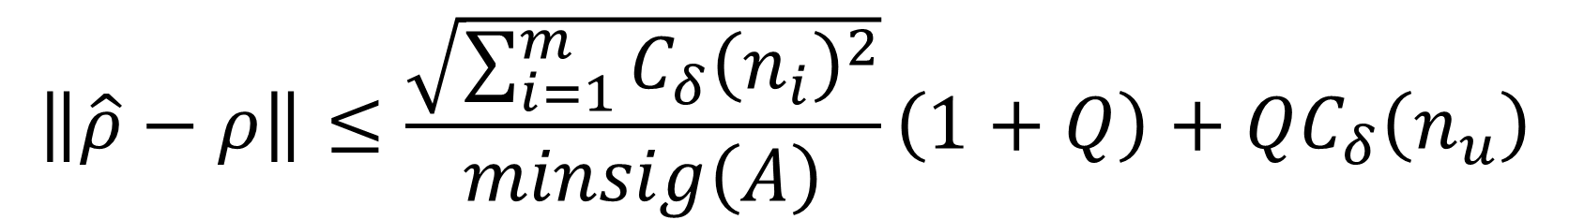

Theorem
If $k$ is normalized characteristic kernel, then with probability atleast $1−δ$, the following holds:
$$\left\|\hat{ρ}−ρ\right\|≤\frac{\sqrt{\sum_{i=1}^{m}{C_{δ}{\left(n_{i}\right)}^{2}}}}{minsig\left(A\right)}\left(1+Q\right)+QC_{δ}\left(n_{u}\right)$$

Slide 60
Summary & Conclusions

Slide 61
Take-home notes
Watch-out for direct estimation opportunities
  New problem set-up: Class-ratio estimation
  More accurate and simpler analysis

Slide 62
Take-home notes
Watch-out for direct estimation opportunities
  New problem set-up: Class-ratio estimation
  More accurate and simpler analysis
Be-aware of distributional assumptions
  Leads to significant improvements in accuracy

Slide 63
Take-home notes
Watch-out for direct estimation opportunities
  New problem set-up: Class-ratio estimation
  More accurate and simpler analysis
Be-aware of distributional assumptions
  Leads to significant improvements in accuracy
Insights provided by theoretical bounds can be far reaching
  New kernel selection algorithm
  Hints for data publishers

Slide 64
Thanks

