Slide 1
Estimating Popularity from UGC
Joint Work by: Arun Iyer, J. Saketha Nath, Sunita Sarawagi

Slide 2
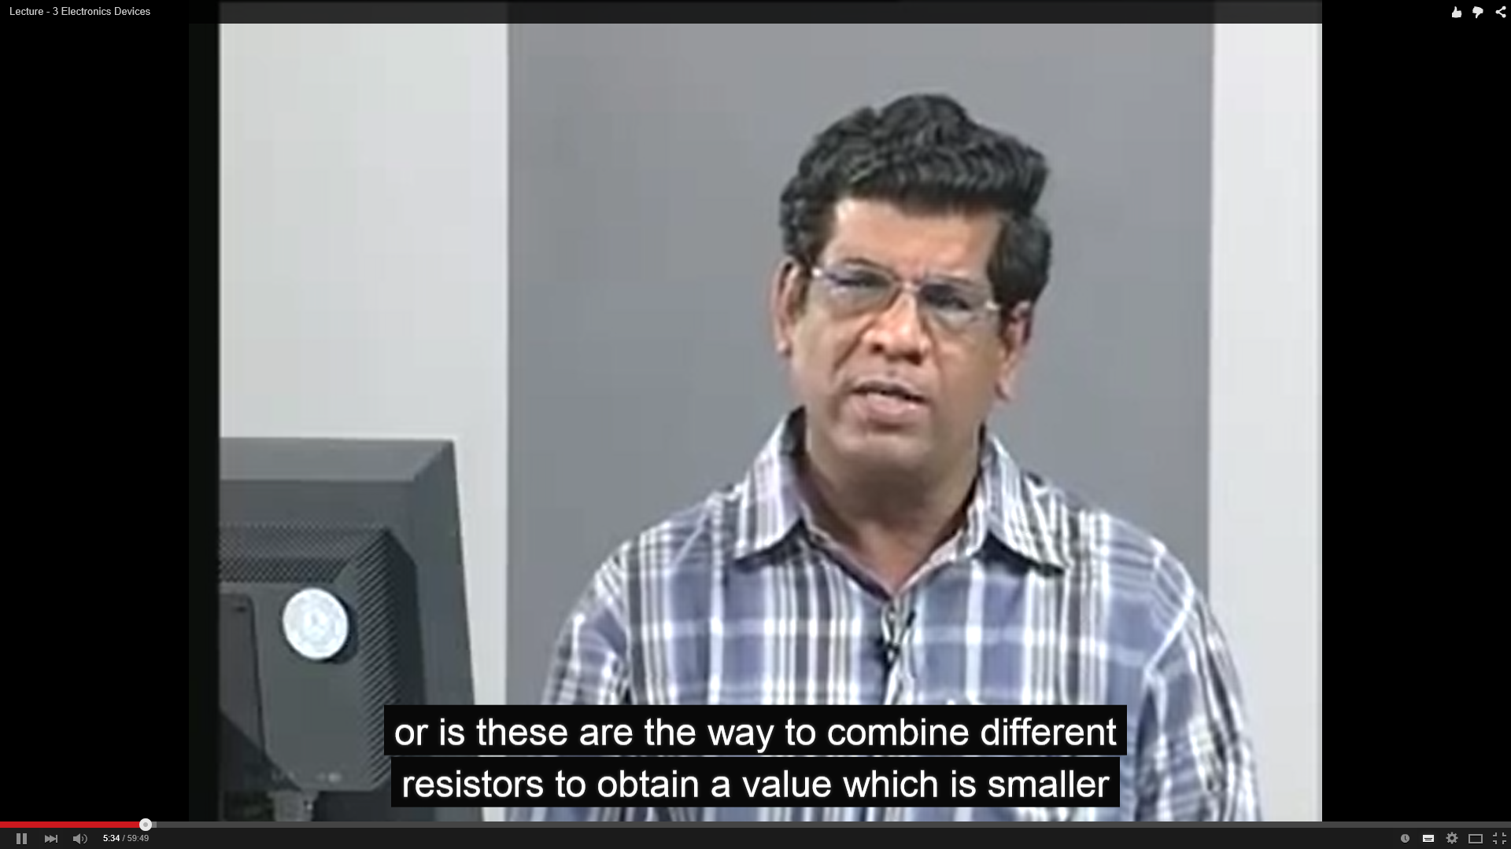
Motivating Example
k roninson
10 months ago (edited)
This Man is brilliant! Every American teacher could learn from this man!!!
Ramapriya D
1 year ago
Sorry but the first 9-odd minutes are utter nonsense
Pallavi Eshwaran
8 months ago
Sir, I have a doubt. In the last part(dual supply voltage measurement demonstration).. what will the multimeter show if we connect the positive and negative terminals of the multimeter to the corresponding +ve and -ve terminals of the dual supply of RPS

Slide 3
Motivating Example
k roninson
10 months ago (edited)
This Man is brilliant! Every American teacher could learn from this man!!!
Ramapriya D
1 year ago
Sorry but the first 9-odd minutes are utter nonsense
Pallavi Eshwaran
8 months ago
Sir, I have a doubt. In the last part(dual supply voltage measurement demonstration).. what will the multimeter show if we connect the positive and negative terminals of the multimeter to the corresponding +ve and -ve terminals of the dual supply of RPS

Slide 4
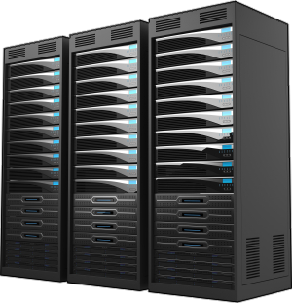
Motivating Example
Popularity
80%

Slide 5
Estimating Popularity $≠$ Inferring Sentiment
Popularity
80%
Each user need NOT be labelled
From ML perspective:
Direct estimation is simpler problem
Leads to better confidence in estimates

Slide 6
Reviews vs. Star Rating
Not all reviews have rating
Perspective of end-user
Reviews implies emphasis

Slide 7
Baseline ML Set-up
$$z_{1}$$
$$z_{2}$$
$$z_{m−1}$$
$$z_{m}$$
+
Training Algorithm
Classifier
Classifier
Classifier
Classifier
Classifier
-
Model
Training Phase
pmf
Inference Phase

Slide 8
Direct Estimator
$$z_{1}$$
$$z_{2}$$
$$z_{m−1}$$
$$z_{m}$$
+
Training Algorithm
CR Estimator
CR Estimator
-
Model
Training Phase
pmf
Inference Phase

Slide 9
A key observation …
Learning requires Training and Test data to be related
Traditional ML insists $L$ and $U$ come from same distribution
Renders CR estimation meaningless

Slide 10
A key observation …
Learning requires Training and Test data to be related
Traditional ML insists $L$ and $U$ come from same distribution
Renders CR estimation meaningless
$$F_{XY}$$
Interesting
Boring
decent
$$T_{1}$$
$$T_{2}$$
$$T_{m}$$
Conditional sampling

Slide 11
A key observation …
Learning requires Training and Test data to be related
Traditional ML insists $L$ and $U$ come from same distribution
Renders CR estimation meaningless
Assume $F_{X/Y}$ same
But, $F_{Y}$ changes
$$F_{XY}$$
Interesting
Boring
decent
$$T_{1}$$
$$T_{2}$$
$$T_{m}$$
Conditional sampling

Slide 12
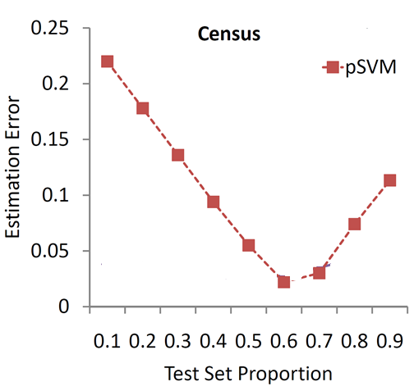
Baseline predicts well ONLY with iid data
Proposed method works under target shift

Slide 13
Key Idea
$$Y=1$$
$Y=$2
$$Y=3$$
X / $Y=$1
X / $Y=$2
X / $Y=$3

Slide 14
Key Idea
$$Y=1$$
$$F_{Y}^{U}$$
$Y=$2
Total Probability Rule
$$Y=3$$
X / $Y=$1
X / $Y=$2
$$F_{X}^{U}$$
X / $Y=$3

Slide 15
Key Idea
$$Y=1$$
$$F_{Y}^{U}$$
$Y=$2
$$Y=3$$
Total Probability Rule
Mild conditions
X / $Y=$1
X / $Y=$2
$$F_{X}^{U}$$
X / $Y=$3

Slide 16
Key Idea
$$Y=1$$
$$F_{Y}^{U}$$
$Y=$2
$$Y=3$$
Total Probability Rule
Mild conditions
X / $Y=$1
X / $Y=$2
$$F_{X}^{U}$$
Since, $F_{X/Y}^{L}=F_{X/Y}^{U}$, they can be estimated from training set $L$
Estimated from test set $U$.
X / $Y=$3

Slide 17
Key Idea
$$Y=1$$
$$F_{Y}^{U}$$
$Y=$2
$$Y=3$$
Total Probability Rule
Mild conditions
X / $Y=$1
X / $Y=$2
$$F_{X}^{U}$$
Distance measure=MMD + Kernel Learning
X / $Y=$3

Slide 18
Strong -> Regular Supervision
$$z_{1}$$
$$z_{2}$$
$$z_{m−1}$$
$$z_{m}$$
+
Training Algorithm
CR Estimator
CR Estimator
-
Model
Training Phase
pmf
Inference Phase

Slide 19
Strong -> Regular Supervision
$$z_{1}$$
$$z_{2}$$
$$z_{m−1}$$
$$z_{m}$$
+
Training Algorithm
CR Estimator
CR Estimator
-
Model
Training Phase
pmf
E.g. Demography based Voter Analysis
Inference Phase

Slide 20
Strong -> Regular Supervision
%
$$z_{1}$$
$$z_{2}$$
$$z_{m−1}$$
$$z_{m}$$
Training Algorithm
CR Estimator
CR Estimator
%
Model
Training Phase
pmf
Inference Phase

Slide 21
Key Idea
$Y=$1
$$F_{Y}^{2}$$
$$F_{Y}^{1}$$
$$Y=2$$
$$F_{Y}^{3}$$
$Y=$3
$$F_{X}^{1}$$
$$F_{X}^{2}$$
$$F_{X}^{3}$$

Slide 22
Key Idea
$Y=$1
$$F_{Y}^{2}$$
$$F_{Y}^{1}$$
$$F_{Y}^{U}$$
$$Y=2$$
$$F_{Y}^{3}$$
Mild conditions
$Y=$3
$$F_{X}^{1}$$
$$F_{X}^{2}$$
$$F_{X}^{U}$$
$$F_{X}^{3}$$

Slide 23
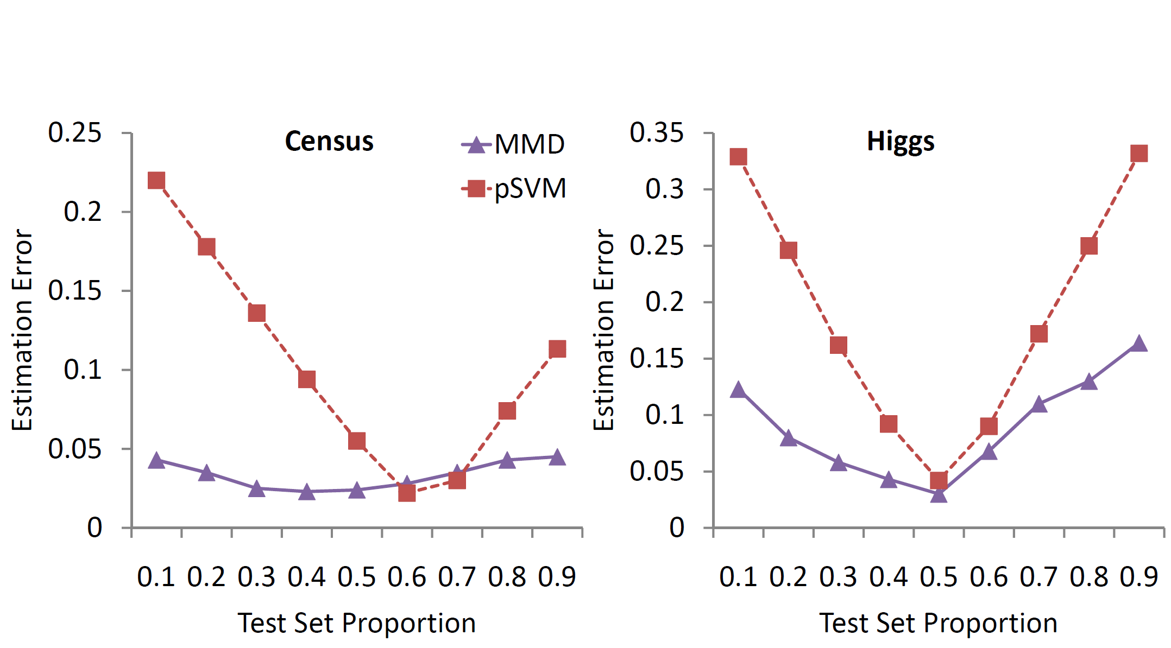
Proposed method adapts and compares well in best case

Slide 24
Summary
UGC has specialities leading to new ML
Direct methods vs. Building blocks

Slide 25
Thanks

