Slide 1
First order methods
For convex optimization
J. Saketha Nath
(IIT Bombay; Microsoft)
Notes:
Test

Slide 2
Topics
Part – I
Optimal methods for unconstrained convex programs
Smooth objective
Non-smooth objective
Part – II
Optimal methods for constrained convex programs
Projection based
Frank-Wolfe based
Prox-based methods for structured non-smooth programs

Slide 3
Non-Topics
Step-size schemes
Bundle methods
Stochastic methods
Inexact oracles
Non-Euclidean extensions (Mirror-friends)

Slide 4
Motivation
& Example ApplicationS

Slide 5
Machine Learning Applications
Training data: $\{ \left(x_{1},y_{1}\right), …, \left(x_{m},y_{m}\right)\}$
Goal: Construct $f : X \underset{→}{} Y$

Slide 6
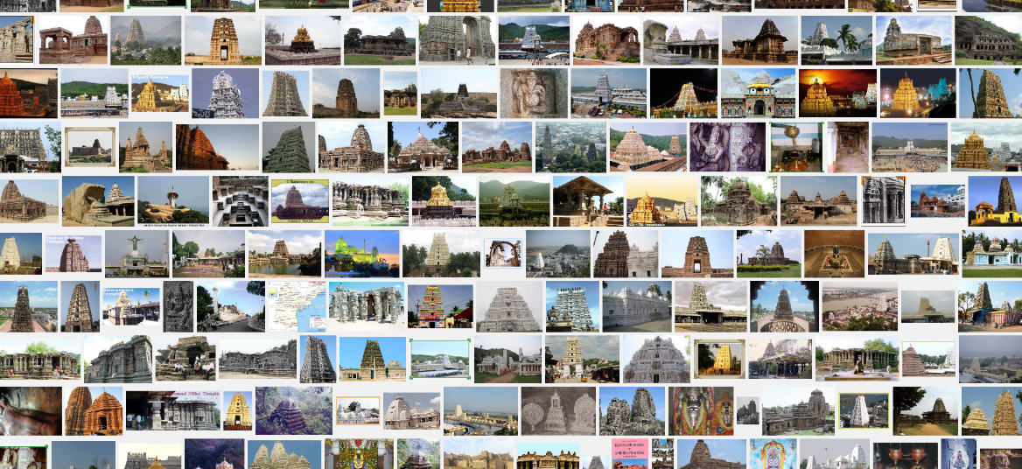
Machine Learning Applications
Set of Temple Images
Corresponding Architecture Labels

Slide 7
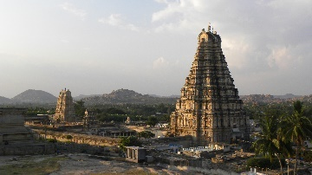
Machine Learning Applications
Set of Temple Images
Corresponding Architecture Labels
$$f\{$$
$$\}=$$
“Vijayanagara Style”

Slide 8
Machine Learning Applications
Input data: $\{ \left(x_{1},y_{1}\right), …, \left(x_{m},y_{m}\right)\}$
Goal: Construct $f : X \underset{→}{} Y$
Model: $f\left(x\right)=w^{T}φ\left(x\right)$

Slide 9
Machine Learning Applications
Input data: $\{ \left(x_{1},y_{1}\right), …, \left(x_{m},y_{m}\right)\}$
Goal: Construct $f : X \underset{→}{} Y$
Model: $f\left(x\right)=w^{T}φ\left(x\right)$
Algorithm: Find simple functions that explain data
$$\min_{w∈W}{Ω(w)+\sum_{i=1}^{m}{l(w^{T}φ\left(x_{i}\right), y_{i})}}$$

Slide 10
Typical Program – Machine Learning
Smooth/Non-Smooth
Smooth surrogate
$$\min_{w∈W}{Ω(w)+\sum_{i=1}^{m}{l(w^{T}φ\left(x_{i}\right), y_{i})}}$$
m, n are large
Data term is a sum
Domain $W$ is restricted

Slide 11
Scale is the issue!
m, n as well as no. models may run into millions!
Even a single iteration of IPM/Newton-variants is in-feasible.
“Slower” but “cheaper” methods are the alternative
Decomposition based
First order methods

Slide 12
First Order Methods - Overview
Iterative, gradient-like information, $O(mn)$per iteration ☺
E.g. Gradient method, Cutting planes, Conjugate gradient
Very old methods (1950s)
Far slower than IPM:
Sub-linear rate ☹ . (Not crucial for ML)
But (nearly) n-independent ☺
Widely employed in state-of-the-art ML systems
Choice of variant depends on problem structure

Slide 13
First Order Methods - Overview
Iterative, gradient-like information, $O(mn)$ per iteration ☺
E.g. Gradient method, Cutting planes, Conjugate gradient
Very old methods (1950s)
No. iterations:
Sub-linear rate ☹ .
But (nearly) n-independent ☺
Widely employed in state-of-the-art ML systems
Choice of variant depends on problem structure

Slide 14
Smooth un-constrained
$$\min_{w∈R^{n}}{\sum_{i=1}^{m}{{\left(w^{T}φ\left(x_{i}\right)−y_{i}\right)}^{2}}}$$

Slide 15
Smooth Convex Functions
Continuously differentiable
Gradient is Lipschitz continuous

Slide 16
Smooth Convex Functions
Continuously differentiable
Gradient is Lipschitz continuous
$\left\|∇f\left(x\right)−∇f(y)\right\|≤L\left\|x−y\right\|$
E.g. $g\left(x\right)≡x^{2}$ is not L-conts. over $R$ but is over $[0,1]$ with L=2
E.g. $g\left(x\right)≡\left|x\right|$ is L-conts. with L=1

Slide 17
Smooth Convex Functions
Continuously differentiable
Gradient is Lipschitz continuous
$\left\|∇f\left(x\right)−∇f(y)\right\|≤L\left\|x−y\right\|$
E.g. $g\left(x\right)≡x^{2}$ is not L-conts. over $R$ but is over $[0,1]$ with L=2
E.g. $g\left(x\right)≡\left|x\right|$ is L-conts. with L=1
Theorem: Let $f$ be convex twice differentiable. Then
$f$ is smooth with const. $L$ $⇔ f^{′′}\left(x\right)≼L{ I}_{n}$

Slide 18
Smooth Convex Functions
$$\min_{w∈R^{n}}{\sum_{i=1}^{m}{{\left(w^{T}φ\left(x_{i}\right)−y_{i}\right)}^{2}}}$$
is indeed smooth!
Continuously differentiable
Gradient is Lipschitz continuous
$\left\|∇f\left(x\right)−∇f(y)\right\|≤L\left\|x−y\right\|$
E.g. $g\left(x\right)≡x^{2}$ is not L-conts. over $R$ but is over $[0,1]$ with L=2
E.g. $g\left(x\right)≡\left|x\right|$ is L-conts. with L=1
Theorem: Let $f$ be convex twice differentiable. Then
$f$ is smooth with const. $L$ $⇔ f^{′′}\left(x\right)≼L{ I}_{n}$

Slide 19
Gradient Method [Cauchy1847]
Move iterate in direction of instantaneous decrease
$x_{k+1}=x_{k}−s_{k}∇f\left(x_{k}\right), s_{k}>0$

Slide 20
Gradient Method
Move iterate in direction of instantaneous decrease
$x_{k+1}=x_{k}−s_{k}∇f\left(x_{k}\right), s_{k}>0$
Regularized minimization of first order approx.
$x_{k+1}=\text{argmi}{\text{n}}_{x∈R^{n}} f\left(x_{k}\right)+∇f{\left(x_{k}\right)}^{T}(x−x_{k})+\frac{1}{2s_{k}}{\left\|x−x_{k}\right\|}^{2}$

Slide 21
Gradient Method
Move iterate in direction of instantaneous decrease
$x_{k+1}=x_{k}−s_{k}∇f\left(x_{k}\right), s_{k}>0$
Regularized minimization of first order approx.
$x_{k+1}=\text{argmi}{\text{n}}_{x∈R^{n}} f\left(x_{k}\right)+∇f{\left(x_{k}\right)}^{T}(x−x_{k})+\frac{1}{2s_{k}}{\left\|x−x_{k}\right\|}^{2}$
$$φ(x_{k})$$
$$φ(x_{k+1})$$
$$f{\left(x_{k}\right)}^{}$$
$$x_{k+1}$$
$$x_{k}$$

Slide 22
Gradient Method
Move iterate in direction of instantaneous decrease
$x_{k+1}=x_{k}−s_{k}∇f\left(x_{k}\right), s_{k}>0$
Regularized minimization of first order approx.
$x_{k+1}=\text{argmi}{\text{n}}_{x∈R^{n}} f\left(x_{k}\right)+∇f{\left(x_{k}\right)}^{T}(x−x_{k})+\frac{1}{2s_{k}}{\left\|x−x_{k}\right\|}^{2}$
Various step-size schemes
Constant ($1/L$)
Diminishing ($s_{k}↓0,∑s_{k}=∞$)
Exact or back-tracking line search

Slide 23
Convergence rate – Gradient method
Theorem[Ne04]: If $f$ is smooth with const. $L$ and $s_{k}=\frac{1}{L}$, then gradient method generates $x_{k}$ such that:
$$f\left(x_{k}\right)−f\left(x^{∗}\right)≤\frac{2L{\left\|x_{0}−x^{∗}\right\|}^{2}}{k+4}.$$
Proof Sketch:
$f\left(x_{k+1}\right)≤f\left(x_{k}\right)+∇f{\left(x_{k}\right)}^{T}\left(x_{k+1}−x_{k}\right)+\frac{L}{2}{\left\|x_{k+1}−x_{k}\right\|}^{2}$
$f\left(x_{k+1}\right)≥f\left(x_{k}\right)+∇f{\left(x_{k}\right)}^{T}\left(x_{k+1}−x_{k}\right)+\frac{1}{2L}{\left\|∇f(x_{k+1})−∇f(x_{k})\right\|}^{2}$
${\left\|x_{k+1}−x^{∗}\right\|}^{2}≤{\left\|x_{k}−x^{∗}\right\|}^{2}−\frac{1}{L^{2}}{\left\|∇f\left(x_{k}\right)\right\|}^{2}$
$Δ_{k+1}≤Δ_{k}−{Δ^{2}}/{r_{0}^{2}}$ (Solve recursion)

Slide 24
Convergence rate – Gradient method
Theorem[Ne04]: If $f$ is smooth with const. $L$ and $s_{k}=\frac{1}{L}$, then gradient method generates $x_{k}$ such that:
$$f\left(x_{k}\right)−f\left(x^{∗}\right)≤\frac{2L{\left\|x_{0}−x^{∗}\right\|}^{2}}{k+4}.$$
Proof Sketch:
$f\left(x_{k+1}\right)≤f\left(x_{k}\right)+∇f{\left(x_{k}\right)}^{T}\left(x_{k+1}−x_{k}\right)+\frac{L}{2}{\left\|x_{k+1}−x_{k}\right\|}^{2}$
$f\left(x_{k+1}\right)≥f\left(x_{k}\right)+∇f{\left(x_{k}\right)}^{T}\left(x_{k+1}−x_{k}\right)+\frac{1}{2L}{\left\|∇f(x_{k+1})−∇f(x_{k})\right\|}^{2}$
${\left\|x_{k+1}−x^{∗}\right\|}^{2}≤{\left\|x_{k}−x^{∗}\right\|}^{2}−\frac{1}{L^{2}}{\left\|∇f\left(x_{k}\right)\right\|}^{2}$
$Δ_{k+1}≤Δ_{k}−{Δ^{2}}/{r_{0}^{2}}$ (Solve recursion)
Majorization minimization

Slide 25
Convergence rate – Gradient method
Theorem[Ne04]: If $f$ is smooth with const. $L$ and $s_{k}=\frac{1}{L}$, then gradient method generates $x_{k}$ such that:
$$f\left(x_{k}\right)−f\left(x^{∗}\right)≤\frac{2L{\left\|x_{0}−x^{∗}\right\|}^{2}}{k+4}.$$
Proof Sketch:
$f\left(x_{k+1}\right)≤f\left(x_{k}\right)+∇f{\left(x_{k}\right)}^{T}\left(x_{k+1}−x_{k}\right)+\frac{L}{2}{\left\|x_{k+1}−x_{k}\right\|}^{2}$
$f\left(x_{k+1}\right)≥f\left(x_{k}\right)+∇f{\left(x_{k}\right)}^{T}\left(x_{k+1}−x_{k}\right)+\frac{1}{2L}{\left\|∇f(x_{k+1})−∇f(x_{k})\right\|}^{2}$
${\left\|x_{k+1}−x^{∗}\right\|}^{2}≤{\left\|x_{k}−x^{∗}\right\|}^{2}−\frac{1}{L^{2}}{\left\|∇f\left(x_{k}\right)\right\|}^{2}$
$Δ_{k+1}≤Δ_{k}−{Δ^{2}}/{r_{0}^{2}}$ (Solve recursion)

Slide 26
Comments on rate of convergence
Sub-linear, very slow compared to IPM
Applies to conjugate gradient and other traditional variants
Sub-optimal (may be?):
Theorem[Ne04]: For any $k≤\frac{n−1}{2}$, and any $x_{0}$, there exists a smooth function f, with const. L, such that with any first order method, we have:
$$f\left(x_{k}\right)−f\left(x^{∗}\right)≥\frac{3L{\left\|x_{0}−x^{∗}\right\|}^{2}}{{32\left(k+1\right)}^{2}}.$$
Proof Sketch: Choose function such that
$$x_{k}∈lin\left(∇f\left(x_{0}\right),…,∇f\left(x_{k−1}\right)\right)⊂R^{k,n}$$

Slide 27
Comments on rate of convergence
Sub-linear, very slow compared to IPM
Applies to conjugate gradient and other traditional variants
Sub-optimal (may be?):
Theorem[Ne04]: For any $k≤\frac{n−1}{2}$, and any $x_{0}$, there exists a smooth function f, with const. L, such that with any first order method, we have:
$$f\left(x_{k}\right)−f\left(x^{∗}\right)≥\frac{3L{\left\|x_{0}−x^{∗}\right\|}^{2}}{{32\left(k+1\right)}^{2}}.$$
Proof Sketch: Choose function such that
$$x_{k}∈lin\left(∇f\left(x_{0}\right),…,∇f\left(x_{k−1}\right)\right)⊂R^{k,n}$$

Slide 28
Comments on rate of convergence
Sub-linear, very slow compared to IPM
Applies to conjugate gradient and other traditional variants
Sub-optimal (may be?):
Theorem[Ne04]: For any $k≤\frac{n−1}{2}$, and any $x_{0}$, there exists a smooth function f, with const. L, such that with any first order method, we have:
$$f\left(x_{k}\right)−f\left(x^{∗}\right)≥\frac{3L{\left\|x_{0}−x^{∗}\right\|}^{2}}{{32\left(k+1\right)}^{2}}.$$
Proof Sketch: Choose function such that
$$x_{k}∈lin\left(∇f\left(x_{0}\right),…,∇f\left(x_{k−1}\right)\right)⊂R^{k,n}$$

Slide 29
Comments on rate of convergence
Strongly convex: $O\left({\left(\frac{Q−1}{Q+1}\right)}^{2k}\right)$
Sub-linear, very slow compared to IPM
Applies to conjugate gradient and other traditional variants
Sub-optimal (may be?):
Theorem[Ne04]: For any $k≤\frac{n−1}{2}$, and any $x_{0}$, there exists a smooth function f, with const. L, such that with any first order method, we have:
$$f\left(x_{k}\right)−f\left(x^{∗}\right)≥\frac{3L{\left\|x_{0}−x^{∗}\right\|}^{2}}{{32\left(k+1\right)}^{2}}.$$
Proof Sketch: Choose function such that
$$x_{k}∈lin\left(∇f\left(x_{0}\right),…,∇f\left(x_{k−1}\right)\right)⊂R^{k,n}$$
Strongly convex: $O\left({\left(\frac{\sqrt{Q}−1}{\sqrt{Q}+1}\right)}^{2k}\right)$

Slide 30
Intuition for non-optimality
All variants are descent methods
Descent essential for proof
Overkill leading to restrictive movements
Try non-descent alternatives!

Slide 31
Intuition for non-optimality
All variants are descent methods
Descent essential for proof
Overkill leading to restrictive movements
Try non-descent alternatives!

Slide 32
Accelerated Gradient Method [Ne83,88,Be09]
$y_{k}=x_{k−1}+\frac{k−2}{k+1}\left(x_{k−1}−x_{k−2}\right)$ (Extrapolation or momentum)
$x_{k}=y_{k}−s_{k}∇f(y_{k})$ (Usual gradient step)
Two step history

Slide 33
Accelerated Gradient Method [Ne83,88,Be09]
$y_{k}=x_{k−1}+\frac{k−2}{k+1}\left(x_{k−1}−x_{k−2}\right)$ (Extrapolation or momentum)
$x_{k}=y_{k}−s_{k}∇f(y_{k})$ (Usual gradient step)
$$x_{k}$$
$$x_{k−2}$$
$$x_{k−1}$$
$$y_{k}$$

Slide 34
Towards optimality [Moritz Hardt]
Sub-optimal: $O\left({\left(1−\frac{1}{Q}\right)}^{k}\right)$
$f\left(x\right)=\frac{1}{2}x^{T}Ax−bx ;x_{0}=b$
$x_{k}=x_{k−1}−\frac{1}{L}\left(Ax_{k−1}−b\right)=x_{0}+\sum_{i=0}^{k}{{\left(I−\frac{A}{L}\right)}^{i}\frac{b}{L}}$
Lemma[Mo12]: There is a (Chebyshev) poly. of degree $O\left(\sqrt{Q}\log{1/ε}\right)$ such that $p\left(0\right)=1$ and $p\left(x\right)≤ε ∀ x∈\left[μ,L\right].$
Chebyshev poly. have two term recursive formula, hence we expect:
$x_{k}=x_{k−1}−s_{k−1}∇f\left(x_{k−1}\right)+λ_{k−1}∇f\left(x_{k−2}\right)$, to be optimal (acceleration)

Slide 35
Towards optimality [Moritz Hardt]
Sub-optimal: $O\left({\left(1−\frac{1}{Q}\right)}^{k}\right)$
$f\left(x\right)=\frac{1}{2}x^{T}Ax−bx ;x_{0}=b$
$x_{k}=x_{k−1}−\frac{1}{L}\left(Ax_{k−1}−b\right)=x_{0}+\sum_{i=0}^{k}{{\left(I−\frac{A}{L}\right)}^{i}\frac{b}{L}}$
Lemma[Mo12]: There is a (Chebyshev) poly. of degree $O\left(\sqrt{Q}\log{1/ε}\right)$ such that $p\left(0\right)=1$ and $p\left(x\right)≤ε ∀ x∈\left[μ,L\right].$
Chebyshev poly. have two term recursive formula, hence we expect:
$x_{k}=x_{k−1}−s_{k−1}∇f\left(x_{k−1}\right)+λ_{k−1}∇f\left(x_{k−2}\right)$, to be optimal (acceleration)
Optimal: $O\left({\left(1−\frac{1}{\sqrt{Q}}\right)}^{k}\right)$

Slide 36
Rate of Convergence – Accelerated gradient
Theorem [Be09]: If $f$ is smooth with const. $L$ and $s_{k}=\frac{1}{L}$, then accelerated gradient method generates $x_{k}$ such that:
$$f\left(x_{k}\right)−f\left(x^{∗}\right)≤\frac{2L{\left\|x_{0}−x^{∗}\right\|}^{2}}{{\left(k+1\right)}^{2}}.$$
Proof Sketch:
$f\left(x_{k}\right)≤f\left(z\right)+L{\left(x_{k}−y\right)}^{T}\left(z−x_{k}\right)+\frac{L}{2}{\left\|x_{k}−y\right\|}^{2} ∀ z∈R^{n}$
Convex combination at $z=x_{k}, z=x^{∗}$ leads to:
$$\frac{{\left(k+1\right)}^{2}}{2L}\left(f\left(x_{k}\right)−f^{∗}\right)+{\left\|{\overline{y}}_{k}−x^{∗}\right\|}^{2}≤\frac{{\left(k\right)}^{2}}{2L}\left(f\left(x_{k−1}\right)−f^{∗}\right)+{\left\|{\overline{y}}_{k−1}−x^{∗}\right\|}^{2}$$
$≤{\left\|x_{0}−x^{∗}\right\|}^{2}$
Indeed optimal!

Slide 37
Rate of Convergence – Accelerated gradient
Theorem [Be09]: If $f$ is smooth with const. $L$ and $s_{k}=\frac{1}{L}$, then accelerated gradient method generates $x_{k}$ such that:
$$f\left(x_{k}\right)−f\left(x^{∗}\right)≤\frac{2L{\left\|x_{0}−x^{∗}\right\|}^{2}}{{\left(k+1\right)}^{2}}.$$
Proof Sketch:
$f\left(x_{k}\right)≤f\left(z\right)+L{\left(x_{k}−y\right)}^{T}\left(z−x_{k}\right)+\frac{L}{2}{\left\|x_{k}−y\right\|}^{2} ∀ z∈R^{n}$
Convex combination at $z=x_{k}, z=x^{∗}$ leads to:
$$\frac{{\left(k+1\right)}^{2}}{2L}\left(f\left(x_{k}\right)−f^{∗}\right)+{\left\|{\overline{y}}_{k}−x^{∗}\right\|}^{2}≤\frac{{\left(k\right)}^{2}}{2L}\left(f\left(x_{k−1}\right)−f^{∗}\right)+{\left\|{\overline{y}}_{k−1}−x^{∗}\right\|}^{2}$$
$≤{\left\|x_{0}−x^{∗}\right\|}^{2}$

Slide 38
Rate of Convergence – Accelerated gradient
Theorem [Be09]: If $f$ is smooth with const. $L$ and $s_{k}=\frac{1}{L}$, then accelerated gradient method generates $x_{k}$ such that:
$$f\left(x_{k}\right)−f\left(x^{∗}\right)≤\frac{2L{\left\|x_{0}−x^{∗}\right\|}^{2}}{{\left(k+1\right)}^{2}}.$$
Proof Sketch:
$f\left(x_{k}\right)≤f\left(z\right)+L{\left(x_{k}−y\right)}^{T}\left(z−x_{k}\right)+\frac{L}{2}{\left\|x_{k}−y\right\|}^{2} ∀ z∈R^{n}$
Convex combination at $z=x_{k}, z=x^{∗}$ leads to:
$$\frac{{\left(k+1\right)}^{2}}{2L}\left(f\left(x_{k}\right)−f^{∗}\right)+{\left\|{\overline{y}}_{k}−x^{∗}\right\|}^{2}≤\frac{{\left(k\right)}^{2}}{2L}\left(f\left(x_{k−1}\right)−f^{∗}\right)+{\left\|{\overline{y}}_{k−1}−x^{∗}\right\|}^{2}$$
$≤{\left\|x_{0}−x^{∗}\right\|}^{2}$

Slide 39
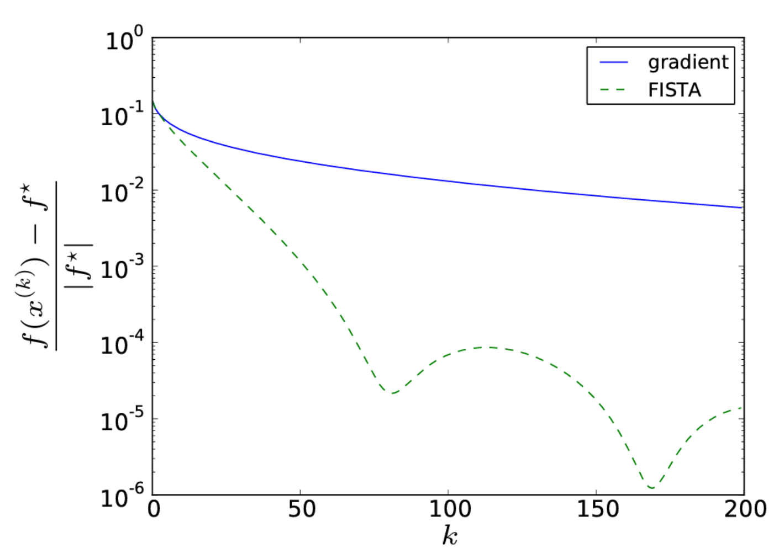
A Comparison of the two gradient methods
$$\min_{x∈R^{1000}}log⁡\left(\sum_{i=1}^{2000}{e^{\left(a_{i}^{T}x+b_{i}\right)}}\right)$$
[L. Vandenberghe EE236C Notes]

Slide 40
Junk variants other than Accelerated gradient?
Accelerated gradient is
Less robust than gradient method [Moritz Hardt]
Accumulates error with inexact oracles [De13]
Who knows what will happen in your application?

Slide 41
Summary of un-constrained smooth convex programs
Gradient method and friends: $ε≈O(1/k)$
Sub-linear and sub-optimal rate.
Additionally, strong convexity gives: $ε≈O\left({\left(\frac{Q−1}{Q+1}\right)}^{2k}\right)$. Sub-optimal but linear rate.
Accelerated gradient methods: $ε≈O(1/{k^{2}})$
Sub-linear but optimal
$O(n)$ computation per iteration
Additionally, strong convexity gives: $ε≈O\left({\left(\frac{\sqrt{Q}−1}{\sqrt{Q}+1}\right)}^{2k}\right)$. Optimal but still linear rate.

Slide 42
Summary of un-constrained smooth convex programs
Gradient method and friends: $ε≈O(1/k)$
Sub-linear and sub-optimal rate.
Additionally, strong convexity gives: $ε≈O\left({\left(\frac{Q−1}{Q+1}\right)}^{2k}\right)$. Sub-optimal but linear rate.
Accelerated gradient methods: $ε≈O(1/{k^{2}})$
Sub-linear but optimal
$O(mn)$ computation per iteration
Additionally, strong convexity gives: $ε≈O\left({\left(\frac{\sqrt{Q}−1}{\sqrt{Q}+1}\right)}^{2k}\right)$. Optimal but still linear rate.

Slide 43
Non-smooth unconstrained
$$\min_{w∈R^{n}}{\sum_{i=1}^{m}{\left|w^{⊤}φ\left(x_{i}\right)−y_{i}\right|}}$$

Slide 44
What is first order info?
$$(x_{0},f(x_{0}))$$

Slide 45
What is first order info?
$$L\left(x\right)≡f\left(x_{0}\right)+∇f{\left(x_{0}\right)}^{T}\left(x−x_{0}\right)$$
$$(x_{0},f(x_{0}))$$

Slide 46
What is first order info?
g is defined as
a sub-gradient
$$(x_{1},f(x_{1}))$$
Canonical form: $L\left(x\right)≡f\left(x_{1}\right)+g^{T}\left(x−x_{1}\right)$.
Multiple $g$ exist such that $L\left(x\right)≤f\left(x\right) ∀x$

Slide 47
First Order Methods (Non-smooth)
Theorem: Let $f$ be a closed convex function. Then
At any $x∈ri(dom f)$, sub-gradient exists and set of all sub-gradients ($denoted by ∂f(x)$; sub-differential set) is closed convex.
If $f$ is differentiable at $x∈int(dom f)$, then gradient is the only sub-gradient.
Theorem: $x∈R^{n}$ minimizes $f$ if and only if $0∈∂f(x)$.

Slide 48
Sub-gradient Method
Assume oracle that throws a sub-gradient.
Sub-gradient method:
$x_{k+1}=\text{argmi}{\text{n}}_{x∈R^{n}} f\left(x_{k}\right)+g_{f}{\left(x_{k}\right)}^{T}\left(x−x_{k}\right)+\frac{1}{2s_{k}}{\left\|x−x_{k}\right\|}^{2}$
$x_{k+1}=x_{k}−s_{k}g_{f}\left(x_{k}\right)$

Slide 49
Can sub-gradient replace gradient?
No majorization minimization
$−g_{f}\left(x\right)$not even descent direction
E.g. $f\left(x_{1},x_{2}\right)≡\left|x_{1}\right|+2|x_{2}|$
$$(1,2)$$
$$(1,0)$$

Slide 50
How far can sub-gradient take?
Expect slower than $O(1/k)$

Slide 51
How far can sub-gradient take?
Always exists!
Theorem[Ne04]: Let $\left\|x_{0}−x^{∗}\right\|≤R$ and L the Lip. const. of $f$ over this ball. Then sequence generated by sub-gradient descent satisfies:
$$\min_{i∈\{1,..,k\}}{f(x_{i})}−f\left(x^{∗}\right)≤\frac{LR}{\sqrt{k+1}}.$$
Proof Sketch:
$2s_{k}Δ_{k}≤r_{k}^{2}−r_{k+1}^{2}+s_{k}^{2}{\left\|g_{f}(x_{k})\right\|}^{2}$
LHS $≤\frac{r_{0}^{2}+\sum_{i=0}^{k}{s_{i}^{2}{\left\|g_{f}\left(x_{k}\right)\right\|}^{2}}}{2\sum_{i=0}^{k}{s_{i}}}≤\frac{R^{2}+\sum_{i=0}^{k}{s_{i}^{2}L}}{2\sum_{i=0}^{k}{s_{i}}}$; Choose $s_{k}=R/{\sqrt{k+1}}$

Slide 52
How far can sub-gradient take?
Theorem[Ne04]: Let $\left\|x_{0}−x^{∗}\right\|≤R$ and L the Lip. const. of $f$ over this ball. Then sequence generated by sub-gradient descent satisfies:
$$\min_{i∈\{1,..,k\}}{f(x_{i})}−f\left(x^{∗}\right)≤\frac{LR}{\sqrt{k+1}}.$$
Proof Sketch:
$2s_{k}Δ_{k}≤r_{k}^{2}−r_{k+1}^{2}+s_{k}^{2}{\left\|g_{f}(x_{k})\right\|}^{2}$
LHS $≤\frac{r_{0}^{2}+\sum_{i=0}^{k}{s_{i}^{2}{\left\|g_{f}\left(x_{k}\right)\right\|}^{2}}}{2\sum_{i=0}^{k}{s_{i}}}≤\frac{R^{2}+\sum_{i=0}^{k}{s_{i}^{2}L^{2}}}{2\sum_{i=0}^{k}{s_{i}}}$; Choose $s_{k}=R/{\sqrt{k+1}}$

Slide 53
Is this optimal?
Theorem[Ne04]: For any $k≤n−1$, and any $x_{0}$ such that
$\left\|x_{0}−x^{∗}\right\|≤R$, there exists a convex $f$, with const. L over the ball, such that with any first order method, we have:
$$f\left(x_{k}\right)−f\left(x^{∗}\right)≥\frac{LR}{2(1+\sqrt{k+1})}.$$
Proof Sketch: Choose function such that
$$x_{k}∈lin\left(g_{f}\left(x_{0}\right),…,g_{f}\left(x_{k−1}\right)\right)⊂R^{k,n}$$

Slide 54
Summary of non-smooth unconstrained
Sub-gradient descent method: $ε≈O\left(\frac{1}{\sqrt{k}}\right).$
Sub-linear, slower than smooth case
But, optimal!
Can do better if additional structure (later)

Slide 55
Summary of Unconstrained Case

Slide 56
Bibliography
[Ne04] Nesterov, Yurii. Introductory lectures on convex optimization : a basic course. Kluwer Academic Publ., 2004. http://hdl.handle.net/2078.1/116858.
[Ne83] Nesterov, Yurii. A method of solving a convex programming problem with convergence rate O (1/k2). Soviet Mathematics Doklady, Vol. 27(2), 372-376 pages.
[Mo12] Moritz Hardt, Guy N. Rothblum and Rocco A. Servedio. Private data release via learning thresholds. SODA 2012, 168-187 pages.
[Be09] Amir Beck and Marc Teboulle. A fast iterative shrinkage-thresholding algorithm for linear inverse problems. SIAM Journal of Imaging Sciences, Vol. 2(1), 2009. 183-202 pages.
[De13] Olivier Devolder, François Glineur and Yurii Nesterov. First-order methods of smooth convex optimization with inexact oracle. Mathematical Programming 2013.

