Slide 1
First order methods
For convex optimization
J. Saketha Nath
(IIT Bombay; Microsoft)
Notes:
Test

Slide 2
Topics
Part – I
Optimal methods for unconstrained convex programs
Smooth objective
Non-smooth objective
Part – II
Optimal methods for constrained convex programs
Projection based
Frank-Wolfe based
Functional constraint based
Prox-based methods for structured non-smooth programs

Slide 3
Constrained Optimization - Illustration
$$F$$
$$f$$
$$x^{∗}$$

Slide 4
Constrained Optimization - Illustration
$$F$$
$$∇f\left(x^{∗}\right)$$
$$f$$
$$x^{∗}$$
$$x^{∗} is optimal⇔∇f{\left(x^{∗}\right)}^{T}u≥0 ∀ u∈T_{F}(x^{∗})$$

Slide 5
Two Strategies
Stay feasible and minimize
Projection based
Frank-Wolfe based

Slide 6
Two Strategies
Alternate between
Minimization
Move towards feasibility set

Slide 7
Projection Based Methods
Constrained Convex Programs

Slide 8
Projected Gradient Method
$X$ is closed convex
$$\min_{x∈X}{f(x)}$$
$x_{k+1} =\text{argmi}{\text{n}}_{x∈X} f\left(x_{k}\right)+∇f{\left(x_{k}\right)}^{T}\left(x−x_{k}\right)+\frac{1}{2s_{k}}{\left\|x−x_{k}\right\|}^{2}$
$= \text{argmi}{\text{n}}_{x∈X} {\left\|x−\left(x_{k}−s_{k}∇f(x_{k})\right)\right\|}^{2}$
$≡Π_{X}\left(x_{k}−s_{k}∇f(x_{k})\right)$

Slide 9
Projected Gradient Method
$$\min_{x∈X}{f(x)}$$
$x_{k+1} =\text{argmi}{\text{n}}_{x∈X} f\left(x_{k}\right)+∇f{\left(x_{k}\right)}^{T}\left(x−x_{k}\right)+\frac{1}{2s_{k}}{\left\|x−x_{k}\right\|}^{2}$
$= \text{argmi}{\text{n}}_{x∈X} {\left\|x−\left(x_{k}−s_{k}∇f(x_{k})\right)\right\|}^{2}$
$≡Π_{X}\left(x_{k}−s_{k}∇f(x_{k})\right)$

Slide 10
Projected Gradient Method
$$\min_{x∈X}{f(x)}$$
$x_{k+1} =\text{argmi}{\text{n}}_{x∈X} f\left(x_{k}\right)+∇f{\left(x_{k}\right)}^{T}\left(x−x_{k}\right)+\frac{1}{2s_{k}}{\left\|x−x_{k}\right\|}^{2}$
$= \text{argmi}{\text{n}}_{x∈X} {\left\|x−\left(x_{k}−s_{k}∇f(x_{k})\right)\right\|}^{2}$
$≡Π_{X}\left(x_{k}−s_{k}∇f(x_{k})\right)$
X is simple:
oracle for projections

Slide 11
Projected Gradient Method
$$\min_{x∈X}{f(x)}$$
$x_{k+1} =\text{argmi}{\text{n}}_{x∈X} f\left(x_{k}\right)+∇f{\left(x_{k}\right)}^{T}\left(x−x_{k}\right)+\frac{1}{2s_{k}}{\left\|x−x_{k}\right\|}^{2}$
$= \text{argmi}{\text{n}}_{x∈X} {\left\|x−\left(x_{k}−s_{k}∇f(x_{k})\right)\right\|}^{2}$
$≡Π_{X}\left(x_{k}−s_{k}∇f(x_{k})\right)$
$$x_{k+1}$$
$$x_{k}$$
$$x_{k}−s_{k}∇f(x_{k})$$

Slide 12
Will it work?
${\left\|x_{k+1}−x^{∗}\right\|}^{2}={\left\|Π_{X}(x_{k}−s_{k}∇f(x_{k}))−x^{∗}\right\|}^{2}$
$≤{\left\| (x_{k}−s_{k}∇f(x_{k}))−x^{∗}\right\|}^{2}$ (Why?)
Remaining analysis exactly same (smooth/non-smooth)
Analysis a bit more involved for projected accelerated gradient
Define gradient map: $h\left(x_{k}\right)≡\frac{x_{k}−Π_{X}\left(x_{k}−s_{k}∇f\left(x_{k}\right)\right)}{s_{k}}$
Satisfies same fundamental properties as gradient!

Slide 13
Will it work?
${\left\|x_{k+1}−x^{∗}\right\|}^{2}={\left\|Π_{X}(x_{k}−s_{k}∇f(x_{k}))−x^{∗}\right\|}^{2}$
$≤{\left\| (x_{k}−s_{k}∇f(x_{k}))−x^{∗}\right\|}^{2}$ (Why?)
Remaining analysis exactly same (smooth/non-smooth)
Analysis a bit more involved for projected accelerated gradient
Define gradient map: $h\left(x_{k}\right)≡\frac{x_{k}−Π_{X}\left(x_{k}−s_{k}∇f\left(x_{k}\right)\right)}{s_{k}}$
Satisfies same fundamental properties as gradient!

Slide 14
Simple sets
Non-negative orthant
Ball, ellipse
Box, simplex
Cones
PSD matrices
Spectrahedron

Slide 15
Summary of Projection Based Methods
Rates of convergence remain exactly same
Projection oracle needed (simple sets)
Caution with non-analytic cases

Slide 16
Frank-Wolfe Methods
Constrained Convex Programs

Slide 17
Avoid Projections
$y_{k+1} =\text{argmi}{\text{n}}_{x∈X} f\left(x_{k}\right)+∇f{\left(x_{k}\right)}^{T}\left(x−x_{k}\right)+\frac{1}{2s_{k}}{\left\|x−x_{k}\right\|}^{2}$
$=\text{argmi}{\text{n}}_{x∈X} ∇f{\left(x_{k}\right)}^{T}x$
Restrict moving far away:
$x_{k+1}≡s_{k}y_{k+1}+\left(1−s_{k}\right)x_{k}$

Slide 18
Avoid Projections
Support function of X at $∇f{\left(x_{k}\right)}^{}$
$y_{k+1} =\text{argmi}{\text{n}}_{x∈X} f\left(x_{k}\right)+∇f{\left(x_{k}\right)}^{T}\left(x−x_{k}\right)+\frac{1}{2s_{k}}{\left\|x−x_{k}\right\|}^{2}$
$=\text{arg}\text{mi}{\text{n}}_{x∈X} ∇f{\left(x_{k}\right)}^{T}x$
Restrict moving far away:
$x_{k+1}≡s_{k}y_{k+1}+\left(1−s_{k}\right)x_{k}$

Slide 19
Avoid Projections [FW59]
$y_{k+1} =\text{argmi}{\text{n}}_{x∈X} f\left(x_{k}\right)+∇f{\left(x_{k}\right)}^{T}\left(x−x_{k}\right)+\frac{1}{2s_{k}}{\left\|x−x_{k}\right\|}^{2}$
$=\text{argmi}{\text{n}}_{x∈X} ∇f{\left(x_{k}\right)}^{T}x$ (Support Function)
Restrict moving far away:
$x_{k+1}≡s_{k}y_{k+1}+\left(1−s_{k}\right)x_{k}$

Slide 20
Illustration
$$x^{+}$$
$$y$$
$$−∇f(x)$$
[Mart Jaggi, ICML 2014]

Slide 21
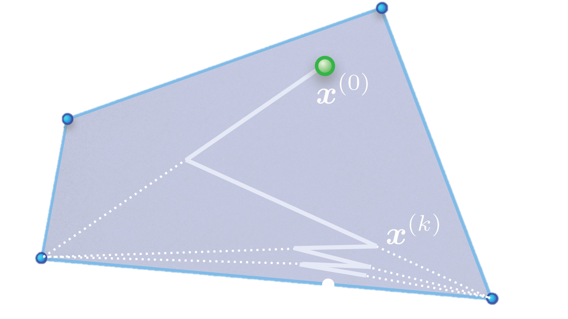
Zig-Zagging (Again!)
[Mart Jaggi, ICML 2014]

Slide 22
Examples of Support Functions
$$X$$ | $$S_{X}\left(x\right)$$ | Eff. Projection?
$${\left\|x\right\|}_{p}≤1$$ | $${\left\|x\right\|}_{\frac{p}{p−1}}$$ | No $(p∉\{1,2,∞\})$
$${\left\|x\right\|}_{1}≤1$$ | $$O(n)$$ | $$O(n\log{n})$$
$${\left\|σ(x)\right\|}_{p}≤1$$ | $${\left\|σ(x)\right\|}_{\frac{p}{p−1}}$$ | No $(p∉\{1,2,∞\})$
$${\left\|σ(x)\right\|}_{1}≤1$$ | Full SVD | First SVD

Slide 23
Rate of Convergence
Theorem[Ma11]: If $X$ is compact convex set and $f$ is smooth with const. $L$, and $s_{k}=\frac{2}{k+2}$, then the iterates generated by Frank-Wolfe satisfy:
$$f\left(x_{k}\right)−f\left(x^{∗}\right)≤\frac{4L d{\left(X\right)}^{2}}{k+2}.$$
Proof Sketch:
$f\left(x_{k+1}\right)≤f\left(x_{k}\right)+s_{k}∇f{\left(x_{k}\right)}^{T}\left(y_{k+1}−x_{k}\right)+\frac{s_{k}^{2}L}{2}d{\left(X\right)}^{2}$
$Δ_{k+1}≤{\left(1−s_{k}\right)Δ}_{k}+\frac{s_{k}^{2}L}{2}d{\left(X\right)}^{2}$ (Solve recursion)
Sub-optimal

Slide 24
Rate of Convergence
Theorem[Ma11]: If $X$ is compact convex set and $f$ is smooth with const. $L$, and $s_{k}=\frac{2}{k+2}$, then the iterates generated by Frank-Wolfe satisfy:
$$f\left(x_{k}\right)−f\left(x^{∗}\right)≤\frac{4L d{\left(X\right)}^{2}}{k+2}.$$
Proof Sketch:
$f\left(x_{k+1}\right)≤f\left(x_{k}\right)+s_{k}∇f{\left(x_{k}\right)}^{T}\left(y_{k+1}−x_{k}\right)+\frac{s_{k}^{2}L}{2}d{\left(X\right)}^{2}$
$Δ_{k+1}≤{\left(1−s_{k}\right)Δ}_{k}+\frac{s_{k}^{2}L}{2}d{\left(X\right)}^{2}$ (Solve recursion)

Slide 25
Sparse Representation – Optimality
$$(0,1)$$
If $x_{0}=0$ and domain is $l_{1}$ball, $x_{k}∈R^{k,n}$
We get exact sparsity! (unlike proj. grad.)
Sparse representation by extreme points
$ε≈O({L d{\left(X\right)}^{2}}/k)$ need atleast $k$ non-zeros [Ma11]
Optimal in terms of accuracy-sparsity trade-off
Not in terms of accuracy-iterations
$$(−1,0)$$
$$(1,0)$$
$$(0,−1)$$

Slide 26
Sparse Representation – Optimality
$$(0,1)$$
If $x_{0}=0$ and domain is $l_{1}$ball, $x_{k}∈R^{k,n}$
We get exact sparsity! (unlike proj. grad.)
Sparse representation by extreme points
$ε≈O({L d{\left(X\right)}^{2}}/k)$ need atleast $k$ non-zeros [Ma11]
Optimal in terms of accuracy-sparsity trade-off
Not in terms of accuracy-iterations
$$(−1,0)$$
$$(1,0)$$
$$(0,−1)$$

Slide 27
Summary comparison of always feasible methods
Property | Projected Gr. | Frank-Wolfe
Rate of convergence | + | -
Sparse Solutions | - | +
Iteration Complexity | - | +
Affine Invariance | - | +

Slide 28
Composite Objective
Prox based methods

Slide 29
Composite Objectives
Non-Smooth g(w)
Smooth f(w)
$$\min_{w∈R^{n}}{Ω(w)+\sum_{i=1}^{m}{l(w^{′}φ\left(x_{i}\right), y_{i})}}$$
Key Idea: Do not approximate non-smooth part

Slide 30
Proximal Gradient Method
$x_{k+1}=\text{argmi}n_{x} f\left(x_{k}\right)+∇f{\left(x_{k}\right)}^{T}\left(x−x_{k}\right)+\frac{1}{2s_{k}}{\left\|x−x_{k}\right\|}^{2}+g(x)$
If $g$ is indicator, then same as projected gr.
If $g$ is support function: $g\left(x\right)=\max_{y∈S}{x^{T}y}$
Assume min-max interchange
$$x_{k+1}=x_{k}−s_{k}∇f\left(x_{k}\right)−s_{k}Π_{S}\left(\frac{1}{s_{k}}\left(x_{k}−s_{k}∇f\left(x_{k}\right)\right)\right)$$

Slide 31
Proximal Gradient Method
$x_{k+1}=\text{argmi}n_{x} f\left(x_{k}\right)+∇f{\left(x_{k}\right)}^{T}\left(x−x_{k}\right)+\frac{1}{2s_{k}}{\left\|x−x_{k}\right\|}^{2}+g(x)$
If $g$ is indicator, then same as projected gr.
If $g$ is support function: $g\left(x\right)=\max_{y∈S}{x^{T}y}$
Assume min-max interchange
$$x_{k+1}=x_{k}−s_{k}∇f\left(x_{k}\right)−s_{k}Π_{S}\left(\frac{1}{s_{k}}\left(x_{k}−s_{k}∇f\left(x_{k}\right)\right)\right)$$
Again, projection

Slide 32
Rate of Convergence
Theorem[Ne04]: If $f$ is smooth with const. $L$, and $s_{k}=\frac{1}{L}$, then proximal gradient method generates $x_{k}$ such that:
$$f\left(x_{k}\right)−f\left(x^{∗}\right)≤\frac{L{\left\|x_{0}−x^{∗}\right\|}^{2}}{2k}.$$
Can be accelerated to $O(1/k^{2})$
Composite same rate as smooth provided proximal oracle exists!

Slide 33
Bibliography
[Ne04] Nesterov, Yurii. Introductory lectures on convex optimization : a basic course. Kluwer Academic Publ., 2004. http://hdl.handle.net/2078.1/116858.
[Ne83] Nesterov, Yurii. A method of solving a convex programming problem with convergence rate O (1/k2). Soviet Mathematics Doklady, Vol. 27(2), 372-376 pages.
[Mo12] Moritz Hardt, Guy N. Rothblum and Rocco A. Servedio. Private data release via learning thresholds. SODA 2012, 168-187 pages.
[Be09] Amir Beck and Marc Teboulle. A fast iterative shrinkage-thresholding algorithm for linear inverse problems. SIAM Journal of Imaging Sciences, Vol. 2(1), 2009. 183-202 pages.
[De13] Olivier Devolder, François Glineur and Yurii Nesterov. First-order methods of smooth convex optimization with inexact oracle. Mathematical Programming 2013.
[FW59] Marguerite Frank and Philip Wolfe. An Algorithm for Quadratic Programming. Naval Research Logistics Quarterly, 1959, Vol 3, 95-110 pages.

Slide 34
Bibliography
[Ma11] Martin Jaggi. Sparse Convex Optimization Methods for Machine Learning. PhD Thesis, 2011.
[Ju12] A Juditsky and A Nemirovski. First Order Methods for Non-smooth Convex Large-Scale Optimization, I: General Purpose Methods. Optimization methods for machine learning. The MIT Press, 2012. 121-184 pages.

Slide 35
Thanks for listening

