Slide 1
Learning Representations of Data
J. Saketha Nath, IIT Bombay
Collaborators:
Pratik Jawanpuria, Arun Iyer, Sunita Sarawagi, Ganesh Ramakrishnan.

Slide 2
Outline
Introduction to Representation Learning
Summary of Research
Case Study: Class-ratio estimation
Concluding remarks

Slide 3
Introduction to Representation Learning

Slide 4
Representation Learning: Illustration
Training
Inference
$${ x}_{1}$$
$${ y}_{1}$$
$${ x}_{1}^{′}$$
$$?$$
$${ x}_{2}$$
$${ y}_{2}$$
$${ x}_{2}^{′}$$
$$?$$
$${ x}_{m}$$
$${ y}_{m}$$
$${ x}_{m}^{′}$$
$$?$$

Slide 5
Representation Learning: Illustration
Training
Inference
$$φ\left(x_{1}\right)$$
$$φ\left(x_{1}^{′}\right)$$
$${ x}_{1}$$
$${ y}_{1}$$
$${ x}_{1}^{′}$$
$$?$$
$$φ\left(x_{2}\right)$$
$$φ\left(x_{2}^{′}\right)$$
$${ x}_{2}$$
$${ y}_{2}$$
$${ x}_{2}^{′}$$
$$?$$
$$φ\left(x_{m}\right)$$
$$φ\left(x_{m}^{′}\right)$$
$${ x}_{m}$$
$${ y}_{m}$$
$${ x}_{m}^{′}$$
$$?$$

Slide 6
Representation Learning: Examples
Training
Inference
$$φ\left(x_{1}\right)$$
$$φ\left(x_{1}^{′}\right)$$
$${ x}_{1}$$
$${ y}_{1}$$
$${ x}_{1}^{′}$$
$$?$$
$$φ\left(x_{2}\right)$$
$$φ\left(x_{2}^{′}\right)$$
$${ x}_{2}$$
$${ y}_{2}$$
$${ x}_{2}^{′}$$
$$?$$
Principle Component Analysis
Deep Learning
(long list :)
$$φ\left(x_{m}\right)$$
$$φ\left(x_{m}^{′}\right)$$
$${ x}_{m}$$
$${ y}_{m}$$
$${ x}_{m}^{′}$$
$$?$$

Slide 7
Representation Learning: Illustration
Training
Inference
$$φ_{k}\left(x_{1}\right)$$
$$φ_{k}\left(x_{1}^{′}\right)$$
$${ x}_{1}$$
$${ y}_{1}$$
$${ x}_{1}^{′}$$
$$?$$
$$φ_{k}\left(x_{2}\right)$$
$${ y}_{2}$$
$$φ_{k}\left(x_{2}^{′}\right)$$
$$?$$
$${ x}_{2}$$
$${ x}_{2}^{′}$$
$$k_{11}$$ | $$k_{12}$$ | $$…$$
$$k_{21}$$ | $$k_{22}$$ | $$…$$
$$…$$ | $$…$$ | $$…$$
$$k_{11}^{′}$$ | $$k_{12}^{′}$$ | $$…$$
$$k_{21}^{′}$$ | $$k_{22}^{′}$$ | $$…$$
$$…$$ | $$…$$ | $$…$$
$$k_{ij}=k\left(x_{i},x_{j}\right)=\left\langle φ_{k}\left(x_{i}\right),φ_{k}\left(x_{j}\right)\right\rangle$$
$$φ_{k}\left(x_{m}\right)$$
$$φ_{k}\left(x_{m}^{′}\right)$$
$${ x}_{m}$$
$${ y}_{m}$$
$${ x}_{m}^{′}$$
$$?$$

Slide 8
Kernel Learning: Illustration
Training
Inference
$$φ_{k}\left(x_{1}\right)$$
$$φ_{k}\left(x_{1}^{′}\right)$$
$${ x}_{1}$$
$${ y}_{1}$$
$${ x}_{1}^{′}$$
$$?$$
$$φ_{k}\left(x_{2}\right)$$
$${ y}_{2}$$
$$φ_{k}\left(x_{2}^{′}\right)$$
$$?$$
$${ x}_{2}$$
$${ x}_{2}^{′}$$
$$k_{11}$$ | $$k_{12}$$ | $$…$$
$$k_{21}$$ | $$k_{22}$$ | $$…$$
$$…$$ | $$…$$ | $$…$$
$$k_{11}^{′}$$ | $$k_{12}^{′}$$ | $$…$$
$$k_{21}^{′}$$ | $$k_{22}^{′}$$ | $$…$$
$$…$$ | $$…$$ | $$…$$
$$k_{ij}=k\left(x_{i},x_{j}\right)=\left\langle φ_{k}\left(x_{i}\right),φ_{k}\left(x_{j}\right)\right\rangle$$
$$φ_{k}\left(x_{m}\right)$$
$$φ_{k}\left(x_{m}^{′}\right)$$
$${ x}_{m}$$
$${ y}_{m}$$
$${ x}_{m}^{′}$$
$$?$$

Slide 9
Kernel Learning: Broad set-ups
Multi-modal Data [NIPS’09, JMLR’11]
Multi-task Learning [SDM’11, ICML’12]
Interpretable Rule Learning [ICML’11, JMLR’15]

Slide 10
Case Study:Class Ratio Estimation
Kernel Learning

Slide 11
Class Ratio Estimation
Labeled
Unlabeled
$${ x}_{1}$$
$${ y}_{1}$$
$${ x}_{1}^{′}$$
$$?$$
$${ x}_{2}$$
$${ y}_{2}$$
$${ x}_{2}^{′}$$
$$?$$
$${ x}_{m}$$
$${ y}_{m}$$
$${ x}_{m}^{′}$$
$$?$$

Slide 12
Class Ratio Estimation
Labeled
Unlabeled
$${ x}_{1}$$
$${ y}_{1}$$
$${ x}_{1}^{′}$$
$${ x}_{2}$$
$${ y}_{2}$$
$${ x}_{2}^{′}$$
$$?$$
What frac. from each class?
$${ x}_{m}$$
$${ y}_{m}$$
$${ x}_{m}^{′}$$

Slide 13
Class Ratio Estimation
$$f_{X}^{U}\left(x\right)=\sum_{i=1}^{c}{f_{Y}^{U}(i)f_{X/Y}^{U}(x/i)}$$

Slide 14
Class Ratio Estimation
$$f_{X}^{U}\left(x\right)=\sum_{i=1}^{c}{f_{Y}^{U}(i)f_{X/Y}^{L}(x/i)}$$
Assumption: $f_{X/Y}^{L}=f_{X/Y}^{U}$

Slide 15
Class Ratio Estimation
$$\min_{θ∈Δ_{c}}{{\left\|f_{X}^{U}−\sum_{i=1}^{c}{θ_{i}f_{X/Y=i}^{L}}\right\|}^{2}}$$

Slide 16
Class Ratio Estimation
$$\frac{1}{m_{u}}\sum_{i=1}^{m_{u}}{φ_{k}(x_{i}^{′})}$$
$$\frac{1}{m_{i}}\sum_{j:y_{j}=i}{φ_{k}(x_{j})}$$
$$\min_{θ∈Δ_{c}}{{\left\|f_{X}^{U}−\sum_{i=1}^{c}{θ_{i}f_{X/Y=i}^{L}}\right\|}^{2}}$$
Representation of data distribution using kernel

Slide 17
Class Ratio Estimation
$$\min_{θ∈Δ_{c}}{{\left\|\frac{1}{m_{u}}\sum_{i=1}^{m_{u}}{φ_{k}(x_{i}^{′})}−\sum_{i=1}^{c}{θ_{i}\left(\frac{1}{m_{i}}\sum_{j:y_{j}=i}{φ_{k}(x_{j})}\right)}\right\|}_{H_{k}}^{2}}$$

Slide 18
Class Ratio Estimation
$$\min_{θ∈Δ_{c}}{{\left\|\frac{1}{m_{u}}\sum_{i=1}^{m_{u}}{φ_{k}(x_{i}^{′})}−\sum_{i=1}^{c}{θ_{i}\left(\frac{1}{m_{i}}\sum_{j:y_{j}=i}{φ_{k}(x_{j})}\right)}\right\|}_{H_{k}}^{2}}$$
Kernel Learning: Which $k$ is best?

Slide 19
Statistical Consistency
Theorem: Let $\hat{θ},θ^{∗}$be the estimated and true class ratios, let $A_{k}$ be a matrix with $i^{th}$ column as $\frac{1}{m_{i}}\sum_{j:y_{j}=i}{φ_{k}(x_{j})}−\frac{1}{m_{c}}\sum_{j:y_{j}=c}{φ_{k}(x_{j})}$, and let $R_{k}=\max_{x∈𝒳}\left\|φ_{k}(x)\right\|$, then with probability $1−δ$, we have:
$${\left\|\hat{θ}−θ^{∗}\right\|}_{2}^{2}≤\frac{R_{k}^{2}\left(\frac{c^{2}+1}{m_{u}}+\sum_{i=1}^{c}{\frac{2}{m_{i}}}\right){\left(1+\sqrt{\log{\frac{2}{δ}}}\right)}^{2}}{mineig(A_{k}^{T}A_{k})}$$
Please refer ICML’14, KDD’16 for details

Slide 20
Kernel Learning
Given: $k_{1}, k_{2},…,k_{n}$.
Goal: Find $k_{λ}=\sum_{i=1}^{n}{λ_{i}k_{i}}, λ_{i}≥0$ such that
$λ$ min. bound on $\left\|\hat{θ}−θ^{∗}\right\|$
mineig$\left(A_{k_{λ}}^{⊤}A_{k_{λ}}\right)=$mineig$\left(\sum_{i=1}^{n}{λ_{i}}A_{k_{i}}^{⊤}A_{k_{i}}\right)$ CONVEX!
$R_{k_{λ}}^{2}=\sum_{i=1}^{n}{λ_{i}^{2}R_{k_{i}}^{2}}$ CONVEX!
$λ$ min. empirical average of $\left\|\hat{θ}−θ^{∗}\right\|$
Posed as a SDP, solved using cutting-planes algorithm

Slide 21
Kernel Learning
Given: $k_{1}, k_{2},…,k_{n}$.
Goal: Find $k_{λ}=\sum_{i=1}^{n}{λ_{i}k_{i}}, λ_{i}≥0$ such that…
$λ$ min. bound on $\left\|\hat{θ}−θ^{∗}\right\|$
mineig$\left(A_{k_{λ}}^{⊤}A_{k_{λ}}\right)=$mineig$\left(\sum_{i=1}^{n}{λ_{i}}A_{k_{i}}^{⊤}A_{k_{i}}\right)$ CONVEX!
$R_{k_{λ}}^{2}=\sum_{i=1}^{n}{λ_{i}^{2}R_{k_{i}}^{2}}$ CONVEX!
$λ$ min. empirical average of $\left\|\hat{θ}−θ^{∗}\right\|$
Posed as a SDP, solved using cutting-planes algorithm

Slide 22
Kernel Learning
Given: $k_{1}, k_{2},…,k_{n}$.
Goal: Find $k_{λ}=\sum_{i=1}^{n}{λ_{i}k_{i}}, λ_{i}≥0$ such that…
$λ$ min. bound on $\left\|\hat{θ}−θ^{∗}\right\|$
mineig$\left(A_{k_{λ}}^{⊤}A_{k_{λ}}\right)=$mineig$\left(\sum_{i=1}^{n}{λ_{i}}A_{k_{i}}^{⊤}A_{k_{i}}\right)$ CONVEX!
$R_{k_{λ}}^{2}=\sum_{i=1}^{n}{λ_{i}^{2}R_{k_{i}}^{2}}$ CONVEX!
$λ$ min. empirical average of $\left\|\hat{θ}−θ^{∗}\right\|$
Posed as a SDP, solved using cutting-planes algorithm

Slide 23
Kernel Learning
Given: $k_{1}, k_{2},…,k_{n}$.
Goal: Find $k_{λ}=\sum_{i=1}^{n}{λ_{i}k_{i}}, λ_{i}≥0$ such that…
$λ$ min. bound on $\left\|\hat{θ}−θ^{∗}\right\|$
mineig$\left(A_{k_{λ}}^{⊤}A_{k_{λ}}\right)=$mineig$\left(\sum_{i=1}^{n}{λ_{i}}A_{k_{i}}^{⊤}A_{k_{i}}\right)$ CONVEX!
$R_{k_{λ}}^{2}=\sum_{i=1}^{n}{λ_{i}^{2}R_{k_{i}}^{2}}$ CONVEX!
$λ$ min. empirical average of $\left\|\hat{θ}−θ^{∗}\right\|$
Posed as a SDP, solved using cutting-planes algorithm

Slide 24
Kernel Learning
Given: $k_{1}, k_{2},…,k_{n}$.
Goal: Find $k_{λ}=\sum_{i=1}^{n}{λ_{i}k_{i}}, λ_{i}≥0$ such that…
$λ$ min. bound on $\left\|\hat{θ}−θ^{∗}\right\|$
mineig$\left(A_{k_{λ}}^{⊤}A_{k_{λ}}\right)=$mineig$\left(\sum_{i=1}^{n}{λ_{i}}A_{k_{i}}^{⊤}A_{k_{i}}\right)$ CONVEX!
$R_{k_{λ}}^{2}=\sum_{i=1}^{n}{λ_{i}^{2}R_{k_{i}}^{2}}$ CONVEX!
$λ$ min. empirical average of $\left\|\hat{θ}−θ^{∗}\right\|$
Posed as a SDP, solved using cutting-planes algorithm

Slide 25
Kernel Learning
Given: $k_{1}, k_{2},…,k_{n}$.
Goal: Find $k_{λ}=\sum_{i=1}^{n}{λ_{i}k_{i}}, λ_{i}≥0$ such that…
$λ$ min. bound on $\left\|\hat{θ}−θ^{∗}\right\|$
mineig$\left(A_{k_{λ}}^{⊤}A_{k_{λ}}\right)=$mineig$\left(\sum_{i=1}^{n}{λ_{i}}A_{k_{i}}^{⊤}A_{k_{i}}\right)$ CONVEX!
$R_{k_{λ}}^{2}=\sum_{i=1}^{n}{λ_{i}^{2}R_{k_{i}}^{2}}$ CONVEX!
$λ$ min. empirical average of $\left\|\hat{θ}−θ^{∗}\right\|$
Posed as a SDP, solved using cutting-planes algorithm

Slide 26
Kernel Learning
Given: $k_{1}, k_{2},…,k_{n}$.
Goal: Find $k_{λ}=\sum_{i=1}^{n}{λ_{i}k_{i}}, λ_{i}≥0$ such that…
$λ$ min. bound on $\left\|\hat{θ}−θ^{∗}\right\|$
mineig$\left(A_{k_{λ}}^{⊤}A_{k_{λ}}\right)=$mineig$\left(\sum_{i=1}^{n}{λ_{i}}A_{k_{i}}^{⊤}A_{k_{i}}\right)$ CONVEX!
$R_{k_{λ}}^{2}=\sum_{i=1}^{n}{λ_{i}^{2}R_{k_{i}}^{2}}$ CONVEX!
$λ$ min. empirical average of $\left\|\hat{θ}−θ^{∗}\right\|$
Posed as a SDP, solved using cutting-planes algorithm

Slide 27
Kernel Learning
Given: $k_{1}, k_{2},…,k_{n}$.
Goal: Find $k_{λ}=\sum_{i=1}^{n}{λ_{i}k_{i}}, λ_{i}≥0$ such that…
$λ$ min. bound on $\left\|\hat{θ}−θ^{∗}\right\|$
mineig$\left(A_{k_{λ}}^{⊤}A_{k_{λ}}\right)=$mineig$\left(\sum_{i=1}^{n}{λ_{i}}A_{k_{i}}^{⊤}A_{k_{i}}\right)$ CONVEX!
$R_{k_{λ}}^{2}=\sum_{i=1}^{n}{λ_{i}^{2}R_{k_{i}}^{2}}$ CONVEX!
$λ$ min. empirical average of $\left\|\hat{θ}−θ^{∗}\right\|$
Posed as a SDP, solved using cutting-planes algorithm

Slide 28
Kernel Learning
Given: $k_{1}, k_{2},…,k_{n}$.
Goal: Find $k_{λ}=\sum_{i=1}^{n}{λ_{i}k_{i}}, λ_{i}≥0$ such that…
$λ$ min. bound on $\left\|\hat{θ}−θ^{∗}\right\|$
mineig$\left(A_{k_{λ}}^{⊤}A_{k_{λ}}\right)=$mineig$\left(\sum_{i=1}^{n}{λ_{i}}A_{k_{i}}^{⊤}A_{k_{i}}\right)$ CONVEX!
$R_{k_{λ}}^{2}=\sum_{i=1}^{n}{λ_{i}^{2}R_{k_{i}}^{2}}$ CONVEX!
$λ$ min. empirical average of $\left\|\hat{θ}−θ^{∗}\right\|$
Posed as a SDP, solved using cutting-planes algorithm
Please refer ICML’14 for details

Slide 29
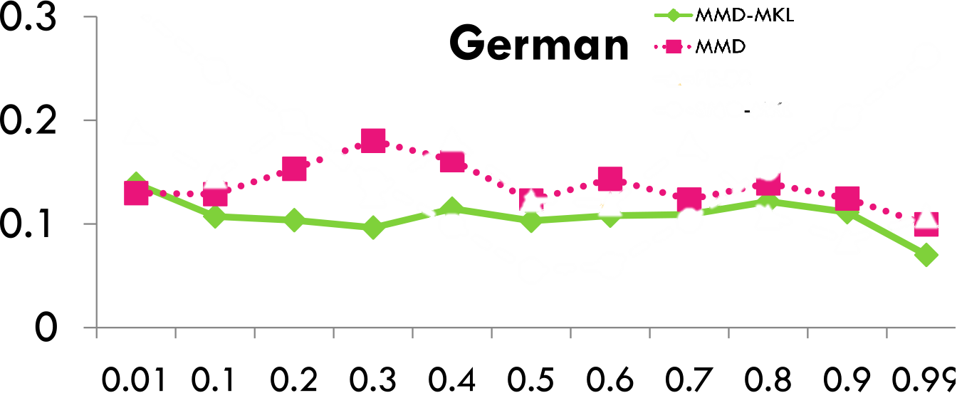
Simulation results
Estimation Error
Varying Negative Class Proportions in U
(proportion in L is set to [0.5, 0.5])

Slide 30
Concluding remarks…
Representation learning improves generalization over expert-crafted ones
01
Learning theory and optimization both need to be leveraged
02
Interplay between kernel and deep learning needs investigation
03

Slide 31
Summary of Research

Slide 32
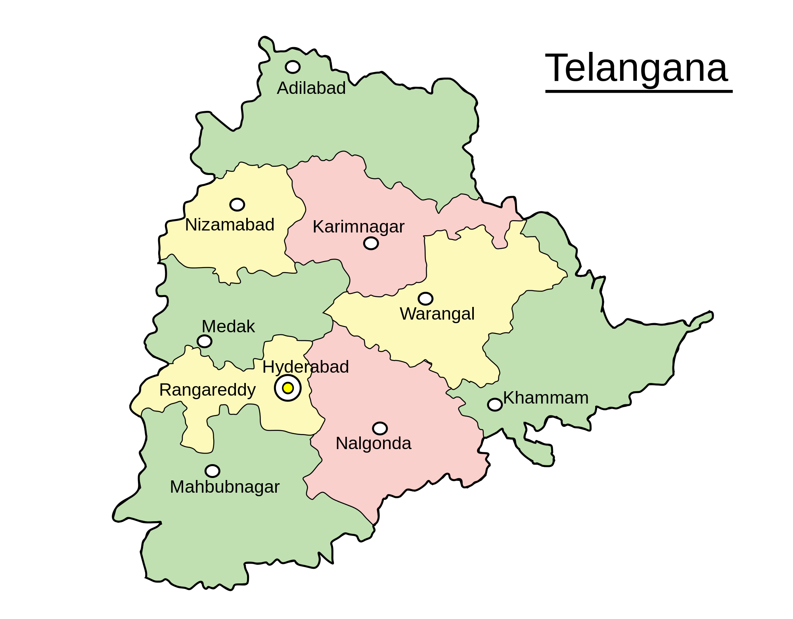
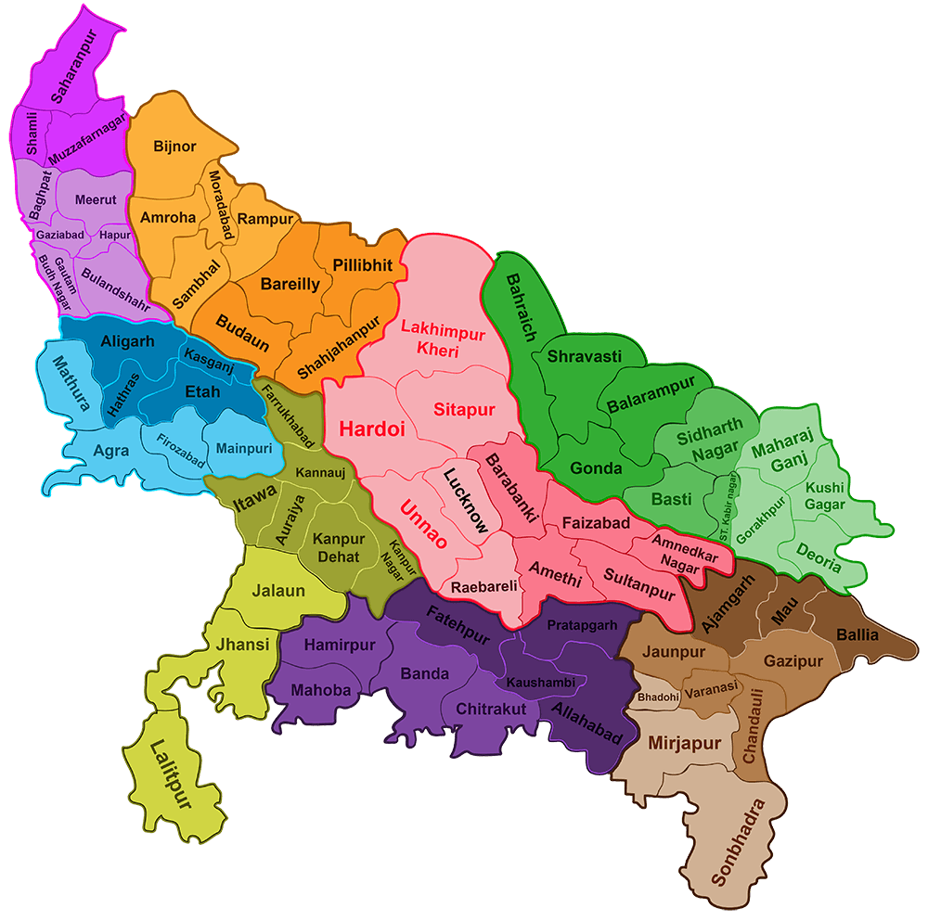
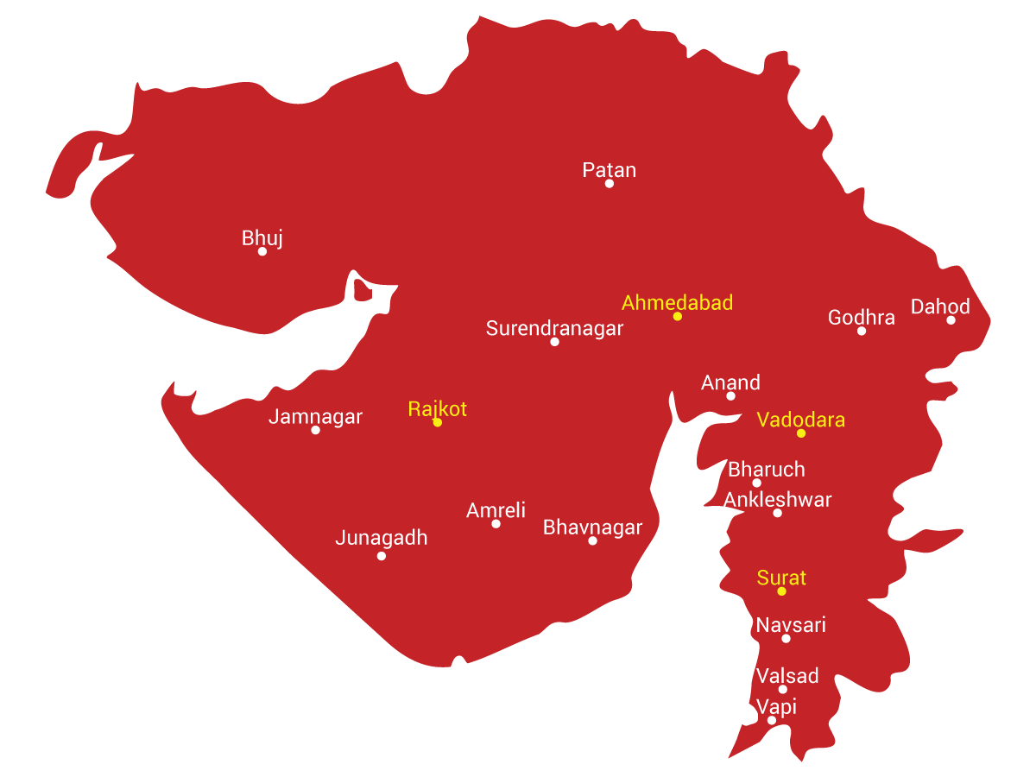
Kernel learning
$$k_{1}^{1}$$
Multi-task learning
SDM’11, ICML’12
$$k_{2}^{1}$$
$$k_{3}^{1}$$
Multi-modal Data
NIPS’09, JMLR’11
DATA
INFERENCE
$$k_{1}^{2}$$
$$k_{2}^{2}$$
$$k$$
$$k_{3}^{2}$$
$$k$$
$$k_{1}^{3}$$
$$k_{2}^{3}$$
$$k_{3}^{3}$$
Rule Ensemble Learning
ICML’11, JMLR’15

Slide 33
Kernel learning
$$k_{1}^{1}$$
Multi-task learning
SDM’11, ICML’12
$$k_{2}^{1}$$
$$k_{3}^{1}$$
Multi-modal Data
NIPS’09, JMLR’11
DATA
INFERENCE
$$k_{1}^{2}$$
$$k_{2}^{2}$$
$$k$$
$$k_{3}^{2}$$
$$k$$
$$k_{1}^{3}$$
$$k_{2}^{3}$$
$$k_{3}^{3}$$
Rule Ensemble Learning
ICML’11, JMLR’15

Slide 34
Kernel learning
$$k_{1}^{1}$$
Multi-task learning
SDM’11, ICML’12
$$k_{2}^{1}$$
$$k_{3}^{1}$$
Multi-modal Data
NIPS’09, JMLR’11
DATA
INFERENCE
$$k_{1}^{2}$$
$$k_{2}^{2}$$
$$k$$
$$k_{3}^{2}$$
$$k$$
$$k_{1}^{3}$$
$$k_{2}^{3}$$
$$k_{3}^{3}$$
Rule Ensemble Learning
ICML’11, JMLR’15

Slide 35
Kernel learning
$$k_{1}^{1}$$
Multi-task learning
SDM’11, ICML’12
$$k_{2}^{1}$$
$$k_{3}^{1}$$
Multi-modal Data
NIPS’09, JMLR’11
DATA
INFERENCE
$$k_{1}^{2}$$
$$k_{2}^{2}$$
$$k$$
$$k_{3}^{2}$$
$$k$$
$$k_{1}^{3}$$
$$k_{2}^{3}$$
$$k_{3}^{3}$$
Rule Ensemble Learning
ICML’11, JMLR’15

Slide 36
Kernel learning – Multi-modal Data
$$k_{1}^{1}$$
$$k_{3}^{1}$$
$$k_{2}^{1}$$
$$k_{1}^{2}$$
Training, Inference
$$k_{2}^{2}$$
$$k$$
$$k_{3}^{2}$$
$$k_{1}^{3}$$
$$k_{2}^{3}$$
$$k_{3}^{3}$$
For details refer NIPS’09, JMLR’11

Slide 37
Kernel learning – Multi-modal Data
Sparse combination of kernels in vogue
$$k_{1}^{1}$$
$$k_{3}^{1}$$
$$k_{2}^{1}$$
$$k_{1}^{2}$$
Training, Inference
$$k_{2}^{2}$$
$$k$$
$$k_{3}^{2}$$
$$k_{1}^{3}$$
$$k_{2}^{3}$$
$$k_{3}^{3}$$
For details refer NIPS’09, JMLR’11

Slide 38
Kernel learning – Multi-modal Data
Sparse combination of kernels in vogue
Key idea
Hierarchy in kernels
Non-sparse over modes
Sparse within each mode
$$k_{1}^{1}$$
$$k_{3}^{1}$$
$$k_{2}^{1}$$
$$k_{1}^{2}$$
Training, Inference
$$k_{2}^{2}$$
$$k$$
$$k_{3}^{2}$$
$$k_{1}^{3}$$
$$k_{2}^{3}$$
$$k_{3}^{3}$$
For details refer NIPS’09, JMLR’11

Slide 39
Kernel learning – Multi-modal Data
Sparse combination of kernels in vogue
Key idea
Hierarchy in kernels
Non-sparse over modes
Sparse within each mode
Mirror-descent algo.
Iterations involve sparse case solution
$$k_{1}^{1}$$
$$k_{3}^{1}$$
$$k_{2}^{1}$$
$$k_{1}^{2}$$
Training, Inference
$$k_{2}^{2}$$
$$k$$
$$k_{3}^{2}$$
$$k_{1}^{3}$$
$$k_{2}^{3}$$
$$k_{3}^{3}$$
For details refer NIPS’09, JMLR’11

Slide 40
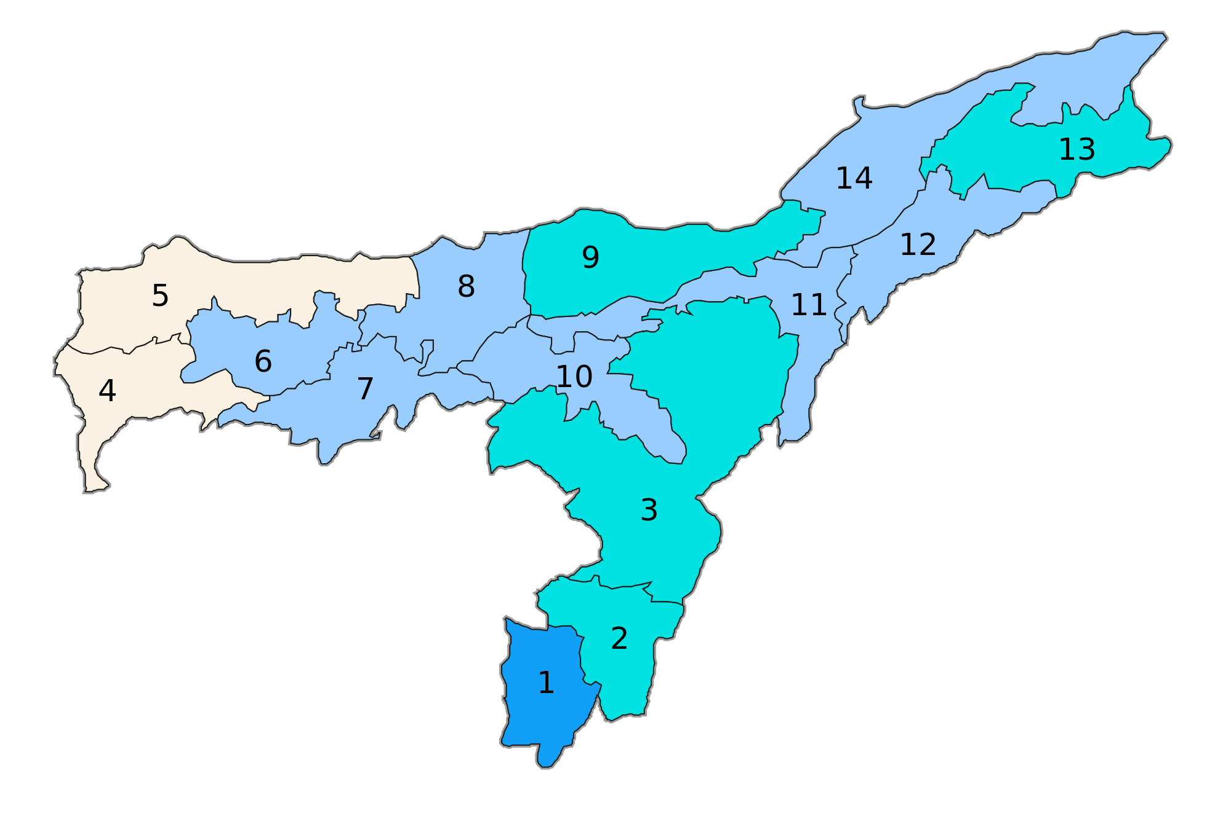
Kernel learning – Multi-task Case
DATA
INFERENCE
$$k$$
For details refer SDM’11, ICML’12

Slide 41
Kernel learning – Multi-task Case
DATA
INFERENCE
Paradigm shift
Multi-task feature learning to multi-task kernel learning
$$k$$
For details refer SDM’11, ICML’12

Slide 42
Kernel learning – Multi-task Case
DATA
INFERENCE
Paradigm shift
Multi-task feature learning to multi-task kernel learning
Generalized to case of unknown task relationships
Few kernels shared by few tasks
Convex formulation and active-set based algorithm
Analysed convergence
$$k_{1}$$
$$k_{2}$$
For details refer SDM’11, ICML’12

Slide 43
Rule Ensemble Learning
For details refer ICML’11, JMLR’15

Slide 44
Rule Ensemble Learning
Posed as kernel learning problem
Convex formulation
Provable bounds on convergence
For details refer ICML’11, JMLR’15

Slide 45
Rule Ensemble Learning
Posed as kernel learning problem
Convex formulation
Provable bounds on convergence
Search for compact rules
Rule is long $⇒$ Descendents are even longer
For details refer ICML’11, JMLR’15

Slide 46
Representation Learning
$$φ\left(x\right)$$
$$x$$
DATA
Training, Inference

Slide 47
Representation Learning
$$φ\left(x\right)$$
Overwhelming choice in representations
$$x$$
DATA
Training, Inference

Slide 48
Representation Learning
$$φ\left(x\right)$$
Overwhelming choice in representations
Data-dependent representation learning
$$x$$
DATA
Training, Inference

Slide 49
Representation Learning - Paradigms
$$φ\left(x\right)$$
Explicit feature learning
Dictionary Learning
Deep Learning
$$x$$
DATA
Training, Inference

Slide 50
Representation Learning - Paradigms
Explicit feature learning
Dictionary Learning
Deep Learning
Implicit feature learning
Kernel learning
$$φ_{k}\left(x\right)$$
$$φ_{k}\left(z\right)$$
$$x$$
DATA
$$z$$
$$k\left(x,z\right)$$
$$\left\langle φ_{k}\left(x\right),φ_{k}\left(z\right)\right\rangle$$
Kernel Methods
$$=$$

Slide 51
Representation Learning - Paradigms
Explicit feature learning
Dictionary Learning
Deep Learning
Implicit feature learning
Kernel learning
$$φ_{k}\left(x\right)$$
$$φ_{k}\left(z\right)$$
$$x$$
DATA
$$z$$
$$k\left(x,z\right)$$
$$\left\langle φ_{k}\left(x\right),φ_{k}\left(z\right)\right\rangle$$
Kernel Methods
$$=$$

