Slide 2
Reflection Spot: Think and Write
Think of one activity that you excel at doing. [~ 1 min]
(Note: Activity could be academics or your hobby)

Slide 3
Reflection Spot: Think and Write
Think of one activity that you excel at doing. [~ 1 min]
(Note: Activity could be academics or your hobby)
Think about why you are so good at this activity [~2 min]
Write down top 3 reasons for your mastery in this activity

Slide 4
Discussion - Excellence
Think of one activity that you feel you excel at doing.
Think about why you are so good at this activity – top 3 reasons
Let me guess - One of your top 3 reasons is likely to be:
Practice or Experience

Slide 5
Discussion - Excellence
Do you feel that you could have gained such mastery by listening to lectures on the topic?
Point to keep in mind:
As learners, we develop mastery through practice (doing activities, rather than simply listening to lectures, or watching demos).
So,
As teachers, we must ensure that we provide our students with practice – sufficient and timely opportunities.

Slide 6
20th Century vs 21st Century Classrooms
In 20th Century
Information was at a premium – No Internet, expensive books, limited access to libraries.
Value for the people who could transmit information, i.e. Teachers
So, students were mostly listeners and note-takers, absorbing information during the lecture, and doing their practice later.

Slide 7
20th Century vs 21st Century Classrooms
In 20th Century
Information was at a premium – No Internet, expensive books, limited access to libraries.
Value for the people who could transmit information, i.e. Teachers
So, students were mostly listeners and note-takers, absorbing information during the lecture, and doing their practice later.
In 21st Century
Information is no longer at premium with internet – lot of accessible materials, devices etc.
Hence, it is not enough for teacher to only transmit information
It is necessary for a teacher to ensure that students are able to assimilate the information, through appropriate practice, during the class itself.

Slide 8
20th Century vs 21st Century Classrooms
In 20th Century
Information was at a premium – No Internet, expensive books, limited access to libraries.
Value for the people who could transmit information, i.e. Teachers
So, students were mostly listeners and note-takers, absorbing information during the lecture, and doing their practice later.
In 21st Century
Information is no longer at premium with internet – lot of accessible materials, devices etc.
Hence, it is not enough for teacher to only transmit information
It is necessary for a teacher to ensure that students are able to assimilate the information, through appropriate practice, during the class itself.
CONTENT-CENTRIC
LEARNER-CENTRIC

Slide 9
How to do learner-centric pedagogy
One way – Active learning techniques.
Students go beyond listening, writing notes, executing prescribed procedures.
Students asked to ‘figure things out’ during class.
Needs attitude shift of teacher:
from content-oriented to learning-oriented.
from “How well am I lecturing?” to “How well are they learning?”

Slide 10
Reflection spot - My lectures are plenty interactive!
I often pause to ask students if they understood the material.
I allow students to interrupt whenever they have doubts.
I never hesitate to answer their questions.
I show them demos and videos.
….
VOTE – Are students doing active learning if teacher does above?
Yes
No (write your vote in the chat window)

Slide 11
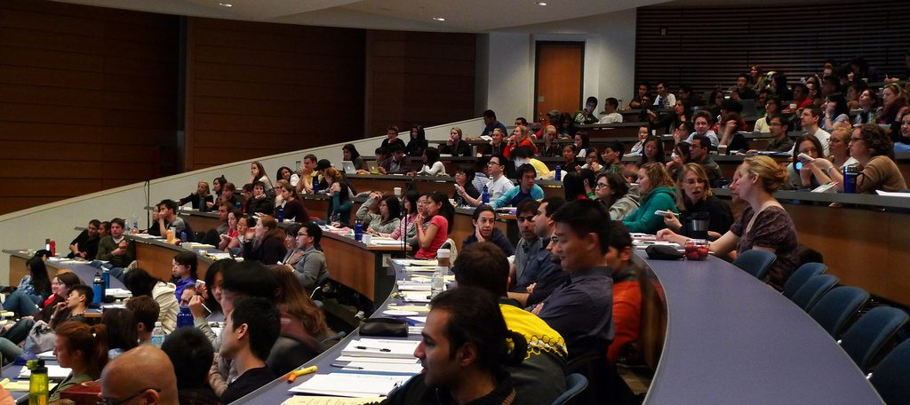
How many students are distracted in your class?

Slide 12
Why interactive lectures may not be enough
Students don’t pay utmost attention throughout the lecture.
Students think that they understand because they can follow the lecture.
- They are not confronted with their misconceptions immediately.
Difficult to ensure that all students in the class participate actively.
Students with high motivation / achievement levels drive the pace.
Students with low achievement levels get left behind.
Students may have a barrier to responding directly to the instructor.
Shy students don’t ask questions, or give answer, even if they have one.
Forcing all students to respond tends to be counter-productive.

Slide 13
So, what are active learning strategies?
Requirements:
Students go beyond listening, copying of notes, execution of prescribed procedures.
Instructor designs activities that require students to talk, write, reflect and express their thinking.
Explicitly based on theories of learning.
Evaluated repeatedly through empirical research.
D. E. Meltzer and R. K. Thornton. "Resource letter ALIP–1: active-learning instruction in physics." Am. J. Phys, 80.6 (2012): 478-496

Slide 14
Peer Instruction (PI) technique
Download the PI-activity-constructor resource sheet from:
Download from www.et.iitb.ac.in/TeachingResources.html
Ask Question
(May vote individually)
…Lecture…
Debrief /
Class Discussion
Peer Discussion
Vote

Slide 15
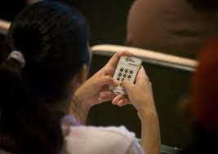
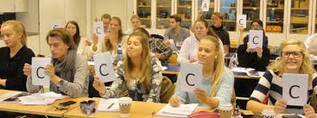
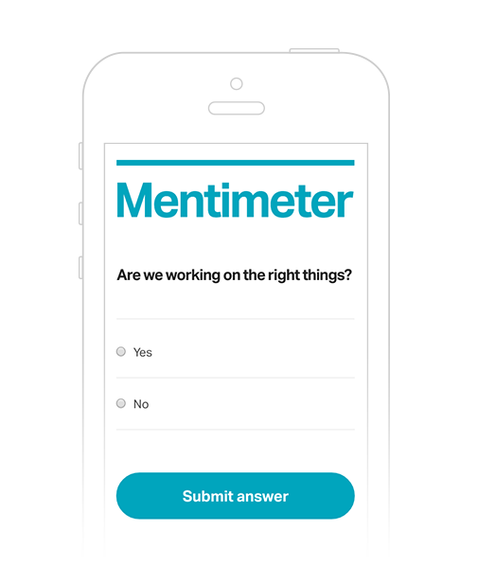
Peer-Instruction implementation
https://youtu.be/wont2v_LZ1E
https://cwsei.ubc.ca/resources/instructor/prs
Crouch, C. H., & Mazur, E. (2001).
Peer instruction: Ten years of experience and results. American journal of physics, 69(9), 970-977.
www.mentimeter.com

Slide 16
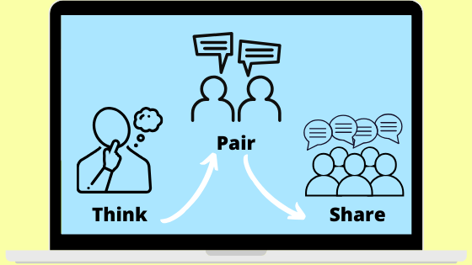
Think-Pair-Share (TPS) technique
Download the TPS-activity-constructor resource sheet from:
Download from www.et.iitb.ac.in/TeachingResources.html

Slide 17
TPS implementation
T (Think): Teacher poses a specific question about the topic. Students "think" and write their own individual answer.
Example: How will you sort a given set of numbers?
P (Pair): Teacher gives a task related to the one in previous phase. Students “pair” with a neighbor to perform the task.
Example: Discuss pros-cons of each others’ sorting solutions.
S (Share): Students share their thinking (or solution) with the class. Teacher facilitates a discussion on the topic.
Example: Discussion on different types of sorting algorithms.

Slide 18
Reflection Spot - TPS for your topic
Write a question that you could use for TPS in your next class; post your response on chat.
Some audience responses:
Pose a question with a non-conventional answer. Pair them to discuss the obvious and non-obvious answer and share.
One slide pitch to potential investors for their startup.
Linear algebra: Give one or two vectors with say 5 elements each and ask them to state dimension of the space spanned by the vector.
Suggest a signal frequency that might not lead to a periodic signal.
What are the possible failure modes of a system? This question would have many answers.

Slide 19
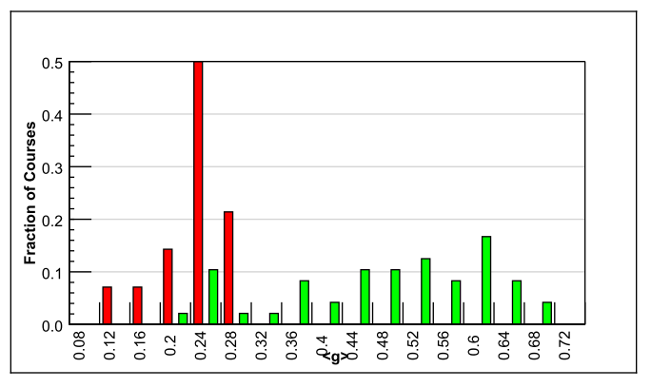
Evidence for active learning – 1
Comparative study of 62 Physics courses (1998)
6542 students
Variety of institutions: high school, college, university
Test of conceptual reasoning – Force Concept Inventory
Pre-post, semester long
Trad lecture (14)
Active learning strategies (48)
Normalized gain
<g> = ^{post-pre} ^{100-pre}
IMPLICATION
Desirable to explicitly incorporate active learning strategies in our teaching-learning.
RESULTS:
Maximum gain from lecture courses was 0.28
- Many instructors had high scores on teaching evaluations
Gain from active-learning courses had a wide range: 0.23-0.7
- AL courses had gains 2-3 times greater than lectures
R. Hake, “Interactive-engagement versus traditional methods: A six-thousand student survey of mechanics test data for introductory physics courses” Am. J. Phys., 66 (1998)

Slide 20
Evidence for active learning – 2
Proc. Natl. Acad. Sc, 111(23), 2014
Meta-analysis of 225 studies (2014)
Exam performance: higher by 0.47 standard deviations in active learning courses– ~ 1/2 letter grade average increase.
Failure rates : 33.8% in traditional classes vs 21.8% in active learning courses
Results hold across STEM disciplines, majors and non-majors, lower- and upper-division courses.

Slide 21
Evidence for active learning – 3
https://dl.acm.org/doi/pdf/10.1145/2493394.2493408
https://dl.acm.org/doi/pdf/10.1145/2591708.2591739

Slide 22
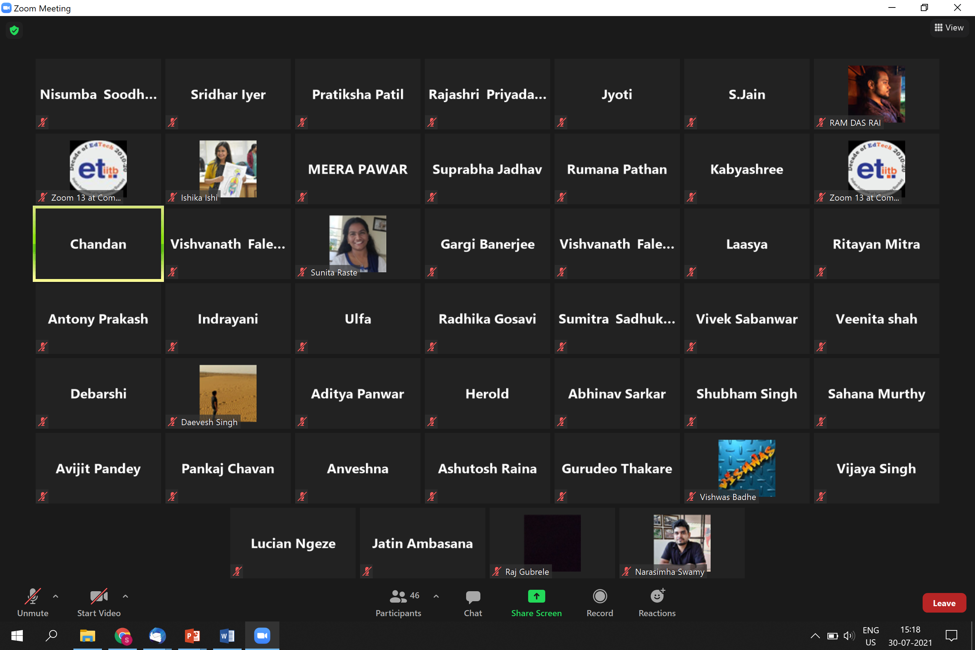
But my class looks like this now!

Slide 23
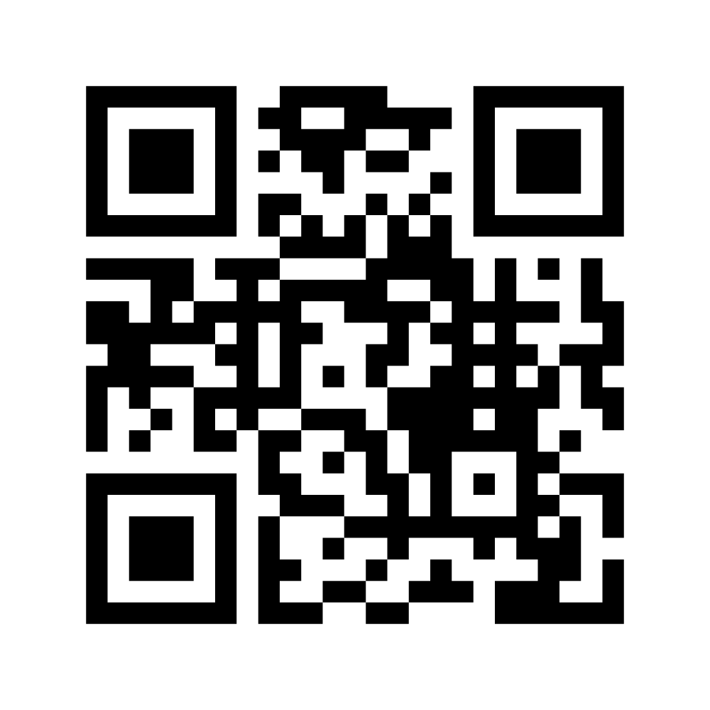
Reflection Spot - Interactivity in online mode
You might have attended different talks, webinars, interaction sessions in the last 1 year. And, on different video conferencing platforms such as Zoom, Webex, Google Meet, MS Teams etc.
List your top 2-3 features of such platforms which you think are effective for live interactions
Go to www.menti.com and use the code 2303 8052
Notes:
Looking at learners/camera
2. Instructor

Slide 24
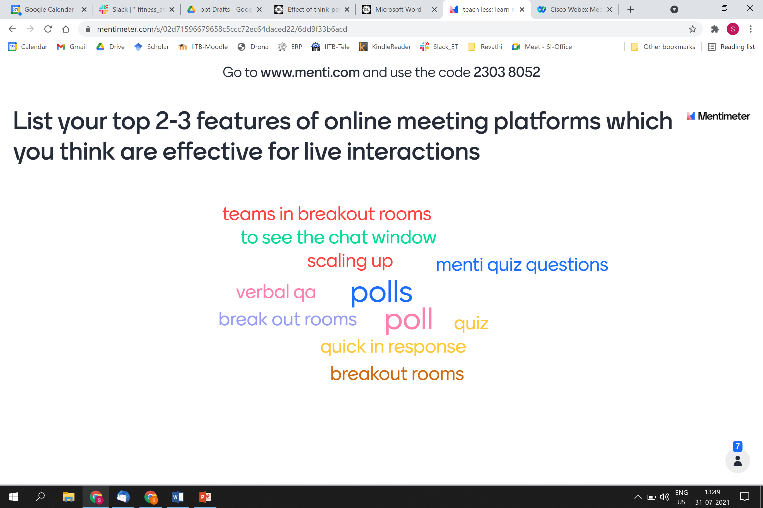
Reflection Spot - Interactivity in online mode
Screenshot of responses
Discussion
Notes:
Looking at learners/camera
2. Instructor

Slide 25
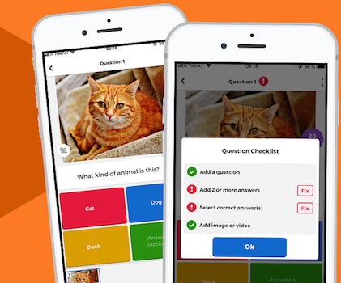
PI - online
Within your class meeting platform – Zoom, Teams, …
Create a poll and ask students to vote
Ask students to discuss with a friend (say using WhatsApp)
Ask students to vote again for the poll
Other tools
Mentimeter
Kahoot
…

Slide 26
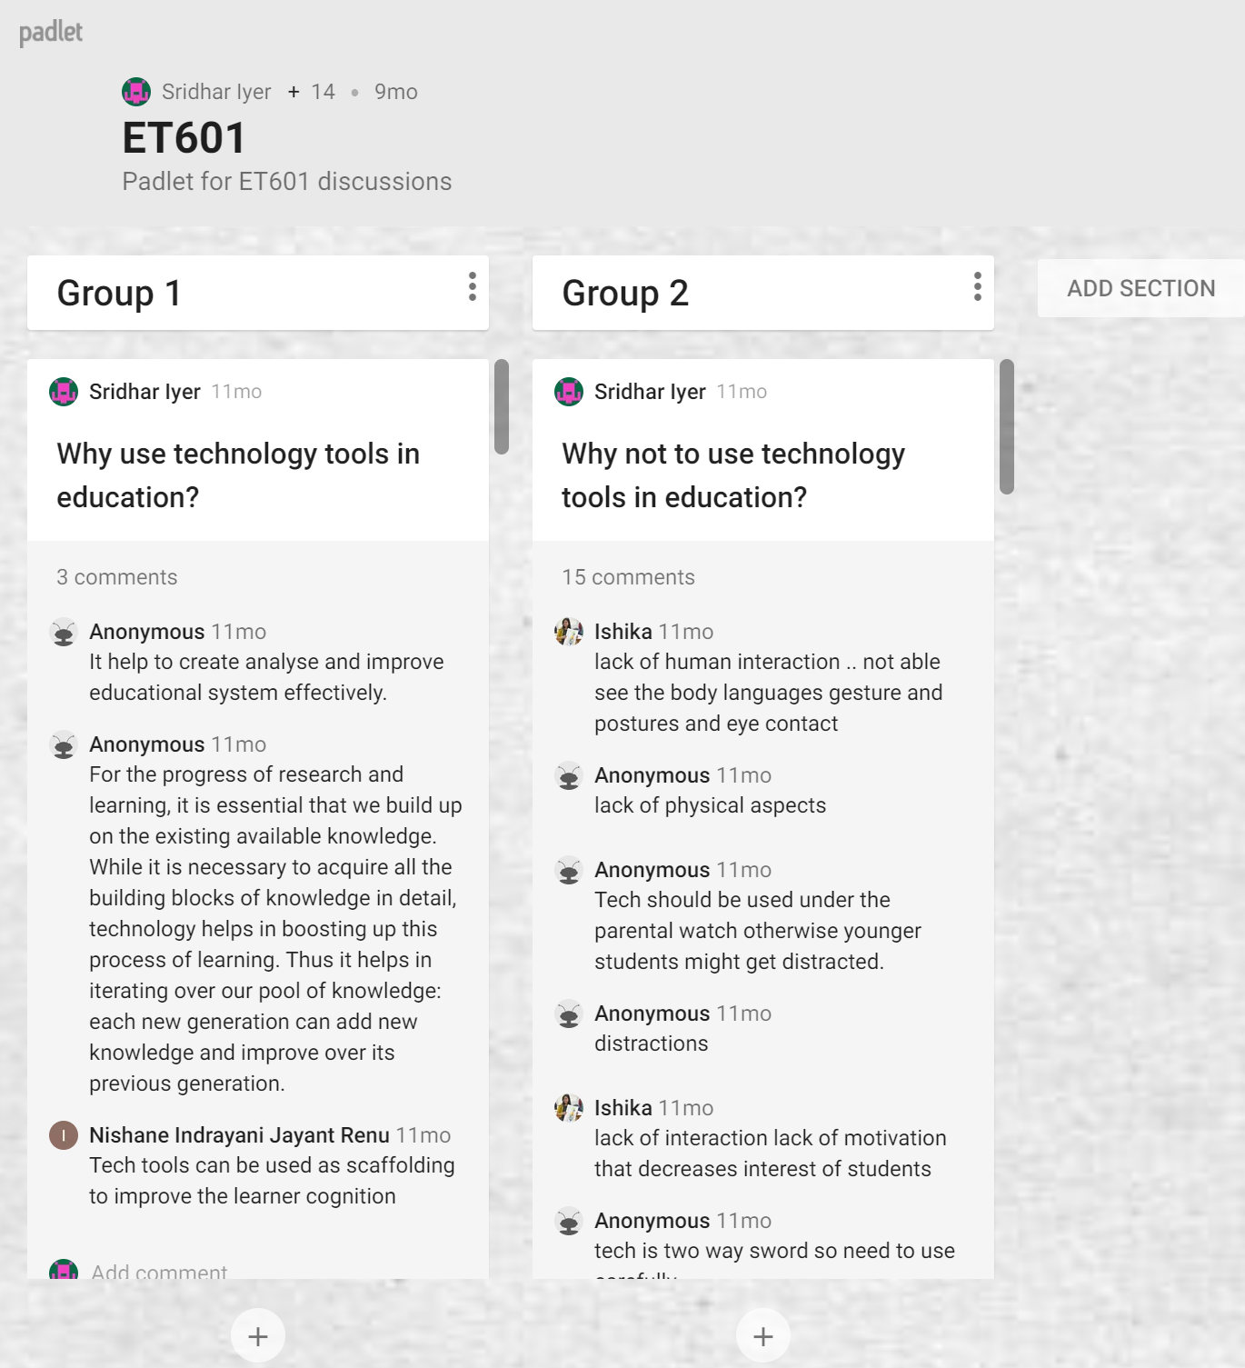
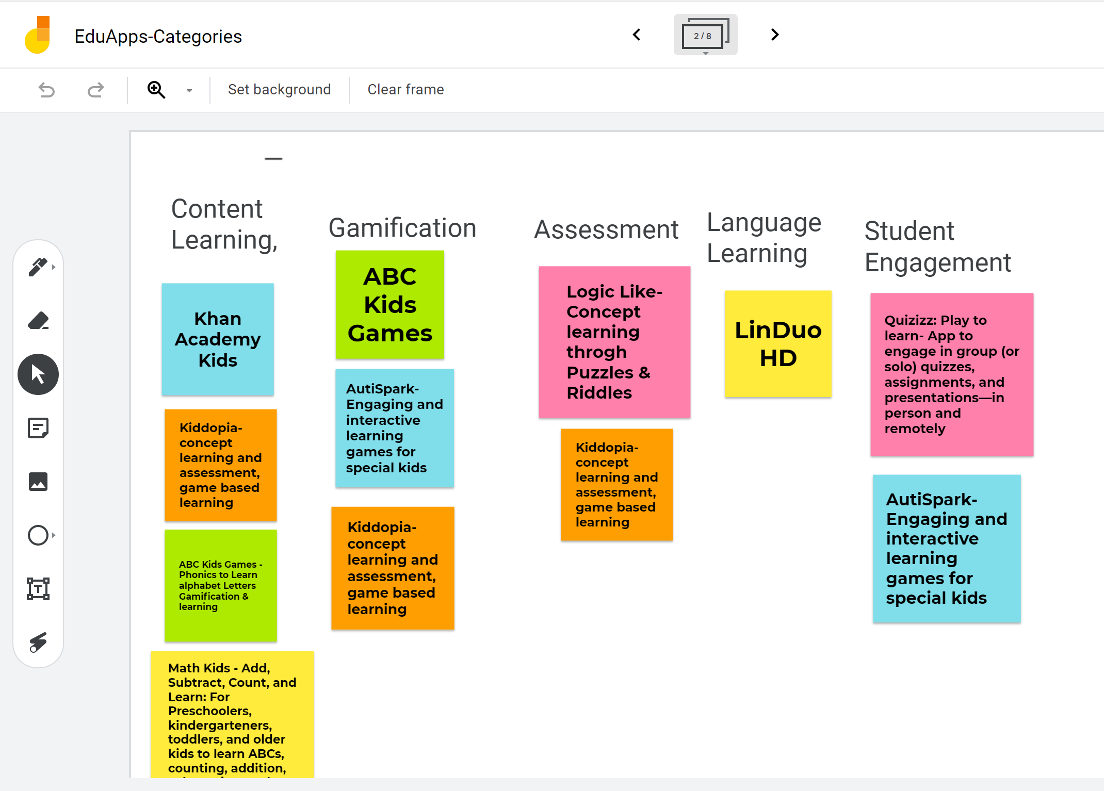
TPS - online
Within your class meeting platform – Zoom, Teams, …
(T): Ask students to write their response on chat; (P): Discuss with a friend using phone; (S): Speak in some order.
More structured way - use the breakout rooms feature.
Other tools
Padlet
Jamboard
…

Slide 27
Some more strategies for effective online mode
End session by asking learners to post muddy points on chat
Address these on course platform by providing supplementary materials, if possible
Ask TAs to write summary of the key points for those who were unable to join and post
Follow up with Learning by Doing (LbD) activities
Video Conferencing Software
LMS

Slide 28
Example – ET 617
I am teaching Educational App Design this semester.
In my last class (1.5 hours slot, two days ago), I had:
Six voting questions to be answered – ‘Is this an educational app?’ to elicit prior conceptions.
One Google Form to be filled – Categorize the ten educational apps described in a video.
One chat response question – ‘Each-one-say-one’ for *must have* features in an educational app.
One Jamboard collaborative activity – Evolve a taxonomy.
Less teaching; more learning

Slide 29
Example – ET 617 - screenshots

Slide 30
Takeaway
Make students grapple with content during class.
Don’t only clarify doubts:
Provide frequent opportunities for learners to work with the content – Active learning.
Ensure immediate and appropriate feedback to learners – Peer discussion.
Active learning techniques:
Peer Instruction: Don’t keep MCQs for the exam, make students do them during class.
Think-Pair-Share: Don’t just lecture, make students do something first.

Slide 31
Principles for online teaching
LeD
Six principles
LbD
LxI
One slide on each
Notes:
Principles are not sacrosanct. They are recommendations for effective student learning.
Some terminology will be introduced. Please refer www.lcm-model.org for details.

Slide 32
Principle #1
Curate before you create
Notes:
There is a lot of good content already available. Don’t re-invent, instead re-purpose.

Slide 33
Principle #2
Keep videos short
Insert in-video reflection spots
LeD: Short content video + Reflection spot
Notes:
Don’t do long lectures. Instead chunk them into multiple LeD.

Slide 34
Principle #3
Give practice opportunity,
immediately and frequently
Give feedback to learn
LbD: Activity + constructive customized feedback
Notes:
Split your homework into a few chunks, corresponding to your LeDs.

Slide 35
Principle #4
Provide diverse resources to cater to different learners
and incentivize the access to resources
Notes:
Give an explanation

Slide 36
Principle #5
Leverage peer-learning to bring in diverse perspectives and solutions, discover additional resources
and avoid isolation issues
LxI: Discussion anchored around focus question, incentivized with Reflection Quiz
Notes:
Give an example here

Slide 37
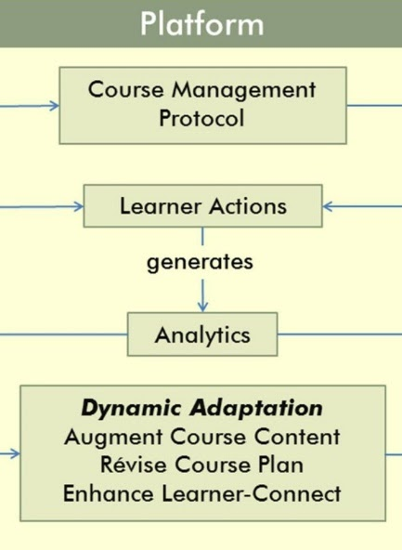
Principle #6
Orchestration dynamics:
Respond to student actions in a timely and appropriate manner
Adapt based on student actions if possible
Notes:
See how they are doing in the course, what they are saying in the discussion forums.
Adapt instruction, Recognize participation.

Slide 38
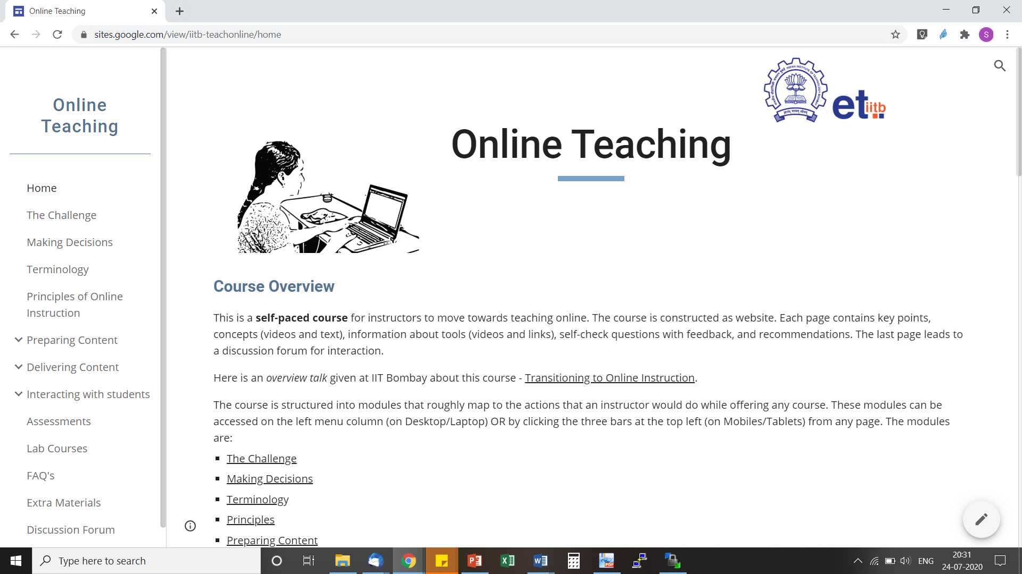
More details
Online Teaching Self-paced course developed at IIT Bombay
https://sites.google.com/view/iitb-teachonline/

Slide 39
Questions, Concerns, … from audience
How do I balance between knowledge dissemination and the active learning component?
Is it advisable to pose a question to a particular student (by name) in online mode? Instead of directing it to the whole class.
How do you ensure that all students participate and there is fair in-class grading if they complain of connectivity challenges?

Slide 40
Thank you
For other such talks,
Go to my webpage, then click on Talks
Educational Technology, IIT Bombay: www.et.iitb.ac.in
This presentation is released under Creative Commons-Attribution 4.0 License. You are free to use, distribute and modify it, including for commercial purposes, provided you acknowledge the source.

