Slide 2
Acknowledgements
Co-instructor of the course iitb-teachonline - Prof. Sahana Murthy
TAs of iitb-teachonline – Ashutosh Raina and Lucian Ngeze
Co-creators of LCM model – Sahana Murthy, Sameer Sahasrabudhe, Jayakrishnan M.
Post-docs on LCM – Gargi Banerjee, Veenita Shah, Mrinal Patwardhan
Tutorials on Tools – Yogendra Pal, Kameswari Chebrolu, P Sunthar, Bhaskaran Raman, Kannan Moudgalya, Santosh Noronha

Slide 3
Educational Technology, IIT Bombay
Inter-Disciplinary Program, started 2010
5 Core faculty
Associate faculty from other departments
2 Post-docs
25 PhD research Scholars; 12 PhDs graduated
Started an M.Tech program in 2019
www.et.iitb.ac.in

Slide 4
What we do in Educational Technology?
Adaptive and
Personalized
Tutoring Systems
Virtual Reality
Pedagogy & Technology for individual and collaborative learning
Augmented
Makerspace
MOOCs
Games
Learning environments
Eye Tracking
Analytics
Assessment

Slide 5
What do we do? – At a glance
Research:
TELoTS: Technology enhanced learning of thinking skills
TUET: Teacher use of educational technologies
EDA: Educational data analytics
EmergE: Emerging technologies
Development:
MOOCs: Massive open online courses – IITBombayX
Trained 5000+ college teachers, 5000+ school teachers
Handbooks: Resources for ET researchers and teachers
RMET, LOBE, …
Tools: To support teaching-learning process
iQuE, iSAT, CuVIS, …
Consultancy
Outreach
Sponsored Projects
Sponsored Research Labs

Slide 6
Online instruction

Slide 7
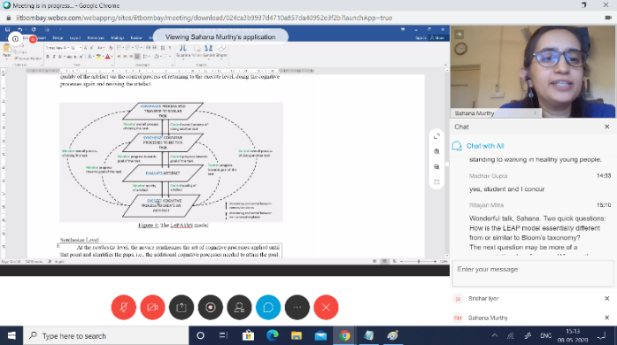
Face-to-Face vs Online classes
Course Materials
60%
70%
40%
30%
Notes:
Online typically involves flipping the classroom.
Make the material available to students; Let them go through it as per their convenience; Do a live interaction

Slide 8
Activity 1 – Each one say one
Your colleague says that for online instruction it is sufficient to give live lectures over a video conferencing software (such as Zoom), record the lecture and upload it somewhere. Students who were unable to attend the lecture can view the recording.
What are some problems with this approach?
Post your response in the chat window.

Slide 9
Problems with virtual classrooms
Consider from students’ point of view
Access issues
No smart phone
Shared device
Lack of flexibility in schedule
Power, Network
2) Hour-long lecture, and over a screen – engagement?
Notes:
The connectivity, access and affordability for internet varies widely in our country.
Do not assume that students have the same access as you do, or that it is uniform for all students.
Conduct a survey for your class/institute and get to know your local context/reality.

Slide 10
Problems with recorded virtual classrooms
Uploading recordings of live sessions may be useful
Not sufficient because
Glitches in recordings (voice break, frozen frame) – lose student attention
Many students study for the test - even short lectures (~10 min) are not watched fully by most; high variability in student motivation
Network bandwidth issues – connectivity, mobile data plan
Lecture alone not enough – need activities for deeper engagement
Notes:
There is a lot of data and studies to support the above points.
Highly motivated students will find ways to attend virtual classroom, persevere through glitches in recordings.
What percentage of your class falls in this category?

Slide 11
Emergency remote teaching
Giving a lecture in a virtual classroom + Uploading its recording, is a form of emergency remote teaching (ERT)
Primary objective of ERT - provide temporary access to instruction and instructional material in a manner that is quick to set up and reasonably easy to access, during an emergency
Typically, ERT attempts to mimic the actions in a face-to-face class
ERT is likely to be ineffective for student engagement and learning
This mode should be used sparingly (< 20% of the course)
Notes:
Use of remote teaching to deliver instruction that would otherwise be done face-to-face, is not wrong.
ERT is likely to be ineffective for student engagement and learning.

Slide 12
Problems with emergency remote teaching
Miss out on necessary aspects of “good” teaching
Interaction
with students
Adapting instruction in real-time
Responding to student actions
Meaningful discussion

Slide 13
Data on student and instructor preferences
Results from a pan-IIT survey of instructors and students
840 instructors and 11,890 students participated
Synchronous virtual classroom vs Asynchronous materials
Full report available at - https://arxiv.org/abs/2007.03613
Mode of delivery | Instructor | Student
Only Synchronous | 47% | 20%
Only Asynchronous | 14% | 28%
Both mode | 40% | 55%

Slide 14
Data on resources to access internet
Only 62% students have access to laptops/desktops
Out of remaining 38%, 33% have access to smartphones
Smartphones are challenging to complete assignments, projects, etc
Only 20% students have stable and good quality internet
80% students use 3G/4G services - Non-stable
One hour of recorded video can be ~100 MB
Full report available at - https://arxiv.org/abs/2007.03613

Slide 15
Online instruction
The goal is to exploit the power of the online medium and utilize it to promote effective student learning
Notes:
Attempting to mimic classroom actions in the online medium is not the goal.

Slide 16
Online instruction involves
Making course materials available for asynchronous access
Giving immediate practice activities and timely feedback to students
Conducting synchronous meetings to address queries and do tutorials
Providing a forum for learners to discuss the content with each other and the instructor
Course Materials

Slide 17
Activity 2 – Self-select your level
As an instructor, which aspects of online instruction do you feel concerned about, if any? Tick all that apply.
Making videos
Time required to prepare for each class
Using the online platform (like Moodle features)
Interacting with students synchronously (like Zoom meetings)
Doing online assessments
Having to use technologies in general
Go to www.menti.com and enter code 46 50 65

Slide 18
What does Online Instruction involve?
Content creation or curation
Upload & share content
Design activities, provide
resources
Interact with students
Assess- ment

Slide 19
Concepts overview
LeD
LbD
LxI
Six principles
One slide on each
Notes:
Principles are not sacrosanct. They are recommendations for effective student learning.
Some terminology will be introduced. Please refer www.lcm-model.org for details.

Slide 20
Principle #1
Curate before you create
Notes:
There is a lot of good content already available. Don’t re-invent, instead re-purpose.
Curation is also a creative activity.
Check institute policy regarding percentage of a course that can be covered using curated materials.

Slide 21
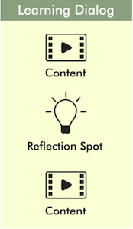
Principle #2
Keep videos short,
and insert reflection spots
Notes:
Don’t do long lectures. Instead chunk them into multiple LeD.

Slide 22
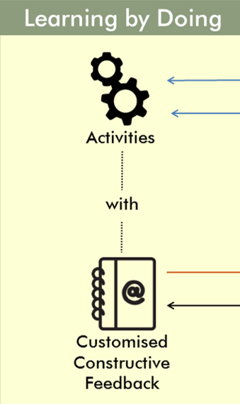
Principle #3
Give practice opportunity,
immediately and frequently,
and give feedback
MCQs, short answer
Objective/Subjective
Notes:
Split your homework into a few chunks, corresponding to your LeDs.

Slide 23
Principle #4
Provide diverse resources to cater to different students,
and incentivize the access to resources
Notes:
Give an explanation

Slide 24
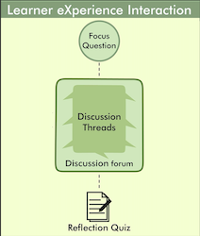
Principle #5
Leverage peer-learning,
to bring in diverse perspectives and solutions,
discover additional resources,
and avoid isolation issues
Notes:
Give an example here

Slide 25
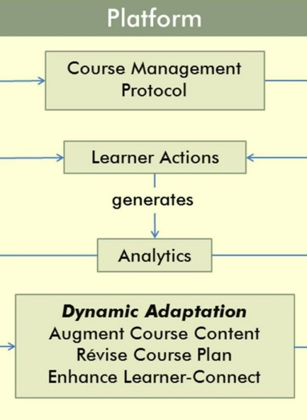
Principle #6
Respond to student actions, in a timely and appropriate manner
Notes:
See how they are doing in the course, what they are saying in the discussion forums.
Adapt instruction, Recognize participation.

Slide 26
The LCM model – operationalizes the principles
www.lcm-model.org
Clarification
Discussions
Lectures
Focus question for discussion + Peer interaction + Reflection Quiz
Learner Experience Interaction
Content + Reflection Spot
Learning Dialogs
LxI
LeD
Orchestration
Additional readings
Self-study material
LxT
LbD
Homeworks
Assignments
Practice problems
Learning Extension
Trajectories
Activities + Customized Feedback
Resources + Assimilation Quiz
Learning
by Doing

Slide 27
Transitioning to online - Conceptual summary
Your face-to-face course:
Lectures and Notes
Homeworks, Assignments
Additional Readings
Interesting Debates, Discussions
Proctored Exams
Your corresponding online course:
LeD – chunk each lecture into sections and include reflection spot in each chunk
LbD - chunk each homework into sections corresponding to each LeD and include immediately
LxT – close the loop for additional readings with an Assimilation Quiz
LxI - Give focus questions for discussions and close the loop with Reflection Quiz
Depends on technology and policy
Notes:
Ungraded Assessments can be done using LbD – Give practice questions with self-evaluation rubrics
Graded Assessments can be done using LbD – Give points for each question
Graded Assessments can be done using LxT and LxI – Give points for Assimilation Quiz and Reflection Quiz

Slide 28
Technologies overview

Slide 29
Hardware resources
Capturing lectures
Camera/ webcam
Headphone/ Earbuds
Tablet / Paper
Recorder/ Mobile phones
Editing lecture videos
Laptop/ Desktop
Uploading videos
Server space
Internet (bandwidth)
Institutional Resources
Studios (Recording)
CDEEP (ones used for f2f class)
Smaller studios (offline recording)
Platform (LMS)
Peak load calculations
Server size, Internet bandwidth
Meetings (Live interaction online)
Internet bandwidth, Software licenses

Slide 30
Software resources
Purposes and corresponding technologies
Creating Content
Video creation – Examples: OBS, Screen recorder, Zoom
Activity creation - Examples: Moodle, Mentimeter, Padlet
Delivering Content
Platform – Examples: BodhiTree, IITBombayX, Moodle
Video hosting – Examples: YouTube, Drive, KPoint
Live interaction – Examples – Zoom, Meet, BigBlueButton, WebEx
For details of technologies visit the course page - iitb-teachonline
Notes:
Talk about criteria for choosing technology

Slide 31
Technology Tools: Content Creation

Slide 32
Content creation involves
Content creation or curation
1
2
3
Video recording
Video editing
Planning of Video recording
Preparing content, e.g. PPT/PDF presentation
Identifying chunks
Deciding video format

Slide 33
Activity 3 – Quick Poll
Specific to your course:
In which of the following ways you will be mostly required to teach the course topics in online mode?
Presentation using slides
Looking at learners
Writing/Sketching on a Digital Whiteboard
Presenting while looking at the learners
Writing/Sketching while looking at learners
Some combinations of the above options

Slide 34
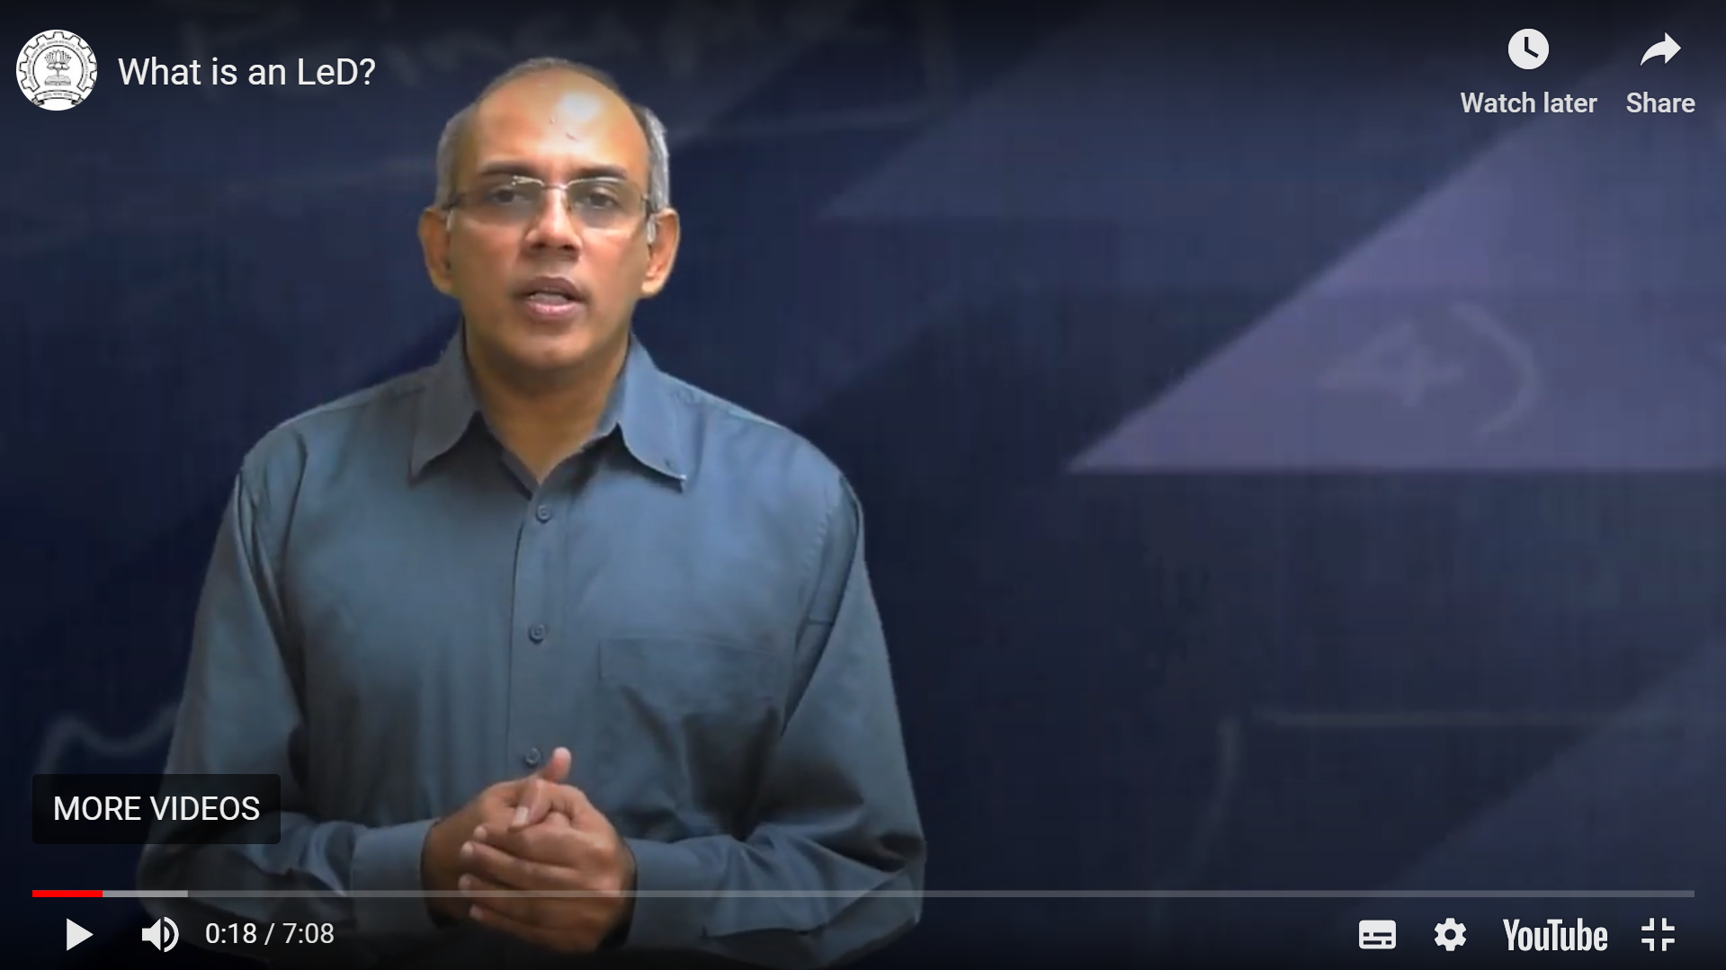
Recommended formats for videos
Presentation using slides: Slidecast
Looking at learners:
Talking Head

Slide 35
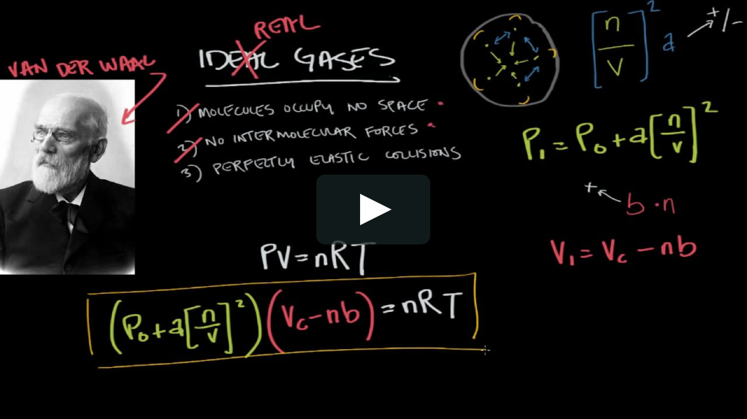
Recommended formats for videos
Writing on a Digital Whiteboard:
Screencast
Presenting while looking at the learners: Pic in Pic

Slide 36
Recommended formats for videos
Writing while looking at learners: Pic in Pic
Talking head → Screencast → Pic in Pic: Transitions
Instructor

Slide 37
Video recording involves
Content creation or curation
1
2
3
Video recording
Video editing
Planning of Video recording
Identifying resources - hw & sw
Selection of video recording tool/software
Recording

Slide 38
Summary - Video format and resources
Video format | Resources (Hardware + Software) | Video Type
Presentation using slides | Laptop (Audio) + PPT File | Slidecast
Looking at learners | Camera Laptop (Webcam + Audio) | Talking Head
Writing on a Digital Whiteboard | IPad Screen + Writing Software Laptop (Audio) + Writing Software | Screencast
Presenting while looking at learners | Laptop (Webcam + Audio) + PPT File | Picture in Picture
Writing while looking at learners | Laptop (Webcam + Audio) + Writing Software IPad (Screen + Webcam) | Picture in Picture
Notes:
This is a summary

Slide 39
Video recording tools/software
Slidecast/Screencast
Screen recorder - Xbox Game Bar, FlashBack Express, QuickTime player (Mac), RecordMyDekstop (Linux)
Talking head
Webcam, Smartphone, Tablet
Pic in Pic
Screen recorder - FlashBack Express, Screencast-o-matic
Transitions - Talking head → Screencast → Pic in Pic
Lot of post processing - Trimming, Joining, Removing unwanted pieces
OBS (Open Broadcaster Software) Studio
Notes:
This is for infomation

Slide 40
Video editing involves
Content creation or curation
1
2
3
Video recording
Video editing
Planning of Video recording
Trim, Slice or Merge
Add/Remove pauses
Add/Remove graphics, transitions
Insert in-video activities
Export videos

Slide 41
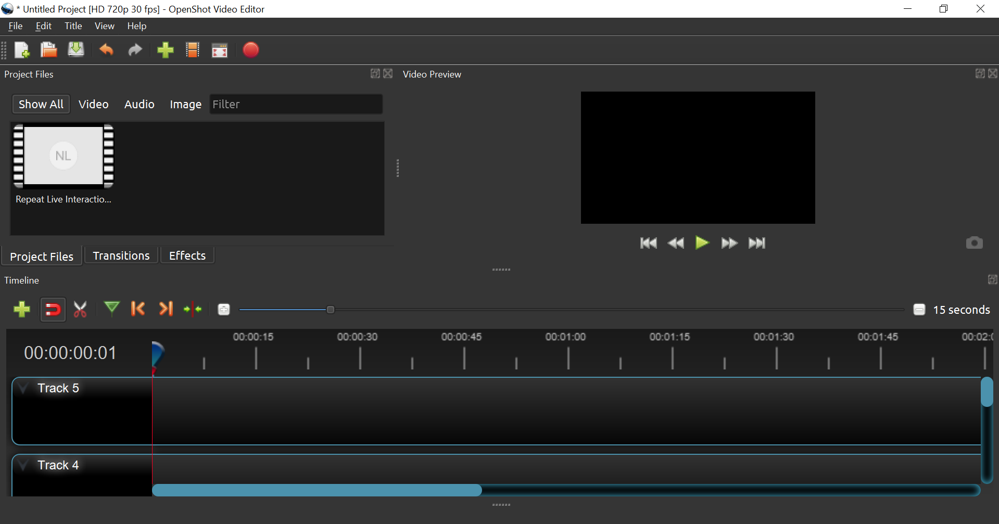
Video editing -(e.g. OpenShot)
- Trim, Slice, Merge - Add/ remove pauses - Add/ remove graphics - Include transitions - Export videos
Video Preview
Drag and drop
Tools
Timeline

Slide 42
Insert in-video activities / quizzes (e.g. using H5P)
Why?
Make videos interactive
Engage students in content
Quick practice & check within video
How?
Use tool like H5P during editing
Or use slide during recording and ask students to pause
Terminology
Reflection Spot (in video activity)
Learning Dialogs (interactive video)

Slide 43
Technology Tools: Uploading & Sharing

Slide 44
Uploading and sharing content involves
Content creation or curation
Upload & share content
Design activities, provide
resources
Interact with students
Assess- ment
Identifying video hosting platform
Identifying sharing platform

Slide 45
Quick clean & upload
Trim the video, chunk if required, remove any long pauses
Export videos; compress if required (Handbrake)
Upload on video hosting platforms like YouTube:
Public vs Unlisted vs Private

Slide 46
Sharing content
Sharing platform: Moodle or other LMS, Google Sites, BodhiTree, …..
Embed videos from Youtube, Vimeo
Write wrappers
Embed quizzes / activities
Notes:
Some sharing platforms - Vimeo - No Ads - No distraction

Slide 47
Technology Tools: Creating activities

Slide 48
Creating activities involves
Content creation or curation
Upload & share content
Design activities, provide
resources
Interact with students
Assess- ment
Creating activities for immediate and frequent practice
Providing feedback on student responses
Providing diverse resources

Slide 49
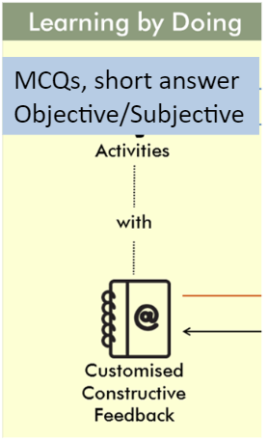
Learning by Doing (LbD) activities
Recommendations
Don’t push all LbD activities to the end to module
Intersperse them between videos
Give feedback -
Customized to MCQ options
Using rubrics for long answers, problems

Slide 50
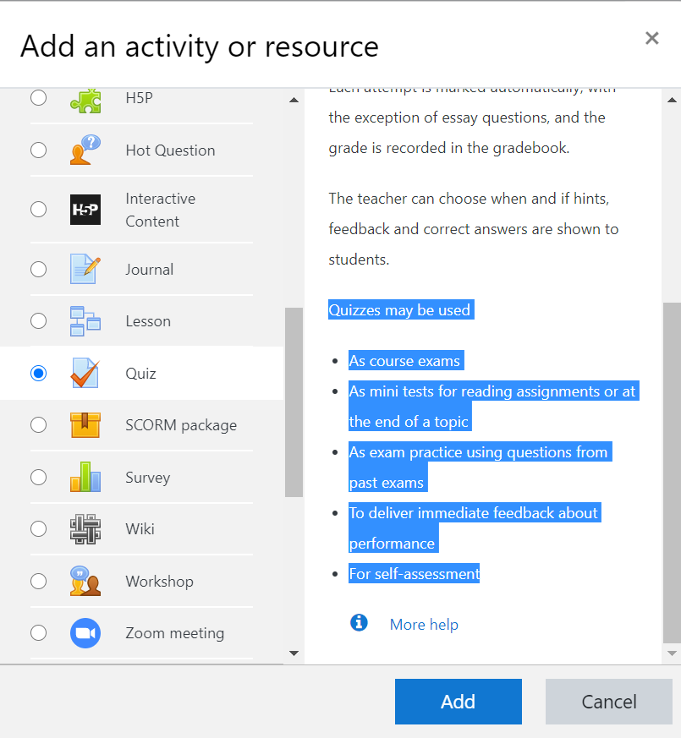
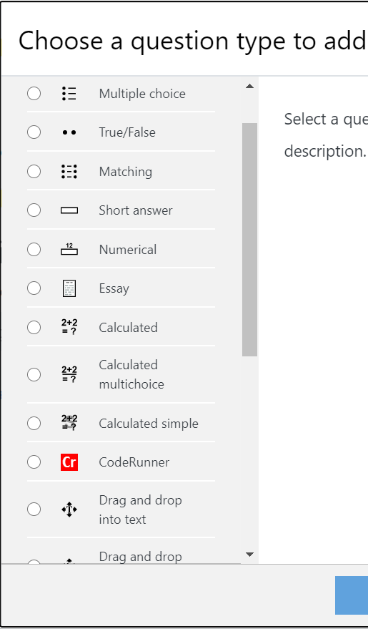
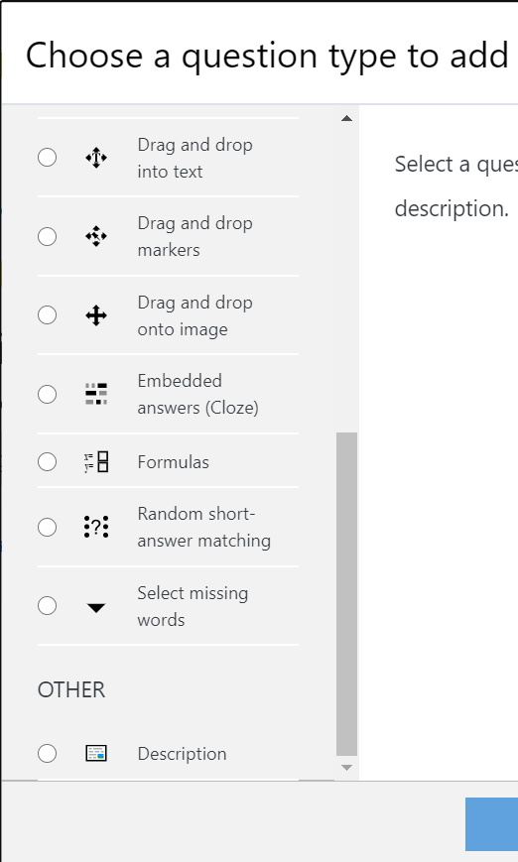
Activities on Moodle - Example
Notes:
Types of LbD activities - After every LeD - Demo - E.g. LCM MOOC
Multiple Choice Quizzes
Short Answer Questions
Open Ended Questions

Slide 51
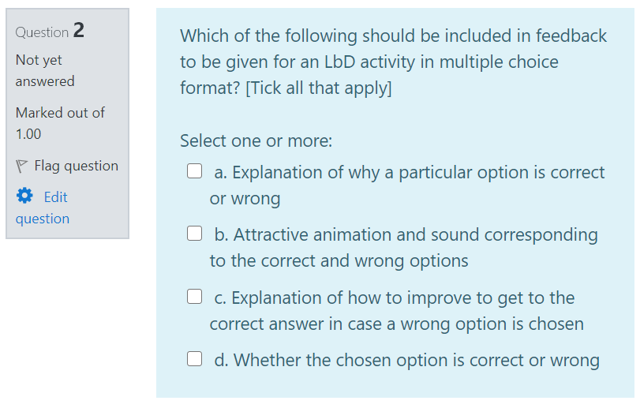
LbD Activity - Assimilation quiz: Giving customized feedback

Slide 52
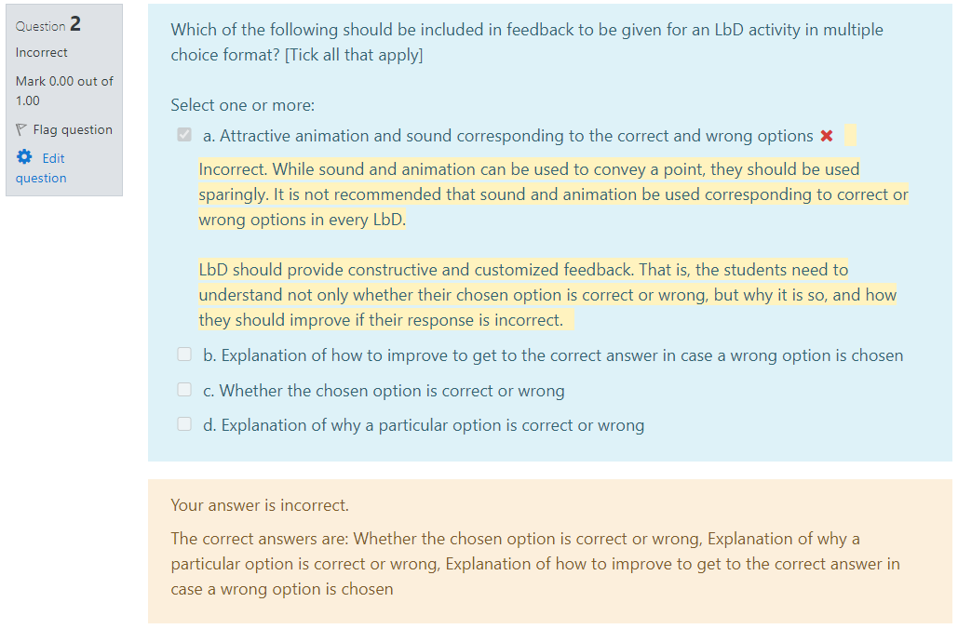
LbD Activity - Assimilation quiz: Giving customized feedback

Slide 53
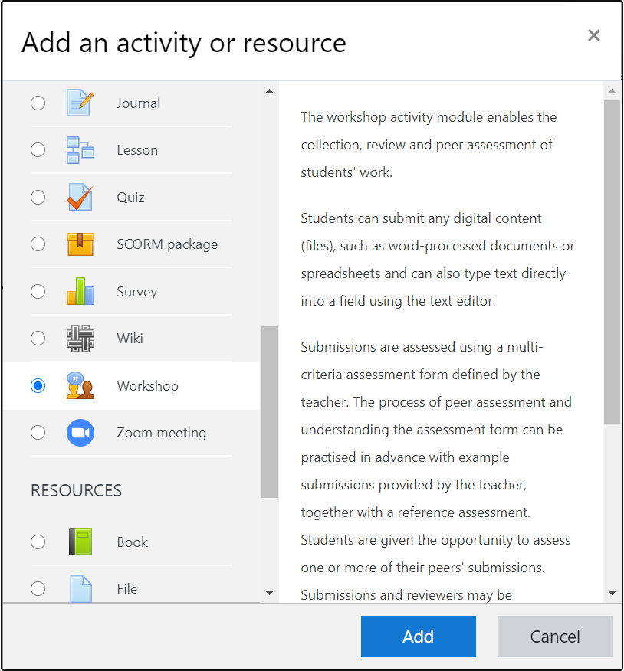
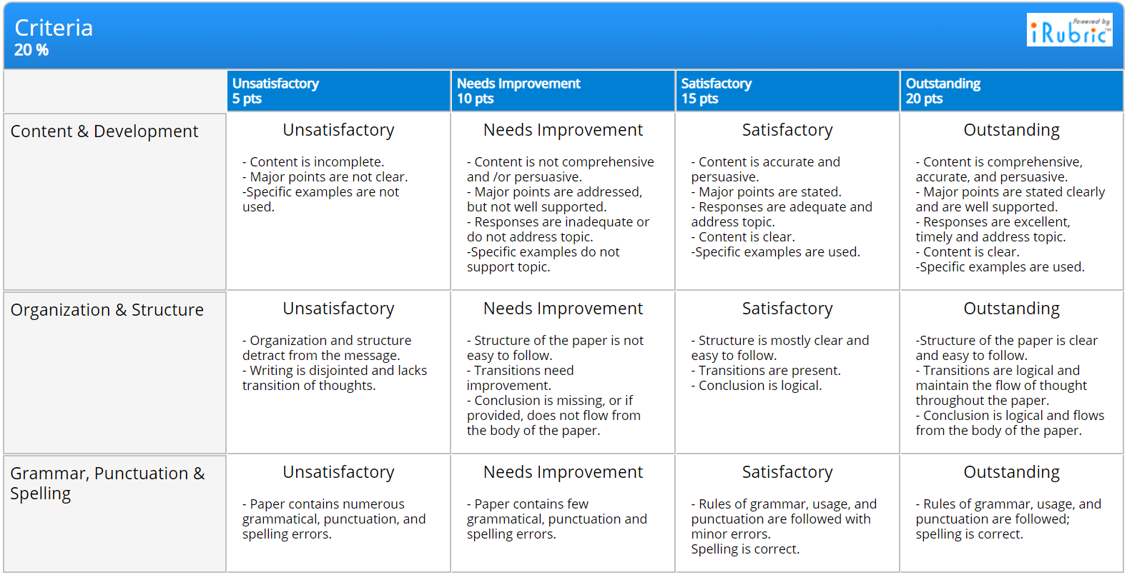
LbD Activities on Moodle - Example
Rubric for grading student responses to open ended questions - Grading criteria
Set of criteria
Description of performance levels

Slide 54
Technology Tools: Interacting with students

Slide 55
Interacting with students involves
Content creation or curation
Upload & share content
Design activities, provide
resources
Interact with students
Assess- ment
Conduct live interactions
Facilitate meaningful discussions in Forums
Set up Muddy points forum

Slide 56
Conducting live interactions
Online platform - Meet students synchronously
Establish personal connect with students
Only asynchronous interaction - May lead to isolation and disinterest
After giving students enough time - asynchronous materials
Live interaction is useful to address their doubts
Get feedback on content
Address questions systematically or do a tutorial (TAs/Instructor)
Ask students to post their questions in advance

Slide 57
How not to do live interactions?
Do not use it as primary mode of delivering content: Caution!!
Using it as ‘substitute’ for f2f is not effective
Access issues
Student engagement - Attention span, Distraction
Live lecture + Recording + Make it available to students
Large file size
No activities to actively engage students
Mantra! Not too many, Not too little - Do it periodically

Slide 58
Effective live interaction - Strategies and technology tools
Have a moderator
Chat, Hand raise, Poll (Yes/no questions, Thumbs up/down)
Encourage students to speak up or participate
Gather feedback from students
End by asking students to post muddiest points on chat
Address these on course platform by providing supplementary materials, if possible
Ask TAs to write summary of the key points for those who were unable to join
Video Conferencing Software

Slide 59
Effective live interaction - Strategies and technology tools
Mentimeter
Ask different types of questions or do activities during live interaction to
Encourage students to participate
Get an idea about students’ progress with asynchronous materials
Gauge in real time students’ level of understanding/ misconceptions
What types of questions?
MCQs, Yes/No, Polls, Word Cloud, …

Slide 60
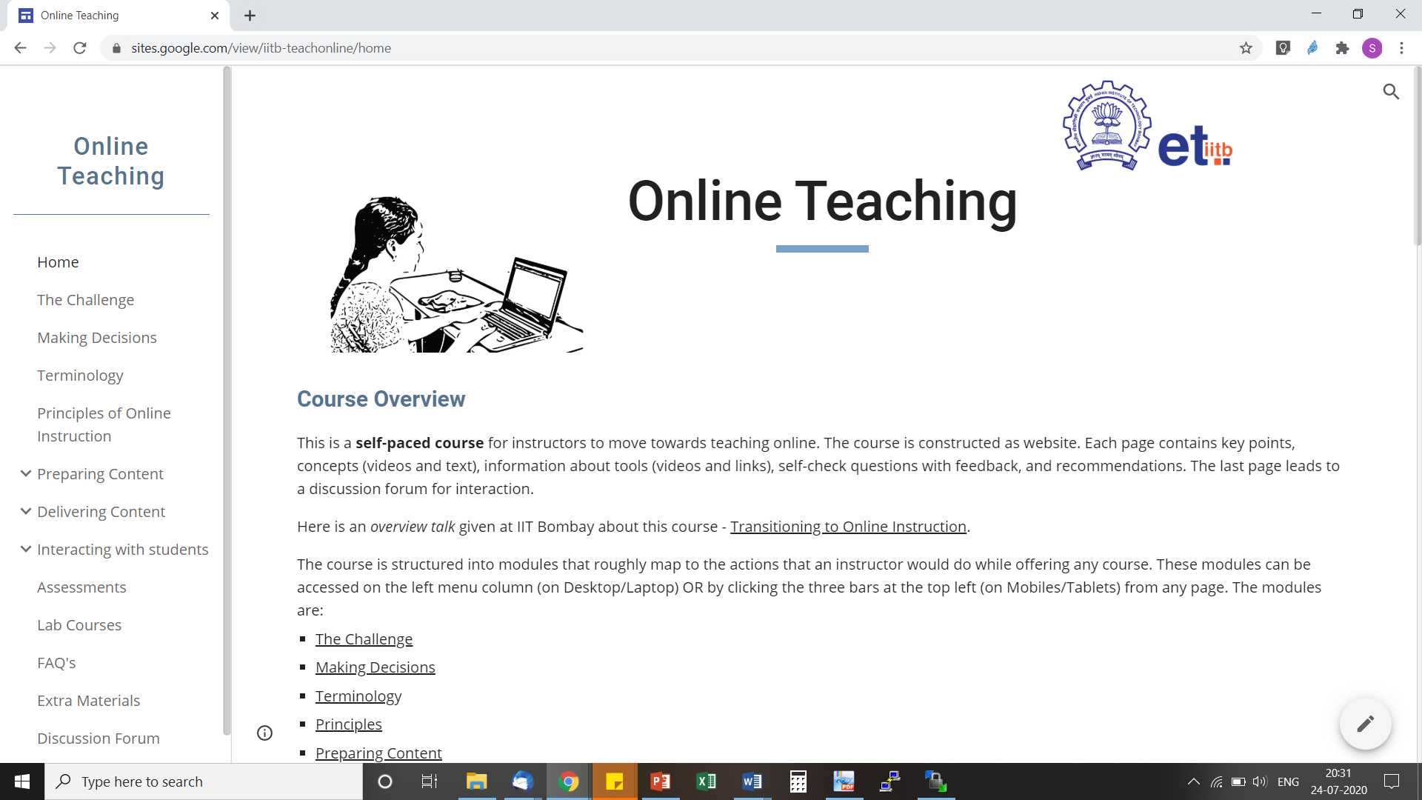
Activity – Website walkthrough
Switch over to website
Online Teaching Self-paced course developed at IIT Bombay
https://sites.google.com/view/iitb-teachonline/

Slide 61
Options for your course
Technology choices
Pedagogical strategies
Pros-cons of choices

Slide 62
There exist many many technology tools
Content creation or curation
Upload & share content
Design activities, provide
resources
Interact with students
Assess- ment
PPT, PDF, Whiteboard FlashBack Express, OBS, OpenShot, ShotCut
YouTube, Vimeo Moodle, Google classroom, Google sites
Moodle activities Google tools (Google classroom/ Google sites)
Zoom, WebEx Big Blue Button, Mentimeter Discussion Forum, Padlet
3rd party proctored exams, remote monitoring, ...
How do we select?
Notes:
Recommendations of specific technologies are not within the scope of this talk. See course page.

Slide 63
What to compare in technology tools?
Video creation – Ease of use, Time taken to render, Size of file, …
Activity creation – Ease of creation, giving feedback, Ease of doing, …
Platform – Ease of use for faculty and students, Support for LCM-based content creation and delivery, Grading and assessments, Analytics, …
Video hosting –Availability (anytime-anywhere), Security, Privacy, …
Live interaction – Scaling, Sharing, Breakout rooms, …
…
Availability of tech-support (within your institute and elsewhere) is an important criteria for comparison, in addition to features.
For comparison of technologies visit the course page - iitb-teachonline
Notes:
Recommendations of specific technologies are not within the scope of this talk. See course page.

Slide 64
Combination of options
Identify the content that you feel you *must* do yourself 50%
Create this content as close to LCM model as you can
Identify the content that is amenable to curation 30%
Find OER resources and give activities
Identify the content that could be left to live session 20%
Do live interaction and upload video
*The percentages are only indicative. They vary depending on institute policy

Slide 65
Time management
Content creation for online instruction takes at least 4X times as compared to the corresponding face-to-face class
Hence:
Curate resources
Give activities to assimilate the content
Get TAs to help with technology
Consult colleagues who have used the technology

Slide 66
Take-away
There is no single correct way of conducting online courses, just as in face-to-face teaching
It is not necessary for all faculty to have the same approach
Be aware of the trade-offs and take considered decisions, not to mimic face-to-face teaching as a default
It is sufficient if you start wherever you are comfortable and go up the levels gradually

Slide 67
What makes online instruction effective?
Focus on
Technology and tools
Effective Online Instruction
Strategies and Practices of Online Teaching

Slide 68
Topics not covered in this talk
How to incorporate Virtual Labs
What to do about physical labs
How to conduct remote exams
What to do about proctoring
What about learning analytics
How to use analytics meaningfully
…

Slide 69
Stop here – over to Moderator
Please enter your questions into the chat window
Speak as directed by the moderator
Thank You

Slide 70
Download Link This presentation is available at:
Then, Click on ‘Talks’
This presentation is released under Creative Commons-Attribution 4.0 License. You are free to use, distribute and modify it , including for commercial purposes, provided you acknowledge the source.

