Slide 1
Entity Ranking and Relationship Queries Using an Extended Graph Model
Ankur Agrawal S. Sudarshan Ajitav Sahoo Adil Sandalwala Prashant Jaiswal
IIT Bombay

Slide 2
History of Keyword Queries
Ca. 1995: Hyper-success of keyword search on the Web
Keyword search a LOT easier than SQL!
Ca. 1998-2000: Can’t we replicate it in databases?
Graph Structured data
Goldman et al. (Stanford) (1998)
BANKS (IIT Bombay)
Model relational data as a graph
Relational data
DBXplorer (Microsoft), Discover (UCSB), Mragyati (IIT Bombay) (2002)
And lots more work subsequently..

Slide 3
Keyword Queries on Graph Data
Rakesh A.
Data Mining of Association ..
Author
Data Mining of Surprising ..
Answer Models
Papers
Tree of tuples that can be joined Query: Rakesh Data Mining
“Near Queries”
A single tuple of desired type, ranked by keyword proximity
Example query: Author near (data mining) → Rakesh Agrawal, Jiawei Han, …
Example applications: finding experts, finding products, ..
Aggregate information from multiple evidences
Spreading activation
Ca. 2004: ObjectRank (UCSD), BANKS (IIT Bombay)

Slide 4
Proximity via Spreading Activation
Idea:
Each “near” keyword has activation of 1
Divided among nodes matching keyword, proportional to their node prestige
Each node
keeps fraction 1-μ of its received activation and
spreads fraction μ amongst its neighbors
Graph may have cycles
Combine activation received from neighbors
a = 1 – (1-a1)(1-a2) (belief function)

Slide 5
Activation Change Propagation
Algorithm to incrementally propagate activation change δ
Nodes to propagate δ from are in queue
Best first propagation
Propagation to node already in queue simply modifies it’s δ value
Stops when δ becomes smaller than cutoff
0.2
0.12
1
.6
0.08
0.08
0.2
0.12

Slide 6
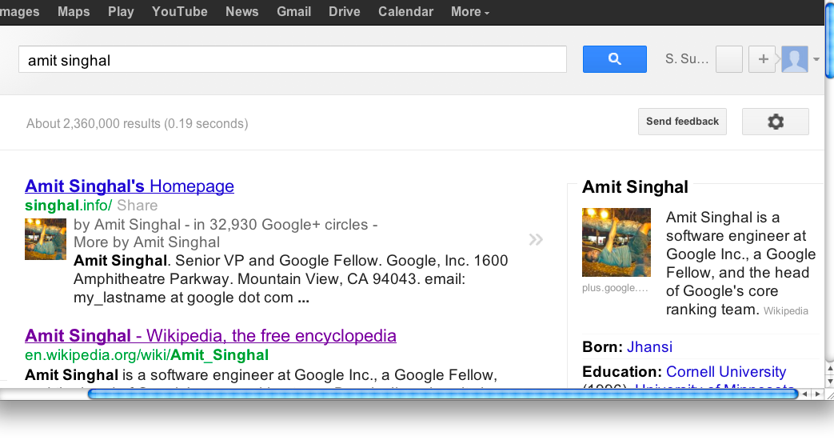
Entity Queries on Textual Data
Lots of data still in textual form
Ca. 2005: Goal: go beyond returning documents as answers
First step: return entities whose name matches query

Slide 7
Keyword Search on Annotated Textual Data
More complex query requirements on textual data
Entity queries
Find experts on Big Data who are related to IIT Bombay
Find the list of states in India
Entity-Relationship
IIT Bombay alumni who founded companies related to Big Data
Relational Queries
Price of Opteron motherboards with at least two PCI slots
OLAP/tabulation
Show number of papers on keyword queries published each year
`
Focus of this talk

Slide 8
Annotated Textual Data
Lots of data in textual form Mayank Bawa co-founded Aster Data…….. Receive results faster with Aster Data's approach to big data analytics.
“Spot” (i.e. find) mentions of entities in text
Annotate spots by linking to entities
probabilistic, may link to more than one
Category hierarchy on entities
E.g. Einstein isa Person, Einstein isa Scientist, Scientist isa Person, ..
In this paper we use Wikipedia, which is already annotated

Slide 9
Entity Queries over Annotated Textual Data
Key challenges:
Entity category/type hierarchy
Rakesh –ISA→ Scientist –ISA→ Person
Proximity of the keywords and entities
… Rakesh, a pioneer in data mining, …
Evidence must be aggregated across multiple documents
Earlier work on finding and ranking entities
E.g. Entity Rank, Entity Search, …
based purely on proximity of entity to keywords in document
Near queries on graph data can spread activation beyond immediately co-occurring entity
E.g. Rakesh is connected to Microsoft
Query: Company near (data mining)

Slide 10
Extended Graph Model
Idea: Map Wikipedia to a graph, and use BANKS near queries
Each Wikipedia page as a node, annotations as edges from node to entity
Result: very poor since proximity was ignored
Many outlinks from a page
Many unrelated keywords on a page
Key new idea: extended graph model containing edge offsets
Keywords also occur at offsets
Allows accounting for keyword-edge proximity

Slide 11
Extended Graph Model
Offsets for text as well as for edges
Apple Inc. … Its best-known hardware products are the Mac line of computers, the iPod, the iPhone, and the iPad.
0
1
100
101
107
112
114
117

Slide 12
Processing Near Queries
Find “Companies” (x) near (“Silicon Valley”).
Category
Keywords
Near
Keywords
Category Lucene Index
Article 1
Article 2
.
.
.
Article
Full-Text
Lucene Index
Initialize
Activation
Document Hit List
Relevant Category List
Article 2
….
Silicon Valley companies Yahoo!, Google,
….
Yahoo!
Google
Spreading Activation
Marissa M.

Slide 13
Processing Near Queries
Query: Company near (Silicon Valley)
Use text index to find categories relevant to ”Company”
Use text index to find nodes (Pages) containing “Silicon” and containing “Valley”
Calculate initial activation based on Node Prestige and text match score.
Spread activation to links occurring near keyword occurrences
Fraction of activation given to a link depends on proximity to keyword
Activation spread recursively to outlinks of pages that receive activation
Calculate score for each activated node which belongs to a relevant category.

Slide 14
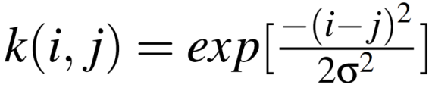
Scoring Model
Activation Score: of Wikipedia documents based on keyword occurrences (lucene score) and on node prestige (based on Page Rank)
Spreading Activation based on proximity
Use Gaussian kernel to calculate amount of activation to spread based on proximity.
Relevance Score: Based on relevance of the category
Each category has score of match with category keyword
Score of a document is max of scores of its categories.
Combined Score:

Slide 15
Entity-Relationship Search
Searching for groups of entities related to each other as specified in the query.
Example Query
find person(x) near (Stanford graduate), company(y) near (”Silicon Valley”) such that x,y near (founder)
Answers
(Google, Larry Page), (Yahoo!, David Filo), …
Requires
Finding and ranking entities related to user-specified keywords.
Finding relationships between the entities.
Relationships can also be expressed through a set of keywords.

Slide 16
Entity Relationship Queries
Entity Relationship Query (ERQ) system proposed by Li et al. [TIST 2011]
Works on Wikipedia data, with Wikipedia categories as entity types, and relationships identified by keywords
Our goal is the same
The ERQ system requires precomputed indices per entity type, mapping keywords to entities that occur in proximity to the keywords
High overhead
Implementation based on precomputed indices, limited to a few entity types
Requires queries to explicitly identify entity type, unlike our system
Our system:
allows category specification by keywords
handles all Wikipedia/Yago categories

Slide 17
Entity-Relationship Search on WikiBANKS
An entity-relationship query involves:
Entity variables.
Selection Predicates.
Relation Predicates.
For example
Find “Person” (x) near (“Stanford” “graduate”) and
“Company” (y) near (“Silicon Valley”)
such that x, y near (“founder”)
Selection
Predicates
Relation
Predicate

Slide 18
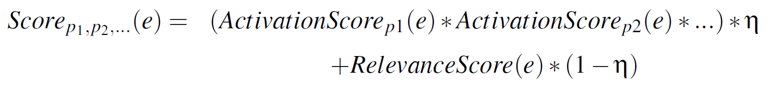
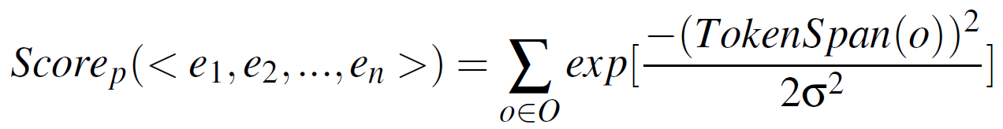
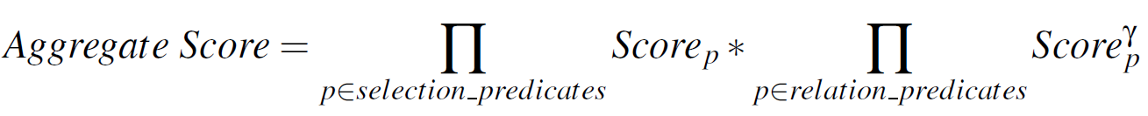
Scoring Model
Selection Predicate Scoring with multiple selections on an entity variable
E.g. find person(x) near (“Turing Award”)_ and near (IBM)
Relation Predicate Scoring
Aggregated Score

Slide 19
ER Query Evaluation Algorithm
Evaluate selection predicates individually to find relevant entities
Use graph links from entities to their occurrences to create (document, offset) lists for each entity type
Find occurrences of relation keywords: (document, offsets) using text index
Merge above lists to find occurrences of entities, and relationship keywords in close proximity with documents
Basically an N-way band-join (based on offset)
Calculate scores based on offsets of the keywords and the entity links
Aggregate scores to find final scores

Slide 20
Near Categories Optimization
Exploiting Wikipedia Category Specificity by matching near Keywords.
Examples of Wikipedia categories
Novels_by_Jane_Austen, Films_directed_by_Steven_Speilberg, Universities_in_Catalunya
Query “films near (Steven Spielberg dinosaur)” mapped also to “films_directed_by_Steven_Spielberg near (dinosaur)”
Near category optimizations: add some initial activation to the entities belonging to the categories containing the near keywords.

Slide 21
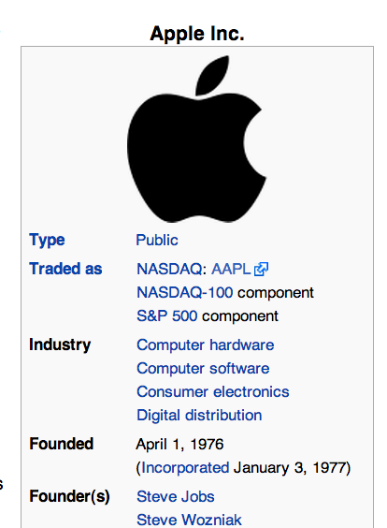
Other Optimizations
Infobox optimization
Infoboxes on Wikipedia page of an entity have very useful information about the entity
Unused in our basic model
We assume that a self-link to the entity is present from each item in the infobox.
E.g. company near (“Steve Jobs”)
Near Title optimization
If the title of an article contains all the near keywords, all the content in the page can be assumed to be related to the keywords.
We exploit this intuition by spreading activation from such articles to its out-neighbors.
E.g. Person near (Apple)
Wikipedia Infobox

Slide 22
Experimental Results
Dataset: Wikipedia 2009, with YAGO ontology
Query Set : Set of 27 queries given by Li et al. [8].
Q1 - Q16 : Single predicate queries i.e. Near queries.
Q17 - Q21 : Multi-predicate queries without join.
Q22 - Q27 : Entity-relationship queries.
Experimented with 5 different versions of our system to isolate the effect of various optimization techniques.
Basic
NearTitles
Infobox
NearCategories
All3

Slide 23
Effect of Using Offset Information
With offsets
Without offsets
Precision @ k
Precision vs. Recall
Results are across all near queries
Optimizations improve above numbers

Slide 24
Effect of Optimizations on Precision @ K
Results are across all queries

Slide 25
Precision @ k by query type
23
Single Predicate Near Query
Entity Relationship QUery

Slide 26
Execution Time
Execution times on standard desktop machine with sufficient RAM

Slide 27
Average Recall

Slide 28
Experimental Results
Each of the optimization techniques improves the precision.
The NearCategories optimization improves the performance by a large margin.
Using all the optimizations together gives us the best performance.
We beat ERQ for near queries, but ERQ is better on entity-relationship queries
We believe this is because of better notion of proximity
Future work: improve our proximity formulae.
Our system handles a huge number of queries that ERQ cannot
Since we allow any YAGO type

Slide 29
Conclusion and Future Work
Using graph-based data model of BANKS, our system outperforms existing systems for entity search and ranking.
Our system also provides greater flexibility in terms of entity type specification and relationship identification.
Ongoing work: entity relationship querying on annotated Web crawl
Interactive response time on 5TB web crawl across 10 machines
Combine Wikipedia information with Web crawl data
Future work
refine notion of proximity
Distance based metric leads to many errors
Li et al. use sentence structure and other clues which seem to be useful
Exploit relationship extractors such as OpenIE

Slide 30
Thank You! Queries?

