Slide 1
DBridge: A program rewrite tool for set-oriented query execution
Mahendra Chavan*, Ravindra Guravannavar, Prabhas Kumar Samanta, Karthik Ramachandra, S Sudarshan
Indian Institute of Technology Bombay,
Indian Institute of Technology Hyderabad
*Current Affiliation: Sybase Inc.

Slide 2
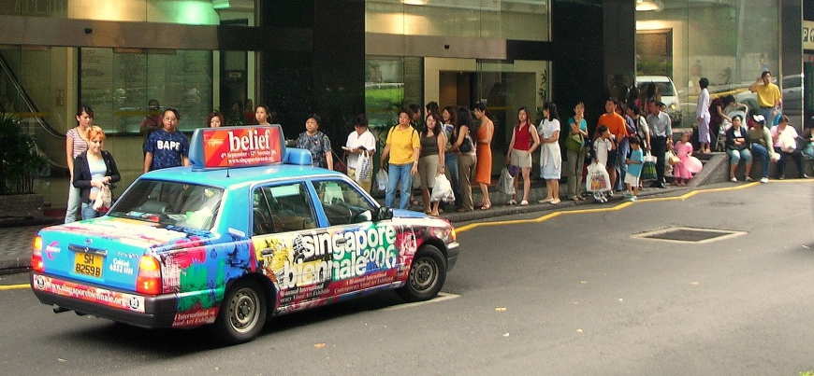

The Problem
Applications often invoke
Database queries/Web Service requests
  repeatedly (with different parameters)
  synchronously (blocking on every request)
Naive iterative execution of such queries is inefficient
  No sharing of work (eg. Disk IO)
  Network round-trip delays
The problem is not within the database engine!
The problem is the way queries are invoked from the application!!
Query optimization:
time to think out of the box

Slide 3

Our Work 1: Batching
Rewriting Procedures for Batched Bindings
Guravannavar et. al. VLDB 2008
Repeated invocation of a query automatically replaced by a single invocation of its batched form.
Enables use of efficient set-oriented
query execution plans
Sharing of work (eg. Disk IO) etc.
Avoids network round-trip delays
Approach
Transform imperative programs using equivalence rules
Rewrite queries using decorrelation, APPLY operator etc.

Slide 4

Our Work 2: Asynchronous query submission
Program Transformation for Asynchronous Query Submission
Chavan et al., ICDE 2011 Research track – 8; April 13th, 14:30-16:00
Repeated synchronous invocation of queries automatically replaced by asynchronous submission.
Application can perform
other work while query
executes
Sharing of work (eg. Disk IO) on the database engine
Reduces impact of network round-trip delays
Extends and generalizes equivalence rules from our VLDB 2008 paper on batching

Slide 5
DBridge: Bridging the divide
A tool that implements these ideas on Java programs that use JDBC
  Set-oriented query execution
  Asynchronous Query submission
Two components:
  The DBridge API
    Handles query rewriting and plumbing
  The DBridge Transformer
    Rewrites programs to optimize database access
Significant performance gains on real world applications

Slide 6
The DBridge API
Java API which extends the JDBC interface, and can wrap any JDBC driver
Can be used with:
  Manual writing/rewriting
  Automatic rewriting (by DBridge transformer)
Same API for both batching and asynchronous submission
Abstracts the details of
  Parameter batching and query rewrite
  Thread scheduling and management

Slide 7
The DBridge API
stmt = con.dbridgePrepareStatement(
"SELECT count(partkey) " +
"FROM part " +
"WHERE p_category=?");
LoopContextTable lct = new LCT();
while(!categoryList.isEmpty()) {
LoopContext ctx=lct.createContext();
category = categoryList.next();
stmt.setInt(1, category);
ctx.setInt(”category”, category);
stmt.addBatch(ctx);
}
stmt.executeBatch();
for (LoopContext ctx : lct) {
category = ctx.getInt(”category”);
ResultSet rs = stmt.getResultSet(ctx);
rs.next();
int count = rs.getInt(”count");
sum += count;
print(category + ”: ” + count);
}
stmt = con.prepareStatement(
"SELECT count(partkey) " +
"FROM part " +
"WHERE p_category=?");
while(!categoryList.isEmpty()) {
category = categoryList.next();
stmt.setInt(1, category);
ResultSet rs = stmt.executeQuery();
rs.next();
int count = rs.getInt(”count");
sum += count;
print(category + ”: ” + count);
}
Before
After

Slide 8
DBridge API – Set oriented execution
LoopContextTable lct = new LoopContextTable();
while(!categoryList.isEmpty()){
LoopContext ctx = lct.createContext();
category = categoryList.next();
stmt.setInt(1, category);
ctx.setInt(”category”, category);
stmt.addBatch(ctx);
}
stmt.executeBatch();
for (LoopContext ctx : lct) {
category = ctx.getInt(”category”);
ResultSet rs = stmt.getResultSet(ctx);
rs.next();
int count = rs.getInt(”count");
sum += count;
print(category + ”: ” + count);
}
Parameter Batch
(temp table)
DB
Set of ResultSets
addBatch(ctx) – insert tuple to parameter batch
executeBatch() – execute set-oriented form of query
getResultSet(ctx) – retrieve results corresponding to the context

Slide 9
DBridge API – Asynchronous submission
LoopContextTable lct = new LoopContextTable();
while(!categoryList.isEmpty()){
LoopContext ctx = lct.createContext();
category = categoryList.next();
stmt.setInt(1, category);
ctx.setInt(”category”, category);
stmt.addBatch(ctx);
}
stmt.executeBatch();
for (LoopContext ctx : lct) {
category = ctx.getInt(”category”);
ResultSet rs = stmt.getResultSet(ctx);
rs.next();
int count = rs.getInt(”count");
sum += count;
print(category + ”: ” + count);
}
Thread
Submit Q
DB
Result array
addBatch(ctx) – submits query and returns immediately
getResultSet(ctx) – blocking wait

Slide 10
DBridge - Transformer
Java source-to-source transformation tool
Rewrites programs to use the DBridge API
Handles complex programs with:
  Conditional branching (if-then-else) structures
  Nested loops
Performs statement reordering while preserving program equivalence
Uses SOOT framework for static analysis and transformation (http://www.sable.mcgill.ca/soot/)

Slide 11
DBridge - Transformer

Slide 12
Batching: Performance impact
Category hiearchy traversal (real world example)
For small no. of iterations, no change observed
At large no. of iterations, factor of 8 improvement
Notes:
Highlight log scale and factor of 8

Slide 13
Asynchronous submission:
Performance Impact
Auction system benchmark application
For small no. (4-40) iterations, transformed program slower
At 400-40000 iterations, factor of 4-8 improvement
Similar for warm and cold cache

Slide 14
Comparison:
Batching vs. Asynchronous submission
Auction system benchmark application
Asynchronous execution with 10 threads

Slide 15
Conclusions and Ongoing Work
Significant performance benefits possible by using batching and/or asynchronous execution for
  Repeated database access from applications
  Repeated access to Web services
DBridge: batching and asynchronous execution made easy
  API + automated Java program transformation
Questions? Contact us at
http://www.cse.iitb.ac.in/infolab/dbridge
  Email: karthiksr@cse.iitb.ac.in

Slide 16
Transformation Walk-through
Input: A Java Program which uses JDBC
PreparedStatement stmt = con.prepareStatement(
"SELECT COUNT(p_partkey) AS itemCount
FROM newpart
WHERE p_category = ?");
while(category != 0){
stmt.setInt(1, category);
ResultSet rs = stmt.executeQuery();
rs.next();
int itemCount = rs.getInt("itemCount");
sum = sum + itemCount;
category = getParent(category);
}

Slide 17
Transformation Walk-through
Step 1 of 5: Identify candidates for set-oriented query execution:
PreparedStatement stmt = con.prepareStatement(
”SELECT COUNT(p_partkey) AS itemCount
FROM part
WHERE p_category = ?");
while(category != 0){
stmt.setInt(1, category);
ResultSet rs = stmt.executeQuery();
rs.next();
int itemCount = rs.getInt("itemCount");
sum = sum + itemCount;
category = getParent(category);
}
Iterative execution
of a parameterized
query
Intention: Split loop at
this point

Slide 18
Transformation Walk-through
Step 2 of 5: Identify dependencies that prevent loop splitting:
PreparedStatement stmt = con.prepareStatement(
"SELECT COUNT(p_partkey) AS itemCount
FROM part
WHERE p_category = ?");
while(category != null){
stmt.setInt(1, category);
ResultSet rs = stmt.executeQuery();
rs.next();
int itemCount = rs.getInt("itemCount");
sum = sum + itemCount;
category = getParent(category);
}
Iterative execution
of a parameterized
query
A Loop Carried Flow Dependency edge
crosses the query execution statement

Slide 19
Transformation Walk-through
Step 3 of 5: Reorder statements to enable loop splitting
PreparedStatement stmt = con.prepareStatement(
"SELECT COUNT(p_partkey) AS itemCount
FROM part
WHERE p_category = ?");
while(category != null){
int temp = category;
category = getParent(category);
stmt.setInt(1, temp);
ResultSet rs = stmt.executeQuery();
rs.next();
int itemCount = rs.getInt("itemCount");
sum = sum + itemCount;
}
Move statement above the
Query invocation
Loop can be safely split
now

Slide 20
Transformation Walk-through
Step 4 of 5: Split the loop (Rule 2)
LoopContextTable lct = new LoopContextTable();
while(category != null){
LoopContext ctx = lct.createContext();
int temp = category;
category = getParent(category);
stmt.setInt(1, temp);
stmt.addBatch(ctx);
}
stmt.executeBatch();
for (LoopContext ctx : lct) {
ResultSet rs = stmt.getResultSet(ctx);
rs.next();
int itemCount = rs.getInt("itemCount");
sum = sum + itemCount;
}
To preserve split local
values and order of
processing results
Accumulates parameters in case of batching;
submits query in case of asynchrony
Query execution statement is
out of the loop and replaced with a
call to its set-oriented form
Process result sets in
the same order as the
original loop

Slide 21
Transformation Walk-through
Step 5 of 5: Query Rewrite
SELECT COUNT(p_partkey) AS itemCount
FROM part
WHERE p_category = ?
Original Query
CREATE TABLE BATCHTABLE1(
paramcolumn1 INTEGER, loopKey1 INTEGER)
INSERT INTO BATCHTABLE1 VALUES(..., …)
SELECT BATCHTABLE1.*, qry.*
FROM BATCHTABLE1 OUTER APPLY (
SELECT COUNT(p_partkey) AS itemCount
FROM part
WHERE p_category = paramcolumn1) qry
ORDER BY loopkey1
Temp table to store
Parameter batch
Batch Inserts into
Temp table
Set-oriented Query

