Slide 1
Holistic Optimization by Prefetching Query Results
Karthik Ramachandra & S. Sudarshan
Indian Institute of Technology Bombay
Supported by
MSR India PhD fellowship
Yahoo! Key Scientific Challenges Award 2011

Slide 2


The Latency problem
Applications that interact with databases/web services experience lot of latency due to
Network round trips to the data source
Disk IO and processing at the data source
Query
Disk IO and
query execution
Network time
Application
Database
Result
Notes:
Remove quote, mention web service

Slide 3
Motivation
Performance of applications can be significantly improved by prefetching query results.
Multiple queries could be issued concurrently
Allows the database to share work across multiple queries
Application performs other processing while query executes
Significantly reduces the impact of network round-trip and server/disk IO latency
Manually inserting prefetch instructions is hard.
Need to identify earliest and safe points in the code to perform prefetching
For queries within nested procedures prefetching has to be done in the calling procedure to get benefits
Hard to manually maintain as code changes occur
Our Goal: Automate the insertion of prefetches
Notes:
Goal is to automate it

Slide 4
Example of Prefetching
for (…) {
…
genReport(custId, city);
}
void genReport(int custId, String city) {
city = …
while (…){
…
}
rs1 = executeQuery(q1, custId);
rs2 = executeQuery(q2, city);
…
}
for (…) {
…
genReport(custId, city);
}
void genReport(int custId, String city) {
submit(q1, custId);
city = …
submit(q2, city);
while (…){
…
}
rs1 = executeQuery(q1, custId);
rs2 = executeQuery(q2, city);
…
}
executeQuery () – normal execute query
submit() – non-blocking call that initiates query and returns immediately; once the results arrive, they are stored in a cache
executeQuery() – checks the cache and blocks if results are not yet available

Slide 5
Example of Prefetching
for (…) {
…
genReport(custId, city);
}
void genReport(int custId, String city) {
city = …
while (…){
…
}
rs1 = executeQuery(q1, custId);
rs2 = executeQuery(q2, city);
…
}
for (…) {
…
genReport(custId, city);
}
void genReport(int custId, String city) {
submit(q1, custId);
city = …
submit(q2, city);
while (…){
…
}
rs1 = executeQuery(q1, custId);
rs2 = executeQuery(q2, city);
…
}
What is the earliest point when we can prefetch?
Will prefetch potentially get wasted?

Slide 6
Example of Prefetching
for (…) {
…
genReport(custId, city);
}
void genReport(int custId, String city) {
city = …
while (…){
…
}
rs1 = executeQuery(q1, custId);
rs2 = executeQuery(q2, city);
…
}
for (…) {
submit(q1, custId); …
genReport(custId, city);
}
void genReport(int custId, String city) {
city = …
submit(q2, city);
while (…){
…
}
rs1 = executeQuery(q1, custId);
rs2 = executeQuery(q2, city);
…
}
What is the earliest point when we can prefetch?
Will prefetch potentially get wasted?
Intra- vs. Inter- procedural prefetching

Slide 7
Related Work
Software prefetching extensively used in compilers, databases and other areas of computer science
Predicting future accesses is based on
Spatial and temporal locality
Request patterns and statistical methods
Static analysis
Query result prefetching based on request patterns
Fido (Palmer et.al 1991), AutoFetch (Ibrahim et.al ECOOP 2006), Scalpel (Bowman et.al. ICDE 2007), etc.
Predict future queries using traces, traversal profiling, logs
Missed opportunities due to limited applicability
Potential for wasted prefetches

Slide 8
Static Analysis based approaches
getAllReports() {
for (custId in …) { …
genReport(custId);
}
}
void genReport(int cId) {
…
r = executeQuery(q, cId);
…
}
Manjhi et. al. 2009 – insert prefetches based on static analysis
No details of how to automate
Only consider straight line intraprocedural code
Prefetches may go waste
Our earlier work
Guravannavar et. al. VLDB 08 – given query in a loop, rewrite loop to create batched query
Chavan et. al. ICDE 11 – as above but using asynchronous query submission
Consider: Loop calls procedure, which executes query
Common in many database applications
Our earlier work is applicable, but requires very intrusive rewriting of procedures

Slide 9
Our Contributions in this paper
Prefetching algorithm purely based on static analysis
Inserts prefetches at earliest possible point in the program
Uses notion of query anticipability; no wasted prefetches*
Works in the presence of loops and interprocedural code
Enhancements that optimize prefetches
Code motion, chaining and rewriting prefetch requests
Increasing applicability
Integrating with loop fission
Applicability for Hibernate, Web Services
Experimental study on real world applications
* except due to exceptions

Slide 10
Prefetch insertion algorithm
Intraprocedural prefetching
Query anticipability analysis
Interprocedural Prefetching
Enhancements
Increasing applicability
System Design and Experimental evaluation

Slide 11
Intraprocedural prefetching
Approach:
Identify valid points of prefetch insertion within a procedure
Place prefetch request submit(q, p) at the earliest point
Valid points of insertion of prefetch
All the parameters of the query should be available, with no intervening assignments
No intervening updates to the database
Should be guaranteed that the query will be executed subsequently
Systematically found using Query Anticipability analysis
extension of a dataflow analysis technique called anticipable expressions analysis
void report(int cId,String city){
city = …
while (…){
…
}
c = executeQuery(q1, cId);
d = executeQuery(q2, city);
…
}

Slide 12

Query anticipability analysis
start
n1
n2
n3
n4
n5
void report(int cId,String city){
city = …
while (…){
…
}
rs1 = executeQuery(q1, cId);
rs2 = executeQuery(q2, city);
…
}
n1
n3
n2
Bit vector = (q1,q2)
= anticipable (valid)
= not anticipable (invalid)
n4
n5
end
Notes:
animate

Slide 13


Query anticipability analysis
start
n1
n2
n3
n4
n5
void report(int cId,String city){
city = …
while (…){
…
}
rs1 = executeQuery(q1, cId);
rs2 = executeQuery(q2, city);
…
}
( , )
( , )
n1
( , )
( , )
( , )
n3
n2
( , )
( , )
( , )
n4
Bit vector = (q1,q2)
= anticipable (valid)
= not anticipable (invalid)
Backward data flow in the control flow graph
( , )
( , )
n5
( , )
end
( , )
Notes:
Dataflow equations fixpoint details in paper

Slide 14
Query anticipability analysis
Definition 3.1. A query execution statement q is anticipable at a program point u if every path in the CFG from u to End contains an execution of q which is not preceded by any statement that modifies the parameters of q or affects the results of q.
u
Data flow information
Stored as bit vectors (1 bit per query)
Propagated against the direction of control flow (Backward Dataflow Analysis)
Captured by a system of data flow equations
Solve equations iteratively till a fixpoint is reached
Details in the paper
q
End

Slide 15
Intraprocedural prefetch insertion
Analysis identifies all points in the program where q is anticipable; we are interested in earliest points
n1: x =…
n1: if(…)
submit(q,x)
submit(q,x)
n2
n2
nq: executeQuery(q,x)
n3
nq: executeQuery(q,x)
Data dependence barriers
Due to assignment to query parameters or UPDATEs
Append prefetch to the barrier statement
Control dependence barriers
Due to conditional branching (if-else or loops)
Prepend prefetch to the barrier statement

Slide 16
Intraprocedural prefetch insertion
void report(int cId,String city){
city = …
while (…){
…
}
rs1 = executeQuery(q1, cId);
rs2 = executeQuery(q2, city);
…
}
void report(int cId,String city){
submit(q1, cId);
city = …
submit(q2, city);
while (…){
…
}
rs1 = executeQuery(q1, cId);
rs2 = executeQuery(q2, city);
…
}
q2 only achieves overlap with the loop
q1 can be prefetched at the beginning of the method

Slide 17
Intraprocedural prefetch insertion
void report(int cId,String city){
city = …
while (…){
…
}
rs1 = executeQuery(q1, cId);
rs2 = executeQuery(q2, city);
…
}
void report(int cId,String city){
submit(q1, cId);
city = …
submit(q2, city);
while (…){
…
}
rs1 = executeQuery(q1, cId);
rs2 = executeQuery(q2, city);
…
}
q2 only achieves overlap with the loop
q1 can be prefetched at the beginning of the method
Can be moved to the method that invokes report()

Slide 18
Interprocedural prefetching
Benefits of prefetching can be greatly improved by moving prefetches across method invocations
Intuition: if a prefetch can be submitted at the beginning of a procedure, it can instead be moved to all its call sites
Use call graph of the program, and CFGs of all procedures
Assumption: Call graph is a DAG (we currently do not handle recursive calls)

Slide 19
Interprocedural prefetching algorithm (intuition)
Iterate through the vertices of the call graph in reverse topological order
Perform intraprocedural prefetching at each method M
If first statement is a submit(), then move it to all callers of M at the point of invocation
Replace formal parameters with actual arguments
void generateAllReports() {
…
genReport(custId, city);
}
void genReport(int cId, String city) {
submit(q2, cId);
…
rs1 = executeQuery(q2, cId);
…
}
void generateAllReports() {
…
submit(q2, custId);
genReport(custId, city);
}
void genReport(int cId, String city) {
…
rs1 = executeQuery(q2, cId);
…
}

Slide 20
Prefetching Algorithm: Summary
Our algorithms ensure that:
The resulting program preserves equivalence with the original program.
All existing statements of the program remain unchanged.
No prefetch request is wasted.
At times, prefetches may lead to no benefits
Enhancements to get beneficial prefetches even in presence of barriers
Equivalence preserving program and query transformations
void proc(int cId){
int x = …;
while (…){
…
}
if (x > 10)
c = executeQuery(q1, cId);
…
}

Slide 21
Enhancements
Prefetch insertion algorithm
Increasing applicability
System Design and Experimental evaluation

Slide 22
1. Transitive code motion (Strong anticipability)
void genReport(int cId){
int x = …;
while (…){
…
}
if (x > 10)
rs1 = executeQuery(q1, cId);
…
}
void genReport(int cId){
int x = …;
boolean b = (x > 10);
if (b) submit(q1, cId);
while (…){
…
}
if (b)
rs1 = executeQuery(q1, cId);
…
}
General Algorithm:
Control dependence barrier:
Transform it into a data dependence barrier by rewriting it as a guarded statement
Data dependence barrier:
Apply anticipability analysis on the barrier statements
Move the barrier to its earliest point followed by the prefetch

Slide 23
2. Chaining prefetch requests
Output of a query forms a parameter to another – commonly encountered
Prefetch of query 2 can be issued immediately after results of query 1 are available.
submitChain similar to submit ; details in paper
void report(int cId,String city){
…
c = executeQuery(q1, cId);
while (c.next()){
accId = c.getString(“accId”);
d = executeQuery(q2, accId);
}
}
void report(int cId,String city){
submitChain({q1, q2’}, {{cId}, {}});
…
c = executeQuery(q1, cId);
while (c.next()){
accId = c.getString(“accId”);
d = executeQuery(q2, accId);
}
}
q2 cannot be beneficially prefetched as it depends on accId which comes from q1
q2’ is q2 with its ? replaced by q1.accId
Typo in paper: In Section 5.2 on chaining and in Figure 10: replace all occurrences of q2 by q4

Slide 24
3. Rewriting Chained prefetch requests
submitChain({“SELECT * FROM accounts WHERE custid=?”,
“SELECT * FROM transactions WHERE accId=:q1.accId”}, {{cId}, {}});
SELECT ∗
FROM (SELECT ∗ FROM accounts WHERE custId = ?)
OUTER APPLY
(SELECT ∗ FROM transactions
WHERE transactions.accId = account.accId)
Chained SQL queries have correlating parameters between them (q1.accId)
Can be used to rewrite them into one query using known techniques such as OUTER APPLY or LEFT OUTER LATERAL operators
Results are split into individual result sets in cache
Reduces network round trips, aids in selection of set oriented query plans

Slide 25
Increasing applicability
Prefetch insertion algorithm
Enhancements
System Design and Experimental evaluation

Slide 26
Integration with loop fission
for (…) { …
addBatch(q, cId);
}
submitBatch(q);
for (…) {
genReport(custId);
}
void genReport(int cId) {
…
r=executeQuery(q, cId);
…
}
for (…) { …
submit(q,cId);
genReport(custId);
}
void genReport(int cId) {
…
r=executeQuery(q, cId);
…
}
for (…) { …
genReport(custId);
}
void genReport(int cId) {
…
r=executeQuery(q, cId);
…
}
Original program
Interprocedural prefetch
Loop Fission
Interprocedural Prefetching enables our earlier work (VLDB08 and ICDE11) on loop fission for Batching/Asynchronous submission

Slide 27
Hibernate and web services
Lot of enterprise and web applications
Are backed by O/R mappers like Hibernate
They use the Hibernate API which internally generate SQL
Well known performance problems when accessing data in a loop
Are built on Web Services
Typically accessed using APIs that wrap HTTP requests and responses
To apply our techniques here,
Transformation algorithm has to be aware of the underlying data access API
Runtime support to issue asynchronous prefetches

Slide 28
System design and experimental evaluation
Prefetch insertion algorithm
Enhancements
Increasing applicability

Slide 29
System design: DBridge
Our techniques have been incorporated into the DBridge holistic optimization tool
Two components:
Java source-to-source program Transformer
Uses SOOT framework for static analysis and transformation (http://www.sable.mcgill.ca/soot/)
Preserves readability
Prefetch API (Runtime library)
For issuing prefetch requests
Thread and cache management
Can be used with manual writing/rewriting or automatic rewriting by DBridge transformer
Currently works for JDBC API; being extended for Hibernate and Web services

Slide 30
Experiments
Conducted on 4 applications
Two public benchmark applications (Java/JDBC)
A real world commercial ERP application(Java/JDBC)
Twitter Dashboard application (Java/Web Service)
Environments
A widely used commercial database system – SYS1
PostgreSQL
Both running on a 64 bit dual-core machine with 4 GB of RAM

Slide 31
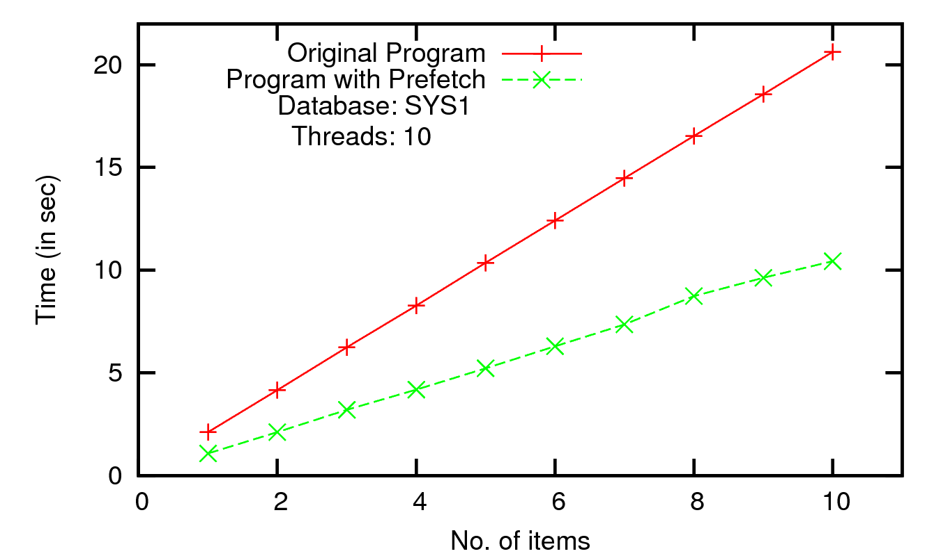
Auction application (Java/JDBC): Intraprocedural prefetching
for(…) {
for(…) {
…
}
exec(q);
}
for(…) {
submit(q);
for(…) {
…
}
exec(q);
}
Single procedure with nested loop
Overlap of loop achieved; varying iterations of outer loop
Consistent 50% improvement

Slide 32
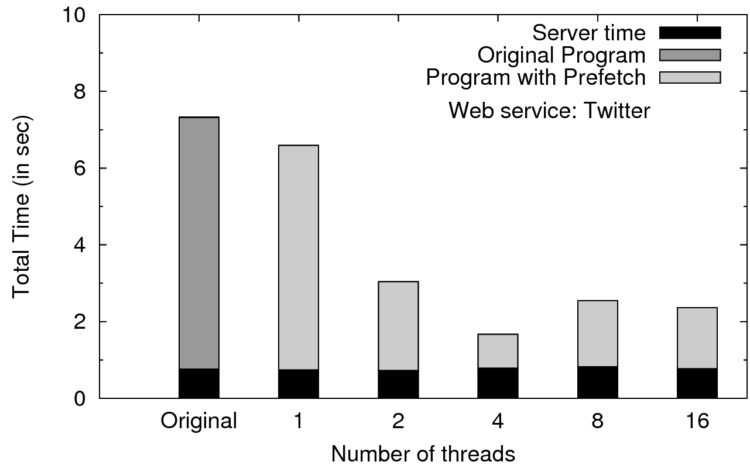
Web service (HTTP/JSON): Interprocedural prefetching
Twitter dashboard: monitors 4 keywords for new tweets (uses Twitter4j library)
Interprocedural prefetching; no rewrite possible
75% improvement at 4 threads
Server time constant; network overlap leads to significant gain
Note: Our system does not automatically rewrite web service programs, this example was manually rewritten using our algorithms

Slide 33
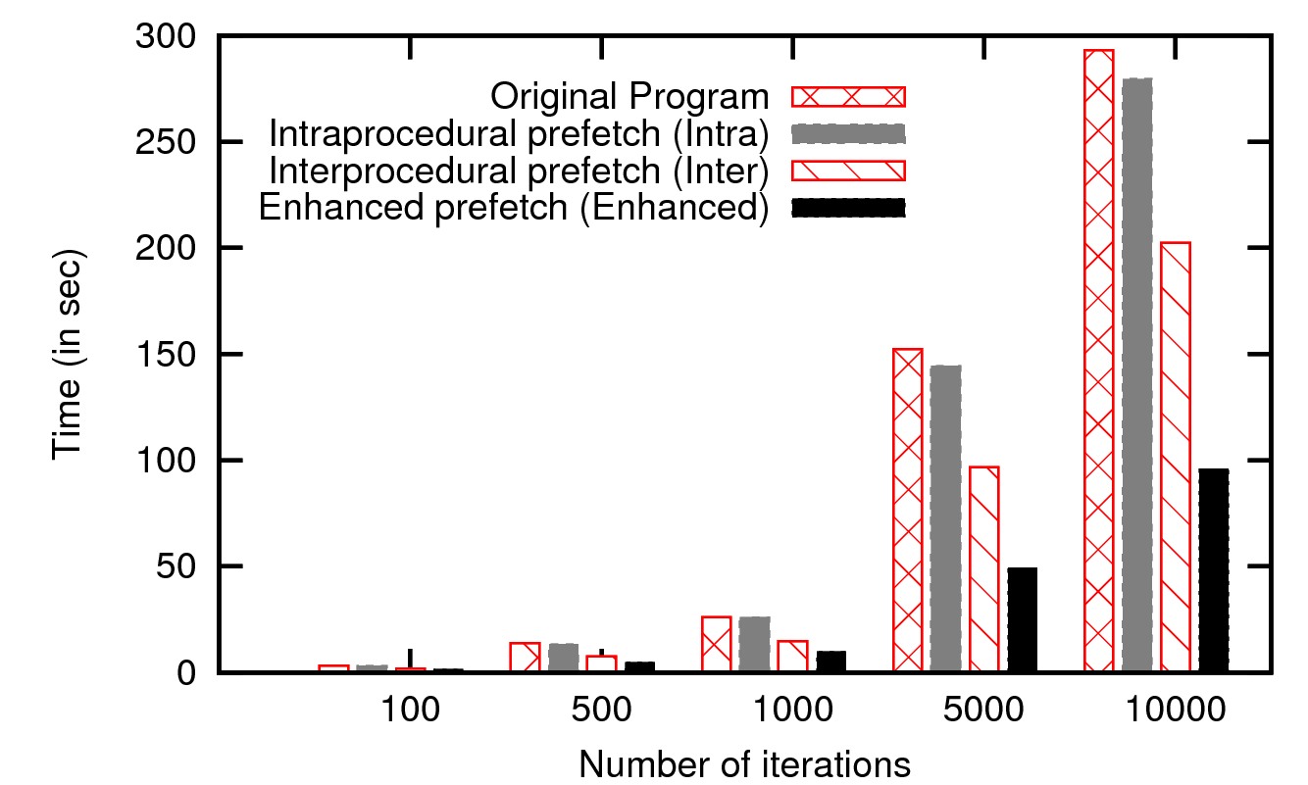
ERP Application: Impact of our techniques
Intraprocedural: moderate gains
Interprocedural: substantial gains (25-30%)
Enhanced (with rewrite): significant gain(50% over Inter)
Shows how these techniques work together

Slide 34
Future Work
Conclusion
Automatically prefetching query results using static analysis
is widely applicable in many real applications
can lead to significant gains.
Which calls to prefetch? And where to place them?
Cost-based speculative prefetching
Implementation
Cross-thread transaction support in runtime library
Completely support Hibernate, web services

Slide 35
Questions?
More Questions?
Today, 15:00 – 16:30
PODS/SIGMOD Research Plenary Poster Session
Location: Vaquero Ballroom B–C
Project website: http://www.cse.iitb.ac.in/infolab/dbridge
Notes:
Conclusion: Auto prefetch can lead to significant improvements, applicable in real world apps

