Slide 1
Optimizing Join Enumeration in Transformation-based Query Optimizers
Anil Shanbhag, S. Sudarshan
IIT Bombay
anils@mit.edu, sudarsha@cse.iitb.ac.in
VLDB 2014

Slide 2
Query Optimization: Quick Background
System R algorithm
Dynamic programming algorithm to find best join order
Time complexity: O(3^{n}) for bushy join orders
Plan space considered includes cross products
For some common join topologies #cross-product free intermediate join results is polynomial
E.g. chain, cycle, ..
Can we reduce optimization time by avoiding cross products?
Algorithms for generation of cross-product free join space
Bottom up: DPccp (Moerkotte and Newmann [VLDB06])
Top-down: TDMinCutBranch (Fender et al. [ICDE11]), TDMinCutConservative (Fender et al. [ICDE12])
Time complexity is polynomial if #cross-product free intermediate join results is polynomial in size

Slide 3
Cross-Product-Free Join Order Enumeration using Graph Partitioning
Key idea for avoiding cross products while finding best join tree:
For set S of relations, find all ways to partition S into S1 and S2 s.t.
the join graph of S1 is connected, and so is the join graph of S2
there is an edge (join predicate) between S1 and S2
Simple recursive algorithm to find best plan in cross-product free join space using partitioning as above
Efficient algorithms for finding all ways to partition S into S1 and S2 as above
MinCutLazy (Dehaan and Tompa [SIGMOD07])
Fender et. al proposed MinCutBranch [ICDE11] and MinCutConservative [ICDE12]
MinCutConservative is the most efficient currently.
S
S1
R1
R2
S2
R4
R3

Slide 4
Volcano/Cascades Framework for Query Optimization
Based on equivalence rules: e.g. A ⋈ B ↔ B ⋈ A
Key benefit: easy to add rules to deal with new operators
e.g. outerjoin group-by/aggregate, limit, ...
Memoization technique which generalizes System R style dynamic programming applicable even with equivalence rules
Used in SQL Server, Tandem, and Greenplum, and several other databases, increasing adoption
Transformation rule sets for join order optimization:
RS-B1
Commutativity + Left Associativity: Takes O(4^n) time
Pellenkoft et. al [VLDB97] suggest new ruleset: O(3^n) time
RS-B2
Both the rulesets generate join orders with cross-products.
Key contribution of paper: Efficient rulesets that avoid cross-products
Notes:
Point 2 – not clear

Slide 5
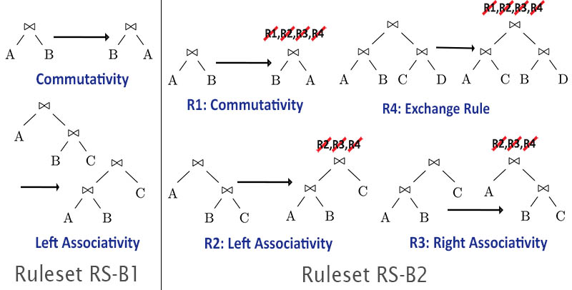
Rulesets
with Cross-Product Suppression (CPS)
RS-B1-CPS/RS-B2-CPS: modification of RS-B1/RS-B2 to suppress cross-products, i.e. block transformation if the result has cross-product
RS-B1-CPS and RS-B2-CPS have been used in some implementations
but not obvious if they are complete, i.e. generate the entire search space

Slide 6
RS-B1-CPS Proof of Completeness
Theorem: RS-B1-CPS is complete i.e. any cross-product free tree Q1 can be converted to any other cross-product free tree Q2 using RS-B1-CPS
Intuition for the proof
Step 1: Given any arbitrary cross-product-free tree Q1 we can convert it into a canonical cross-product free left-deep tree Qc= (..((R1⋈R2)⋈R3)..)⋈Rk) with relations in sorted order using RS-B1-CPS
Step 2: Above steps can be reversed using RS-B1-CPS for any cross-product free tree
Can go from any Q1 to any Q2 as above via Qc

Slide 7
RS-B2-CPS is Incomplete
Some cross-product free trees may not be reachable from other cross-product free trees using RS-B2-CPS.
Proof of incompleteness of RS-B2-CPS using counter-example below
Q and Q2 are both cross-product free join trees
Starting with Q, we can go to Q2 only via application of exchange rule at root join op
This will always result in an intermediate tree with cross-product !

Slide 8
Problem and Potential Fix
Problem: RS-B1-CPS and RS-B2 are complete, however
RS-B1-CPS generates exponential number of duplicates (Pellenkoft et al.)
RS-B2 explores significantly larger search space (no CPS)
Key idea: incorporate graph-partitioning based top-down enumeration into Volcano/Cascades framework

Slide 9
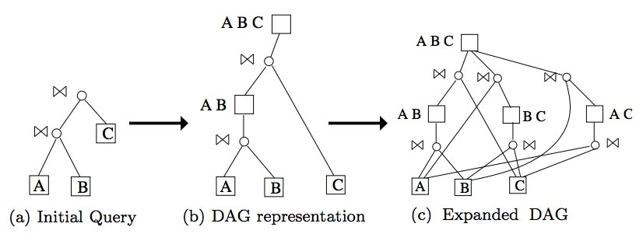
AND-OR DAG Representation in Volcano/Cascades
Repeatedly apply a set of rules until fixedpoint
Store the alternatives efficiently using AND-OR DAG representation .
Example shows join enumeration for a simple query in transformation-based QO :

Slide 10
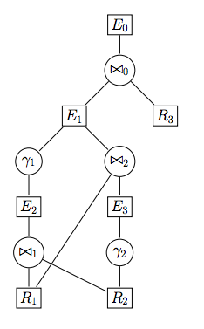
Join Sets
For applying graph-partitioning based enumeration, we need to create a join graph consisting of nodes being joined
A maximal join set at an equivalence node E is a maximal set of equivalence nodes Ei being joined below E such that none of the Ei have any join operators below them.
There can be multiple maximal join sets at an equivalence node
we store all of them.
In the example to the right, at E₀
(R₁, E₃ , R₃) is a maximal join set,
But (E₁, R₃) is not since E1 has join operator below it

Slide 11
Transformation Rule RS-Graph
E
Rule RS-Graph: matches pattern E1 ⋈ E2
On match, For each pair (J1, J2) where J1 ∈ join sets of E1 and J2 ∈ join sets of E2
If J1 U J2 has not been enumerated at node E, where E is the parent equivalence node of E1 ⋈ E2
Call the partitioning algorithm on the join graph of J1 U J2 to generate all cross-product free partitions
For each such partition S1, (J1 U J2)\S1
We check if there is equivalence node representing S1 (similarly G\S1)
This is done efficiently by inserting a dummy n-ary join operator into the DAG and using standard Volcano/Cascades duplicate expression check .
If yes, we simply use the equivalence node in place of S1.
If not, we create a left-deep join tree of relations in S1 and insert it into the DAG. Use the equivalence node thus created for S1.
⋈
E1
E2
Notes:
Key things to note: RS-Graph enumerates all partitions at once, giving rise to multiple child join-op nodes. The eq-node children of these join-op nodes have their own join sets, and the rule is applied on those eq-nodes also.

Slide 12
RS-Graph (Contd.)
The Volcano/Cascades framework will recursively apply RS-Graph on generated nodes to generate entire space
Join sets at a node may change as transformations are applied at child equivalence nodes
Join sets can be maintained in a bottom-up fashion.
Theorem: RS-Graph is complete
Potential risk: equivalence nodes may have many maximal join sets
Good news: For commonly encountered rulesets, each equivalence node has a single maximal join set.

Slide 13
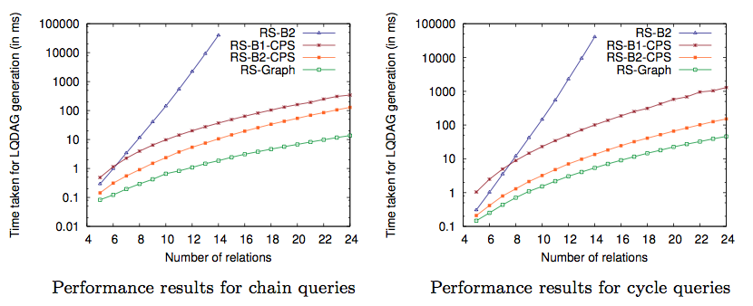
Performance
Incompleteness of RS-B2-CPS observed in cycle queries (# Eq. Nodes)
LQ DAG Expansion time (ms) Chain Queries Cycle Queries
Colour code in graph: RS-B2, RS-B1-CPS, RS-B2-CPS, RS-Graph
RS-Graph significantly outperforms RS-B1-CPS, RS-B2, and even RS-B2-CPS (which is incomplete). (Results on RS-B2-CPS not in paper, added subsequently)
Notes:
Chain Query Timings:
14 1.856197 37.102756 10.56679 39884.0 -> 5.7 times faster than RS-B2-CPS, 20 times faster than RS-B1-CPS
24 13.726648 343.0 129.0
Cycle Query Timings:
14 5.406084 101.0 13.495744 40784.0 -> 18.7 times faster than RS-B1-CPS
24 46.127441 1293.0 152.0
Further results with number of equivalence nodes, number of operation nodes, number of operation node addition attempts are in paper

Slide 14
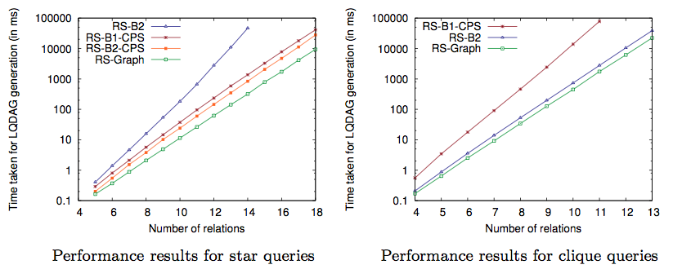
Performance
LQ DAG Expansion time (ms) Star Queries Clique Queries
For star and clique join graphs
Colour code in graph: RS-B2, RS-B1-CPS, RS-B2-CPS, RS-Graph
Further results with number of equivalence nodes, number of operation nodes, number of operation node addition attempts are in paper
Notes:
For star queries:
10 11.370394 37.39816 24.042197 182.0 -> 3.3 x faster than RS-B1-CPS, 2.1 x faster than RS-B2-CPS
For clique queries:

Slide 15
Conclusion
Cross-Product Free Join Order Enumeration in Transformation-based QO is inefficient :
RS-B1-CPS is complete but generates exponential number of duplicates
RS-B2-CPS is incomplete
RS-B2 explores a significantly larger space
We propose a new ruleset RS-Graph which uses join graph partitioning
It is complete
It does not generate duplicates
Performs significantly better than existing rulesets

Slide 16
Thank You

Slide 17
RS-Graph is Complete
Proof consists of two parts:
An equivalence node stores all the maximal join sets
Having all the join sets, the RS-Graph rule generates all the join order alternatives below the equivalence node
Part 2 was shown by Pit Fender et. al, given a join set we construct the join graph. The partitioning algorithm generates all S1 ⋈ S2 alternatives possible below this equivalence node.
Part 1 comes from the correctness of the join set maintenance. Interested reader may refer to the paper for this.

Slide 18
Potential Risk
Each equivalence node stores a set of maximal join sets. There may be multiple maximal join sets and hence we might have blow up ?
Good news: For commonly encountered rulesets, this does not happen. Each equivalence node has a single maximal join set.
Consider the example to the right:
The set of maximal join sets of E₀ consists of single entry [({R₁ E₃ R₃}, {t₂ t₀})]

