Slide 1
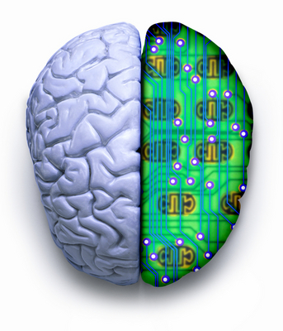
AI and the Brain
Shailesh Appukuttan : 0933 0003
M.Tech 1st Year
CS344 Seminar
Image Source: http://www.interintelligence.org

Slide 2

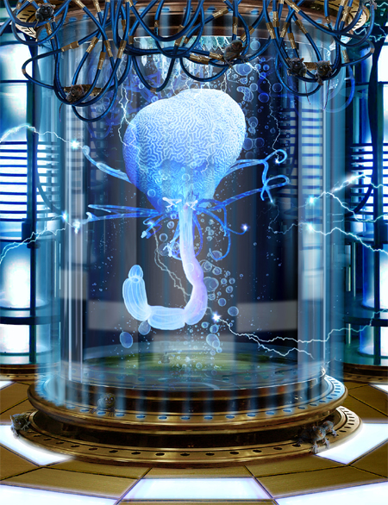
An Artificial Brain
Ever since the modern computer was invented people have wondered if the human brain could be simulated, perhaps so well that the organic brain could be replicated in a machine!
Image Source: http://www.onlineinvestingai.com/blog/tag/markets/page/2/

Slide 3
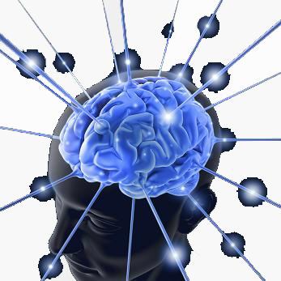
The Brain
“The most complex thing we have yet discovered in our Universe“
James Watson
Molecular Biologist, Co-discoverer
of the helical structure of DNA
Image Source: http://haktech.blogspot.com/2009/11/

Slide 4
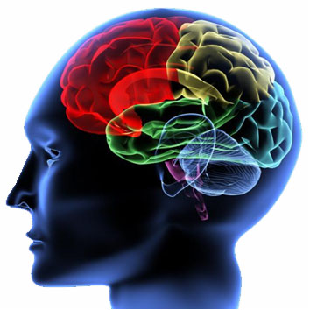
The Brain
It is a product of many millions of years of evolution
Called a Neural Network of neurons whereby individual cells act as processors that share information with other neurons to produce thought. This idea is the basis of Artificial Neural Networks
Image Source: http://neuronarrative.wordpress.com/2009/03/16/

Slide 5
The Mind-Body Problem
Dualism…
Mind, or Soul, exists separately from the Brain
If the mind is separable from the brain, then true AI could never be realized, as the something else (namely the mind, spirit etc.) could never be realized in the physical object (the computer)
Materialism…
Mind arises from activity in the Brain
The evidence for materialism is overwhelming
Modern brain imaging techniques can detect brain activity correlated with thought

Slide 6
Strong A.I. vs Weak A.I.
Weak A.I.
Weak AI only claims that machines can act intelligently
Machine intelligence need only mimic the behavior of human intelligence
Not intended to match/exceed the capabilities of human beings
Strong A.I.
Strong AI claims that a machine that acts intelligently also has mind and understands in the same sense people do
Given the appropriate programming a computer actually becomes a mind
A.I. that matches or exceeds human intelligence

Slide 7
Can Machines Really Think?
“Not until a machine could write a sonnet or compose a concerto because of thoughts and emotions felt, and not by the chance fall of symbols, could we agree that machine equals brain….”
- (Geoffrey Jefferson, 1949, quoted by A. Turing)

Slide 8

Searle’s Criticism of Strong AI
John Searle
- A famous philosopher
Searle’s criticism of strong AI’s analogy “Mind is to brain as program is to computer”
seems justified since “mental states and events are literally a product of the operation of the brain, but the program is not in that way a product of the computer”.
Image Source: http://www.nndb.com/people/457/000070247/
Notes:
John Searle
Famous philosopher at University of California, Berkeley. Most well-known in philosophy of language, philosophy of mind and consciousness studies

Slide 9
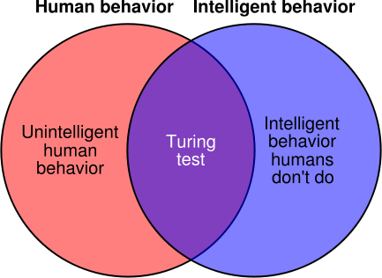
Artificial Intelligence
With the advent of the field of A.I., Philosophers and Scientists debated about very fundamental and important questions like – “Can machines think?”, “Is AI possible?” etc.
Alan Turing then formulated the question “Can machines think?” into a test, which became famous as The Turing Test.
Image Source: http://commons.wikimedia.org/wiki/

Slide 10
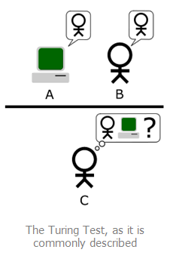
The Turing Test
If a machine can conduct a conversation so well that people cannot tell whether they are talking with a person or with a computer, then the computer can think. It passes the Turing Test.
Image Source: http://commons.wikimedia.org/wiki/

Slide 11
Questions
Is there anything essential that a human being can do that a computer could never do? Why?
Even if a computer can pass a Turing test, how do we know it is really thinking as opposed to imitating or simulating thought?
If the Turing test is not a good test for actual thinking, is there any better test?

Slide 12
Searle’s Argument
Searle argues against both functionalism (the computer model of mind) and the claim that a computer that passes the Turing test would actually be thinking.
He does so by using a counter-example wherein a system passes the Turing test, but is not at all thinking or understanding.
It is called the Chinese Room Experiment.
Source: www.storobia.com/ai/philosophy/chinese-room.html

Slide 13
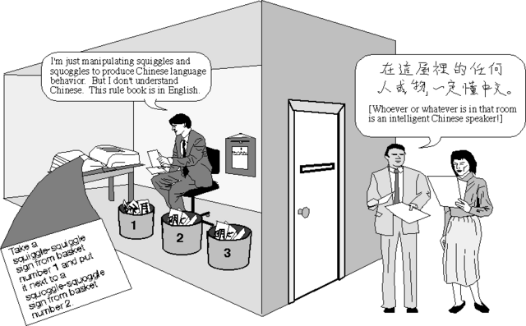
The Chinese Room
He does not know Chinese
Chinese Writing is given to the person
Correct Responses
Set of rules, in English, for transforming phrases
Image Source: http://pzwart.wdka.hro.nl/mdr/research/
Notes:
Searle is in a room with input and output windows, and a list of rules, in English, about manipulating Chinese characters.
The characters are all meaningless “squiggles and squoggles” to him.
Chinese texts and questions come in from the input window.
Following the rules, he manipulates the characters and produces each reply, which he pushes through the output window.
The answers in Chinese that Searle produces are very good. In fact, so good, no one can tell that he is not a native Chinese speaker!
Searle’s Chinese Room passes the Turing Test. In other words, it functions like an intelligent person.
Searle has only conducted symbol manipulation, with no understanding, yet he passes the Turing Test in Chinese.
Therefore, passing the Turing Test does not ensure understanding.

Slide 14
The Chinese Room
Applet Source: http://www.mind.ilstu.edu/curriculum/searle_chinese_room/searle_chinese_room.php

Slide 15
Objections
The answers in Chinese that Searle produces are very good. In fact, so good, no one can tell that he is not a native Chinese speaker!
Searle has only conducted symbol manipulation, with no understanding, yet he passes the Turing Test in Chinese.
Therefore, passing the Turing Test does not ensure understanding.
Source: http://www.mind.ilstu.edu/curriculum/searle_chinese_room/searle_chinese_room.php

Slide 16
Counter Objections
Searle is part of a larger system. Searle doesn’t understand Chinese, but the whole system (Searle + room + rules) does understand Chinese.
The knowledge of Chinese is in the rules contained in the room. The ability to implement that knowledge is in Searle.
The system as a whole understands Chinese.
Source: http://www.mind.ilstu.edu/curriculum/searle_chinese_room/searle_chinese_room.php

Slide 17
Searle’s Conclusion
Searle concludes that symbol manipulation alone can never produce understanding
Computer programming is only symbol manipulation
Computer programming can never produce understanding
Strong AI is false

Slide 18
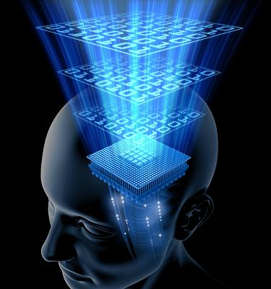
Whole Brain Emulation
Also knows as Mind Uploading
An approach to Strong AI
Often called as its Ultimate Goal
Hypothetical process of scanning and
mapping a biological brain in detail
and copying its state into a computer
system
Could lead to Immortality and
Parallel Existence
Image Source: http://www.futuretimeline.net/22ndcentury/2100-2149.htm

Slide 19
Why all the fuss?
“The question of whether a computer can think is no more interesting than the question of whether a submarine can swim.”
Edsger W. Dijkstra
Computer Scientist
Is an artificial Picasso painting considered a Picasso painting?
Are artificial sweeteners sweeteners?
Distinction seems to depend on intuition
Extracted From: Stuart Russell and Peter Norvig, 2005

Slide 20
References
Searle J. R. Mind, brains and programs. Behavioral and Brain Sciences, 1980.
Marvin Minsky, Why People Think Computers Can’t, AI Magazine, vol. 3 no. 4, 1982.
Searle J.R. Mind, brains and science. Harvard Univ. Press, Cambridge, 1984.
Searle J. R. Is the brain’s mind a Computer Program? Scientific American, 1990.
Stuart Russell and Peter Norvig. Artificial Intelligence – A Modern Approach. Pearson Education, Second Edition, 2005.
http://www.alanturing.net
http://brain.web-us.com
http://www.mind.ilstu.edu/curriculum/searle_chinese_room/searle_chinese_room.php
http://en.wikipedia.org

Slide 21

Questions?
Image Source: http://www.legis.state.wi.us/senate/sen11/news/

