Slide 1
Boredom and AI
Manas Joglekar (07005006)
Harsh Pareek (07005007)
Viraj Deshpande (07005008)
Mehul Jain (07005021)
Rohit Singh (07005034)

Slide 2
Outline
Introduction
  Definition
  Psychology, Philosophy and Biological
Does intelligence require boredom?
  Boredom as awareness of self
Modeling Boredom
  Behavioral tests
  Using AI
Applications
Future Directions

Slide 3

Definition
Boredom is an emotional state experienced during periods lacking activity or when individuals are uninterested in the opportunities surrounding them.
The first record of the word boredom is in the novel Bleak House by Charles Dickens, written in 1852
How people have described boredom:
Boredom [is] the desire for desires
  Leo Tolstoy, Anna Karenina
A man can stand almost anything except a succession of ordinary days.
Goethe, the great 18th century German poet, dramatist, and scientist, described boredom as “the mother of invention”.
Man is the only animal that can be bored.
  Erich Fromm, The Sane Society (1955)

Slide 4
Psychology
Boredom is an unpleasant, transient affective state in which the individual feels a pervasive lack of interest and difficulty concentrating on the current activity.
Positively, a response to a moderate challenge for which the subject has more than enough skill
Boredom has been traditionally associated with clinical depression and attention disorders.

Slide 5
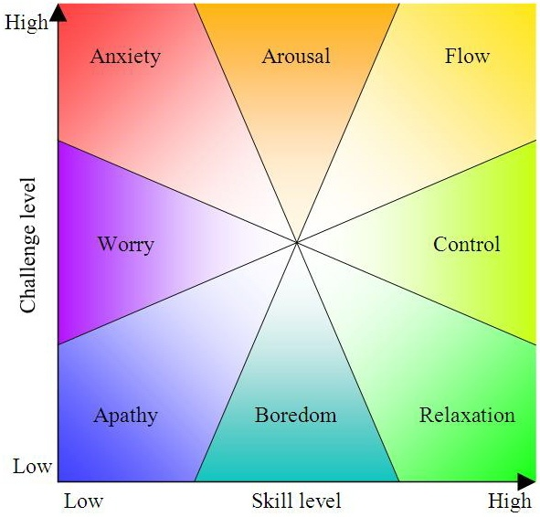
Mental State as a Function of Skill and Challenge Levels
- Mihaly Csikszentmihalyi

Slide 6
Philosophy
situational boredom
chronic boredom
- existential boredom
Arthur Schopenhauer used the existence of boredom in an attempt to prove the vanity of human existence,
"...for if life, in the desire for which our essence and existence consists, possessed in itself a positive value and real content, there would be no such thing as boredom: mere existence would fulfill and satisfy us ” .

Slide 7
Default Network
The bored brain : incredibly active, generates daydreams and engages in mental time travel.
An elaborate electrical conversation between the front and rear parts of the mind.
In humans: generates spontaneous thoughts during mind-wandering, believed to be an essential component of creativity.

Slide 8
Boredom and limits of AI
Can we build machines which can think?
Can we build machines which can think like human beings?
Can computers imitate human behaviour(intelligence)?
Can we identify an aspect of intelligence which seems to be really difficult for computers to achieve?

Slide 9
Can computers be creative?
Creativity: ability to produce unanalyzable leaps of imagination (“creative sparks”).
Is everyone creative or is it that only a few of us are?
"noncreative intelligence“- a flat-out contradiction in terms.
Still vague…
Notes:
Creativity is part of the very fabric of all human thought, rather than
some esoteric, rare, exceptional, and fluky by-product of the ability to think, which
every so often surfaces in places spread far and wide.It
is an intrinsic ingredient of the everyday mental activity of everyone.

Slide 10
Creativity as a network of concepts
having creativity is an automatic consequence of having the proper representation of concepts in the mind.
concepts derive all their power from their connectivity to one another
Vaguely: concepts are the rules, facts and data available to an intelligent being.
What kind of objects have such a representation of concepts and what kinds do not?

Slide 11
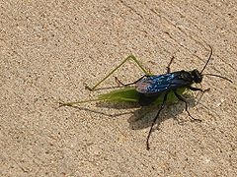
Boring Multimedia ☺
Computer Bug
Playing Cat
Sphex
Notes:
It's interesting to think that what the mantis' tiny brain is actually doing when it calculates how to lunge at the cursor may not be all that different from what a cat's brain is doing when it calculates how to lunge at a bit of string...but with a mantis there isn't much sense of a personality behind the lunging, whereas with a cat there is, probably because of all the other stuff going on in the cat's brain not directly related to figuring out the best bodily motions to grab its target. For example, a cat will eventually get bored with string games, or take breaks to sort of assess the situation and see what the string is doing, but the mantis would probably mechanically repeat the same grabbing-at-the-cursor forever, with no apparent sense of futility and also no sense of "playfulness".

Slide 12
Sphexishness
Hofstadter{Metamagical Themas Questing for the Essence of Mind and Pattern(1982)}; Christopher von B’ulow(2003)
--Can’t analyze its own behavior… Never gets bored!
What is the mantis lacking?
a general sensitivity to patterns, an ability to spot patterns of unanticipated types in unanticipated places at unanticipated times in unanticipated media.
(there’s a pattern up there too… did you recognize it?)
Human Beings: “loop detector”
losing the disposition responsible for the loop.
Notes:
Breaking out of a loop is not interesting if it
happens purely by chance; we want the organism to break out as a result of some
[4 [March 22, 2003] Christopher von B¨ulow]
kind of adaptation, of “learning”, i.e., of losing the disposition responsible for the
loop.
Why We Make the Same Mistakes Over and Over Again
Christopher von B¨ulow
Abstract
Why is it that sometimes we do the same inappropriate things over and over
again, i.e., why are we sphexish? It’s because we have adopted detrimental, but
self-reinforcing, routines and beliefs – memes –

Slide 13
Can we create antisphexish machines?
Does your computer get bored?
Requires “self-watching” at various levels of abstraction.
Should a computer yawn after every similar set of instructions it executes?
Watching one's own internal microscopic patterns is bound to be boring.
The computer needs to identify regular behavior due to huge patterns of activity at a higher level

Slide 14
Contd…
Self-watching : monitoring changes in “data structures” ,filtering and recording interesting aspects in other data structures(“watchers”).
Shouldn’t we set up a second level of data structures to monitor these “watchers”?
-Territory for infinite regress!
That’s not all! Shouldn’t we have a watcher for this infinite chain?
Notes:
Thus patterns in the changes taking place in one set of data
structures would get recorded in another set of data structures. Should we then not set
up a third level of data structures, to watch the second level, should patterns occur in
it? And a fourth, to watch the third? This seems prime territory for an infinite regress:
an endless hierarchy of structures, each one monitoring changes in the level below it.
The problem is, there's nothing to prevent the co-level itself from going into
loops-so if we're going to obviate that, we have to have a higher watcherconventionally
called "w+ I".
There is a problem once you
start getting into infinite regresses composed of other infinite regresses -the whole
thing just never stops, and it becomes a bore. Or not exactly a bore, but a very
complex and confusing thing, whose reality and relevance become ever more
questionable.

Slide 15
"Minds, Machines, and Gödel“ -J.R. Lucas
Machines cannot think like humans!
Humans cannot get into an infinite loop but a machine will!
Knowledge Chain: A conscious being knows something, knows that he knows it, and that he knows that he knows that he knows it, and so on.
Argument against AI: A machine can be made in a manner of speaking to “consider” its performance, but it cannot take this “into account” without thereby becoming a different machine, namely the “old machine with a new part added”.
Notes:
Although conscious beings have the power of going on, we do not
wish to exhibit this simply as a succession of tasks they are able to perform, nor
do we see the mind as an infinite sequence of selves and super-selves and supersuper-
selves. Rather, we insist that a conscious being is a unity, and though we
talk about parts of the mind, we do so only as a metaphor, and will not allow it
to be taken literally.
Lucas seems to think that to be human is to be endowed with this "BOOLE"
ability-this total and perfect antisphexishness-intrinsically. On reflection, however,
one realizes this surely is not the case. Despite not being Sphex wasps or Airedales,
we humans are all still vulnerable to getting caught in ruts, as I attempted to point out
in the dozen-item list above. None of us is immune. Each of us-even the Mozarts
among us-exhibits a "cognitive style" that in essence defines the ruts we are
permanently caught in.

Slide 16
Conclusion: perfectly antisphexish machines are impossible
Remember the Halting Problem?
Is there any program inspecting other programs before they run predicting termination?
Closely related (diagonalization…)
Difference between the two problems(AI survives):
a self-watching program(for AI): not really so concerned with the mathematical perfection but with likelihood of survival in a complex world;
It seems that self watching is essential for an AI program (e.g. “learning”) but perfect self watching is something one cannot achieve. We have to settle with some approximation that works.
Notes:
whether there exists any computer program that can inspect other programs before they run, and reliably predict whether or not they will go into infinite loops
The problem is, there's nothing to prevent the co-level itself from going into
loops-so if we're going to obviate that, we have to have a higher watcherconventionally
called "w+ I".
There is a problem once you
start getting into infinite regresses composed of other infinite regresses -the whole
thing just never stops, and it becomes a bore. Or not exactly a bore, but a very
complex and confusing thing, whose reality and relevance become ever more
questionable.
This is related to a classic problem in the theory of computability, called the
halting problem: It is the question of whether there exists any computer program that
can inspect other programs before they run, and reliably predict whether or not they will go into infinite loops
--similarity
Probably the most significant difference between the halting problem and the
idea of a self-watching program is that in trying to build an artificial intelligence, we
are not really so concerned with the mathematical perfection of our self-watching
system as with its likelihood of survival in a complex world;
there is no finite mechanism that can possibly
detect all patterns, patterns of patterns, patterns of patterns of patterns of patterns

Slide 17
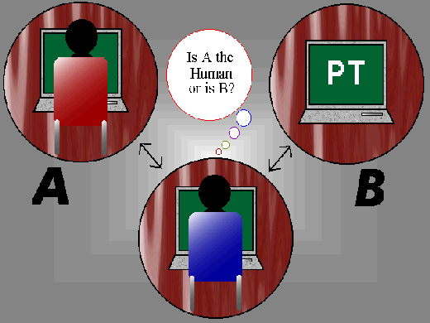
Turing Test
A human judge engages in a natural language conversation with one human and one machine, each of which tries to appear human. All participants are placed in isolated locations
If the judge cannot reliably tell the machine from the human, the machine is said to have passed the test.

Slide 18
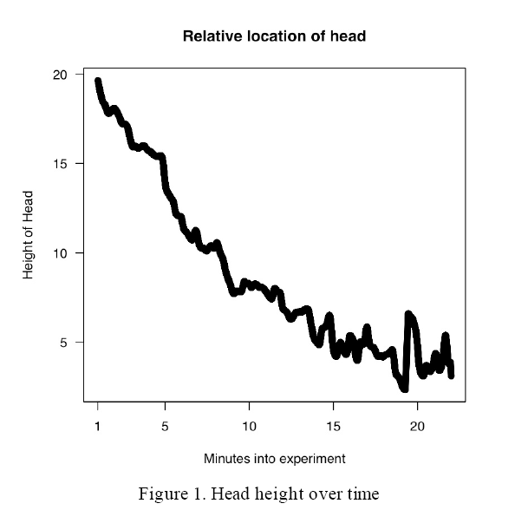
Measuring Boredom
Non-verbal tests: Audio-visual feedback techniques
  Facial expression
  Sitting position
    Pressure map on chair
    Head height
    Leaning / slouching
  Resistance across
  points on skin
  Heart beat
  Blood pressure
  Audio feedback

Slide 19
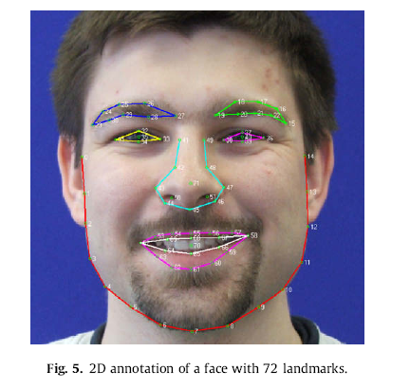
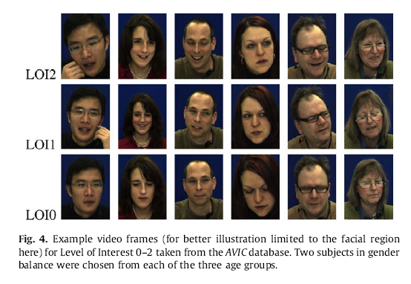
Processing audio-visual feedback
Computational techniques used:
  Hidden Markov models
  Feed-forward neural networks
  Support vector machines
  Fuzzy ARTMAP network

Slide 20
Measuring Boredom in Humans
Boredom Proneness Scale
Cognitive scale proposed in 1986 by Farmer, R. & Sundberg, N. D.
This has been widely studied to obtain variation of proneness to boredom across gender, age, race, work, personality, etc.
Relevance of this scale has been highly studied and various modifications have been suggested.
Instead of one-dimensional bipolar scale: 5 dimensions can be extracted from the survey:
External Stimulation, Internal Stimulation, Constraints, Affective Response, and Perception of Time
Other proposed scales:
EASI-III Temperament Survey
36-point Academic Boredom scale

Slide 21
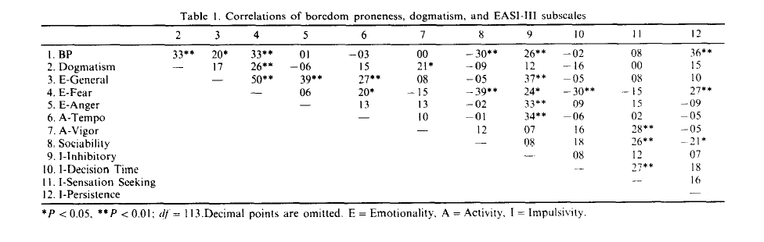
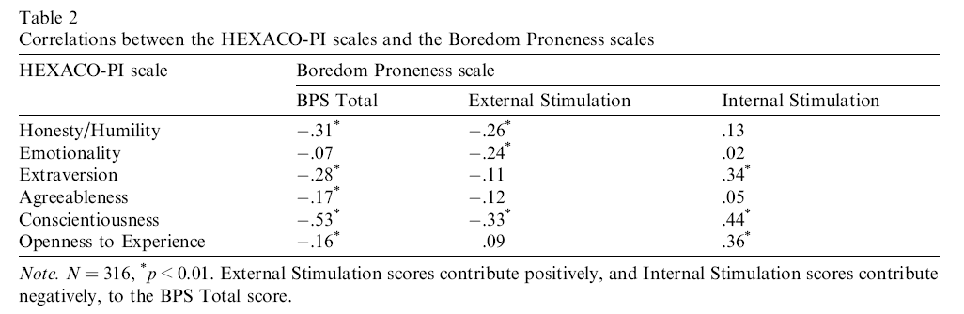
Some results

Slide 22
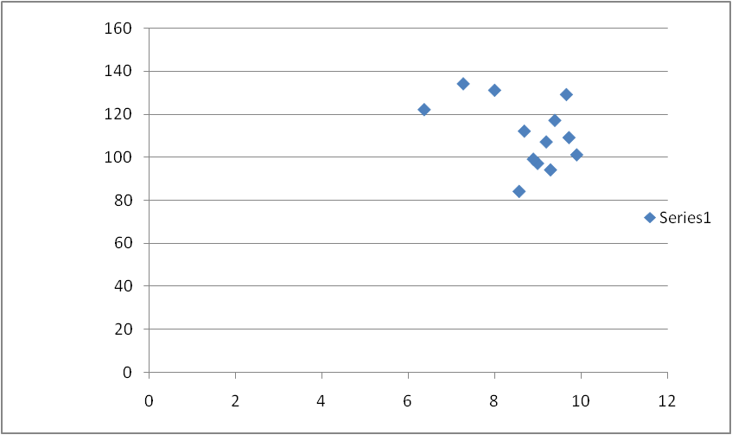
Data for our class
BP Vs CPI

Slide 23
Non-rigid scales:
Difficult to design and heavy computation.
Modeling boredom and flow using web activity of users:
  Type of activity:
    Information retrieval
    Creating webpages
    Communication: Social/personal (email/chatting)
    Playing games
  Response time/ immediate feedback
  Design of websites most visited
  Clear goals

Slide 24
Applications
Academic boredom:
  Intelligent tutoring systems
    Systems with adaptive strategies based on audio-visual feedback from students
  Predicting dropouts from e-courses
    Time invariant vs. Time variant parameters
Work environment boredom:
  Detecting boredom before significant drop in performance is observed
  Self-organizing task allocation among agents
    2 agent experiment

Slide 25
Future Directions
Should a system stop a computation if it notices a pattern?
Or perhaps use a pattern to speed up computation?
Eg. Learning rate in typical AI systems
Stop when not making progress

Slide 26
References
  http://en.wikipedia.org/wiki/Boredom
  http://www.bartneck.de/publications/2008/emotionAndAI/index.html
  http://chaos.uncc.edu/~heckel/papers/JacobsEtAlHRI2009.pdf
  Metamagical Themas: Questing For The Essence Of Mind And Pattern by: Douglas Hofstadter
  http://uwf.edu/svodanov/boredom/bps.htm - A Boredom Proneness test on a 7-point scale
  Farmer, R. & Sundberg, N. D. (1986). Boredom proneness: The development and correlates of a new scale. Journal of Personality Assessment, 50, 4–17
  http://scienceblogs.com/cortex/2009/03/boredom.php
  http://mightymouse.brynmawr.edu/~dblank/papers/epirob-abs.pdf
  Boredom proneness: temperamental and cognitive components .Frederick T. L, Leong and Gregory R. Schneller
  The relations of two facets of boredom proneness with the major dimensions of personality Neil A. Culp
  Personality and Individual Differences 41 (2006) 999–1007
  Being bored? Recognising natural interest by extensive audiovisual integration for real-life application. Björn Schuller, Ronald Müller, Florian Eyben, Jürgen Gast, Benedikt Hörnle, Martin Wöllmer, Gerhard Rigoll, Anja Höthker, Hitoshi Konosu.Image and Vision Computing 27 (2009) 1760–1774
  Optimal experience of Web activities,Hsiang Chen, R.T. Wigand, M.S. Nilan
  Computers in Human Behavior 15 (1999) 585-608

Slide 27
References
  How do you know that I don’t understand? A look at the future of intelligent tutoring systems,Abdolhossein Sarrafzadeh, Samuel Alexander, Farhad Dadgostar, Chao Fan, Abbas Bigdeli.Computers in Human Behavior 24 (2008) 1342–1363
  Dropout prediction in e-learning courses through the combination of machine learning techniques,Ioanna Lykourentzou, Ioannis Giannoukos, Vassilis Nikolopoulos, George Mpardis, Vassili Loumos.Computers & Education 53 (2009) 950–965
  Behavioral and Physiological Indices of Fatigue in a Visual Tracking Task
  D. J. Mascord and R. A. Heath.JOWMI of Safiq Research, 1992
  Formalizing self-organizing processes of task allocation
  Kees Zoethout *, Wander Jager, Eric Molleman
  Simulation Modelling Practice and Theory 14 (2006) 342–359
  Human Sphexishness
  Why We Make the Same Mistakes Over and Over Again
  Christopher von Bulow∗¨
  Robot Self-Motivation: Balancing Boredom and Confusion
  James B. Marshall Douglas Blank Lisa Meeden
  http://mightymouse.brynmawr.edu/~dblank/papers/epirob-abs.pdf

