Slide 1
CS344: Introduction to Artificial Intelligence
Vishal Vachhani
M.Tech, CSE
Lecture 34-35: CLIR and Ranking in IR

Slide 2
Road Map
Cross Lingual IR
  Motivation
  CLIA architecture
  CLIA demo
Ranking
  Various Ranking methods
  Nutch/lucene Ranking
  Learning a ranking function
  Experiments and results

Slide 3
Cross Lingual IR
Motivation
  Information unavailability in some languages
  Language barrier
Definition:
  Cross-language information retrieval (CLIR) is a subfield of information retrieval dealing with retrieving information written in a language different from the language of the user's query (wikipedia)
Example:
  A user may ask query in Hindi but retrieve relevant documents written in English.

Slide 4

Why CLIR?
Query in Tamil
System
search
English Document
Marathi Document
Snippet Generation and Translation
English Document

Slide 5
Cross Lingual Information Access
Cross Lingual Information Access (CLIA)
  A web portal supporting monolingual and cross lingual IR in 6 Indian languages and English
  Domain : Tourism
  It supports :
    Summarization of web documents
    Snippet translation into query language
    Temple based information extraction
  The CLIA system is publicly available at
    http://www.clia.iitb.ac.in/clia-beta-ext

Slide 6
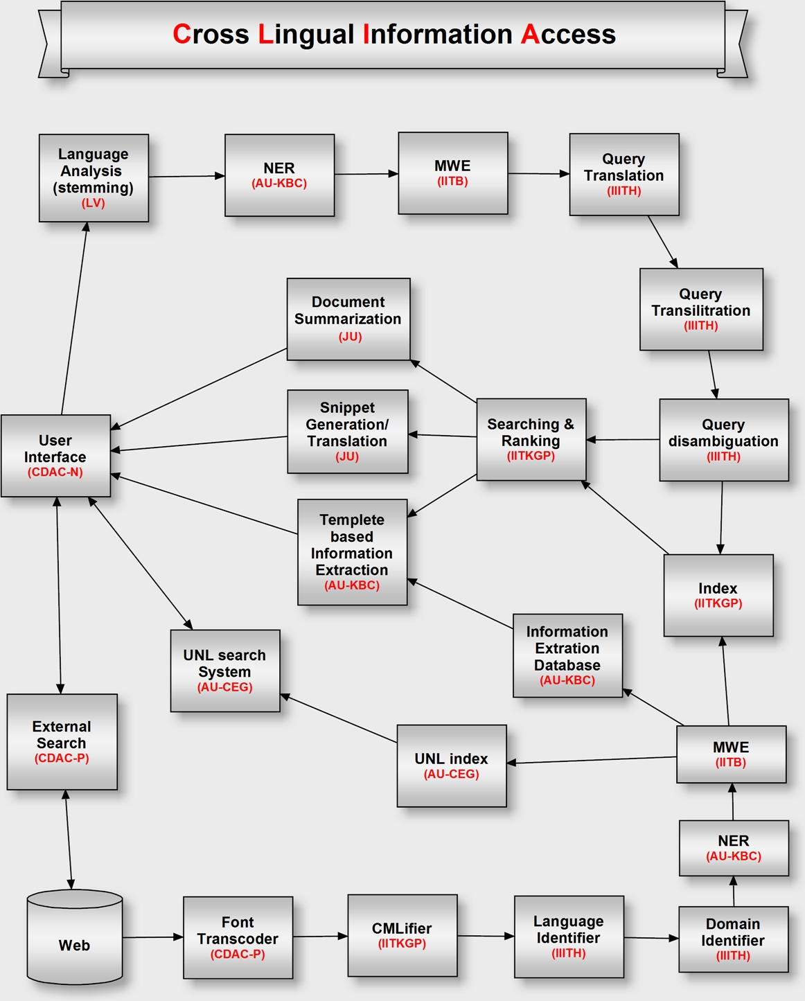

Slide 7
CLIA Demo

Slide 8
Various Ranking methods
Vector Space Model
  Lucene, Nutch , Lemur , etc
Probabilistic Ranking Model
  Classical spark John’s ranking (Log ODD ratio)
  Language Model
Ranking using Machine Learning Algo
  SVM, Learn to Rank, SVM-Map, etc
Link analysis based Ranking
  Page Rank, Hubs and Authorities, OPIC , etc

Slide 9
Nutch Ranking
CLIA is built on top on Nutch – A open source web search engine.
It is based on Vector space model

Slide 10
Link analysis
Calculates the importance of the pages using web graph
  Node: pages
  Edge: hyperlinks between pages
Motivation: link analysis based score is hard to manipulate using spamming techniques
Plays an important role in web IR scoring function
  Page rank
  Hub and Authority
  Online Page Importance Computation (OPIC)
Link analysis score is used along with the tf-idf based score
We use OPIC score as a factor in CLIA.

Slide 11
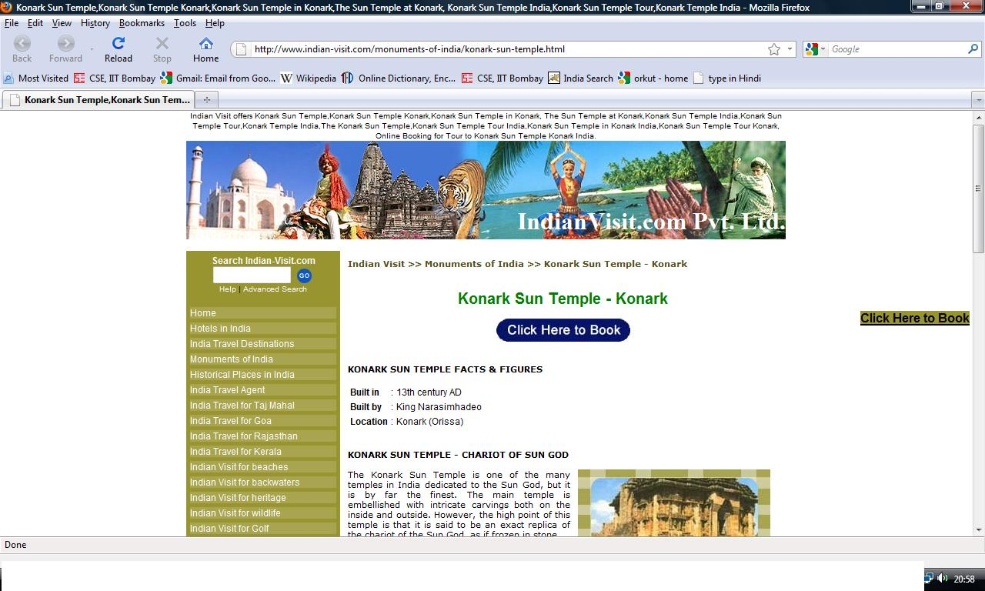

Slide 12
Learning a ranking function
How much weight should be given to different part of the web documents while ranking the documents?
A ranking function can be learned using following method
  Machine learning algorithms: SVM, Max-entropy
  Training
    A set of query and its some relevant and non-relevant docs for each query
    A set of features to capture the similarity of docs and query
    In short, learn the optimal value of features
  Ranking
    Use a Trained model and generate score by combining different feature score for the documents set where query words appears
    Sort the document by using score and display to user

Slide 13
Extended Features for Web IR
Content based features
  Tf, IDF, length, co-ord, etc
Link analysis based features
  OPIC score
  Domains based OPIC score
Standard IR algorithm based features
  BM25 score
  Lucene score
  LM based score
Language categories based features
  Named Entity
  Phrase based features

Slide 14
Content based Features

Slide 15
Details of features
Feature No | Descriptions
1 | Length of body
2 | length of title
3 | length of URL
4 | length of Anchor
5-14 | C1-C10 for Title of the page
15-24 | C1-C10 for Body of the page
25-34 | C1-C10 for URL of the page
35-44 | C1-C10 for Anchor of the page
45 | OPIC score
46 | Domain based classification score

Slide 16
Details of features(Cont)
Feature No | Descriptions
48 | BM25 Score
49 | Lucene score
50 | Language Modeling score
51 -54 | Named entity weight for title, body , anchor , url
55-58 | Multi-word weight for title, body , anchor , url
59-62 | Phrasal score for title, body , anchor , url
63-66 | Co-ord factor for title, body , anchor , url
71 | Co-ord factor for H1 tag of web document

Slide 17
Experiments and results
 |  |  |  | MAP
Nutch Ranking | 0.2267 | 0.2267 | 0.2667 | 0.2137
DIR with Title + content | 0.6933 | 0.64 | 0.5911 | 0.3444
DIR with URL+ content | 0.72 | 0.62 | 0.5333 | 0.3449
DIR with Title + URL + content | 0.72 | 0.6533 | 0.56 | 0.36
DIR with Title+URL+content+anchor | 0.73 | 0.66 | 0.58 | 0.3734
DIR with Title+URL+ content + anchor+ NE feature | 0.76 | 0.63 | 0.6 | 0.4

Slide 18
Thanks

