Slide 1

Recognizing Textual Entailment using UNL framework
Arpit Maheshwari
Under the guidance of
Prof. Pushpak Bhattacharyya
8th April 10

Slide 2
Contents
Introduction
  Textual Entailment
  Approaches
  UNL representation
Illustration
  Outline of the Algorithm
  About the corpora
Phenomenon Handled
  Examples from the corpora
Algorithm
  Growth Rules
  Matching Rules
  Efficiency Aspects
Experimentation
  Creation of Data
Results
Conclusion and Future Work

Slide 3
Textual Entailment
Whether one piece of text follows from another
Text entailment (TE) can be looked upon as mapping between variable language forms
Mapping possible at different levels of the language.
  Lexical level
  Syntactic level
  Semantic level
TE as a framework for other NLP applications like QA, Summarization, IR etc

Slide 4
Some Examples
 | TEXT | HYPOTHESIS | ENTAIL-MENT
1 | . The Hubble is the only large visible light and ultra-violet space telescope we have in operation. | Hubble is a Space telescope. | True
2 | Google files for its long awaited IPO. | Google goes public. | True
3 | After the deal closes, Teva will earn about $7 billion a year, the company said. | Teva earns $7 billion a year. | False
4 | The SPD got just 21.5% of the vote in the European Parliament elections, while the conservative opposition parties polled 44.5%. | The SPD is defeated by the opposition parties. | True

Slide 5
Natural Language and Meaning
Meaning
Variability
Ambiguity
Language
Notes:
Text understanding in a nutshell
Levels of representation.

Slide 6
Text Entailment = Text Mapping
Assumed Meaning (by humans)
Variability
Language
(by nature)
Notes:
The only way to test understanding – as we do not have access to actual meaning: how do I know that you understand (by phone)?
A version of Turing test
(I ignore entailment direction here)

Slide 7
Basic Representations
Meaning
Representation
Inference
Logical Forms
Semantic Representation
Representation
Syntactic Parse
Raw Text
Local Lexical
Text Entailment
Page 7
Notes:
7
Interpretation approach: supposedly easier to infer entailment at the meaning representation language
The only way to test understanding – as we do not have access to actual meaning: how do I know that you understand (by phone)?
A version of Turing test
(I ignore entailment direction here)

Slide 8
Approaches towards TE
Learning template based entailment rules [5], inference via graph matching [1], logical inference [3] etc.
  Lexical: Ganesh bought a book. |= Ganesh purchased a book.
  Syntactic: Shyam was singing and dancing. |= Shyam was dancing.
  Semantic: John married Mary. |= Mary married John.
Observations.
  Logic based methods : precise but lack robustness.
  Shallow methods : robust but lack precision.
A deep semantic representation having captured knowledge at lexical, syntactic and semantic levels is eminently suitable for recognizing text entailment

Slide 9
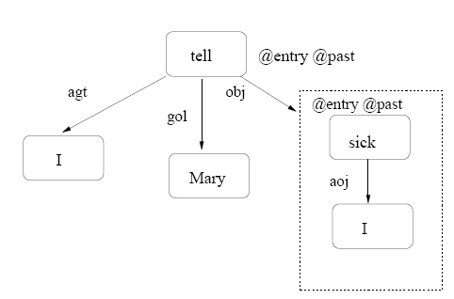
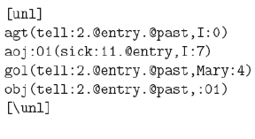
UNL Representation
UNL represents each sentence in natural language as directed graphs with hyper-nodes.
Features : Concept words, Relations, attributes.
e.g. I told Mary that I am sick.

Slide 10
Our Approach
Represent both text and hypothesis in their UNL form and do analysis on the UNL expressions.
List of atomic facts (predicates) emerging from the UNL graph of the hypothesis statement must be a subset (either explicitly or implicitly) of the atomic facts emerging from the UNL graph of the text statement.
The algorithm has two main parts.
  A: Extending the set of atomic truths of the text graph based on those which are present. (referred to as growth-rules)
  B: Carrying out the matching of the atomic facts in the hypothesis and the text graph (referred to as matching-rules)

Slide 11
Illustration
Manmohan Singh along with president George Bush signed a letter in 2006.╞ Bush signed a document.
Text expression
  agt(sign@entry@past,Manmohan_Singh) agt(sign@entry@past,Manmohan_Singh)
  cag(sign@entry@past,President) cag(sign@entry@past,President)
  nam(President,George_Bush) nam(President,George_Bush)
  obj(sign@entry@past,letter@indef) obj(sign@entry@past,letter@indef)
  tim(sign@entry@past,2006) tim(sign@entry@past,2006)
    aoj(President,George_Bush)
Hypothesis expression
  agt(sign@entry@past,Bush)
  obj(sign@entry@past,document@indef)
  tim(sign@entry@past,2006)

Slide 12
Illustration
Manmohan Singh along with president George Bush signed a letter in 2006.╞ Bush signed a document.
Text expression
  agt(sign@entry@past,Manmohan_Singh) agt(sign@entry@past,Manmohan_Singh)
  cag(sign@entry@past,President) cag(sign@entry@past,President)
  nam(President,George_Bush) nam(President,George_Bush)
  obj(sign@entry@past,letter@indef) obj(sign@entry@past,letter@indef)
  tim(sign@entry@past,2006) tim(sign@entry@past,2006)
    aoj(President,George_Bush)
  cag(sign@entry@past,George_Bush)
Hypothesis expression
  agt(sign@entry@past,Bush)
  obj(sign@entry@past,document@indef)
  tim(sign@entry@past,2006)

Slide 13
Illustration
Manmohan Singh along with president George Bush signed a letter in 2006.╞ Bush signed a document.
Text expression
  agt(sign@entry@past,Manmohan_Singh) agt(sign@entry@past,Manmohan_Singh)
  cag(sign@entry@past,President) cag(sign@entry@past,President)
  nam(President,George_Bush) nam(President,George_Bush)
  obj(sign@entry@past,letter@indef) obj(sign@entry@past,letter@indef)
  tim(sign@entry@past,2006) tim(sign@entry@past,2006)
    aoj(President,George_Bush)
  cag(sign@entry@past,George_Bush)
Hypothesis expression
  agt(sign@entry@past,Bush)
  obj(sign@entry@past,document@indef)
  tim(sign@entry@past,2006)

Slide 14
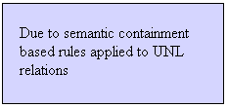
Illustration
Manmohan Singh along with president George Bush signed a letter in 2006. ╞ Bush signed a document.
Text expression
  agt(sign@entry@past,Manmohan_Singh)
  cag(sign@entry@past,President)
  nam(President,George_Bush)
  obj(sign@entry@past,letter@indef)
  tim(sign@entry@past,2006)
  aoj(President,George_Bush)
  cag(sign@entry@past,George_Bush)
Hypothesis expression
  agt(sign@entry@past,Bush)
  obj(sign@entry@past,document@indef)
  tim(sign@entry@past,2006)

Slide 15
Illustration
Manmohan Singh along with president George Bush signed a letter in 2006. ╞ Bush signed a document.
Text expression
  agt(sign@entry@past,Manmohan_Singh)
  cag(sign@entry@past,President)
  nam(President,George_Bush)
  obj(sign@entry@past,letter@indef)
  tim(sign@entry@past,2006)
  aoj(President,George_Bush)
  cag(sign@entry@past,George_Bush)
Hypothesis expression
  agt(sign@entry@past,Bush)
  obj(sign@entry@past,document@indef)
  tim(sign@entry@past,2006)

Slide 16
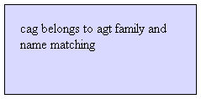
Illustration
Manmohan Singh along with president George Bush signed a letter in 2006. ╞ Bush signed a document.
Text expression
  agt(sign@entry@past,Manmohan_Singh)
  cag(sign@entry@past,President)
  nam(President,George_Bush)
  obj(sign@entry@past,letter@indef)
  tim(sign@entry@past,2006)
  aoj(President,George_Bush)
  cag(sign@entry@past,George_Bush)
Hypothesis expression
  agt(sign@entry@past,Bush)
  obj(sign@entry@past,document@indef)
  tim(sign@entry@past,2006)

Slide 17
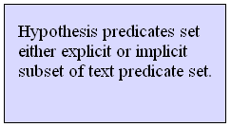
Illustration
Manmohan Singh along with president George Bush signed a letter in 2006. ╞ Bush signed a document.
Text expression
  agt(sign@entry@past,Manmohan_Singh)
  cag(sign@entry@past,President)
  nam(President,George_Bush)
  obj(sign@entry@past,letter@indef)
  tim(sign@entry@past,2006)
  aoj(President,George_Bush)
  cag(sign@entry@past,George_Bush)
Hypothesis expression
  agt(sign@entry@past,Bush)
  obj(sign@entry@past,document@indef)
  tim(sign@entry@past,2006)

Slide 18
About the Corpora
RTE Corpus
  The first PASCAL Recognizing Textual Entailment Challenge (15 June 2004 - 10 April 2005) provided the first benchmark for the entailment task.
  We work on the examples from RTE-3 corpus.
The examples in these corpora are arranged as a pair (text, hypothesis) of sentences along with the correct entailment decisions.

Slide 19
Examples from the Corpora
Syntactic Matching
  Text :The Gurkhas come from Nepal and their name comes from the city state of Goorka, which they were closely associated with at their inception.
  Hypo: The Gurkhas come from Nepal
Synonyms
  Text: She was transferred again to Navy when the American Civil War began in 1861.
  Hypo: The American Civil War started in 1861.

Slide 20
Examples from the Corpora
Generalizations
    Text: Indian firm Tata Steel has won the battle to take over Anglo-Dutch steelmaker Corus.
    Hypo: Tata Steel bought Corus.
Noun-verb relations
  Text : Gabriel Garcia Marquez is a novelist and winner of the Nobel prize for literature.
  Hypo: Gabriel Garcia Marquez won the Nobel for Literature.
  agt-aoj belong to the same family, and definition of winner

Slide 21
Examples from the Corpora
Compound Nouns
  Text: Assisting Gore are physicist Stephen Hawking, Star Trek actress Nichelle Nichols and Gary Gygax, creator of Dungeons and Dragons.
  Hypo: Stephen Hawking is a physicist.
  Subjective verb to predicative verb.
  Because of growth rule nam-aoj.

Slide 22
Examples from the Corpora
Definitions
  Text: A German nurse, Michaela Roeder, 31, was found guilty of six counts of manslaughter and mercy killing.
  Hypo: A German nurse was convicted of manslaughter and mercy killing.
  Convict - find someone guilty

Slide 23
Examples from the Corpora
World Knowledge: General ,Frames
  Scripts
    RTE -255 requires the sequence in the script of ‘journey’ : “..Travel..land..”
  An example like RTE-6..introduction of the word ‘member’ because of the UNL relation ‘iof’
    Text: “Yunupingu is one of the clan of..."
    Hypothesis: "Yunupingu is a member of..."

Slide 24
Examples from the Corpora
Dropping Adjuncts
Many examples from this category, covered by absence of predicates in the hypothesis.
  Text: Many delegates obtained interesting results from the survey.
  Hypo: Many delegates obtained results from the survey.
  Text : The Hubble is the only large visible light and ultra-violet space telescope we have in operation.
  Hypo: Hubble is a Space telescope.
Exceptions like dropping intrinsically negative modifiers handled.
  E.g. Ram hardly works, contradicts Ram works.

Slide 25
Growth Rules
pos-mod rule:
  Navy of India → Indian Navy
  Presence of pos(A,B) add mod(A,B)
Plc closure:
  Presence of plc(A,B) and plc(B,C) leads to the addition of plc(A,C).
    text :Born in Kingston-upon-Thames, Surrey, Brockwell played his county cricket for the very strong Surrey side of the last years of the 19th century.
    Hypo: Brockwell was born in Surrey.
Introduction of words based on UNL relations and attributes
  Attributes
    @end → ‘finish’ or ‘over’
  Relations
    ‘plc’ → ‘located ’.
    ‘pos’ → ‘belongs to’ , ‘owned by’

Slide 26
Matching Rules
Of Two types:
  A: Matching the UNL relations (predicate names).
  B: Matching the argument part.
Part A: Look up whether a relation belongs to the same family as other.
  E.g. src(source),plf(place from),plc(place) belong to the same family.
  agt(agent),cag(co-agent),aoj(attribute of object) also belong to the same family.

Slide 27
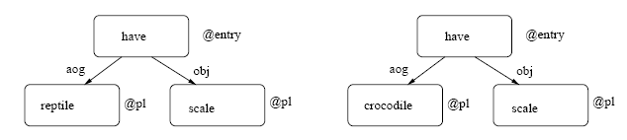
Matching Rules
Semantic containment based (monotonicity framework modeled using UNL)
A narrowing edit of thing pointed to by ‘aoj’.

Slide 28
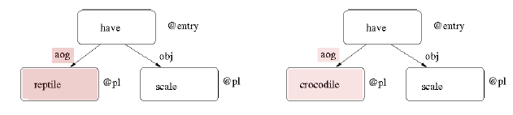
Matching Rules
Semantic containment based (monotonicity framework modeled using UNL)
A narrowing edit of thing pointed to by ‘aoj’.

Slide 29
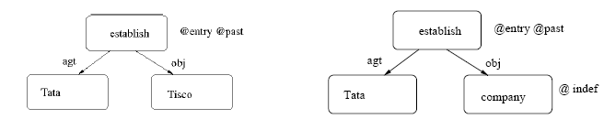
Matching Rules
Semantic containment based (monotonicity framework modeled using UNL)
A broadening edit of thing pointed to by ‘obj’.

Slide 30
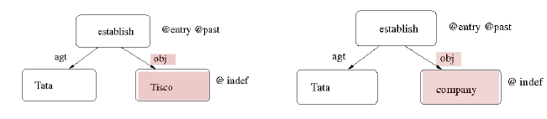
Matching Rules
Semantic containment based (monotonicity framework modeled using UNL)
A broadening edit of thing pointed to by ‘obj’.

Slide 31
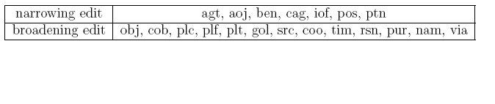
Matching Rules
Semantic containment based (monotonicity framework modeled using UNL)
A broadening edit of thing pointed to by ‘obj’.

Slide 32
Scope level matching
Alignment based on @entry
  English sentences S-V-O
  UNL representation : verb-centric
    E.g. Ram ate rice ╞ Ram consumed rice
Compare only matching scope.
  Larger sentences obtained by embedding.
    E.g. Shyam saw that Ram ate rice.
Importance in Contradiction detection
More efficient than matching all text predicates.

Slide 33
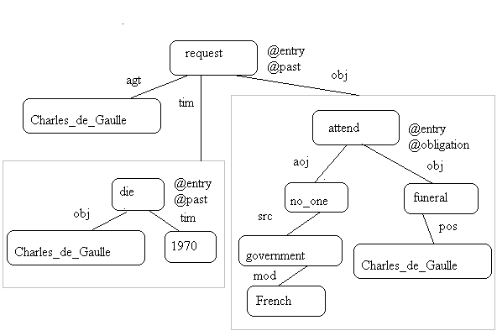
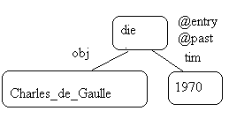
Illustration
Text: When Charles de Gaulle died in 1970, he requested that no one from the French government should attend his funeral.
Hypothesis: Charles de Gaulle died in 1970.

Slide 34
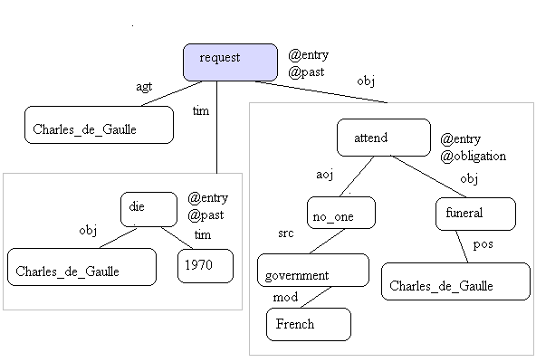
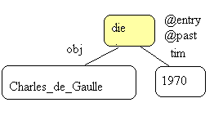
Illustration
Text: When Charles de Gaulle died in 1970, he requested that no one from the French government should attend his funeral.
Hypothesis: Charles de Gaulle died in 1970.

Slide 35
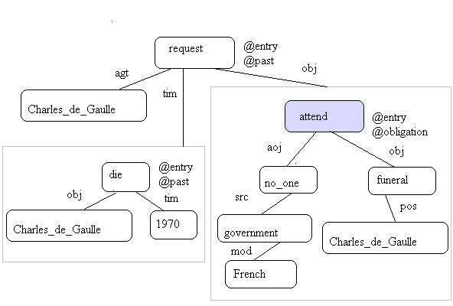
Illustration
Text: When Charles de Gaulle died in 1970, he requested that no one from the French government should attend his funeral.
Hypothesis: Charles de Gaulle died in 1970.

Slide 36
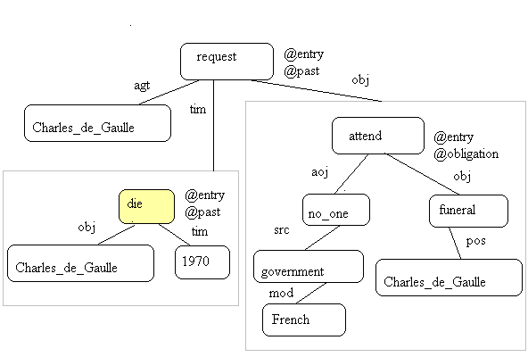
Illustration
Text: When Charles de Gaulle died in 1970, he requested that no one from the French government should attend his funeral.
Hypothesis: Charles de Gaulle died in 1970.

Slide 37
Algorithm
Step1: Preprocessing
  Preprocess both the text and the hypothesis UNL expressions.
  e.g. Handling the presence of ‘or’ by introduction of the attribute ‘@possible’.
Step2: Apply Growth rules ( on text predicates)
  E.g nam-aoj rule
Step3: Matching rules (match hypothesis and text predicates)
  Try @entry based efficient matching (Part I)
    Matching part A: (Matching predicate names: for matching scopes)
    Matching part B: (Matching argument part based on containment : for matching scopes)
  Decision
    If all the hypothesis predicates are matched with some predicates of the scope, we decide that entailment holds else we decide otherwise.
  If Part I returns ‘unknown’ match hypothesis with entire text predicates
    Matching part A: (Matching predicate names)
    Matching part B: (Matching argument part based on containment )
  Decision
    If all the hypothesis predicates are matched with some predicates of the text, we decide that entailment holds else we decide otherwise.

Slide 38
Experimentation
Creation of data for experimentation
Around 230 pairs (text, hypothesis), comprising of various language phenomenon, converted to UNL gold standard by hand for training the system
Resources like wordnet, verbocean were coupled with the system (using nltk-toolkit)

Slide 39
Results
Systems\Evaluations | Precision | Accuracy | Recall | F-score
EDITS | 0.49 | 0.49 | 0.79 | 0.61
WANG | 0.5 | 0.5 | 0.78 | 0.61
VENSES | 0.58 | 0.57 | 0.69 | 0.62
UNL | 0.96 | 0.8 | 0.63 | 0.76

Slide 40
Conclusion
Text Entailment via ‘deep semantics approach’
A novel framework for recognizing textual entailment using the UNL was created
Modeling semantic containment phenomenon in the UNL framework
Experimentation, showing interesting results

Slide 41
References
[1] A. Ng A. Haghighi and C. D. Manning. Robust textual inference via graph
matching. In Proceedings of the Conference on Empirical Methods in Natural Language Processing (EMNLP-05). 2005.
[2] Hendrik Blockeel and Luc De Raedt. Top-down induction of logical decision trees. In Artificial Intelligence, 1998.
[3] J. Bos and K. Markert. Recognizing textual entailment with logical inference. In Proceedings of HLT/EMNLP 2005. Vancouver, Canada, 2005.
[4] UNDL Foundation. Universal networking language (unl) specifications version 2005, edition 2006, august 2006. http://www.undl.org/unlsys/unl/
unl2005-e2006/.
[5] Dan Roth Ido Dagan and Fabio Massimo Zanzotto. Tutorial on textual en-
tailment. In 45th Annual Meeting of the Association for Computational Lin
guistics. 2007.

Slide 42
References contd..
[6] Bill MacCartney and Christopher D. Manning. Natural logic for textual infer-
ence. In Proceedings of the ACL-PASCAL Workshop on Textual Entailment
and Paraphrasing., pages 193–200, Prague, June 2007. Association for Com-
putational Linguistics.
[7] Bill MacCartney and Christopher D. Manning. Modeling semantic contain-
ment and exclusion in natural language inference. In Proceedings of the 22nd
International Conference on Computational Linguistics (Coling 2008), pages
521–528, Manchester, UK, August 2008. Coling 2008 Organizing Committee.
[8] John Thompson William Murray Jerry Hobbs Peter Clark, Phil Harrison and
Christiane Fellbaum. On the role of lexical and world knowledge in rte3.
In Proceedings of the ACL-PASCAL Workshop on Textual Entailment and
Paraphrasing, pages 54–59, Prague, June 2007. Association for Computational
Linguistics.
[9] M. Krishna Rajat Mohanty, Sandeep Limaye and Pushpak Bhattacharyya.
Semantic graph from english sentences. Pune, India, December 2008. Inter-
national Conference on NLP (ICON08).

