Slide 1
Teaching-Learning of Expand-Reduce Skills in the context of Software Design
DEEPTI REDDY
Under the supervision of
PROF. SRIDHAR IYER, PROF. SASIKUMAR M.

Slide 2
Presentation Flow
Problem
Software design
Expert vs Novice approach
Solution
Solution
Design Based Research (Cycle 1-3)
Conclusion
Generalizability
Research Gap and Goal
Limitations
Contributions & Future work
Local Learning Theories
Expand-Reduce skills

Slide 3
Software Design
Design a Library Record-Keeping System
Software Design problem characteristics
Problem space
Incompletely stated requirements
Sub-problems: data models and functional models are not well-defined
Solution space
Alternative correct solutions exist
Criteria to evaluate and select solution may not be stated.
Multiple stakeholders involved
Unknown problem domain
Multiple solution paths
(Pressman, 2010;Adelson, 1985; Tang, 2008; 2010, Guindon, 1990; Carmen, 2007; Jonassen, 2006)
Notes:
Explain problem, characteristics, process
Software design is a complex activity because the designers have to work in a unknown domian, where the business requrements are not clearly stated, the stakeholders are unknown.

Slide 4
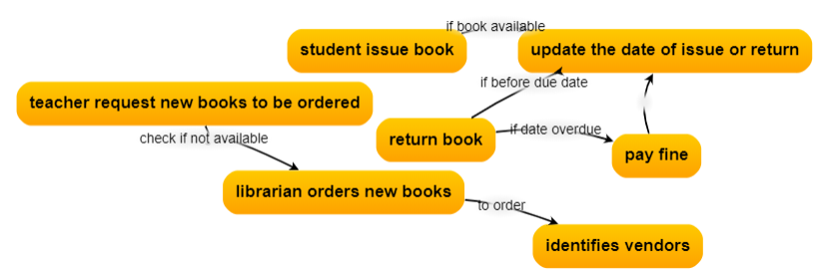
Illustration: Library problem- Expert approach
Design a Library Record-keeping System (LS)
Issue_books()
Generate solution
Issue_book()
Store books in a vector
books should be accessible quickly.
assess if the solution is generating the desired behaviour
Selection criteria
Generate solution
Order_book()
Order_books()
Note taking
Constraints
Requirements
Test Cases
Problem space
Solution space
(Adelson 1985, Guindon 1990, Tang 2008, 2010, Kunene 2005, Ellspermann 2007)
Notes:
It is observed in studies that the designers expand problem space by creating and simulating mental models at various levels of abstraction. Eventually, from these mental models, the sub-problems are decomposed.
For drawing such diagrams, designers start with one component (action, command, or entity) and systematically expand by showing related actions related to the initial entity and how other components are interacting as a whole. The experts form internal working model of the problem and the evidence is the external diagrams produced.
The ability to build a representation for simulations depends on the prior experience in solving problems in similar domain.

Slide 5
Cognitive Skills exhibited by experts
Cognitive Skills
Simulate mental models
Scenario generation
Systematic expansion of models
Constraints consideration
Problem Space Decision
Problem Space Decisions:
Analyse problem
Formulate Problem
Solution Space Decision
Cognitive Skills
Trade-off analysis
Option generation
Evaluation criteria
Explicit reasoning and Justification
Solution Space Decisions:
Generate Solution
Evaluate Solution
Select Solution
Iterative design decision making model
Design activities
(Adelson, 1984; Guindon, 1990; Tang, 2008; 2010).
Notes:
Drawing, model, assess, criteria, generating solutions

Slide 6
Illustration: Library problem- Novice approach
Design a Library Record-keeping System (LS)
Search book availability
If available issue book
books should be accessible quickly.
assess if the solution is generating the desired behaviour
Selection criteria
Books to be ordered are taken by teachers and stored in array
Search vendor..
Problem space
Solution space
Notes:
For drawing such diagrams, designers start with one component (action, command, or entity) and systematically expand by showing related actions related to the initial entity and how other components are interacting as a whole. The experts form internal working model of the problem and the evidence is the external diagrams produced.
The ability to build a representation for simulations depends on the prior experience in solving problems in similar domain.

Slide 7
Expert-Novice behaviour in Software Design
Cognitive Skills | Expert | Novice
Problem space exploration | Simulate scenarios, draw diagrams, simulate system as a whole | Novice considers commands at a programming level and not able to form or simulate the mental model.
Identifying selection criteria | Good at identifying the selection criteria and selecting the right option | Not able to identify selection criteria thus tend to adhere to initial design
Generating solutions | They think of alternatives if the solution is not satisfying the requirements or constraints. | Usually commits early to decisions
Co-evolve problem-solution space | Yes | Work in solution space and not able to go back and forth.
Notes:
Programming level, not seeing problem as a whole, simulate scenarios

Slide 8
Expand-Reduce Skills (ER skills)
ER in Problem Space
ER in Solution Space
Problem Space-
Expansionist- To understand the system as a whole by identifying the parts and interrelationship between the parts.
Reductionist -To break the problem into subproblems (Volkema 1983, Ackoff 1991, Ellspermann 2007).
Solution Space-
Divergent- To generate all possible alternative solutions .
Convergent - To systematically evaluate and select the appropriate solution based on selection criteria
(Liu 2004, Howard 2008, Basadur 1990, 2000).
Understand the problem as a whole
Generate alternative solutions
Expand
Define the goals and sub goals
Select solution based on selection criteria
Reduce
We will refer to these skills as expand-reduce(ER) skills- the ability to explore all possibilities and based on a selection criteria reduce to well defined sub-problems and solution.
Notes:
The problem solving skills that can mitigate these risk in problem space are expansionist-reductionist, and in solution space are divergent
explores issues and ideas before decisions are made, particularly on wicked problems [IBIS].
Conklin J. The IBIS manual: a short course in IBIS methodology,
1998. http://www.touchstone.com/tr/wp/IBIS.htm.

Slide 9
Research Gap
Research studies in problem-solving that have established the importance of ER skills in solving design problems efficiently (Ackoff, 1979; Volkema, 1983; Liu, 2004; Ellspermann, 2007, Adelson, 1984; Guindon, 1990; Tang, 2008).
Current engineering education and CSE research is more focussed on teaching well-structured problems or concepts and less on complex problem solving skills ((Cooperrider, 2008; Dym, 2005,Jonassen 2006, Cross 2001)
Notes:
Research focussed on content,

Slide 10
Research Goal
Teaching-learning of ER skills in the context of software design problem to novice using technology enhanced learning environment.
Broad research question- How to teach ER skills to novice learners in the context of solving software design problem?
The specific research questions (RQ) are:
RQ1: How to assess the level of the novices (undergraduate engineering student) in applying the ER skills?
RQ2:What is the level of scaffolding that is needed in teaching-learning of ER skills?
RQ3:How can technology affordances be used in learning ER skills?

Slide 11
Scope
Problem: Software design using data structures and algorithms.
The college library maintains books of various departments like Computer engineering, Electronics engineering, etc. The library staff maintains records of all books, return and issue of books to students and teachers. It was becoming tedious for teachers and students to search for a book in library. The librarian decided to provide online service for students and teachers to search availability of the books. The system will search for the availability of the given book and display if the book is available/not available with its shelf number (location of the book).
Design software using appropriate data structures and algorithms.
Learners: Undergraduate Engineering Students
Prior Knowledge: Data Structures and Algorithms

Slide 12
Problem
Software design
Expert vs. Novice approach
Solution
Solution
Design Based Research (Cycle 1-3)
Conclusion
Generalizability
Research Gap and Goal
Limitations
Contributions & Future work
Local Learning Theories
Expand-Reduce skills

Slide 13
Solution (Fathom-Ver3)
Demo

Slide 14
Pedagogy of Fathom-Ver3
1. Problem Analysis
Learning path for each skill
1.1Understand the problem from multiple perspectives
Demo/ Example
Prompts +Explanation+ Hints
Learner performs Activity
Feedback (system generated)
Collaboration with peer to compare, evaluate and reflect
1.2 Formulate the problem
.
.
.
.
.
.
2. Design the solution
Systematic Guidance to ER skills
The prompts to triggers the ER skills
Metacognitive activity
2.1 Generate Solutions
2.2 Analyze solutions
Cognitive activity- The workspace will be provided to perform the activity supported with cognitive tools for ER skills.
2.3 Identify constraints
2.4 Evaluate and Select
The responses are saved into database.
Notes:
Add animation

Slide 15
Research Methodology
Design Based Research (DBR)
  Framework used in educational research (Reeves, 2006; Amiel, 2008)
  Aims to build strong connections between educational technology, educational research, and real-world problems
  Iterative research process that involves design-evaluate an innovative product or intervention
  Systematically refine the innovation while also producing design principles.
DBR is chosen as it suits our research requirement of working with students to solve the problem of teaching-learning of ER skills.
Notes:
DBR, Why DBR?

Slide 16
Overall DBR cycles
 | DBR Cycle 1 | DBR Cycle 2 | DBR Cycle 3
Problem analysis | To assess the level of ER skills in novice. Study 1(N=40), Exploratory study | To redesign the TELE with improved level of scaffolding and introduce reflection activities. | To revise the metacognitive activities for effective monitoring and controlling of ER skills.
Solution | Fathom-Ver1 | Fathom-Ver2 | Fathom-Ver3
 | Pedagogy- Prompts ER cognitive tools | Pedagogy- Prompts ER Cognitive tools Worked example Self-assessment | Pedagogy- Prompts ER Cognitive tools Worked example System generated feedback Self-assessment Peer review, Chat with peer
Evaluation | Study 2 (N= 49), Exploratory study | Study 3 (N= 49), Experimental pre-posttest | Study 4 (N= 50), Experimental pre-posttest

Slide 17
DBR Cycle 1
  Assess the level of novice in applying ER skills (Study 1)
  Assess the difficulties faced by novices in doing ER with initial version of TELE- Fathom-ver1 (Study 2)

Slide 18
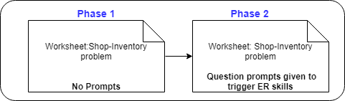
DBR Cycle 1 : Study 1
RQ1: What is the level of a novice in applying ER skills in solving software design problem?
Research Method: Exploratory research method (N=40 students)
Data Collected and analyzed: Student perception questionnaire, Rubric designed to assess ER skills
Results:
  No significant difference (p=0.88) was seen in the quality of the design with and without prompts.
  Students perceived that they had difficulty in breaking the problem into sub-problems, and the criteria for choosing the solution was the one recently studied or easy to implement.

Slide 19
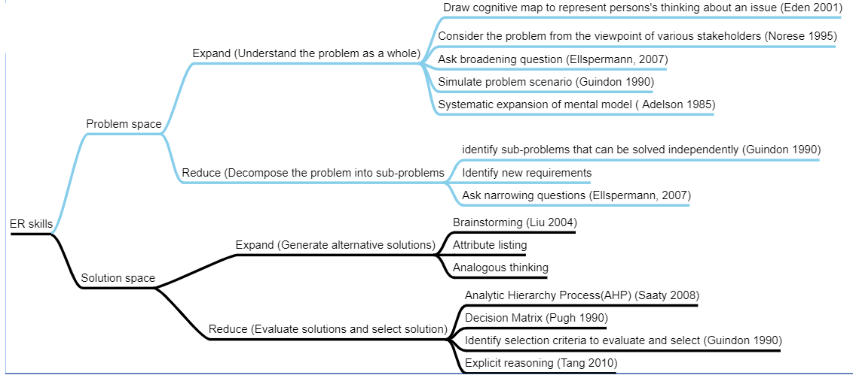
  Literature review question
  What are the cognitive processes/tools used by experts to expand and reduce the problem and solution space?
DBR Cycle 1 : Problem Analysis
Saaty, Thomas L. "Decision making with the analytic hierarchy process." International journal of services sciences 1.1 (2008): 83-98.
Notes:
Incorporate tool and teaching techniques both in one diagram

Slide 20
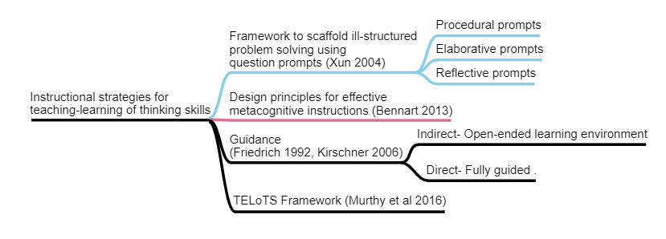
  Literature review question
  What are the scaffolding techniques for teaching-learning of ill-structured problem solving skills?
DBR Cycle 1 : Problem Analysis

Slide 21
DBR Cycle 1: Solution Design
Mapping of ER cognitive tools to software design
Software design phases
Mapping of ER skills in each phase
ER cognitive tools
Example
customer’s perspective
Draw the cognitive map of the whole system from the perspective of multiple stakeholders point of view
employee’s perspective
Expand- Understand the problem as a whole
Problem analysis
Reduce- Formulate the problem
Write goal and identify sub-goals
Based on the goal, identify
data and operations
Array
Expand- Generate alternative solutions
Draw attribute listing map to list all possible data structures and algorithms for each sub-goal. Combine these options to generate alternative solutions.
Data
List
Tree
Design solution
Linear
Reduce- Evaluate based on criteria and constraints, select and justify
Identify design criteria by doing pros and cons analysis of alternative solutions.
Identify constraints applicable to the problem.
Search
Binary
Hash
Criteria | Search time | Traverse time | Rank
Sol 1 | Low | Low | 1
Sol 2 | High | High | 3
Sol 3 | High | Low | 2
Evaluate alternative solutions against constraints using decision matrix. Rank , select and justify.
Notes:
the process of initial problem exploration, formulation of sub-goals, and explicit generation of alternative solutions improves the quality of design, especially for novices (Adelson 1985; Tang 2008,2010).

Slide 22
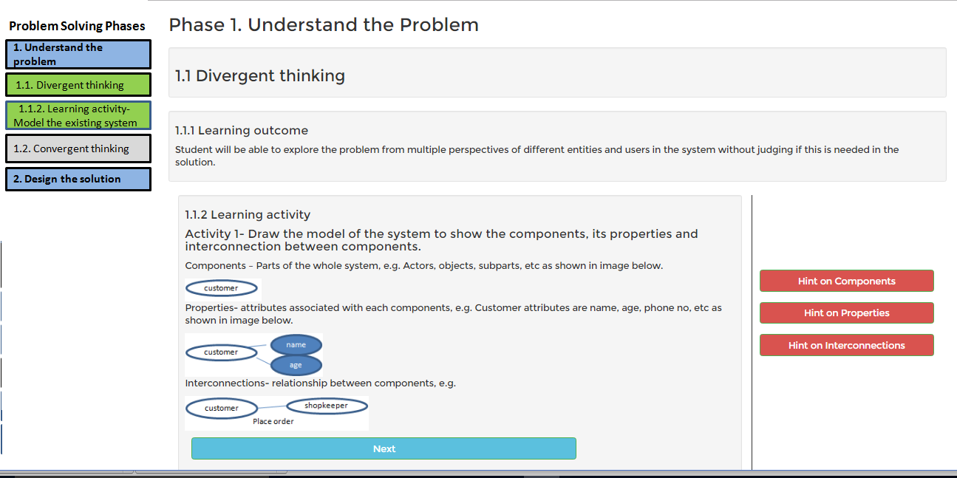
DBR Cycle 1- Solution Design of Fathom-Ver1
Learning outcome
Activity
Prompt
Detailed explanation with example

Slide 23
DBR Cycle 1- Solution Design of Fathom-Ver1
Problem solving steps
Learning path for each step
1. Problem Analysis
The responses are saved into database.
Systematic Guidance to ER skills
1.1Understand the problem from multiple perspectives
Prompts+ explanation & example , hint
Learner performs Activity
1.2 Formulate the problem
.
.
.
.
2. Design the solution
The prompts to triggers the ER skills
2.1 Generate Solutions
The hints were provided to help learners with low prior knowledge.
2.2 Evaluate solutions
The workspace will be provided to perform the activity supported with cognitive tools for ER skills.
2.3 Select solution
Notes:
Show screen shot and then design

Slide 24
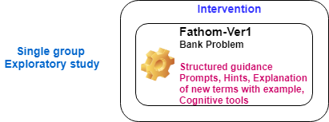
DBR cycle1- Evaluation: Study 2
RQ2- What are the difficulties faced by novices in performing ER skills using Fathom-Ver1?
Findings-
  The prompts were not effective in triggering the ER cognitive processes: draw the system model and formulate the problem.
  The cognitive tools were not effectively used which resulted in low performance in ER skills.
  During interview and survey, students perceived that more help is needed in all the activities.
Notes:
Change the RQ, dont have RQs with binary answers
animations and examples useful in understanding the activity and to have more simulations and examples

Slide 25
Overall DBR cycles
 | DBR Cycle 1 | DBR Cycle 2 | DBR Cycle 3
Problem analysis | To assess the level of ER skills in novice. Study 1(N=40), Exploratory study | To redesign the TELE with improved level of scaffolding and introduce reflection activities. | To revise the metacognitive activities for effective monitoring and controlling of ER skills.
Solution | Fathom-Ver1 | Fathom-Ver2 | Fathom-Ver3
 | Pedagogy- Prompts ER cognitive tools | Pedagogy- Prompts ER Cognitive tools Worked example Self-assessment | Pedagogy- Prompts ER Cognitive tools Worked example System generated feedback Self-assessment Peer review, Chat with peer
Evaluation | Study 2 (N= 49), Exploratory study | Study 3 (N= 49), Experimental pre-posttest | Study 4 (N= 50), Experimental pre-posttest

Slide 26
DBR Cycle 2
Support novice in doing and learning of ER skills

Slide 27
DBR Cycle 2: Problem Analysis
Literature survey questions:
What are the effective cognitive scaffolds to do ER skills effectively?
The experts are engaged at both cognitive and metacognitive level (Xun, 2004; James, 1994; Bennert, 2013)
The novice need to be trained explicitly in using both cognitive and metacognitive skills needed to solve ill-structured problems effectively (James, 1999; Xun, 2004; Redish, 2008; Cooperinder, 2008)
Cognitive skills
Monitor
Control
Justify
Evaluate
Metacognitive skills
Notes:
Research suggests that for effective learning of complex problem-solving skills, the learners needs to be engaged at both cognitive and metacognitive level (James, 1999; Xun, 2013; Bannert, 2013). The expert designers exhibit metacognitive behavior in the form of continuously assessing the solution against the test cases and constraints to identify the gaps and take appropriate control action plan to improve (Adelson, 1985; Tang, 2010).

Slide 28
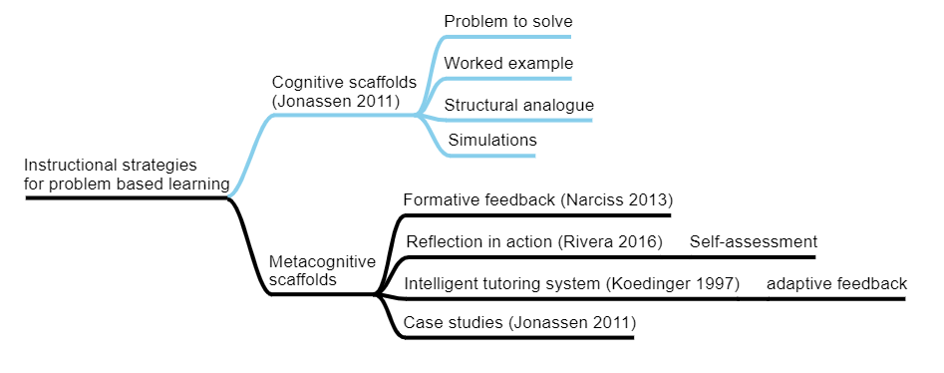
DBR Cycle 2: Problem Analysis
Cognitive, Metacognitive scaffolds
Notes:
students compare the problem to solve with structurally similar problems, they gain more robust conceptual knowledge about the problems.
In-action reflection is a metacognitive activity in which learner reviews his/her cognitive process or experience.

Slide 29
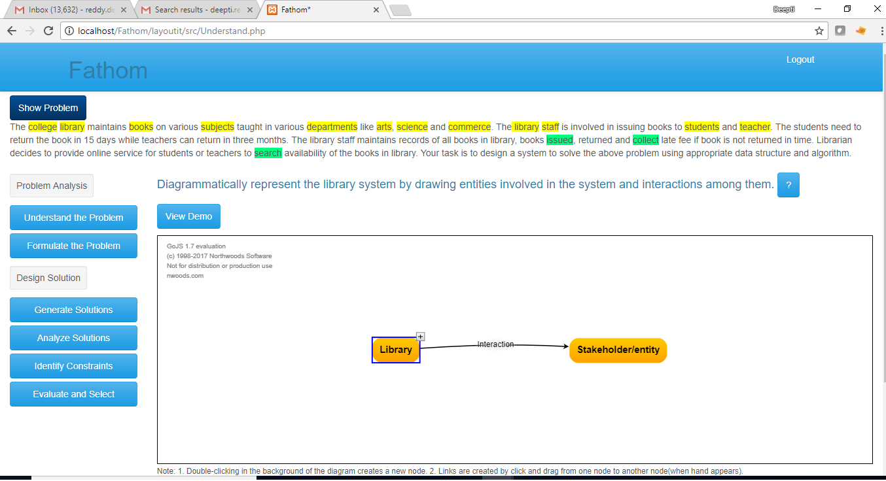
DBR Cycle 2- Solution Design- Fathom Ver.2
Domain specific prompt
Video illustrating the drawing of diagram using example
Drawing tool
Notes:
The TELE named Fathom was designed to teach ER skills.

Slide 30
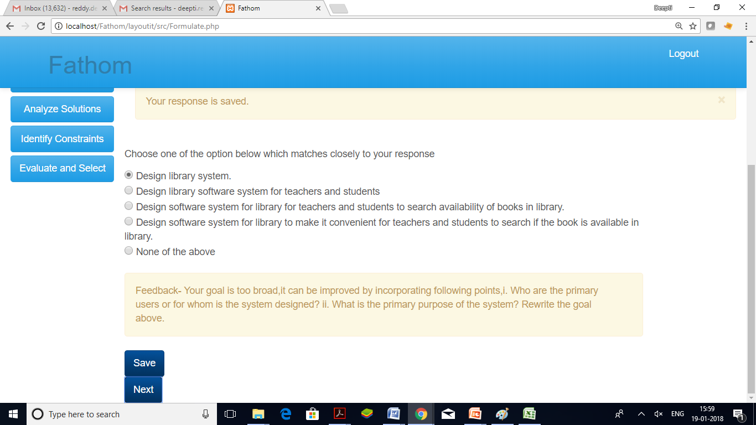
DBR Cycle 2- Solution Design- Fathom Ver.2
Self-evaluation activity
Feedback
Notes:
The TELE named Fathom was designed to teach ER skills.

Slide 31
DBR Cycle 2- Solution Design- Fathom Ver.2
1. Problem Analysis
Learning path for each skill
1.1Understand the problem from multiple perspectives
Demo/ Example
Prompts +Explanation+ Hints
Learner performs Activity
Feedback (system, self-evaluated)
Analyze ER skills for a new problem
1.2 Formulate the problem
.
.
.
.
.
.
2. Design the solution
Systematic Guidance to ER skills
The prompts to triggers the ER skills
2.1 Generate Solutions
Metacognitive activity of self-evaluation of ER skills
2.2 Evaluate solutions
The workspace will be provided to perform the activity supported with cognitive tools for ER skills.
2.3 Select and Justify
The responses are saved into database.
Notes:
The TELE named Fathom was designed to teach ER skills.

Slide 32
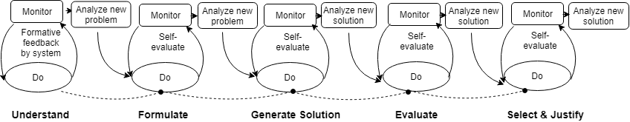
DBR Cycle 2- Solution Design: Overall learning path in Fathom-Ver.2
Notes:
The evaluate in third level and second level are confusing. Say analyze the new problem.

Slide 33
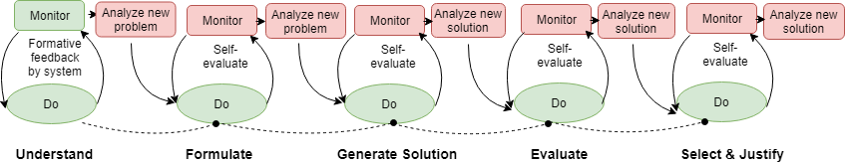
DBR Cycle 2- Study 3 Findings
RQ3: How effective is Fathom-Ver2 in doing and learning of ER skills?
  The pedagogical features helped to do ER skills and were able to apply ER skills in a new problem.
  The students are weak at self-evaluation of the skill. They are not able to monitor and control their skills on their own.
  The evaluation of new problem was adding a cognitive load as students had to do context switch between two problems.
Feedback for next cycle
  Scaffold the metacognitive activities to enable students to do, evaluate the gap.
Notes:
Compare two cycles; show two screenshots and highlight the changes done in both.

Slide 34
DBR Cycle 3
Support novice to regulate the learning of ER skills at metacognitive level

Slide 35
DBR Cycle 3- Problem Analysis
Literature review question
How to scaffold the metacognitive skill to enable students to monitor and control the ER skills?
Interactive tutoring feedback model(ITF) (Narciss 2013)
Peer review (Xun 2014)
Collaborative learning conversation skill taxanomy (Soller 1999)
Notes:
It was suggested that to improve the learning via peer review; the learners should be given the opportunity to make comments and suggestions to each other, instead of just viewing each other’s responses (Xun, 2013).
To engage learners to actively evaluate their peer’s responses, we referred to effective collaborated learning methods to allow participants to actively demand explanation and justification from their peers.

Slide 36
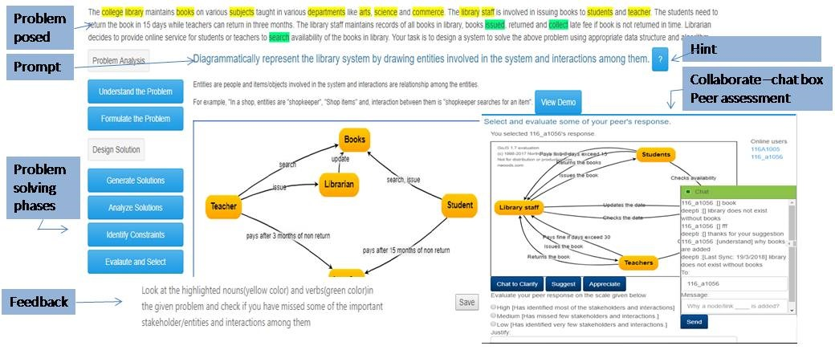
DBR Cycle 3- Solution Design

Slide 37
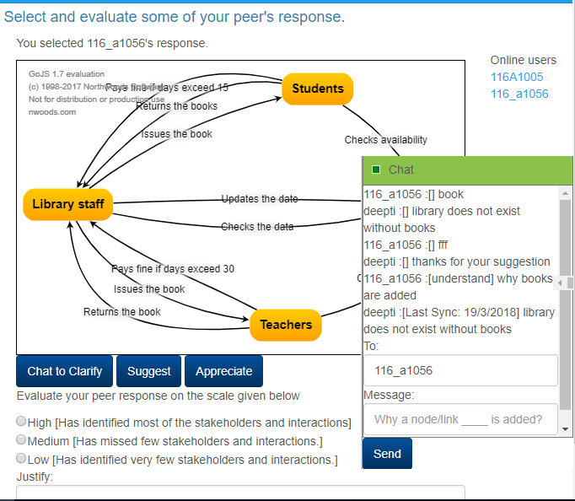
DBR Cycle 3- Solution Design
List of online users
Interact with peer to clarify/ suggest/ appreciate
Evaluate peers response

Slide 38
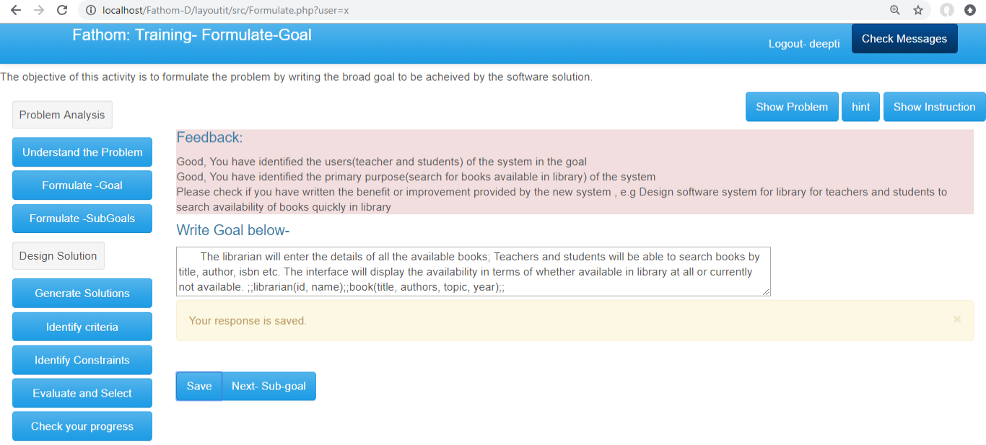
DBR Cycle 3- Solution Design
System generated feedback based on comparing keywords.

Slide 39
DBR Cycle 3- Solution Design
1. Problem Analysis
Learning path for each skill
1.1Understand the problem from multiple perspectives
Demo/ Example
Prompts +Explanation+ Hints
Learner performs Activity
Feedback (system generated)
Peer-review , self-evaluation and Chat
1.2 Formulate the problem
.
.
.
.
.
.
2. Design the solution
Revised features
2.1 Generate Solutions
2.2 Analyze solutions
2.3 Identify constraints
2.4 Evaluate and Select

Slide 40
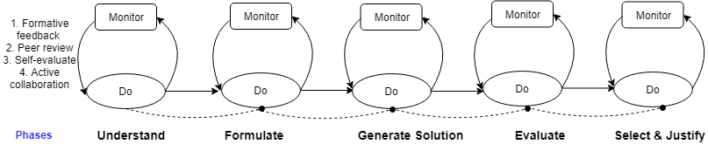
Solution Design- Overall learning path in all phases of Fathom-Ver.3

Slide 41
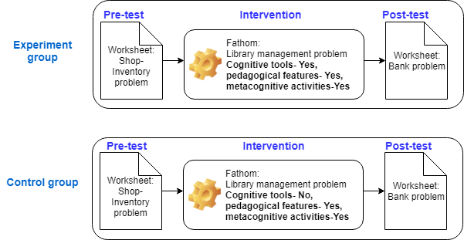
DBR Cycle 3- Evaluation: Study 4
RQ4: How effective is Fathom –Ver3(Cognitive tools, pedagogical and metacognitive activities) in learning of ER skills?
Data Collected and analyzed-
  1. Analyzed the students artifacts generated during pretest, posttest and intervention
  2. Students perception survey
  3. Focus group Interview
  4. Log data analysis

Slide 42
DBR Cycle 3- Evaluation: Study 4: Results and Findings
  The cognitive tools were effective in performing and learning ER skills
  Experiment group had significant gain in ER skills in posttest over control group
    Understand problem (p=0.00, effect size = 0.99)
    Formulate goal (p=0.00 , effect size =1.01)
    Generate solutions (p=0.03, effect size =0.61)
    Solution quality (p=0.00, effect size =1.81)
The overall pedagogical features helped to learn ER skills
  Significant gain from Pretest-Postest
    quality of problem formulation (p=0.05, effect size= 0.66)
    solution quality (p=0.00, effect size= 1.23)
    Justification (p=0.01, effect size 1.24)
System generated feedback was effective in regulating learning
  Log data analysis showed that 80 % of students revised their skills after feedback or peer collaboration.
  The self-evaluation, peer-evaluation and active chat facility was not used effectively.

Slide 43
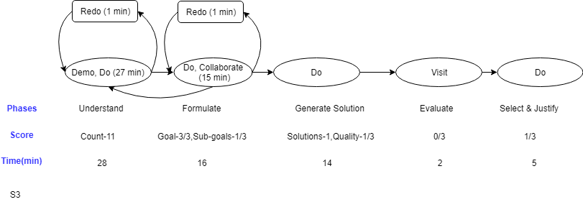
DBR Cycle 3- Evaluation: Study 4: Results
Pattern of activities- Low performer
Not efficiently using the help provided in the environment
Based on the feedback- Not evaluating and taking appropriate action to improve their skill
Collaborating with peers superficially, no evaluation during collaboration

Slide 44
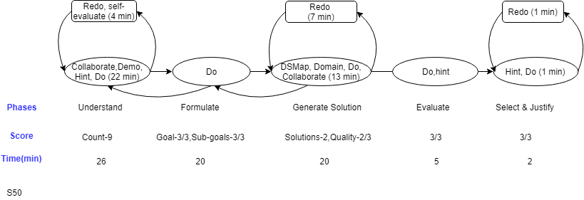
DBR Cycle 3- Evaluation: Study 4: Results
Log data analysis: Pattern of activities- high performers
Solutions-2, Quality- 3/3
Used the help provided in the environment
Based on the feedback- Evaluating and taking appropriate action to improve their skill
Self-evaluating peers and own responses
Notes:
Show time taken in evaluate and peer- review, to show that high performers are spending more time in upper region and low performers are spending more time in lower region.
Clearly define low and high performers. May be on the basis of final product. Need to rethink.
Show the instance of log data and its analysis.
Compare all three cycles.
Show where are we using overall solution path.

Slide 45
Local Learning Theories
Cognitive skills | Evidence
The drawing of entity-interaction diagram enabled learners to systematically expand the problem space and reduce to sub-problems. | 1. Significant gain ofexperiment group equipped with cognitive tools over the control group (study 4) 2. Interview data analysis
The attribute list map was providing the affordance to visualize various design options for each sub-problem and think of the evaluation criteria to reduce to optimal solution.
Metacognitive skills | Evidence
Elaborated Feedback addressing gaps and necessary action to improve is allows learners to evaluate the gap and improve the skill at task. | Log data analysis (study 4) showed that 80% learners modified their responses after reading feedback and 50% on peer review.
Peer review enables learners to see alternative ways of solving the problem but it may be detrimental if learners just use it to copy.
Peer-evaluation, self-evaluation and active collaboration allow high performers to enhance the learning of ER skills | Screen capture analysis and log data analysis.
Notes:
How and why is the learning happening
Connect to TELoTs ver2 framework

Slide 46
Design principles
Design Principles | Evidence
In TEL environment, learning activities scaffolded with ER cognitive tools, domain specific prompts with detailed explanation and worked example, enables novices to perform and learn ER skills. | Significant gain from pretest to posttest in study 3 and study4. Interview data analysis of study 4.
System generated feedback addressing both the positive and corrective action plan is necessary to regulate the learning of ER skills for novices. | Log data analysis of study 4.
The peer-review, self-evaluation, and peer-evaluation with active chat facility allow high performers to elicit explanation, question or appreciate the design decisions taken by the peers. | Log data analysis of study 4.

Slide 47
Problem
Software design
Expert vs Novice approach
Solution
Solution
Design Based Research (Cycle 1-3)
Conclusion
Generalizability
Research Gap and Goal
Limitations
Contributions & Future work
Local Learning Theories
Expand-Reduce skills

Slide 48
Generalizability
Fathom is validated for learning ER skills in software design using data structures and algorithms.
  Other software design problems-
  The overall pedagogical approach of Fathom can be used
  ER cognitive tools can be used as it is
  Redesign of the prompts, worked example, hints, and feedback depending on the new problem.
  Needs to be verified
Other domain design problems (designing a electronic circuit, computer network )-
The overall pedagogy of Fathom can be used
The nature of diagrams, prompts, explanation, example, feedback may change.
Needs to be verified
Notes:
Dimensions
Web applications
Mobile application
Numerical problem
Remove data structure and replace it with other domains, what is specific to DS that is preventing from using other problems, if not specific then it should work but has to be verified.
Can it be used for electronic design or building design, there is some similarity but the nature of approach will be different. You can chane the diagram, prompt, question, content but I will use your methodology.

Slide 49
Limitations
Learner and domain
The findings of our research studies are limited to computer engineering students in data structures and algorithms course.
Not tested for design problems in other similar courses or other engineering domains.
Instructional design
The course instructor has no active role in authoring the instructional design.
Research studies
The research studies were done to test the near transfer of ER skills in the same course.
We did not test the far transfer as the studies were not longitudinal in nature.

Slide 50
Contributions
Contributions | Implications for
1. Characterization of ER skills in the process of software design | Novice software designers, Engineering educators
2. Providing insights about the cognitive biases of novice towards applying ER skills in the context of solving software design problem. Tend to formulate the problem only from the perspective of single user. The novice tends to reduce early to the solution that they are more comfortable with or is easy to implement without exploring alternative design options suitable to the problem. | Engineering educators, Educational Technology researchers
3. Identification of effective cognitive and metacognitive scaffolds in technology enhanced learning environment for doing and learning of ER skills to novice. Cognitive scaffolds- Prompts, worked example. Metacognitive scaffolds- Formative feedback, Peer review and active collaboration. | Engineering educators, Instructional designers, Educational Technology researchers

Slide 51
Contributions (continued)
Contributions | Implications for
4. Identification of ER cognitive tools for doing and learning of ER skills in the context of solving software design problem. Drawing of entity-interaction diagram Writing goal and sub-goals Drawing of attribute listing map Identification of selection criteria, evaluate and select. | Engineering educators, Instructional designers, Educational Technology researchers
5. The studies contribute to the research space in field of technology-enhanced learning of thinking skills (TELoTS) in terms of replicable research methods, data collection methods (quantitative and qualitative), assessment instruments (rubric to assess ER skills) and findings. | Educational Technology researchers
6. The Fathom has pedagogical features to enable novices to learn ER skills in the context of software design problem solving. | Engineering students
7. Engineering educators can also directly use Fathom in lab setting for teaching-learning of ER skills to their students. | Engineering educators

Slide 52
Directions for future work
The pedagogy of Fathom can be tested and validated for other type of design problems (Software, Network, Electronic Software).
The longitudinal studies can be conducted over a period of one year on same set of students and test for far transfer of ER skills.
The instructor authoring feature can be incorporated to allow teachers to create a problem solving environment for learning ER skills in their own courses.
The learning patterns of the students can be further analyzed to identify the low performers during the intervention and take timely actions to motivate them towards learning.
The feedback mechanism based on keyword checking can be improved by incorporating sophisticated NLP algorithms.

Slide 53
Publications
Reddy, Deepti, Sridhar Iyer, and M. Sasikumar. "Technology Enhanced Learning (TEL) Environment to Develop Expansionist-Reductionist (ER) Thinking Skills through Software Design Problem Solving." 2018 IEEE Tenth International Conference on Technology for Education (T4E). IEEE, 2018.
Patil Deepti Reddy, Sridhar Iyer, Sasikumar M, “FATHOM: TEL environment to develop divergent and convergent thinking skills in software design”, Advanced Learning Technologies (ICALT), 2017 IEEE 17th International Conference on. IEEE, 2017.
Reddy Patil Deepti, Sridhar Iyer, M. Sasikumar, "Teaching and Learning of Divergent and Convergent Thinking through Open-Problem Solving in a Data Structures Course", IEEE International Conference on Learning and Teaching in Computing and Engineering (LaTiCE), 2016.
Patil Deepti Reddy, "Teaching and Learning of Divergent and Convergent Thinking through Open-Problem Solving in a Data Structures Course“, Doctoral Consortium of LaTiCE 2016

Slide 54
Acknowledgements
Engineering instructors
Students and Interns
ET research scholars and staff
Professors
Friends and Family

Slide 55
DBR Cycle 2- Evaluation: Study3
RQ3- How effective is Fathom in doing and learning of ER skills?
RQ 3.1. How effective are the pedagogical features of Fathom-Ver2 in helping students to perform and learn ER skills?
RQ 3.2. How effective is structured versus semi-structured sequence of learning activities in performing ER skills?
RQ 3.3. How effective is the feedback mechanism (system generated, self-evaluated) in monitoring and controlling the ER skills?
RQ 3.4. How effective are in-action reflection activities enabling student to assess the ER skills in a new case study problem?
Notes:
RQs are to be reframed

Slide 56
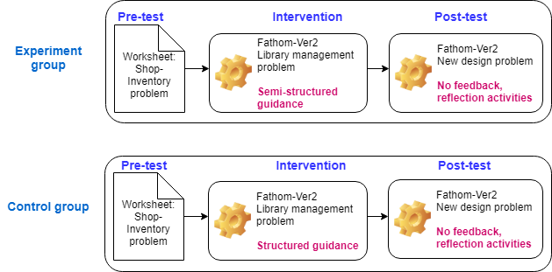
DBR Cycle 2- Evaluation: Study3
RQ3: How effective is Fathom-Ver2 in doing and learning of ER skills?
Results:
  Significant improvement from pretest to posttest in quality of the problem formulation and solution.
  Based on log data analysis, only 24 % of students were revising their responses based on self-evaluation based feedback.
  Evaluating a new problem after each ER activity was not effective as only 10% students were able to evaluate correctly.

Slide 57
DBR Cycle 3- Evaluation: Study 4: Rubric for evaluating ER skills
Criteria | Score descriptors
Expand-Problem space Understand the problem | The count of entities and interactions identified
Goal | 3- The goal has addressed following points- requirements broadly defined, primary users and benefits written 2- The goal missed one of the above point 1- The goal missed most of the points
Reduce- Sub-Goal (quality) (Booch 1999) | 3-Identified all the data items and operations for achieving the stated goal. 2- missed to identify one of the data items or operations that will achieve the goal 1- missed to identify many data item or operation which are important for achieving the goal.
Expand- Generate solution (Quantity) | The count of solutions(DS & algorithms) generated
Solution quality | 3- The solution is- complete and correct. In the solution the data structure is valid and the operations are mapped to correct algorithms . 2-has less clarity on what data is stored or how the algorithms are used for each operation. 1- the solution is incomplete or the solution is not correct.
Reduce- Criteria | The count of criteria identified
Constraints | The count of constraints correctly applicable to the problem
Select and justify | 3- selected the correct DS and justified clearly and correctly how the solution satisfies all the constraints applicable to the problem and is optimal than other alternatives 2- selected a correct DS and justified without considering all constraints or did not consider other alternatives. 1- selected a incorrect DS and did not justify based on the constraints applicable to the problem.
Reliability of the rubric is established by two expert instructors.

Slide 58
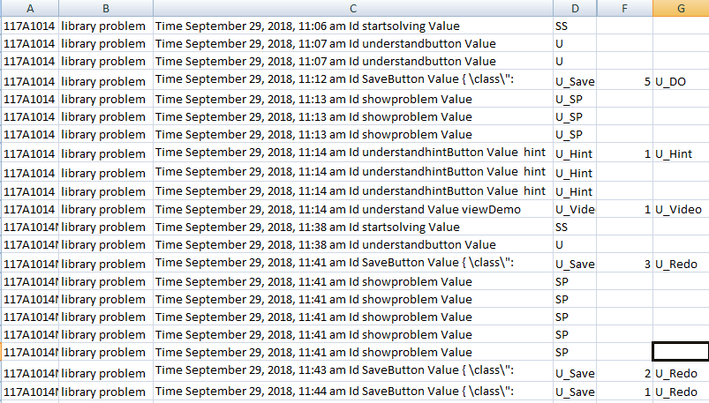
DBR Cycle 3- Evaluation: Study 4: Log-data analysis- interaction analysis
Student_id and problem
Date&Time
Button name
Codes
Time taken(min)
Analysis

Slide 59
DBR Cycle 3- Evaluation: Study 4: Interview data analysis
The interview of three students was done by playing their respective screen-recording and prompting questions towards how the activities helped to perform ER skill.
The interview data was transcribed and the content analysis method (Bengstton 2016) was used to identify meaningful units of analysis.
Learning of ER skills perceived by students | Quotes
Got a basic idea of how to approach a problem | “I actually got a basic idea to how to construct, how to approach the problem because first time(pretest) I did not know how to approach itself”.
The drawing tools helped to visualize and expand the problem and solution space | “it helped to visualize the problem and it helps me to see that all the other entities are linked so that it simplified the problem”
The understand activity helped to break the problem into sub-problem. | “In pretest I could not think of alternative solutions because did not knew how to break the problem and think of each sub-problem as a separate unit which has different solution options”.
Generating solutions helped them to think of evaluating based on various criteria and select | “When we think of more solutions, then we decide which one is better, easier or presentable for the user who is using it
Feedback was helping to identify the gap or correct it. | “First I did wrong, Well then I changed. Then I understood what exactly is”

Slide 60
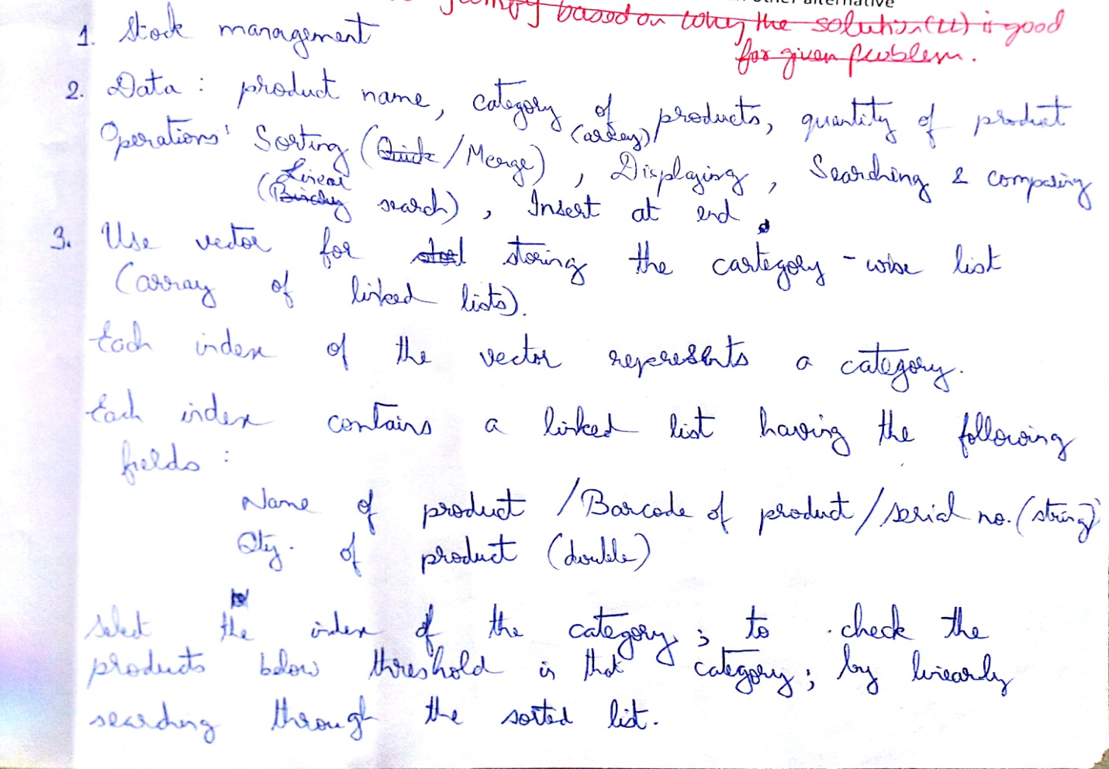
Pretest sample worksheet of student S1
Goal- broadly written
No attempt of exploring problem space
Sub-goal: Data and operation written at programming level, not able to abstract out sub-problems.
Reduced to solution without exploring alternatives
Incomplete solution

Slide 61
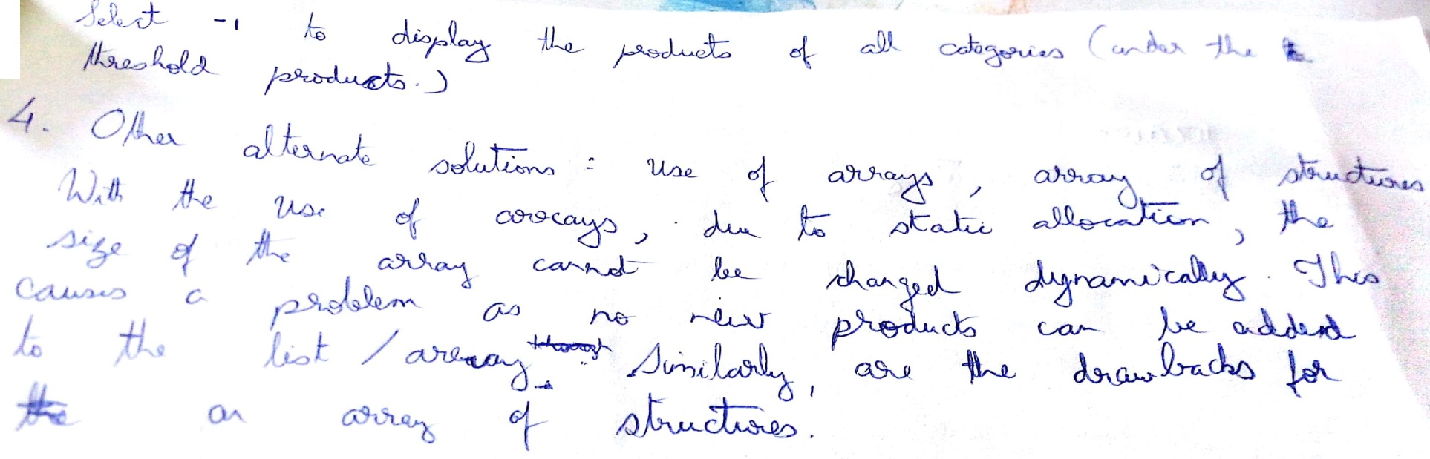
Pretest sample worksheet of student S1
Justification- not able to justify how the selected design option is suited for the given goal.
Lack of selection criteria and evaluation of alternative solutions

Slide 62
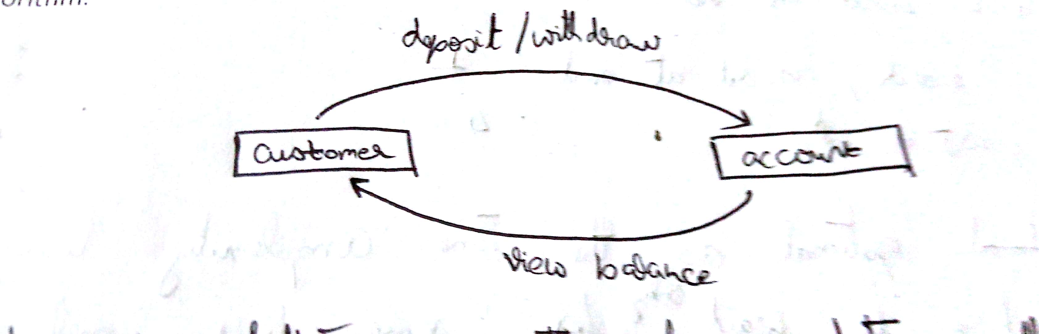
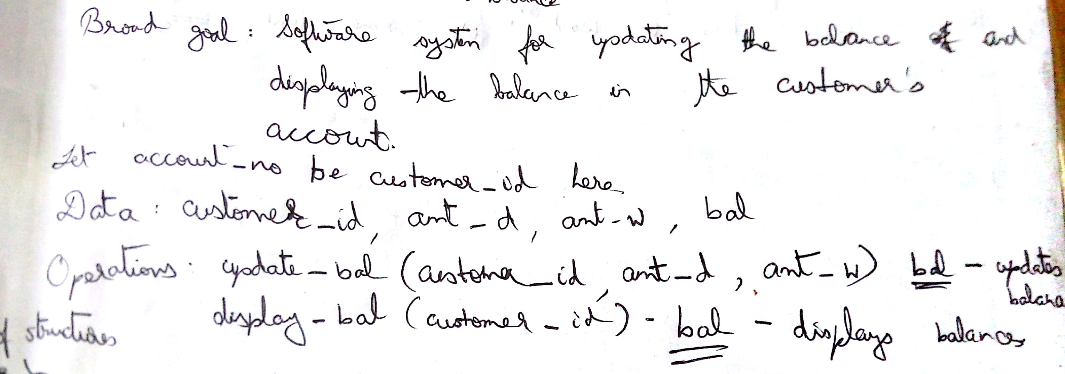
Posttest sample worksheet of student S1
Exploring problem space using
Entity-interaction diagram
Goal written from the point of view of users
Sub-goals: Able to abstract sub-problems

Slide 63
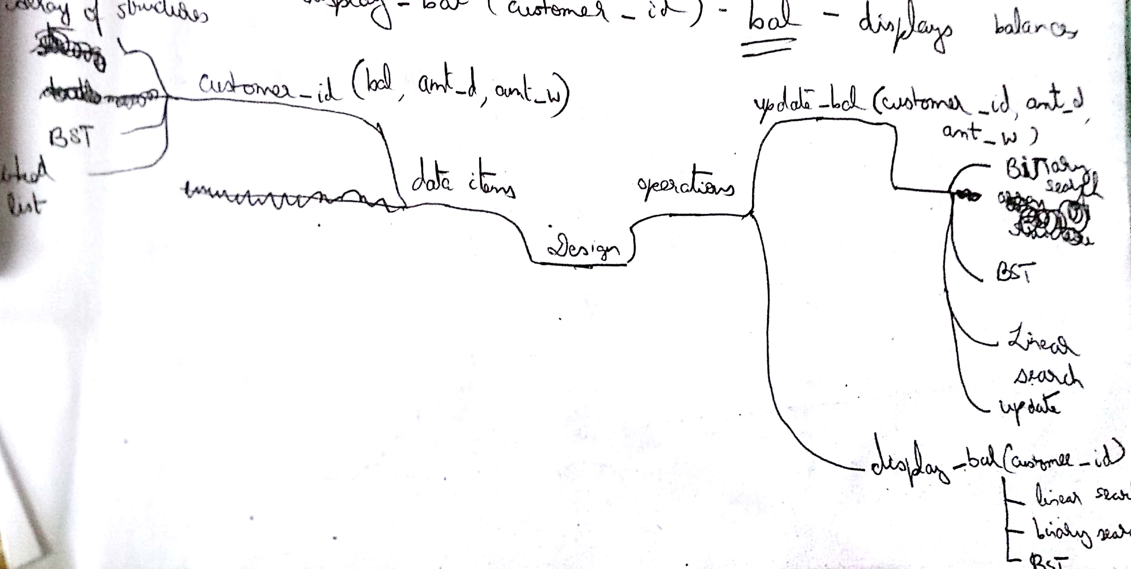
Posttest sample worksheet of student S1
Is able to explore solution alternatives for each sub-problem using Attribute listing map
Subgoal: Data and operations | Product name, quantity, Operation: Sorting, searching. | Customer_id, account_no, balance, Operations: Update_balance(amt_withdraw, amt_deposited)..

Slide 64
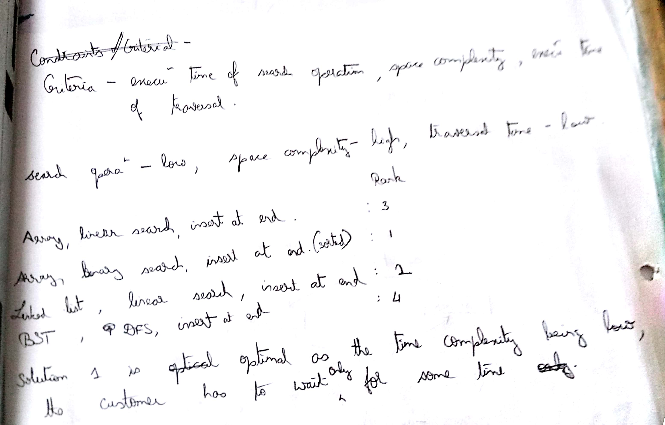
Posttest sample worksheet of student S1
Identified Criteria
Constraints
Evaluation of alternative solution and select
Justify

Slide 65
Literature Review
Ill-Structured Problem Solving
Problem Structuring
Engineering Design
Creative Problem solving
Software Design
Expansionist-Reductionist Skills
Divergent-Convergent Thinking Skills
Integrated Models
Notes:
Creative problem solving, problem structuring, software design..

