Slide 1





Designing Learner Centric MOOCs
Sridhar Iyer | Jayakrishnan M | Sahana Murthy | Sameer Sahasrabudhe
Indian Institute of Technology Bombay | Indian Institute of Technology Madras
This presentation is released under Creative Commons-Attribution 4.0 License. You are free to use, distribute and modify it , including for commercial purposes, provided you acknowledge the source.

Slide 2
Warm-up: Differentiate between
Scenario1: Consider a class in the 20th century.
Scenario2: Consider a class in the 21st century.
Come up with one difference between these scenarios wrt:
1) Students’ access to information.
2) Role of teachers.

Slide 3
Differences between
20th and 21st century classrooms
Note Audience Responses here:
Google, Wikipedia, Youtube versus Notebook
Access
Distractions
NPTEL vs

Slide 4
Summarizing differences
20th century class:
•Information was at a premium – No Internet, expensive books, limited access to libraries.
•Hence, those who had access to information and could transmit it effectively were highly valued.
•So, students were mostly listeners and note-takers, absorbing information during the lecture, and doing their practice later.
21st century class:
•Information is no longer at a premium – WWW! Lots of accessible videos, demos, etc
•Hence, not enough for a teacher to only transmit information. Also - impossible to compete with WWW.
•It is necessary for a teacher to ensure that students are able to assimilate the information, through appropriate and timely practice.

Slide 5
Massive Open Online Courses in 21st century
Provide access to information anytime, anywhere
Technology platforms to support scale
Instructor provides content in the form of videos, slides etc.
Learners access content and do assessments.
Existing platforms - NPTEL, edX, Coursera, Futurelearn

Slide 6
Scenario
In order to create a MOOC, an instructor creates lecture videos, provides exercises, clarifies queries on discussion forums and does assessment.
What has this instructor missed?

Slide 7
What do you think – what has been missed?
Note Audience Responses here
Real-time interaction, Knowing the pulse
Getting Feedback from students
Incorporating Corrective measures

Slide 8
What’s missing
Attention to learner motivation
Getting learners to express their reasoning
Opportunities for immediate micro-application
Formative assessment and instant feedback
Explicit activities to foster peer-learning
Ensuring learner connect during the MOOC
Established theories of How People Learn is missing

Slide 9
Traditional MOOCs
Provide anytime anywhere access to learners for:
Information – lectures, resources
Assessment - activities and exercises
Discussion – with peers and instructor(s)

Slide 10
Implications
Common MOOC problems may persist - low student engagement, low participation in discussion forums, low completion rates
Problems of engagement worsen in a MOOC setting - distance, scale and diversity of learners are all high

Slide 11
What might go wrong if we mimic a typical classroom
In a typical classroom (recall teacher-centric class):
  The standard 1-hr lecture is not too engaging
  Lecture + HW at the end is known to be not too effective
  Even asking questions in between - did you understand, what doubts do you have - may only get a few students to respond
Problems of engagement and effectiveness worsen in a MOOC setting - distance, scale and diversity of learners are all high
Takeaway: Do not attempt to mimic a typical classroom.
Instead incorporate effective, learner-centric approaches.

Slide 12
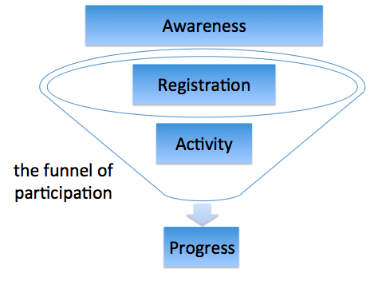
Challenges in MOOC
Funnel of participation (Clow, 2013)
Well organized and presented but lack good instructional design (Margaryan et. al., 2015)
Inadequate attention on existing research on pedagogy (Fischer, 2014)
Source: https://commons.wikimedia.org/wiki/File:Funnel_of_participation.png

Slide 13
Need - Learner Centric MOOCs
Not sufficient to focus only on the technology features
Not effective to mimic a typical classroom
Need:
Incorporate learner-centric approaches
using technology affordances

Slide 14

Why LCM

Slide 15
Learner-Centric MOOC (LCM) Model
Focus question for discussion +
Peer interaction + Reflection Quiz
Learner Experience Interaction
Content + Reflection Spot
Learning Dialogs
LxI
LeD
Orchestration
LxT
LbD
Learning Extension
Trajectories
Activities + Customized Feedback
Resources + Assimilation Quiz
Learning
by Doing

Slide 16
Sneak Preview - Creating Learner Centric MOOC
Classroom Scenario
Lectures and Demos
Assignments and Activities
Instructor-Learner interaction
Learner-Learner interaction
Additional Readings
Exams and Assessment

Slide 17
Sneak Preview - Creating Learner Centric MOOC
Classroom Scenario
Lectures and Demos
Assignments and Activities
Instructor-Learner interaction
Learner-Learner interaction
Additional Readings
Exams and Assessment
LCM Model
Learning Dialogues (LeD)
Learning by Doing (LbD)
Response and Feedback (RF)
Learning experience Interactions (LxI)
Learning extensions (LxT)
Knowledge Consolidation (KC)

Slide 18
Learner-Centric MOOC (LCM) Model
Learner Experience Interaction
Learning Dialogs
LxI
LeD
Orchestration
LxT
LbD
Learning Extension
Trajectories
Activities + Customized Feedback
Learning
by Doing

Slide 19
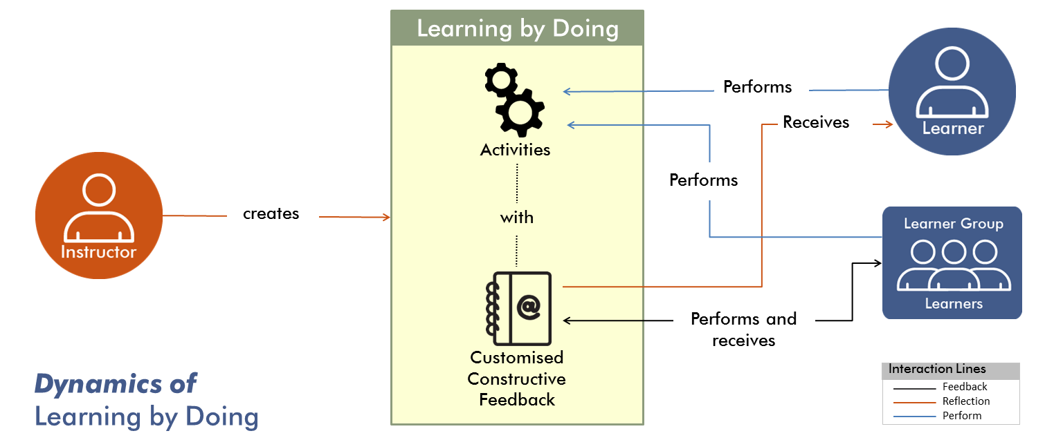

Slide 20
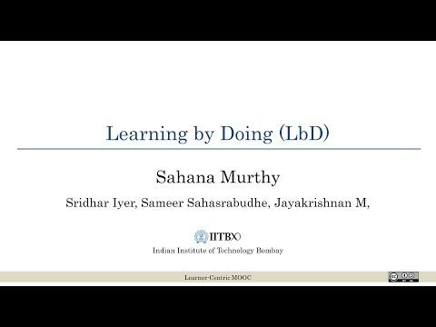
What is Learning by Doing?

Slide 21
Examples of LbD

Slide 22
Research Evidence
“We estimate the learning benefit from extra doing (1 SD increase) to be more than six times that of extra watching or reading.”
(Koedinger et. al., 2015)
91.8% people found LbD activities useful [N=695]

Slide 23
LbD Takeaway
Intersperse videos with Learning by Doing activities
Provide customized constructive feedback

Slide 24
LbD on creating your own LbD
Write an LbD for one video in your NPTEL Course

Slide 25
Learner-Centric MOOC (LCM) Model
Learner Experience Interaction
Learning Dialogs
Content + Reflection Spot
LxI
LeD
Orchestration
LxT
LbD
Learning Extension
Trajectories
Learning
by Doing

Slide 26
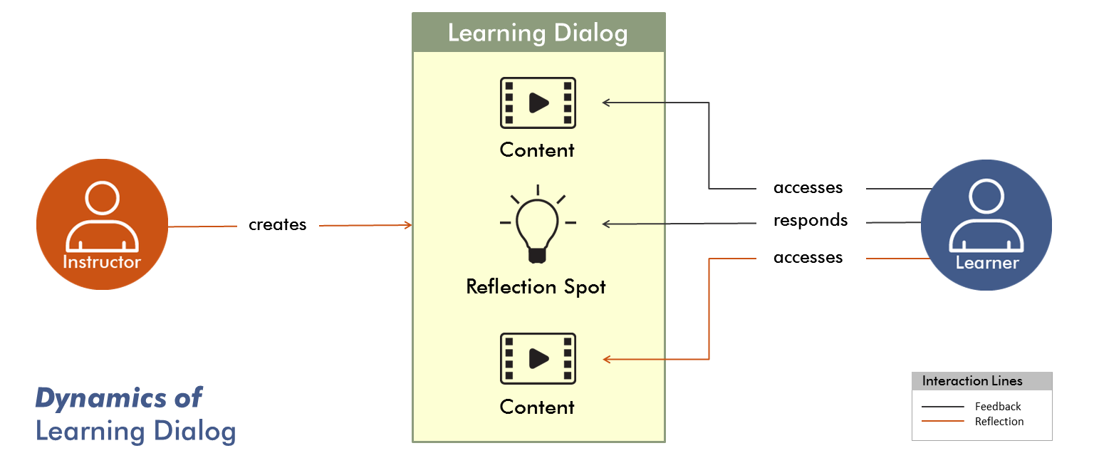

Slide 27
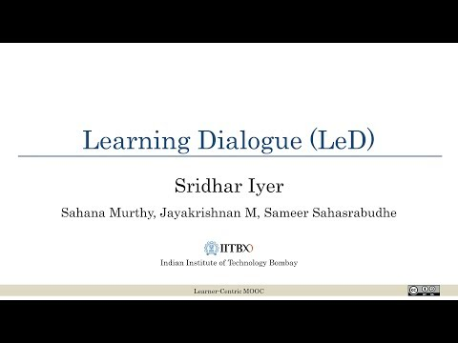
What is Learning Dialog?

Slide 28
Examples of LeD

Slide 29
Research Evidence
Drop-off in the first few minutes
One question per 8.7 minute increased engagement to 71-86%
(Cummins et. al., 2016)
Average retention rate in FDP101x:
  LeD videos : 69.9%
  Regular videos : 55.73%
Participants highlighted relevance and usefulness of LeD.

Slide 30
LeD Takeaway
Include reflection spot in videos
Reflection spot should be connected to immediate preceding content; Learner should get opportunity to express their ideas

Slide 31
LbD on creating your own LeD
Write a Reflection Spot for one video in your NPTEL Course

Slide 32
Learner-Centric MOOC (LCM) Model
Learner Experience Interaction
Learning Dialogs
LxI
LeD
Orchestration
LxT
LbD
Learning Extension
Trajectories
Resources + Assimilation Quiz
Learning
by Doing

Slide 33
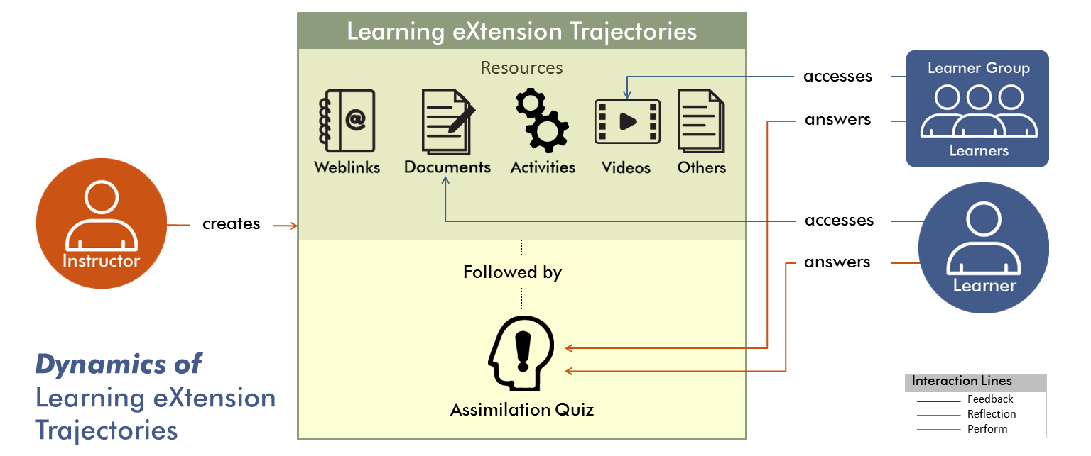

Slide 34
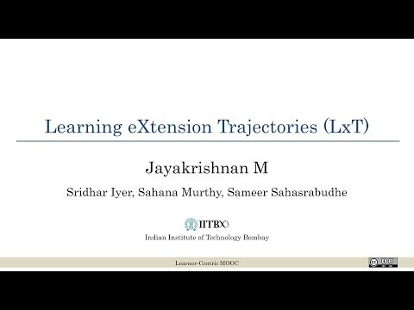
What is Learning Extension Trajectory?

Slide 35
Examples of LxT

Slide 36
Research Evidence
  “Having the assimilation quiz following the LxT resources made us look into those resources […] we realized that the LxT resources gives you details about strategies and their uses at different places” [ET611Tx participant]
  “Watching videos of Prof. Mazur made me realize that students in my class may also be nodding their heads without really understanding the concept” [ET601Tx participant]

Slide 37
LxT Takeaway
Cater to diverse learners and diverse learning levels
Provide resources to increase depth and breadth
Close the loop with Assimilation Quiz

Slide 38
LbD on creating your own LxT
Identify LxT resources for one week in your NPTEL Course
Write the Assimilation Quiz for the LxT

Slide 39
Learner-Centric MOOC (LCM) Model
Learner Experience Interaction
Learning Dialogs
LxI
LeD
Orchestration
LxT
LbD
Learning Extension
Trajectories
Activities + Customized Feedback
Learning
by Doing

Slide 40
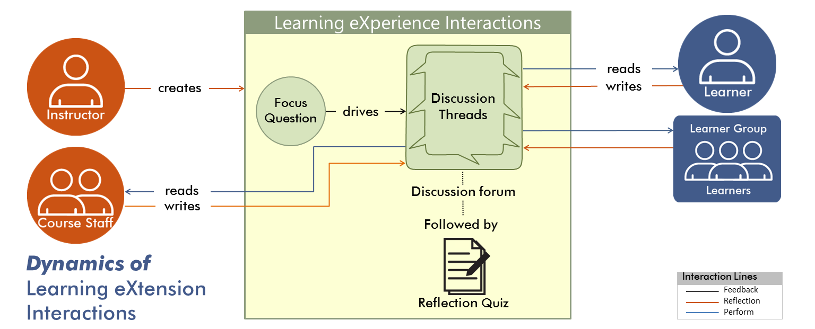

Slide 41
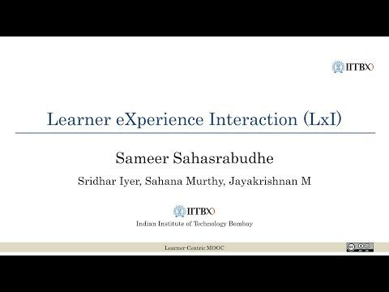
What is Learner Experience Interaction?

Slide 42
Examples of LxI

Slide 43
Research Evidence
1691 active participants in the discussion forum
Total of 29355 posts across 8 weeks.
(Banerjee et. al., 2018)

Slide 44
LxI Takeaway
Leverage peer learning
Anchor discussions around focus question
Close the loop with Reflection Quiz

Slide 45
Learner-Centric MOOC (LCM) Model
Learner Experience Interaction
Learning Dialogs
LxI
LeD
Orchestration
LxT
LbD
Learning Extension
Trajectories
Learning
by Doing

Slide 46
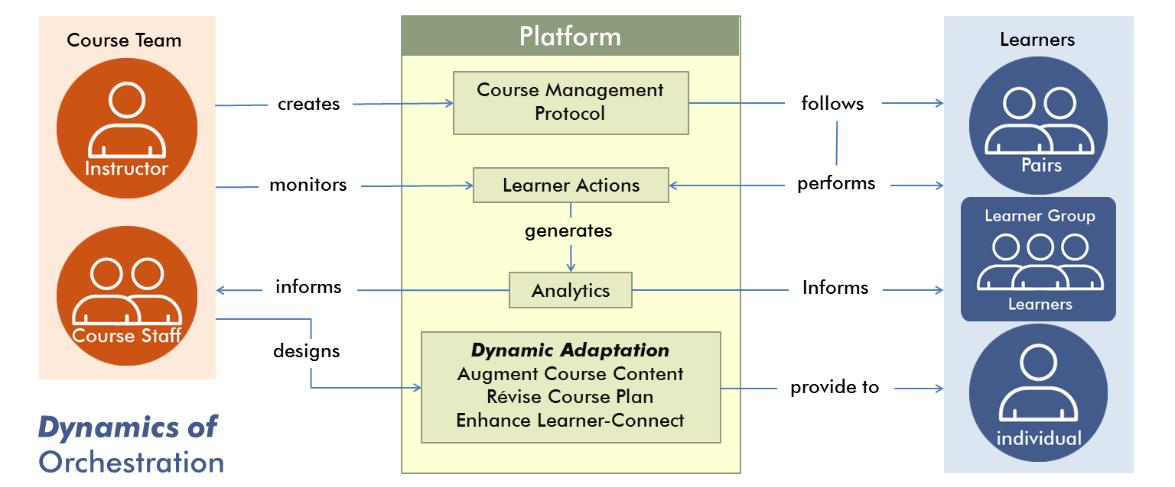

Slide 47
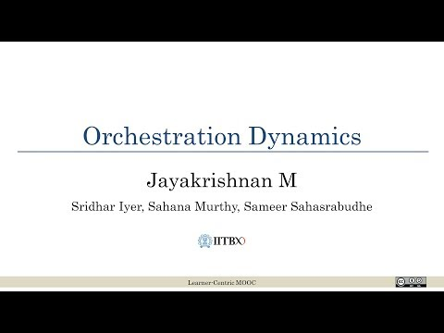
What is Orchestration Dynamics

Slide 48
Examples of Orchestration

Slide 49
Research Evidence
ET601Tx : Jan- Mar 2016, 5500 participants, engg instructors
Active participants: 67%
(participated in at least one activity – LeD, submit LbD, LXI post, quiz …)
Persistence rate: 37%
(completed all activities / active participants)
Completion rate: 23%
(completed all activities / registered participants)

Slide 50
Orchestration Takeaway
Exploit the power of analytics to
Identify learner engagement
Adapt the course content for the cohort
Provide response to learner actions.
Envisage different learner actions and design customised responses.

Slide 51
Closing
A MOOC is a balanced combination of various learning activities using appropriate media, not just a collection of lecture videos and exercises.
Use the LCM model to achieve the balance.

Slide 52
References
MOOC Challenges
Clow, D. (2013, April). MOOCs and the funnel of participation. In Proceedings of the Third International Conference on Learning Analytics and Knowledge (pp. 185-189). ACM.
Fischer, G. (2014). Beyond hype and underestimation: identifying research challenges for the future of MOOCs. Distance education, 35(2), 149-158.
Margaryan, A., Bianco, M., & Littlejohn, A. (2015). Instructional quality of massive open online courses (MOOCs). Computers & Education, 80, 77-83.
LCM Elements
Cummins, S., Beresford, A., & Rice, A. (2016). Investigating engagement with in-video quiz questions in a programming course. IEEE Transactions on Learning Technologies, (1), 1-1.
Koedinger, K. R., Kim, J., Jia, J. Z., McLaughlin, E. A., & Bier, N. L. (2015, March). Learning is not a spectator sport: Doing is better than watching for learning from a MOOC. In Proceedings of the second (2015) ACM conference on learning@ scale (pp. 111-120). ACM.
Banerjee, G., Warriem, J. M., & Mishra, S. (2018, December). Learning experience interaction (LxI): Pedagogy for peer connect in MOOCs. In Proceedings of 26th International Conference on Computers in Education (ICCE2018). in press.

Slide 53
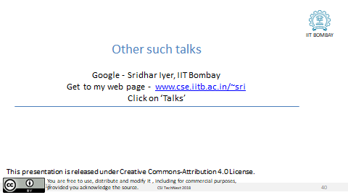
Thank you

